Slide 1
What is HTML?
HTML stands for Hypertext Markup Language.
It is used to design web pages using a markup language.
HTML is the combination of Hypertext and Markup language.
Hypertext defines the link between web pages.
A markup language is used to define the text document within the tag which defines the structure of web pages.
HTML consists of a series of elements
HTML elements tell the browser how to display the content

Slide 2
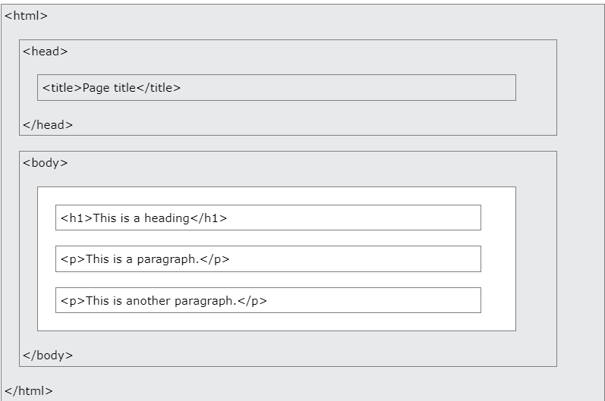
HTML PAGE STRUCTURE

Slide 3
TAGS EXPLAINED
The <!DOCTYPE html> declaration defines that this document is an HTML5 document
The <html> element is the root element of an HTML page
The <head> element contains meta information about the HTML page
The <title> element specifies a title for the HTML page (which is shown in the browser's title bar or in the page's tab)
The <body> element defines the document's body, and is a container for all the visible contents, such as headings, paragraphs, images, hyperlinks, tables, lists, etc.
The <h1> element defines a large heading
The <p> element defines a paragraph

Slide 4
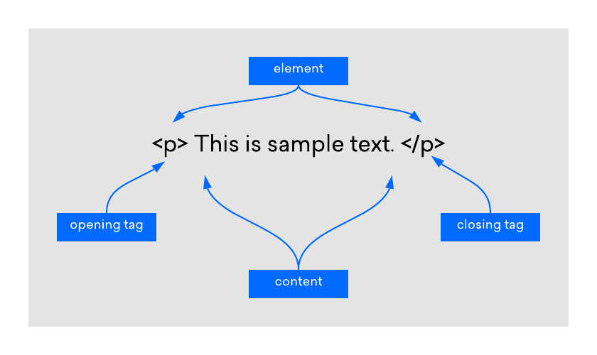
HTML ELEMENTS

Slide 5
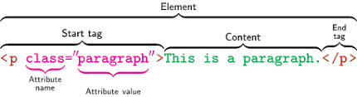
HTML ELEMENTS

Slide 6
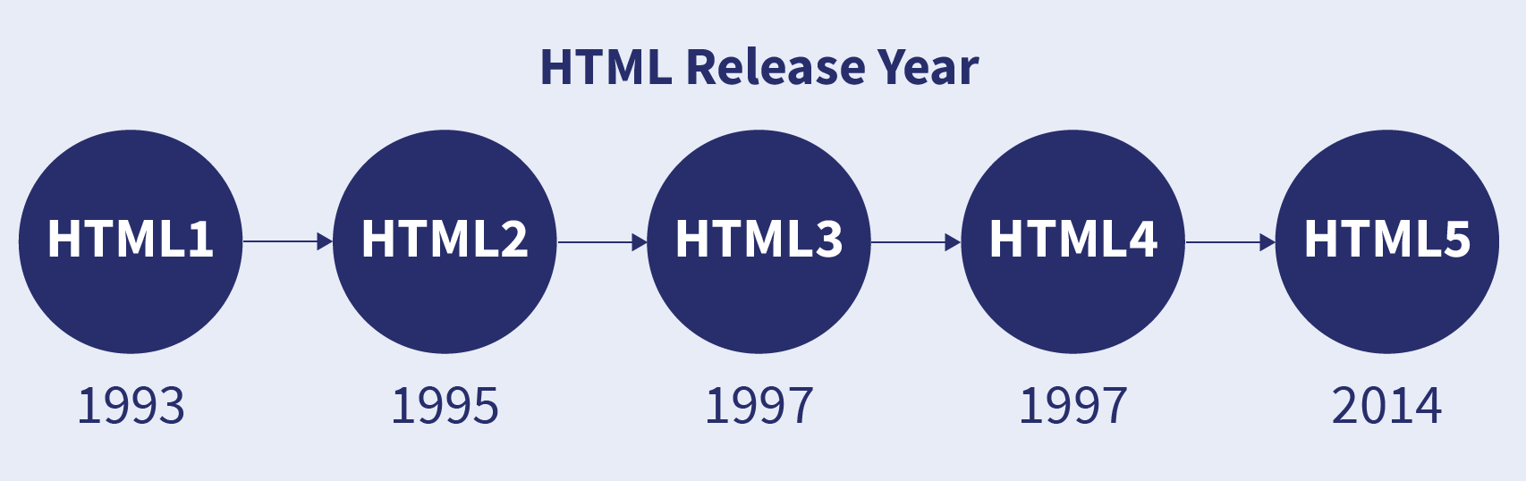
HTML VERSION

Slide 7
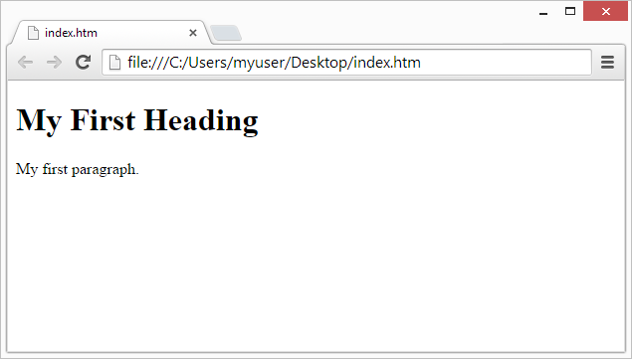
WEB BROWSER
The purpose of a web browser (Chrome, Edge, Firefox, Safari) is to read HTML documents and display them correctly.

Slide 8
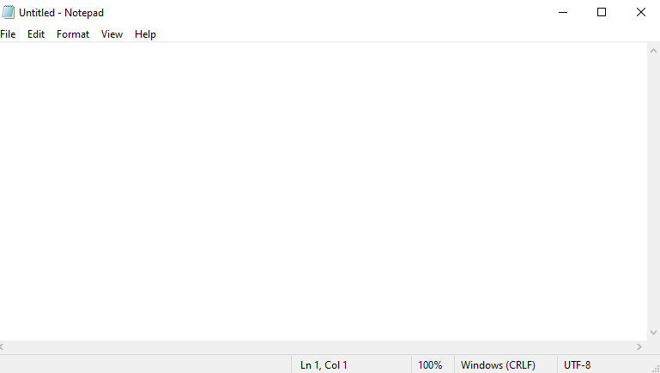
TEXT/CODE EDITOR
Step 1: Open Notepad (PC)

Slide 9
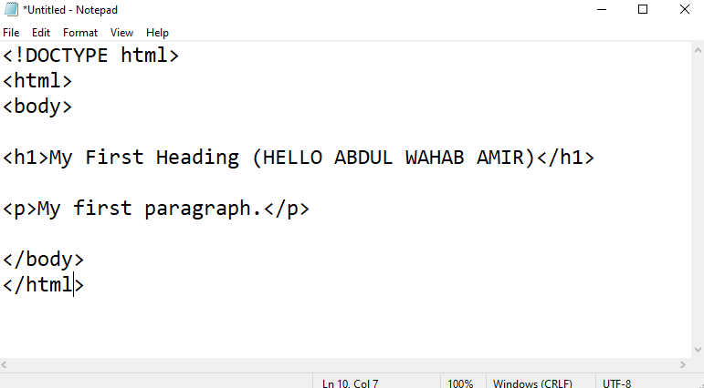
TEXT/CODE EDITOR
Step 2: Write Some HTML

Slide 10
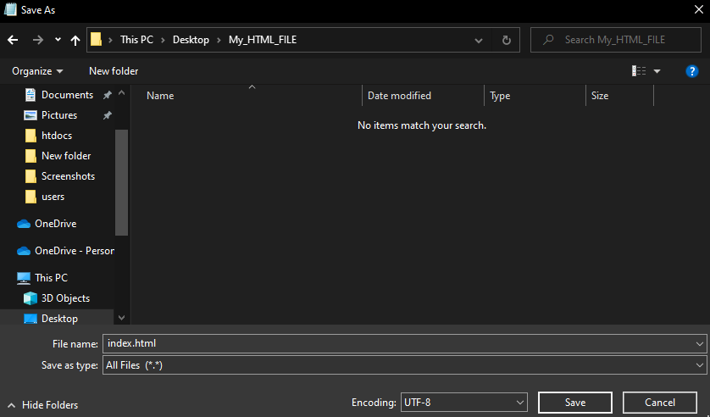
TEXT/CODE EDITOR
Step 3: Save the HTML Page

Slide 11
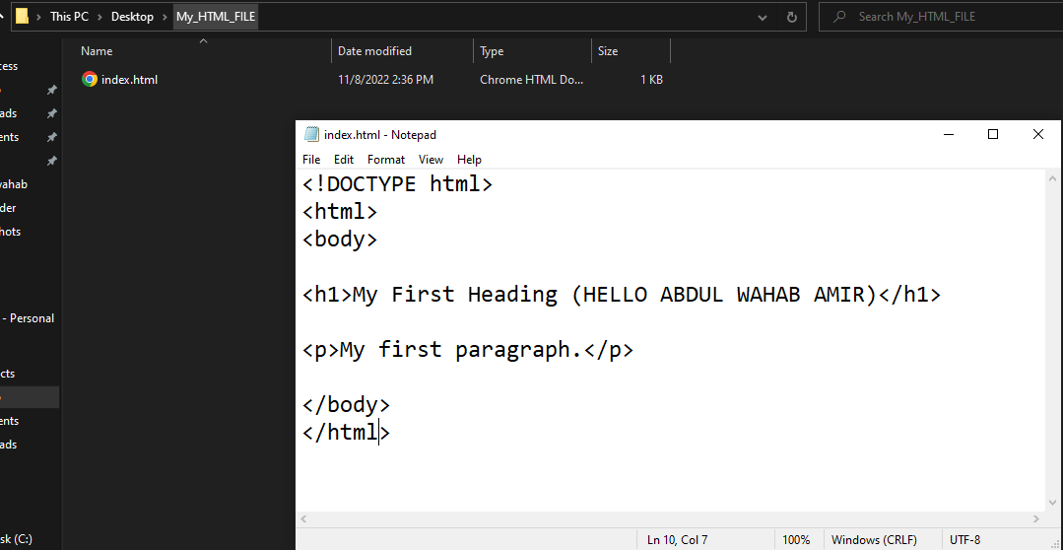
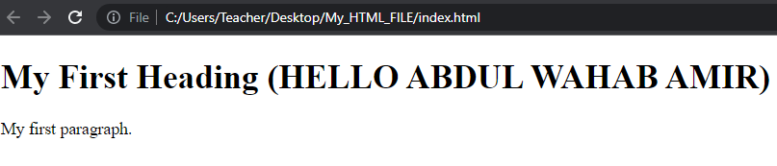
TEXT/CODE EDITOR
Step 4: View the HTML Page in Your Browser

Slide 12
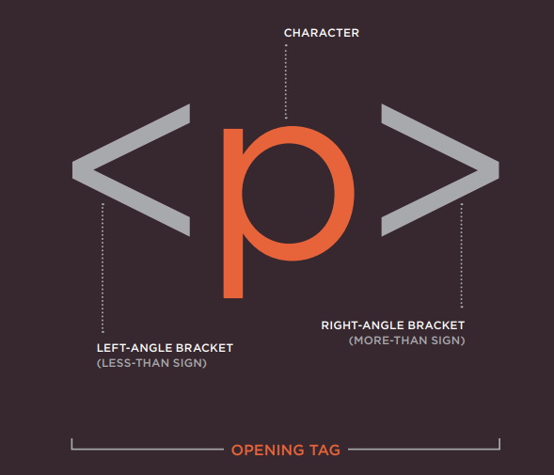

Slide 13
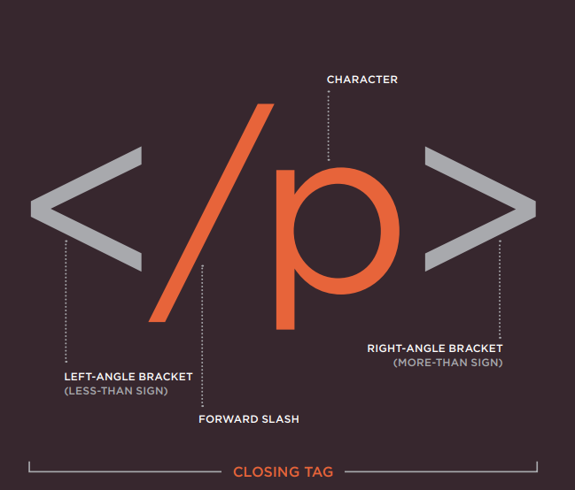

Slide 14

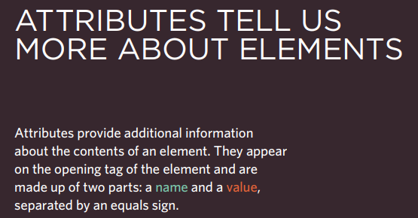

Slide 15
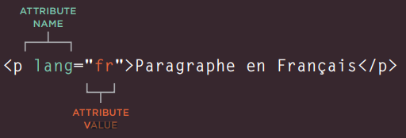
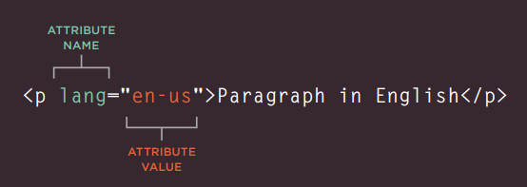

Slide 16
HTML pages are text documents.
HTML uses tags (characters that sit inside angled brackets) to give the information they surround special meaning. X Tags are often referred to as elements.
Tags usually come in pairs. The opening tag denotes the start of a piece of content; the closing tag denotes the end.
Opening tags can carry attributes, which tell us more about the content of that element.
Attributes require a name and a value.
To learn HTML you need to know what tags are available for you to use, what they do, and where they can go.

Slide 17
FORMATING OF TEXT

Slide 18

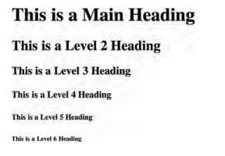
1) HEADINGS
Structural markup: the elements that you can use to describe both headings and paragraphs

Slide 19
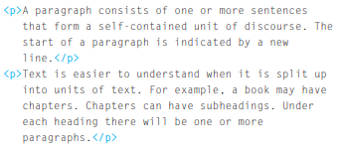
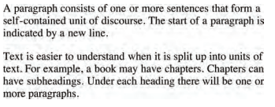
2) PARAGRAPH

Slide 20
3) BOLD AND ITALIC
4)SUPERSCRIPT & SUBSCRIPT
5)WHITESPACE
6)LINE BREAK
7)HORIZONTAL RULE

Slide 21
8) SEMANTIC MARKUPS
There are some text elements that are not intended to affect the structure of your web pages, but they do add extra information to the pages — they are known as semantic markup.
8.1) STRONG AND EMPHASIS
8.2)ABBREVIATIONS & ACRONYMS
8.3) INSERT AND DELETE
8.4) CITATIONS
7)HORIZONTAL RULE

Slide 22
HTML elements are used to describe the structure of the page (e.g. headings, subheadings, paragraphs).
They also provide semantic information (e.g. where emphasis should be placed, the definition of any acronyms used, when given text is a quotation).

Slide 23

LIST IN HTML

Slide 24
Ordered lists are lists where each item in the list is numbered. For example, the list might be a set of steps for a recipe that must be performed in order, or a legal contract where each point needs to be identified by a section number
Unordered lists are lists that begin with a bullet point (rather than characters that indicate order).
Definition lists are made up of a set of terms along with the definitions for each of those terms

Slide 25
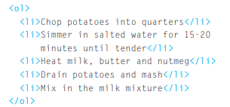
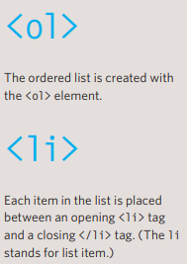

ORDERED LIST
👉👉

Slide 26
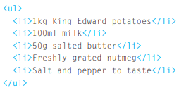
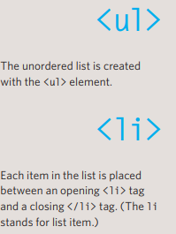

UNORDERED LIST
👉👉

Slide 27
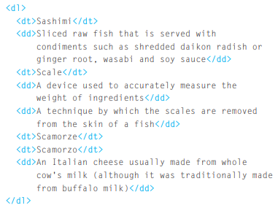
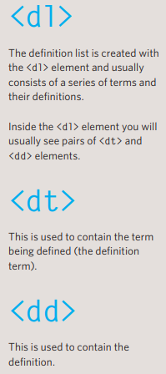
DEFINATION LIST
👉👉

Slide 28
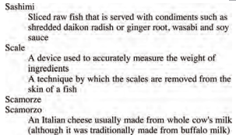
DEFINATION LIST

Slide 29
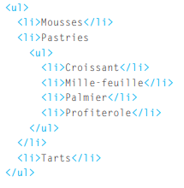
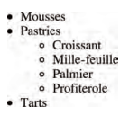
NESTED LIST
👉👉👉👉

Slide 30
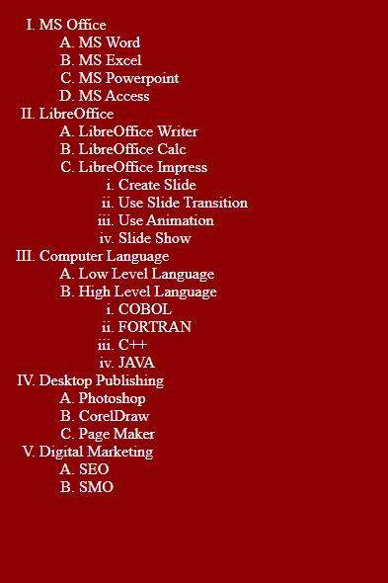
DO IT YOURSELF

Slide 31
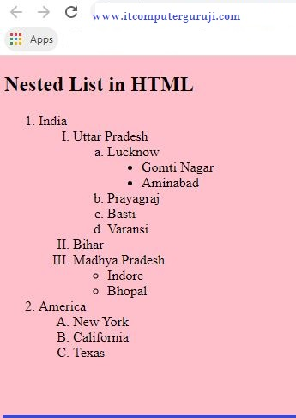
DO IT YOURSELF

Slide 32
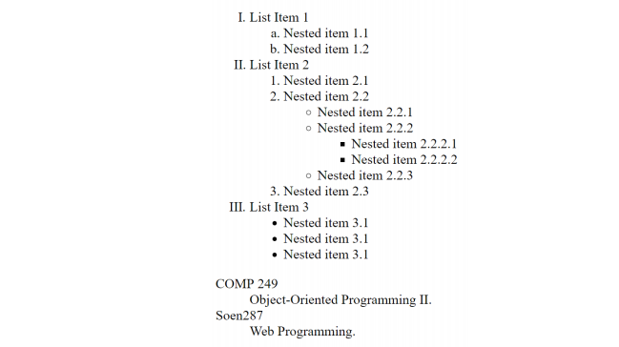
DO IT YOURSELF

Slide 33
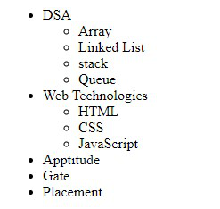
DO IT YOURSELF

Slide 34
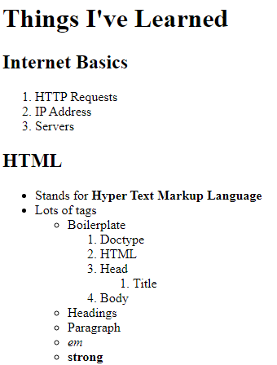
DO IT YOURSELF

Slide 35
SUMMARY
There are three types of HTML lists: ordered, unordered, and definition.
Ordered lists use numbers.
Unordered lists use bullets.
Definition lists are used to define terminology.
Lists can be nested inside one another.

Slide 36

LINKS IN HTML

Slide 37
LINKS
Links are the defining feature of the web because they allow you to move from one web page to another — enabling the very idea of browsing or surfing
You will commonly come across the following types of links:
Links from one website to another
Links from one page to another on the same website
Links from one part of a web page to another part of the same page
Links that open in a new browser window
Links that start up your email program and address a new email to someone

Slide 38
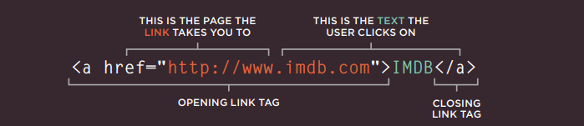

WRITING A LINKS
Links are created using the element. Users can click on anything between the opening tag and the closing tag. You specify which page you want to link to using the href attribute.

Slide 39
TAKE CARE OF IT 💀
The text between the opening tag and closing tag is known as link text. Where possible, your link text should explain where visitors will be taken if they click on it
Many people navigate websites by scanning the text for links. Clear link text can help visitors find what they want
To write good link text, you can think of words people might use when searching for the page that you are linking to

Slide 40

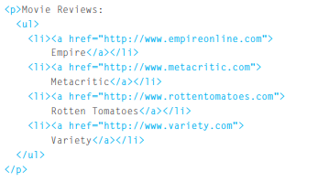
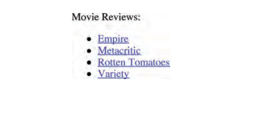
LINKING TO OTHER SITES
Links are created using the element which has an attribute called href. The value of the href attribute is the page that you want people to go to when they click on the link

Slide 41
LINKING TO OTHER SITES
When you link to a different website, the value of the href attribute will be the full web address for the site, which is known as an absolute URL.
URL stands for Uniform Resource Locator. Every web page has its own URL. This is the web address that you would type into a browser if you wanted to visit that specific page

Slide 42
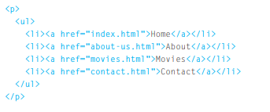
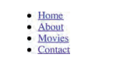
Linking to Other Pages on the Same Site
When you are linking to other pages within the same site, you do not need to specify the domain name in the URL. You can use a shorthand known as a relative URL.
If all the pages of the site are in the same folder, then the value of the href attribute is just the name of the file.

Slide 43



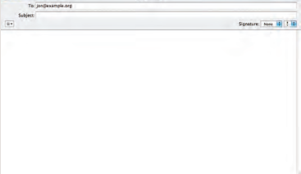
Email Links
To create a link that starts up the user's email program and addresses an email to a specified email address, you use the element. However, this time the value of the href attribute starts with mailto: and is followed by the email address you want the email to be sent to.

Slide 44



Opening Links in a New Window
If you want a link to open in a new window, you can use the target attribute on the opening tag. The value of this attribute should be _blank.
Generally you should avoid opening links in a new window, but if you do, it is considered good practice to inform users that the link will open a new window before they click on it.

Slide 45
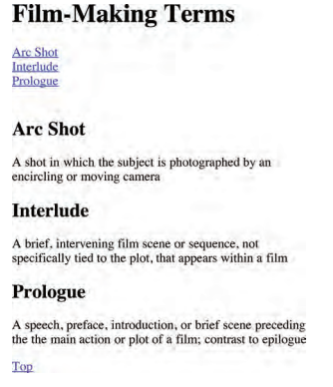
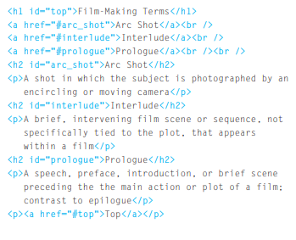
Linking to a Specific Part of the Same Page
At the top of a long page you might want to add a list of contents that links to the corresponding sections lower down. Or you might want to add a link from part way down the page back to the top of it to save users from having to scroll back to the top

Slide 46
Linking to a Specific Part of the Same Page
Links are created using the element.
The element uses the href attribute to indicate the page you are linking to.
If you are linking to a page within your own site, it is best to use relative links rather than qualified URLs.
You can create links to open email programs with an email address in the "to" field.
You can use the id attribute to target elements within a page that can be linked to.

