Slide 1

J QUERY INTRODUCTION
ABDUL WAHAB AMIR| APTECH LEARNING | J QUERY OVERVIEW

Slide 3
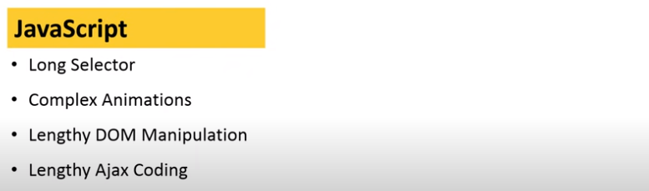
LENGTHY CODE OF JAVASCRIPT 🥺🥺🥺

Slide 4
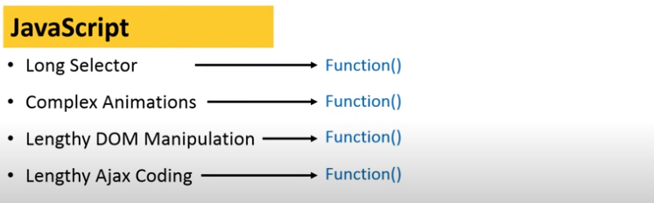
HURRAH ! WE HAVE J QUERY 🤩🤩🤩

Slide 5
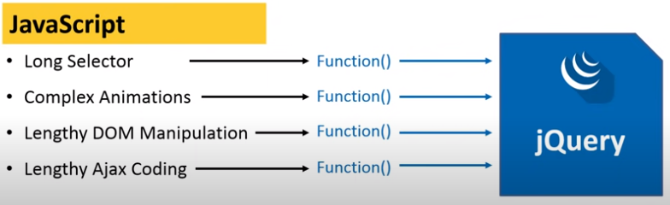
HURRAH ! WE HAVE J QUERY 🤩🤩🤩

Slide 6

J QUERY MOTIVE

Slide 7




Slide 8
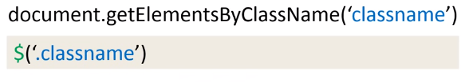

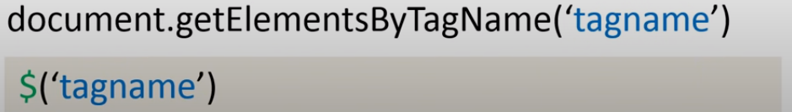

Slide 9
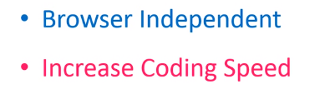

Slide 10
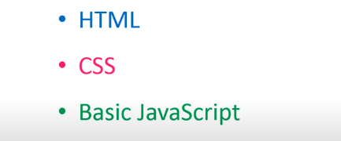

Slide 11
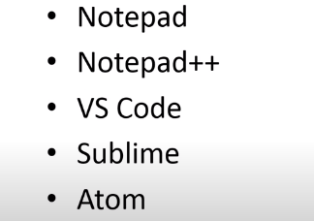

Slide 12


Slide 16
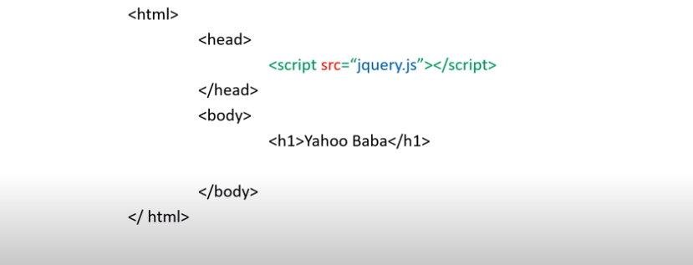

Slide 17
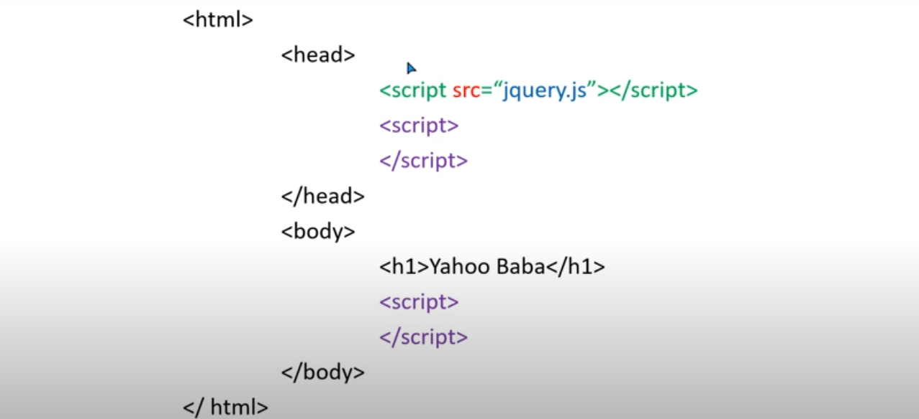

Slide 18
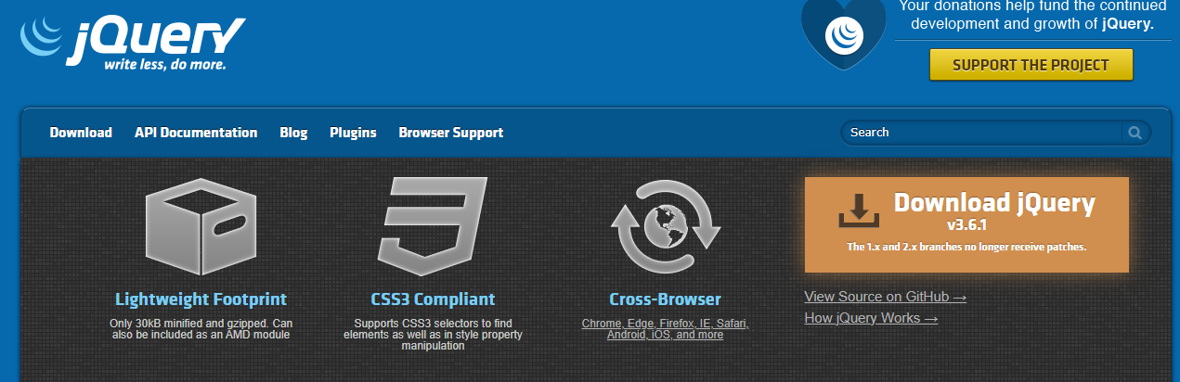
DOWNLOAD THE J QUERY FROM ITS WESITE
👈👈👈👈

Slide 19
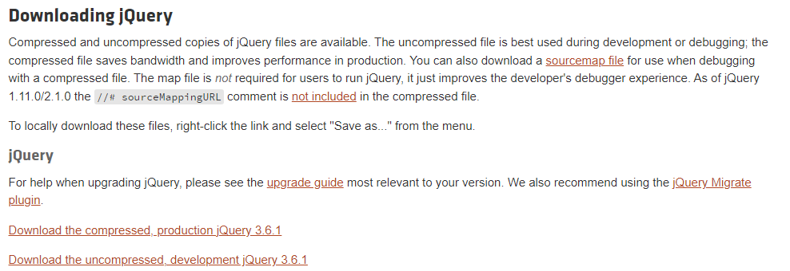
👉
👉

Slide 20
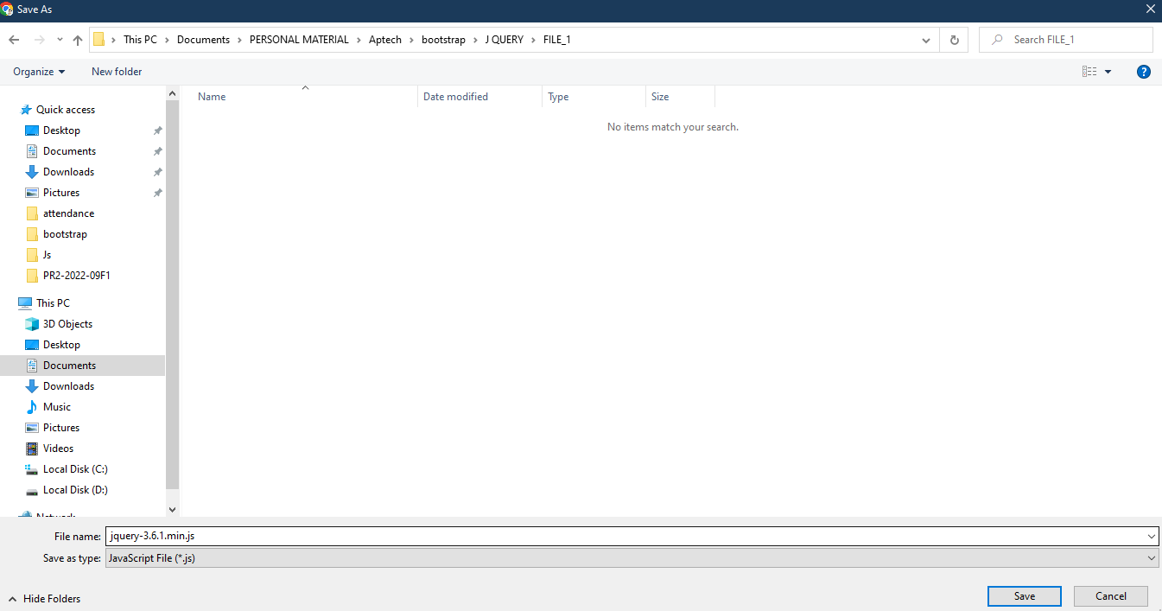

Slide 21
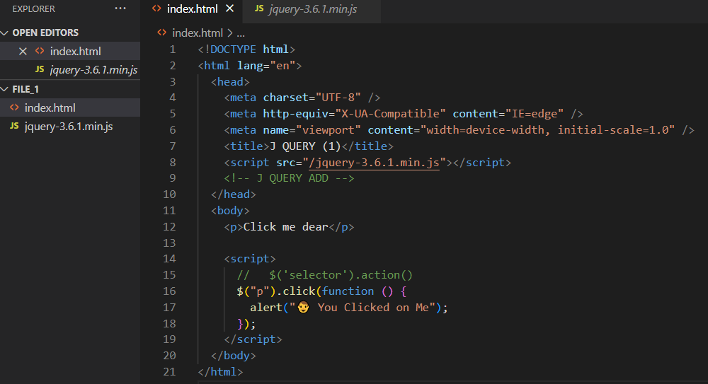

Slide 22


