Slide 1
What is OneNote?
OneNote is an electronic notebook, which is a part of Microsoft Office since 2003. It allows you to organize notes, files, articles, pictures, and more information in a single digital notebook. It is available approximately for all devices such as Mobile, Laptops, Desktops, and also for all the operating system (IOS, MAC, Windows, and Android).

Slide 2
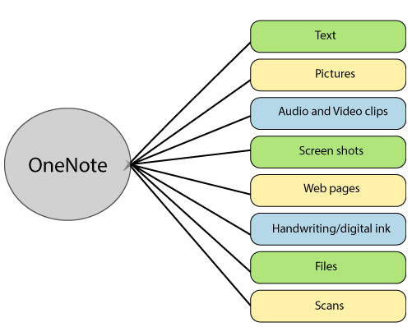

Slide 3
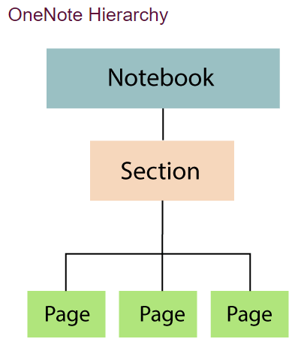

Slide 4
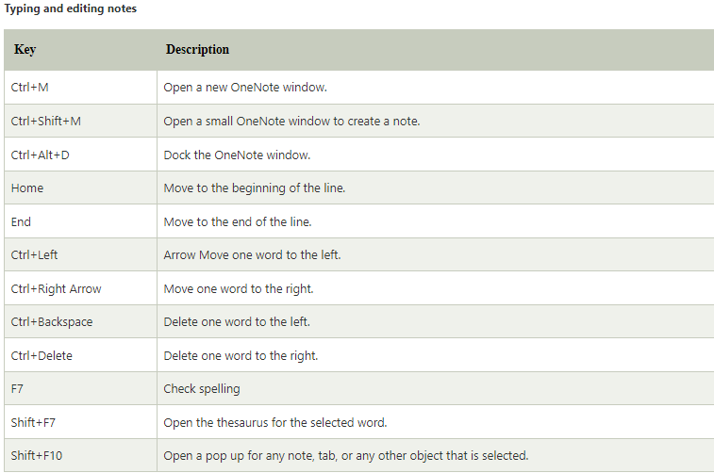

Slide 5
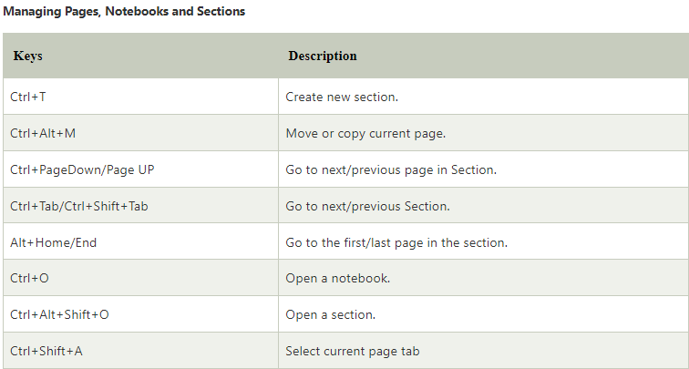

Slide 6
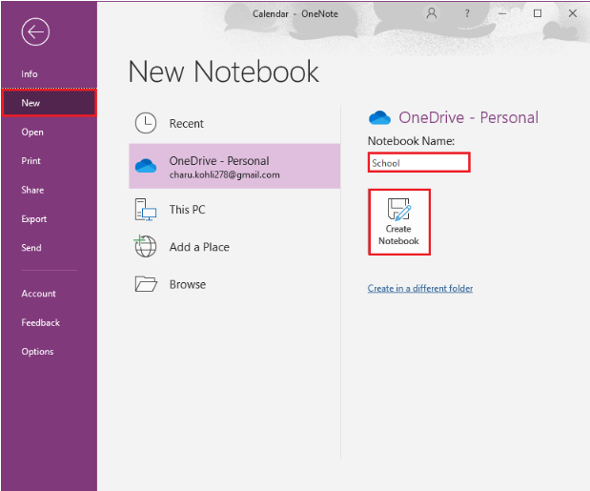
Step1: Open OneNote2016. Click on File->New->provide the notebook name. Then click on create Notebook.

Slide 7
