Slide 1
MORPH EFFECTS

Slide 2
MORPH EFFECTS

Slide 3
MORPH EFFECTS

Slide 4
ANIMATION PANE
IT WILL COME FIRST
IT WILL COME SECOND
IT WILL COME THIRD

Slide 5
PERFECT SHAPES AND LINE

Slide 6
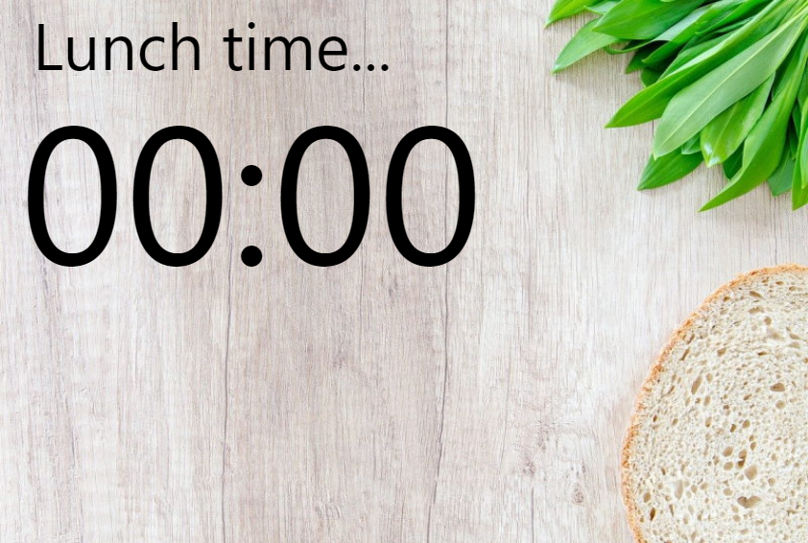
CUTDOWN TIMER

Slide 7
MERGE SHAPES

Slide 8
ALIGN OBJECTS & GROUPS

Slide 9
SELECTION PANE & LAYERS

Slide 10



EYE DROPPER WITH SNIP
ABDUL WAHAB AMIR

Slide 11


RECORD CURRENT SLIDE

Slide 12
PRESENTATION SHORTCUTS F1

Slide 13
HOW TO CREATE INTRESTING SLIDES RATHER THAN BORING SLIDES
The word 'lorem', for example, isn't a real Latin word, it's a shortened version
I am here for you
My story in one line

Slide 14




