Slide 1

ONE DRIVE TUTORIALS
ABDUL WAHAB AMIR

Slide 2
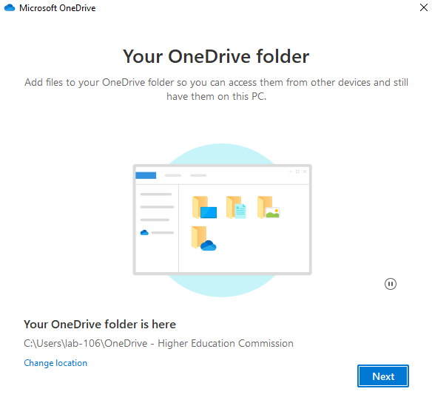
CREATING PAGES AND NAME IT AND EDIT IT

Slide 3
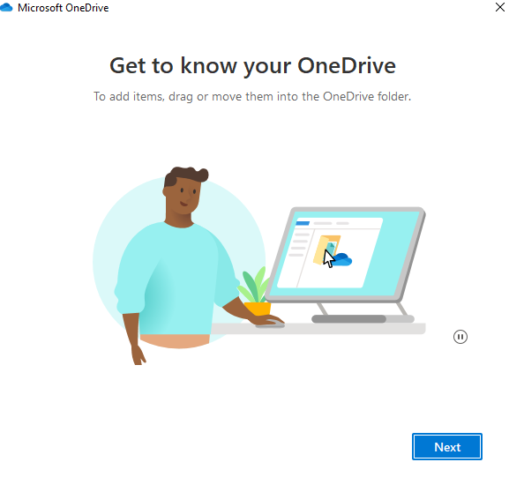
PROCESS TO ONE DRIVE

Slide 4
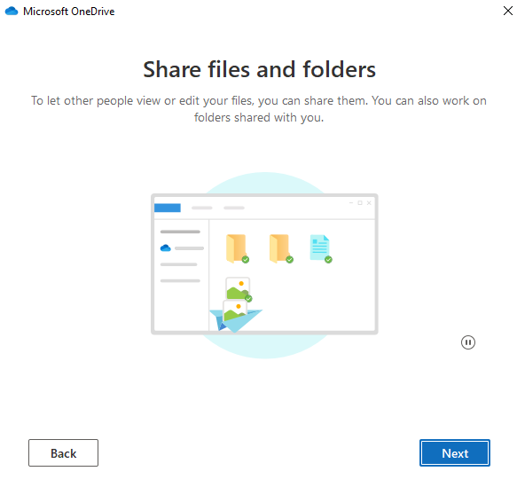
SHARE FILES AND FOLDER TO CLIENTS

Slide 5
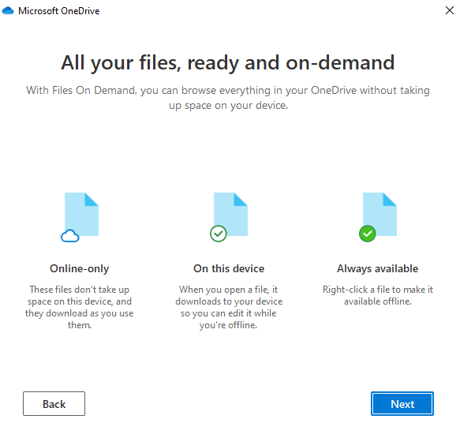
COMPLETELY AVAILABLE FRO YOU

Slide 6
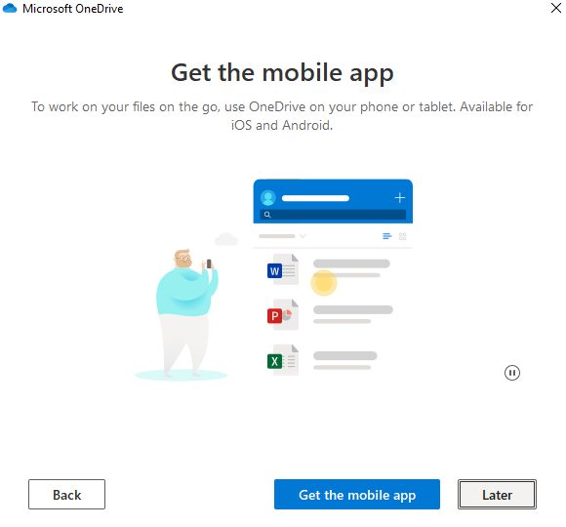
WAOO, I HAVE MY MOBILE APP OF ONE DRIVE

Slide 7
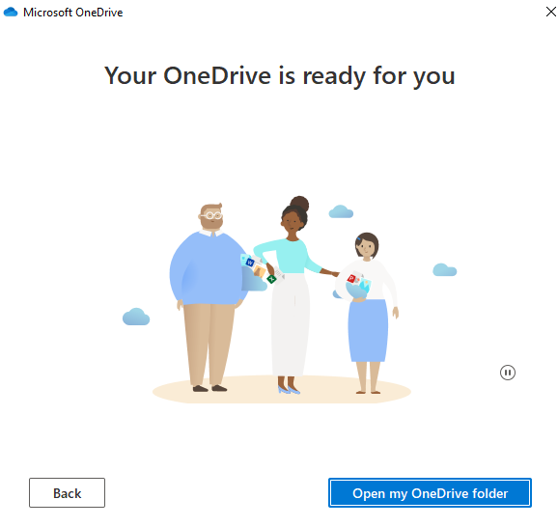
AFTER GETTING LOGING

Slide 8
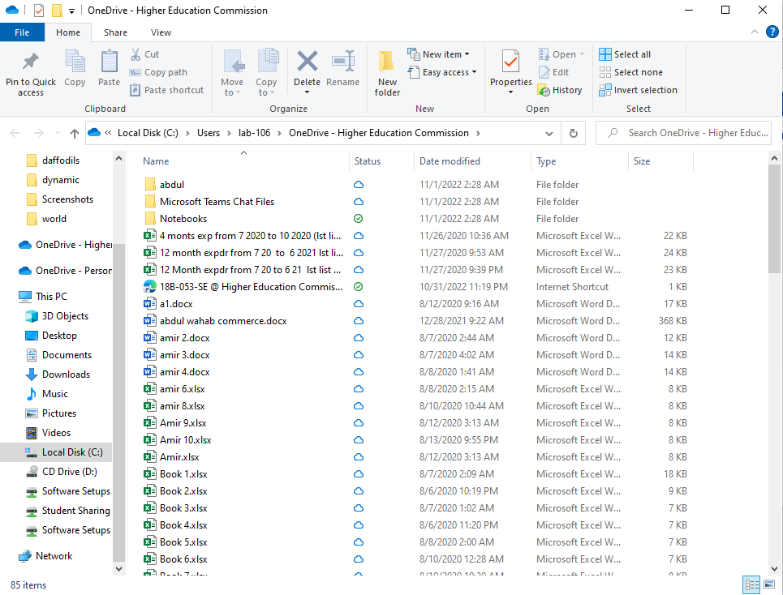
MY ONE DRIVE FOLDER

Slide 9
