Slide 1
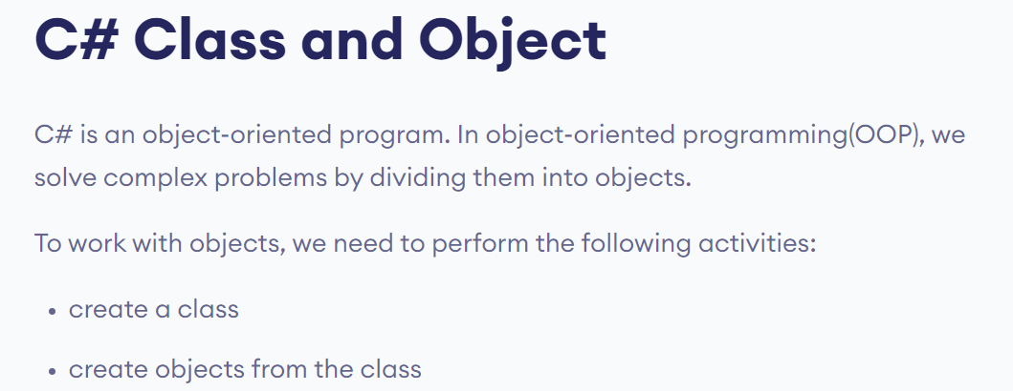

Slide 2
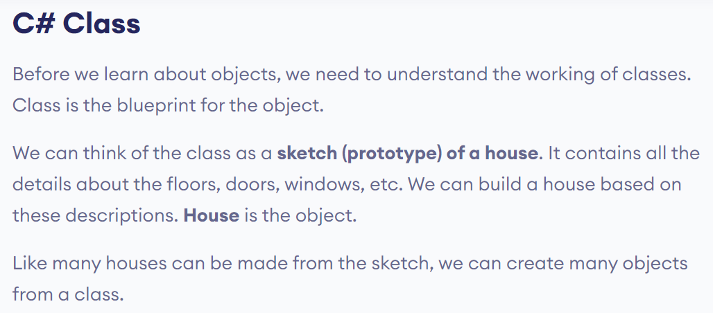

Slide 3
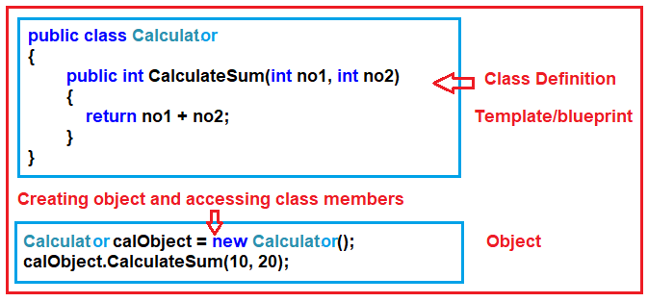

Slide 4
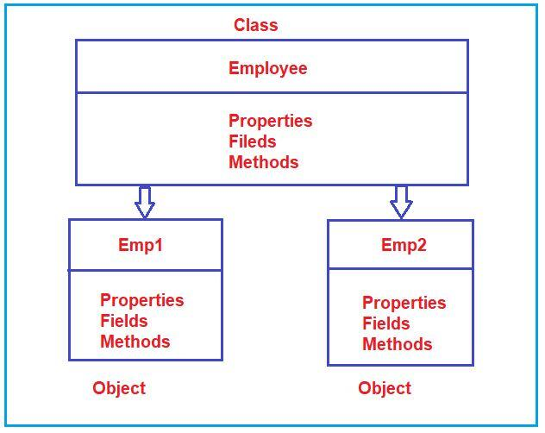

Slide 5
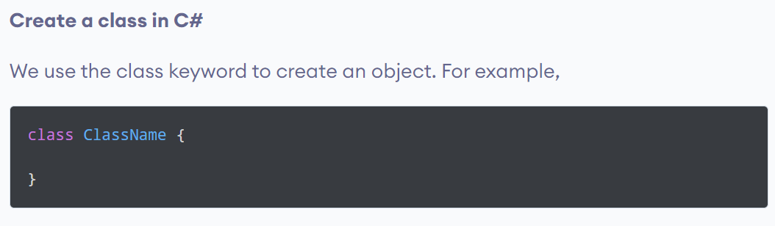

Slide 6
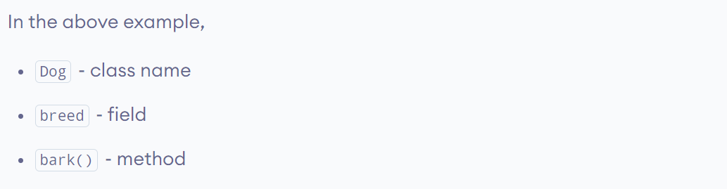

Slide 7
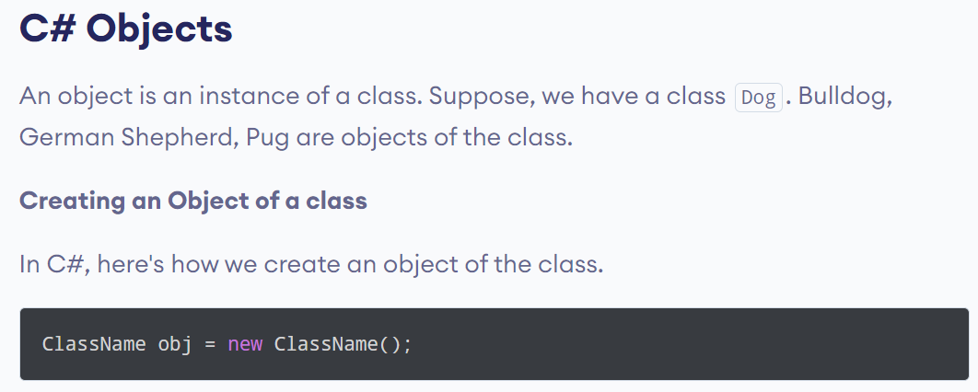

Slide 8
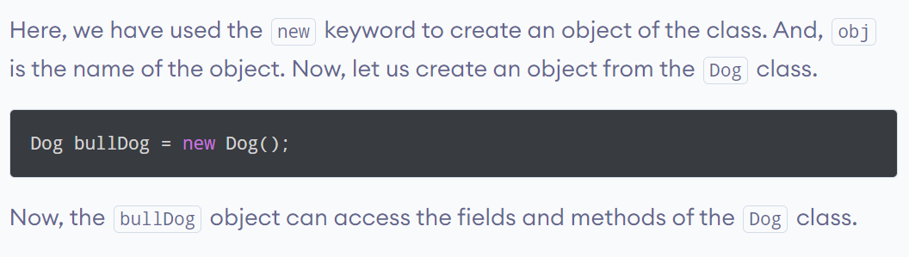

Slide 9
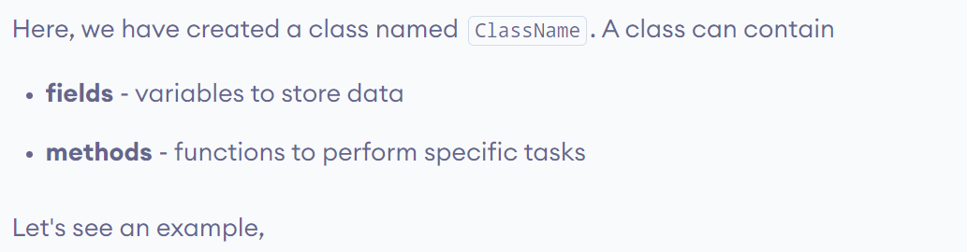
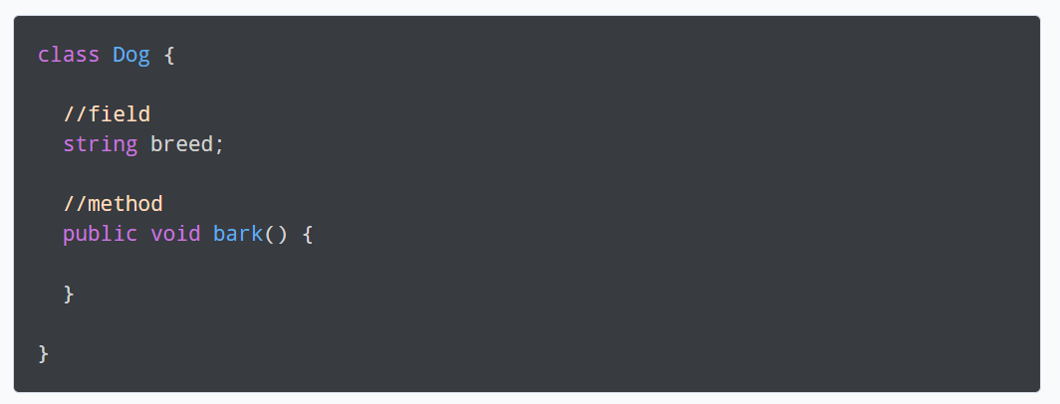

Slide 10
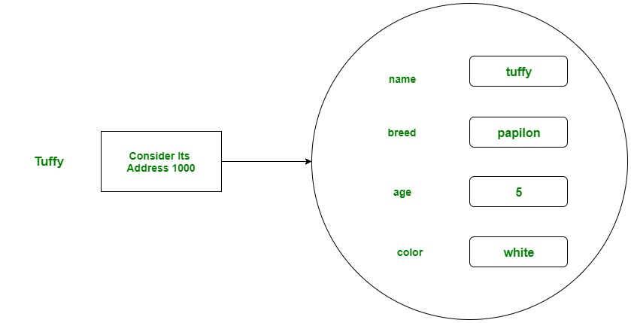

Slide 11
using System;
// Class Declaration
public class Dog {
// Instance Variables
String name;
String breed;
int age;
String color;
// Constructor Declaration of Class
public Dog(String name, String breed,
int age, String color)
{
this.name = name;
this.breed = breed;
this.age = age;
this.color = color;
}

Slide 12
// Property 1
public String GetName()
{
return name;
}
// Property 2
public String GetBreed()
{
return breed;
}
// Property 3
public int GetAge()
{
return age;
}
// Property 4
public String GetColor()
{
return color;
}

Slide 13
// Method 1
public String ToString()
{
return ("Hi my name is " + this.GetName()
+ ".\nMy breed, age and color are " + this.GetBreed()
+ ", " + this.GetAge() + ", " + this.GetColor());
}
// Main Method
public static void Main(String[] args)
{
// Creating object
Dog tuffy = new Dog("tuffy", "papillon", 5, "white");
Console.WriteLine(tuffy.ToString());
}
}

Slide 14
using System;
namespace ClassObjectsDemo
{
class Program
{
static void Main(string[] args)
{
//Creating object
Calculator calObject = new Calculator();
//Accessing Calculator class member using Calculator class object
int result = calObject.CalculateSum(10, 20);
Console.WriteLine(result);
Console.ReadKey();
}
}
//Defining class or blueprint or template
public class Calculator
{
public int CalculateSum(int no1, int no2)
{
return no1 + no2;
}
}
}

Slide 15
