Slide 2
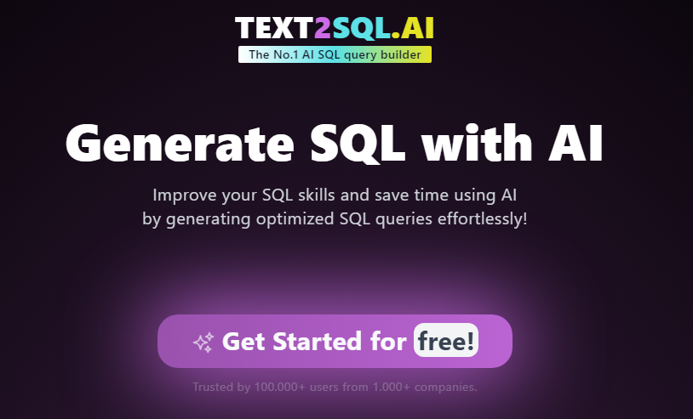
https://www.text2sql.ai/app

Slide 3
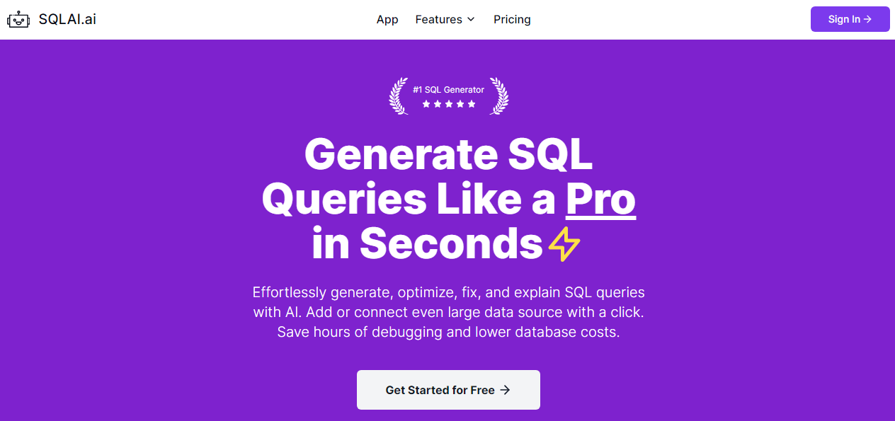
https://www.sqlai.ai/

Slide 4
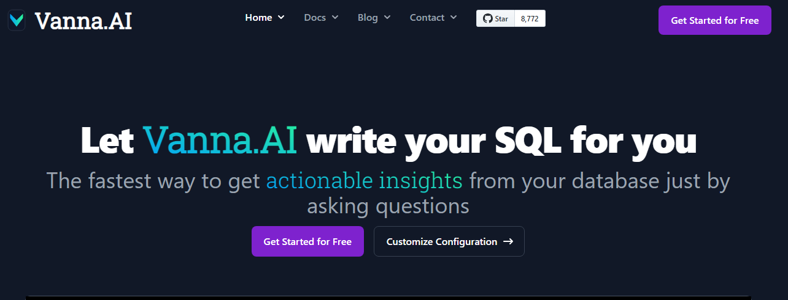
https://vanna.ai/

