Slide 1

Section Header01
Subtitle

Slide 2

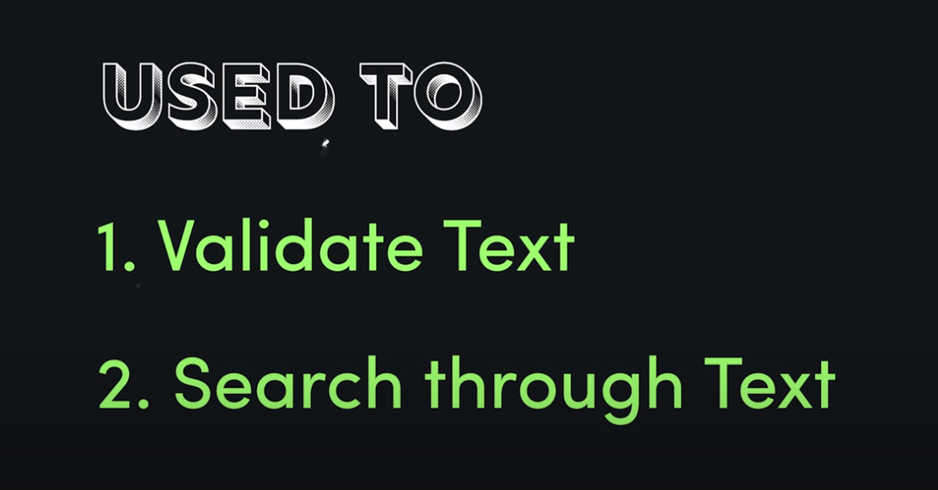
Section Header01
Subtitle

Slide 3
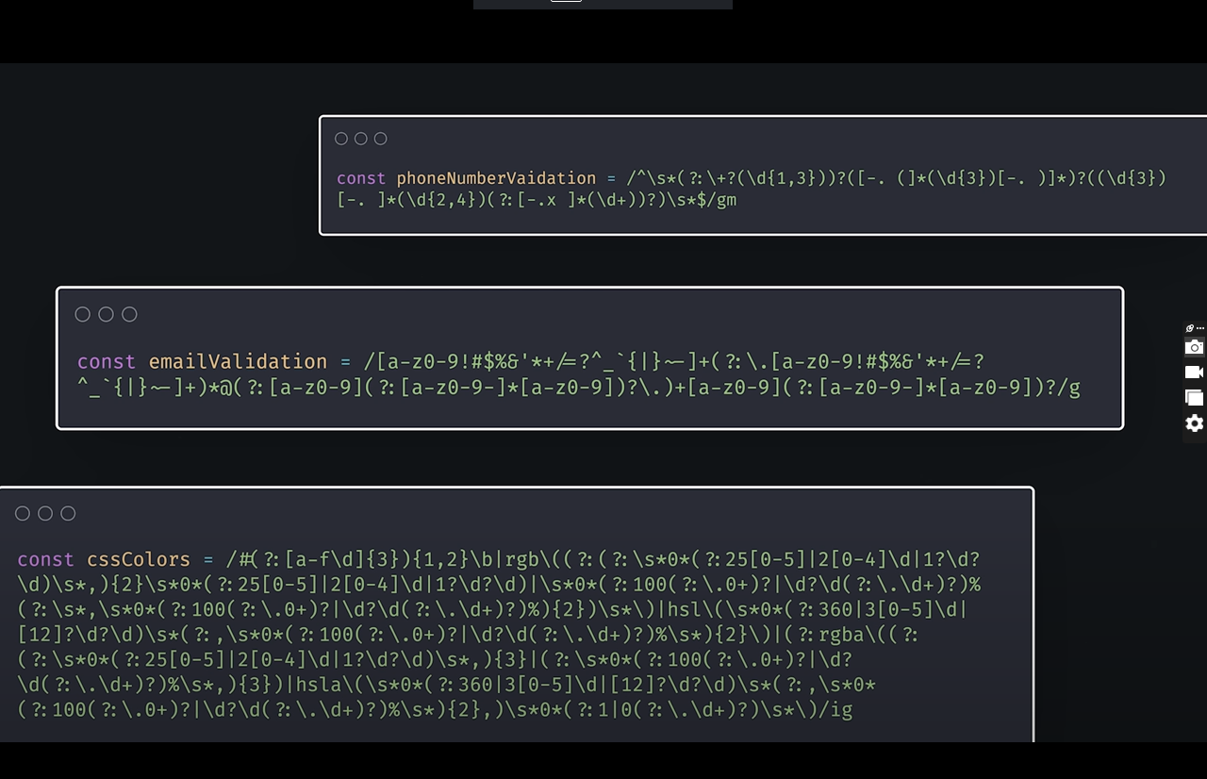
Section Header01
Subtitle

Slide 4
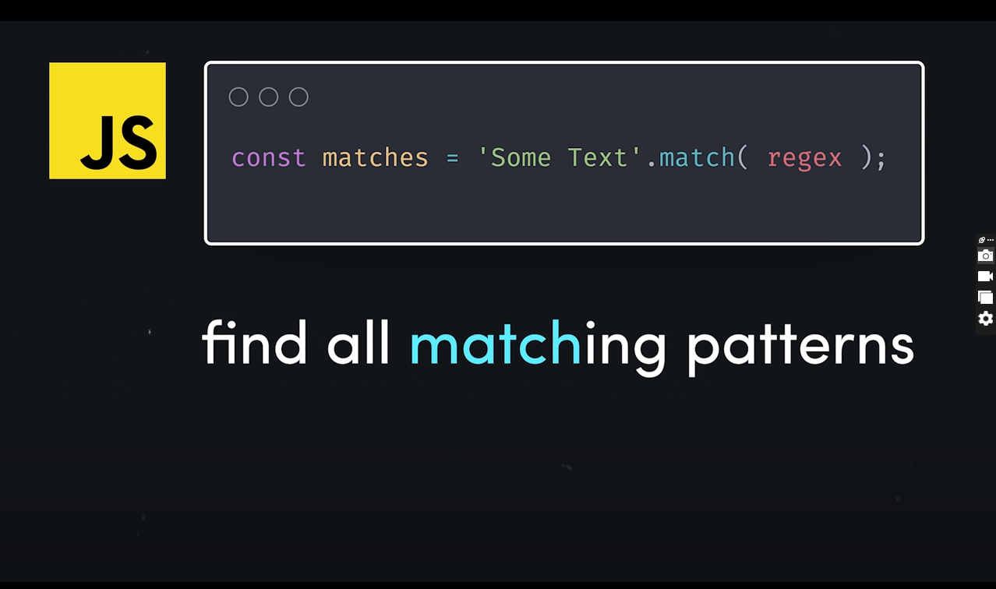
Section Header01
Subtitle

Slide 5
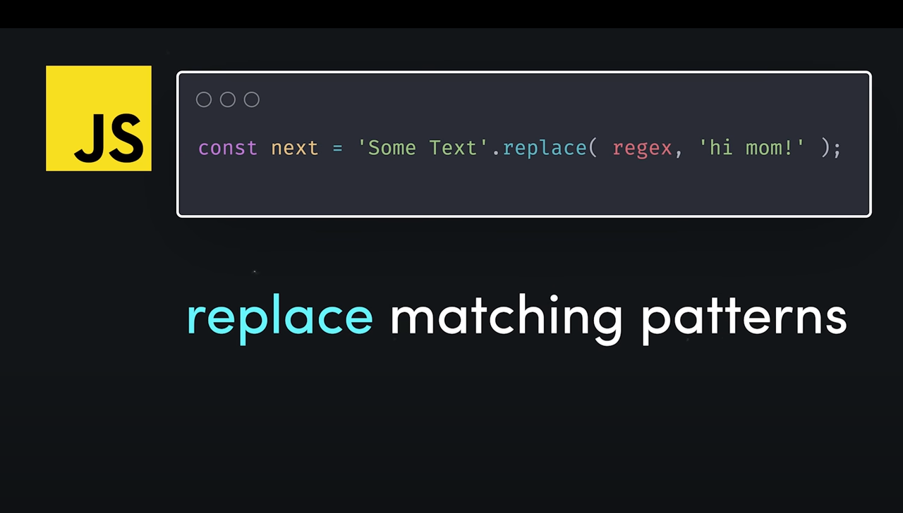
Section Header01
Subtitle

Slide 6
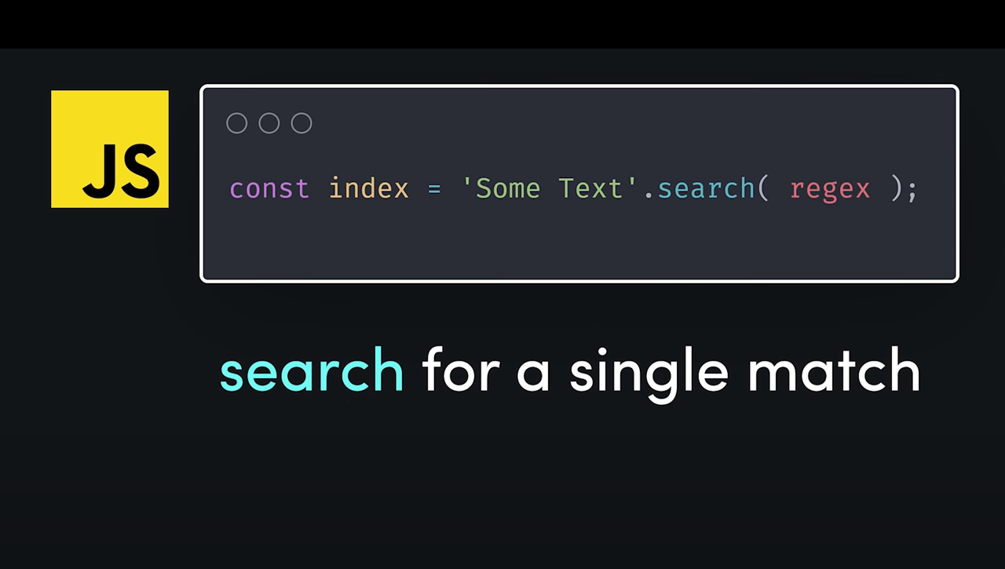
Section Header01
Subtitle

Slide 7
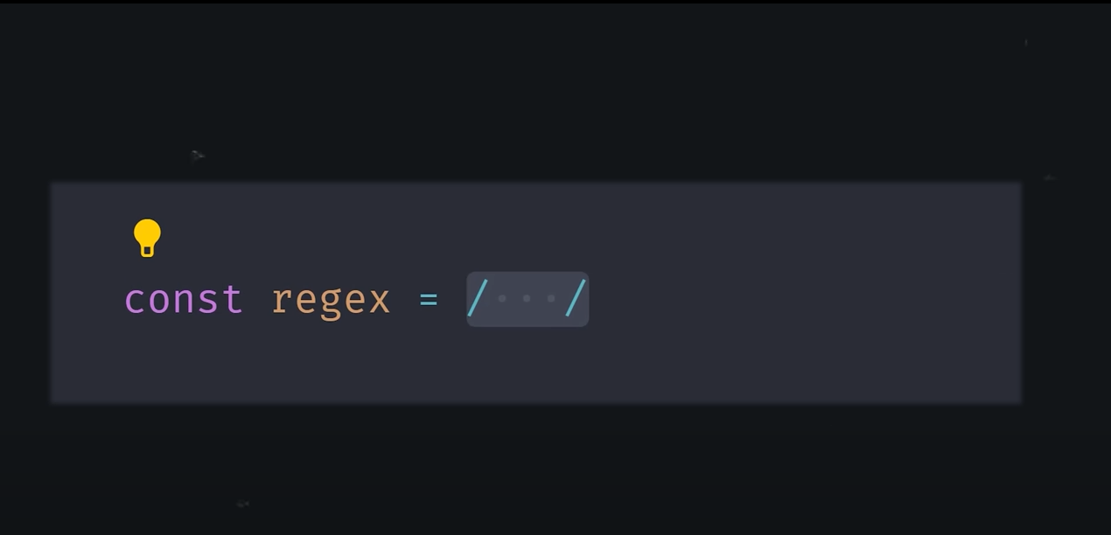
Section Header01
Subtitle

Slide 8
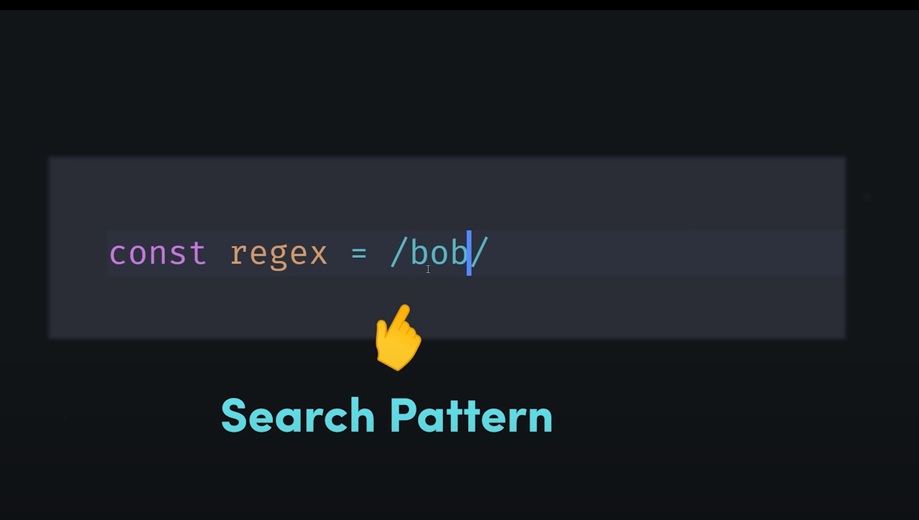
Section Header01
Subtitle

Slide 9
Section Header01
Subtitle

Slide 10
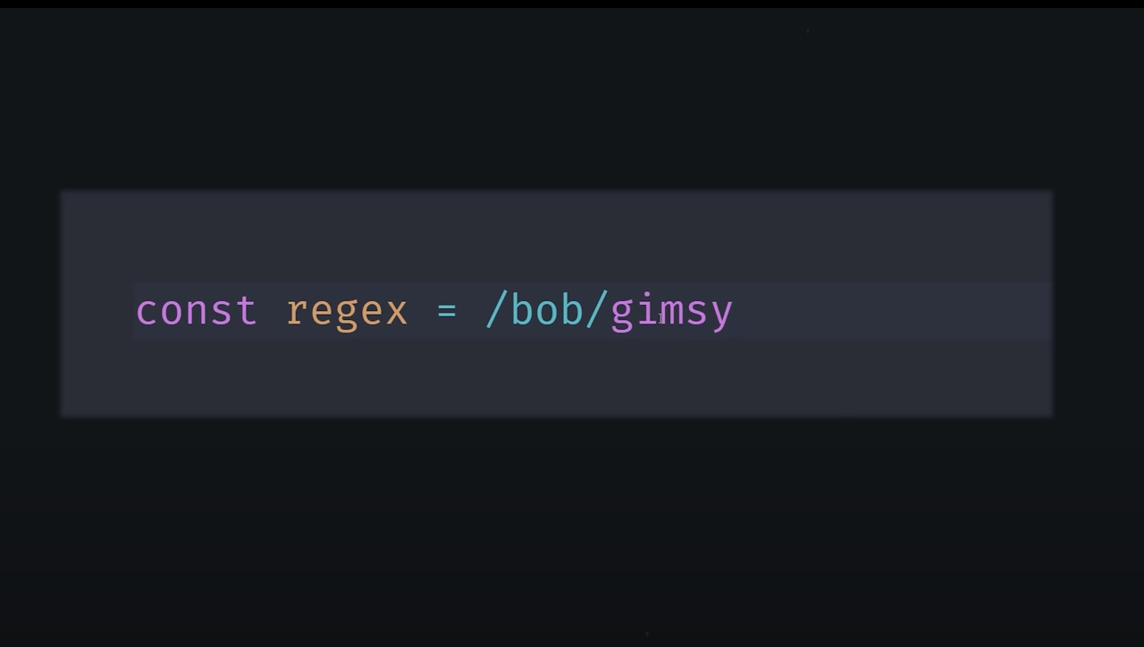
Section Header01
Subtitle

Slide 11
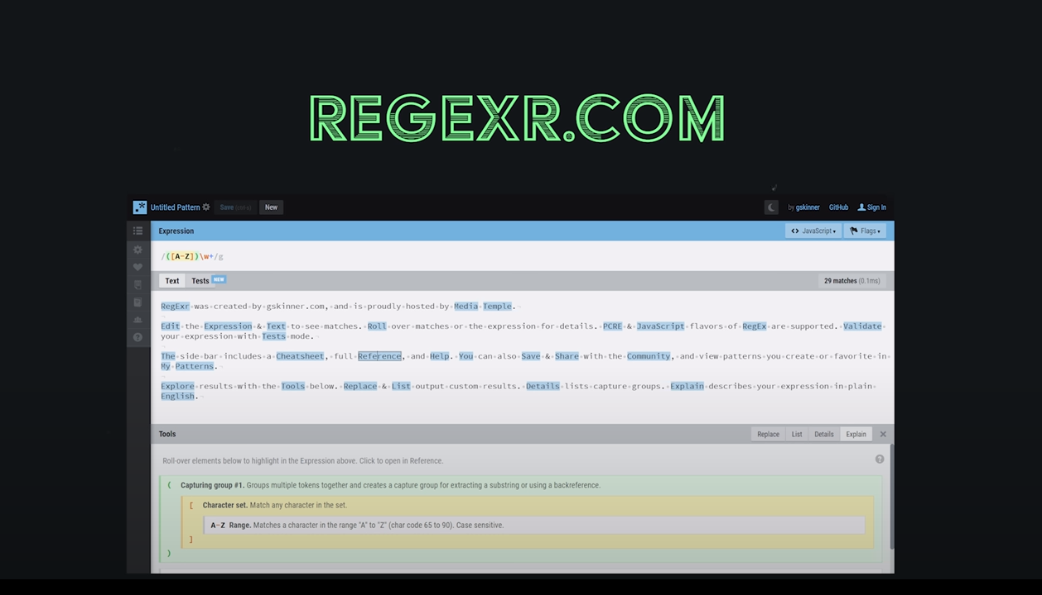
Section Header01
Subtitle

Slide 12
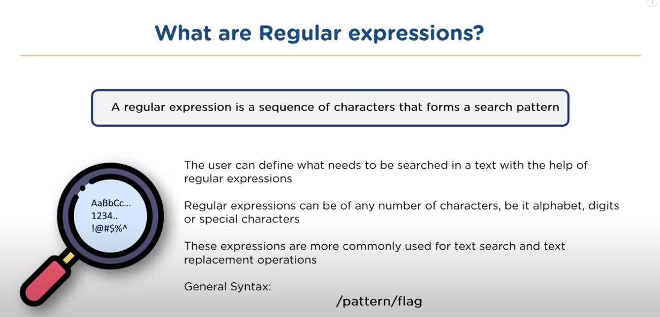
Section Header01
Subtitle

Slide 13
Section Header01
Subtitle

Slide 14
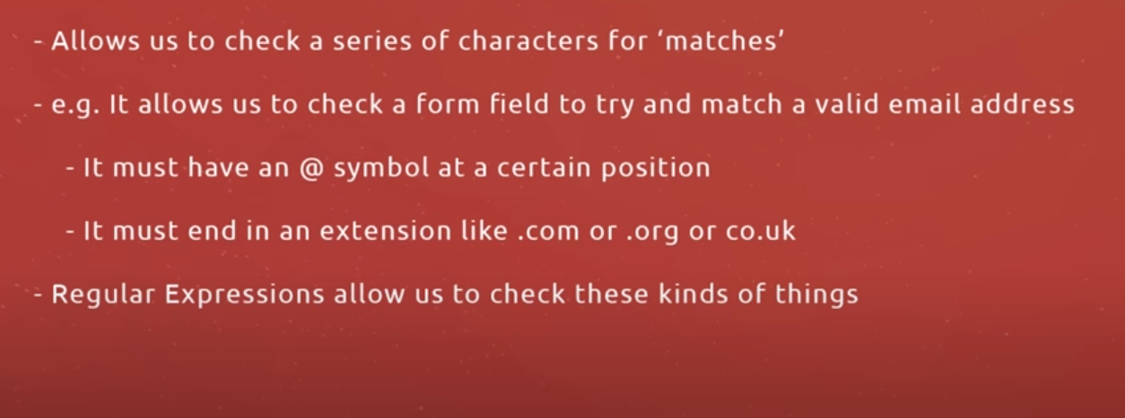
Section Header01
Subtitle

Slide 15
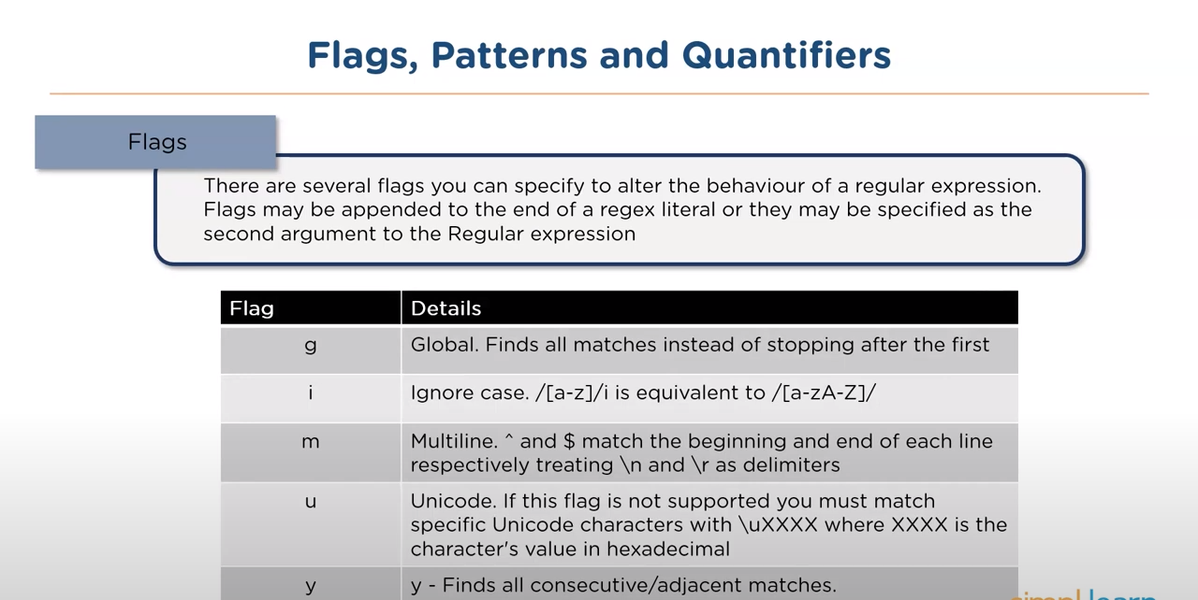
Section Header01
Subtitle

Slide 16
Section Header01
Subtitle

Slide 17
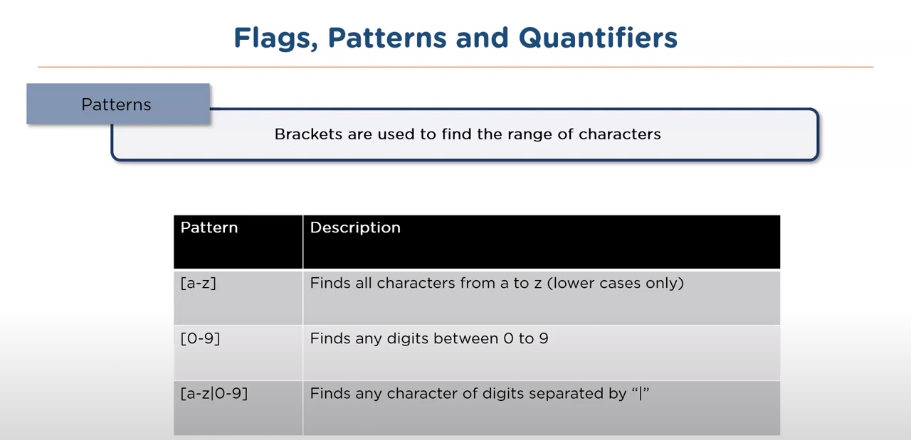
Section Header01
Subtitle

Slide 18
Section Header01
Subtitle

Slide 19

Section Header01
Subtitle

Slide 20
Section Header01
Subtitle

Slide 21
Section Header01
Using String Methods
In JavaScript, regular expressions are often used with the two string methods: search() and replace().
The search() method uses an expression to search for a match, and returns the position of the match.
The replace() method returns a modified string where the pattern is replaced.
Subtitle

Slide 22
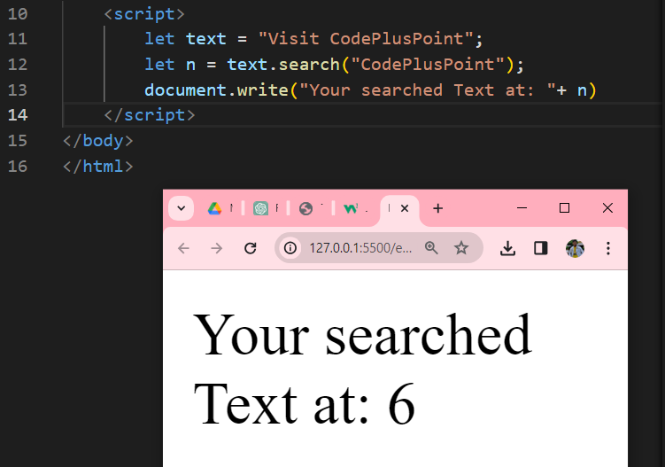
Section Header01
Using String search()
Subtitle

Slide 23
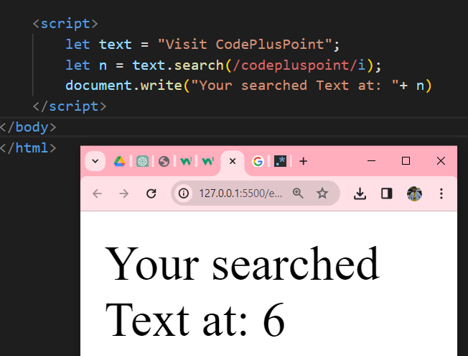
Section Header01
Using String search() With a Regular Expression
Subtitle

Slide 24
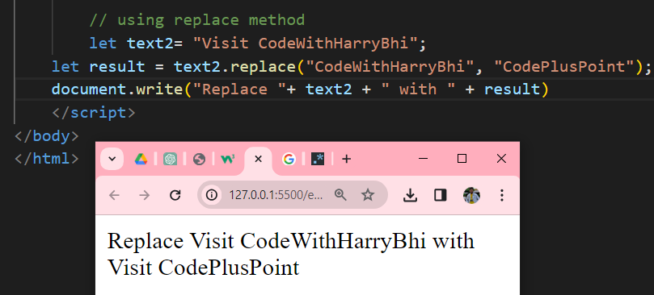
Section Header01
Using String replace() With a String
Subtitle

Slide 25
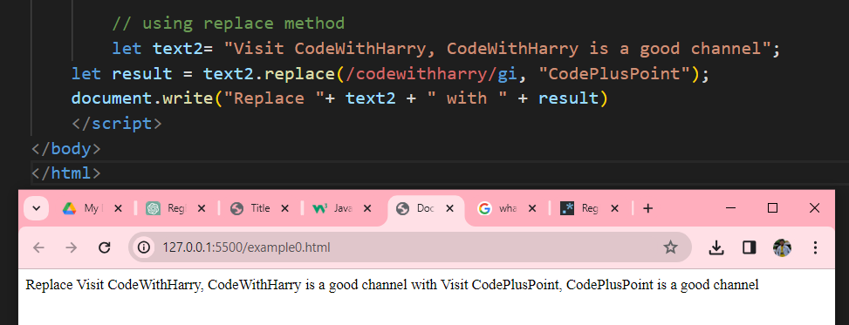
Section Header01
Using String replace() With a Regular Expression
Subtitle

Slide 26
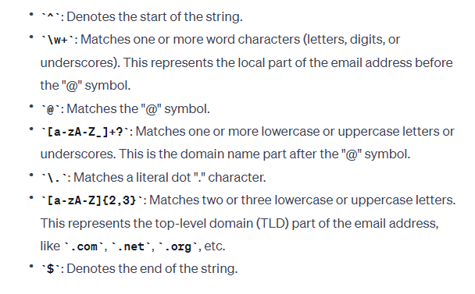
Section Header01
EMAIL VALIDATION
used to validate email addresses in JavaScript
regex = /^\w+@[a-zA-Z_]+?\.[a-zA-Z]{2,3}$/;
Subtitle

Slide 27
Section Header01
EMAIL VALIDATION
used to validate email addresses in JavaScript
regex = /^\w+@[a-zA-Z_]+?\.[a-zA-Z]{2,3}$/;
VALID EMAIL ADDRESSES MATCHING THIS REGEX PATTERN:
user@example.com
someone_123@sub.domain.org
Subtitle

Slide 28
Section Header01
EMAIL VALIDATION
regex = /^\w+@[a-zA-Z_]+?\.[a-zA-Z]{2,3}$/;
Subtitle

Slide 29
Section Header01
PASSWORD VALIDATION
regex = /^(?=.*\d)(?=.*[a-z])(?=.*[A-Z]).{8,}$/;
Password should be at least 8 characters long, contain at least one uppercase letter, one lowercase letter, and one digit
Subtitle

Slide 30
Section Header01
URL VALIDATION
regex = /^(http|https):\/\/[^ "]+$/;
Matches URLs starting with http:// or https://
https://www.example.com
Subtitle

Slide 31
Section Header01
Subtitle

Slide 32
Section Header01
Subtitle

Slide 33
Section Header01
Subtitle

Slide 34
Thank You

