Slide 1
SEND MAIL TO PEOPLE
How to send mail from localhost XAMPP using PHP

Slide 2
SMTP
SIMPLE MAIL TRANSFER PROTOCOL
To send mail from localhost XAMPP using Gmail, configure XAMPP after installing it. Follow the below steps for the same. Steps to Send Mail From Localhost XAMPP Using Gmail:

Slide 3
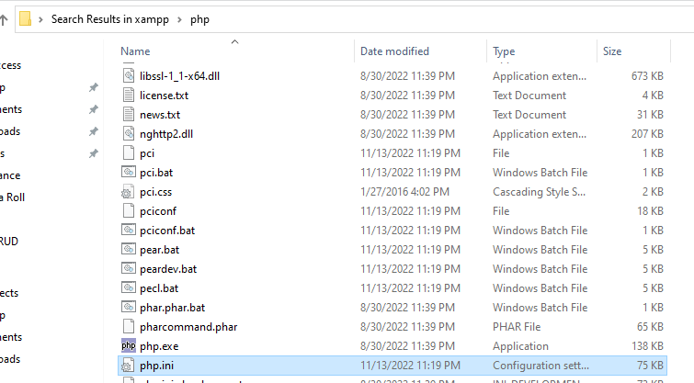
FIRST STEP: GO TO XAMPP , THEN PHP , THEN OPE PHP.INI FILE

Slide 4
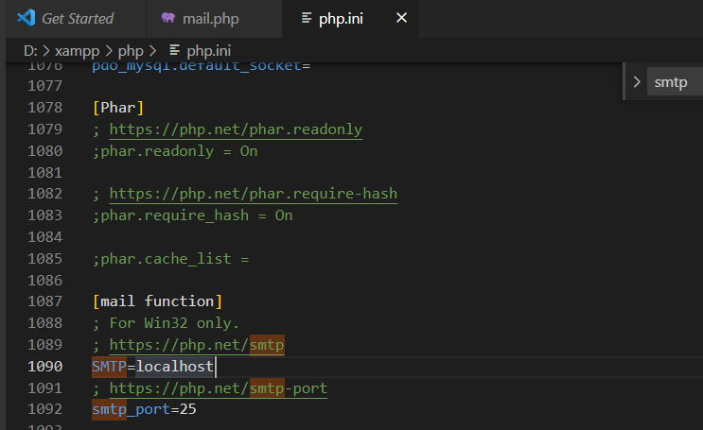
FILE PHP.INI AND SEARCH SMTP

Slide 5
THE WHOLE PROCESS IS HERE ! FOR PHP.INI FILE
Go to C:\xampp\php and open the php.ini file. Find [mail function] by pressing ctrl + f. Search and pass the following values: SMTP=smtp.gmail.com smtp_port=587 sendmail_from = YourGmailId@gmail.com sendmail_path = "\"C:\xampp\sendmail\sendmail.exe\" -t"

Slide 6
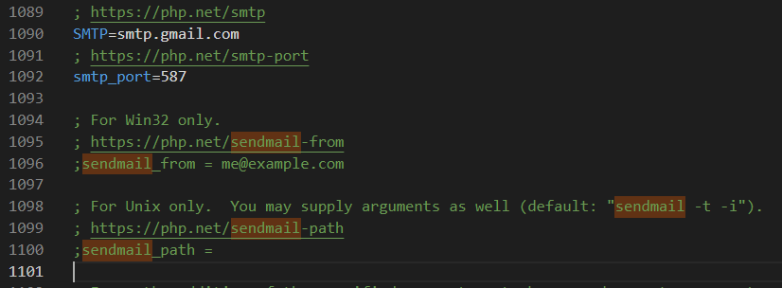
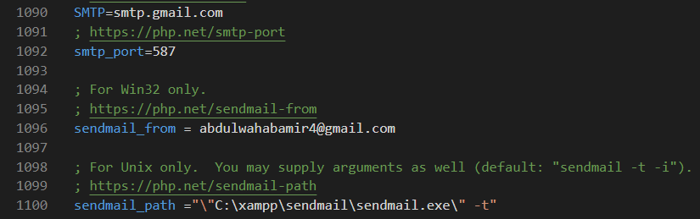
DO CHANGES AND SAVE IT MUST
BEFORE
AFTER

Slide 7
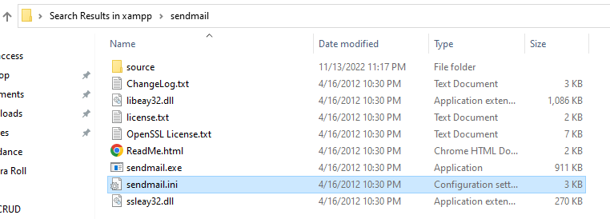
NOW, OPEN XAMPP , THEN SENDMAIL , OPEN SENDMAIL.INI FILE

Slide 8
THE WHOLE PROCESS IS HERE ! FOR SENDMAIL.INI FILE
Now, go to C:\xampp\sendmail and open the sendmail.ini file. Find [sendmail] by pressing ctrl + f. Search and pass the following values smtp_server=smtp.gmail.com smtp_port=587 or 25 //use any of them error_logfile=error.log debug_logfile=debug.log auth_username=YourGmailId@gmail.com auth_password=Your-Gmail-Password force_sender=YourGmailId@gmail.com(optional)

Slide 9
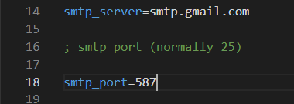
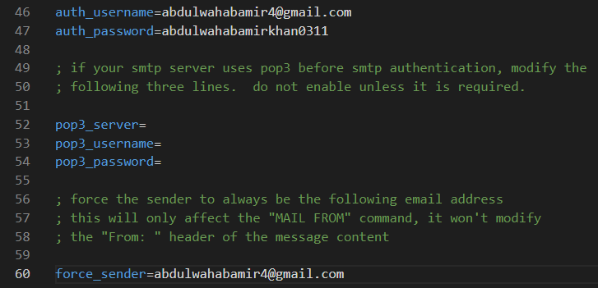
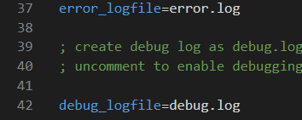
AFTER CHANGES

Slide 10
THE CODE FOR PHP MAIL
<?php $to_email = "receipient@gmail.com"; $subject = "Simple Email Test via PHP"; $body = "Hi, This is test email send by PHP Script"; $headers = "From: sender email"; if (mail($to_email, $subject, $body, $headers)) { echo "Email successfully sent to $to_email..."; } else { echo "Email sending failed..."; }

Slide 11
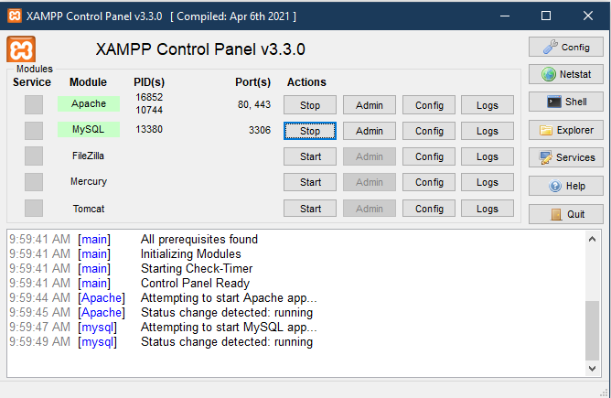
RESTART XAMPP SERVER , CLOSE IT AND THEN IT

Slide 12
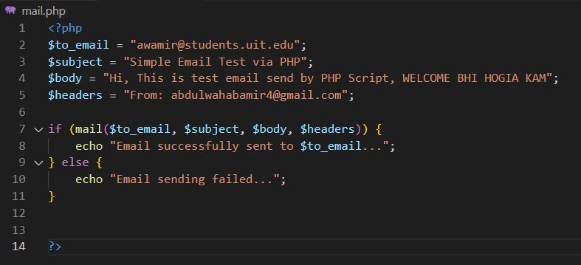
PASTE THE CODE AND GIVE A PROPER MAIL

Slide 13
GOOGLE SETTING MUST TO DO BEFORE EMAILING
=> Turning on 'less secure apps' settings as mailbox user Go to your (Google Account). On the left navigation panel, click Security. On the bottom of the page, in the Less secure app access panel, click Turn on access. If you don't see this setting, your administrator might have turned off less secure app account access (check the instruction above). Click the Save button.

