Slide 1

PHP CRUD
CREATE
READ
UPDATE
DELETE

Slide 2


Slide 3
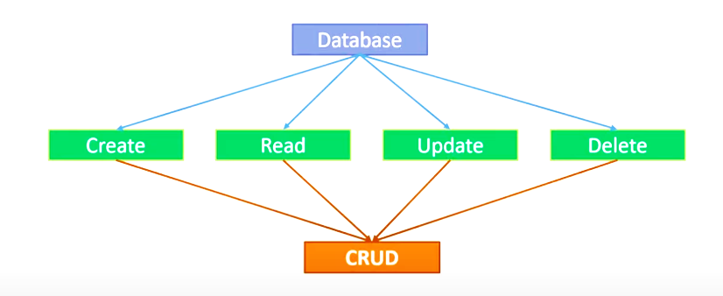

Slide 4
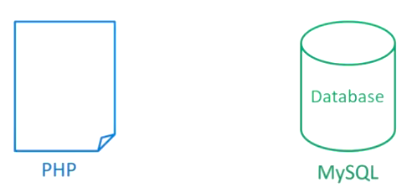
3 STEPS

Slide 5
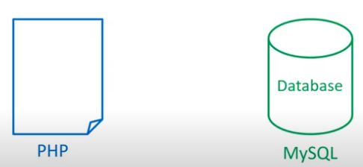
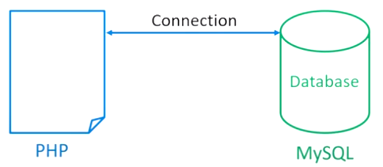
CONNECTION

Slide 6
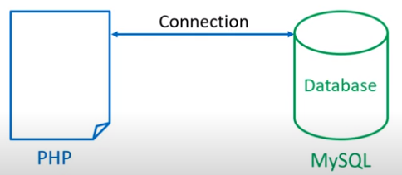
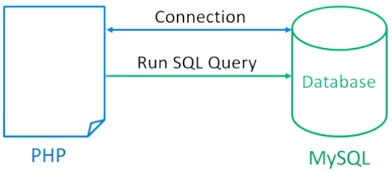
RUN SQL QUERY

Slide 7
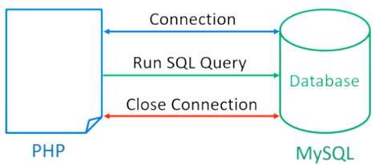
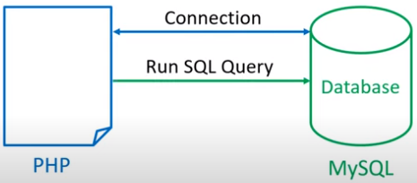
CLOSE CONNECTION

Slide 8
1)CONNECTION

Slide 9
2)RUN SQL QUERY
SELECT
UPDATE
DELETE

Slide 10
2)CLOSE CONN

Slide 11

CREATE DATABASE

Slide 12
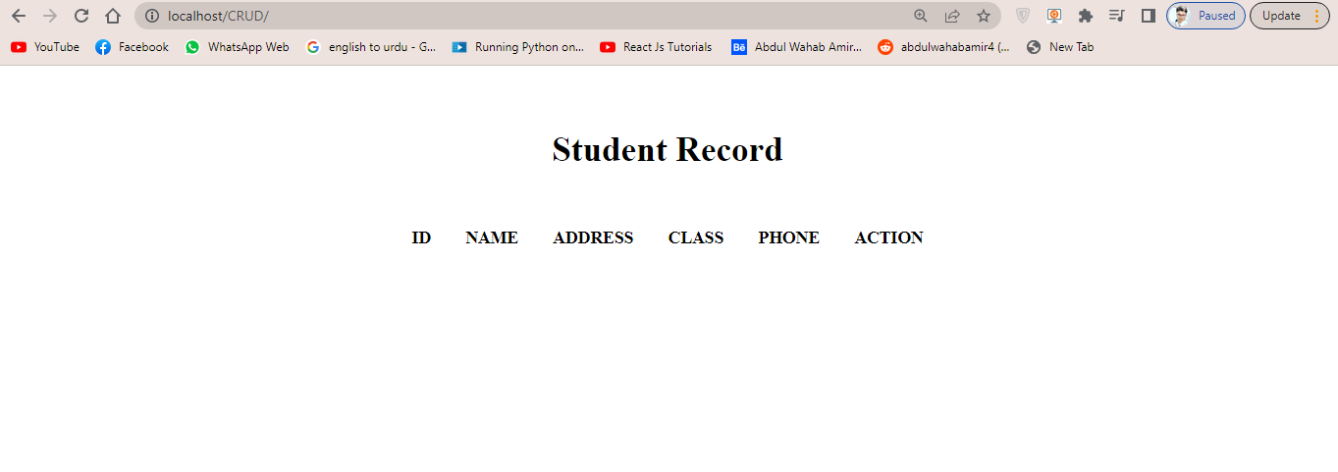
CREATE TABLE

Slide 13
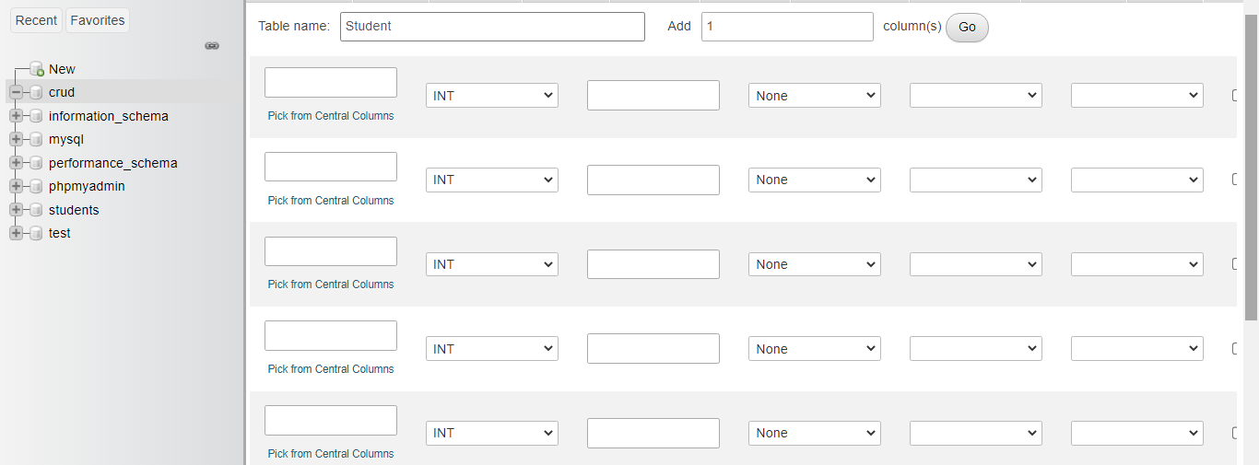
CREATE TABLE

Slide 14
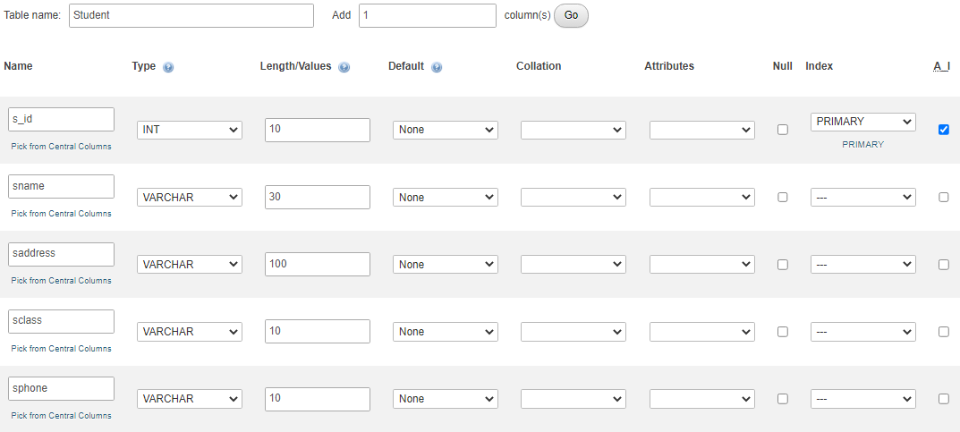
CREATE TABLE

Slide 15


Slide 16


Slide 17
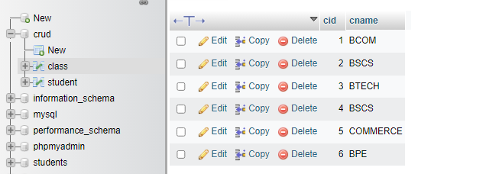

Slide 18


Slide 19



Slide 20


Slide 21
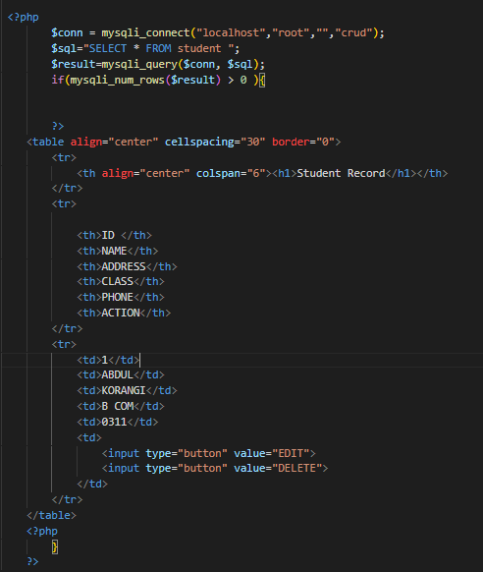

Slide 22
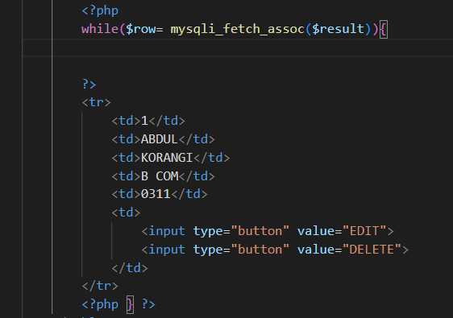

Slide 23
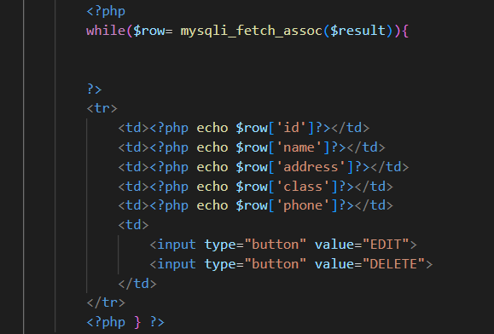

Slide 24


Slide 25
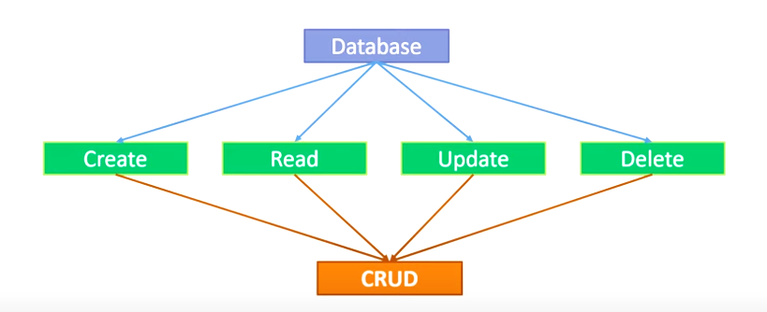

Slide 26
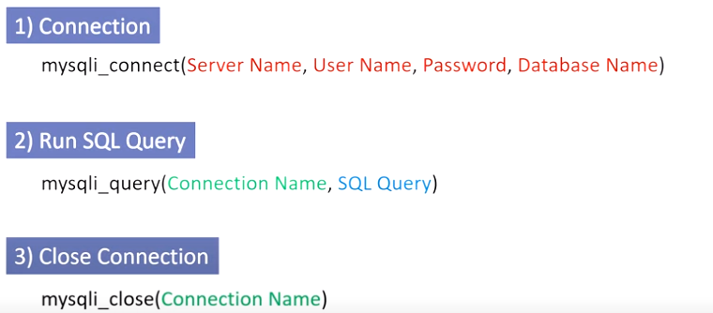

Slide 27
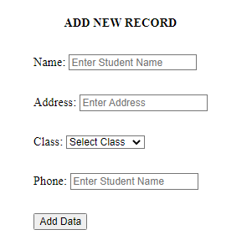

Slide 28
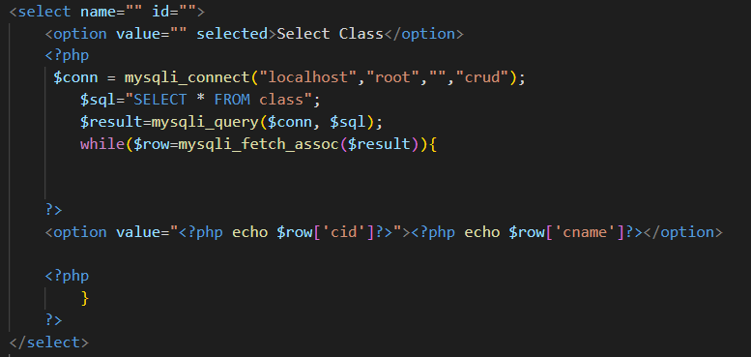
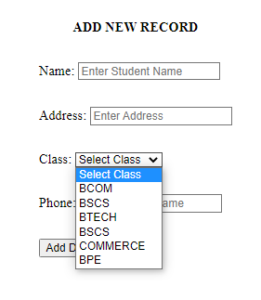

Slide 29


Slide 30


Slide 31
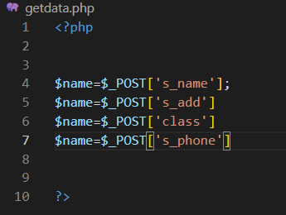

Slide 32
