Slide 1

A Prediction Model On Loan Defaulters
A Case Study
By： Andree Qi

Slide 2

A Prediction Model On Loan Defaulters
01
Data Inspection
How the Dataset is Structured.
02
Data Preprocessing
How Data is Cleaned
03
Model Application
Apply Models to Classify Data
Contents
04
Limitation of Models
What are the problems in the Model?

Slide 3

A Prediction Model On Loan Defaulters
https://www.ypppt.com/
PART ONE
Data Inspection
How the Dataset is Structured.

Slide 4


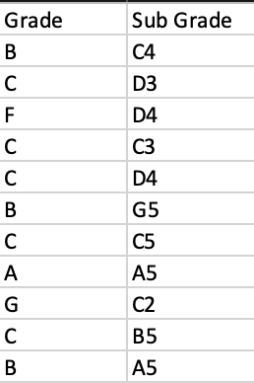
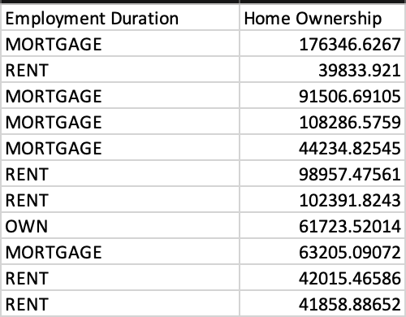
Data Inspection
Number of Columns: 35
Data Type: Numerical and Categorical
Emitted Variables:
Suspicious Variables:
ID
Batch Enrolled
Grade vs Sub Grade
Home Ownership vs Employment Duration
Bathroom
Loan Title
Credit Loan vs Credit Debt
Dept consolidation
Payment Plan
Accounts Delinquent

Slide 5
A Prediction Model On Loan Defaulters
https://www.ypppt.com/
PART TWO
Data Preprocessing
How Data is Cleaned.

Slide 6
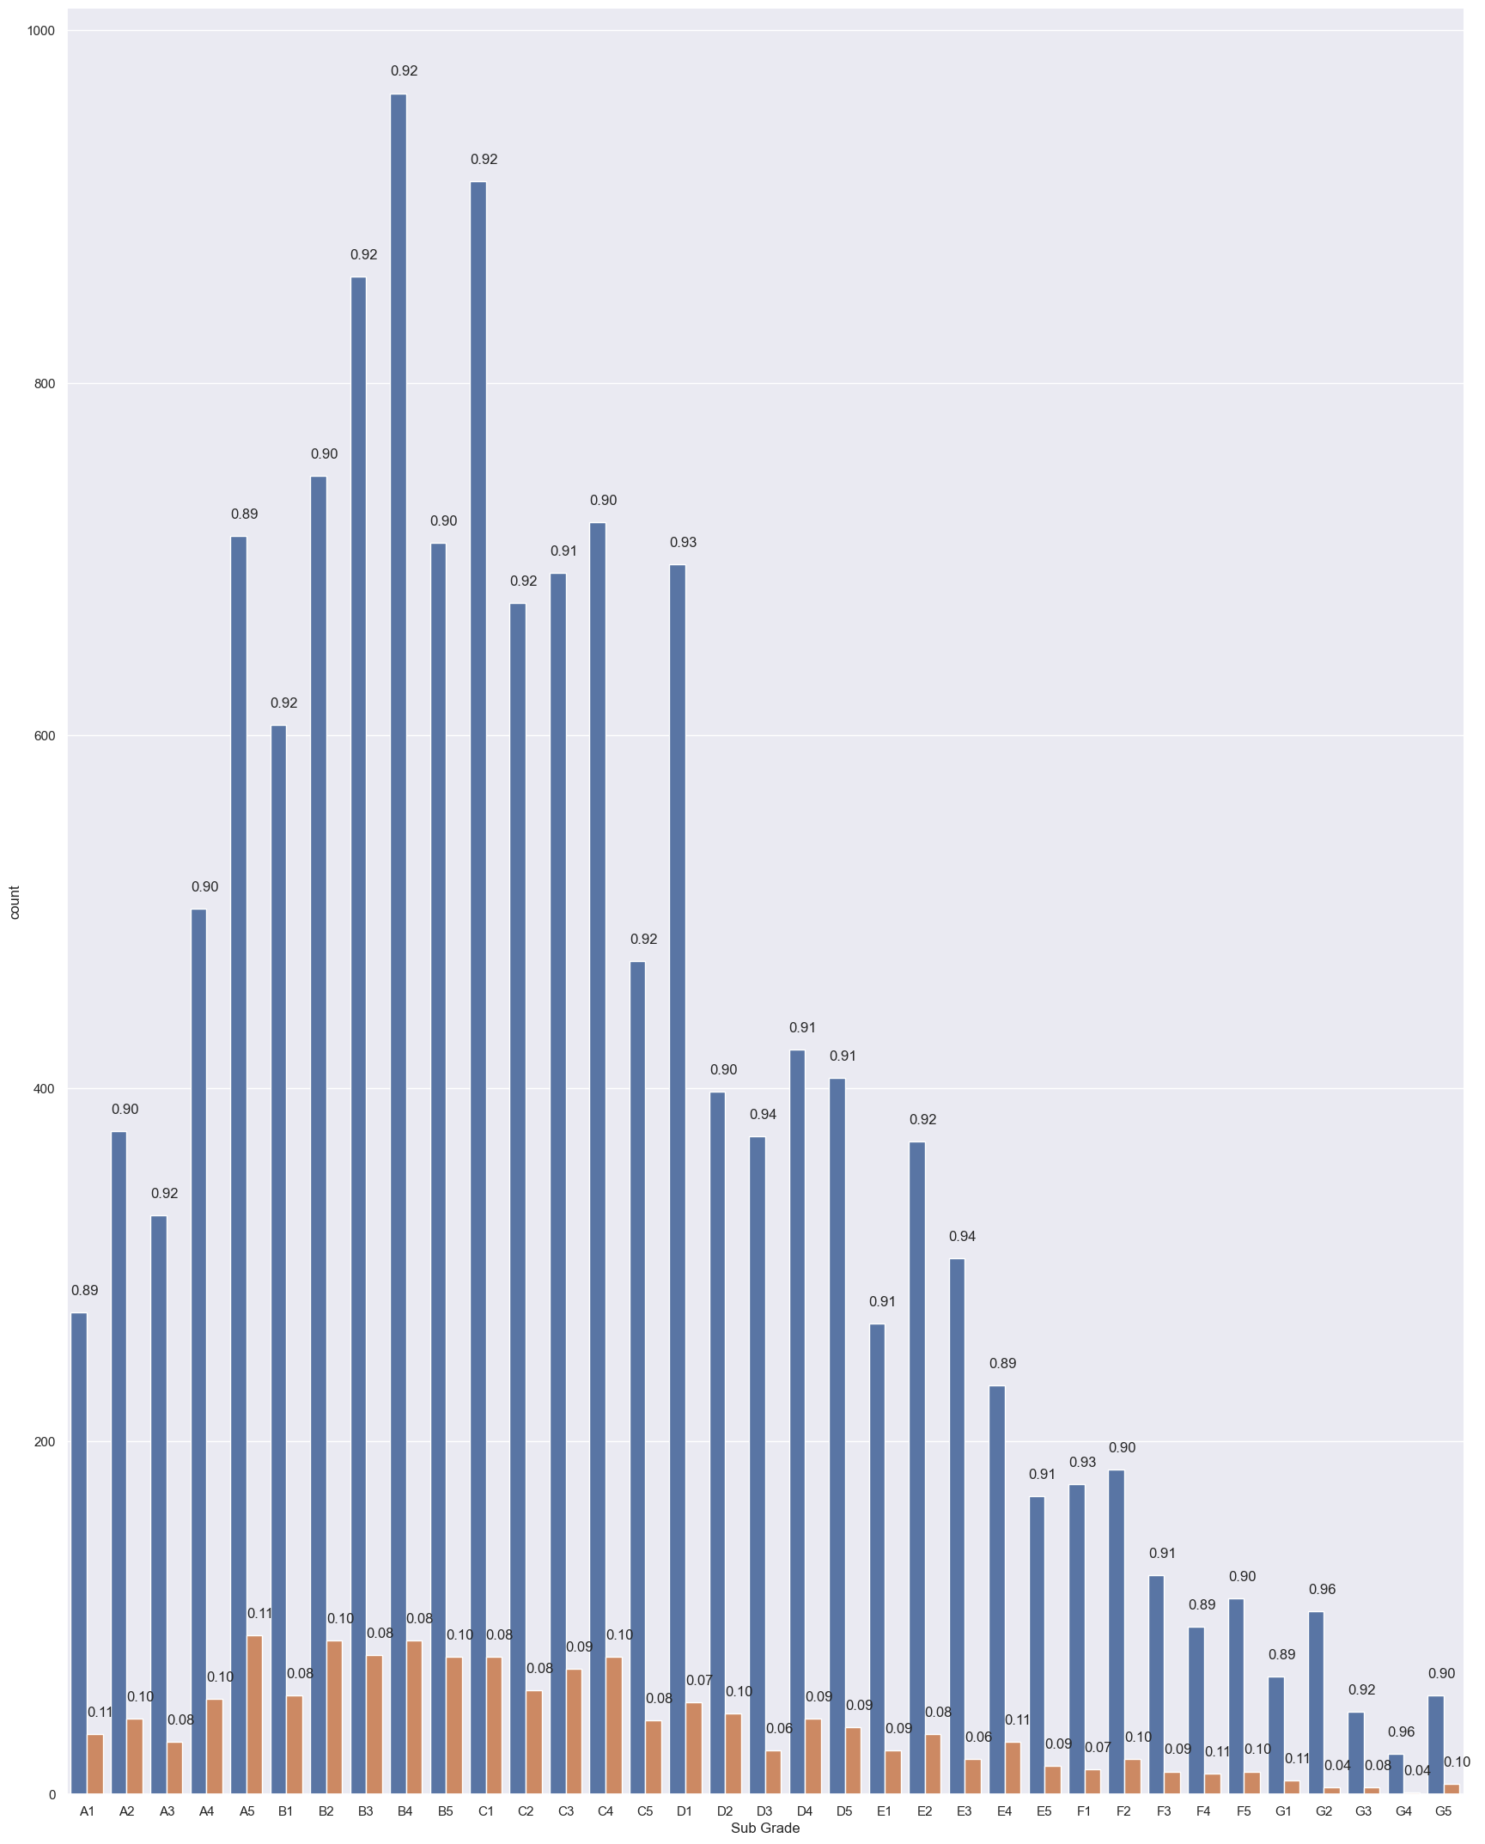
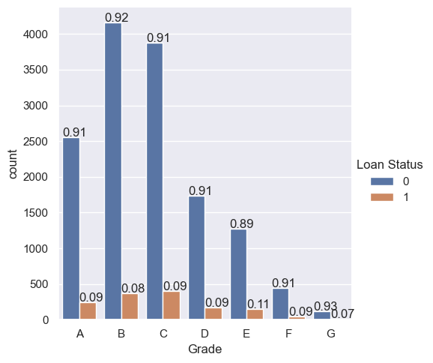
Data Preprocessing
1. Delete uninformative variables
2. Fix the Home Ownership variable
3. Transform categorical variables to dummy variables
4. Recognize and remove outliers
5. Plot Grade/Sub Grade vs Loan Status

Slide 7
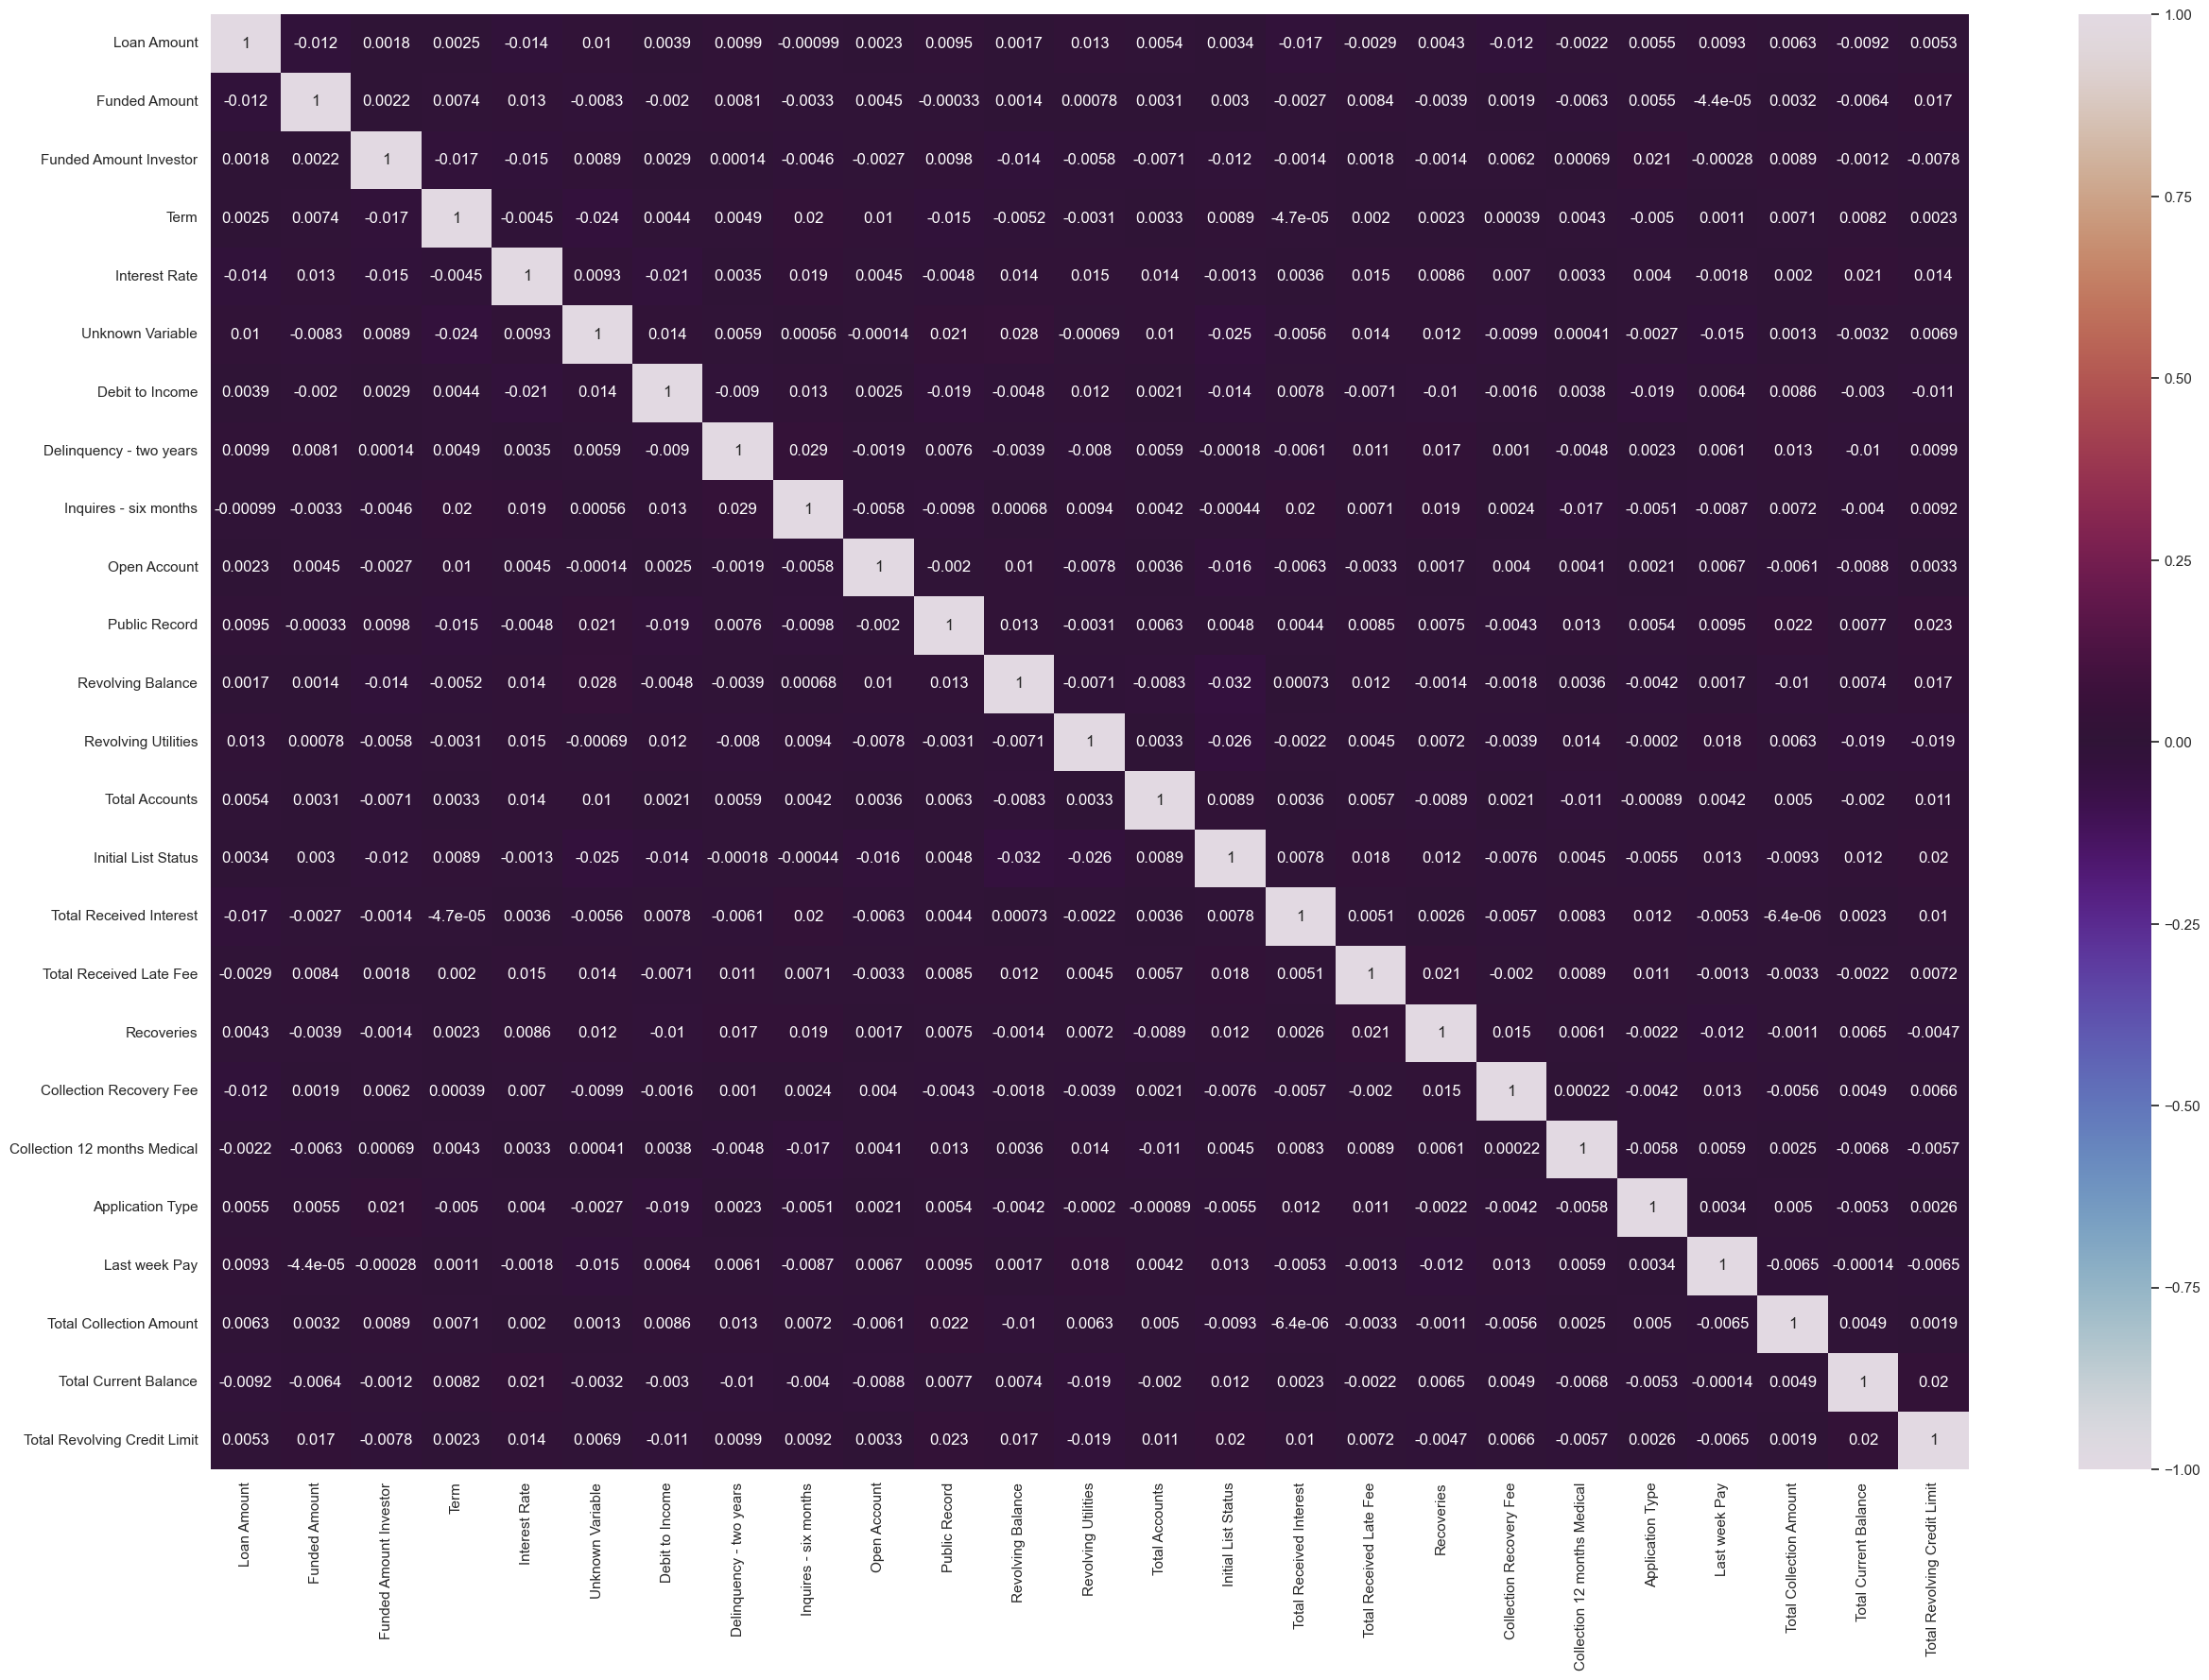
Correlation Chart

Slide 8
A Prediction Model On Loan Defaulters
https://www.ypppt.com/
PART THREE
Model Application
Apply Models to Classify Data

Slide 9

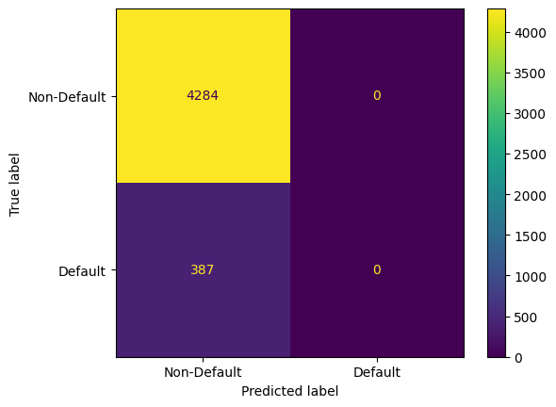


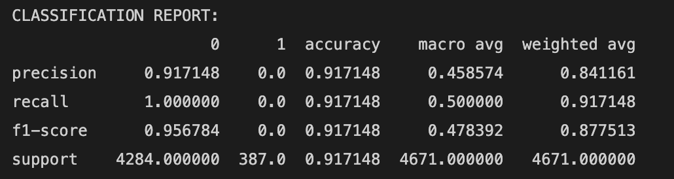

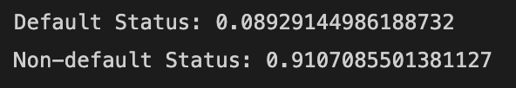
Logistic Regression
After Normalizing Dataset:
Imbalanced Training Data
Notes:
Non-linear relationship

Slide 10

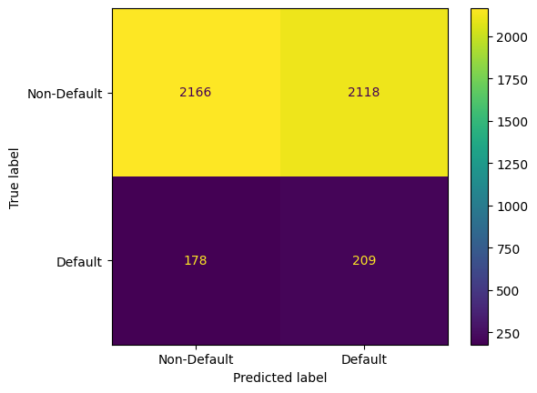
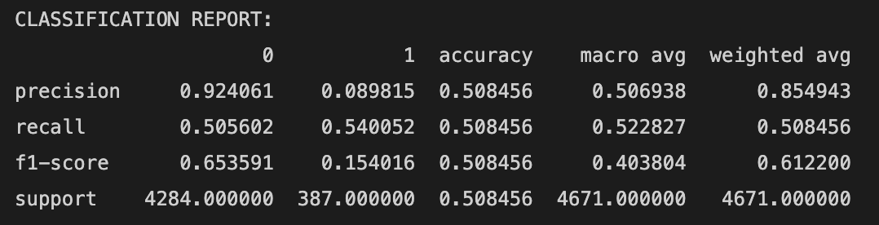
Logistic Regression
Oversampling with SMOTE (Synthetic Minority Oversampling Technique)
Training Dataset
No Linear Correlation
Notes:
Non-linear relationship

Slide 11
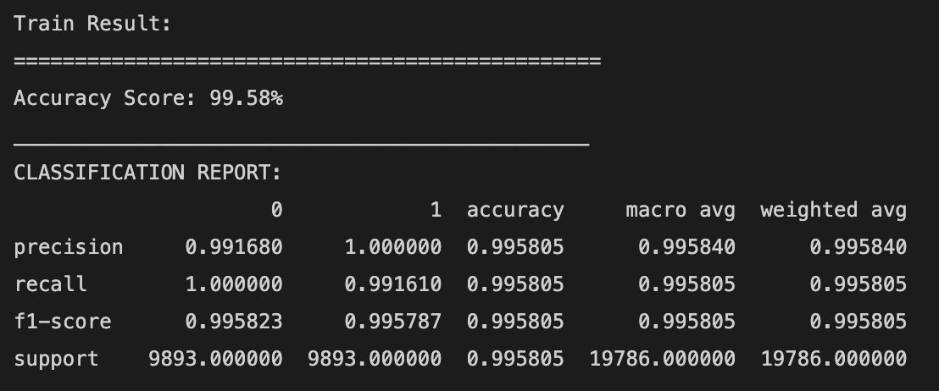

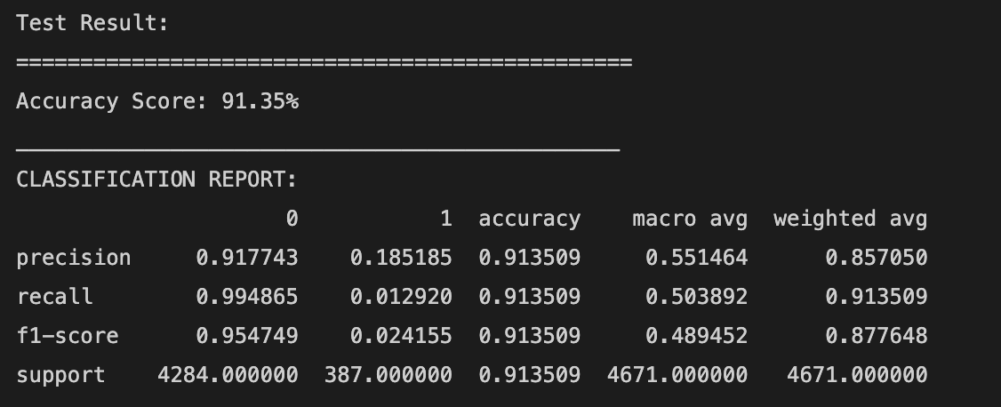
Random Forest
Notes:
Non-linear relationship

Slide 12
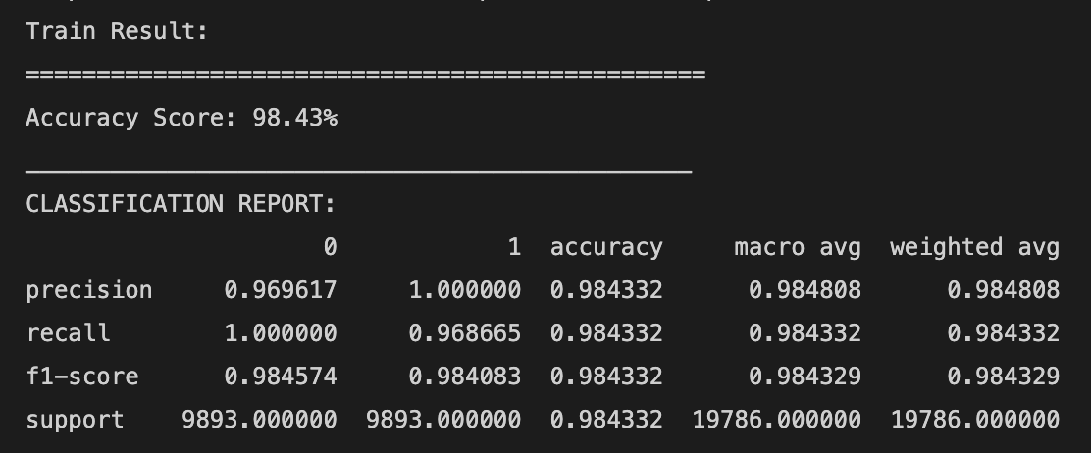

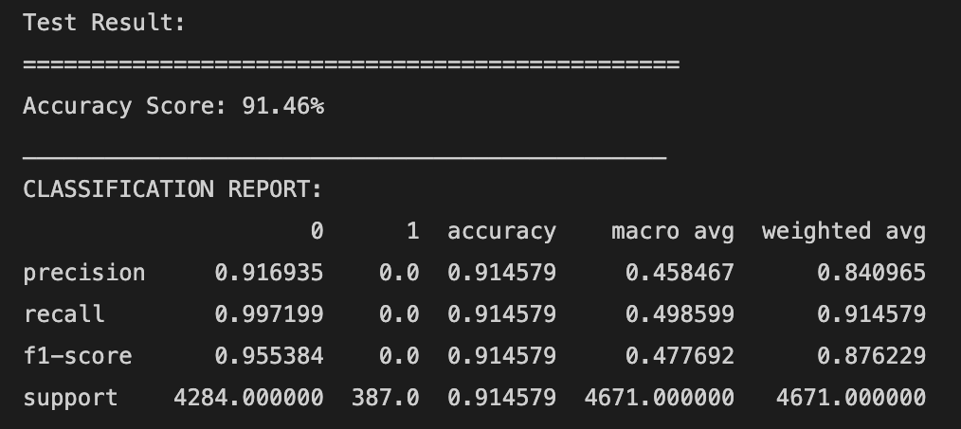
XGBooster Classifier
Notes:
Non-linear relationship

Slide 13
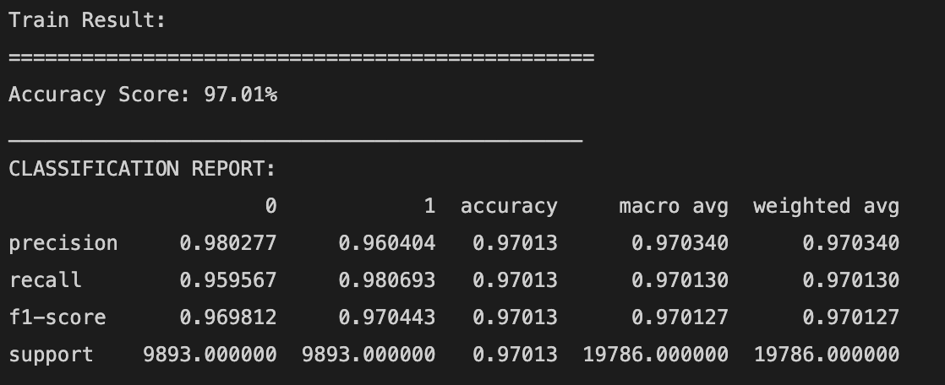
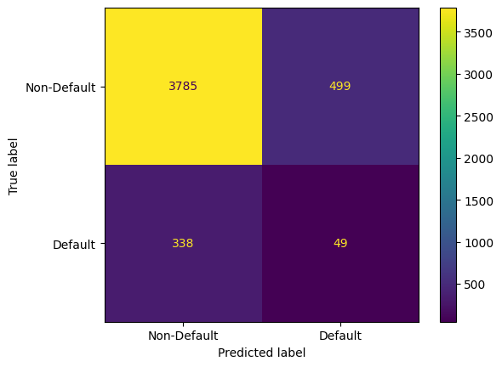
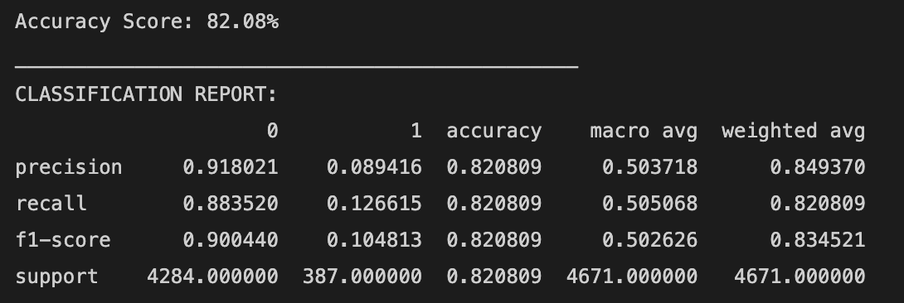
Artificial Neural Networks
Activation Function:
Hidden Layer: ReLU Function
Learning Rate: 0.001
Epochs: 20
Hidden Layer: Sigmoid Function
Notes:
Non-linear relationship

Slide 14
A Prediction Model On Loan Defaulters
https://www.ypppt.com/
PART FOUR
Limitation of Models
What are the problems in the Model?

Slide 15
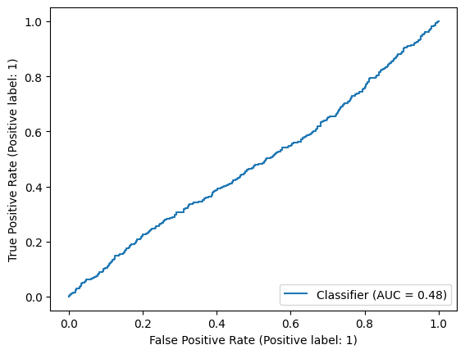
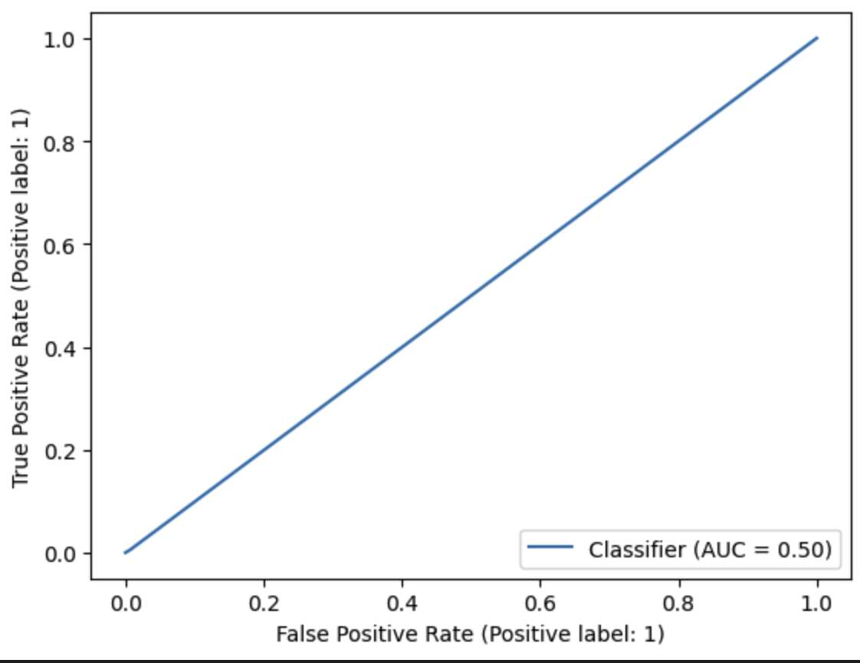
Limitation
1. Overfitting – Result from oversampling the training set
2. The ROC Curve
Random Classifier?

Slide 16
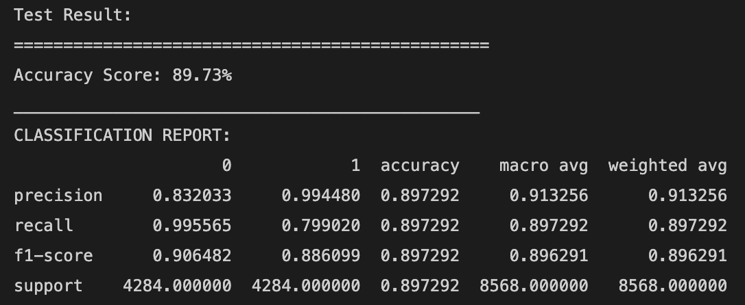
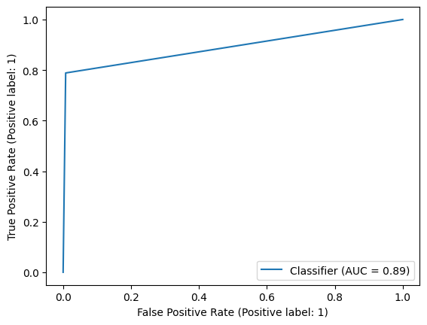
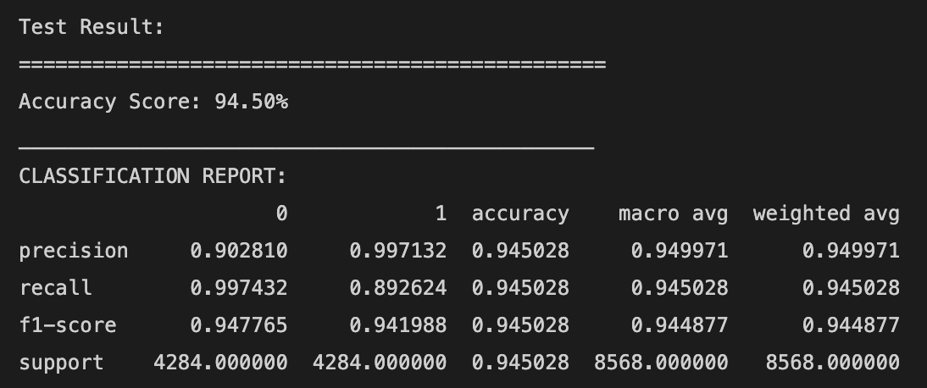
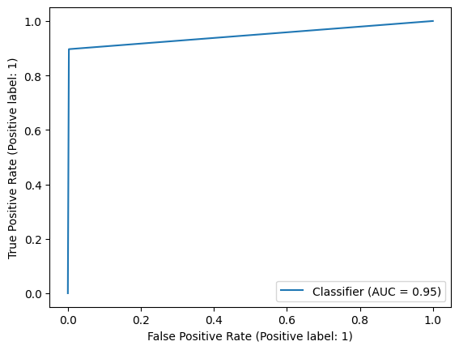
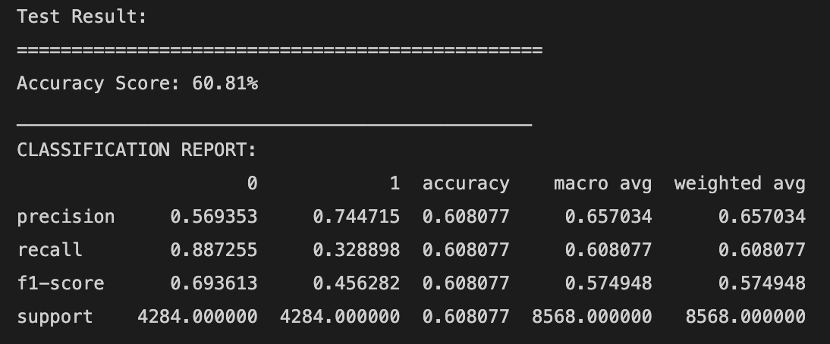
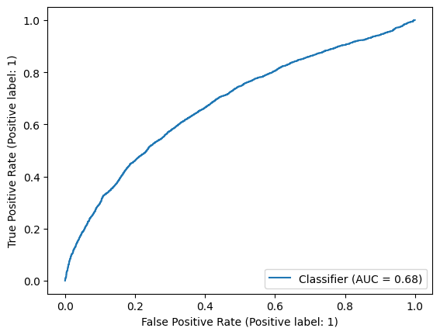
My Test – Add SMOT on Test Dataset
Random Forest
XGBooster
Artificial Neural
Network

Slide 17
A Prediction Model On Loan Defaulters
THANKS
Any questions?

