Slide 1

Project Title - Seasonal Agriculture Performance Analysis
[Aniket Kumar
Maharaja Surajmal Institute Of Technology ]
AICTE STU ID : ( STU665dbb1ca34551717418780 )

Slide 2

PROBLEM STATEMENT
Agricultural activities are influenced by seasonal variations in environmental conditions, farming practices, resource availability and market conditions. As a result, agricultural performance may differ from one season to another. However, raw agricultural data does not clearly explain how agricultural performance changes across seasons or what patterns can be observed in different seasonal conditions. The problem is to analyze the given agricultural dataset and investigate seasonal differences in agricultural performance by identifying meaningful patterns, trends, relationships and variations within the available data.

Slide 3
Project Description
Overview: A data analytics study evaluating agricultural performance across 4,000 farm records spanning Kharif, Rabi, and Zaid seasons.
Scope & Dimensions: An analysis of 28 features included environmental conditions like rainfall, temperature, and humidity; farming inputs such as fertilizers, pesticides, and irrigation methods; crop productivity metrics like yield and total production; and financial outcomes including cost, revenue, and net profit.
Data Processing: Handled missing values using median imputation across environmental and yield metrics, examined distribution skewness, and evaluated extreme outliers using IQR boundaries.
Analytical Approach: Applied univariate distributions, bivariate comparisons, multivariate interactions, and correlation analysis to uncover seasonal efficiency and profitability drivers.

Slide 4

WHO ARE THE END USERS?
Farmers & Farm Producers: To make informed decisions on crop selection based on seasonal input costs, expected yields, and actual profit margins rather than focusing solely on volume.
Agricultural Extension Officers & Agronomists: To guide rural communities on optimal irrigation methods such as drip vs. flood and disease risk management during high-humidity seasons.
Agri-Policy Makers & Planners: To structure regional input subsidies, water conservation policies, and seasonal credit programs for vulnerable crops and dry cycles like Zaid.
Agricultural Supply Chain & Commodity Traders: To anticipate seasonal production volumes, yield shifts, and pricing dynamics across staple grains and commercial crops.

Slide 5

Technology Used
Programming Language: Python
Data Manipulation & Cleaning: Pandas, NumPy
Data Visualization: Matplotlib, Seaborn
Development Environment: Google Colab
Version Control & Collaboration: Git & GitHub

Slide 6
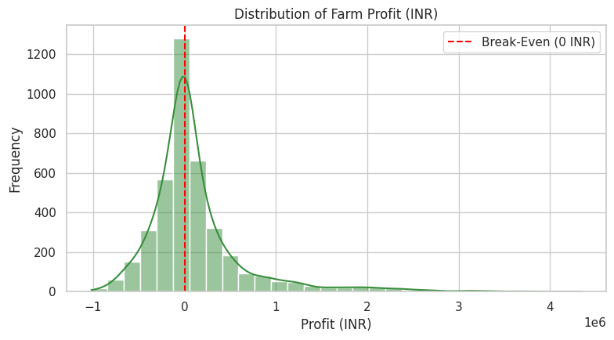
RESULTS
The histogram shows profit spread with the dashed red break-even line.
Most farms cluster tightly around the break-even line at 0 INR, with a large group operating at a net loss.
A small subset of large commercial farms pulls the upper tail past ₹10–40 Lakhs.
High harvest volume does not guarantee profit unless input costs are strictly controlled.

Slide 7
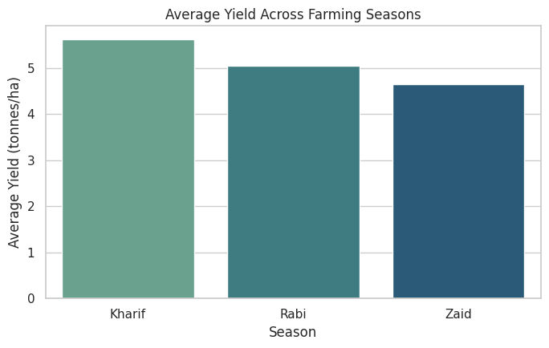
RESULTS
The histogram of Farm Profit with the dashed red break-even line.
Kharif leads overall production with an average yield of 5.63 tonnes/ha, followed by Rabi at 5.04 tonnes/ha.
Zaid records the lowest output at 4.64 tonnes/ha due to harsh dry-season conditions.
Ample monsoon rainfall gives Kharif a clear structural advantage in crop biomass.

Slide 8
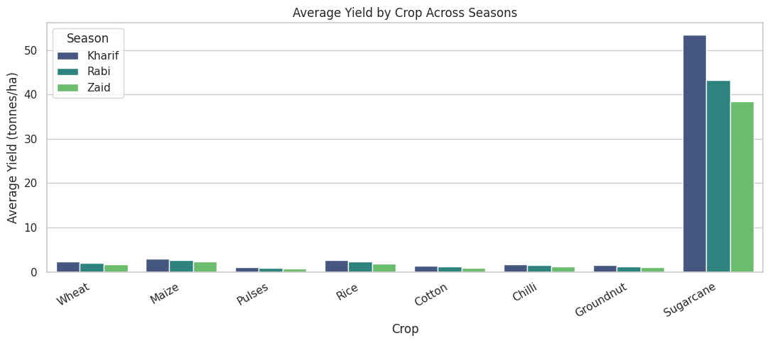
RESULTS
Grouped bar chart comparing yields across all 8 crops grouped by Kharif, Rabi, and Zaid.
Sugarcane dominates total volume across every season, producing between 38 and 53 tonnes/ha.
Staple grains (Rice, Wheat, Maize) remain in a narrow band of 1.7 to 3.0 tonnes/ha across cycles.
Output variations are driven far more by the crop choice itself than seasonal weather alone.

Slide 9
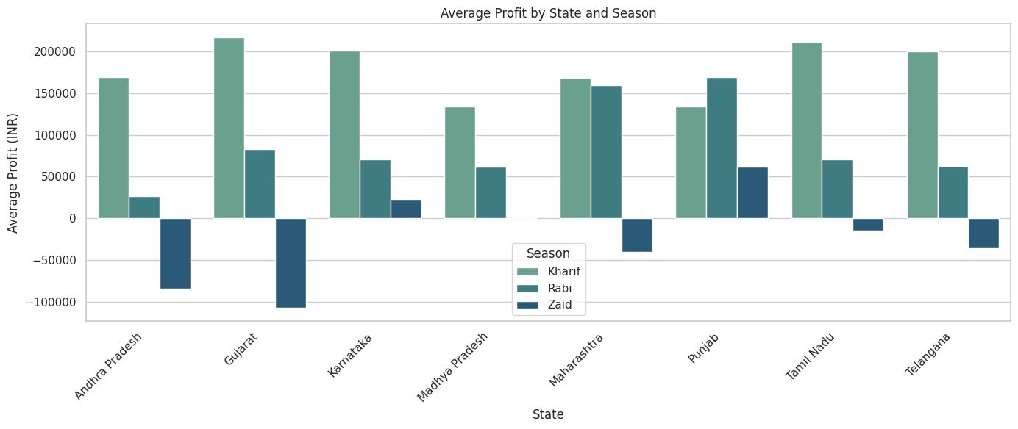
RESULTS
The grouped bar plot shows average profit by state across Kharif, Rabi, and Zaid.
  Farm earnings fluctuate sharply across state geographies, with southern regions showing higher seasonal earnings stability.
  Kharif remains the most consistently profitable cycle across nearly all states, while Zaid yields negative average returns in multiple regions.
  Local water access and varied regional input costs heavily dictate whether a farm remains profitable during dry months.

Slide 10
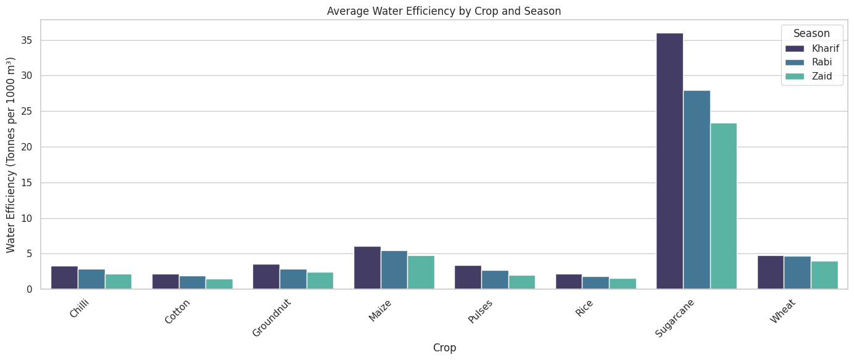
RESULTS
The grouped bar plot shows average water efficiency across crops and seasons.
Sugarcane achieves the highest water efficiency by a wide margin, producing 23 to 36 tonnes per 1,000 m³ of applied water.
Staple grains and oilseeds average under 6 tonnes per 1,000 m³, with pulses showing the lowest physical return per water unit.
Water productivity drops across all crops during Zaid, highlighting significant evaporative losses during summer cycles.

Slide 11
Future scope
Predictive Machine Learning Models: Creating models with Random Forest, XGBoost, and other algorithms to predict crop yield and farm profitability before planting, based on early seasonal forecasts.
Granular Cost Breakdown: Incorporating detailed expenditure categories such as machinery fuel, manual labor wages, transport, and storage costs to isolate exact cost-cutting targets for unprofitable staple grains.
Climate & Multi-Year Time-Series Analysis: Expanding beyond cross-sectional data to analyze multi-year seasonal trends and assess the effects of climate change on water tables and seasonal shifts.
Farm-Level Recommendation Dashboard: Building an interactive web dashboard using Streamlit or Flask that allows smallholders to input their soil specs and budget to receive personalized crop and irrigation recommendations.

Slide 12
GitHub Link
https://github.com/A-aniket-k/Seasonal_Agriculture_Performance_Data_Analysis_.git

Slide 13

VOIS Course completion certificate -
Course name- Data Visualization

Slide 14
Thank you
.
.

