Slide 1

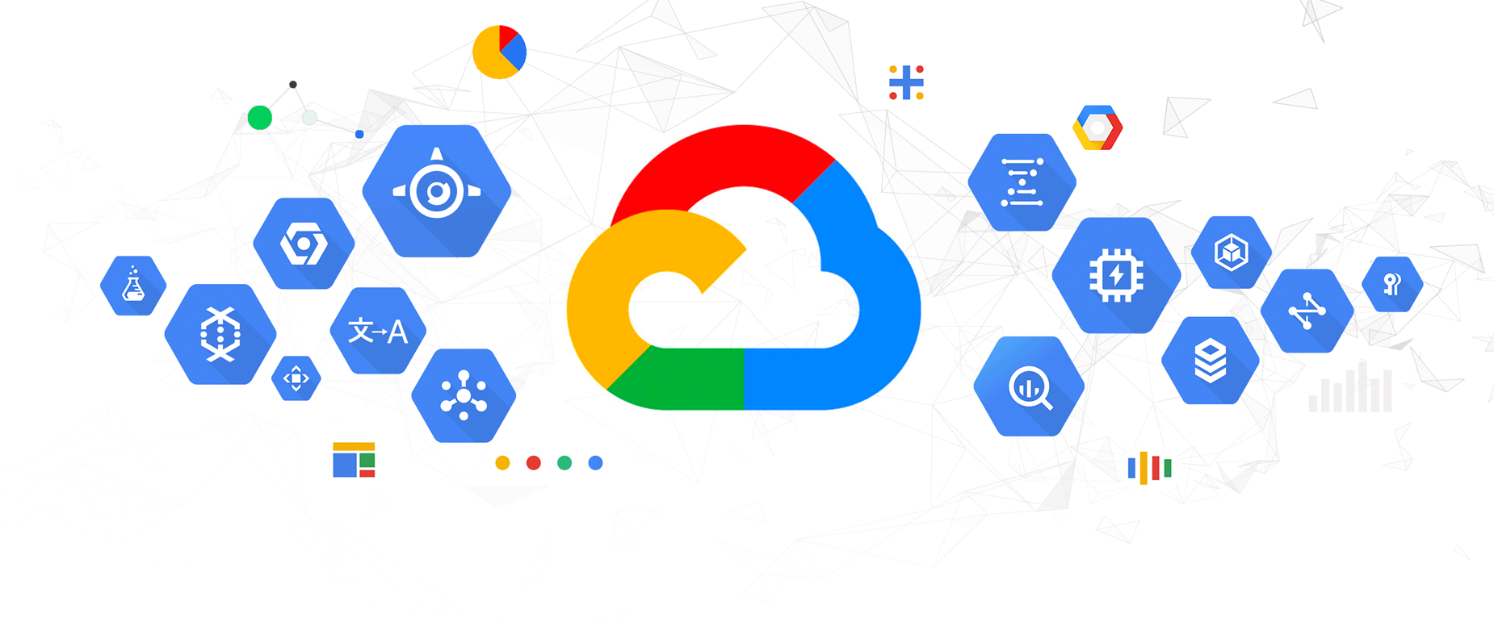


Slide 2

Online Book Store System
A project by:
Team Cloudphilics
Mohammad Shaad
Abirami Gurushanker
Deepthi Balasubramanian

Slide 3

Problem Statement
Difficulty in visiting bookstore in-person to purchase books.

Slide 4

Project Objective
A system to purchase books online and to store the inventory data securely can be built using MySQL inside the Google Cloud Platform environment.

Slide 5
Project Characteristics
Secured database
Cloud hosted service
Easy navigation
Integrated payment systems
User history tracked

Slide 6

Project Features
Simple profile registration
Authenticated user login
Add to cart option
Google cloud hosted MySQL DataBase

Slide 7

Project Implementation

Slide 8
Application Frontend
A full stack web application is created using HTML, CSS, JavaScript, Node.js, Express.js.
The frontend is connected to a MySQL database to maintain the inventory of books.

Slide 9

Application GUI

Slide 10
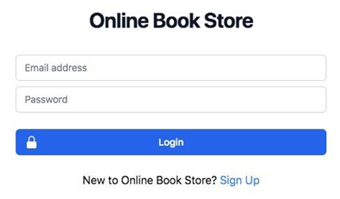
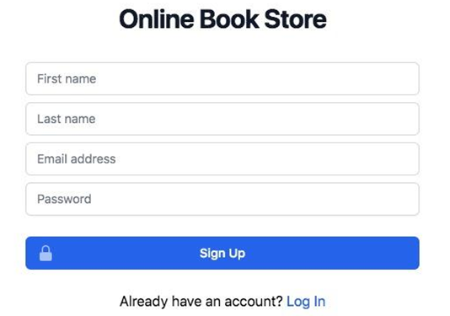
Login/Sign up pages

Slide 11
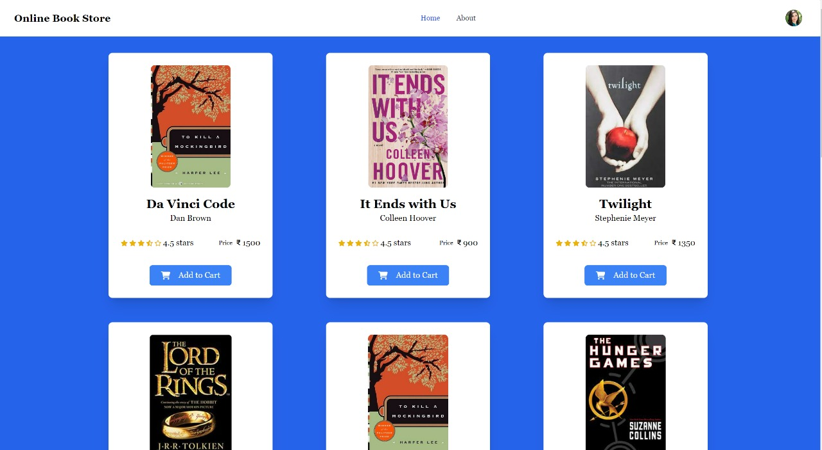
Home page/Dashboard

Slide 12
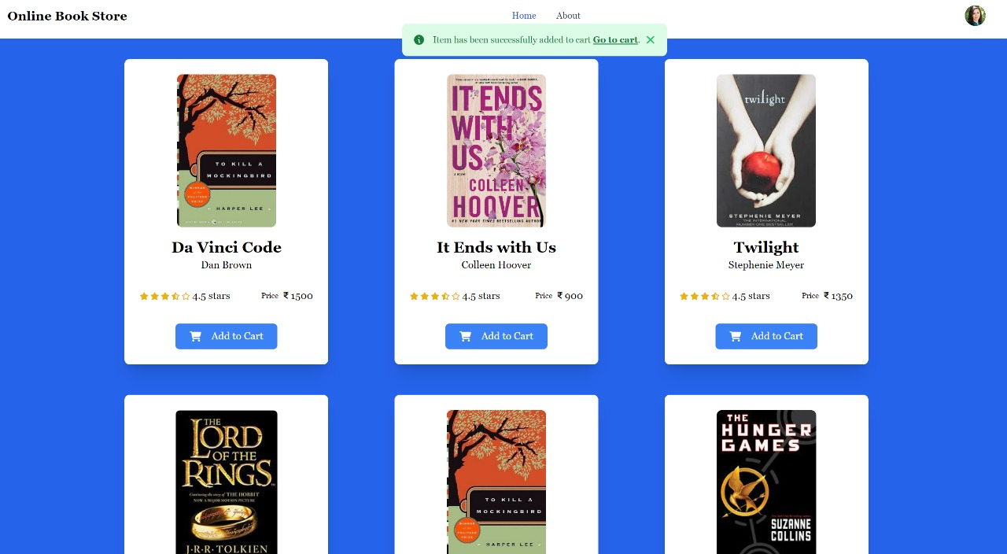
Add to Cart

Slide 13
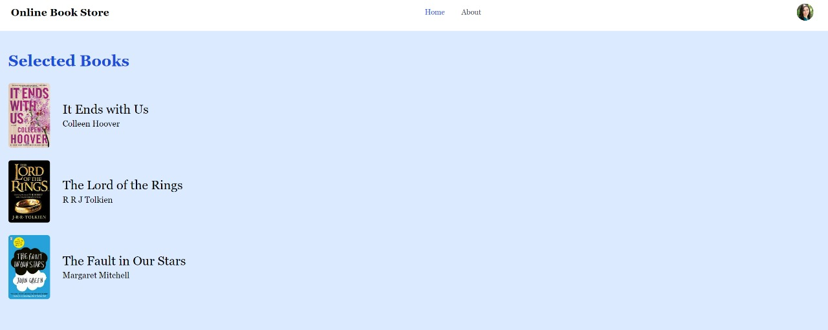
Recommendation Section

Slide 14

DATABASE

Slide 15

MySQL is one of the easy to understand and proficient languages available today, and its features can be utilized efficiently to build an online system for storing data related to the books.

Slide 16
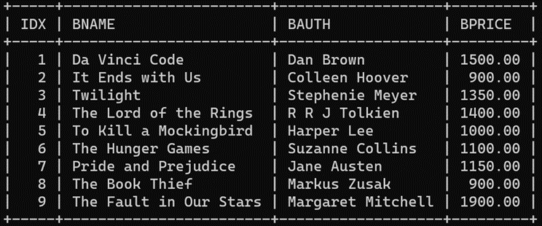
Book Inventory with Details

Slide 17
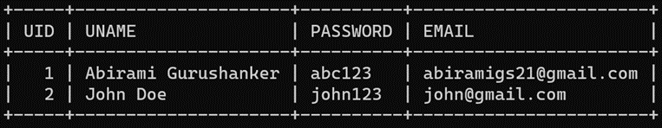
User Profile Creation

Slide 18

Use of
Google Cloud Resources in the Project

Slide 19

Compute Engine
Virtual machine to host web application

Slide 20

Cloud SQL
Backend MySQL database to store book details

Slide 21

Cloud Storage
Storing book cover thumbnails and users’ profile picture

Slide 22

Project Scope
Easily adapt updates and additions to its features, thus making it useful in the long term.
Since books are purchased online, the cost associated with displaying the books in shops as well as maintenance costs can be cut down.

Slide 23
Suggestive Additions
The following features can be added to the project with subsequent updates:
Provision for returning books
Request for books not in list/out of stock
Option to review books
Subscription to auto-deliver newsletters/magazines for every edition.
Donate money/new books/used books to help educate underprivileged children
Provide an online sample of a few pages per book, to encourage users to purchase the product.

Slide 24

Thank you!
Google

