Slide 1

X86 ARCADE
Balloon shooting game
Shoot balloons in assembly !

Slide 2
AGENDA
About the game
The game play
The game sequence
Video example
Our team
01
02
03
04
05

Slide 3
ABOUT THE GAME
01
Bluto is a villain who lives in Mars, he sends many balloons loaded with evil forces to destroy the Earth
Your mission is to shoot as many balloons as you could before they find their way to our planet.

Slide 4
The game play
02
The Game allows up to 2 players at a time . the two players take turns playing the game , first the type their initials and they're ready to go . Each player has up to 8 misses at a time so he/she better shoots precisely . the game has 3 levels , the player by default starts at level 1 then after 2 hits the game elevates to level 2 where the balloon gets faster hence harder to shoot and if the player is clever enough to get 4 hits the game reaches its final level where the balloon is the fastest .. we dare you to score a hit in that level ! While the player is playing , the highest score that's been reached within that series of games is shown so that is basically the score to beat . After 8 misses the game over window is shown where a score table that shows the highest score of each player is shown and they can choose which player to play next and that repeats for eternity .

Slide 5
03
The game Sequence
Draw welcome screen with instructions
Wait for enter button to be pressed
Draw player1 and scoreboard , render loons and begin the loop
After the player1 presses enter , clear the screen and get his/her name
Check if player1 hits space button to render and track an arrow
If there’s an arrow on the screen checks if it’s in the same position of a loon
Update the scoreboard in case of a hit or a miss
If the arrow hits a loon count a hit . Else if the loon reaches the top of the screen remove it and count a miss

Slide 6
The game Sequence cont.
If the misses is still below 8 , cnt. Looping . Else clear the screen and go to game over
Draw the game over screen and the score list that contains each player highest score
Repeats the same sequence
Users can choose who to play next player1 or player2

Slide 7
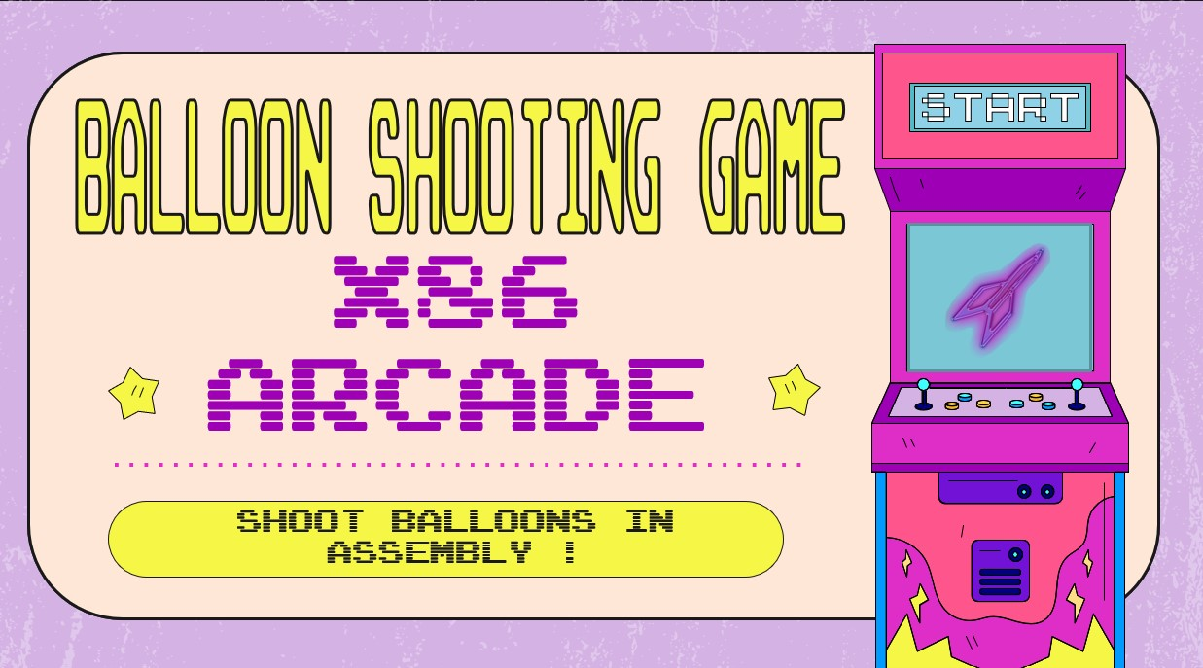
Video example
04

Slide 8
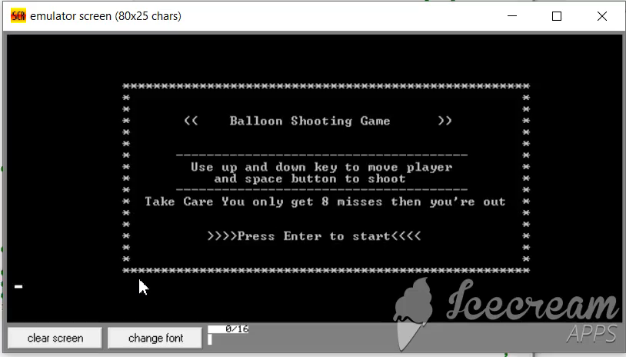

Slide 9
OUR TEAM
05
Mohamed Abelghany
Ahmed Ghonim
Nourhan Ashraf
Abdelrahman hesham
Amr mohamed

Slide 10
THANKS!
Under the supervision of Prof Abdelhamid and Eng Ahmed Bakr

