Slide 1


Data Cleaning using Pandas

Slide 2
Content
Working with Duplicates and Missing Values
Which values should be replace with missing values based on data
Identifying and Eliminating Outliers
Dropping duplicate data
Filling missing data

Slide 3
Working Missing Values
Missing Data can occur when no information is provided for one or more items or for a whole unit.
In Pandas missing data is represented by two value:
None: None is a Python singleton object
NaN : NaN (an acronym for Not a Number),
There are useful functions for finding missing values in Pandas DataFrame :
isnull()
notnull()
Dropping missing values by using following methods
dropna(),dropna(how=’all’),dropna(axis=0),dropna(axis=1)

Slide 4
Working with duplicates in DataFrame
An important part of Data analysis is analyzing Duplicate Values and removing them.
Pandas duplicated() method helps in analyzing duplicate values only. It returns a boolean series which is True only for Unique elements.
the duplicated() method returns False for Duplicates, the NOT of the series is taken to see unique value in Data Frame.
Step1 : Returning a boolean series
Step2: Removing duplicates

Slide 5
Replacing data
Pandas dataframe.replace() function is used to replace a string, list, dictionary, series, number etc. from a dataframe
Values of the DataFrame are replaced with other values dynamically
df.replace(to_replace=value, value)
df.replace(to_place=[value1,value2,value3],value)
df.replace(to_place=np.nan,value)

Slide 6
Filling missing data
If only a few of the values are missing, we can perform data imputation to substitute the missing data with some other value(s).
There are many different methods for to replace missing values
Using the mean,median value and the most frequent value
Using Filling in missing values with a constant by fillna(constant)
Filling null values with the previous ones by
df[‘column_name’].fillna(method = "pad")
Filling null values with the before ones by
df[‘column_name’].fillna(method = "bfill")

Slide 7
Dropping duplicate data
An important part of Data analysis is analyzing Duplicate Values and removing them
df.dropna() - drops all rows having null values and returns the dataframe
drop_duplicates() - Return DataFrame with duplicate rows removed.
df.drop_duplicates(subset = "column_name")
df.drop_duplicates(subset = ["column_name1",’column_name2’])

Slide 8
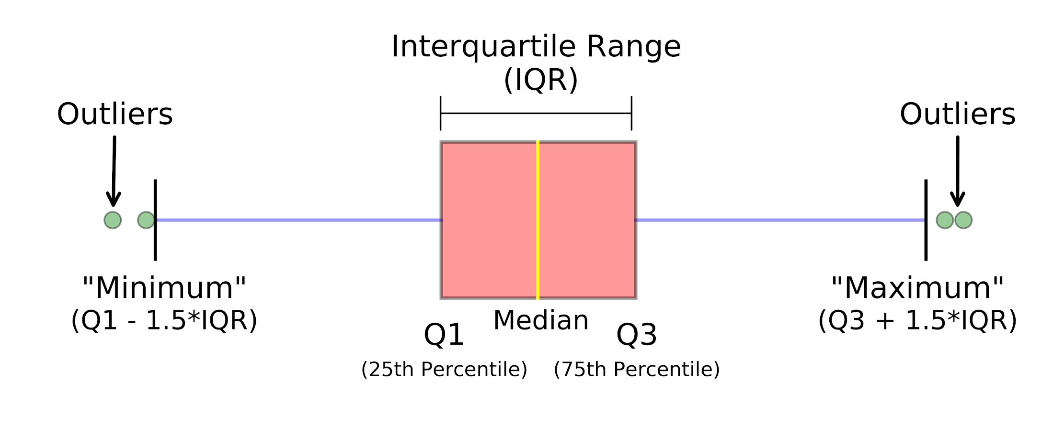
Identifying and Eliminating Outliers
Outliers are observations that are significantly different from other data points
Outliers can adversely affect the training process of a machine learning algorithm, resulting in a loss of accuracy.
Need to use the mathematical formula and retrieve the outlier data.
interquartile range(IQR) = Q3(quantile(0.75)) − Q1(quantile(0.25))

Slide 9


Print(“THANK YOU”)
Slides created, maintained and distributed by Andhra Pradesh State Skill Development Corporation

