Slide 1
RECOMMENDATION · FOR DECISION TODAY
Direct the SAR 40M to the 8 regions below 65%, weighted by gap
THE ASK
Approve SAR 40M, weighted by gap
Far behind
SAR 34.7M
Najran, N. Borders, Al-Baha, Jazan
Tayseer is above target nationally at 66.2%, but 8 of 13 regions are not. Funding them by size of gap puts 87% of the money where the gap is widest.
Almost there
SAR 5.3M
Asir, Tabuk, Hail, Al-Jouf
with a monthly adoption checkpoint until December.
Presented by Abdulaziz Alfuraih – Abdulmajeed Alnashwan – Naif Alsmari – Khalid Alhaidary
SDAIA Academy · SDA-DSC-112 Capstone
Page 01

Slide 2
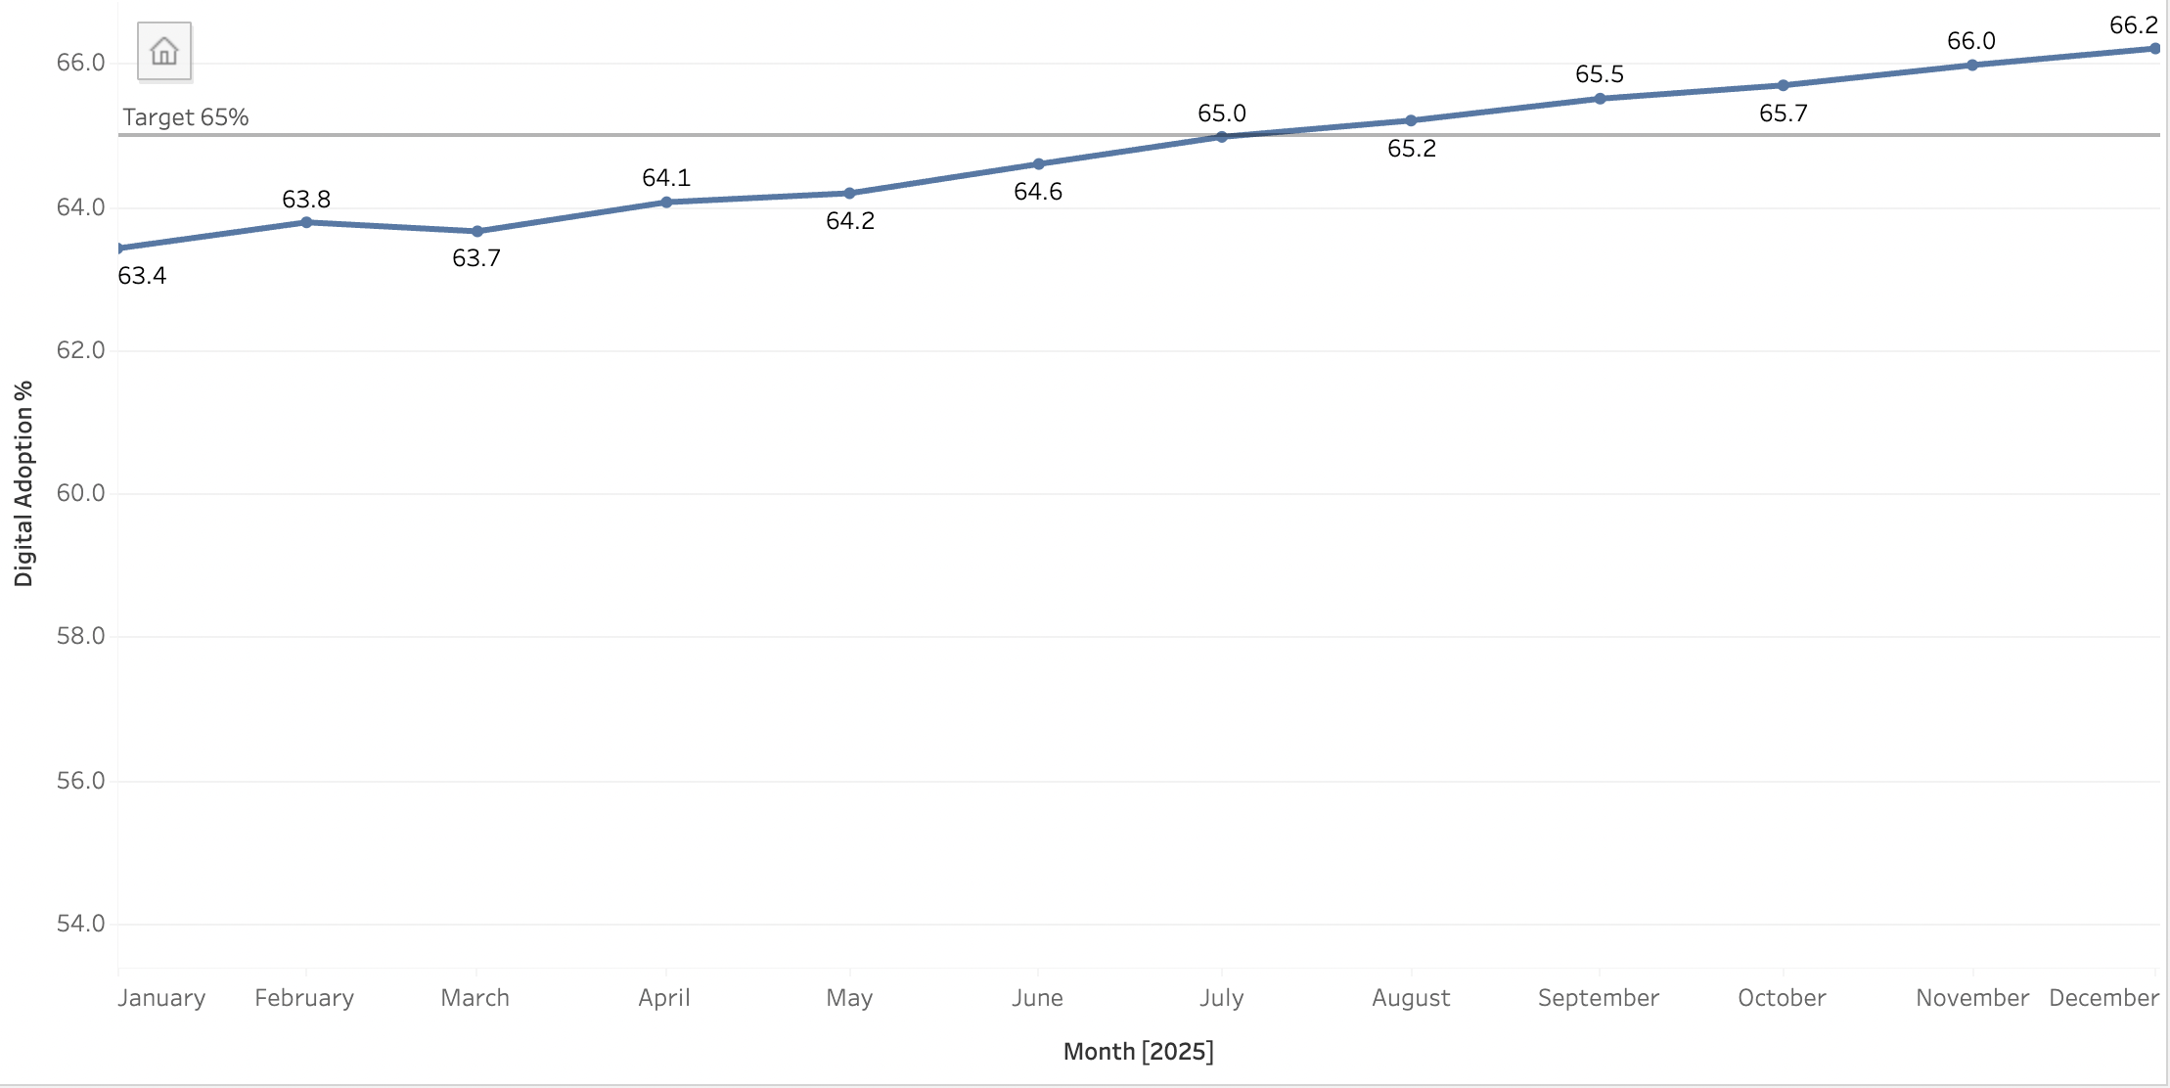
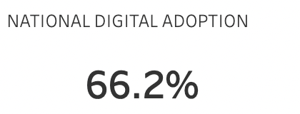
Nationally, Tayseer is above target: adoption is 66.2%, 1.2 pts over 65%
SO WHAT
The national 65% goal is already met. The next question is whether every region has met it.
SDAIA Academy · SDA-DSC-112 Capstone
Page 02

Slide 3
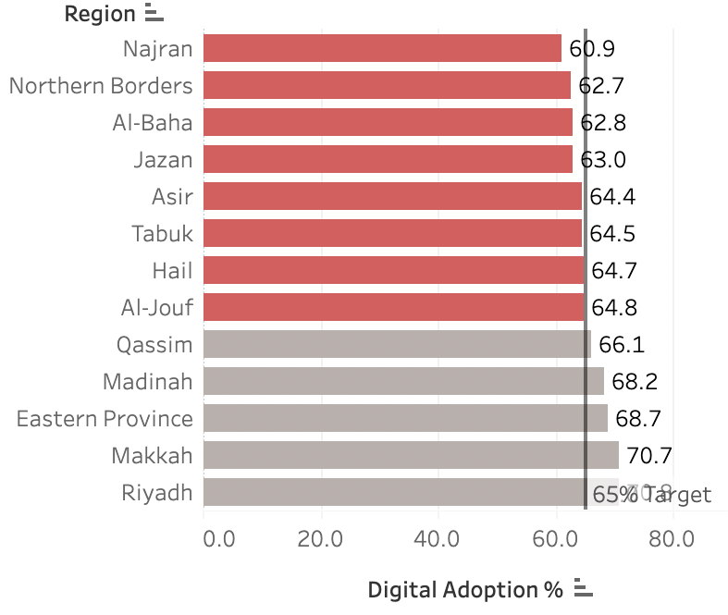
8 of 13 regions are still below 65%, hidden by the national average
BELOW TARGET
ADOPTION
Najran
60.9%
Northern Borders
62.7%
Al-Baha
62.8%
Jazan
63.0%
Asir
64.4%
Tabuk
64.5%
Hail
64.7%
Al-Jouf
64.8%
SDAIA Academy · SDA-DSC-112 Capstone
Page 03

Slide 4
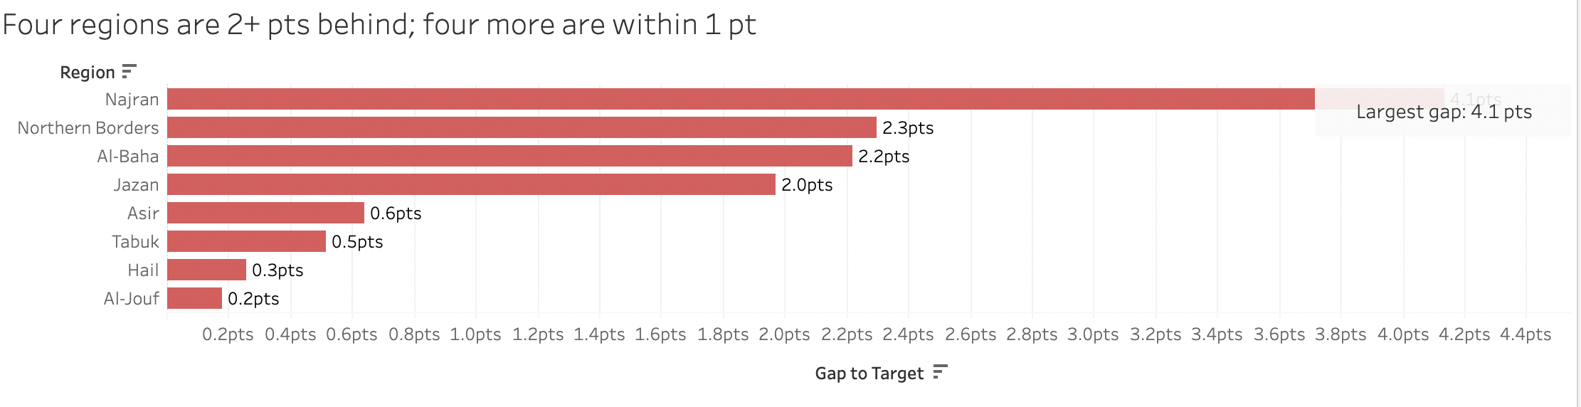
Four regions are 2+ pts behind; four more are within 1 pt of the target
FAR BEHIND · 4 REGIONS
ALMOST THERE · 4 REGIONS
2.0–4.1 pts
0.2–0.6 pts
Najran, N. Borders, Al-Baha, Jazan
Asir, Tabuk, Hail, Al-Jouf
Page 04

Slide 5
There are three realistic ways to use the SAR 40M, each with a different trade-off
A
B
C
Spread evenly
Target the 8 lagging regions
Fix one channel nationally
Split SAR 40M across all 13 regions, about SAR 3.1M each.
Fund only the regions below 65%, weighted by each region's gap.
Invest in one digital channel or service across all regions.
+ Simple and seen as fair.
– SAR 15.4M goes to 5 regions already above 65%.
+ Funds only regions with a gap.
– No new funds for regions above 65%.
+ Better experience for every user.
– Not aimed at the regions below target.
WHO BENEFITS
WHO BENEFITS
WHO BENEFITS
All 13 regions
8 regions below 65%
Users of one channel
SDAIA Academy · SDA-DSC-112 Capstone
Page 05

Slide 6
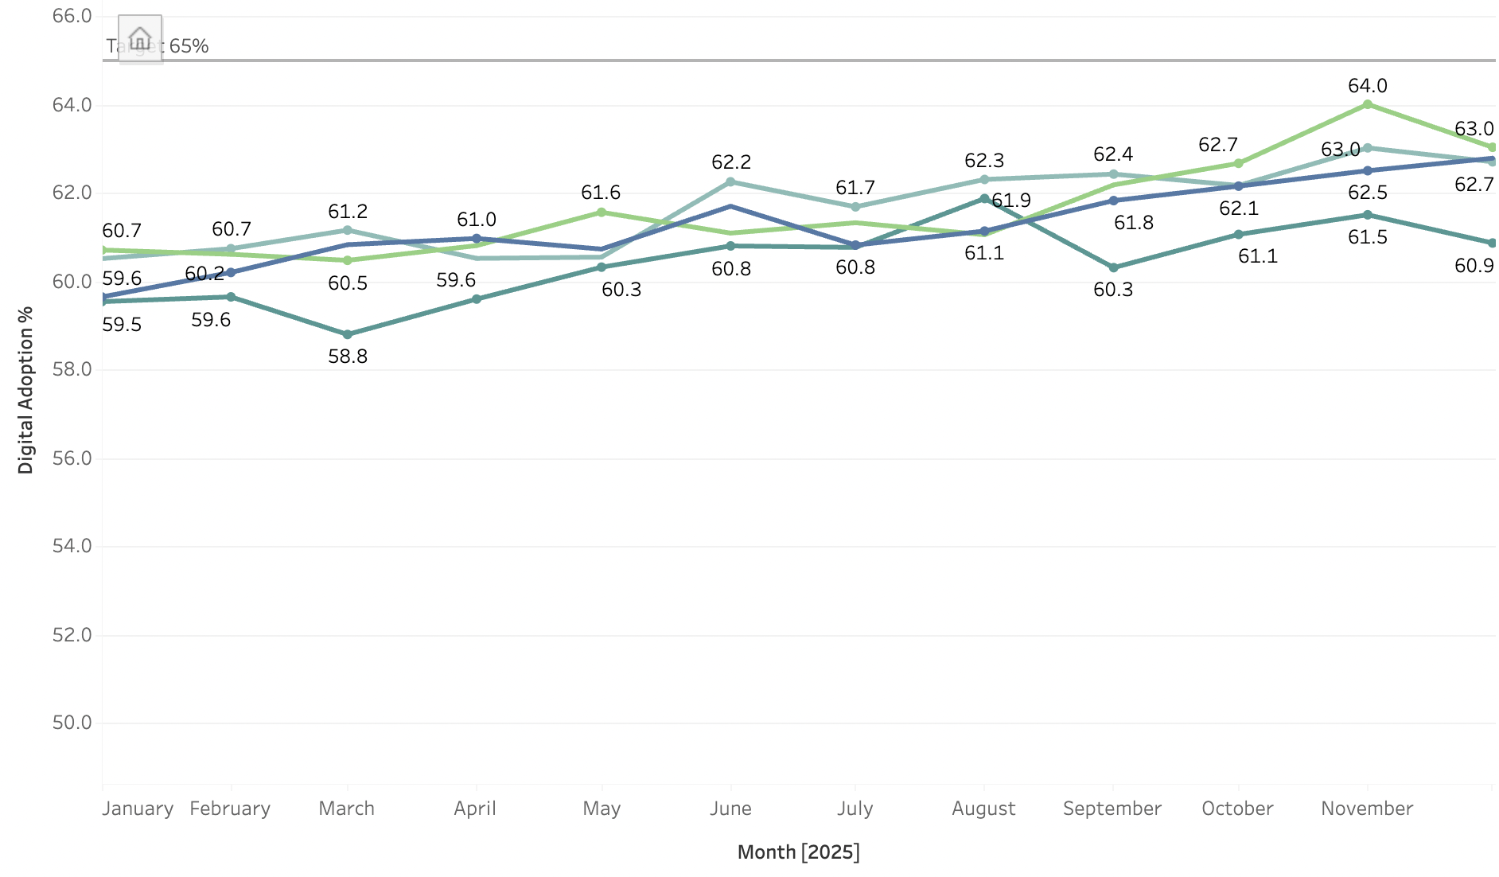
Weight the SAR 40M by gap: 87% goes to the four furthest-behind regions
Region
Adoption
Gap
Share
SAR
Najran
60.9%
4.1 pts
33.6%
13.4M
Northern Borders
62.7%
2.3 pts
18.9%
7.5M
Al-Baha
62.8%
2.2 pts
18.0%
7.2M
Jazan
63.0%
2.0 pts
16.4%
6.6M
Asir
64.4%
0.6 pts
4.9%
2.0M
Tabuk
64.5%
0.5 pts
4.1%
1.6M
Hail
64.7%
0.3 pts
2.5%
1.0M
HOW THE SPLIT WORKS
Share = region's gap ÷ 12.2 pts total. Najran: 4.1 ÷ 12.2 = 34% → SAR 13.4M.
Goal: all 13 regions at 65% or above by December.
Al-Jouf
64.8%
0.2 pts
1.6%
0.7M
Total
12.2 pts
100%
40.0M
Shaded red = far behind (2+ pts): SAR 34.7M. Grey = almost there: SAR 5.3M.
SDAIA Academy · SDA-DSC-112 Capstone
Page 06

Slide 7
THE ASK
Approve SAR 40M today for the 8 regions below 65%, weighted by gap
1
2
3
4
Today
Next month
Monthly
December
Committee approves the gap-weighted allocation
Funds released; regional plans launched
Adoption checkpoint on the Tableau dashboard
All 13 regions at 65% or above
SDAIA Academy · SDA-DSC-112 Capstone
Page 07

