Slide 1
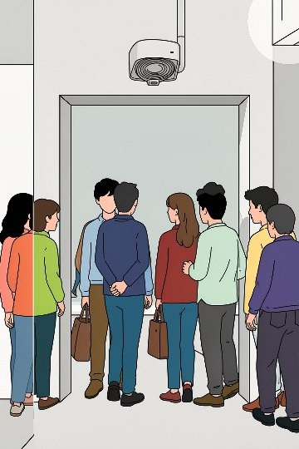
Smart Visitor Counter — Team Unemployed
Course project: IoT systems • Team members: Amrithavarsh K V, Ajul P

Slide 2
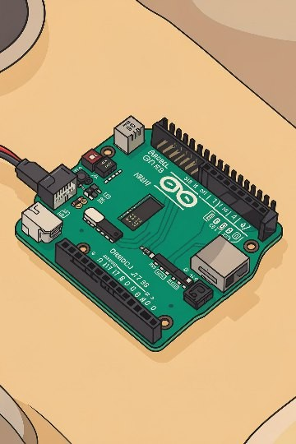
Project Overview
Automatic entry/exit counting with real-time dashboard. Low-cost, deployable for Shops, classrooms, libraries, ofﬁces, events.

Slide 3
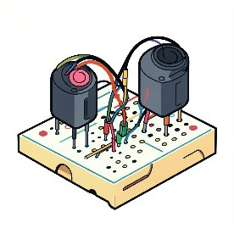
Problem & Objective
Problem: manual counting errors, delays
Objective: reliable, automated visitor tracking
Use cases: attendance, occupancy limits, analytics

Slide 4
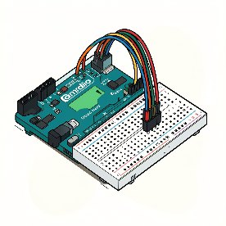
Components & Tech
Hardware: Arduino Uno, 2 IR sensors, breadboard, jumper wires Optional: ESP8266/ESP32 for Wi-Fi
Software: Arduino IDE; Dashboard: ThingSpeak / Blynk / custom

Slide 5
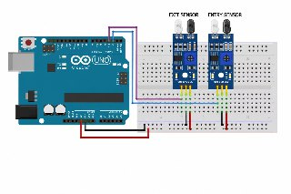
Connection / Circuit Diagram
Two IR sensors aligned across entrance Arduino digital inputs counter logic display + serial out to Wi-Fi module

Slide 6
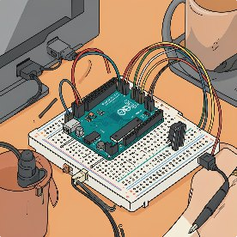
Actual Hardware Setup
Breadboard 100x160 with jumper wiring Arduino Uno Rev3 (no ESP onboard)
Sensor placement: staggered to detect direction

Slide 7
Detect
Decide
Update
Realtime loop: detect decide (entry/exit) update + push to dashboard.

Slide 8
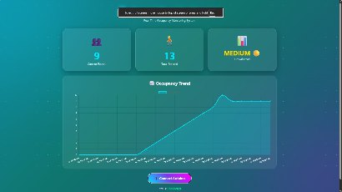
Dashboard & Demo
Live counter widget + time-series graph
Demo: short video shows people entering/exiting and counter updating
Screenshots: current count, historical trend

Slide 9

Results, Observations & Challenges
Accurate counting in single-entry ﬂows
Fast sensor response; near real-time dashboard updates Limitations: simultaneous two-person entries can miscount Robustness: wiring neatness and sensor alignment matter

Slide 10
Future Enhancements & Conclusion
Add ESP8266/ESP32 for cloud sync and remote access Mobile notiﬁcations, mobile app integration
Camera-based detection / ML for multi-person accuracy
Conclusion: system automates counts, reduces error, scalable for many venues

