Slide 1

Department of Computer Science & Engineering Artificial Intelligence & Machine Learning A.P. Shah Institute of Technology G.B.Road, Kasarvadavli, Thane(W), Mumbai-400615 UNIVERSITY OF MUMBAI Academic Year 2023-2024

Slide 2
Attendance using face recognition
Computer Science & Engineering
Artificial Intelligence and Machine Learning
By
Ayush Kargutkar(21106042)
Prabudh Gaikwad (21106038)
Maviya Bubere(21106022)
Shreyash Gharge(21106063)
Under the Guidance of
Prof. Shraddha Shinde

Slide 3
0 Index
Introduction
Objectives
Features
Tools/Softwares, Languages used
Block Diagram
Implementation
Conclusion
References

Slide 4

Introduction
This innovative project harnesses the power of facial recognition technology to streamline the
attendance tracking process.
It is done by simply scanning and identifying the faces of participants, our system not only eliminates the need for manual attendance taking but also ensures precision and security.
1

Slide 5
Objectives
Automated Attendance Tracking: Create a system that automates attendance tracking by scanning and recording faces without manual intervention.
Real-time Monitoring: Enable real-time monitoring and reporting of attendance data for administrators and instructors.
Facial Recognition Integration: Implement robust facial recognition technology to accurately identify individuals in real-time.

Slide 6
Features
Voice-Based Confirmation: Incorporates voice recognition technology to enhance attendance tracking by allowing users to verbally confirm their presence, increasing accessibility and inclusivity.
Face detection: The system uses computer vision algorithms to detect and locate human faces in images or video streams.
Face recognition: It identifies and recognizes individual faces by comparing them to a database of known faces. This allows for accurate attendance tracking and verification.

Slide 7




Tools/Softwares, Languages used

Slide 8
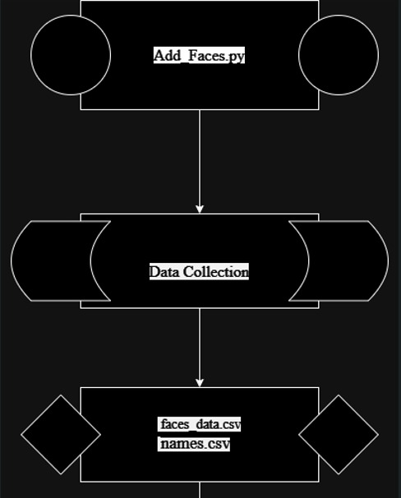
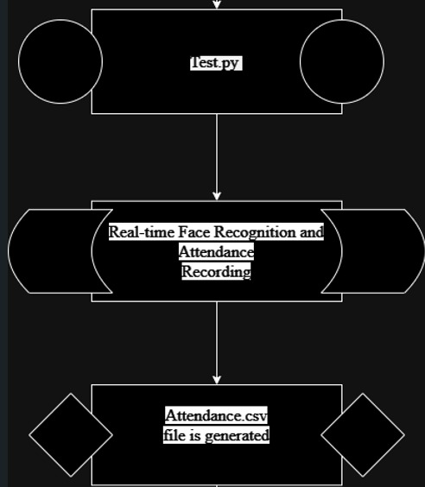
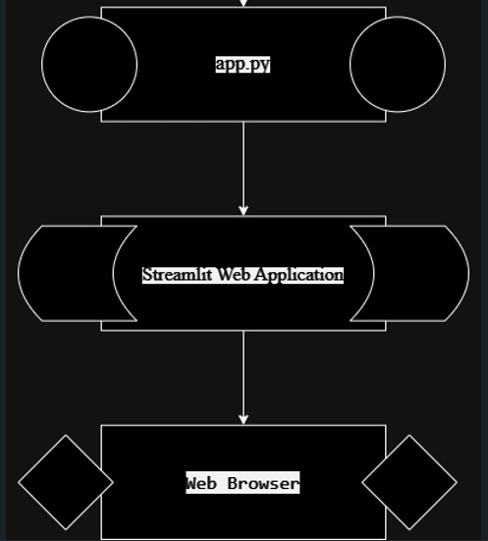
Block Diagram

Slide 9
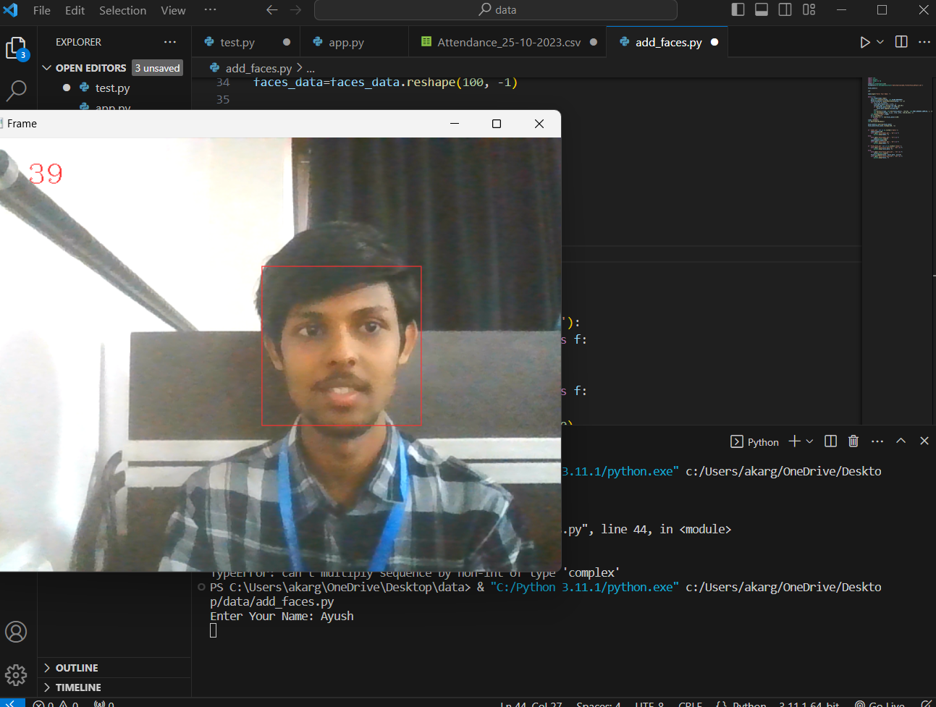
Implementation

Slide 10
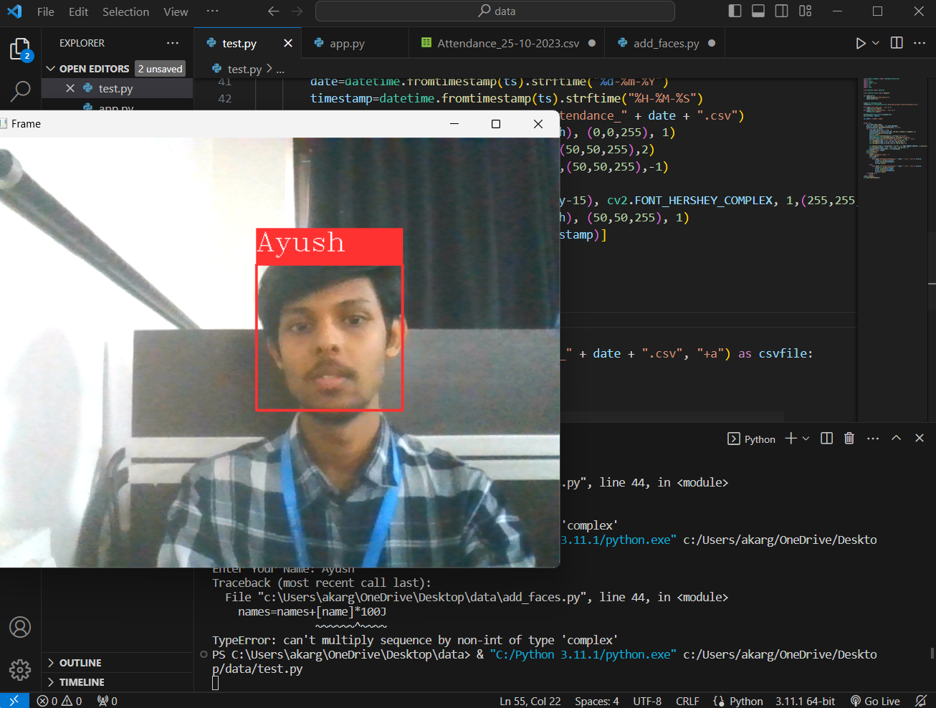

Slide 11
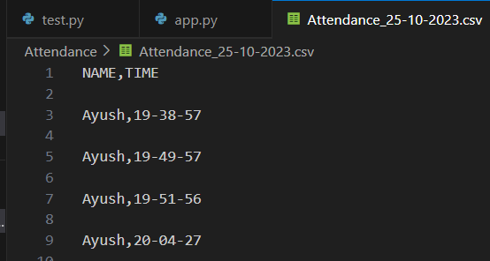


Slide 12
Conclusion
In conclusion, a face detection attendance system is a powerful and efficient solution for organizations and institutions to track attendance accurately and securely.
By leveraging advanced face detection and recognition algorithms, the system offers real-time monitoring, biometric authentication, and seamless integration with existing systems.
It simplifies attendance management processes, reduces errors, and provides reliable attendance records.
Overall, a face detection attendance system enhances efficiency, accuracy, and convenience in attendance tracking, making it an invaluable tool for modern organizations.

Slide 13
Thank you

