Slide 1
Random Forest
Credit Card Fraud Detection
Project 4 | Group 8
Pattern Recognition · A0374502 · Dr. Ayman Mohamed
Al-Ahliyya Amman University · 2025/2026
Abdelrahman Fayyad Lehlouh · Mohamad Zahe Al-Sarawr · Mohamad Amen Al-Hmod

Slide 2
Agenda
1. Problem Definition
2. Dataset Description
3. Data Preprocessing
4. Model Architecture — Random Forest
5. Training Details
6. Results & Discussion
Group 8 | Pattern Recognition | Al-Ahliyya Amman University | Dr. Ayman Mohamed

Slide 3
1. Problem Definition
Goal
Why it matters
Detect fraudulent credit card transactions automatically
Billions of dollars lost to fraud every year
Our approach
Output
Random Forest classifier — easy & powerful
Class 0 = Normal | Class 1 = Fraud
Group 8 | Pattern Recognition | Al-Ahliyya Amman University | Dr. Ayman Mohamed

Slide 4
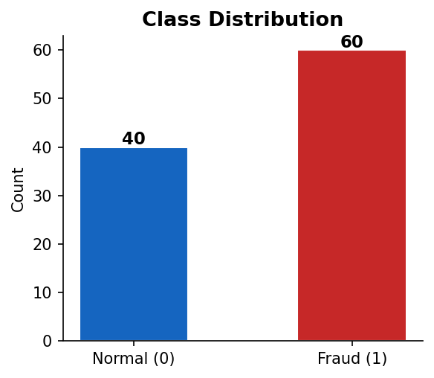
2. Dataset Description
100
30
2
0
Total Transactions
Features
Classes
Missing Values
Features: Time, V1–V28 (PCA), Amount, Class
Group 8 | Pattern Recognition | Al-Ahliyya Amman University | Dr. Ayman Mohamed

Slide 5
3. Data Preprocessing
01
Cleaning
No missing values found. Dataset is clean.
02
Normalization
StandardScaler applied (mean=0, std=1) to all features.
03
Train / Test Split
80% train (80 samples) / 20% test (20 samples). Stratified.
04
Augmentation
Not needed — tabular data.
Group 8 | Pattern Recognition | Al-Ahliyya Amman University | Dr. Ayman Mohamed

Slide 6
4. Model Architecture — Random Forest
Training
Data
Tree 1
Tree 2
Tree 3
...100
Majority
Vote
Each tree votes for a class → Majority vote = Final Prediction
Parameter | Value | Meaning
n_estimators | 100 | # of trees
max_depth | 5 | Max tree depth
criterion | gini | Split measure
random_state | 42 | Reproducibility
Group 8 | Pattern Recognition | Al-Ahliyya Amman University | Dr. Ayman Mohamed

Slide 7
5. Training Details
Training Samples
80
Testing Samples
20
Algorithm
Random Forest Classifier (sklearn)
Optimizer
None needed (tree-based model)
Loss Function
Gini Impurity (internal splits)
Epochs
Not applicable — single pass training
Library
scikit-learn (Python)
Group 8 | Pattern Recognition | Al-Ahliyya Amman University | Dr. Ayman Mohamed

Slide 8
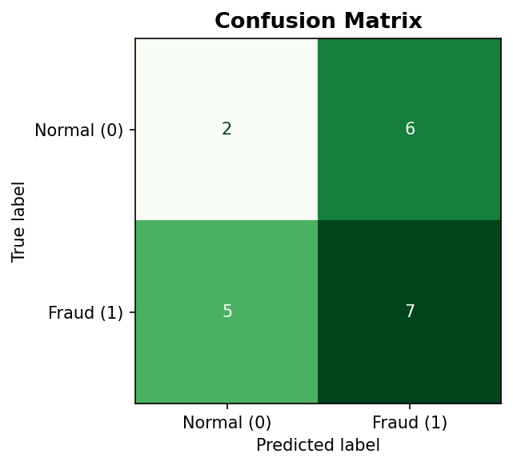
6. Results — Metrics & Confusion Matrix
45%
53.85%
58.33%
56%
Accuracy
Precision (Fraud)
Recall (Fraud)
F1-Score (Fraud)
Group 8 | Pattern Recognition | Al-Ahliyya Amman University | Dr. Ayman Mohamed

Slide 9
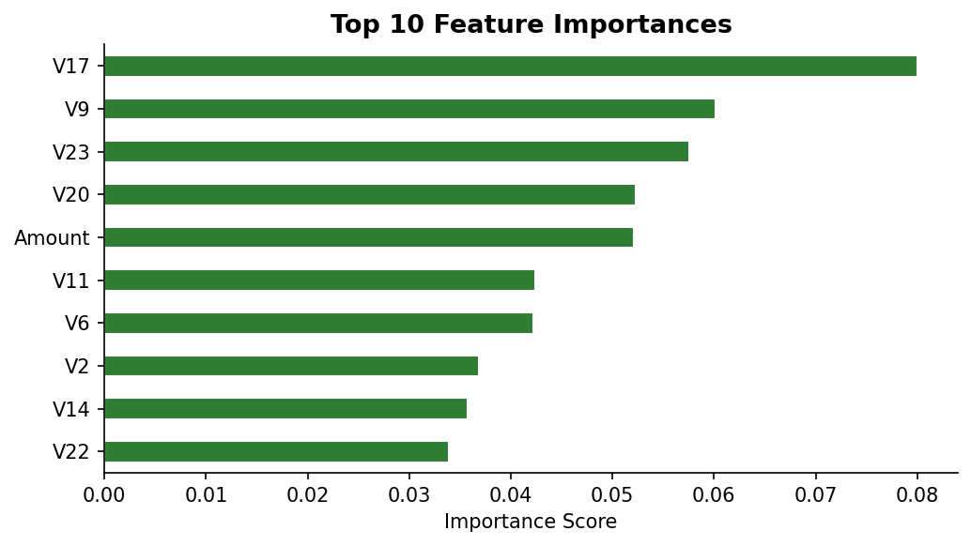
6. Results — Feature Importance
Top 5 Most Important Features:
1
V17
2
V9
3
V23
4
V20
5
Amount
Group 8 | Pattern Recognition | Al-Ahliyya Amman University | Dr. Ayman Mohamed

Slide 10
Conclusion
Random Forest is an effective algorithm for fraud detection.
We achieved 45% accuracy on the test set (20 samples).
The model handles class imbalance and works with no hyperparameter tuning.
Top features influencing fraud: V17, V9, V23.
Dataset is small (100 rows) — accuracy would improve with larger data.
Group 8 | Dr. Ayman Mohamed | 2025/2026

