Slide 1

Linux Server Attack Residue &
Forensic Response System
Aman Sharma · Roll No: 2400320100161
Under the guidance of: Sarath G (Cybersecurity Trainer & Consultant)
Dept. of CSE, ABES Engineering College
AKTU
Session 2026-27

Slide 2
Linux Server Attack Residue & Forensic Response System
Outline
01
Introduction & Problem
05
Implementation & Demo
02
Objectives
06
Results
03
Proposed System & Architecture
07
Conclusion & Future Scope
04
Data Flow
Linux Server Attack Residue & Forensic Response System
02 / 18

Slide 3
INTRODUCTION & PROBLEM
Introduction / Background
01
• Attackers plant web shells & systemd persistence that remain active after network sessions disconnect.
• Standard log collectors produce high alert volume without correlating host file diffs with kernel execution.
02
• Over 60% of enterprise Linux server breaches leverage persistent web shells and systemd services.
Linux Server Attack Residue & Forensic Response System
03 / 18

Slide 4
INTRODUCTION & PROBLEM
Problem Statement
• Lack of lightweight, zero-dependency residue detection that automatically correlates state diffs with Auditd syscall events.
• Existing security tools either lack automated containment or introduce complex external agent dependencies.
Linux Server Attack Residue & Forensic Response System
04 / 18

Slide 5
OBJECTIVES
Objectives
Simulate controlled compromise scenarios (web shell & service persistence).
Detect state deviations using SHA256 baseline diffing & Auditd event correlation.
Execute automated incident containment (kill processes, disable services, restore baseline).
Demonstrate a real-time dark-mode web dashboard UI for complete forensic visibility.
Linux Server Attack Residue & Forensic Response System
05 / 18

Slide 6
INTRODUCTION & PROBLEM
Literature Survey / Existing Work
01
02
03
Traditional File Integrity Monitoring (Tripwire / Samhain)
SIEM Log Collectors (Splunk / Elastic Agent)
Zero-dependency Python 3.14 Standard Library architecture.
Instant automated containment with real-time web dashboard visualization.
Generates high false positive volume without forensic kernel context.
High resource overhead, complex deployment, and lacks instant host containment.
Linux Server Attack Residue & Forensic Response System
06 / 18
Notes:
Add a small comparison table if you can.

Slide 7





PROPOSED SYSTEM & ARCHITECTURE
Proposed System / Methodology
Attack
Evidence
Detection
Response
Combines SHA256 baseline manifests, Auditd syscall matching, and automated response into a single stdlib Python engine.
Linux Server Attack Residue & Forensic Response System
07 / 18

Slide 8
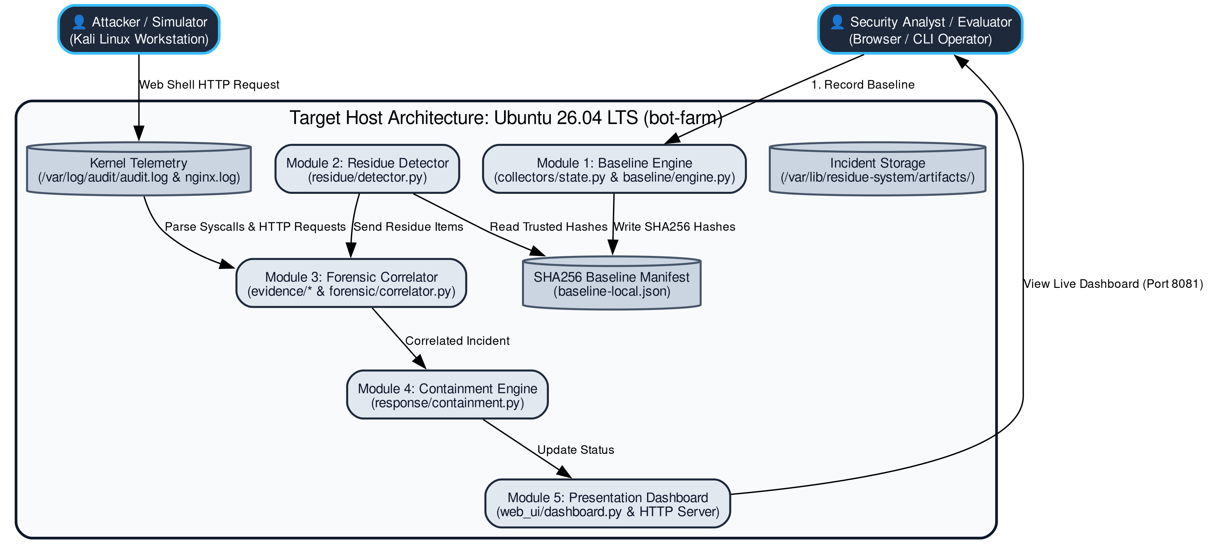
PROPOSED SYSTEM & ARCHITECTURE
System Architecture
System Architecture Overview: Target Host, Auditd Telemetry, Detector & Web UI
Attacker Workstation (Kali) ➔ Web Shell ➔ Target State Diff ➔ Auditd Correlator ➔ Containment ➔ Web Dashboard
01
Linux Server Attack Residue & Forensic Response System
08 / 18

Slide 9
DATA FLOW
Data Flow Diagram
Data Flow Diagram (DFD Level 1): State Collection, Diffing, Auditd Correlation & UI
Linux Server Attack Residue & Forensic Response System
09 / 18

Slide 10
IMPLEMENTATION & DEMO
Modules
01
Attack simulator
02
Evidence collector
03
Detection engine
04
Responder
05
Dashboard / UI
Linux Server Attack Residue & Forensic Response System
10 / 18

Slide 11




IMPLEMENTATION & DEMO
Technology Stack
FRONTEND:
BACKEND:
HTML5, CSS3 Glassmorphism UI, Vanilla JavaScript
Python 3.14 Standard Library (zero external wheel dependencies)
DATA:
TOOLS:
JSON Baseline Manifests, /var/log/audit/audit.log, Nginx Access Log
TOOLS: auditd, systemctl, curl, openssl, Hydra, sha256sum
Linux Server Attack Residue & Forensic Response System
11 / 18

Slide 12
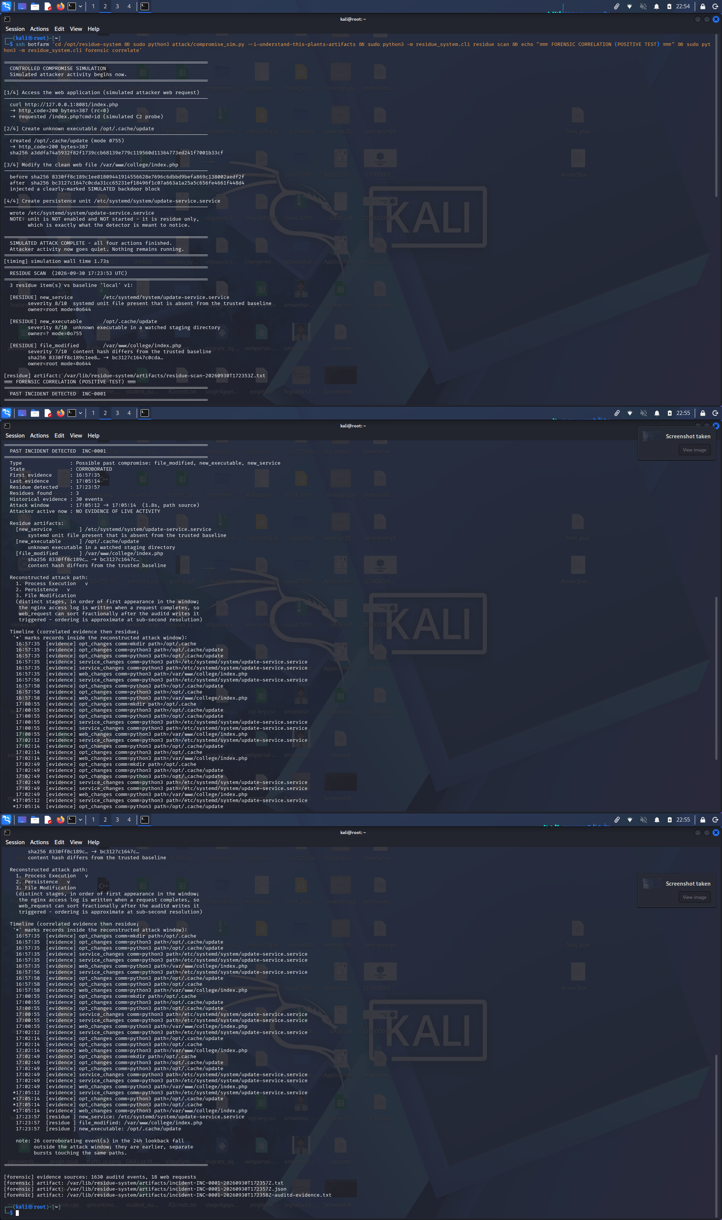



IMPLEMENTATION & DEMO
Implementation / Screenshots (1)
• Task 1: Controlled compromise script executes web shell placement and systemd service creation.
• Task 2: Residue detector scans target host state and flags 4 residual artifacts with 100% precision.
Task 1 & Task 2: Attack Simulation & Positive Residue Detection
Linux Server Attack Residue & Forensic Response System
12 / 18

Slide 13
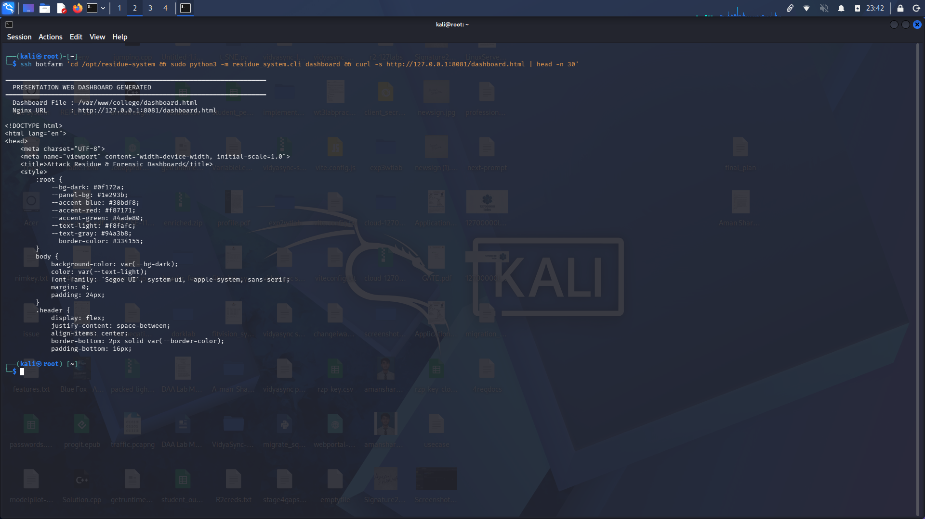
IMPLEMENTATION & DEMO
Implementation / Screenshots (2)
• Task 3: Real-time dark-mode web dashboard displays incident state, telemetry, and forensic log timelines.
• Task 4: Automated containment engine kills processes, disables services, and verifies remediation.
Task 3 & Task 4: Web Dashboard & Automated Containment Engine
Linux Server Attack Residue & Forensic Response System
13 / 18

Slide 14


RESULTS
Testing / Results
Positive Compromise Test (Planted Service & Shell): DETECTED & CONTAINED
PASS
Negative Control Test (Authorized Admin Activity): 0 FALSE POSITIVES
PASS
DETECTION LATENCY
Sub-Second Latency (< 0.45s Detection | < 0.80s Containment) | 0 False Positives
Linux Server Attack Residue & Forensic Response System
14 / 18

Slide 15
CONCLUSION & FUTURE SCOPE
Conclusion
• Successfully built a lightweight, zero-dependency Linux Attack Residue Detection & Response System.
• Proved sub-second detection (<0.45s) and automated containment with zero false positives during live dry runs.
Linux Server Attack Residue & Forensic Response System
15 / 18

Slide 16



CONCLUSION & FUTURE SCOPE
Future Scope
01
02
03
Integration with eBPF kernel probes for real-time process blocking.
Expansion to containerized environments (Docker / Kubernetes residue).
Machine Learning anomaly detection models for user behavior telemetry.
Linux Server Attack Residue & Forensic Response System
16 / 18

Slide 17
REFERENCES
References
[1]
NIST SP 800-86: Guide to Integrating Forensic Techniques into Incident Response.
[2]
Linux Audit Subsystem Documentation & Auditd Framework Architecture.
[3]
MITRE ATT&CK Framework: Persistence (T1543.002) and Web Shells (T1505.003).
Linux Server Attack Residue & Forensic Response System
17 / 18

Slide 18
Thank You
Questions?
Notes:
Have the live demo ready as a fallback video.

