Slide 1


Phase-field modeling and verification of multiphase transition processes at Tin-based electrode
Name： Qi Huang
E-mail： qihuang0908@163.com;
huang.qi@partner.kit.edu;
Supervisor： Prof. Dr. Yong Du, Prof. Dr. Britta Nestler

Slide 2
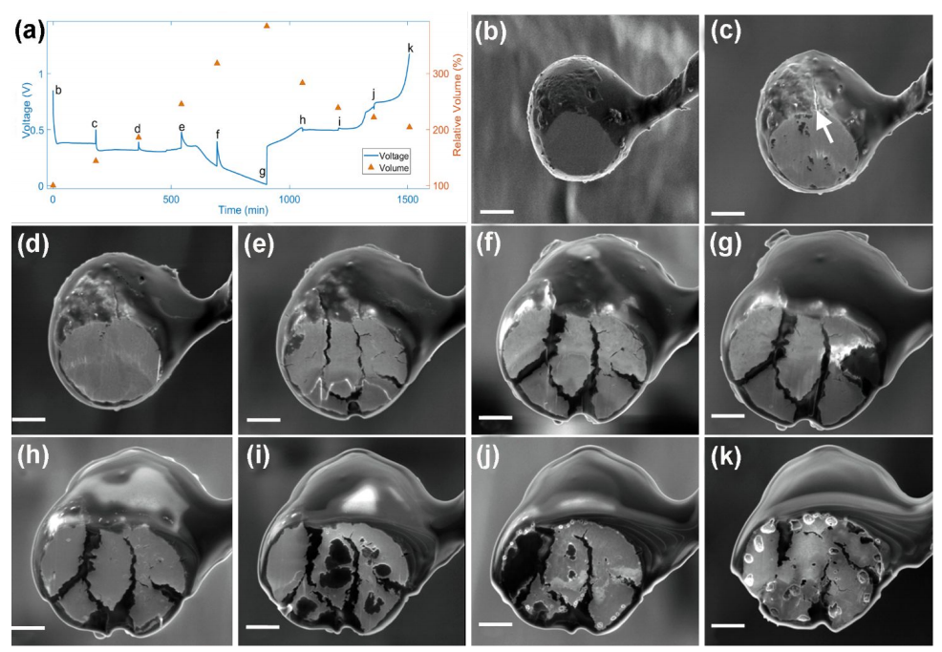
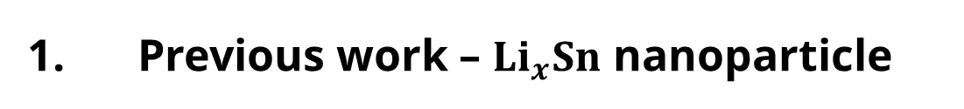


1. Previous work – ${Li}_{x}Sn$ nanoparticle
Background - ${Li}_{x}Sn$ electrode nanoparticle
high theoretical capacity $994 mAh/g$
large volume deformation $\sim 300\%$
multiphase transformation
$Sn$ , ${Li}_{0.4}Sn$, $LiSn$,
${Li}_{2.333}Sn$, ${Li}_{2.5}Sn$,
${Li}_{2.6}Sn$, ${Li}_{3.5}Sn$ and
${Li}_{4.4}Sn$ (or ${Li}_{4.25}Sn$)
Xinwei Zhou, ACS Applied Materials & Interfaces, 2019.

Slide 3
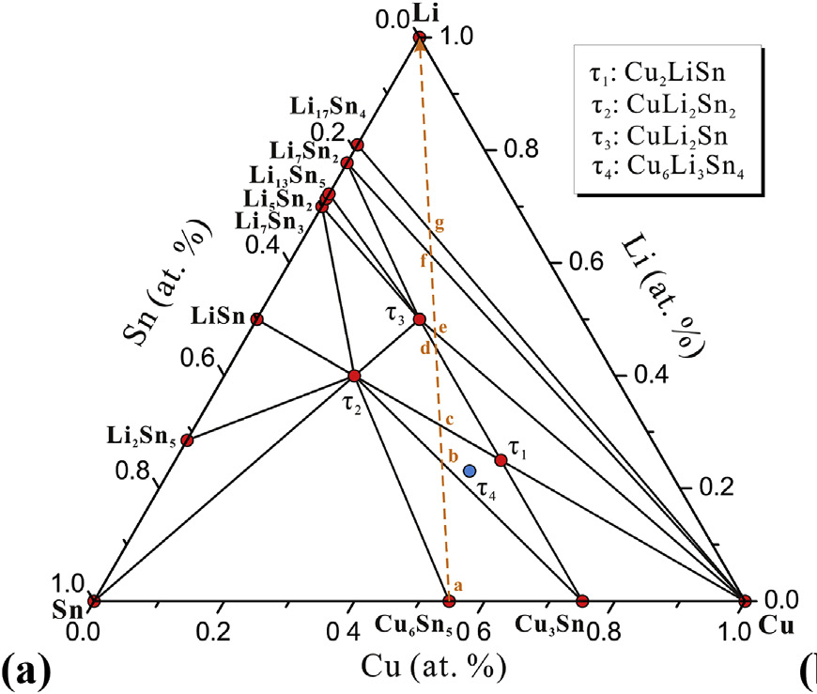

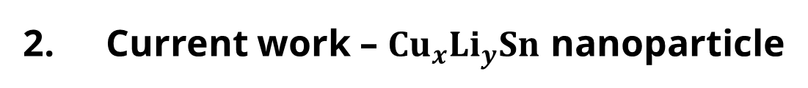
2. Current work – ${Cu}_{x}{Li}_{y}Sn$ nanoparticle
Phase-field Modeling of polycrystalline nanoparticle
Cu-Li-Sn system, Fan Zhang, Journal of Alloys and Compounds, 2019

Slide 4




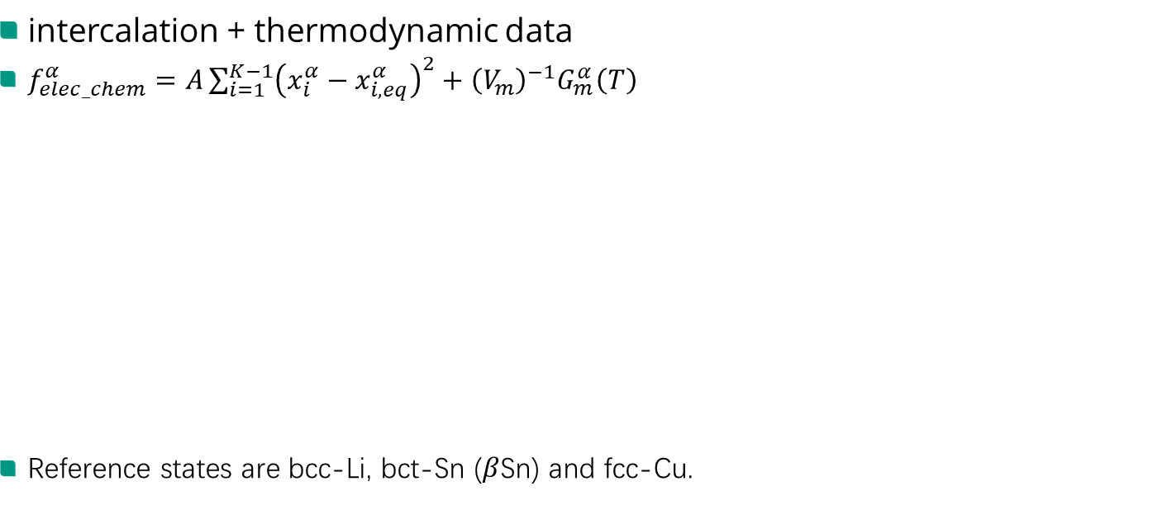







2. Current work – ${Cu}_{x}{Li}_{y}Sn$ nanoparticle
$$Li$$
intercalation + thermodynamic data
$f_{elec_chem}^{α}=A\sum_{i=1}^{K−1}{{\left(x_{i}^{α}−x_{i,eq}^{α}\right)}^{2}}+{\left(V_{m}\right)}^{−1}G_{m}^{α}\left(T\right)$
Reference states are bcc-Li, bct-Sn ($β$Sn) and fcc-Cu.
Phases | calculated formation energy $\left(kJ∙{mol}^{−1}\right)$ | Component ratio
$$LiSn$$ | $$−33.31$$ | 0.0, 0.5 $(x_{Cu,eq}^{ }, x_{Li,eq}^{ })$
$$Cu{Li}_{2}{Sn}_{2}$$ | $$−32.595$$ | 0.2, 0.4
$${Cu}_{2}LiSn$$ | $$−20.776$$ | 0.5, 0.25
$${Li}_{7}{Sn}_{3}$$ | $$−39.62$$ | 0.0, 0.7
$$Cu{Li}_{2}Sn$$ | $$−33.23$$ | 0.25, 0.5
$${Li}_{7}{Sn}_{3}$$
$$LiSn$$
$$Cu{Li}_{2}Sn$$
$$Cu{Li}_{2}{Sn}_{2}$$
$${Cu}_{2}LiSn$$
$$Sn$$
$${Cu}_{6}{Sn}_{5}$$
$${Cu}_{3}{Sn}_{ }$$
$$Cu$$

Slide 5

2. Current work – ${Cu}_{x}{Li}_{y}Sn$ nanoparticle
intercalation + thermodynamic data
Define
$G^{∗}=RT=8.314\left[J∙{\left(mol∙K\right)}^{−1}\right]∗300\left[K\right]$
${\left(V_{m}\right)}^{−1}{\hat{G}}_{m}^{α}\left(T\right)=\frac{{\left(V_{m}\right)}^{−1}G_{m}^{α}\left(T\right)}{{\left(V_{m}\right)}^{−1}G^{∗}}$
Define
$\hat{A}=500.0$
A值的确认

Slide 6
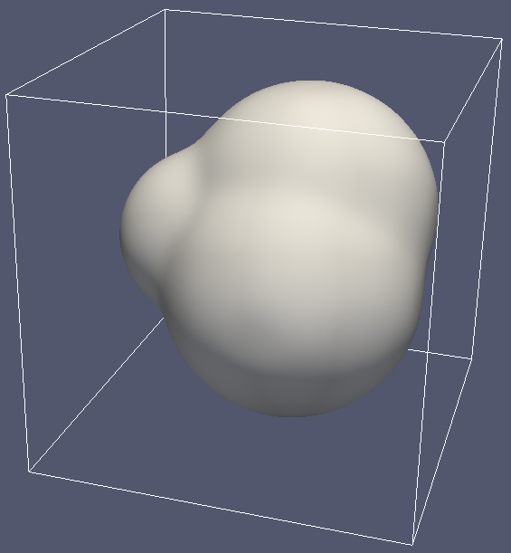
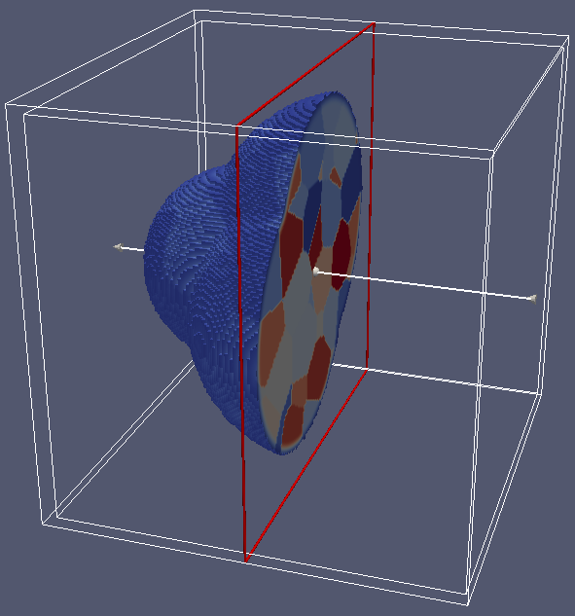
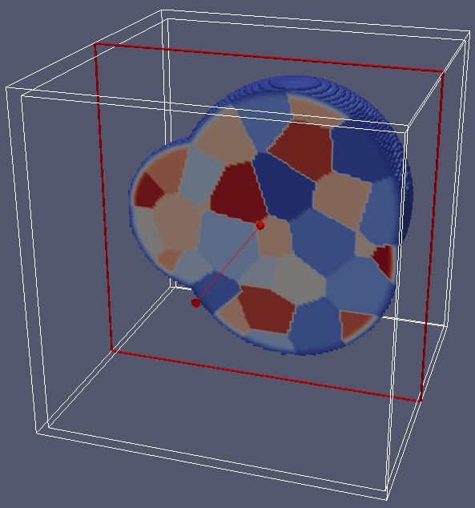
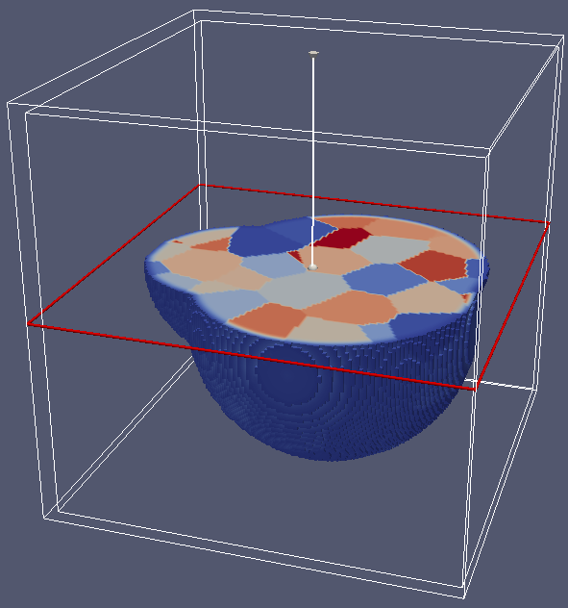
2. Current work – ${Cu}_{x}{Li}_{y}Sn$ nanoparticle
intercalation + thermodynamic data
Init multigrain structure (100 grains in nanoparticle, box = 128 x 128 x 128)

Slide 7
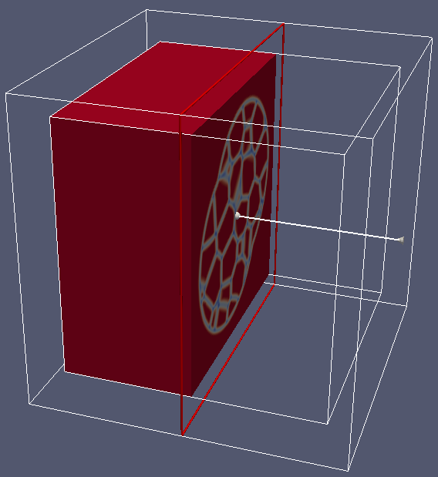
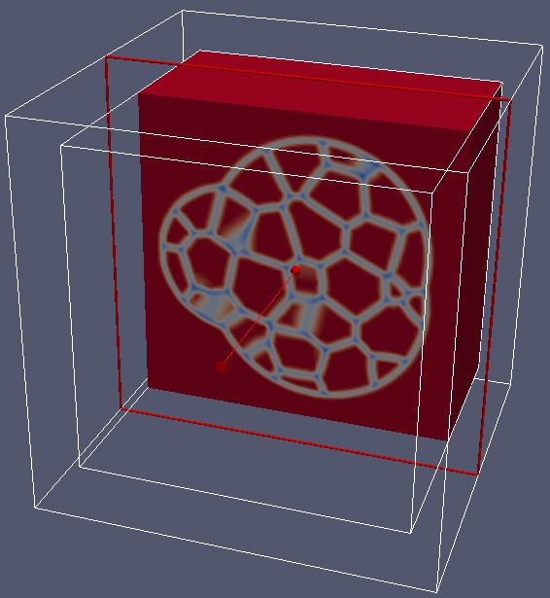
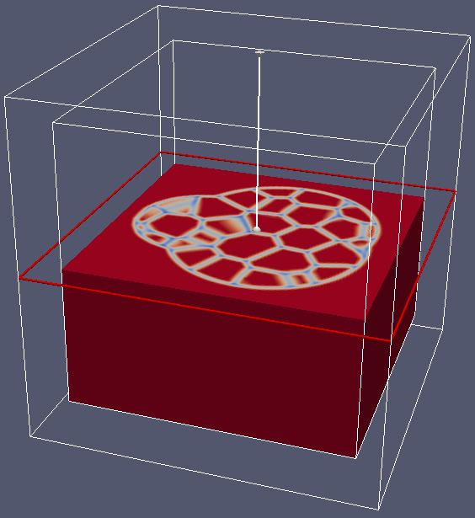
2. Current work – ${Cu}_{x}{Li}_{y}Sn$ nanoparticle
intercalation + thermodynamic data
Relax interface

Slide 8
2. Current work – ${Cu}_{x}{Li}_{y}Sn$ nanoparticle
intercalation + thermodynamic data
Merging phases

Slide 9
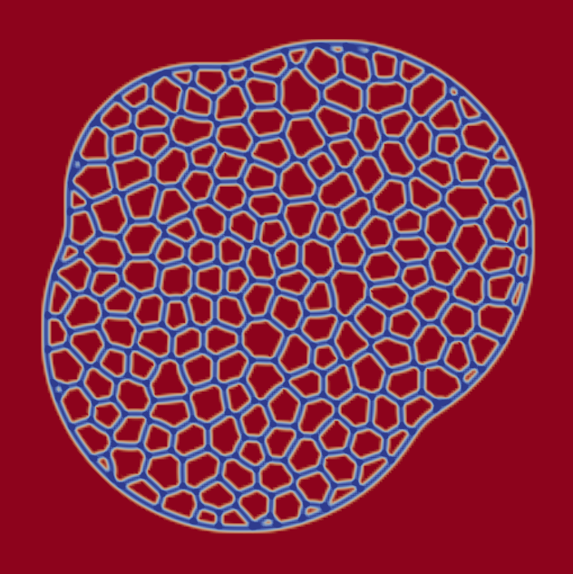
2. Current work – ${Cu}_{x}{Li}_{y}Sn$ nanoparticle
intercalation + thermodynamic data
多晶电极颗粒，嵌锂过程

Slide 10
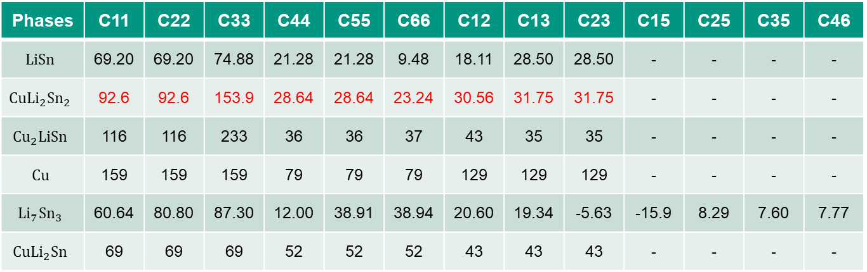

2. Current work – ${Cu}_{x}{Li}_{y}Sn$ nanoparticle
intercalation + thermodynamic data + elastoplastic data $\left(GPa\right)$
Phases | C11 | C22 | C33 | C44 | C55 | C66 | C12 | C13 | C23 | C15 | C25 | C35 | C46
$$LiSn$$ | 69.20 | 69.20 | 74.88 | 21.28 | 21.28 | 9.48 | 18.11 | 28.50 | 28.50 | - | - | - | -
$$Cu{Li}_{2}{Sn}_{2}$$ | 92.6 | 92.6 | 153.9 | 28.64 | 28.64 | 23.24 | 30.56 | 31.75 | 31.75 | - | - | - | -
$${Cu}_{2}LiSn$$ | 116 | 116 | 233 | 36 | 36 | 37 | 43 | 35 | 35 | - | - | - | -
$$Cu$$ | 159 | 159 | 159 | 79 | 79 | 79 | 129 | 129 | 129 | - | - | - | -
$${Li}_{7}{Sn}_{3}$$ | 60.64 | 80.80 | 87.30 | 12.00 | 38.91 | 38.94 | 20.60 | 19.34 | -5.63 | -15.9 | 8.29 | 7.60 | 7.77
$$Cu{Li}_{2}Sn$$ | 69 | 69 | 69 | 52 | 52 | 52 | 43 | 43 | 43 | - | - | - | -
phases | $$LiSn$$ | $$Cu{Li}_{2}{Sn}_{2}$$ | $${Cu}_{2}LiSn$$ | $$Cu$$ | $${Li}_{7}{Sn}_{3}$$ | $$Cu{Li}_{2}Sn$$
Shear modulus | 18.49 | 31.75 | 45 | 53 | 25.55 | 36

Slide 11




2. Current work – ${Cu}_{x}{Li}_{y}Sn$ nanoparticle
intercalation + thermodynamic data + elastoplastic data $\left(GPa\right)$
本征应变模型
$$β$$
$$α$$
$$γ$$

Slide 12


2. Current work – ${Cu}_{x}{Li}_{y}Sn$ nanoparticle
intercalation + thermodynamic data + elastoplastic data $\left(GPa\right)$
$$β$$
$$α$$
$$γ$$

Slide 13
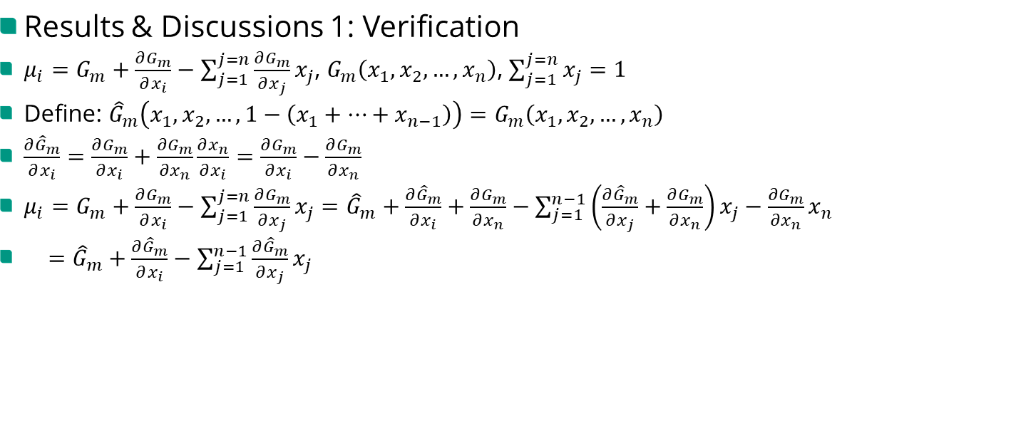
2. Current work – ${Cu}_{x}{Li}_{y}Sn$ nanoparticle
Results & Discussions 1: Verification
$μ_{i}=G_{m}+\frac{∂G_{m}}{∂x_{i}}−\sum_{j=1}^{j=n}{\frac{∂G_{m}}{∂x_{j}}}x_{j}$, $G_{m}\left(x_{1},x_{2},…,x_{n}\right)$, $\sum_{j=1}^{j=n}{x_{j}}=1$
Define: ${\hat{G}}_{m}\left(x_{1},x_{2},…,1−\left(x_{1}+…+x_{n−1}\right)\right)=G_{m}\left(x_{1},x_{2},…,x_{n}\right)$
$\frac{∂{\hat{G}}_{m}}{∂x_{i}}=\frac{∂G_{m}}{∂x_{i}}+\frac{∂G_{m}}{∂x_{n}}\frac{∂x_{n}}{∂x_{i}}=\frac{∂G_{m}}{∂x_{i}}−\frac{∂G_{m}}{∂x_{n}}$
$μ_{i}=G_{m}+\frac{∂G_{m}}{∂x_{i}}−\sum_{j=1}^{j=n}{\frac{∂G_{m}}{∂x_{j}}}x_{j}={\hat{G}}_{m}+\frac{∂{\hat{G}}_{m}}{∂x_{i}}+\frac{∂G_{m}}{∂x_{n}}−\sum_{j=1}^{n−1}{\left(\frac{∂{\hat{G}}_{m}}{∂x_{j}}+\frac{∂G_{m}}{∂x_{n}}\right)}x_{j}−\frac{∂G_{m}}{∂x_{n}}x_{n}$
$={\hat{G}}_{m}+\frac{∂{\hat{G}}_{m}}{∂x_{i}}−\sum_{j=1}^{n−1}{\frac{∂{\hat{G}}_{m}}{∂x_{j}}}x_{j}$

Slide 14
2. Current work – ${Cu}_{x}{Li}_{y}Sn$ nanoparticle
Results & Discussions 2: Cu content

Slide 15
2. Current work – ${Cu}_{x}{Li}_{y}Sn$ nanoparticle
Results & Discussions 3: Crack propagation

Slide 16
4. The End
Thanks for listening !

Slide 17










$$Li$$
$${Li}_{7}{Sn}_{3}$$
$$LiSn$$
$$Cu{Li}_{2}Sn$$
$$Cu{Li}_{2}{Sn}_{2}$$
$${Cu}_{2}LiSn$$
$$Sn$$
$${Cu}_{6}{Sn}_{5}$$
$${Cu}_{3}{Sn}_{ }$$
$$Cu$$
Cu-Li-Sn system, Fan Zhang, Journal of Alloys and Compounds, 2019

Slide 18
Cu-Li-Sn system, Fan Zhang, Journal of Alloys and Compounds, 2019

