Slide 1
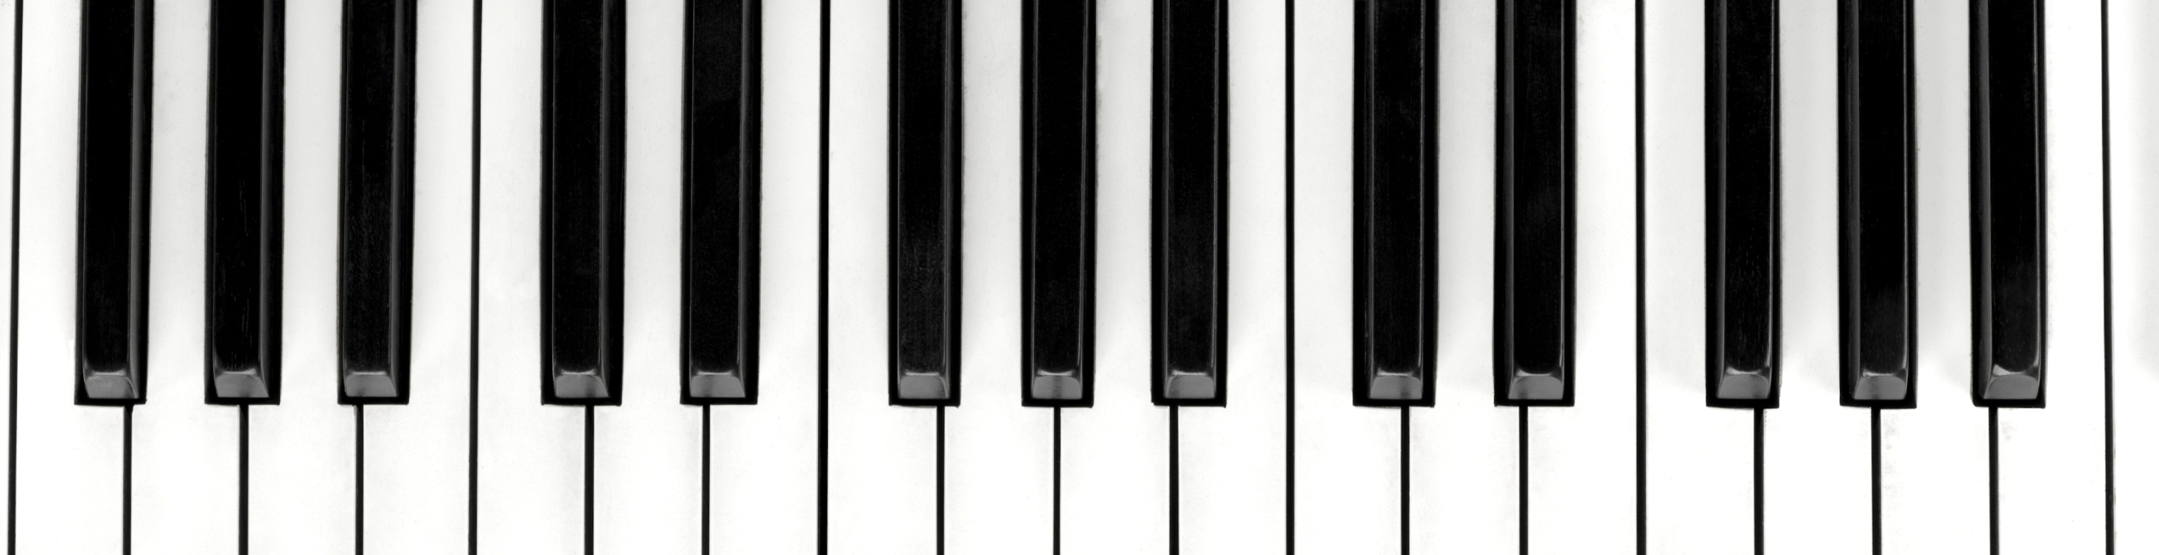
MIDI Standardization
- based on Machine Learning

Slide 2
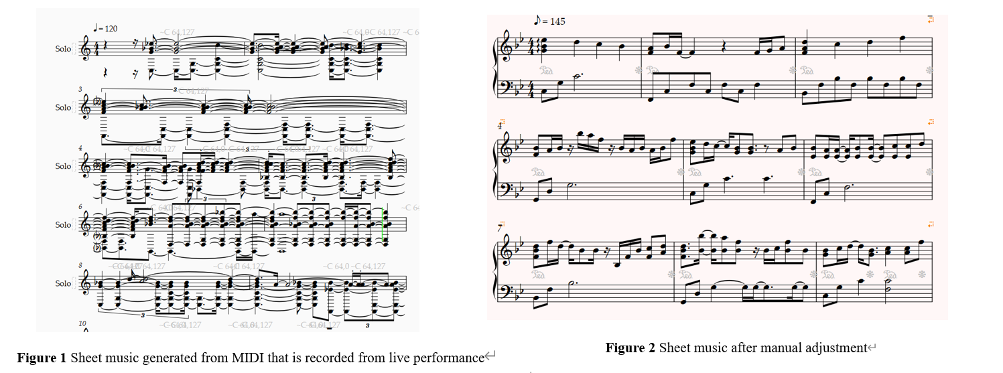

Slide 3
User stories
As someone who transcribes music, I may use AI models to generate MIDI files. I want these MIDI files to be transformed into sheet music automatically. Small errors are acceptable. This is much faster than editing sheet music from scratch.
As a music producer, I’d like to make a demo where all notes are exactly where they belong. I don’t want to adjust every note manually in DAWs.
As a music software developer, I hope to integrate a feature into my software to automatically standardize MIDI, facilitating users in arranging music, creating sheet music, or producing standardized demos.

Slide 4
MIDI files include…
Note Events
Controller Info (i.e., pedals)
Tempo Info
Program Changes (Type of instruments)
…
- Digital signals (Instructions for making sounds)
- In binary format, unlike MP3, WAV, …

Slide 5
From Live MIDI to standard MIDI
↓ MIDI keyboard inputs, transcribed by ML/AI methods,…
↑ ≈sheet music, just open it in editors
Live MIDI…
Lacks Tempo Info
Notes may deviate from their original positions
L. Liu, Q. Kong, V. Morfi, and E. Benetos, "Performance MIDI-to-score conversion by neural beat tracking", in 23rd International Society for Music Information Retrieval Conference (ISMIR), Dec. 2022.
- did rhythm quantisation using a convolutional-recurrent neural network (CRNN)
- also predicted the key signatures, time signatures, and hand parts

