Slide 1


Terraform Driver
【 Practice 】
In this Document, “IT Automation” will be written as “ITA”.
Exastro IT Automation ver 1.9
Exastro developer

Slide 2
Table of contents
1.Introduction
1.1 Introduction
1.2 Environment
2. Terraform Driver Practice
2.1 Scenario
2.2 Preparation
3. Preparation
3.1 Interface Information Registration
3.2 Registering and linking Organization
3.3 Registering and linking Workspace
3.4 Operation pattern (Movement) Registration
3.5 Module file Registration
3.6 Specify Module file to Movement
4. Execution
4.1 Operation registration
4.2 Setting variable values
4.3 Execution
4.4 Checking Operation status
4.5 Change values and re-run

Slide 3
Table of contents
1.Introduction
1.1 Introduction
1.2 Environment
2. Terraform Driver Practice
2.1 Scenario
2.2 Preparation
3. Preparation
3.1 Interface Information Registration
3.2 Registering and linking Organization
3.3 Registering and linking Workspace
3.4 Operation pattern (Movement) Registration
3.5 Module file Registration
3.6 Policy file Registration
3.7 Policy Set Registration
3.8 Linking Policy Set and Policy file
3.9 Linking Policy Set and Workspace
3.10 Specifying Module file in Movement
4. Operation
4.1 Operation Registration
4.2 Setting variable values
4.3 Confirm Plan
4.4 Confirm PolicyCheck log 4.5 Change and check VM size
4.6 Re-confirm PolicyCheck log
4.7 Execution
4.8 Checking Operation status
4.9 Change and re-run values

Slide 4
1. Introduction

Slide 5
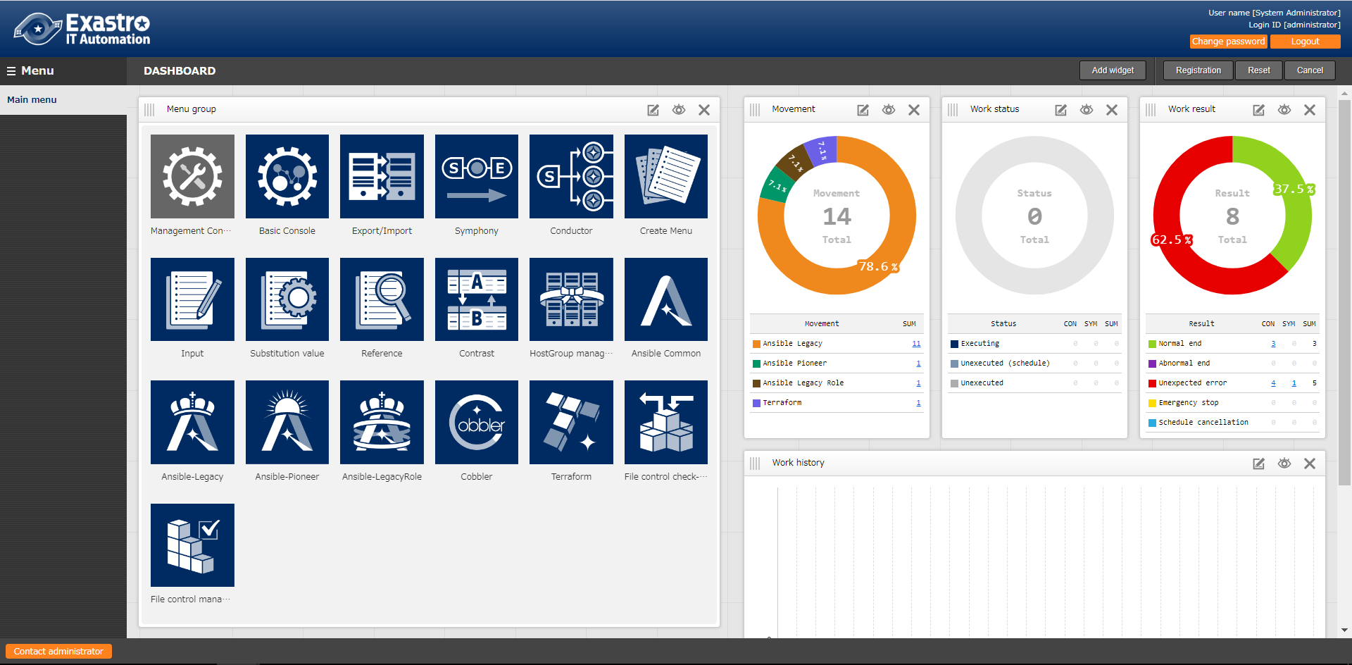
1. Introduction
Main Menu
This document aims to teach the readers about the Terraform Menu group while giving them hands-on experience.

Slide 6




1.2 Environment
Environment
The working environment used in this manual is as follows.
In addition to an ITA Server, please prepare an AWS and Azure account and a Terraform environment (Terraform account if you are using Terraform Cloud).
ITA host server
CentOS7 (*)
ITA ver 1.9
*In this scenario, the host server will be running on CentOS7, but ITA can be installed on RHEL7 and RHEL8 type OS as well.
Terraform
・Terraform Enterprise
or ・Terraform Cloud
Target AWS
Microsoft Azure
AWS
CentOS 7
ITA 1.9

Slide 7
2. Terraform Driver Practice

Slide 8
2.1 Scenario
About the scenario
This scenario uses ITA's Terraform Driver to check the plan to create the VM's on Public cloud (AWS,Azure) After that, it will use the defined policies to create the VM on the different cloud environments.
Once you have followed the "Preparation" part of this document and have linked/registered all the necessary parts, you can repeat the “Execution” part of the scenario and reconfigure/re-register target machines. (Automation)
【Preparation】
【Execution】
① Register Interface information
⑥ Register Policy files
① Register Input operation name
② Register and link Organization
⑦ Register Policy set
② Configure variables
③ Register and link Workspace
⑧ Link Policy to PolicySet
③ Check Plan
④ Register operation pattern (Movement
⑨ Link PolicySet to Workspace
③ Start Operation
⑤ Register Module files
⑩ Specify Module files to Movement
④ Check Execution status.

Slide 9
2.2 Preparation (1/6)
Create Modules
Here, we will create the 4 modules that will be used in this scenario
【 Attention 】 Make sure that the character code is “UTF-8”, the Line feed code is LF and the file extension is “tf.
variable "access_key" {}
variable "secret_key" {}
variable "region" {}
variable "ami" {}
variable "key_name" {}
variable "security_group" {}
variable "tags_name" {}
variable "hello_tf_instance_count" {
default = 2
}
variable "hello_tf_instance_type" {
default = "t2.micro"
}
File name: aws_create_instance_variables.tf
This file defines variables for creating AWS Instances.
A concrete value variable will be assigned to the variable

Slide 10
2.2 Preparation (2/6)
Create IaC
provider "aws" {
access_key = var.access_key
secret_key = var.secret_key
region = var.region
}
resource "aws_instance" "hello-tf-instance" {
ami = var.ami
key_name = var.key_name
security_groups = [var.security_group]
tags = {
Name = "${var.tags_name}-${count.index+1}"
}
count = var.hello_tf_instance_count
instance_type = var.hello_tf_instance_type
}
File name:
aws_create_instance.tf
This file defines variables for creating AWS Instances.
Create Security groups and key pairs in AWS in advance.

Slide 11
2.2 Preparation (3/6)
Create IaC
variable "subscription_id" {}
variable "tenant_id" {}
variable "client_id" {}
variable "client_secret" {}
variable "resource_group_name" {}
variable "security_group" {}
variable "location" {}
variable "Vnet_name" {}
variable "Vnet_address_space" {}
variable "subnet_name" {}
variable "address_prefixes" {}
variable "public_ip_name" {}
variable "allocation_method" {}
variable "domain_name_label" {}
variable "network_interface_name" {}
variable "NIC_name" {}
variable "VM_name" {}
variable "VM_size" {}
variable "publisher" {}
variable "offer" {}
variable "sku" {}
variable "source_image_version" {}
variable "admin_username" {}
variable "ssh_public_key" {}
variable "os_disk_name" {}
variable "caching" {}
variable "storage_account_type" {}
variable "VM_count" {}
File name:azure_create_instance_variables.tf
This file defines variables for creating Azure instances.
A concrete value variable will be assigned to the variable

Slide 12
2.2 Preparation (4/6)
Create IaC
File name: azure_create_instance.tf (1/3)
resource "azurerm_network_security_group" "hogehoge" {
name =var.security_group
location = azurerm_resource_group.hogehoge.location
resource_group_name = azurerm_resource_group.hogehoge.name
security_rule {
name = "SSH"
priority = 1001
direction = "Inbound"
access = "Allow"
protocol = "Tcp"
source_port_range = "*"
destination_port_range = "22"
source_address_prefix = "*"
destination_address_prefix = "*"
}
security_rule {
name = "HTTP"
priority = 1002
direction = "Inbound"
access = "Allow"
protocol = "Tcp"
source_port_range = "*"
destination_port_range = "80"
source_address_prefix = "*"
destination_address_prefix = "*"
}
}
Resources for creating Azure instance
Definition file.
This file creates resource groups, as well as their network security group and virtual networks.
It will also create the a virtual machine, disk and network interface for each VM.
provider "azurerm" {
features {}
subscription_id = var.subscription_id
client_id = var.client_id
client_secret = var.client_secret
tenant_id = var.tenant_id
}
resource "azurerm_resource_group" "hogehoge" {
name = var.resource_group_name
location = var.location
}

Slide 13
2.2 Preparation (5/6)
Create IaC
resource "azurerm_virtual_network" "hogehoge" {
name = var.Vnet_name
address_space = [var.Vnet_address_space]
location = azurerm_resource_group.hogehoge.location
resource_group_name = azurerm_resource_group.hogehoge.name
}
resource "azurerm_subnet" "hogehoge" {
name = var.subnet_name
resource_group_name = azurerm_resource_group.hogehoge.name
virtual_network_name = azurerm_virtual_network.hogehoge.name
address_prefixes = [var.address_prefixes]
}
resource "azurerm_public_ip" "hogehoge" {
count = var.VM_count
name = "${var.public_ip_name}-${count.index}"
location = azurerm_resource_group.hogehoge.location
resource_group_name = azurerm_resource_group.hogehoge.name
allocation_method = var.allocation_method
domain_name_label = "${var.domain_name_label}-${count.index}"
}
File name:
azure_create_instance.tf (2/3)
resource "azurerm_network_interface" "hogehoge" {
count = var.VM_count
name = "${var.network_interface_name}-${count.index}"
location = azurerm_resource_group.hogehoge.location
resource_group_name = azurerm_resource_group.hogehoge.name
ip_configuration {
name = var.NIC_name
subnet_id = azurerm_subnet.hogehoge.id
private_ip_address_allocation = var.allocation_method
public_ip_address_id = azurerm_public_ip.hogehoge[count.index].id
}
}

Slide 14
2.2 Preparation (6/6)
Create IaC
resource "azurerm_network_interface_security_group_association" "hogehoge" {
count = var.VM_count
network_interface_id = azurerm_network_interface.hogehoge[count.index].id
network_security_group_id = azurerm_network_security_group.hogehoge.id
}
resource "azurerm_linux_virtual_machine" "hogehoge" {
count = var.VM_count
name = "${var.VM_name}-${count.index}"
resource_group_name = azurerm_resource_group.hogehoge.name
location = azurerm_resource_group.hogehoge.location
size = var.VM_size
admin_username = var.admin_username
network_interface_ids = [azurerm_network_interface.hogehoge[count.index].id]
admin_ssh_key {
username = var.admin_username
public_key = var.ssh_public_key
}
os_disk {
name = "${var.os_disk_name}-${count.index}"
caching = var.caching
storage_account_type = var.storage_account_type
}
source_image_reference {
publisher = var.publisher
offer = var.offer
sku = var.sku
version = var.source_image_version
}
}
File name:
azure_create_instance.tf (3/3)

Slide 15
2.2 Preparation (7/7)
Create Policy
File name：
limit-proposed-monthly-cost.sentinel
import "tfrun"
import "decimal"
limit = decimal.new(50)
cost_limit_by_workspace = func() {
if tfrun.cost_estimate else null is null {
print("no cost estimates available")
return false
}
workspace_name = tfrun.workspace.name
proposed_cost = decimal.new(tfrun.cost_estimate.proposed_monthly_cost)
if proposed_cost.less_than(limit) {
print("Proposed monthly cost", proposed_cost.string,
"of workspace", workspace_name,
"is under the limit: $", limit)
return true
}
if proposed_cost.greater_than(limit) {
print("Proposed monthly cost", proposed_cost.string,
"of workspace", workspace_name,
"is over the limit: $", limit)
return false
}
}
cost_validated = cost_limit_by_workspace()
main = rule {
cost_validated
}
This policy limits the monthly cost.
The Terraform will not apply if the monthly cost exceeds 50$.
It will also output an estimate of the monthly cost.
This can be used for both AWS and Azure.

Slide 16
3. Preparation

Slide 17
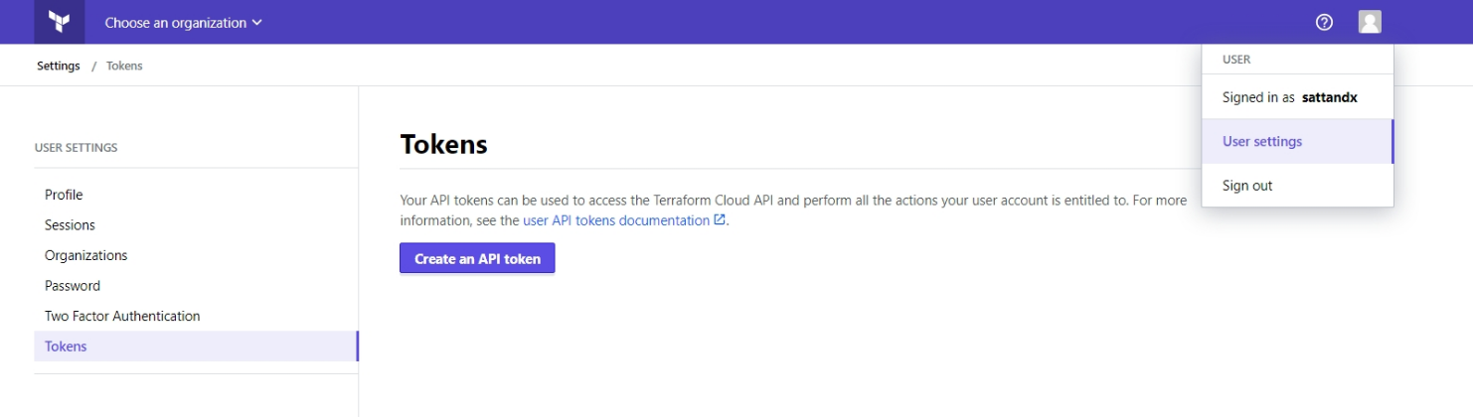
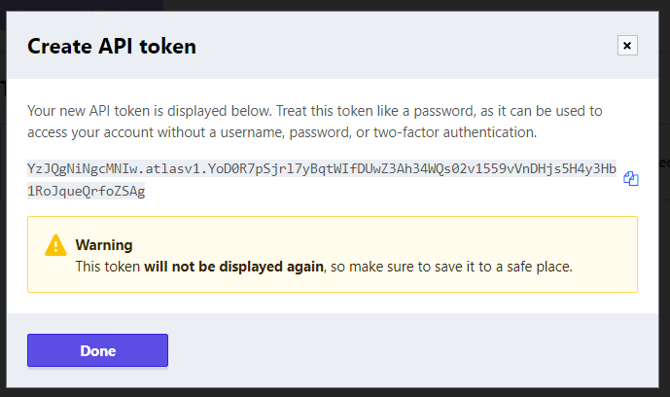
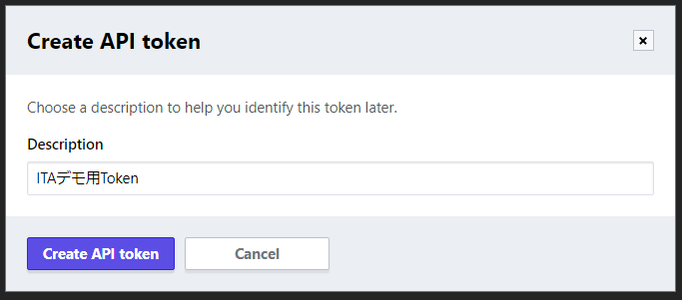
3.1 Register Interface Information(1/2)
Create User Token
In order to link Terraform Driver with Terraform, we will need to create a User Token from Terraform
Log in to Terraform from your browser and go to [User Setting]→[Tokens]→[Create an API token]
①
③
Make sure to write down the token
*It will not be displayed again if you close the screen.
②
⑤
④

Slide 18
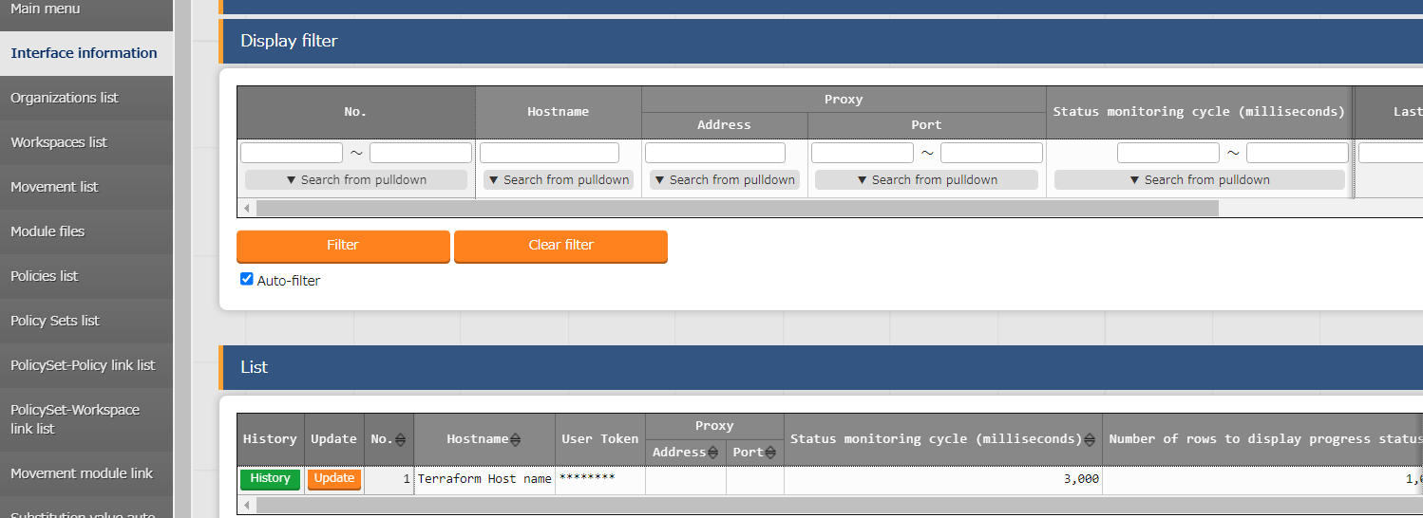
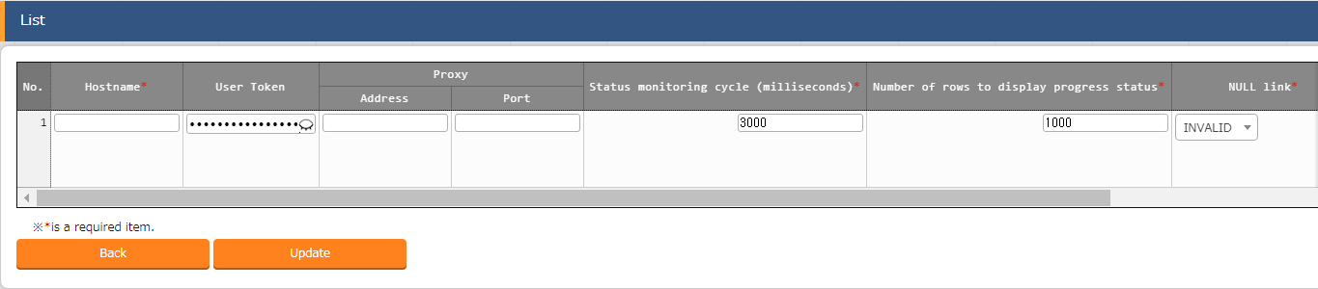
3.1 Registration of interface information(2/2)
Interface information
Input the Terraform Hostname and the created UserToken
*Since only one Terraform can be linked to ITA, you need to update the item that is already there.
Menu: Terraform> Interface Information
Open the list and press the item’s update button.
Enter the following information and press "Register".
Hostname | User Token
app.terraform.io | (Input User Token)

Slide 19
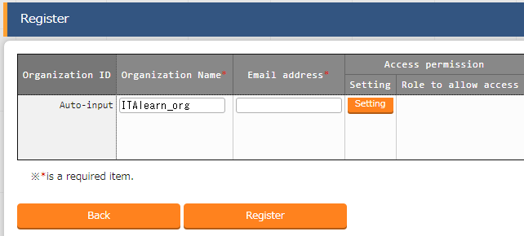
3.2 Register and Link Organization(1/2)
Register Organization
In this step, we will create an Organization.
Menu: Terraform > Organizations list
Click Register> Start Registration.
Enter the following information and press "Register".
Organization Name | Email address
ITAlearn_org | (Input Mail Address)

Slide 20
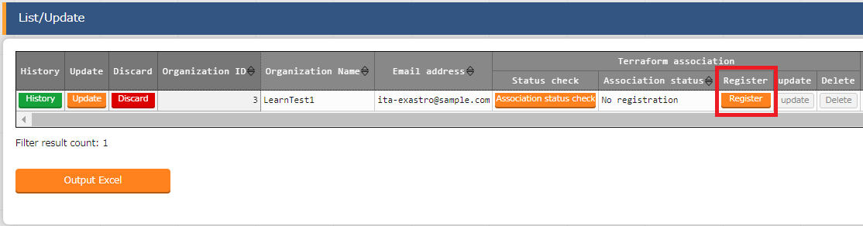
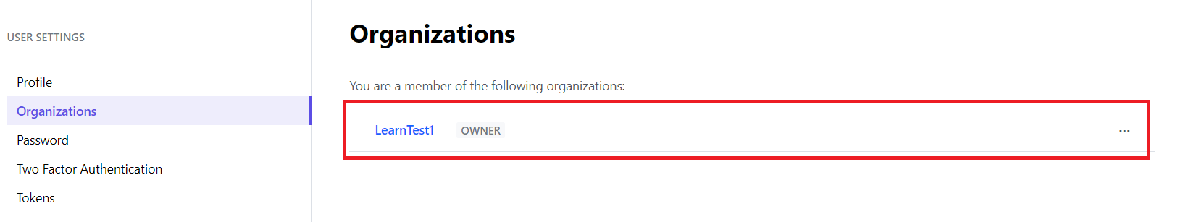
3.2 Register and Link Organization(2/2)
Link Organization
After creating the Organization item from Organization Management
You can check if the Organization has been added to the target Terraform by clicking the [Linkage status check].
If it says"Not registered", you can press the register button to create an Organization in Terraform.

Slide 21
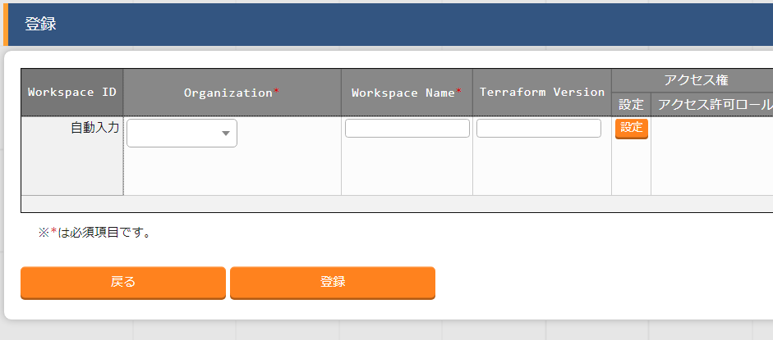
3.3 Register and Link Workspace(1/2)
Register Workspace In this section, we will create a Workspace.
Menu：Terraform > Workspaces list
Click Register> Start Registration.
Enter the following information and press "Register".
Organization | Workspace Name
ITAlearn_org | ITA-demo-AWS
ITAlearn_org | ITA-demo-Azure

Slide 22
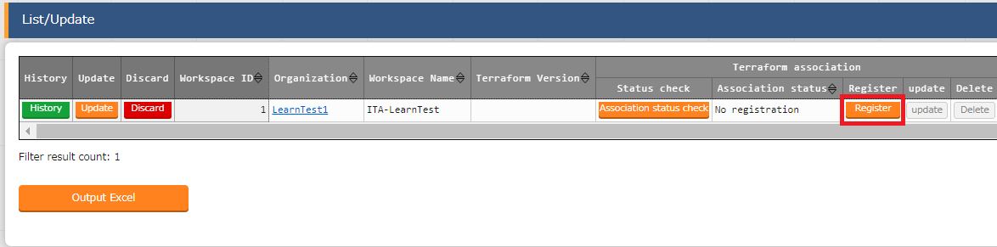
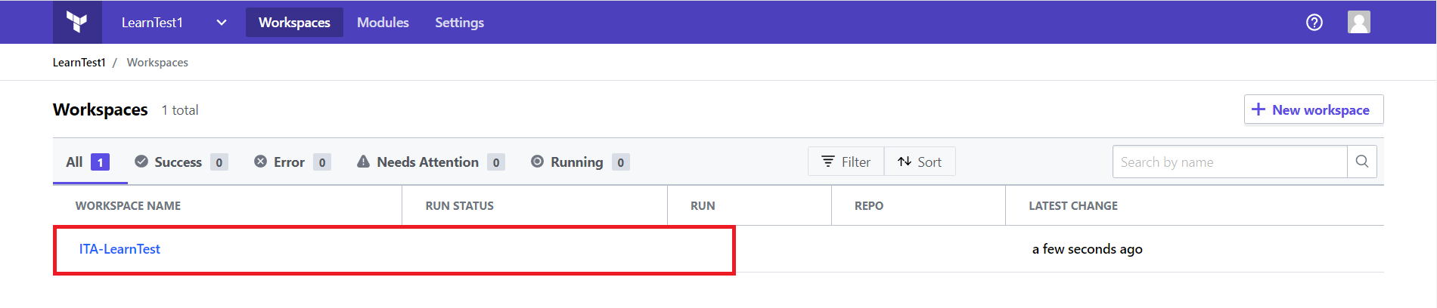
3.3 Register and Link Workspace(2/2)
Link Workspace
After creating a Workspace item in Workspaces list, You can check if the Workspace has been added to the target Terraform by clicking the “Association status check” button
If it says “Not registered”, you can press the “Register” button to create a Workspace on the target Terraform
* As a Workspace is created inside an Organization, make sure to create an Organization first.

Slide 23
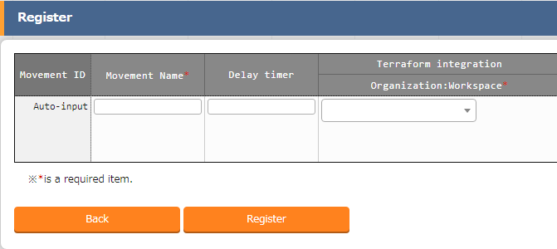
3.4 Register Operation pattern(Movement)
Create Movement In this section, we will register a Movement that we can link to the playbook we created earlier. Menu: Terraform> Movement list
Click Register> Start Registration.
Select or enter the following and press "Register".
Movement name | Terraform User information Organization: Workspace
CreateVM(AWS) | ITA-demo-AWS
CreateVM(Azure) | ITA-demo-Azure

Slide 24
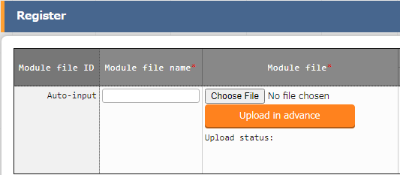
3.5 Register Module files
Register Module In this section, we will register our Modules to ITA.
Menu: Terraform> Module Files
Click Register> Start Registration.
Press "Browse" and select your playbook and press "Upload in advance".
Follow the table below and press “Register”
Module file name | Module file
aws_create_instance_variables | aws_create_instance_variables.tf
aws_create_instance_body | aws_create_instance.tf
azure_create_instance_variables | azure_create_instance_variables.tf
azure_create_instance_body | azure_create_instance.tf

Slide 25
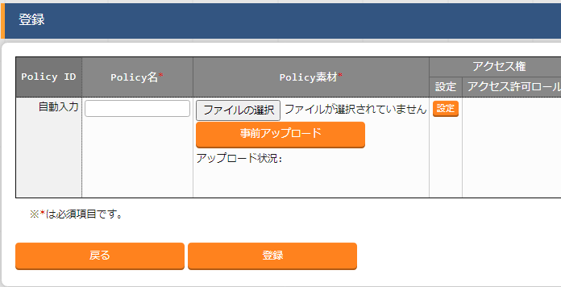
3.6 Register Policy file
Register Policy file In this section, we will register the policy file we created.
Menu：Terraform > Policies list
Click Register> Start Registration.
Select the policy you want to upload and press “Upload in advance”.
Follow the table below and press “Register”
Policy name | Policy file
limit-proposed-monthly-cost | limit-proposed-monthly-cost.sentinel

Slide 26
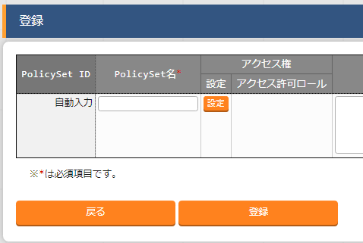
3.7 Register Policy Set
Register Policy Set In this section, we will register a Policy set.
Menu：Terraform > Policy Sets list
Click Register> Start Registration.
Follow the table below and press “Register”
PolicySet name
PolicySet_demo

Slide 27
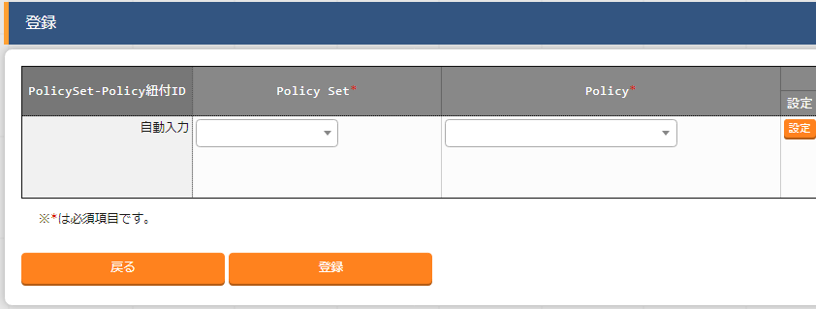
3.8 Link Policy Set and Policy
Link Policy Set and Policy In this section, we will link the previously created Policy Set and Policy file.
Menu：Terraform > PolicySet-Policy link list
Click Register> Start Registration.
Follow the table below and press “Register”
Policy Set | Policy
1:PolicySet_demo | 1:limit-proposed-monthly-cost

Slide 28
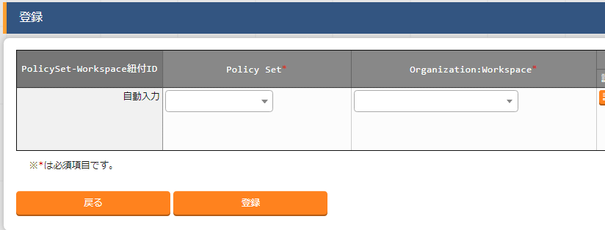
3.9 Link Policy Set and Workspace
Link Policy Set and Workspace In this section, we will link the Policy Set and the Workspace.
Menu：Terraform > PolicySet-Workspace link list
Click Register> Start Registration.
Follow the table below and press “Register”
Policy Set | Organization:Workspace
1:PolicySet_demo | ITAlearn_org:ITA-demo-AWS
1:PolicySet_demo | ITAlearn_org:ITA-demo-Azure

Slide 29
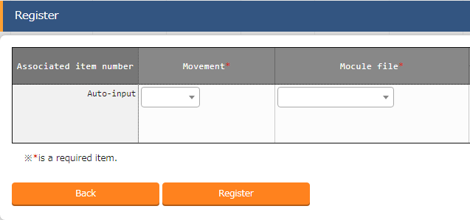
3.10 Specify Module file to Movement
Link Module to Movement In this section, we will link our Movement and Module file Menu: Terraform> Movement-Module Link
Click Register> Start Registration.
Select or enter the following and press "Register".
Movement | Module file
Create VM (AWS) | aws_create_instance_variables
Create VM (AWS) | aws_create_instance_body
Create VM (Azure) | azure_create_instance_variables
Create VM (Azure) | azure_create_instance_body

Slide 30
4. Execution

Slide 31
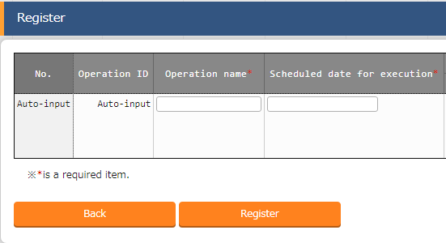
4.1 Operation registration
Register new Operation In this section, we will create an Operation
Menu: Basic Console > Input Operation List
Click Register> Start Registration.
Enter the following information and press "Register".
Operation name | Scheduled implementation date and time
Terraform_demo | (Free field)
* (Scheduled implementation date and time) is an item for management. The operation will not be automatically executed when the scheduled date passes .

Slide 32
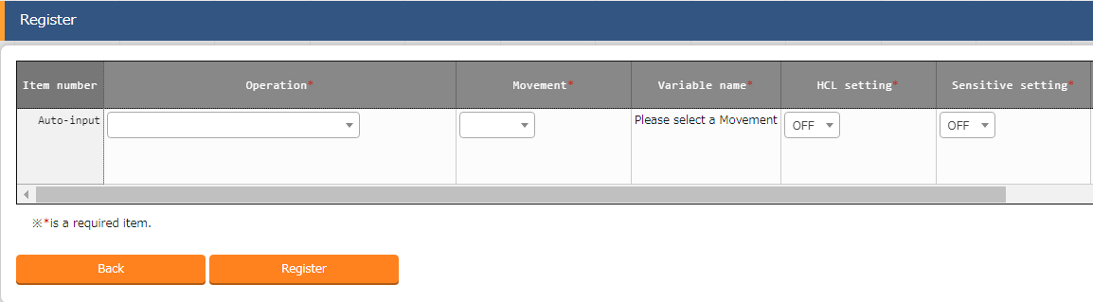
4.2 Variable value setting (1/4)
Configure values to Variables. In this section, we will configure specific values to the Module variables Menu: Terraform> Substitution value list
Click Register> Start Registration.
Select or enter the following and press "Register".

Slide 33
4.2 Variable value setting (2/4)
Configure values to Variables(1/3) Please refer to the table below and register substitute values.
* Security groups and key pairs must be created in advance.
Operation | Movement | Variable name | Specific value
Terraform_demo | CreateVM(AWS) | security_group | ita-demo-sg *
Terraform_demo | CreateVM(AWS) | key_name | ita-demo-key *
Terraform_demo | CreateVM(AWS) | access_key | (AWS access key )
Terraform_demo | CreateVM(AWS) | secret_key | (AWS secret key )
Terraform_demo | CreateVM(AWS) | Region | ( Any region )
Terraform_demo | CreateVM(AWS) | tags_name | ita-demo-instance
Terraform_demo | CreateVM(AWS) | hello_tf_instance_type | t2.large
Terraform_demo | CreateVM(AWS) | hello_tf_instance_count | 3
Terraform_demo | CreateVM(AWS) | AMI | ( Any AMI)

Slide 34
4.2 Variable value setting (3/4)
Configure values to Variables(2/3) Please refer to the table below and register substitute values.
* Security groups and key pairs must be created in advance.
Operation | Movement | Variable name | Specific value
Terraform_demo | CreateVM(Azure) | subscription_id | (Azure Authentication information )
Terraform_demo | CreateVM(Azure) | tenant_id
Terraform_demo | CreateVM(Azure) | client_id
Terraform_demo | CreateVM(Azure) | client_secret
Terraform_demo | CreateVM(Azure) | resource_group_name | ita-demo-rg
Terraform_demo | CreateVM(Azure) | location | (Input desired Azure location)
Terraform_demo | CreateVM(Azure) | security_group | ita-demo-security-group
Terraform_demo | CreateVM(Azure) | Vnet_name | ita-demo-vnet
Terraform_demo | CreateVM(Azure) | Vnet_address_space | 10.0.0.0/16
Terraform_demo | CreateVM(Azure) | subnet_name | ita-demo-subnet
Terraform_demo | CreateVM(Azure) | address_prefixes | 10.0.2.0/24
Terraform_demo | CreateVM(Azure) | public_ip_name | ita-demo-public-ip
Terraform_demo | CreateVM(Azure) | allocation_method | Dynamic
Terraform_demo | CreateVM(Azure) | domain_name_label | (Global domain name)

Slide 35
4.2 Setting variable values(4/4)
Configure values to Variables(3/3) Please refer to the table below and register substitute values.
※Use the SSH key that you prepared. The Specific value is the text of the key, ”ssh-rsa xxxxxxxx～”
Operation | Movement | Variable name | Specific value
Terraform_demo | CreateVM(Azure) | network_interface_name | ita-demo-nwif
Terraform_demo | CreateVM(Azure) | NIC_name | ita-demo-NIC
Terraform_demo | CreateVM(Azure) | VM_name | ita-demo-web-azure
Terraform_demo | CreateVM(Azure) | publisher | OpenLogic
Terraform_demo | CreateVM(Azure) | offer | CentOS
Terraform_demo | CreateVM(Azure) | sku | 8_2
Terraform_demo | CreateVM(Azure) | source_image_version | latest
Terraform_demo | CreateVM(Azure) | os_disk_name | ita-demo-os-disk
Terraform_demo | CreateVM(Azure) | storage_account_type | Standard_LRS
Terraform_demo | CreateVM(Azure) | caching | ReadWrite
Terraform_demo | CreateVM(Azure) | admin_username | ita-demo
Terraform_demo | CreateVM(Azure) | ssh_public_key | (Public SSH key)※
Terraform_demo | CreateVM(Azure) | VM_size | Standard_B2MS
Terraform_demo | CreateVM(Azure) | VM_count | 3

Slide 36
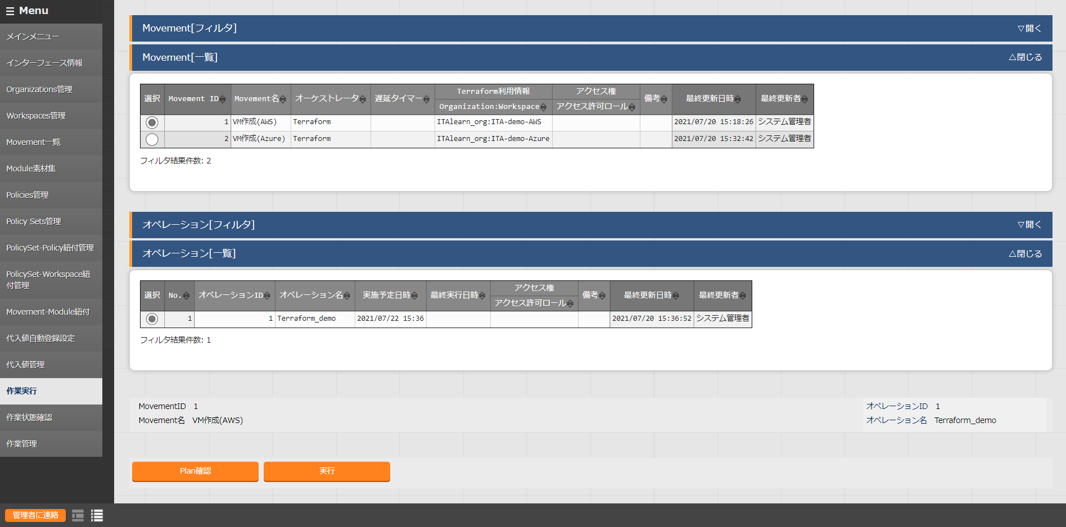
4.3 Check Plan
Check Plan In the previous section, we have created the Movement and registered the substitute values. In the next section, we are going to check that the module follows the policy.
Menu： Terraform > Execution
Select the movement you want to check
１
Select Operation
２
Tips
“Plan Check” runs the operation and stops after the Plan/PolicyCheck.
Press “Plan check”.
3

Slide 37
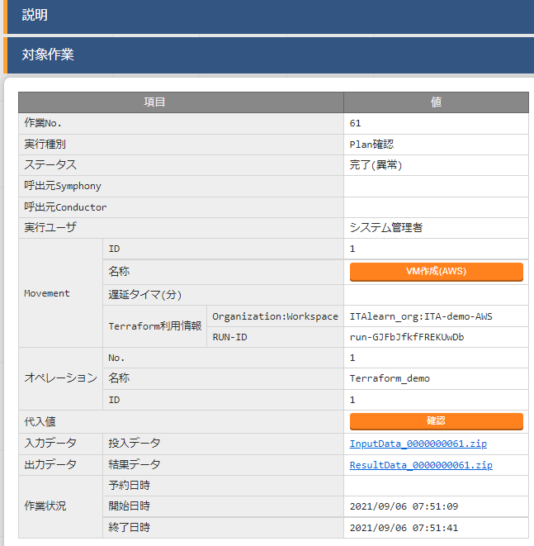
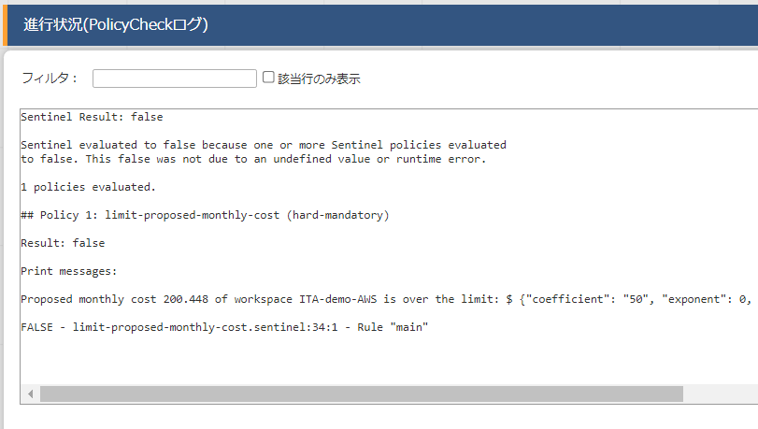
4.4 Check PolicyCheck log
Check PolicyCheck log Checking the PolicyCheck log will move the user to the screen below and tell that an error has occurred. Scroll down to see the PolicyCheck log.
Tips
We can see that the proposed cost will exceed 50$

Slide 38
4.5 Change the VM size
Change the size of the VM and re-run the operation. Lastly, we will change the size of the VM and run the operation again.
Go to Terraform > Substitute list and use the table below to change the values. Then check the plan like we did in Chapter 4.3
Before
Operation | Movement | Variable name | Specific value
Terraform_demo | CreateVM(AWS) | hello_tf_instance_type | t2.large
Terraform_demo | CreateVM(Azure) | VM_size | Standard_B2MS
Instance size
AWS:t2.large→t2.micro
Azure:Standard_B2MS→Standard_B1LS
After
Tips
Operation | Movement | Variable name | Specific value
Terraform_demo | CreateVM (AWS) | hello_tf_instance_type | t2.micro
Terraform_demo | CreateVM(Azure) | VM_size | Standard_B1LS

Slide 39
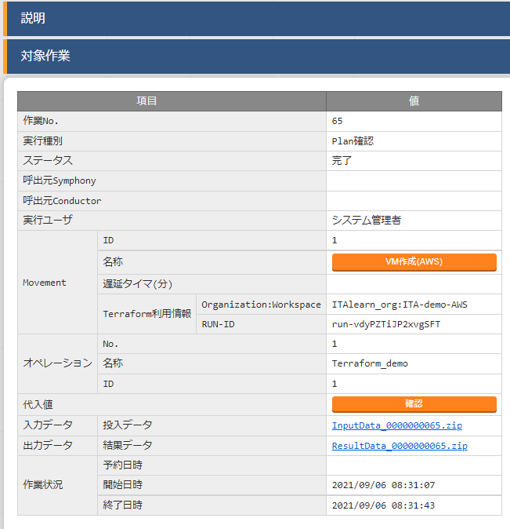
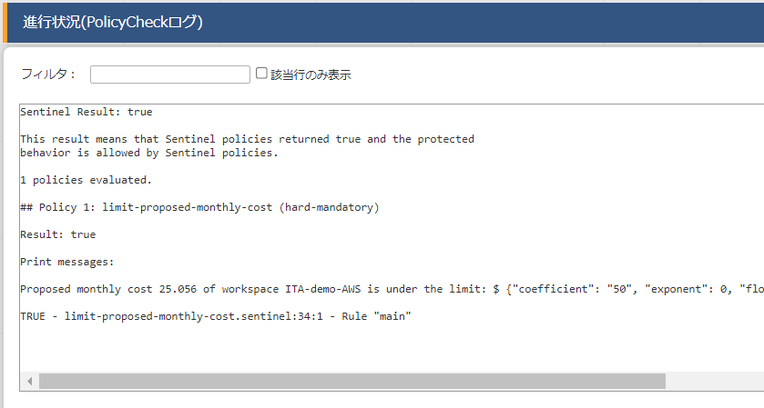
4.6 Confirm PolicyCheck log
Confirm PolicyCheck log Now if check the PolicyCheck log, we can see that it has finished successfully.
After checking the log, we can go to the next step and run the Movement.
Tips
We can now see that the proposed cost is below 50%

Slide 40
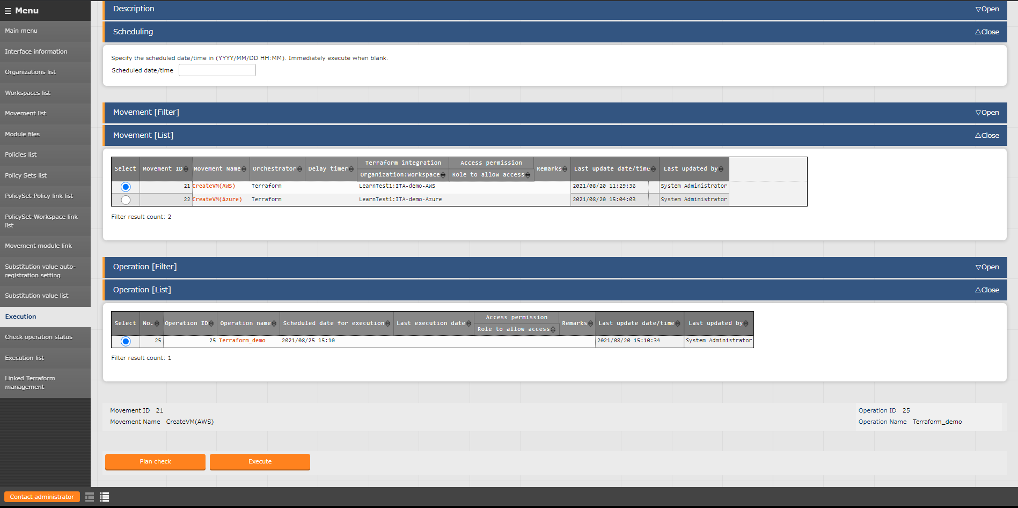
4.7 Execution
Execute Movement We have now finished creating the Movements and registering the Substitute values we are going to use. Lastly, we will execute the Movement and check the result in the target host.
Menu: Terraform> Execution
Select the Movement you want to Execute.
1
Select an operation.
2
Tips
After execution, the user will automatically be moved to the "check operation status" screen.
Click [Execute].
3

Slide 41
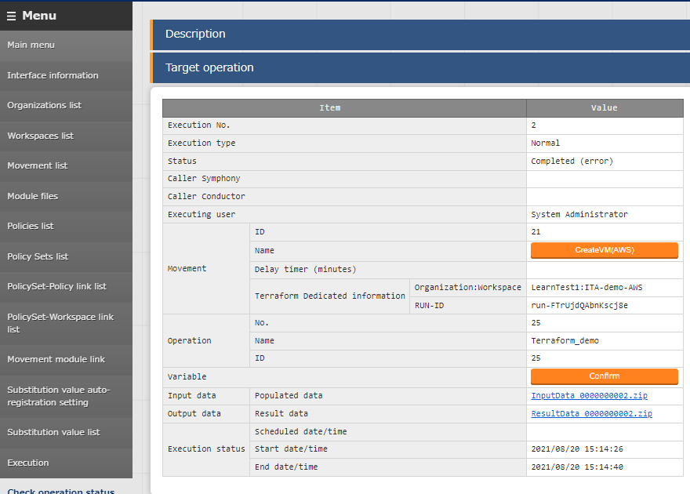
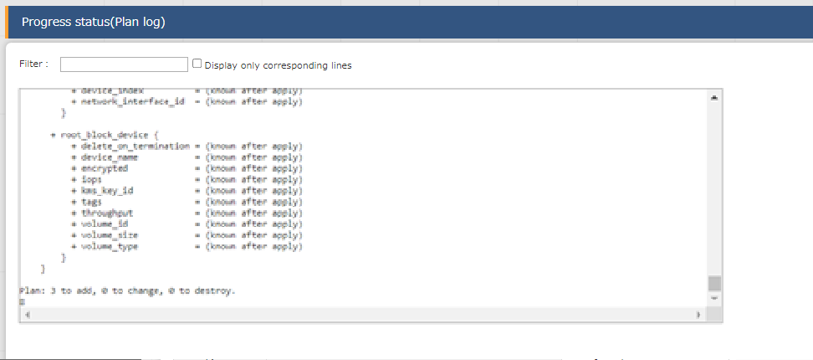
4.8 Checking Operation status
Check the detailed results of the Movement After executing, the user will be moved to a screen where they can see the Execution status and Execution logs.
It is also possible to see the input and output data.
Tips
Tips
Users can download a zip file which contains the input data and the result data.
For the results, please access the Azure account and check that all of the 3 VM has been created.

Slide 42
4.9 Change the value and execute again(1/2)
Change the number of instances and execute again. Finally, change the number of instances to deploy and repeat.
From Terraform> Substitution Value Management, refer to the table below and change the specific values and do the same as we did in chapter 4.3
Before
Operation | Movement | Variable name | Specific value
Terraform_demo | CreateVM(AWS) | hello_tf_instance_count | 3
Terraform_demo | CreateVM(Azure) | VM_count | 3
Change the Deploy instances:
AWS: From 3 to 5
Azure: From 3 to 1
After
Tips
Operation | Movement | Variable name | Specific value
Terraform_demo | CreateVM(AWS) | hello_tf_instance_count | 5
Terraform_demo | CreateVM(Azure) | VM_count | 1

Slide 43
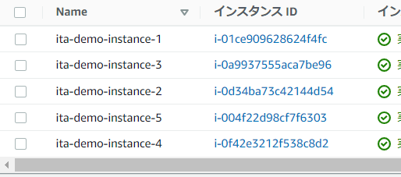
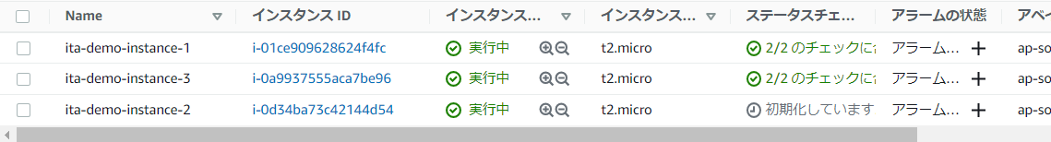
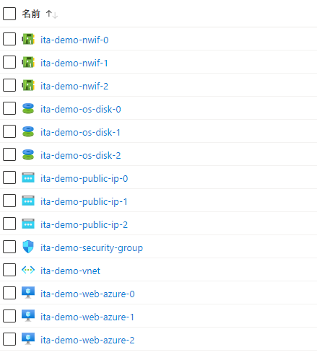
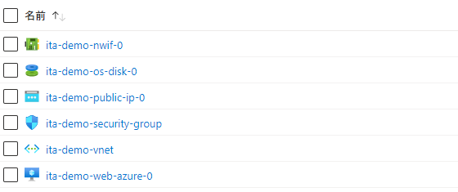
4.9 Change the value and execute again(2/2)
Check that the instances has been reduced. Access AWS ・Azure from your browser and check that the VM instances has been reduced.
AWS
Azure

