Slide 1


BASE Practice
※Exastro IT Automation is written as “ITA” in this document.
Exastro IT Automation Version 1.9
Exastro developer

Slide 2
Table of contents
Introduction
1.1 Document Overview
Practice Scenario 1
2.1 Operation Environment
2.2 RBAC for Menu scenario
2.3 Create and register new users
2.4 Create and register Roles
2.5 Link Roles and Menus
2.6 Link Roles and Users
2.7 Register Device/Operation list
2.8 Check access permission
Practice Scenario 2
3.1 Operation Environment
3.2 RBAC for Data records scenario
3.3 Create and register new users
3.4 Create and register Roles
3.5 Link Roles and Menus
3.6 Link Roles and Users
3.7 Register Movement list
3.8 Check access permission

Slide 3
1. Introduction

Slide 4
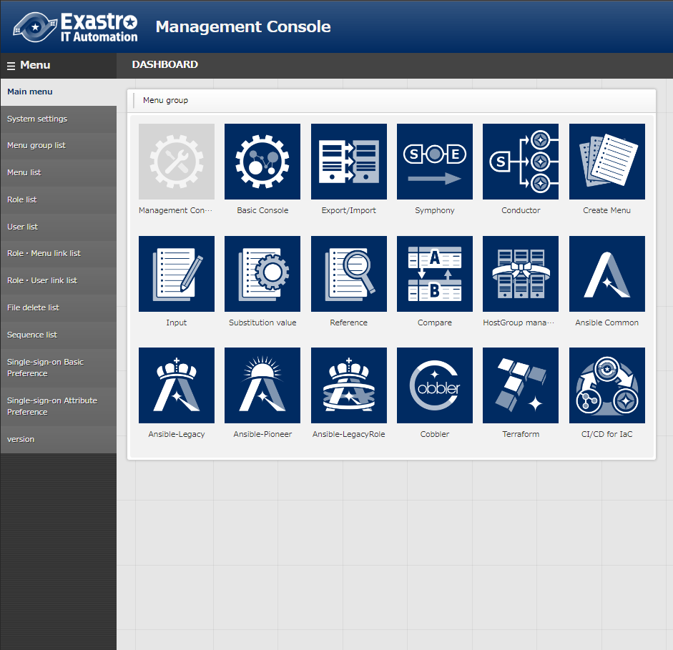
1.1 Document overview
About this document
This document will have the reader go through a couple of sample scenarios in order to learn more about the Role based access restriction function.
Scenario 1 will have to user experience RBAC for Menus.
Scenario 2 will have the user experience RBAC for data records.

Slide 5
2. Scenario 1

Slide 6

2.1 Operation environment
Environment
The following is required in order to finish this document’s scenarios.
You will need 1 server.
Client device
・Windows10
・Google Chrome
ITA server
・CentOS7 (※1)
・ITA 1.9.0
・Ansible 2.11
CentOS 7.8
Google Chrome
Exastro IT Automation
1.9.0
Ansible 2.11
Windows10
※1 In this scenario, the host server will be running CentOS7. However, ITA can be implemented to any RHEL7 or RHEL8 type OS.

Slide 7
2.2 RBAC for Menus scenario（1/2)
Scenario
This scenario will have the reader use the Management console -> Menu link list function to control RBAC for different menus.
User 1 is linked to Role A and Role B, meaning that they can edit contents in both the “Operation list” and the “Device list”.
User 2 is linked to Role B, meaning that they can edit in “Device list”.
User 3 is linked to Role C, meaning that they can view in the “Device list”.
User 4 is not linked to any role, meaning that they cannot view any of the menus.
Edit
View
user1
Role A
Basic console: Operation list
user2
Role B
Basic console:
Device list
user3
Role C
<- User 4 is not linked to any role, meaning that they cannot see or change data.
user4

Slide 8
2.2 RBAC for Menus Scenario（2/2)
Scenario procedure
2.3 Create and register new users
2.4 Create and register roles
2.5 Link roles and menus
2.6 Link roles and users
2.7 Register data in the “Device list” and “Operation list” menus.
2.8 Check RBAC

Slide 9
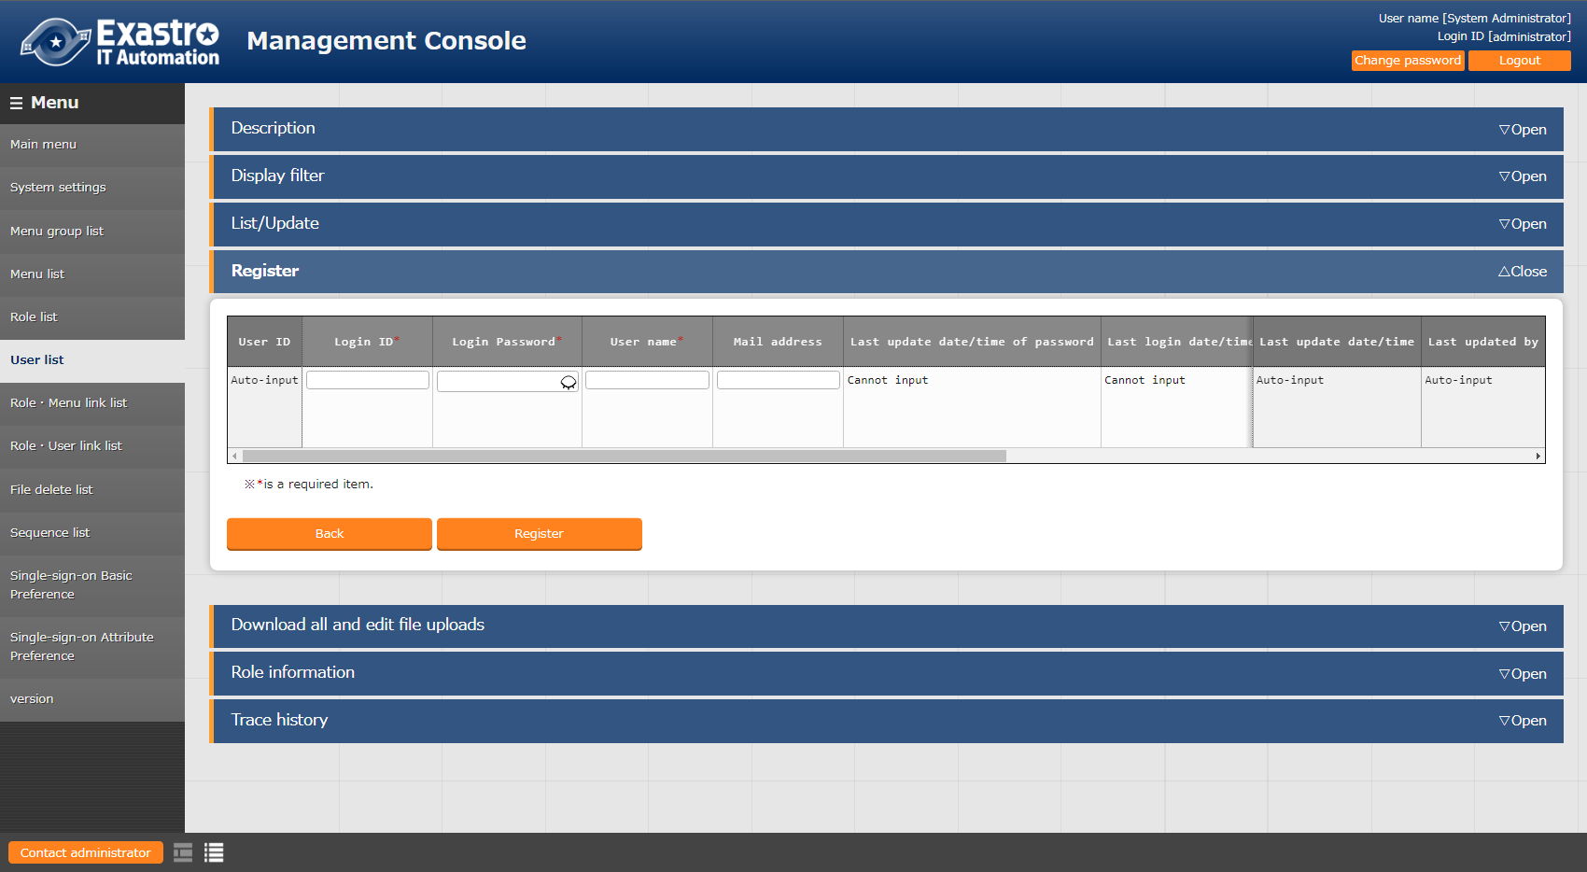
2.3 Create and Register new users
Create and register new users
Create and register new users
In order to check the different access permissions, we will create 4 different users.
Menu: Management console > User list
Register > Start registration
Follow the table below and press “Register”
Create and register Roles
Link Roles and Menus
Link Roles and Users
Register Device/Operation list
Check access permission
Login ID | Login PW | User name
user1 | （Free field） | Test1
user2 | （Free field） | Test2
user3 | （Free field） | Test3
user4 | （Free field） | Test4
2

Slide 10
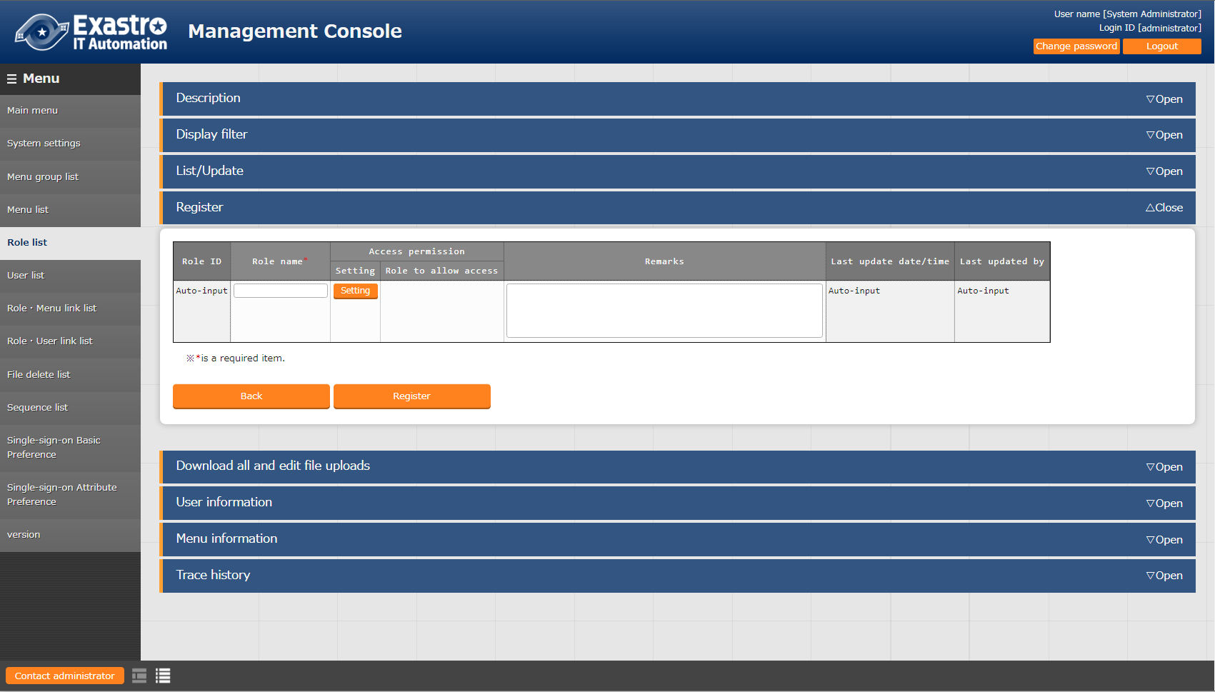
2.4 Create and register roles
Create and register new users
Create and register roles
Create and register the roles that controls user access
Menu: Management console> Role list
Register > Start registration
Follow the table below and press “Register”
Create and register Roles
Link Roles and Menus
Link Roles and Users
Register Device/Operation list
Role name
Role A
Role B
Role C
Check access permission
１
2

Slide 11
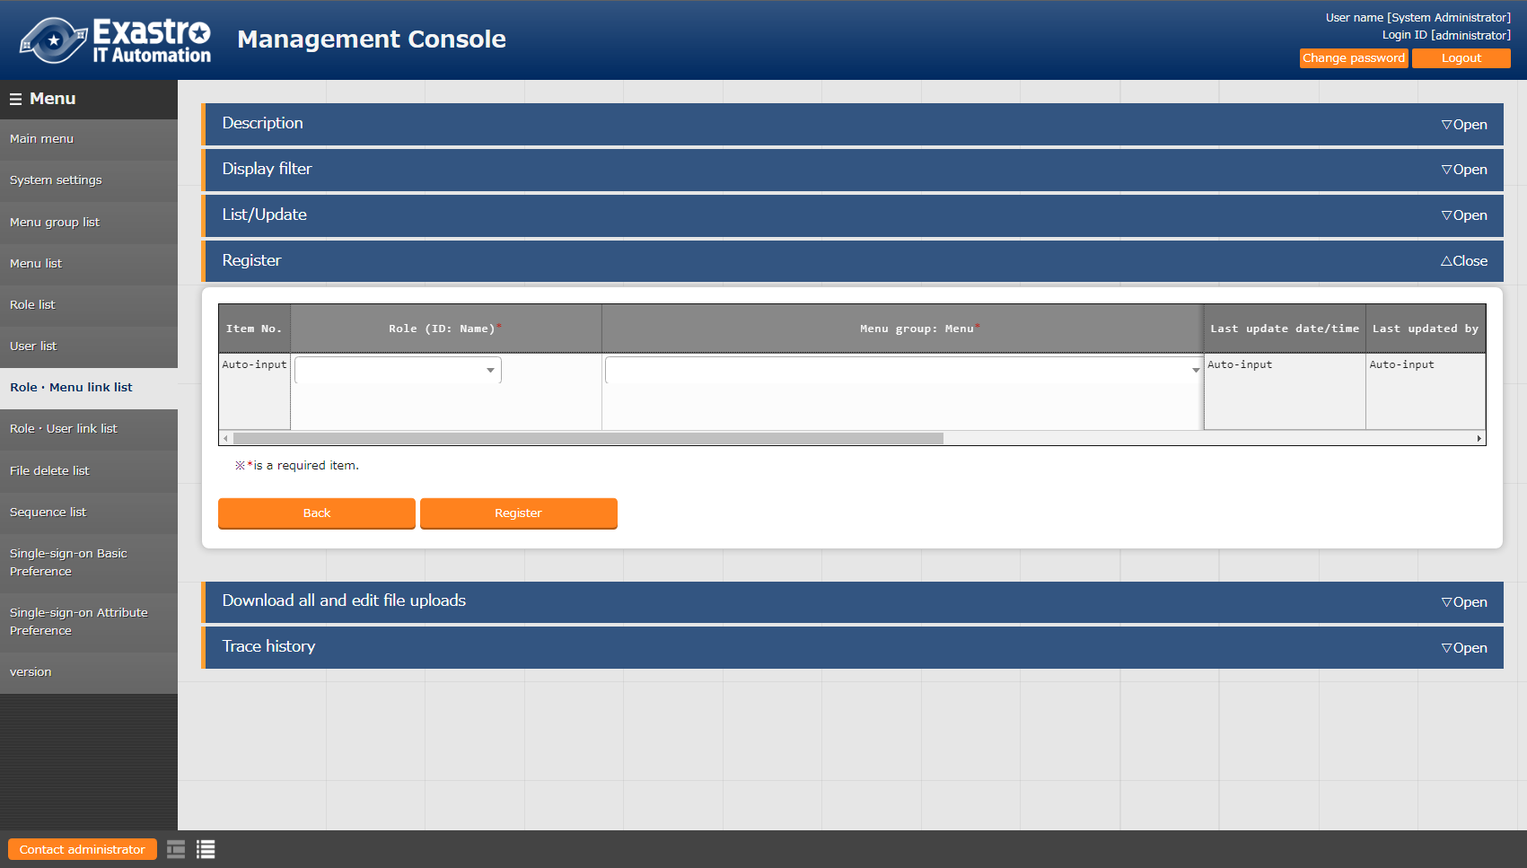
2.5 Role・Menu link
Create and register new users
Link Role and menus
Link menus to the different roles and select permission type
Menu: Management console> Role ・Menu link list
Register > Start registration
Follow the table below and press “Register”
Create and register Roles
Link Roles and Menus
Link Roles and Users
Register Device/Operation list
Check access permission
2
１
Role name | Menu group: Menu | Associate
Role A | Basic console: Operation list | Edit
Role B | Basic console: Device list | Edit
Role C | Basic console: Device list | View

Slide 12
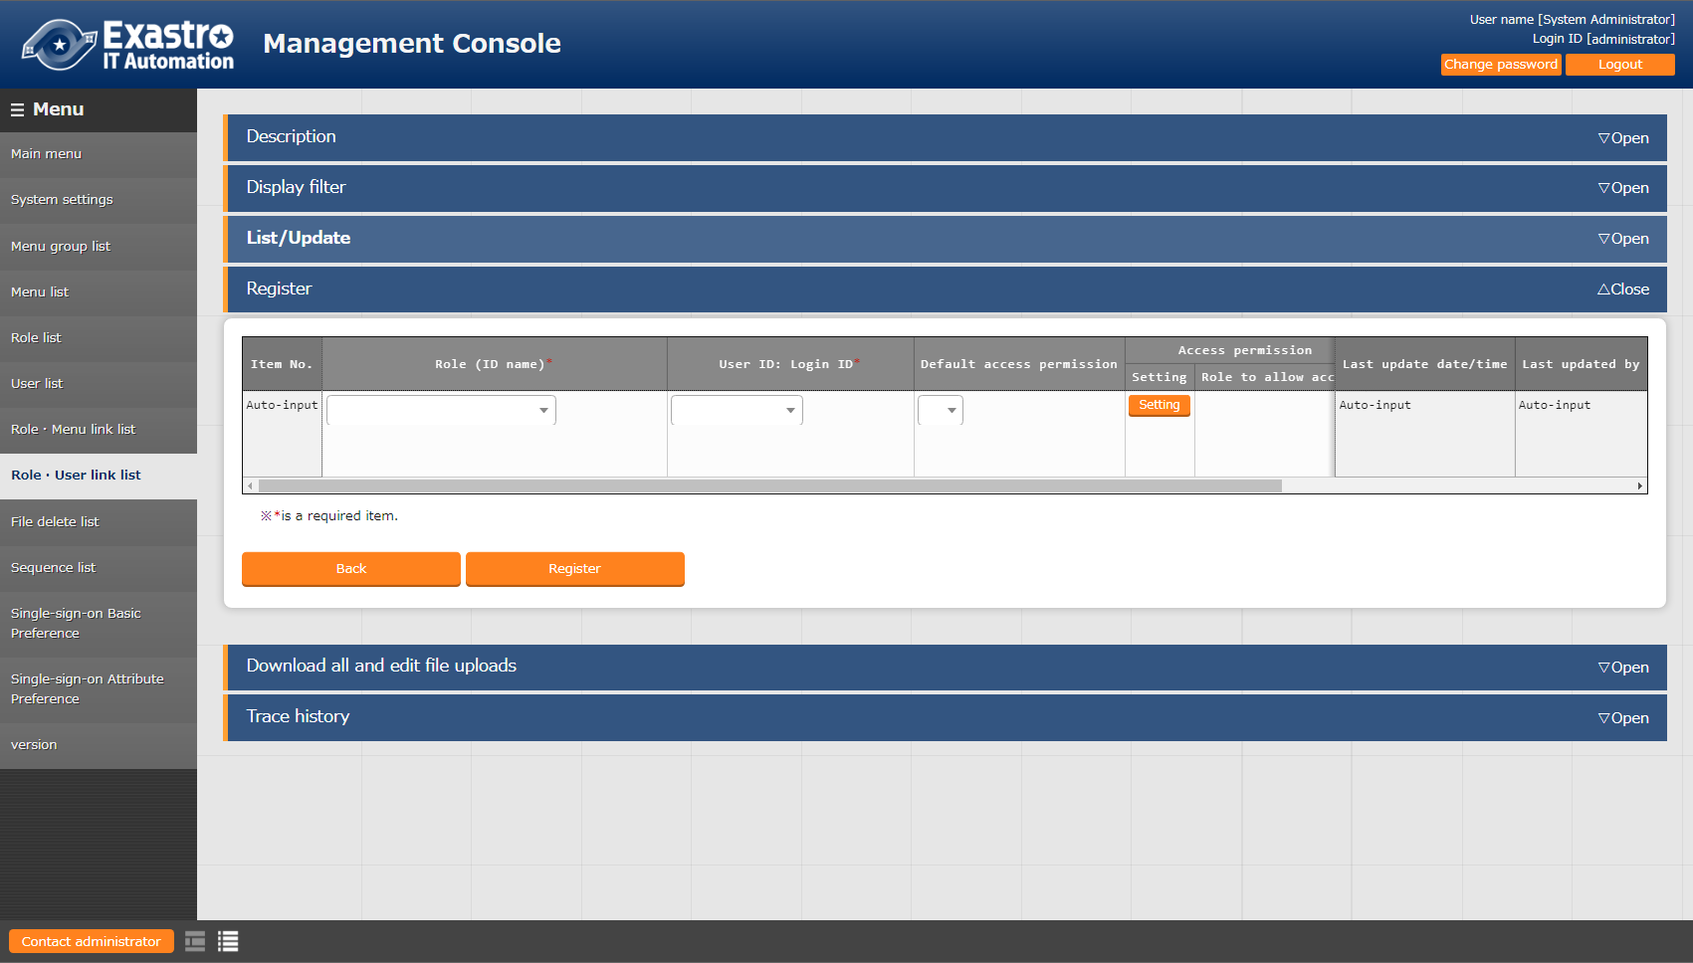
2.6 Role ・User link
Create and register new users
Link Role and user information
Link a roles to the different users
Menu: Management console> Role ・User link list
Register > Start registration
Follow the table below and press “Register”
Create and register Roles
Link Roles and Menus
Link Roles and Users
Register Device/Operation list
Check access permission
Role name | User ID | Default access permission
Role A | user1 | ●
Role B | user1 | ●
Role B | user2 | ●
Role C | user3 | ●
2
Point
Selecting "●" for "Default access permission" will make the registered access permission default to the role when registering new data.

Slide 13
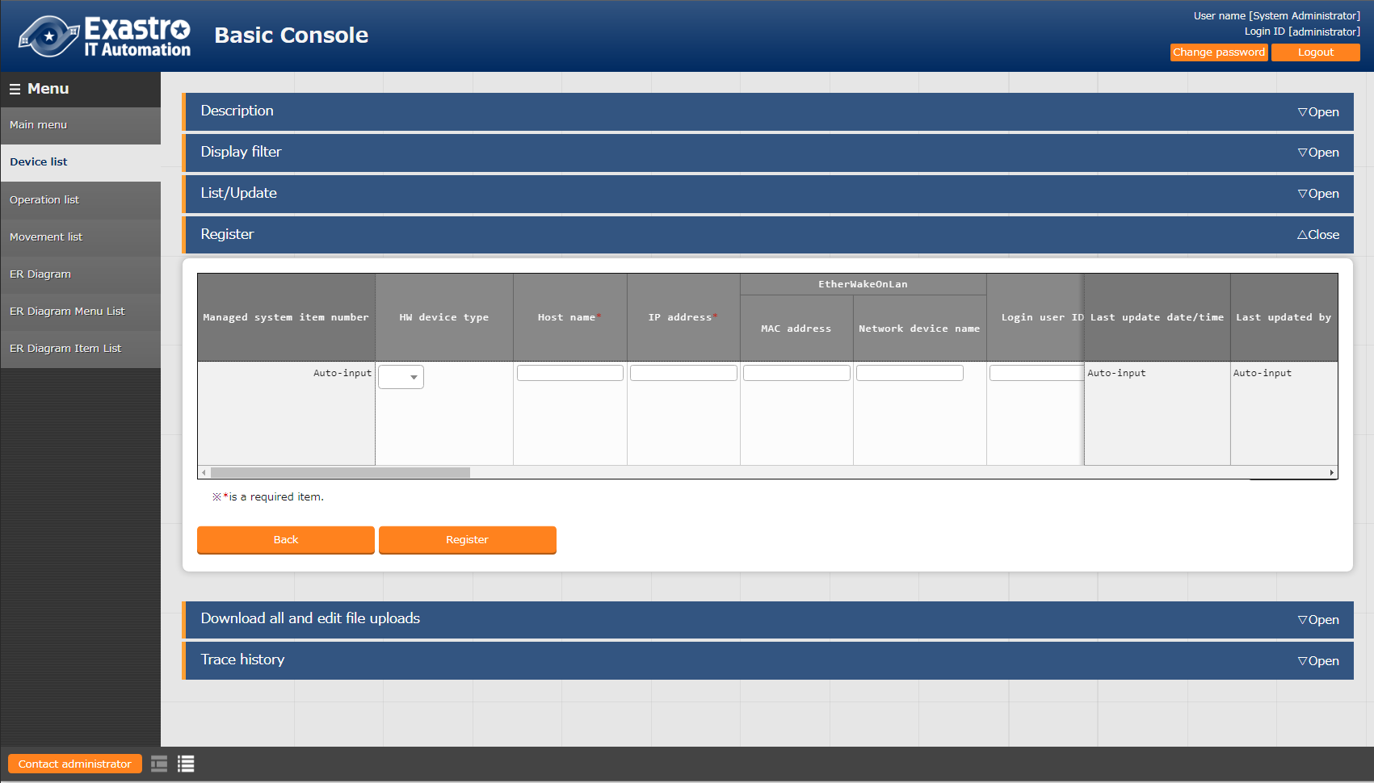
2.7 Device list/Operation list registration(1/2)
Create and register new users
Register new data in the Device list menu.
The following must be done while logged in as Administrator. Register a new item in the Device list. This allows us to check the access permissions for the different users. Do not set access permission roles in this step. Menu: Basic console > Device list
Register > Start registration
Follow the table below and press “Register”
Create and register Roles
Link Roles and Menus
Link Roles and Users
Register Device/Operation list
Check access permission
2
HW device type | Host name | IP address
SV | （Free host name） | （Free IP address）

Slide 14
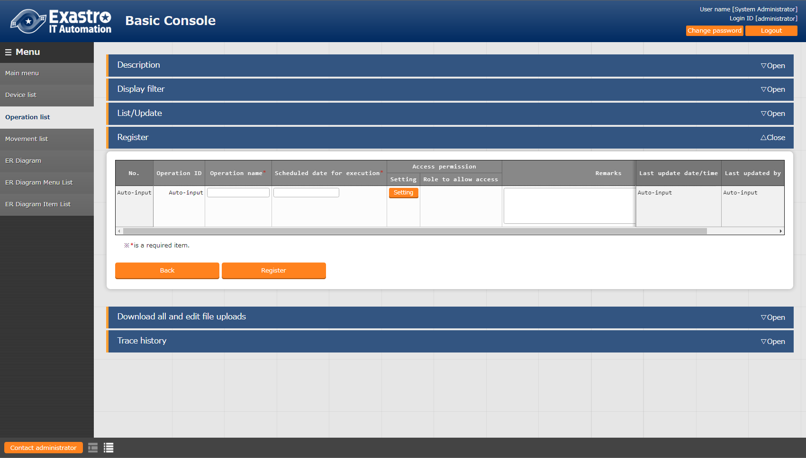
2.7 Device list/Operation list registration(2/2)
Create and register new users
Register new operation
The following must be done while logged in as Administrator. Create a new operation. This allows us to check the access permissions for the different users. Do not set access permission roles in this step. Menu: Basic console > Operation list
Register > Start registration
Follow the table below and press “Register”
Create and register Roles
Link Roles and Menus
Link Roles and Users
Register Device/Operation list
Check access permission
2
Operation name | Scheduled execution date
OP1 | （Free field）
OP2 | （Free field）

Slide 15
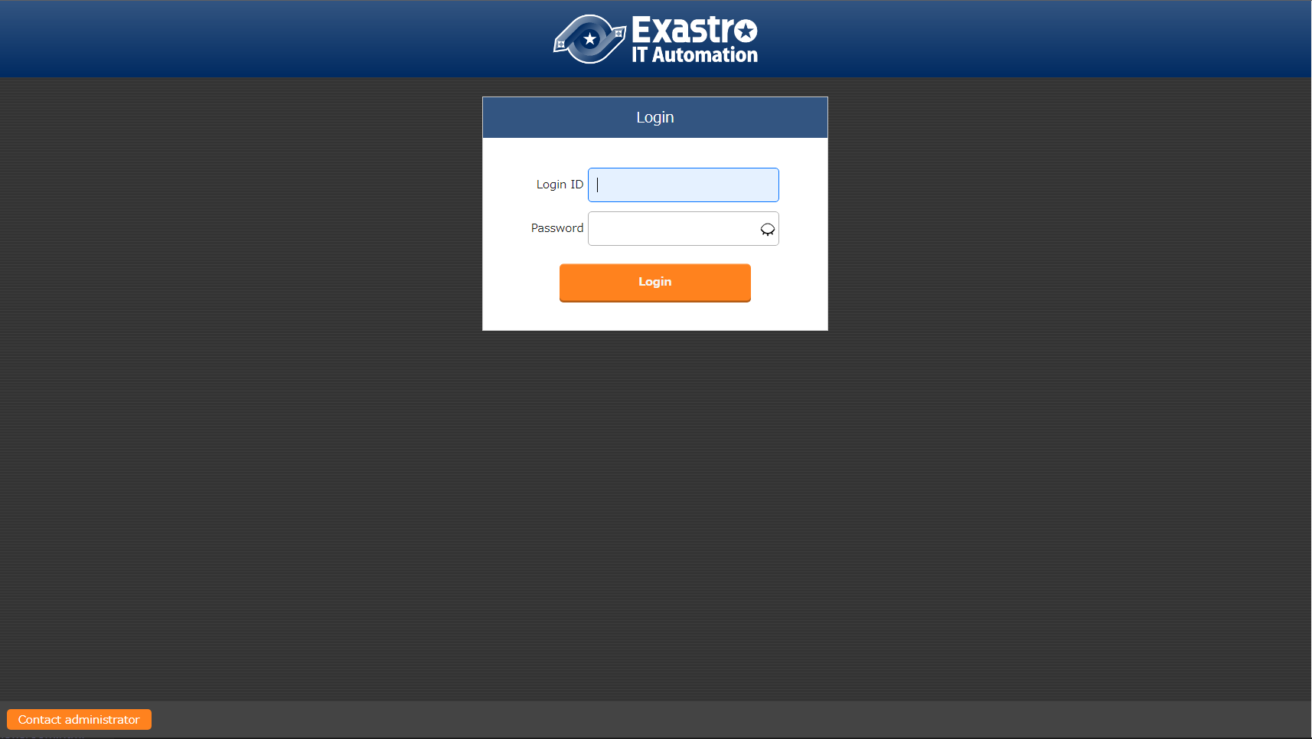
2.8 Check access permission(1/12)
Create and register new users
Change account
Log out from the Admin account and log in as the different users we created earlier in chapter 2.3
Create and register Roles
Link Roles and Menus
Link Roles and Users
Register Device/Operation list
Check access permission
１
Login ID
user1
Password
(Password input in chapter 2.3)

Slide 16
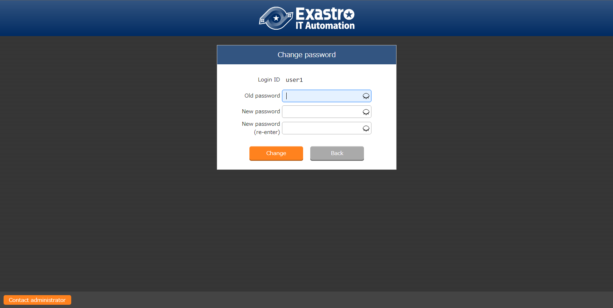
2.8 Check access permission(2/12)
Create and register new users
Configure new password
Users will be asked to create a new password when logging in for the first time.
Log in and create a new password for all the users.
Create and register Roles
Link Roles and Menus
Link Roles and Users
Register Device/Operation list
Check access permission
2
Login ID
user1
Old password
(Password input in chapter 2.3)
New password
（Free value）
New password（re-enter）
（Free value）

Slide 17
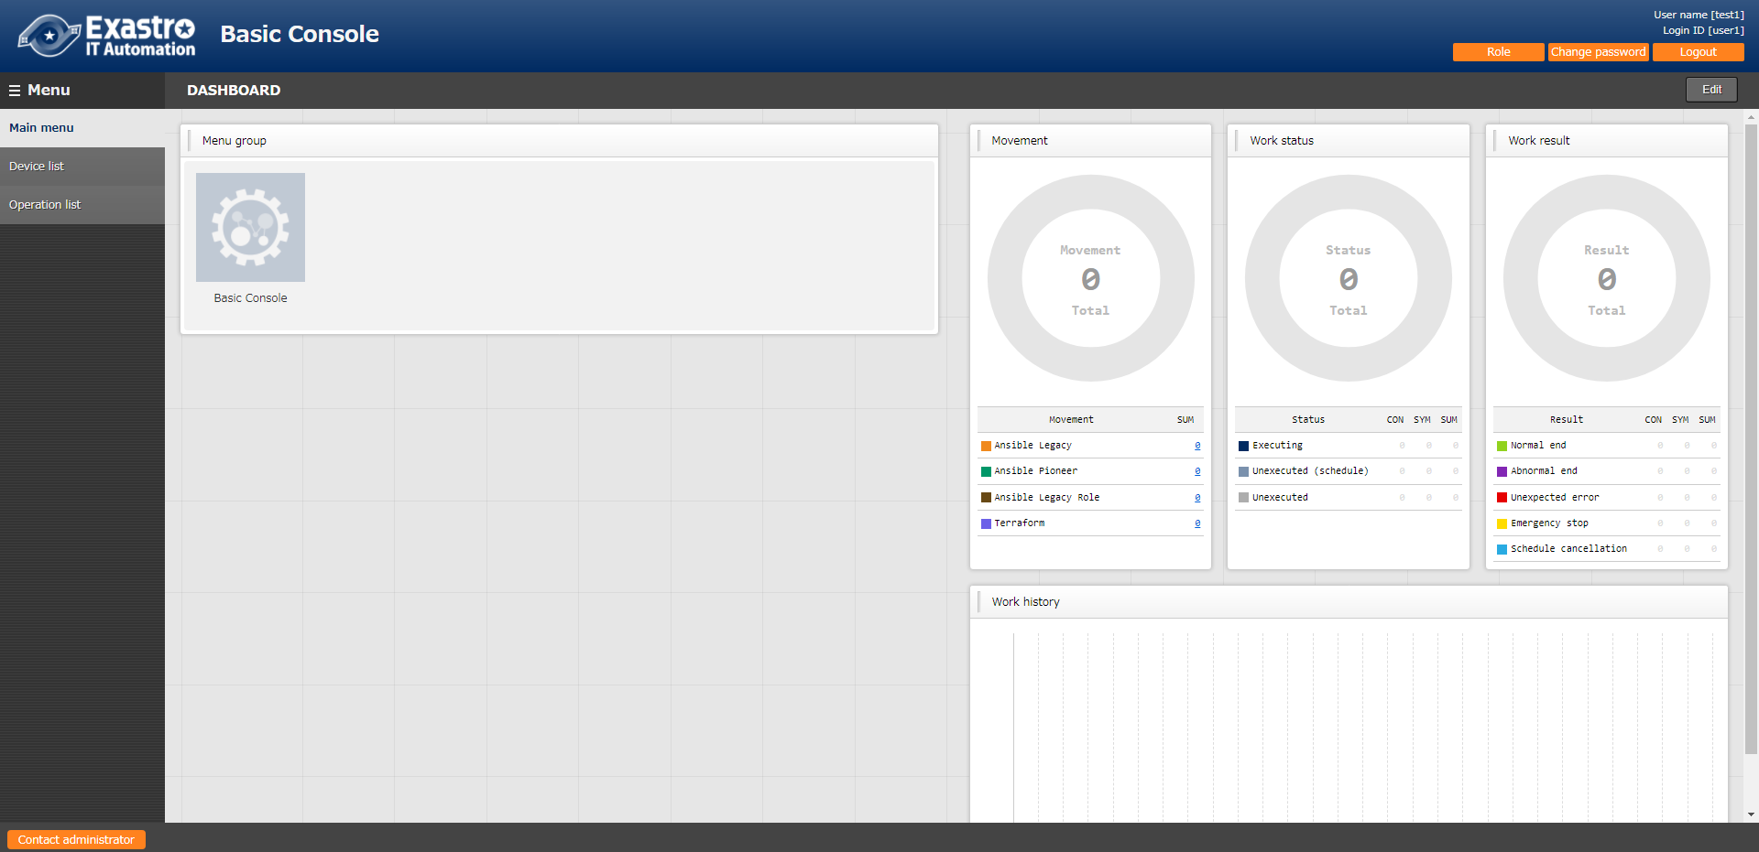
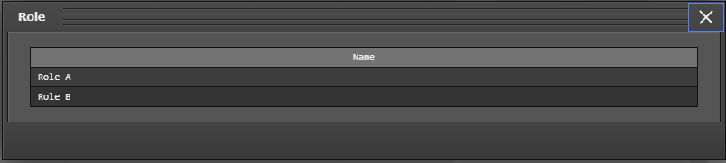
2.8 Check access permission(3/12)
Create and register new users
Check User 1's access permissions
Log in as User 1 and check the access permissions
Check that the Login ID is “user1” and the Login user is “Test1” in the upper right corner.
Press roll button to see “Role A” and “Role B” is displayed
Create and register Roles
Link Roles and Menus
Link Roles and Users
Register Device/Operation list
Check access permission
１
２
Point
Press role button to check role tied up with login user

Slide 18
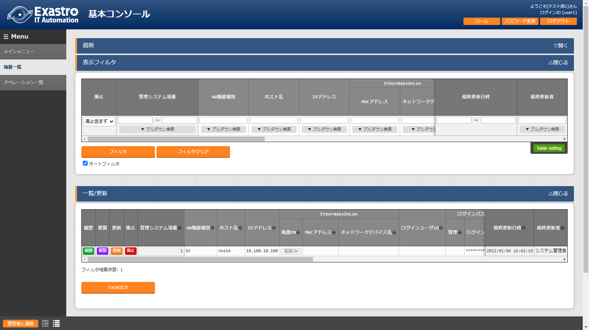
2.8 Check access permission(4/12)
Create and register new users
Check User 1's access permissions
Log in as User 1 and check the access permissions
Menu: Basic console > Operation list
Display filter > Press “Filter”
Check that device list are displayed and that you can edit them
Create and register Roles
Link Roles and Menus
Link Roles and Users
Register Device/Operation list
Check access permission
1
２
Users with "Can maintain" displayed in the link settings are able to edit.
(See more information on slide 22.)

Slide 19
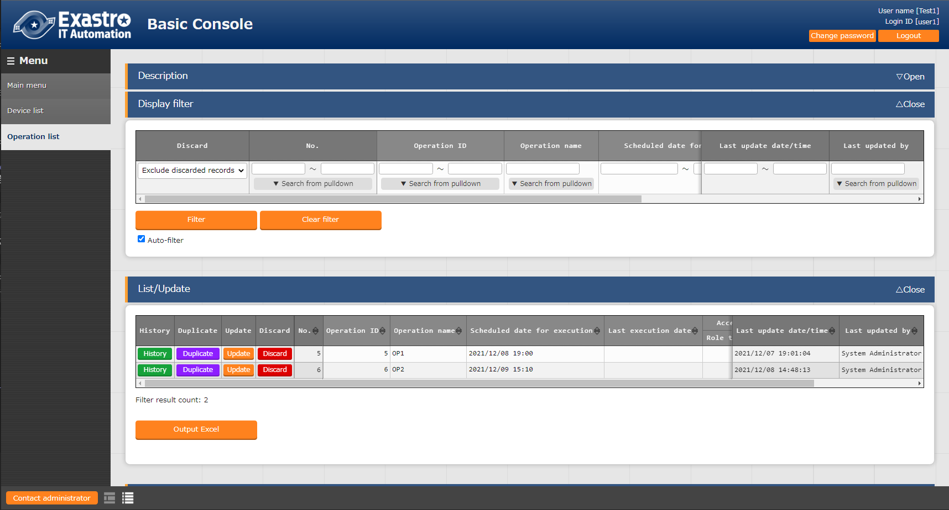
2.8 Check access permission(5/12)
Create and register new users
Check User 1's access permissions
Log in as User 1 and check the access permissions
Menu: Basic console > Operation list
Display filter > Press “Filter”
Check that both OP1 and OP2 are displayed and that you can edit them
Create and register Roles
Link Roles and Menus
Link Roles and Users
Register Device/Operation list
Check access permission
1
2
Users with "Can maintain" displayed in the link settings are able to edit.
(See more information on slide 22.)

Slide 20
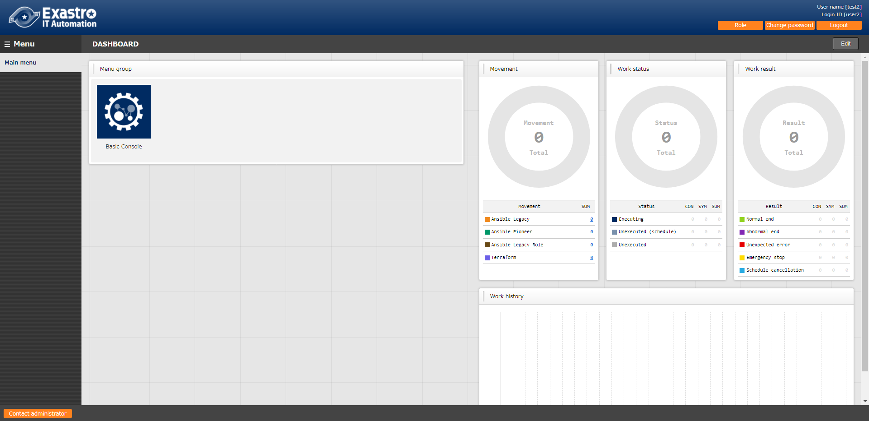
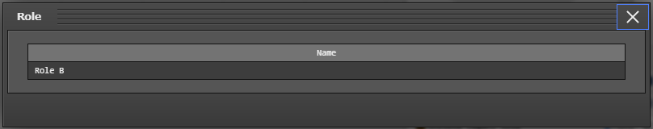
2.8 Check access permission(6/12)
Create and register new users
Check User 2's access permissions
Log in as User 2 and check the access permissions
Check that the Login ID is “user2” and the Login user is “Test2” in the upper right corner.
Press roll button to see “Role B” is displayed
Create and register Roles
Link Roles and Menus
Link Roles and Users
Register Device/Operation list
Check access permission
１
２

Slide 21
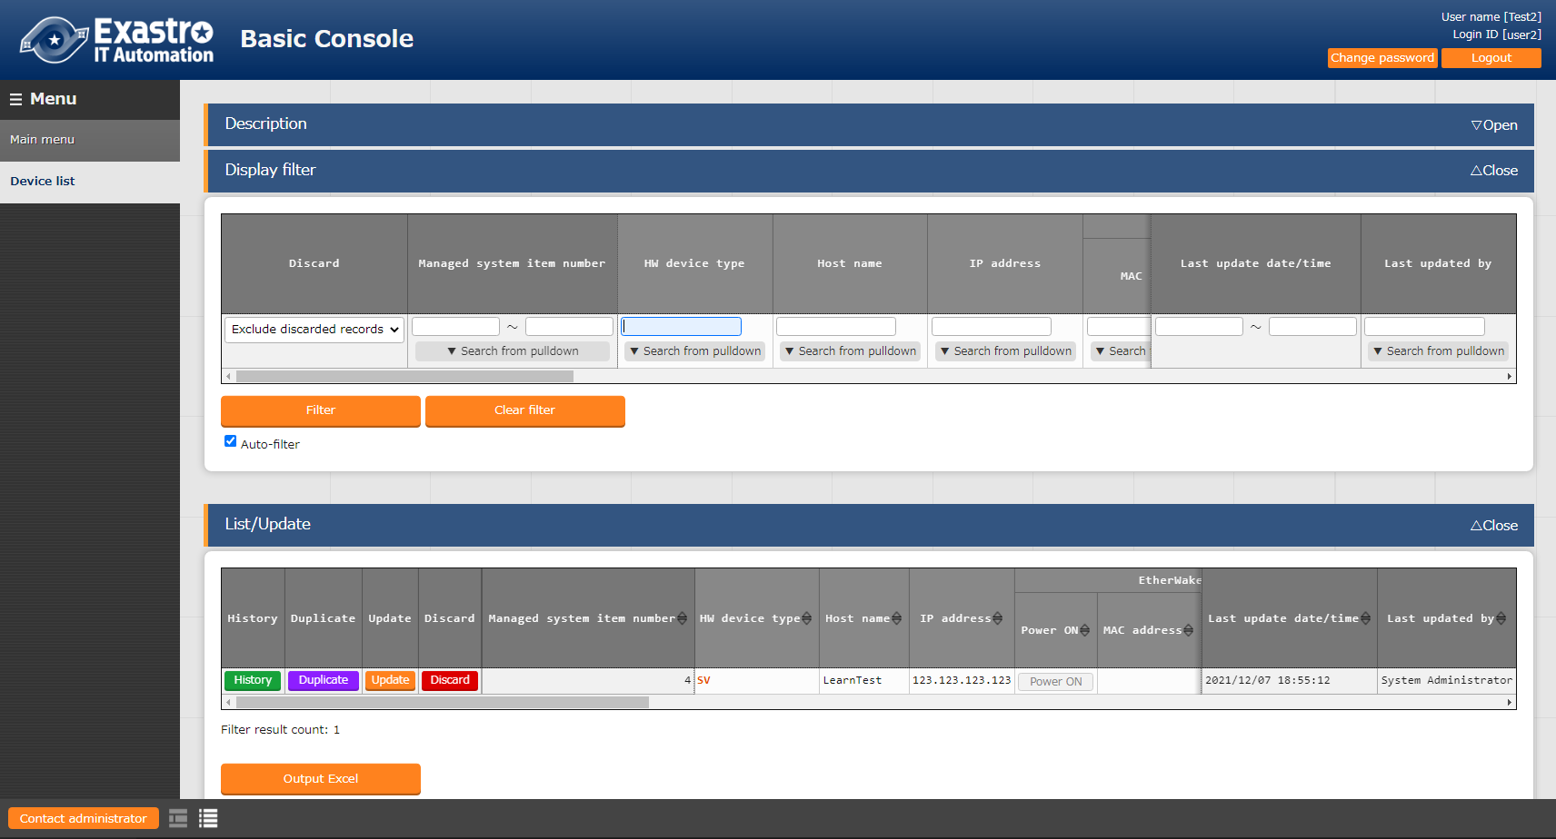
2.8 Check access permission(7/12)
Create and register new users
Check User 2's access permissions
Log in as User 2 and check the access permissions
Check that the Login ID is “user2” and the Login user is “Test2” in the upper right corner.
Press roll button to see “Role B” is displayed
Create and register Roles
Link Roles and Menus
Link Roles and Users
Register Device/Operation list
Check access permission
1
2
Users with "Can maintain" displayed in the link settings are able to edit.
(See more information on slide 20.)

Slide 22
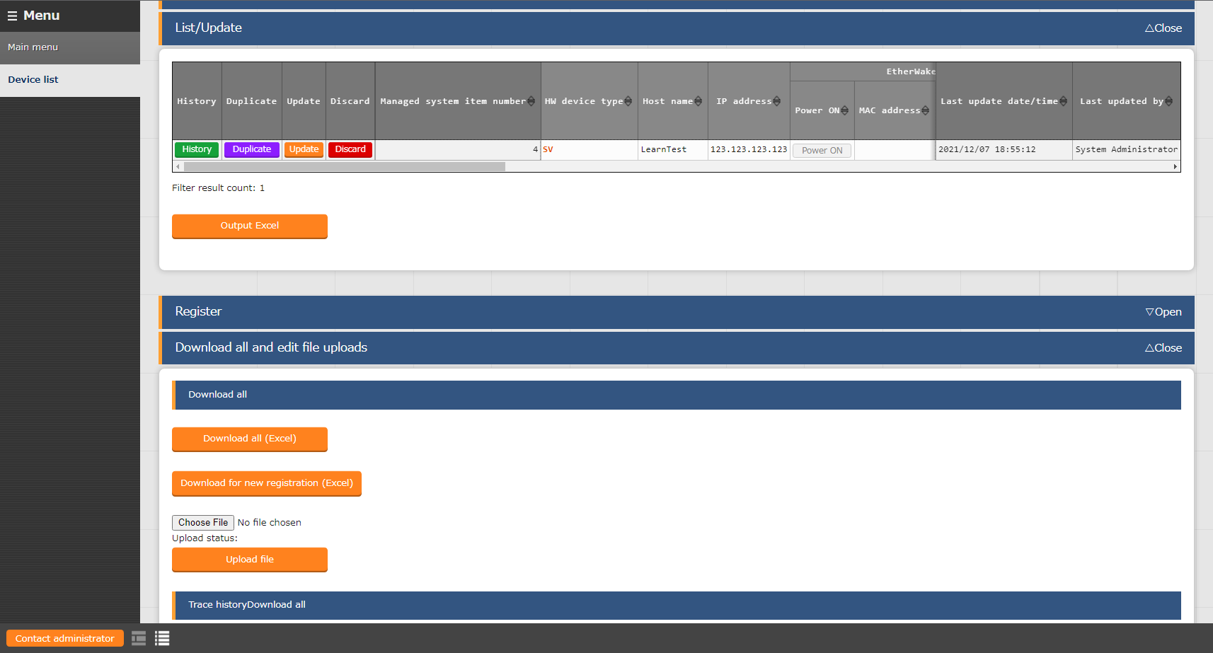
2.8 Check access permission(8/12)
Create and register new users
“Can maintain” access permission settings
If the link settings says "Can maintain", the user will have access to the different edit functions.
Create and register Roles
Link Roles and Menus
Link Roles and Users
Register Device/Operation list
Check access permission
Point
If the user has “Can maintain” permissions, functions such as “Update”, “Register”, “Upload file” and others will be available.

Slide 23
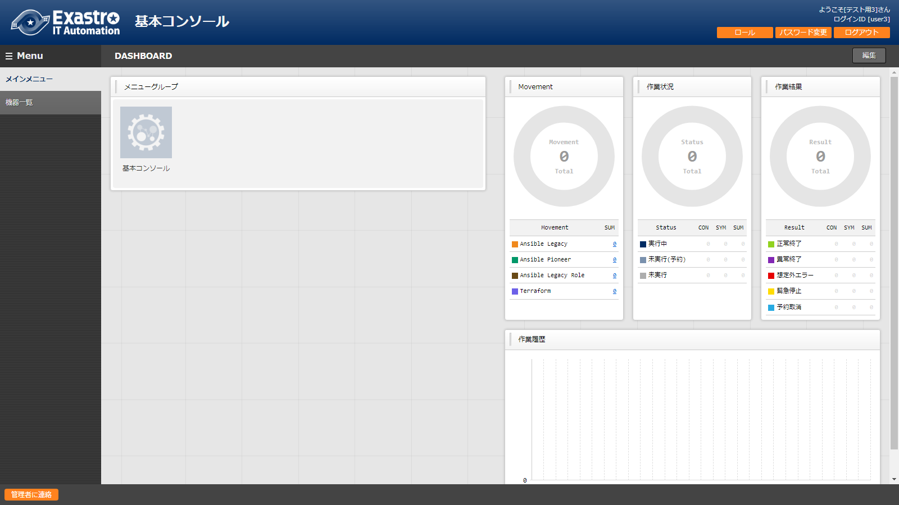
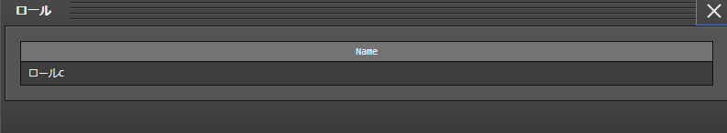
2.8 Check access permission(9/12)
Create and register new users
Check User 3's access permissions
Log in as User 3 and check the access permissions
Check that the Login ID is “user3” and the Login user is “Test3” in the upper right corner.
Press roll button to see “Role C” is displayed
Create and register Roles
Link Roles and Menus
Link Roles and Users
Register Device/Operation list
１
Check access permission
２

Slide 24
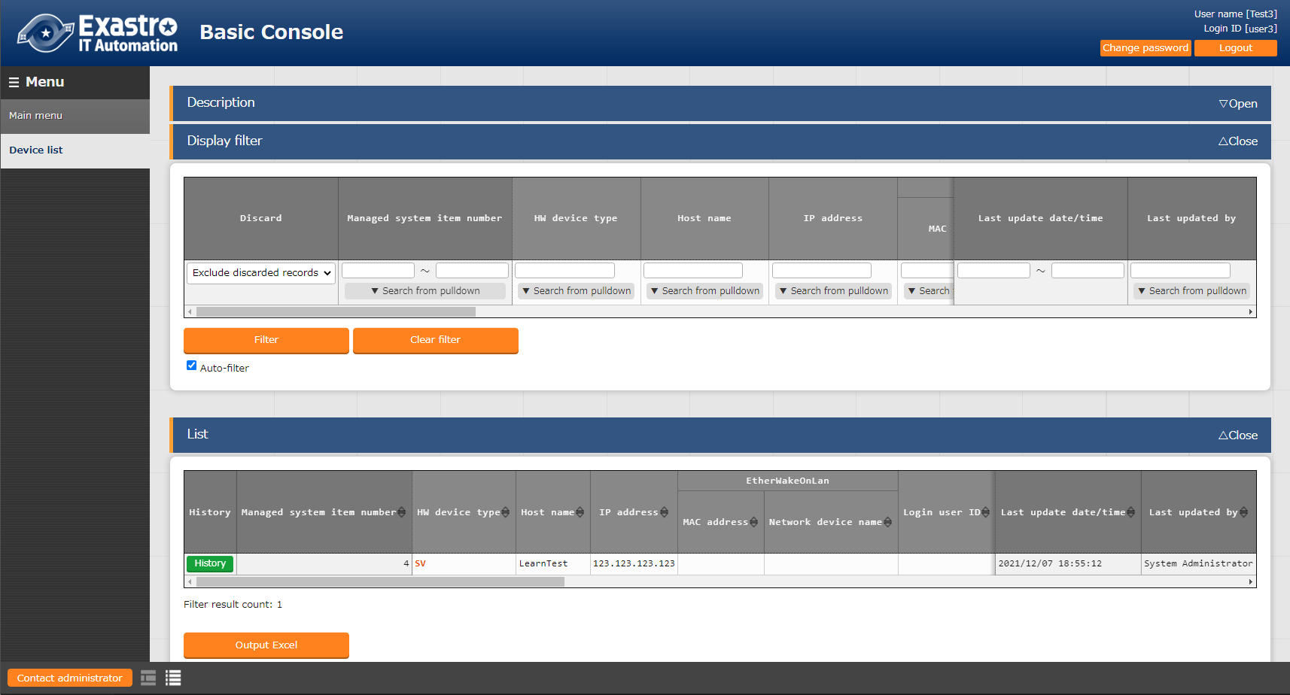
2.8 Check access permission(10/12)
Create and register new users
Check User 3’s access permissions
Log in as User 3 and check the access permissions
Check that the Login ID is user3 and the Login user is “Test3” in the upper right corner
Menu: Basic console > Device list
Display filter > Press “Filter”
Check that the user can view ,but not edit contents.
Create and register Roles
Link Roles and Menus
Link Roles and Users
Register Device/Operation list
Check access permission
1
2
The user will not be able to edit contents if the permission settings is set to “View only”.
（See Slide 22)

Slide 25
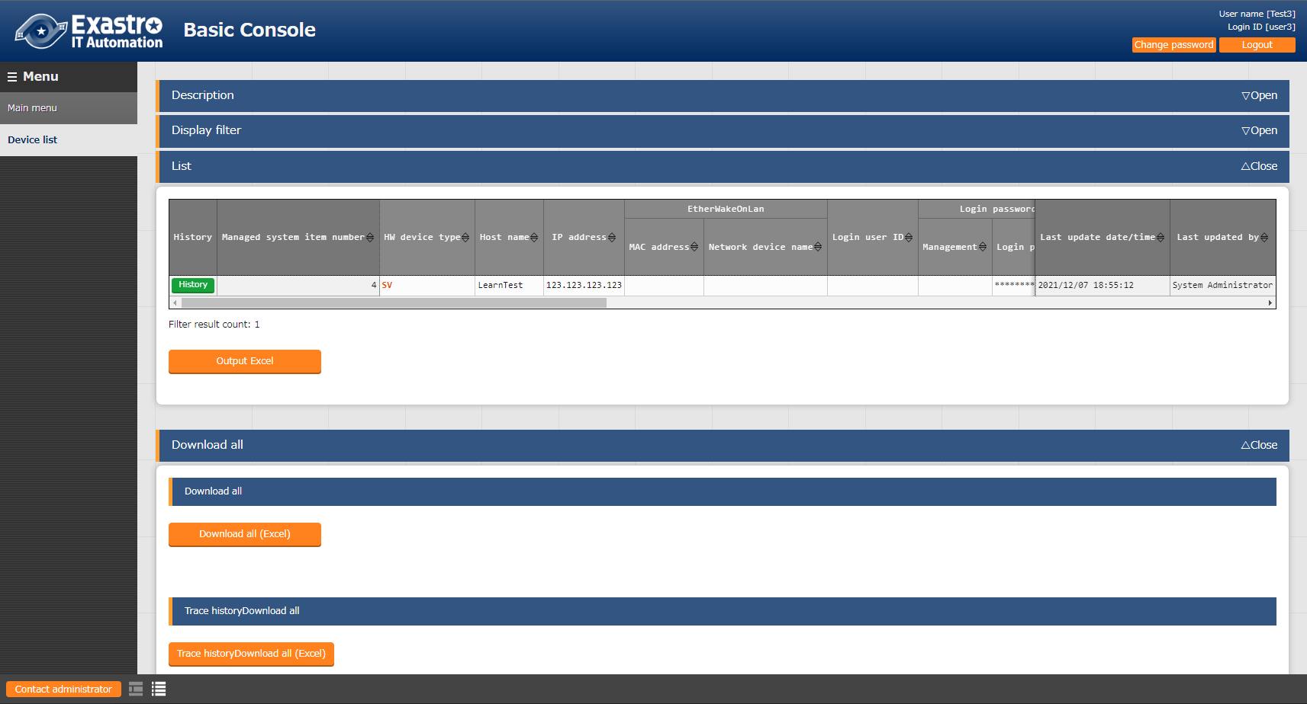
2.8 Check access permission(11/12)
Create and register new users
“View Only” access permission settings
If the permission settings set to the link is set to “View only”, the user will not be able to edit the contents.
Create and register Roles
Link Roles and Menus
Link Roles and Users
Register Device/Operation list
Check access permission
Point
Edit functions such as “Edit,” “Abolish” and “Restore” will not be available for users with “View only” permission.

Slide 26
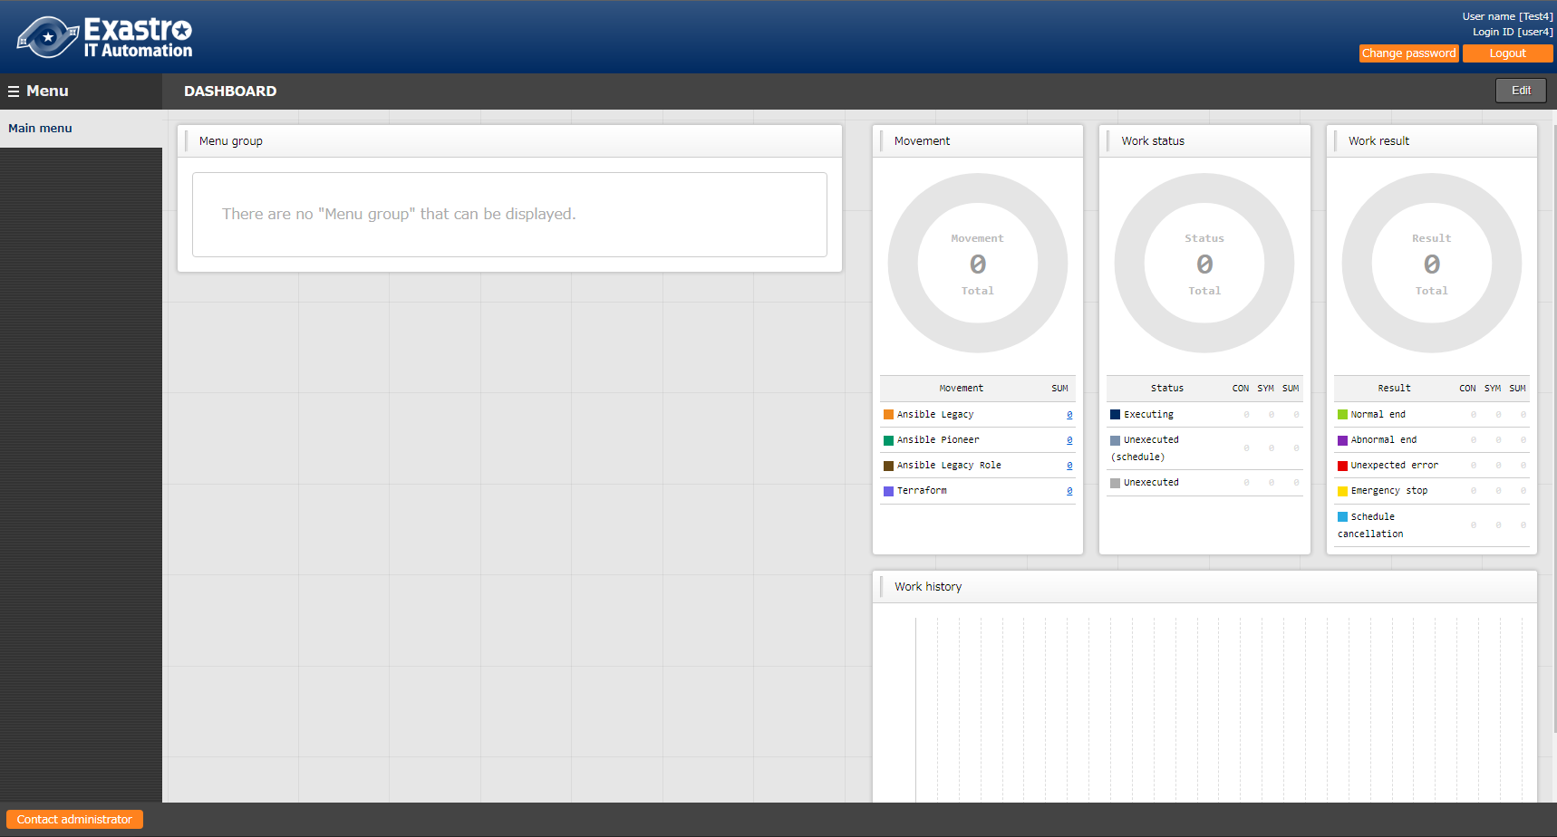
2.8 Check access permission(12/12)
Create and register new users
Check user 4’s access permissions
Log in as User 4 and check the access permissions
Login ID: Log in as user4
Check that the Login ID is user4 and the Login user says “Test4” in the upper right corner
As this user does not have permission to anything, they should not be able to see anything.
Create and register Roles
Link Roles and Menus
Link Roles and Users
Register Device/Operation list
Check access permission
2

Slide 27
3. Scenario 2

Slide 28
3.1 Operation Environment
Operation Environment
The following is required in order to finish this document’s scenarios.
You will need 1 server.
Client Device
・Windows10
・Google Chrome
ITA Server
・CentOS7 (※1)
・ITA 1.9.0
・Ansible 2.11
CentOS 7.8
Google Chrome
Exastro IT Automation
1.9.0
Ansible 2.11
Windows10
※1 In this scenario, the host server will be running CentOS7. However, ITA can be implemented to any RHEL7 or RHEL8 type OS.

Slide 29

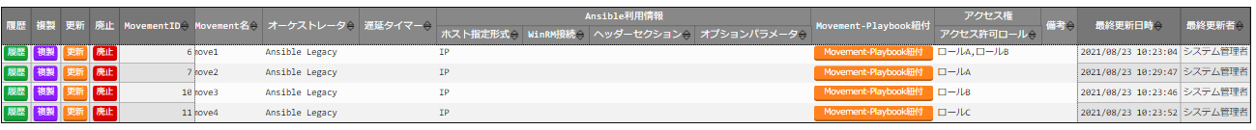

3.2 RBAC for Data records(1/3)
Scenario 1
In this scenario, we will give the different roles access permission for all the different data records. That way, the reader can experience the RBAC for Data records function.
user1, who is linked to Role A, B and C, will be able to see Move1~4
user2, who is linked to Role B, will be able to see Move1~3
user3, who is linked to Role B and Role C, will be able to see Move 1,3 and 4
■ User name : System administrator
Login ID: administrator
Role : System administrator
■ User name : Test2
Login ID: user2
Role : Role B

Slide 30
3.2 RBAC for Data records(2/3)
Scenario 2(Figure)
Role and User link
Access permission per Movement
 | Role A | Role B | Role C
user1 | ● | ○ | ○
user2 |  | ●
user3 |  | ● | ●
 | move1 | move2 | move3 | move4
Role A | ● | ●
Role B | ● |  | ●
Role C |  |  |  | ●
●…With Default access permission
○…Without Default access permission
●…Has access
What Movement can be seen by which user
 | move1 | move2 | move3 | move4
user1 | ● | ● | ● | ●
user2 | ● |  | ●
user3 | ● |  | ● | ●
●…Movement displayed

Slide 31
3.2 RBAC for Data records(3/3)
Scenario Procedure
※Users who have completed Scenario 1 can start from chapter 3.5
3.3 Create and register new users
3.4 Create and register roles
3.5 Role ・Menu link
3.6 Role ・User link
3.7 Movement list registration
3.8 Check access permission

Slide 32
3.3 Create and register new users
Create and register new users
Create and register new users
In order to check the different access permissions, we will create 3 different users.
Menu: Management console > User list
Register > Start registration
Follow the table below and press “Register”
Create and register Roles
Link Roles and Menus
Link Roles and Users
Register Movement list
Check access permission
Login ID | Login PW | User name
user1 | （Free field） | Test1
user2 | （Free field） | Test2
user3 | （Free field） | Test3
2

Slide 33
3.4 Create and register roles
Create and register new users
Create and register roles
Create and register the roles that controls user access
Menu: Management console> Role list
Register > Start registration
Follow the table below and press “Register”
Create and register Roles
Link Roles and Menus
Link Roles and Users
Register Movement list
Role name
Role A
Role B
Role C
Check access permission
2

Slide 34
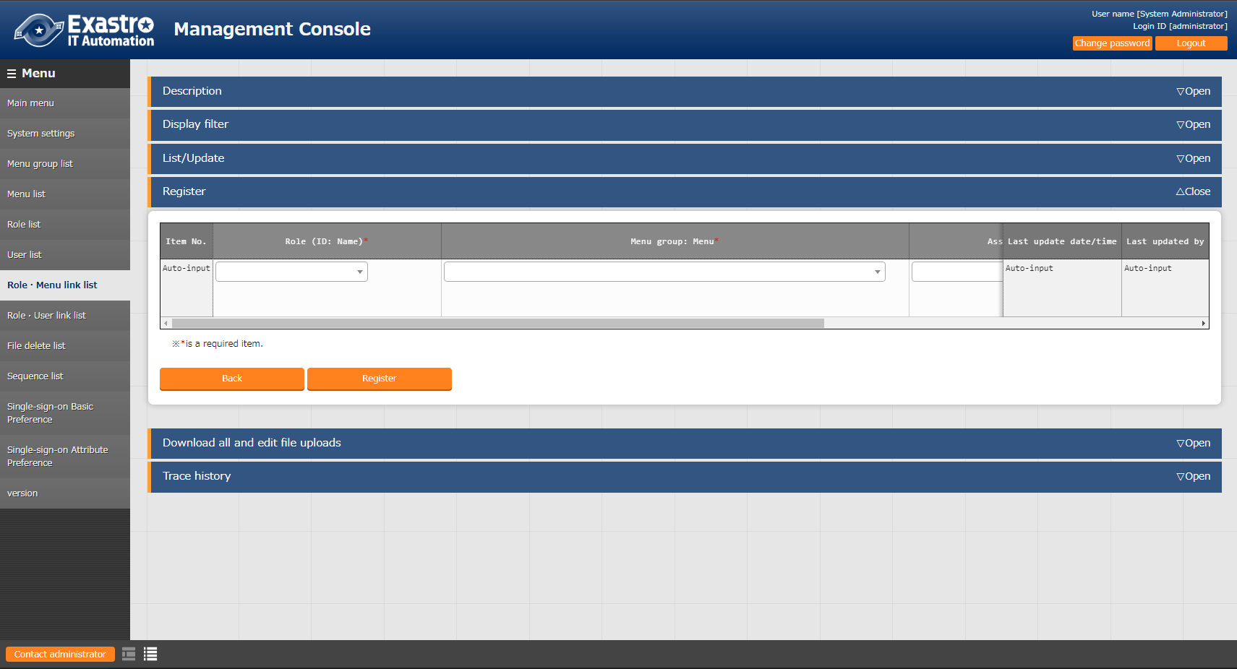
3.5 Role ・Menu link
Create and register new users
Link role and Menu information
Link Menu to role and grant access permissions.
Menu: Management console> Role ・Menu link list
Register > Start registration
Follow the table below and press “Register”
Create and register Roles
Link Roles and Menus
Link Roles and Users
Register Movement list
Check access permission
２
Role | Menu group: Menu | Link
Role A | AnsibleLegacy: Movement list | Can Maintain
Role B | AnsibleLegacy: Movement list | Can Maintain
Role C | AnsibleLegacy: Movement list | Can Maintain

Slide 35
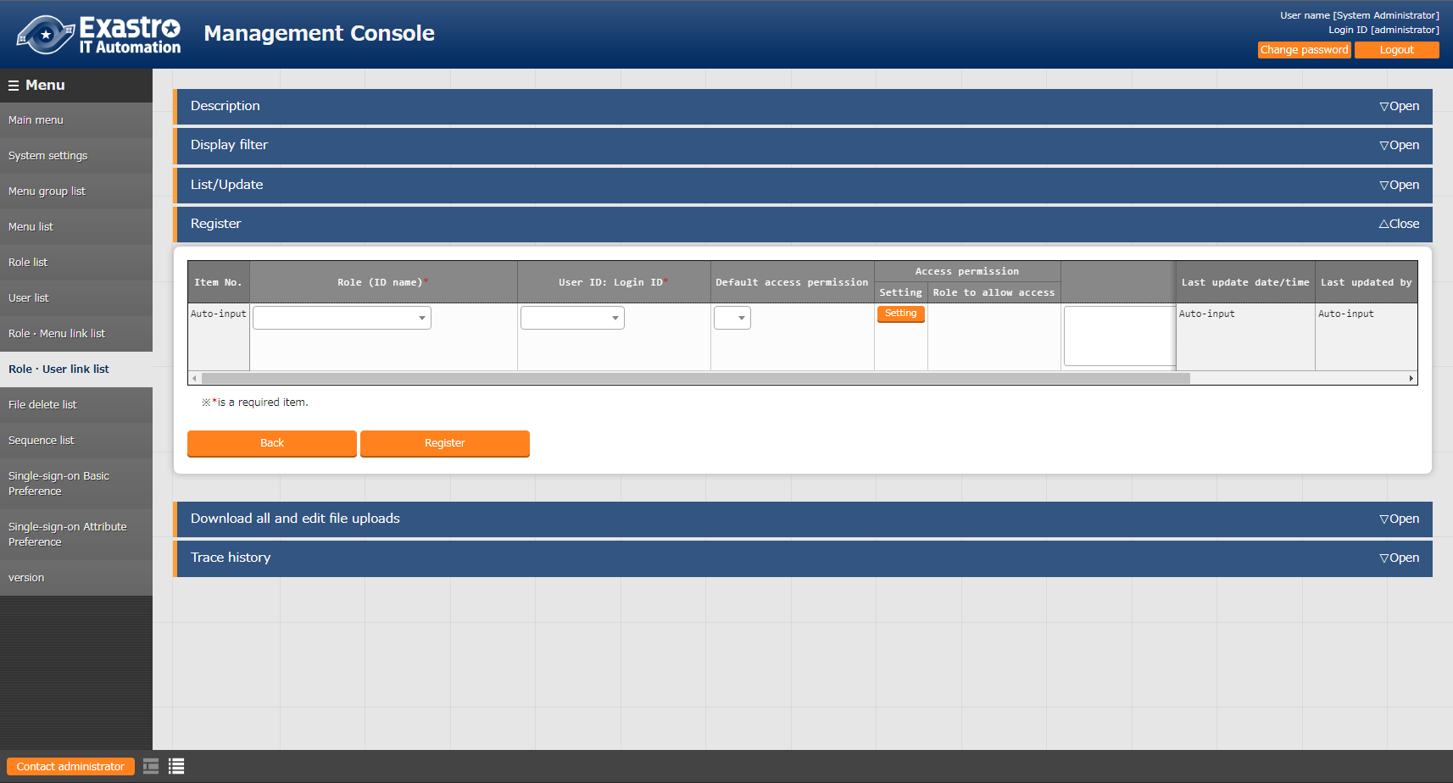
3.6 Role ・User link(1/4)
Create and register new users
Link Role and User information
Link roles to the users.
Menu: Management console> Role ・User link list
Register > Start registration
Follow the table below and press “Register”(See next page）
Create and register Roles
Link Roles and Menus
Link Roles and Users
Register Movement list
Check access permission
２
Role name | User ID: Login ID | Default access permission
Role A | administrator | （blank）
Role B | administrator | （blank）
Role C | administrator | （blank）

Slide 36
3.6 Role ・User link(2/4)
Create and register new users
Link Role and User information
Link roles to the users.
Menu: Management console> Role ・User link list
Register > Start registration
Follow the table below and press “Register”(See next page）
Create and register Roles
Link Roles and Menus
Link Roles and Users
Register Movement list
Check access permission
２
Role name | User ID: Login ID | Default access permission
Role A | user1 | ●
Role B | user1 | (blank)
Role C | user1 | (blank）

Slide 37
3.6 Role ・User link(3/4)
Create and register new users
Link Role and User information
Link roles to the users.
Menu: Management console> Role ・User link list
Register > Start registration
Follow the table below and press “Register”(See next page）
Create and register Roles
Link Roles and Menus
Link Roles and Users
Register Movement list
Check access permission
２
Role name | User ID: Login ID | Default access permission
Role B | user2 | ●

Slide 38
3.6 Role ・User link(4/4)
Create and register new users
Link Role and User information
Link roles to the users.
Menu: Management console> Role ・User link list
Register > Start registration
Follow the table below and press “Register”
Create and register Roles
Link Roles and Menus
Link Roles and Users
Register Movement list
Check access permission
２
Role name | User ID: Login ID | Default access permission
Role B | user3 | ●
Role C | user3 | ●

Slide 39
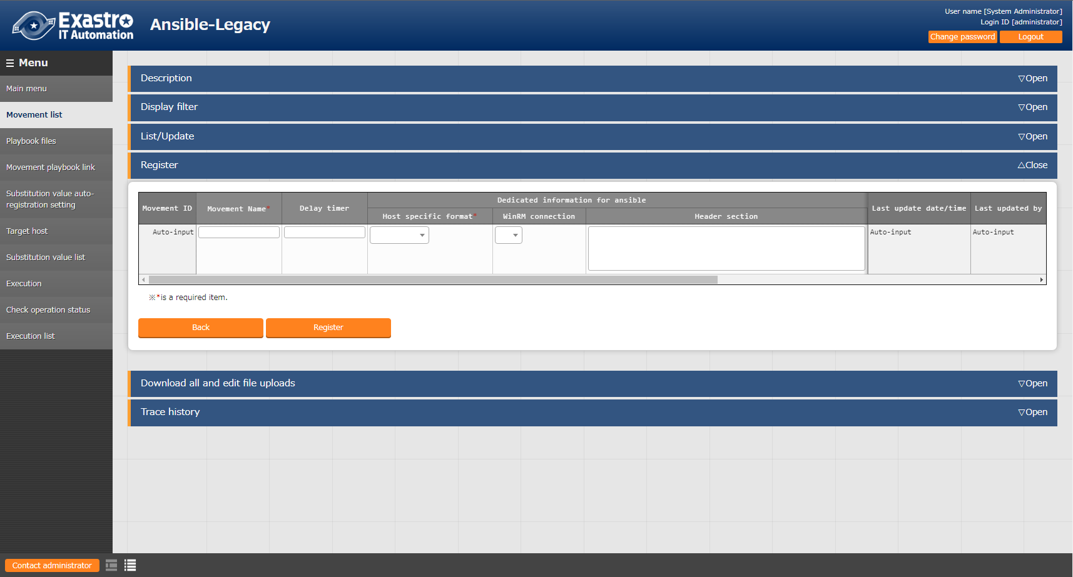
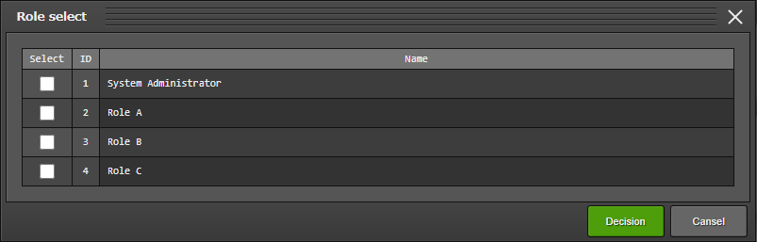
3.7 Movement list registration
Create and register new users
Register new movement as Admin
In this section, we will register a new Movement so we can see the how
the Default access permissions work.
We can then configure access permissions to the data we register Menu: Ansible-Legacy > Movement list
Register > Start registration
Follow the table below and press “Register”
Create and register Roles
Link Roles and Menus
Link Roles and Users
Register Movement list
Check access permission
Change Access permission role
２
Movement name | Host specification format | Access permission Role
move1 | IP | Role A Role B
move2 | IP | Role A
move3 | IP | Role B
move4 | IP | Role C
Only users that are linked to access permission roles can see and edit the data.

Slide 40
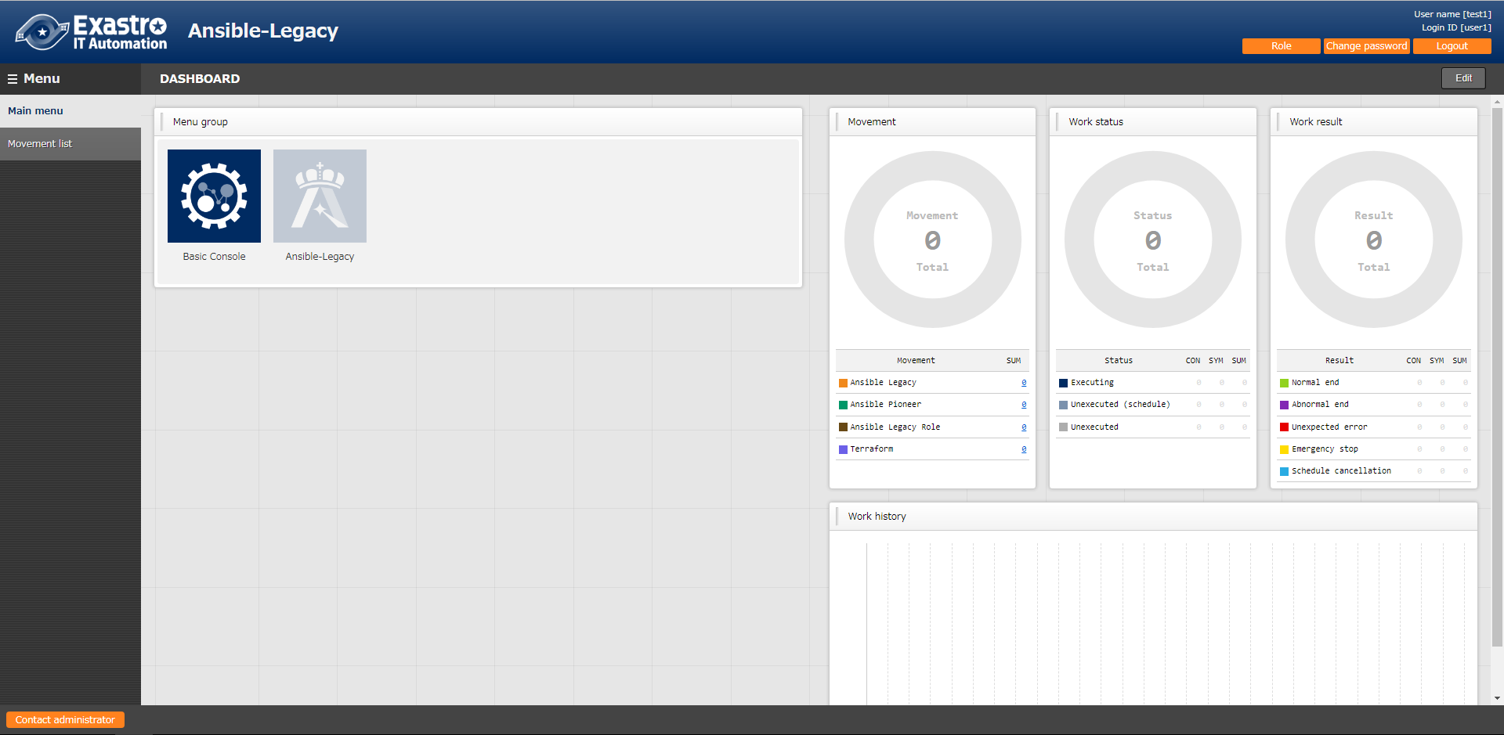
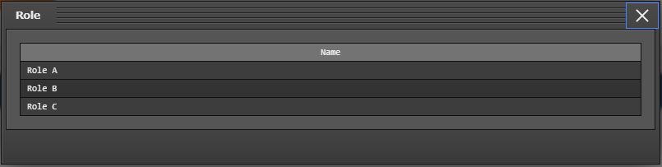
3.7 Check access permissions(1/9)
Create and register new users
Check User 1's access permissions
Log in as User 1 and check the access permissions
Check that the Login ID is “user1” and the Login user is “Test1” in the upper right corner.
Press roll button to see “Role A”, “Role B”, and “Role C” is displayed
Create and register Roles
Link Roles and Menus
Link Roles and Users
Register Movement list
１
Check access permission
２

Slide 41
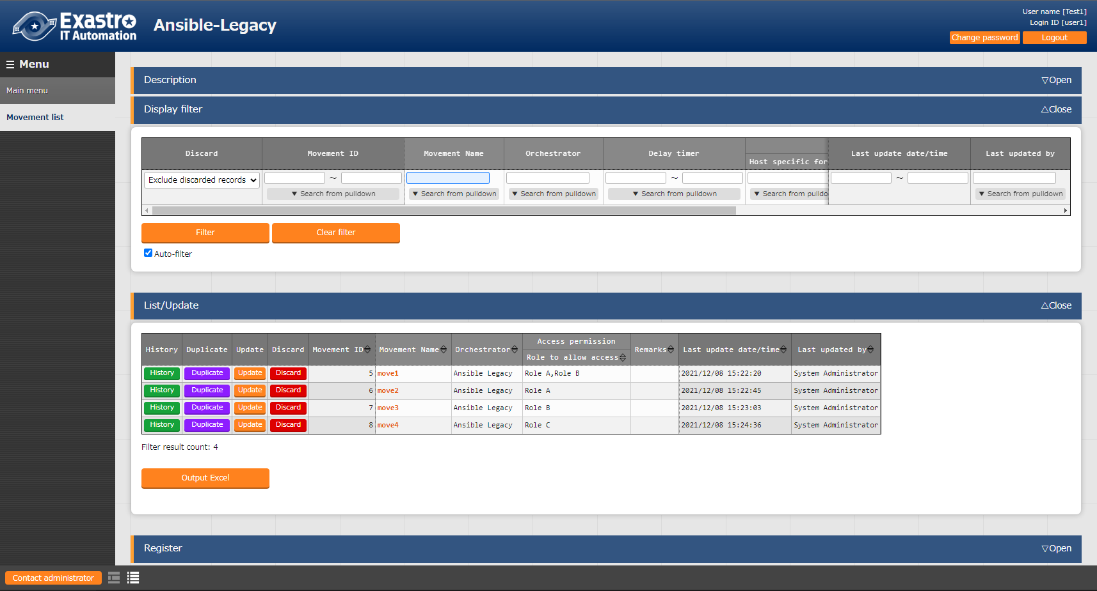
3.7 Check access permission(2/9)
Create and register new users
Check User 1’s access permissions
Log in as User 1 and check the access permissions
Menu: Ansible-Legacy > Movement list
Display filter > Press “Filter”
Create and register Roles
Link Roles and Menus
Link Roles and Users
Register Movement list
Check access permission
1
User 1 is linked to Role A, B and C, meaning that it has permission to see
all the 4 registered Movements.

Slide 42
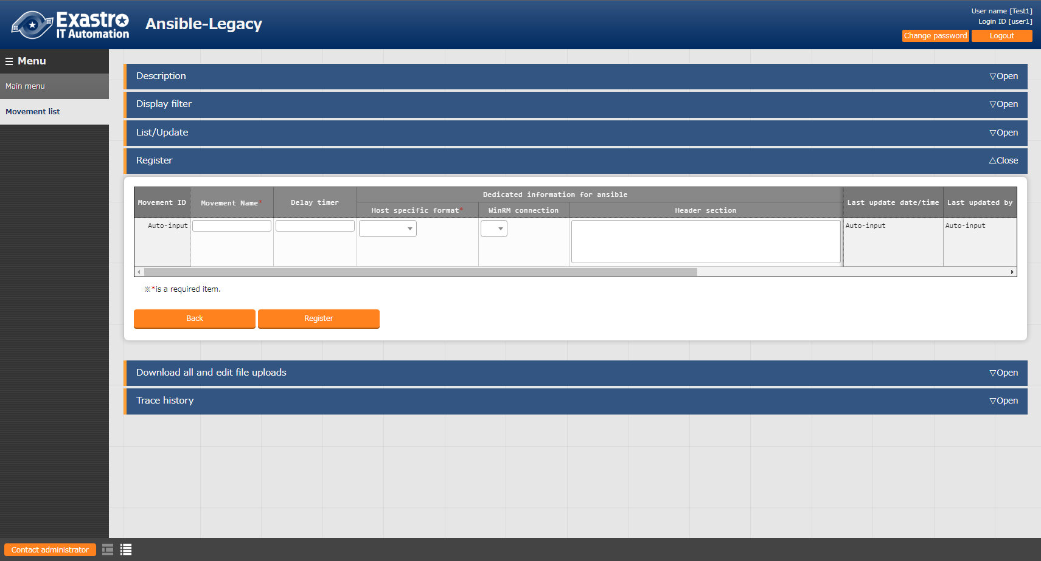
3.7 Check access permission(3/9)
Create and register new users
Register new Movement as User 1
In this section, we will register a new Movement so we can check how Default access permissions work.
Menu: Ansible-Legacy > Movement list
Register > Start registration
Follow the table below and press “Register”
Check that Role A is set as access permission role
Create and register Roles
Link Roles and Menus
Link Roles and Users
Register Movement list
Check access permission
Movement name | Host specification format
movement1 | IP
２
３
Point
user1 has "Role A" set with "With Default access permission", meaning that Role A will automatically be set as Access permission role.

Slide 43


3.7 Check access permission(4/9)
Create and register new users
Check User 2's access permissions
Log in as User 2 and check the access permissions
Check that the Login ID is “user2” and the Login user is “Test2” in the upper right corner.
Press roll button to see “Role B” is displayed
Create and register Roles
Link Roles and Menus
Link Roles and Users
Register Movement list
1
Check access permission
２

Slide 44
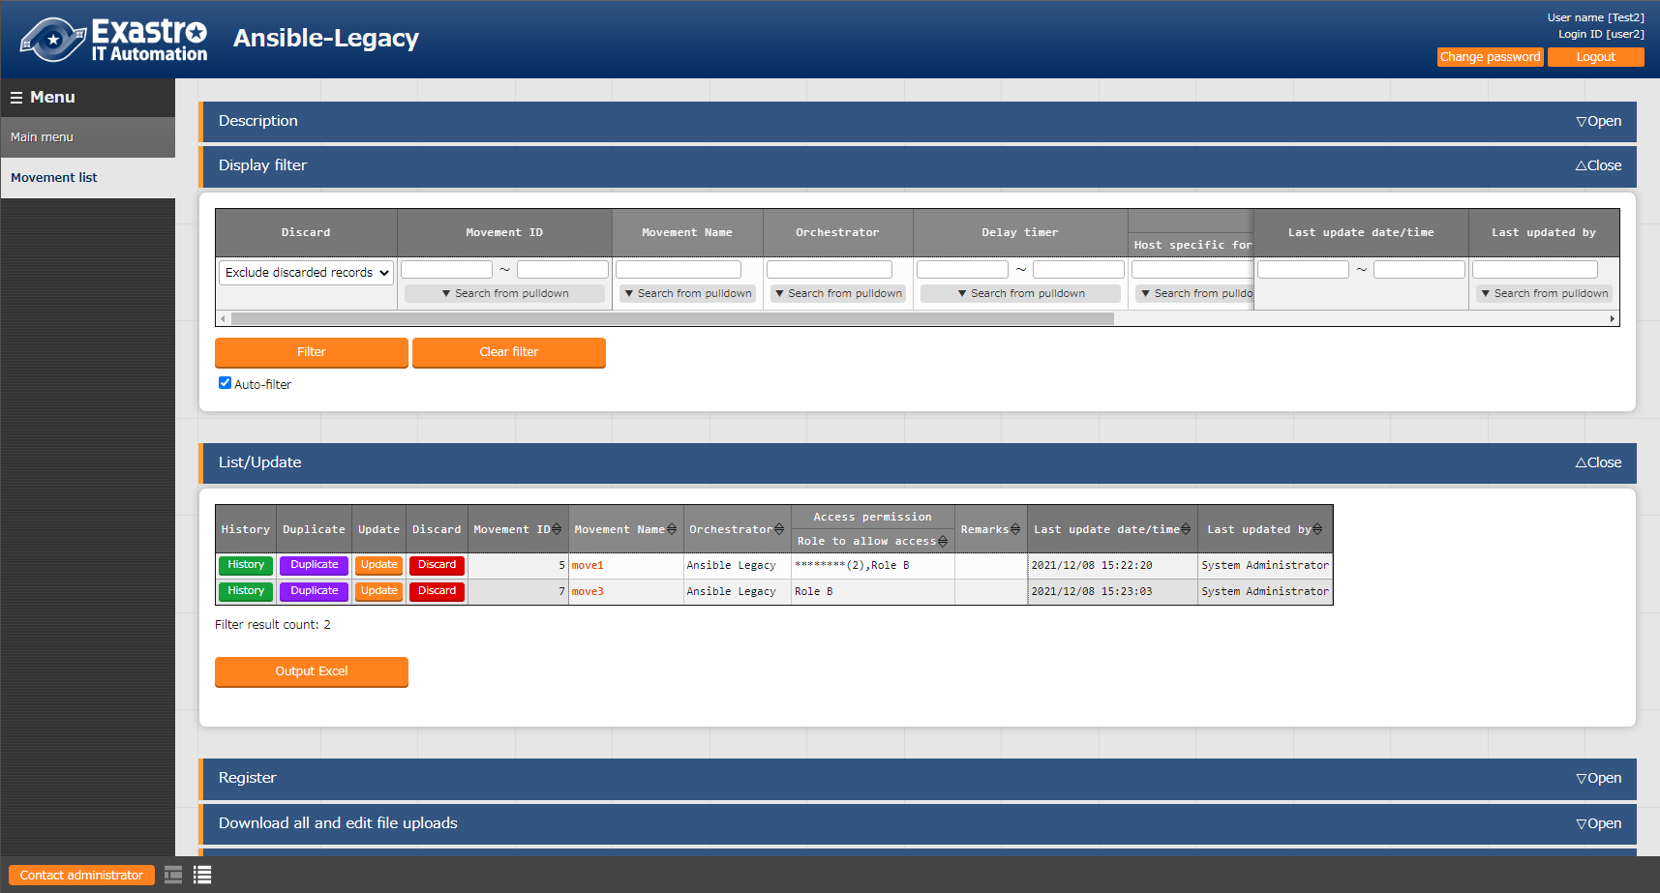
3.7 Check access permission(5/9)
Create and register new users
Check User 2's access permissions
Log in as User 2 and check the access permissions
Menu: Ansible-Legacy > Movement list
Display filter > Press “Filter”
Create and register Roles
Link Roles and Menus
Link Roles and Users
Register Movement list
Check access permission
1
User 2 has Role B set to it, meaning that
only 2 Movements will be displayed.

Slide 45


3.7 Check access permission(6/9)
Create and register new users
Register new Movement as User2
In this section, we will register a new Movement so we can check how Default access permissions work.
Menu: Ansible-Legacy > Movement list
Register > Start registration
Follow the table below and press “Register”
Check that Role B is set as access permission role
Create and register Roles
Link Roles and Menus
Link Roles and Users
Register Movement list
Check access permission
Movement name | Host specification format
movement2 | IP
２
Point
user2 has "RoleB" set with "With Default access permission", meaning that Role B will automatically be set as Access permission role.

Slide 46

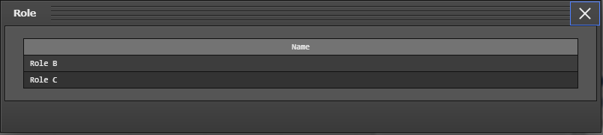
3.7 Check access permission(7/9)
Create and register new users
Check User 3's access permissions
Log in as User 3 and check the access permissions
Check that the Login ID is “user3” and the Login user is “Test3” in the upper right corner.
Press roll button to see “Role B” and “Role C” is displayed
Create and register Roles
Link Roles and Menus
Link Roles and Users
Register Movement list
1
Check access permission
２

Slide 47

3.7 Check access permission(8/9)
Create and register new users
Check User 3’s access permissions
Log in as User 3 and check the access permissions
Menu: Ansible-Legacy > Movement list
Display filter > Press “Filter”
Create and register Roles
Link Roles and Menus
Link Roles and Users
Register Movement list
Check access permission
2
User 3 has Role B and Role C set to it, meaning that 3 Movements will be displayed.
The Movement registered using User 2 will also be displayed.

Slide 48

3.7 Check access permission(9/9)
Create and register new users
Register new Movement as role 3
In this section, we will register a new Movement so we can check how Default access permissions work.
Menu: Ansible-Legacy > Movement list
Register > Start registration
Follow the table below and press “Register”
Check that Role B and Role C is set as access permission role
Create and register Roles
Link Roles and Menus
Link Roles and Users
Register Movement list
Check access permission
Movement name | Host specification format
movement3 | IP
２
Point
User3 has “RoleB” and “RoleC” set with “With Default access permission”,
meaning that both Role B and C will automatically be set as
access permission role.

