Slide 1


version update
※ In this document, “Exastro IT Automation” is described as “ITA".
Exastro IT Automation Version 1.9
Exastro developer

Slide 2
Table of contents
Introduction
1.1 About this guide
System configuration
2.1 System requirement
ITA update procedure
3.1 Preparation（1/1）
3.2 ITA update work flow
3.3 Update（1/6）
3.4 Update（2/6）
3.5 Update（3/6）
3.6 Update（4/6）
3.7 Update（5/6）
3.8 Update（6/6）
ITA operation check
4.1 Operation check（1/1）

Slide 3
1. Introduction

Slide 4
1.1 About this guide
About this guide
This document describes the procedure to update the ITA environment constructed in all-in-one configuration.

Slide 5
2. System configuration

Slide 6
2.1 System requirement
About the environment of ITA to perform update
The procedure in this document can be performed on ITA environment constructed in all-in-one configuration.
The version of ITA that supports version update is 1.4.0 or later. The environment of ITA version 1.4.0 or later can be updated by executing the procedure in this document.

Slide 7
3. ITA construction procedure

Slide 8
3.1 Preparation（1/1）
List of ITA construction tool
The list of ITA construction tool is as follows.
Description | File | Storage path
Library collection script | ita_gather_library.sh | /(Installation file extract path)/ita_install_package/install_scripts/
Environment construction tool (For offline installation) | ita_builder_offline.sh | /(Installation file extract path)/ita_install_package/install_scripts/
Environment construction tool (For online installation) | ita_builder_online.sh | /(Installation file extract path)/ita_install_package/install_scripts/
Setting file | ita_builder_setting.txt | /(Installation file extract path)/ita_install_package/install_scripts/
ITA installer | ita_installer.sh | /(Installation file extract path)/ita_install_package/install_scripts/
Answer file | ita_answers.txt | /(Installation file extract path)/ita_install_package/install_scripts/
Update tool | ita_version_up.sh | /(Installation file extract path)/ita_install_package/install_scripts/
Not used for version update

Slide 9
3.2 ITA update work flow
Version update work flow
The work flow of version update is as follows.
①Back up ITA environment
②Download file from Github
③Edit answer file
④Execute update tool
Operation content
Install library (optional)
Update database
Update ITA file

Slide 10
3.3 Update（1/6）
*Execute update as root user.
Back up ITA environment
Please back up ITA environment before update.
Download file from Github
Download file with the following command # curl -OL https://github.com/exastro-suite/it-automation/releases/download/vx.x.x/exastro-it-automation-x.x.x.tar.gz ※Please install curl command beforehand.
※Please change the version (x.x.x) according to the file.
Deploying the materials.
Unzip the .tar.gz file. # tar zxf exastro-it-automation-x.x.x.tar.gz
Change directory
Switch current directory to the directory where the answer file and shell is located. # cd it-automation-x.x.x/ita_install_package/install_scripts

Slide 11
3.4 Update（2/6）
Edit answer file (ita_answers.txt)
Please edit the answer file to set ITA update.
“ita_directory” is the only item used for update, other items are not used.
Item | Required | Default value | Description
install_mode | ー | Install | Installation mode: Install or Uninstall
ita_directory | ○ | － | Specify the absolute path to the directory where IT Automation will be installed. If the directory does not exist, it will be newly created.
ita_language | ー | en_US | IT Automation display language: ja_JP (Japanese) or en_US (English)
ita_os | ー | RHEL7 | OS for IT Automation: RHEL7 or RHEL8
db_root_password | ー | － | Root password for MariaDB
db_name | ー | － | Database name for MariaDB
db_username | ー | － | Database username for MariaDB
db_password | ー | － | Database password for MariaDB
ita_base | ー | yes | Only yes can be specified to install IT Automation.
Material | ー | no | Whether the Management of configuration materials function is to be installed
create_param | ー | yes | Whether the Creation of menus function is to be installed
Hostgroup | ー | yes | Whether the Host grouping function is to be installed
ansible_driver | ー | yes | Whether the Ansible driver is to be installed
cobbler_driver | ー | no | Whether the Cobbler driver is to be installed
openstack_driver | ー | no | Whether the OpenStack driver is to be installed
terraform_driver | ー | no | Whether the Terraform driver is to be installed
Not used for version update
Not used for version update

Slide 12
3.5 Update（3/6）
Sample of the answer file (ita_answers.txt)
The following shows an example of the answer file (ita_answers.txt)
#Select install mode. ("Install" or "Uninstall")
# e.g) install_mode:Install
install_mode:
#Enter install directory.
# e.g) ita_directory:/exastro
ita_directory:/exastro
# Select language. ("en_US" or "ja_JP")
# e.g) ita_language:en_US
ita_language:
# Select Operation System. ("RHEL7” or “RHEL8")
# e.g) ita_os:RHEL8
ita_os:
# Enter the MariaDB root user's password
# e.g) db_root_password:sample_root_password
db_root_password:
# Decide the database name, username, and password for ITA.
# e.g) db_name:sample_db_name
db_name:
# e.g) db_username:sample_db_username
db_username:
# e.g) db_password:sample_db_password
db_password:
# Select the target you need to install.
# yes : need
# no : no need
ita_base:
material:
createparam:
hostgroup:
ansible_driver:
cobbler_driver:
openstack_driver:
terraform_driver:
“ita_directory” is the only item used for update, other items are not used.

Slide 13
3.6 Update（4/6）
Execute update tool
Execute the update tool with the following command
# sh ita_version_up.sh
The following confirmation message will be displayed during execution, please enter yes or no to decided install libraries required for ITA or not. Enter “yes” to automatically install libraries in online environment. Enter “no” for offline environment or not install libraries automatically. For the libraries that is installed for each version, please refer to next page.
Check operation
If the operation is ended normally, the version will be updated to the version of the downloaded file.
The content of operation executed by update tool is output to ita_version_up.log
Log storage path
/(Installation file extract path)/ita_install_package/install_scripts/log/
QUESTION : Automatically install the libraries that are required for ITA? Enter "yes" or "no".

Slide 14
3.7 Update（5/6）
List of libraries that will be installed during update
If “yes” is entered for library installation during install, the following libraries will be automatically installed according to the installed driver. If ”no” is entered, please install the libraries manually.
Version | Installed driver | Library name | Install command | Required | Usage
1.5.0 | ita_base | php-devel | yum install –y php-devel | 〇 | Used for YAML analysis library (yaml)
 |  | libyaml | yum install –y libyaml | 〇 | Used for YAML analysis library (yaml)
 |  | libyaml-devel | yum install –y libyaml-devel | 〇 | Used for YAML analysis library (yaml)
 |  | make | yum install –y make | 〇 | Used for YAML analysis library (yaml)
 |  | yaml | pecl install yaml | 〇 | Used for YAML analysis library (yaml)
 | ansible-driver | nc | yum install –y nc | - | Used for SSH command option when executing Ansible Playbook by connecting SSH from ITA under proxy environment to external server such as AWS via proxy server.
 |  | paramiko | pip3 install paramiko | - | Required to connect to a network device by specifying network_cli for ansible_connection.
1.6.0 | There are no libraries added in Version 1.6.0.
1.6.1 | There are no libraries added in Version 1.6.1.
1.6.2 | There are no libraries added in Version 1.6.2.
1.6.3 | There are no libraries added in Version 1.6.3.
1.7.0 | ansible-driver | boto | Pip3 install boto | - | Used for community.aws.iam of Ansible module.
1.7.1 | There are no libraries added in Version 1.7.1.
1.7.2 | There are no libraries added in Version 1.7.2.

Slide 15
3.8 Update（6/6）
Version | Installed driver | Library name | Install command | Required | Usage
1.8.0 | There are no libraries added in Version 1.8.0.
1.8.1 | There are no libraries added in Version 1.8.1.
1.8.2 | There are no libraries added in Version 1.8.2.
1.9.0 | There are no libraries added in Version 1.9.0.
1.9.1 | There are no libraries added in Version 1.9.1.

Slide 16
4. ITA Operation check

Slide 17
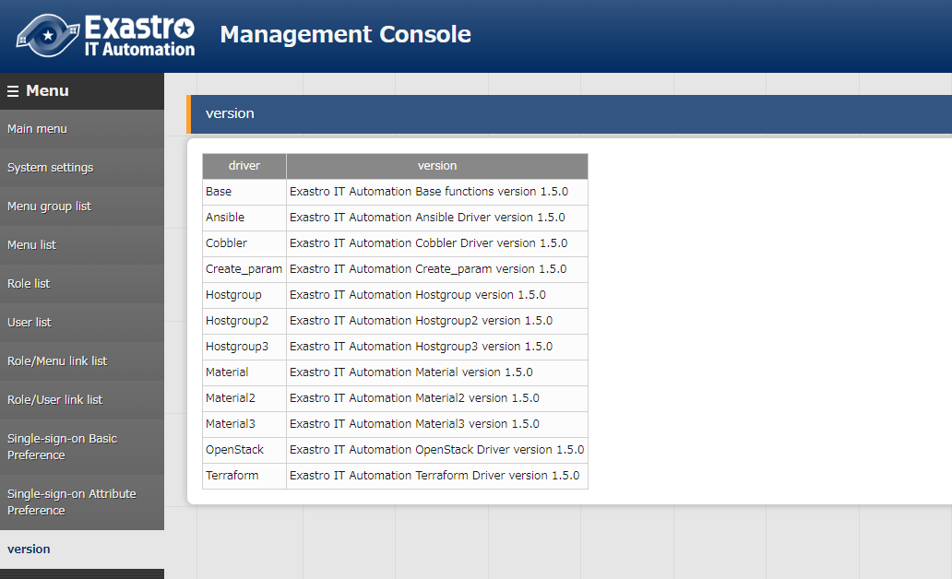
4.1 Operation check（1/1）
Check version
After logging into ITA, check if the version is updated in “Management console” - “Version”.

