Slide 1


Host group management・Menu creation【Practice】
※In this document, “Exastro IT Automation” is described as “ITA".
Version 1.0
Exastro developer

Slide 2
Table of contents
１．Introduction
About this document
Work environment
Scenario
２．Practice Scenario 1
Pre-preparation
Operation registration
Movement configuration
Conductor creation
Host group configuration
Menu list
Data registration
Substitution value automatic register configuration
Check Substitution value・Target host
Execution Conductor
Check reference parameter sheet
３． Practice Scenario 2
Operation registration
Add host to host group
Register data
Check Substitution value・Target host
Conductor execution

Slide 3
1. Introduction

Slide 4
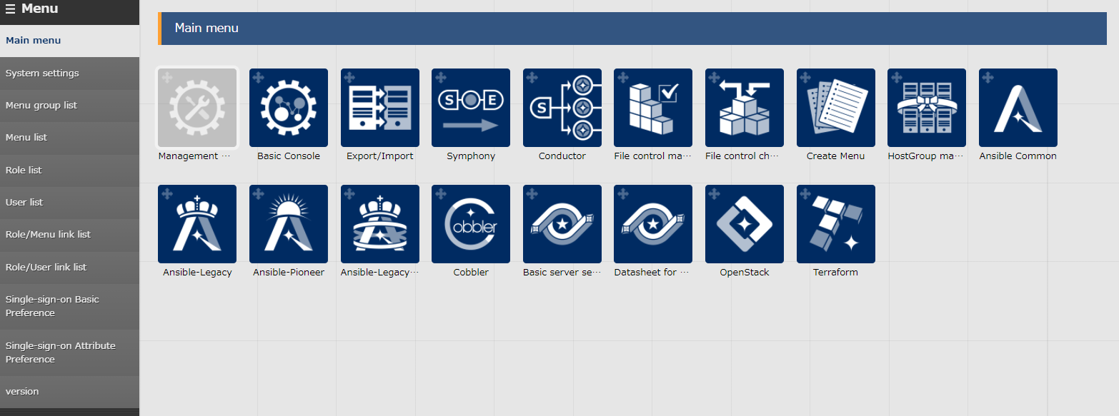
1.1 About this document
About this document This document will guide users through a practice scenario where users will be able to get some hands on experience to get a deeper understanding about the following functions. We will use Ansible Legacy to execute the operations.
Host group Management
Create menu

Slide 5


1.2 Work environment
Work environment The work environment used in this document is as follows. Please prepare 5 servers in addition to the ITA Host server.(※1)The additional servers will be work targets. ITA host server ・CentOS 7 (※2) ・ITA 1.5.0 ・Ansible 2.9.12 Target ・CentOS 7.8 (※3) … ５servers
CentOS 7
ITA
1.5.0
Ansible
2.9.12
ITA host server
CentOS 7 Target server group
※1 While we recommend that you prepare 5 servers in order to get the best experience, it is possible to complete this scenario with 3~4 servers.
※2 Now CentOS7 will be used as the host server, but ITA can be installed on OS RHEL7 and RHEL8. ※3 Any OS compatible with Ansible can be used.

Slide 6
1.3 Scenario (1/2)
Scenario 1. Set basic settings for the whole server Use the host group and menu creation functions to execute the tasks below.
Set a common time zone for the parent host group "All_SV".
Set different IP address of DNS server for child host group "db_SV" and "web_SV".
Set individual host name for each host.
All_SV
timezone: Asia/Tokyo
Inheritance
Inheritance
db_SV
web_SV
nameserver: 10.15.1.30 or 10.15.1.62
host | timezone | nameserver | hostname
dbA | Asia/Tokyo | 10.15.1.30 | dbA
dbB | Asia/Tokyo | 10.15.1.30 | dbB
webA | Asia/Tokyo | 10.15.1.62 | webA
webA | Asia/Tokyo | 10.15.1.62 | webB
dbA
dbB
webA
webB

Slide 7

1.3 Scenario (2/2)
Scenario 2 execute only on the added server Assume the work of adding a server after working on the previous section. If the playbook is idempotent,
1)Add the additional server to host group.2)Execute the same operation settings completed.
However, there are some playbooks are not idempotent such as those that add to the file. If this is applied repeatedly to the same host, excess Post Scripts and other troubles might occur. Taking that into consideration, all operation in scenario 2 will take place on the additional servers. The contents of the Conductor that is going to get executed are the same as the ones in scenario 1.
All_SV
timezone: Asia/Tokyo
Inheritance
db_SV
web_SV
nameserver: 10.15.1.62
host | timezone | nameserver | hostname
webC | Asia/Tokyo | 10.15.1.62 | webC
dbA
dbB
webA
webB
webC (additions)

Slide 8
2. Practice Scenario 1

Slide 9
2.1 Pre-preparation (1/2)
Playbook creation This scenario will use the following three playbooks. Please create a file with the following contents. [Attention] Create the yml file with Character code " UTF-8", New line code "LF".
- name: Set Timezone
timezone:
name: "{{ VAR_locale_timezone }}"
File name: 1-set_timezone.yml
Changes the time zone to the specified value.
In this scenario, all host`s common value will be substituted.
- name: Set Hostname
hostname:
name: "{{ VAR_hostname }}"
File name: 2-set hostname.yｍl Changes the hosts name.
In this scenario, value will be substituted per host.
- name: Add Nameserver
shell: ‘echo nameserver {{ VAR_nameserver_ip }} >> /etc/resolv.conf’
File name: 3-set nameserver.yml Adds postscript to /etc/resolv.conf.
As it isn’t idempotent, it will be only be executed to each host once.

Slide 10
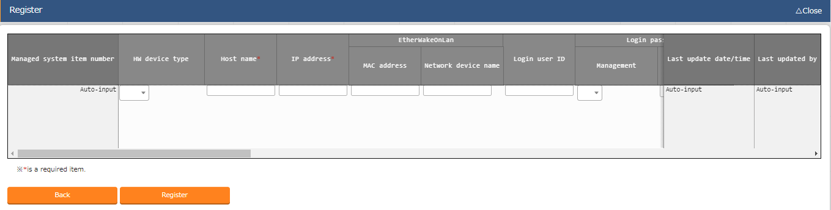
2.1 Pre-preparation(2/2)
Target host registration Register host to execute the work in ITA. This time, we will register 5 servers. ※ webC is used in scenario 2. Menu : Basic Console > Device list
Click Register > Start Registration.
Select or input the following information for each item and click "Register".
Item | 1Server | 2Server | 3Server | 4Server | 5Server
HW device type | SV
Host name | webA | webB | dbA | dbB | webC
IP address | Target device IP address
Login ID | (Enter arbitrary value)
Management | ●
Login password | (Enter arbitrary value)
Authentication method | ssh

Slide 11
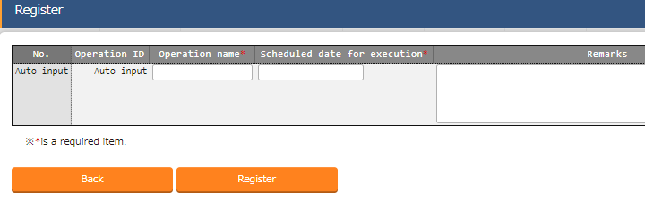
2.2 Operation registration
Register new operation Create operation
Menu : Basic Console > Input operation list
Click Register > Start Registration.
Input the following information for each item and click "Register".
Operation name | Scheduled date for execution
Basic settings all | (Enter arbitrary value)
※ "Scheduled date for execution" is just an item for management. It will not be executed automatically.

Slide 12
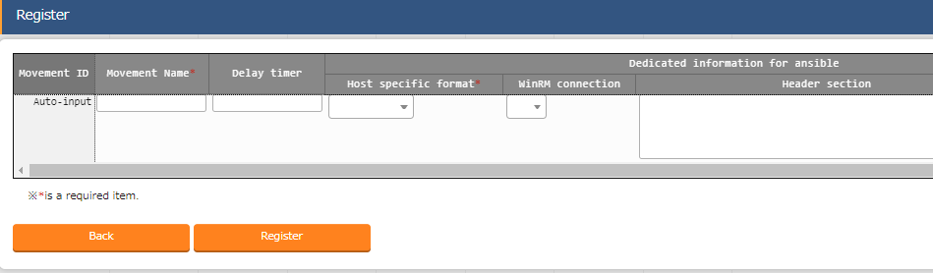
2.3 Movement configuration (1/3)
Create Movement Register the Movements that is going to be associated with the playbooks. Menu : Ansible-Legacy > Movement list
Click Register > Start Registration.
Select or input the following information for each item and click "Register".
Movement name | Host specification format
Set Timezone | IP
Set Hostname | IP
Add Nameserver | IP

Slide 13
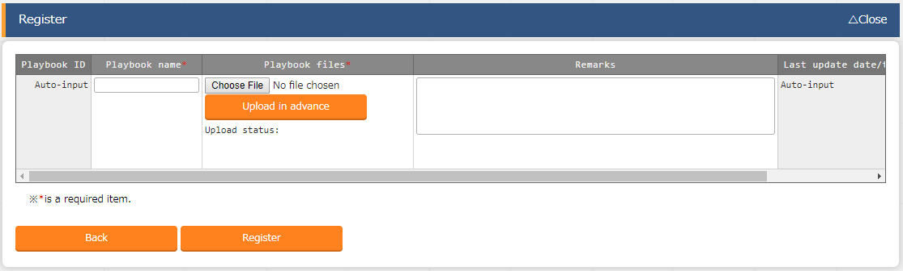
2.3 Movement configuration (2/3)
Register playbook Register the created playbook in ITA.
Menu : Ansible-Legacy > playbook files
Click Register > Start Registration.
Select a playbook from "Browser" and click "Upload in advance".
Input the following information for each item and click "Register".
Playbook file name | Playbook file
set_timezone | 1-set_timezone.yml
add_nameserver | 2-.set_nameserver.yml
set_hostname | 3-set_hostname.yml

Slide 14
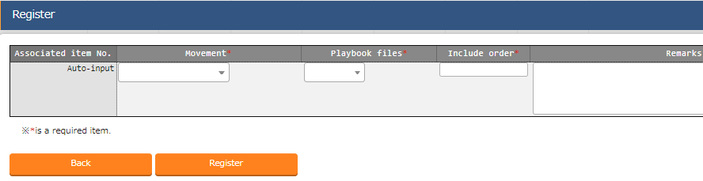
2.3 Movement configuration (3/3)
Register the playbook in Movement. Link the created Movement and Playbook files. Menu : Ansible-Legacy > Movement details
Click Register > Start Registration.
Select or input the following information for each item and click "Register".
Related table
Movement | Playbook file | Include order
Set Timezone | set_timezone | 1
Add Nameserver | add_nameserver | 1
Set Hostname | set_hostname | 1

Slide 15
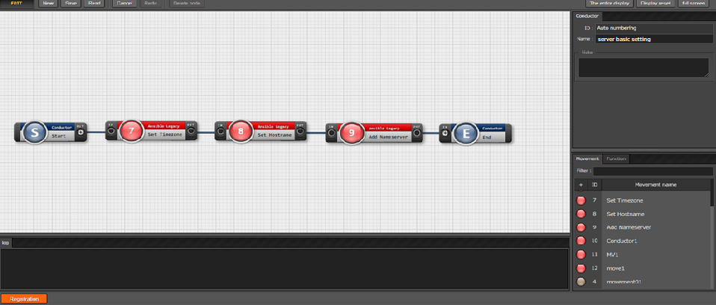
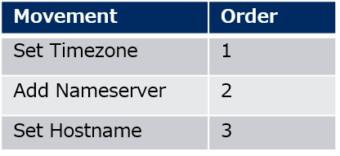
2.4 Conductor creation
Create Conductor Create a Conductor that collects the defined Movements.
Menu: Conductor > Conductor class edit
１
Input Conductor name.
Conductor name
Basic server setting
３
Connect nodes to each others.
２
Add the required Movement by
dragging and dropping.
４
Click "Registration".

Slide 16
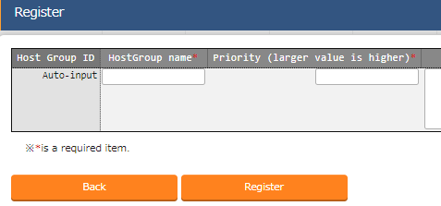
2.5 Host group setting (1/4)
Define host groups First, create the host groups to which the host belongs. Menu : Host group management > Host group list
Click Register > Start Registration.
Select or input the following information for each item and click "Register".
Host group name | Priority order
All_SV | 1
web_SV | 2
db_SV | 3

Slide 17
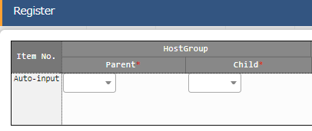
2.5 Host group setting (2/4)
Define the parent-child relationship of host groups Define the parent-child relationship in host groups. Menu : Host group management > Host group parent-child link list
Click Register > Start Registration.
Select the following information for each item and click "Register".
Image
Host group parent | Host group child
All_SV | web_SV
All_SV | db_SV
All_SV
db_SV
web_SV

Slide 18
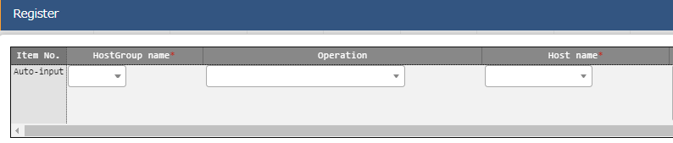
2.5 Host group setting (3/4)
Register the host to host group Link the target host with the created host group. Menu : Host group management > Host link list
Click Register > Start Registration.
Select the following information for each item and click "Register".
Image
All_SV
Host group name | Operation | Host name
web_SV |  | webA
web_SV |  | webB
db_SV |  | dbA
db_SV |  | dbB
db_SV
web_SV
dbA
dbA
webA
webB

Slide 19
2.5 Host group setting (4/4)
Check host group variable The Host name registered in the Host group is automatically variablized by the "Host Group Variablization" function. Check the contains.
Menu : Host group management > Host group variable
Click "Filter".
Check that the variables are correctly converted by the "Host Group Variablization Function".
Point
Each host that directly belongs a host group also belongs to
the parent host group of the parent host group.

Slide 20
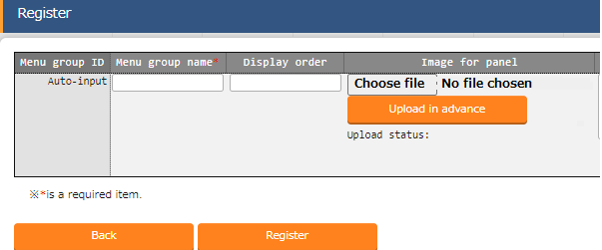
2.6 Menu list(1/8)
Menu group creation Create a menu group that is going to contain all of the menus (Parameter sheets). At the same time, create the group that is going to contain menus and data sheets (both for referencing).
Menu: Management console > Menu group list
Click Register > Start Registration.
Input the following information for each item and click "Register".
Menu group name | Display order
Basic server setting(for host group) | 120
Basic server setting(for host) | 125
Basic server setting(for reference) | 130
Data sheet for pull-down selection | 140

Slide 21
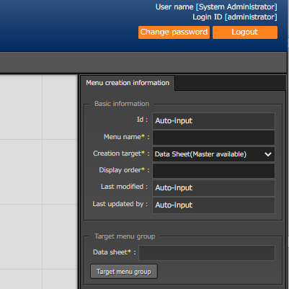
2.6 Menu list(2/8)
Create data sheet Create data sheet. The value registered here will later be selectable from a pull-down menu.
Menu : Create menu > Create/Define menu
Input the following information for each item.
Click "Target menu group".(Next item)
Item name | Input contents
Menu name | Time zone list
Target operation | Data sheet(Master available)
Display order | 1

Slide 22
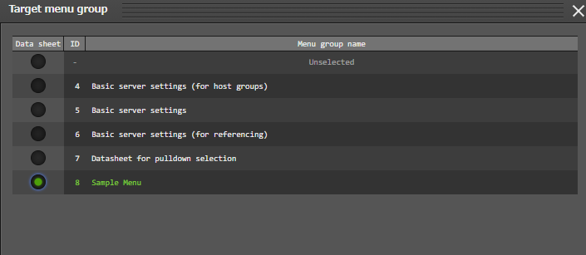
2.6 Menu list(3/8)
Create data sheet. In "Menu Group Selection", select the menu groups that are going to contain the menus that you want to create.
Select as shown below.
Press " Decision" on the bottom of the screen.

Slide 23
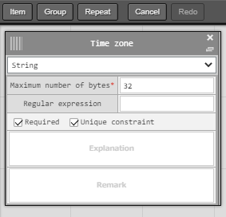
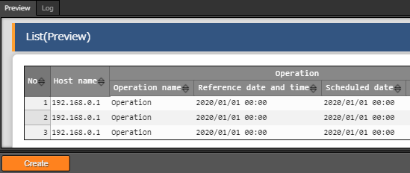
2.6 Menu list(4/8)
Define the item name of the data sheet Continuing from the previous section, define the items on the sheet.
Menu : Create menu > Create/Define menu
Click "Item" and add a new item.
Input the following for each of the items.
Click "Create" at the bottom of the screen.
１
2
Item name | Input method | Maximum no. of bytes | Required | Unique constraint
Timezone | string | 32 | ✓ | ✓
３

Slide 24
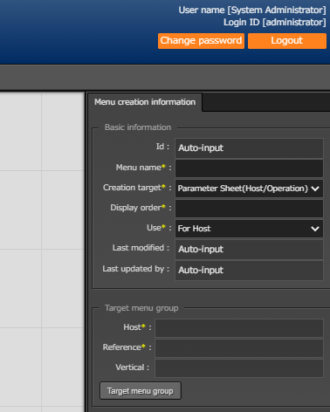
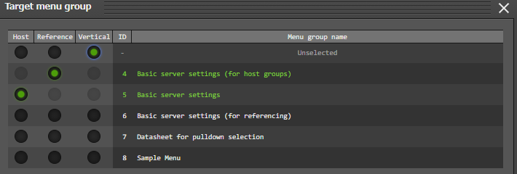
2.6 Menu list(5/8)
Create the menu for the host group Create a parameter sheet for the host group and manage the parameters that apply to your host group.
Menu : Create menu > Create/Define menu
"Basic information" Input the following information for each item.
Click "Target menu group" and select the Target menu group.(Next item)
Item name | Enter content
Manu name | Parameter for server
Creation target | Parameter sheet (Host/Operation)
Display order | 1
Use | For Host

Slide 25
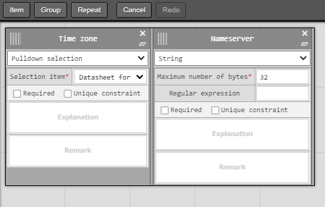
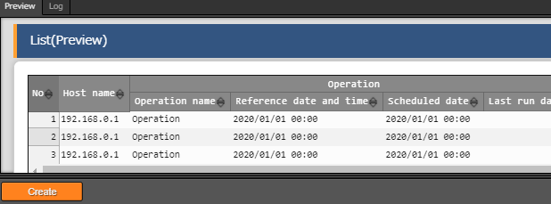
2.6 Menu list(6/8)
Define the item name of the parameters sheet Continuing from the previous section, define the items on the sheet.
Menu : Create menu > Create/Define menu
Click "Item" and add a new item.
Input the following for each of the items.
Click "Create" at the bottom of the screen.
1
2
Item name | Input method | Select item
Timezone | Pulldown selection | Basic server settings: Timezone list: Parameter/Timezone
Item name | Input method | Maximum no. of bytes
Nameserver | String | 32
3

Slide 26
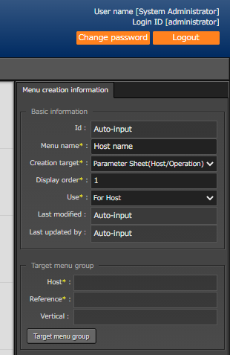
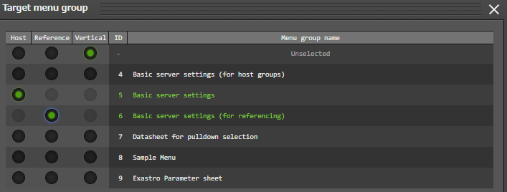
2.6 Menu list(7/8)
Create the menu for the host group Create a parameter sheet for the host group and manage the parameters that apply to your host group.
Menu : Create menu > Create/Define menu
"Basic information" Input the following information for each item.
Click "Target menu group" and select the Target menu group.(Next item)
Item name | Enter content
Menu name | Host name
Creation target | Parameter sheet (Host/Operation)
Display order | 1
Use | For host

Slide 27
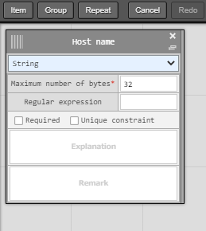
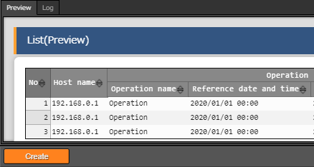
2.6 Menu list(8/8)
Define the item name of the parameters sheet Continuing from the previous section, define the items on the sheet.
Menu : Create menu > Create/Define menu
Click "Item" and add a new item.
Input the following for each of the items.
Click "Create" at the bottom of the screen.
１
2
2
Item name | Input method | Maximum number of bytes
Hostname | String | 32
3

Slide 28
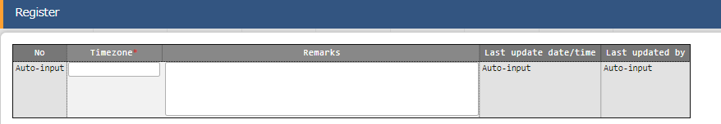
2.7 Data registration(1/3)
Register data to the data sheet. The Data and Parameter sheet are now created. Move to the created menu and input the data.
Menu: Data sheet for pull-down selection > Time zone list
Click Register > Start Registration.
Select or input the following information for each item and click "Register".
Timezone
Asia/Tokyo
America/New_York

Slide 29
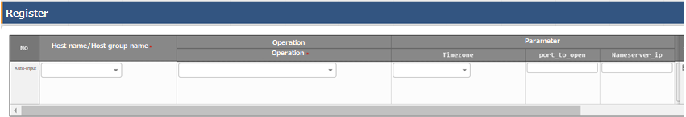
2.7 Data registration(2/3)
Register data to the parameter sheet Move to the created menu and input the data.
Menu: Basic server setting(for host group) > Server parameter
Click Register > Start Registration.
Select or input the following information for each item and click "Register".
Point
Users can select from the contents entered in
the data sheet in the previous section.
Host name/Host group name | Operation | Timezone | Nameserver_ip
[HG]All_hosts | Basic settings all | Asia/Tokyo | 10.15.1.30
[HG]web_SV | Basic settings all | Asia/Tokyo | 10.15.1.62
[HG]db_SV | Basic settings all | Asia/Tokyo | 10.15.1.30

Slide 30
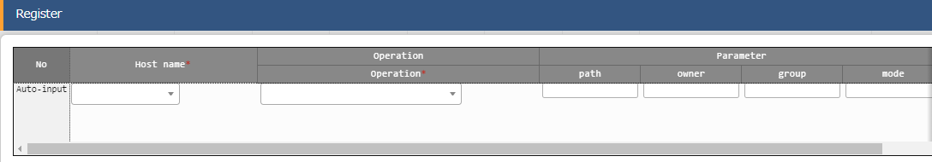
2.7 Data registration(3/3)
Register data to the parameter sheet Next, register the data from the menu created in the menu group for the host.
Menu: Basic server setting(Host) > Host name
Click Register > Start Registration.
Select or input the following information for each item and click "Register".
Host name | Operation | Hostname
webA | Basic settings all | webA
webB | Basic settings all | webB
dbA | Basic settings all | dbA
dbB | Basic settings all | dbB

Slide 31
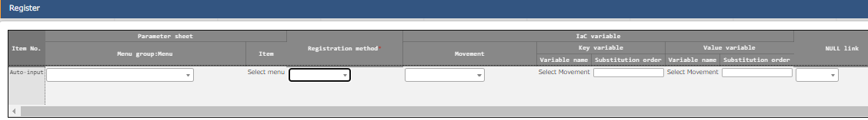
2.8 Substitution Value Automatic Registration setting
Set Substitute Value Automatic Registration settings Connect the variables to each item after entering the data in the parameter sheet.
Menu: Ansible-Legacy > Substitution value automatic registration setting
Click Register > Start Registration.
Select or input the following information for each item and click "Register".
Menu | Item | Registration method | Movement | Value variable Variable name | Substitution order
Parameter for server | Timezone | Value type | Set Timezone | VAR_locale_timezone
Parameter for server | Nameserver_ip | Value type | Add Nameserver | VAR_nameserver_ip
Host name | Hostname | Value type | Set Hostname | VAR_hostname

Slide 32
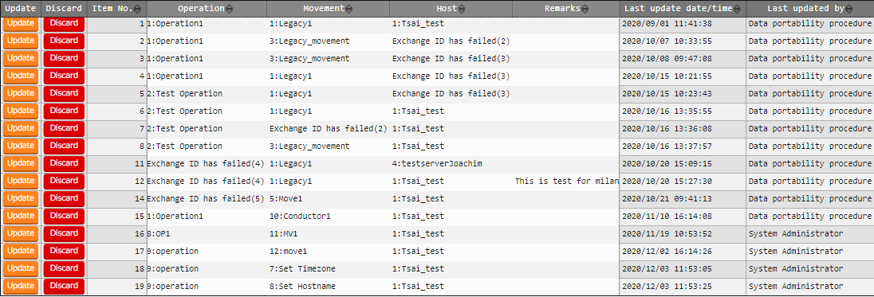
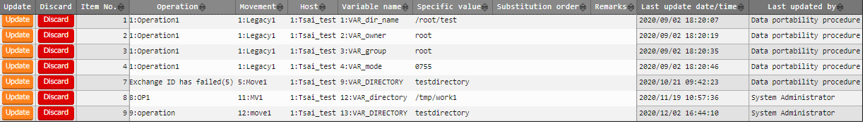
2.9 Check Substitution value・Target host
Check Substitution value and Target host Check the value specified by the substituted value automatic registration and the target host.
Menu: Ansible-Legacy > Target host & Ansible-Legacy > Substitution value list
Click "Filter".
Check that the correct value is specified by "legacy substitution value automatic registration setting procedure".
Target host
Substitution value list

Slide 33
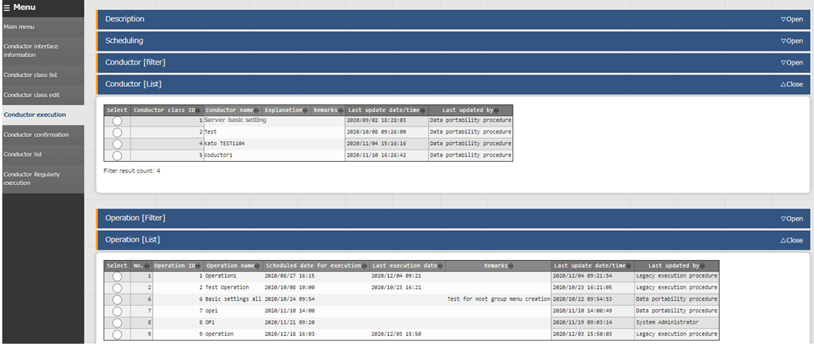
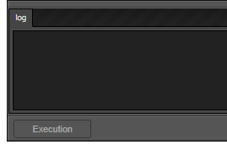
2.10 Conductor execution(1/2)
Execute Conductor If you finished the operations in the previous section, the Conductor should be created and the substitute values should be registered. Finally, execute Conductor and check the result on the target host.
Menu： Conductor > Conductor execution
Select "Server basic setting"
from the Conductor list.
１
Select Operation "Basic setting all“.
２
Tips
The screen will automatically change
to the "Conductor Confirmation"
screen after executing.
Click "Execution" at the bottom
of the screen.
3

Slide 34
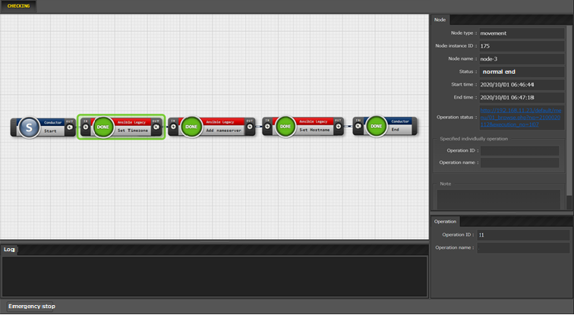
2.10 Conductor execution(2/2)
Check the Conductor Execution results In the work confirmation screen, you can check the results of the whole execution or execution per node. Selecting an inputted Movement will show a link to a more detailed result screen.
Menu： Conductor > Conductor confirmation
Select the node you want to check.
２
Link and operation
information are displayed.
１

Slide 35
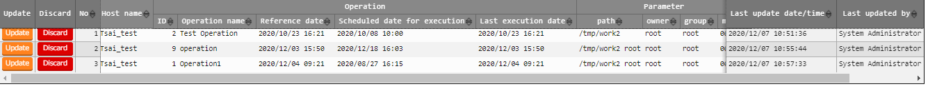
2.11 Reference parameter sheet confirmation
Check contents of the reference parameter sheet By completing the operation in the previous section, the set parameters have now been applied to the target host. Finally, check the reference parameter sheet and confirm that the update date and time etc. are recorded. Menu: Basic server setting(Reference)
Click "Filter".
Confirm that the “Reference date/time" and "Last update date/time" are updated.

Slide 36
3. Practice Scenario 2

Slide 37
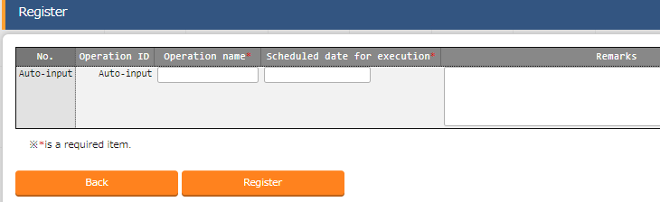
3.1 Operation registration
Register new operation Create an additional operation.
Menu : Basic Console > Input operation list
Click Register > Start Registration.
Input the following information for each item and click "Register".
Operation name | Scheduled date for execution
Basic setting Additional server only | (Enter arbitrary value)
※ "Scheduled date for execution" is just an item for management. It will not be executed automatically.

Slide 38
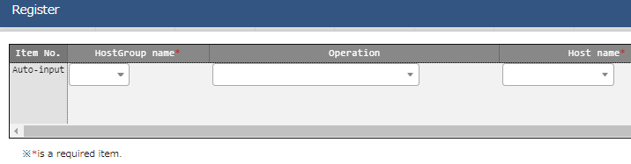
3.2 Add host to host group
Register host to host group Register additional hosts in the host group. In order to remove WebA and webB from being work targets, we also will change the settings that we set in Scenario 1. Menu: Host group management > Host link list
Click List/Update > Update Click "New register "Register > Start Registration.
Select the following information for each item and click "Register".
Image
All_SV
db_SV
web_SV
Host group name | Operation | Host name
web_SV | Basic settings all | webA
web_SV | Basic settings all | webB
web_SV | Basic settings additional server only | webC
dbA
dbB
webA
webB
webC
Point
In this case,
When "Basic settings all servers" is executed, only WebA and B will be targets.
When "Basic settings Additional server" is executed, only webC will be target.

Slide 39
3.3 Data registration(1/2)
Register data in the parameter sheet Move to the menu created in scenario 1 and input the data.
Menu: Basic server setting(Host group) > Server parameter
Click Register > Start Registration.
Select or input the following information for each item and click "Register".
Point
Users can select from the contents entered in
the data sheet in the previous section.
Host name/Host group name | Operation | Timezone | Nameserver_ip
[HG]web_SV | Basic settings additional server only | Asia/Tokyo | 10.15.1.62

Slide 40
3.3 Data registration(2/2)
Register data in the parameter sheet Next, register the data from the menu created in the menu group for the host.
Menu: Basic server setting(Host) > Host name
Click Register > Start Registration.
Select or input the following information for each item and click "Register".
Host name | Operation | Hostname
webC | Basic settings additional server only | webC

Slide 41
3.4 Check Substitution value・Target host
Check Substitution value and Target host Check the value specified by the substituted value automatic registration and the target host.
Menu: Ansible-Legacy > Target host & Ansible-Legacy > Substitution value list
Click "Filter".
Check that only the data of "webC" is added by the "legacy substitution value automatic registration setting procedure".
Target host
Substitution value list

Slide 42
3.5 Conductor execution
Execute Conductor Execute Conductor again. Ensure that the work is reflected only on the host "webC".
Menu: Conductor > Conductor execution
Select "Server basic setting"
from the Conductor list.
１
Select Operation "Basic setting all“.
２
Tips
After execution, the screen will transition
to the "Conductor Confirmation" screen.
The more information about the Result
Confirmation screen, please see this
from earlier.
Click "Execution" at the bottom
of the screen.
3

