Slide 1


Conductor【Tutorial】
※In this document, “Exastro IT Automation” is described as “ITA".
Version 1.0
Exastro developer

Slide 2
Table of contents
Introduction
About this documents
About description of Conductor
About Conductor
Conductor feature
Description of the functions in Conductor Menu
Conductor workflow

Slide 3
1. Introduction

Slide 4
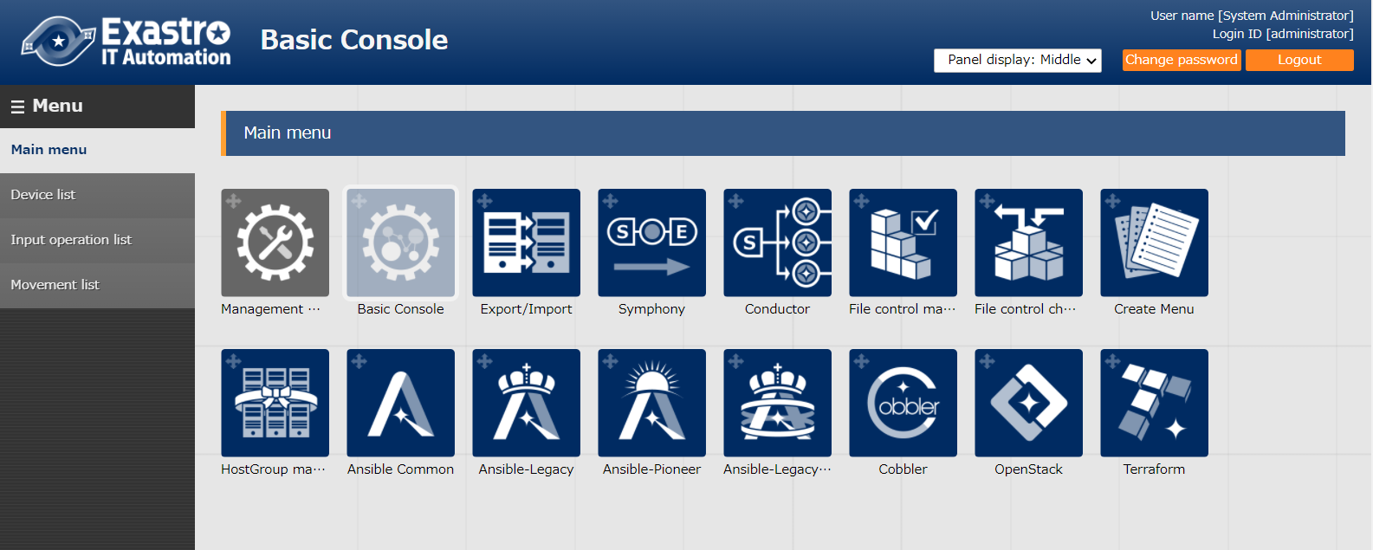
1.1 Ansible driverについて X/X
1.1 About this document
Main menu
About the "Conductor" of menu group are explained in this document.

Slide 5
2. Description about Conductor

Slide 6
1.1 Ansible driverについて X/X
2.1 About Conductor
Conductor is a function added to ITA from ver1.5.0.
Conductor refers to a single unit of a series of work in ITA and execute in association with the operation name. (workflow)
Conductor
Movement A
Movement B
Movement C
parameter（variable）
IaC 1
VAR_a
IaC 2
VAR_b
VAR_c
IaC 3
None

Slide 7
2.2 Conductor features
In conductor, users can prepare work execution functions similar to the Symphony functions, as well as the functions listed below.
According to this Conductor allows to perform more sophisticated job follows.
Parallel execution of movement
Call another job flow
Conditional branching according to the execution result of movement
Workflow-A
Movement B
call A
Movement A
Movement G
Movement C
Workflow- B
Call A
normal end
Movement E
Movement D
Movement F
error

Slide 8
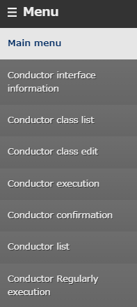
2.3 Description of the functions in Conductor Menu （1/9）
Introduction of main functions in the Conductor Menu
①Conductor class edit Create an operation using the a created movement.
②Conductor execution
Executing the operation. ③Conductor confirmation Confirm the created operation. ④Conductor Regularly execution Register an operation and performs execution period.
①
②
③
④

Slide 9
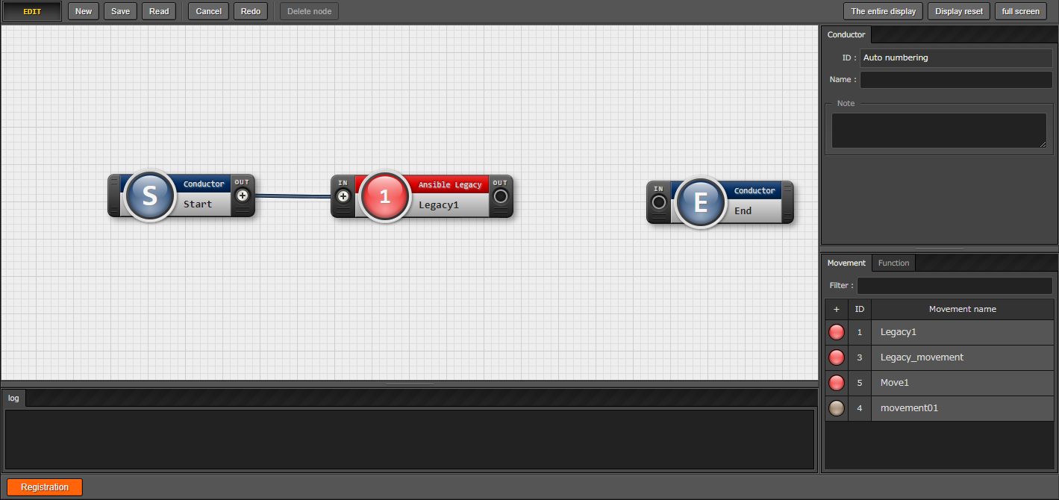
2.3 Description of the functions in Conductor Menu （2/9）
Conductor class edit（1/3）
In the "Conductor class edit" menu Movement and Functions that perform various controls can be added and deleted.
Movements can be combined
by dragging and dropping
in/out for each movement.
Choose between various Functions.
Arrange Movement by
dragging and dropping.

Slide 10
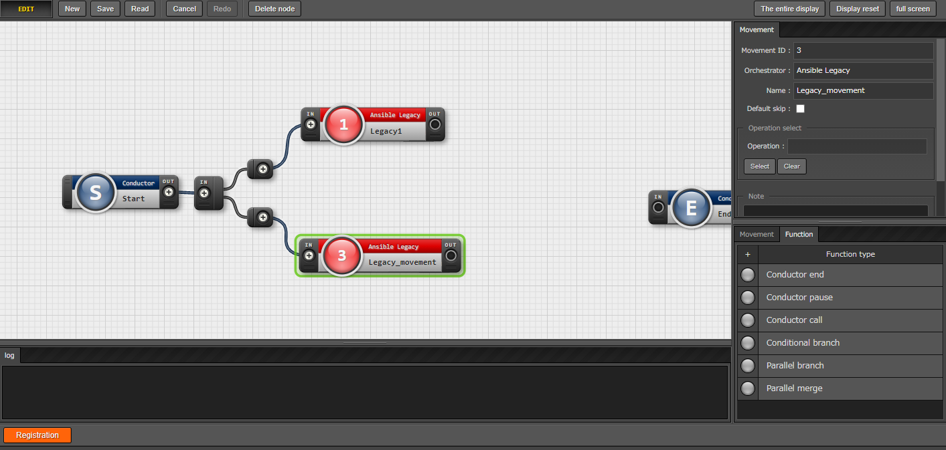
2.3 Description of the functions in Conductor Menu （3/9）
Conductor class edit（2/3）
From the tab near the center right of the screen, select and use the function that controls the conditional branching of the operation.
Similar to Movement, operation can be combined in/out by dragging and
dropping.
The function arrangement can be changed by dragging and dropping.
Choose between various
Functions.

Slide 11
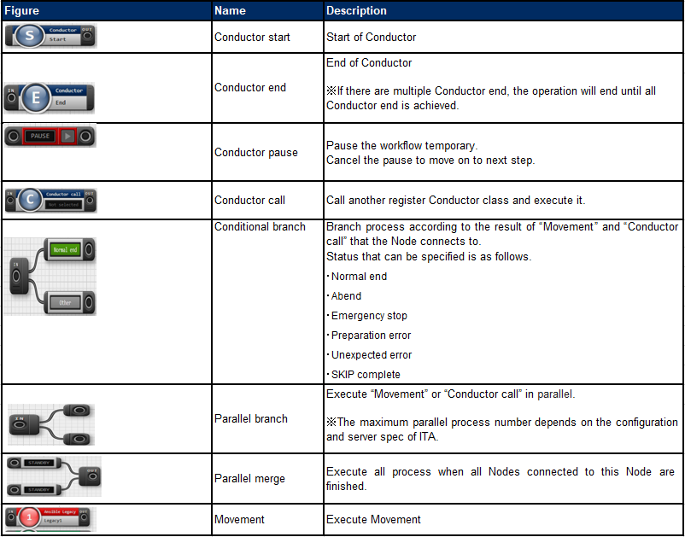
2.3 Description of the functions in Conductor Menu （4/9）
Conductor class edit（3/3）
Possible to describes the functions. For details refer to menu.

Slide 12
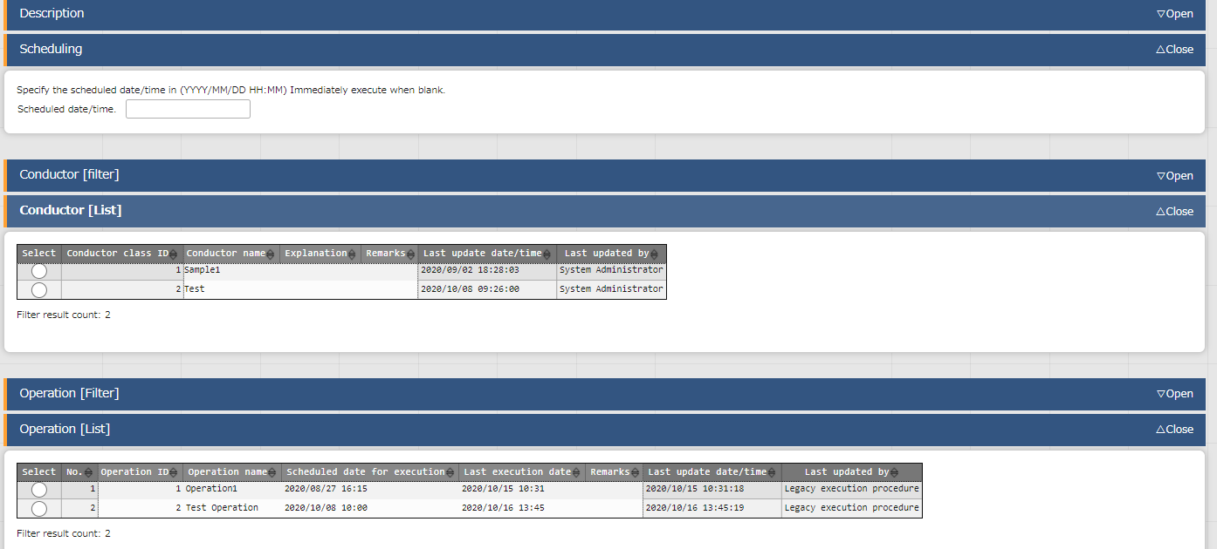
2.3 Description of the functions in Conductor Menu（5/9）
Conductor execution(1/2)
Choose and execute the created Conductor in the "Conductor execution" menu.
Possible to schedule
execution timing.
Select operation and executed Conductor.

Slide 13
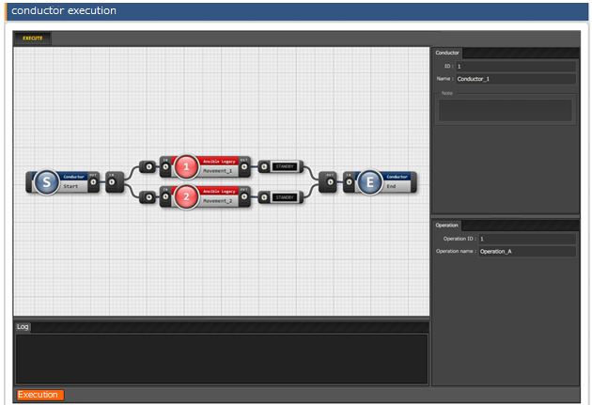
2.3 Description of the functions in Conductor Menu （6/9）
Conductor execution (2/2)
The conductor and operation selected at the top of the page will be displayed.
If there is no problem with the
contents, press the
"Execute" button to execute.

Slide 14
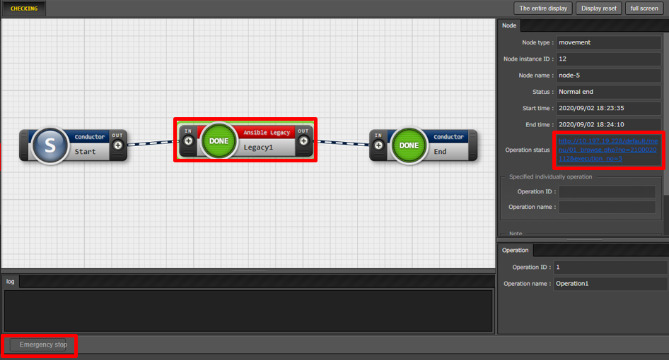
2.3 Description of the functions in Conductor Menu （7/9）
Conductor confirmation
Check the execution status from the "Conductor Confirmation Menu“.
Check a detailed status of the
execution results by pressing a Movement. Click here for more details.
If the conductor has a set schedule
which has yet to be executed,
users can cancel the schedule by
pressing the " schedule cancelling"
button.

Slide 15
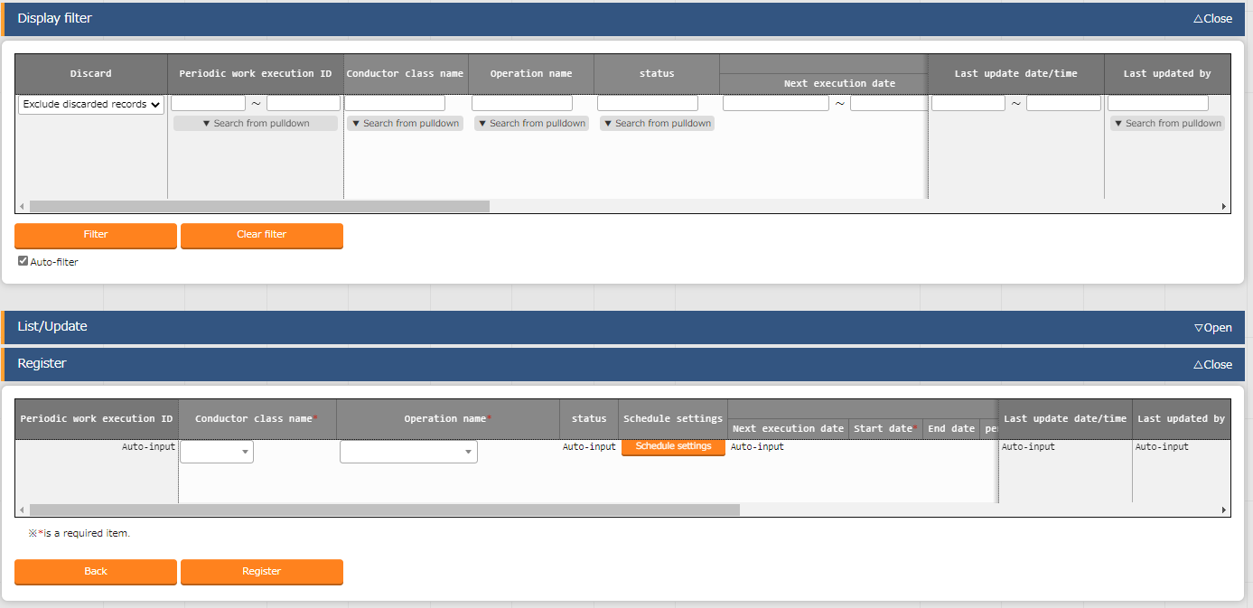
2.3 Description of the functions in Conductor Menu （8/9）
Conductor Regularly execution（1/2）
In the "Conductor Regularly execution" menu, manage work schedule to be executed regularly.
A detailed schedule can be
set from the" Schedule Settings“.

Slide 16
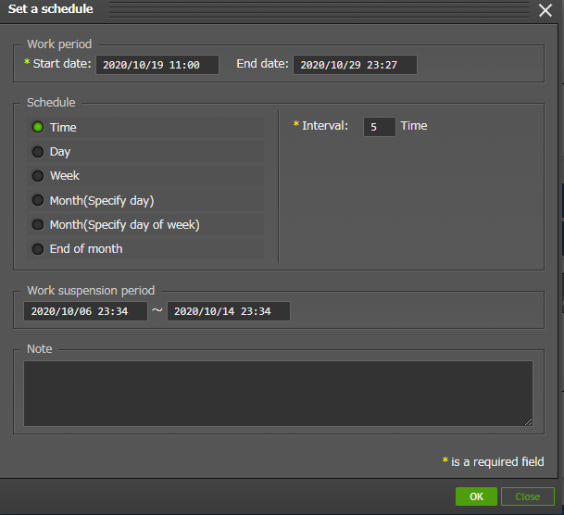
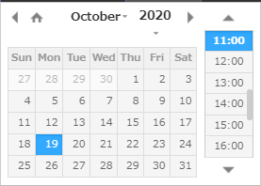
2.3 Description of the functions in Conductor Menu （9/9）
Conductor Regularly execution（2/2）
"Schedule setting“ allows user to set detailed settings such as the regular execution period and the period for stopping work as shown below.
Clicking it will display
a calendar.

Slide 17
2.4 Conductor workflow
Conductor workflow is as follows. Actual operation is described in the training.
①Register device information
Basic console menu
②Register operation
③ Register Movement
Various driver menu
④Check Movement
⑤Register interface information
Conductor menu
⑥Register Conductor
⑦Check Conductor
⑧Execution Conductor
⑨Check execution result
⑩Check execution history

