Slide 1


Export/Import
【Tutorial】
※In this document, “Exastro IT Automation” is described as “ITA".
Version 1.7.1
Exastro developer

Slide 2
Table of contents
Introduction 1. About this document
Export/Import function
Overview(overall)
Overview(menu)
Menu overview
Work flow
Menu Description

Slide 3
2. Export/Import function

Slide 4
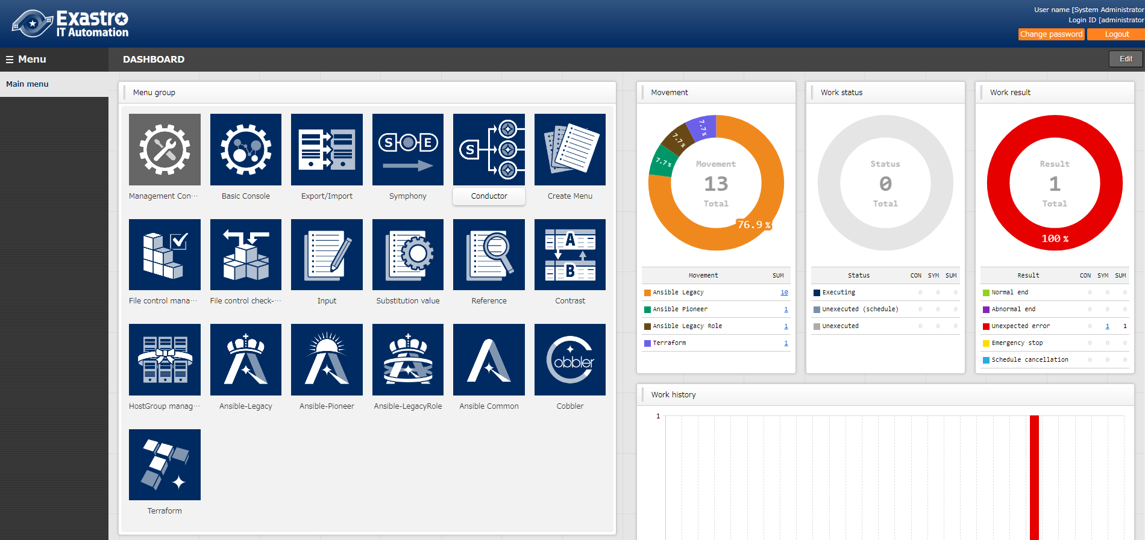
1.1 Ansible driverについて X/X
1.1 Introduction
About this document This document aims to explain the "Export/Import " Menu and its functions. Detailed specifications are described in the User Instruction Manual
Please refer to it as needed.

Slide 5
2. Export/Import function

Slide 6



2.1 Overview (overall)
Overview of Export/Import function
By using the "Export/Import" function, users can move Data registered in one ITA System (Parameter sheets, Conductor, Playbooks, etc) to a different ITA server.
Export
kym
ITA Server A
S
E
Export/Import Data
(kym file)
Import
kym
ITA Server B
S
E
Export/Import data
(kym file)
Notes:
ｖ

Slide 7




2.2 Overview(menu)
Export/Import menu Register information can be migrated to the ITA server as menu units. During import, all existing same menus will be replaced. It is possible to export all menus that exist on the ITA server and select and export only the required menus.
Figure
I want to move only the required menus from the test environment to the main environment (ITA Server B)
kym
kym file
ITA Server A
ITA Server B

Slide 8
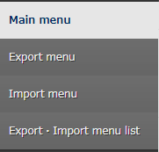
2.3 Menu overview
Menu overview Here is an overview of the Export/Import menus and their functions.
Select and export Menus
Import files exported in "Export menu".
Check the Export/Import status and download the data.

Slide 9
2.4 Work flow
Work flow
The work flow of export/import are as follows. In the practice document, we handle each work in more detail, so please check it.
1. Export
Export menu
2. Download kym file
Export/Import list
3. Import
Import menu
4. Check Import
Export/Import list

Slide 10
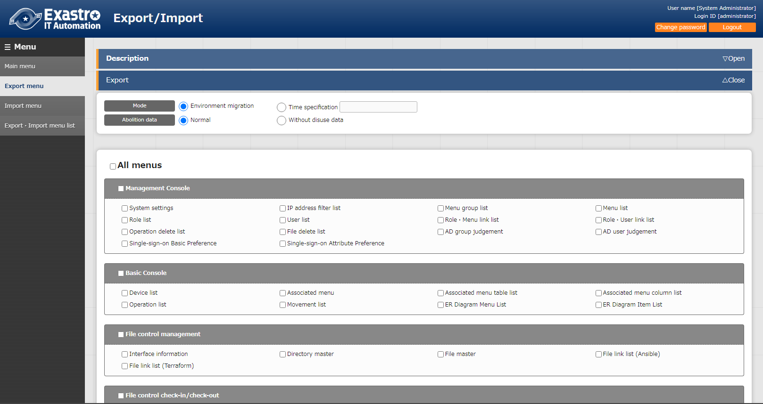
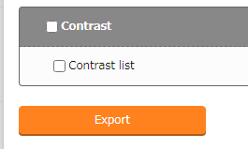
2.7 Menu Description (1/3)
Export menu
All menus are displayed in a list and can be selected if the user wishes to export them. There are two types of modes. One that overwrites all the existing data and one where users can choose whether to insert or overwrite data based on unique menu items (ID,No, Etc) after a specified time has passed.
"Abolition data" decides if you want to include abolished data or not when you import.
Select the menus to be
exported with the check box.
Click “Export” to execute.

Slide 11
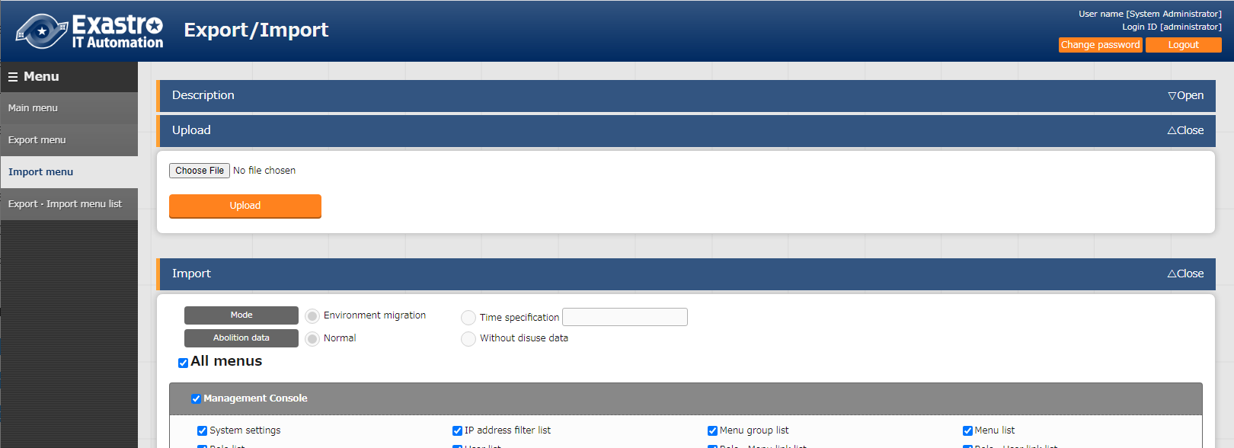
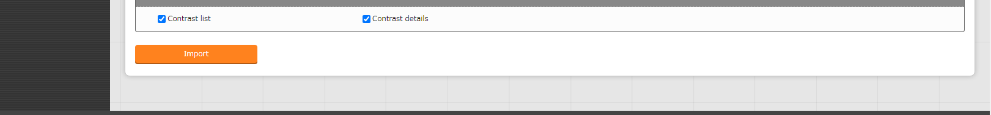
2.7 Menu Description (2/3)
Import menu
Upload the exported data in the "Export menu " and import the desired menus.
Use these buttons to upload kym files
Select the menu you want to import by marking menu’s check box.
Click here to start the Import.

Slide 12
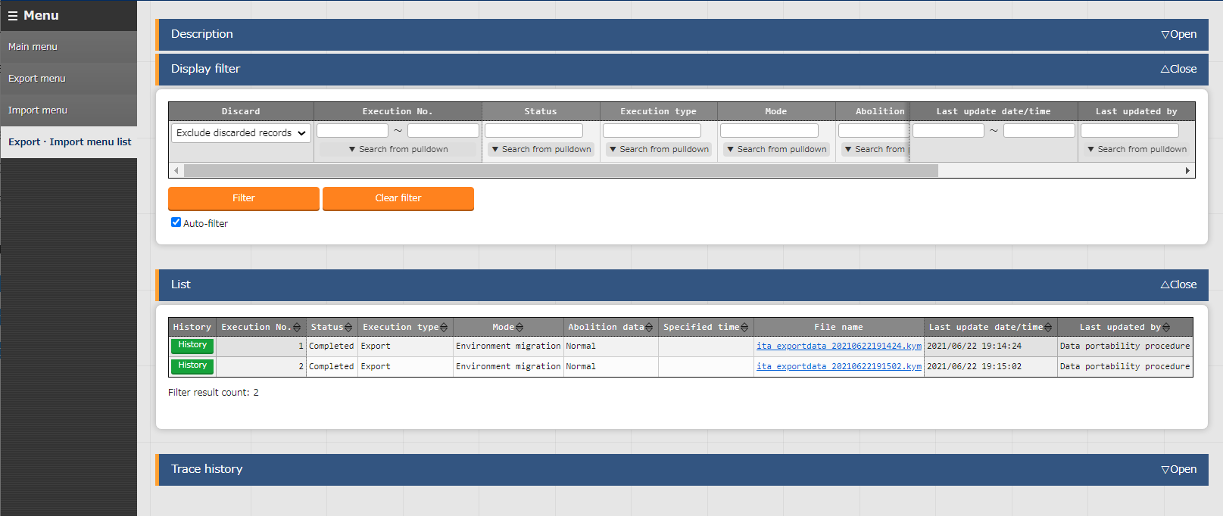
2.7 Menu Description (3/3)
Export/Import menu list
Check the information that can be executed Export/Import. User can check the progress status of each operation and download moved data.
Check the status here.
It will go from "Not Executed“ to "Executing" and lastly “Completed".
Check/Download the export/import file here
See here for mode and Abolition data status

