Slide 1


Online Installation
※ In this document, “Exastro IT Automation” is described as “ITA".
Version 1.5
Exastro developer

Slide 2
Table of Contents
Introduction
1.1 About This Guide
System Organization
2.1 Functions executed in conjunction with other tools
2.2 System Requirements
IT Automation Configuration Procedure
3.1 Online Installation
3.2 Preparation (1/2)
3.3 Preparation (2/2)
3.4 Flow of IT Automation Configuration
3.5 Configuration (1/7)
3.6 Configuration (2/7)
3.7 Configuration (3/7)
3.8 Configuration (4/7)
3.9 Configuration (5/7)
3.10 Configuration (6/7)
3.11 Configuration (7/7)
IT Automation Operation Check
4.1 Operation Check (1/6)
4.2 Operation Check (2/6)
4.3 Operation Check (3/6)
4.4 Operation Check (4/6)
4.5 Operation Check (5/6)
4.6 Operation Check (6/6)
4.7 Reference

Slide 3
1. Introduction

Slide 4
1.1 About This Guide
About this guide
This guide describes how to set up IT Automation in an all-in-one configuration by using its installer and external repositories.

Slide 5
2. System Organization

Slide 6
2.1 Functions executed in conjunction with other tools
Functions executed in conjunction with other tools
IT Automation supports the tools for the following functions:
Driver | Tool name (orchestrator) | Function name | Description | Installable with the IT Automation configuration tool | To be installed through this guide
Material | Git | Management of configuration materials | This function allows you to “Check out” and “Check in” configuration materials registered in the standard configuration tools and to manage the versions of the materials via Git. | Yes | No
Create_param | - | Creation of menus | This function allows you to create menus. | - | Yes
Hostgroup | - | Host grouping | This function allows you to group hosts into logical units (functions and roles) and to manage the parameters to be applied. | - | Yes
Ansible driver | Ansible | System construction | A Red Hat-provided OSS tool for setting up a platform. For a networked device, this tool allows you to install software, configure various settings, transfer files, and apply patches, based on an IaC called Playbook. | Yes | Yes
 | Ansible Tower | System construction | A management platform to enhance Ansible with such functions as access control, job scheduling, and task visualization. | No
Cobbler driver | Cobbler | OS installation | An OSS tool for automating installation. For a networked device, this tool allows you to install an OS, based on a prepared template. | No | No
OpenStack driver | OpenStack | Virtual system construction | An OSS tool for setting up a cloud environment. This tool allows you to set up virtual machines, storages, and networks. | No | No
Terraform driver | Terraform | System construction | Terraform is an orchestration tool provided by HashiCorp, Inc. that improves the efficiency of infrastructure process. The construction is executed after the execution plan is generated based on the infrastructure configuration coded in HCL(HashiCorp Configuration Language). Furthermore, with Policy as Code, it's also possible manage access policy in code. | No | No

Slide 7
2.2 System Requirements
The followings are the system requirements to use IT Automation:
We are preparing a manual for Exastro-ITA system configuration and environment construction.

Slide 8
3. IT Automation Configuration Procedure

Slide 9

3.1 Online Installation
Installation procedure
When the IT Automation server has an internet-connection, install necessary libraries via the Internet and execute the IT Automation installer to perform configuration.
IT Automation server
IT Automation
IT Automation installation package
Repositories
PHP
httpd
aaaaaayum
MariaDB
IT Automation server
Internet

Slide 10
3.2 Preparation (1/2)
Enabling repositories (only for online installation)
Depending on your OS version, enable the following repositories:
OS | Repository
RHEL7 | https://dl.fedoraproject.org/pub/epel/epel-release-latest-7.noarch.rpm
 | https://downloads.mariadb.com/MariaDB/mariadb_repo_setup
 | http://rpms.remirepo.net/enterprise/remi-release-7.rpm
 | rhel-7-server-optional-rpms
RHEL8 | https://dl.fedoraproject.org/pub/epel/epel-release-latest-8.noarch.rpm
 | codeready-builder-for-rhel-8-xxxxxx-rpms
CentOS7 | epel-release
 | https://downloads.mariadb.com/MariaDB/mariadb_repo_setup
 | http://rpms.remirepo.net/enterprise/remi-release-7.rpm
CentOS8 | epel-release
 | PowerTools
RHEL7_AWS | https://dl.fedoraproject.org/pub/epel/epel-release-latest-7.noarch.rpm
 | https://downloads.mariadb.com/MariaDB/mariadb_repo_setup
 | http://rpms.remirepo.net/enterprise/remi-release-7.rpm
 | rhui-rhel-7-server-rhui-optional-rpms
RHEL8_AWS | https://dl.fedoraproject.org/pub/epel/epel-release-latest-8.noarch.rpm
 | codeready-builder-for-rhel-8-rhui-rpms
＊) RHEL7_AWS : RHEL7 on AWS
RHEL8_AWS : RHEL8 on AWS
xxxxxx:architecture

Slide 11
3.3 Preparation (2/2)
IT Automation configuration tools
The following table lists tools for configuring IT Automation:
Description | File | Path location
Library collection script | ita_gather_library.sh | /(Extract path)/ita_install_package/install_scripts/
Configuration tool (for offline installation) | ita_builder_offline.sh | /(Extract path)/ita_install_package/install_scripts/
Configuration tool (for online installation) | ita_builder_online.sh | /(Extract path)/ita_install_package/install_scripts/
Setting file | ita_builder_setting.txt | /(Extract path)/ita_install_package/install_scripts/
IT Automation installer | ita_installer.sh | /(Extract path)/ita_install_package/install_scripts/
Answer file | ita_answers.txt | /(Extract path)/ita_install_package/install_scripts/

Slide 12
3.4 Flow of IT Automation Configuration
Configuration flow (online)
The configuration flow is as follows:
(1) Downloading the materials from Github
(2) Changing the permission of the installation scripts
(3) Editing the setting file
(4) Editing the answer file
(5) Executing the configuration tools
(for online installation)
Process flow
Configuring the OS
Configuring the settings of the yum repository
Installing MariaDB
Installing Apache
Installing PHP and related programs
(Installing Ansible)
Executing the IT Automation installer

Slide 13
3.5 Configuration (1/7)
*Environment building users must be root users.
Downloading the materials from Github
Download the materials with the following command: # wget https://github.com/exastro-suite/it-automation/archive/vx.x.x.tar.gz *The wget command needs to be installed in advance. *Change the (x.x.x) for the version to be installed.
Deploying the materials.
Unzip the .tar.gz file. # tar zxf vx.x.x.tar.gz
Changing the directory
Move to the directory where the setting file and the shell are stored for configuration. # cd it-automation-x.x.x/ita_install_package/install_scripts

Slide 14
3.6 Configuration (2/7)
Editing the setting file
The following table lists what to be edited in the setting file (ita_builder_setting.txt) for IT Automation configuration:
Item | Required | Initial value | Description
linux_os | Yes (for all OS) | - | OS of the IT Automation server ("CentOS7","CentOS8","RHEL7","RHEL8“, "RHEL7_AWS“,“RHEL8_AWS") *)RHEL7_AWS : RHEL7 on AWS RHEL8_AWS : RHEL8 on AWS
redhat_user_name | For RHEL OS other than on AWS | - | Username for the Red Hat account
redhat_user_password |  | - | Password for the Red Hat account
pool_id |  | - | Pool ID for the Red Hat account

Slide 15
3.7 Configuration (3/7)
Sample of the setting file (ita_builder_setting.txt)
The following shows an example of the setting file (ita_builder_setting.txt):
# Select Operation System. ("CentOS7","CentOS8","RHEL7","RHEL8","RHEL7_AWS","RHEL8_AWS")
# Select Operation System. ("CentOS7,"CentOS8","RHEL7","RHEL8")
# e.g) linux_os:RHEL8
linux_os: RHEL7
#####################################################
#Only when you select linux_os with RHEL7 or RHEL8
# Enter the Red Hat user name and user password
# e.g) redhat_user_name:sample
redhat_user_name:sample
# e.g) redhat_user_password:sample_password
redhat_user_password: sample_password
# e.g) pool_id:samplePoolID
pool_id: samplePoolID
#####################################################
OS of the installation target server: RHEL 7
Enter values for these items only if you use RHEL.

Slide 16
3.8 Configuration (4/7)
Editing the answer file (ita_answers.txt)
Edit the answer file for IT Automation installation in advance.
For ita_base, ansible_driver, create_param, and Hostgroup, each of the initial values is set to yes. Change the value to no if the corresponding installation is not necessary.
Item | Required | Default value | Description
install_mode | Yes | Install | Installation mode: Install or Uninstall
ita_directory | Yes | － | Specify the absolute path to the directory where IT Automation will be installed. If the directory does not exist, it will be newly created.
ita_language | Yes | en_US | IT Automation display language: ja_JP (Japanese) or en_US (English)
ita_os | Yes | RHEL7 | OS for IT Automation: RHEL7 or RHEL8
db_root_password | Yes | － | Root password for MariaDB
db_name | Yes | － | Database name for MariaDB
db_username | Yes | － | Database username for MariaDB
db_password | Yes | － | Database password for MariaDB
ita_base | Yes | yes | Only yes can be specified to install IT Automation.
Material | Yes | no | Whether the Management of configuration materials function is to be installed
create_param | Yes | yes | Whether the Creation of menus function is to be installed
Hostgroup | Yes | yes | Whether the Host grouping function is to be installed
ansible_driver | Yes | yes | Whether the Ansible driver is to be installed
cobbler_driver | Yes | no | Whether the Cobbler driver is to be installed
openstack_driver | Yes | no | Whether the OpenStack driver is to be installed
terraform_driver | Yes | no | Whether the Terraform driver is to be installed

Slide 17
3.9 Configuration (5/7)
Sample of the answer file (ita_answers.txt)
The following shows an example of the answer file (ita_answers.txt):
#Select install mode. ("Install" or "Uninstall")
# e.g) install_mode:Install
install_mode:Install
#Enter install directory.
# e.g) ita_directory:/exastro
ita_directory:/exastro
# Select language. ("en_US" or "ja_JP")
# e.g) ita_language:en_US
ita_language:en_US
# Select Operation System. ("RHEL7" or "RHEL8")
# e.g) ita_os:RHEL8
ita_os:RHEL7
# Enter the MariaDB root user's password
# e.g) db_root_password:sample_root_password
db_root_password: sample_root_password
# Decide the database name, username, and password for ITA.
# e.g) db_name:sample_db_name
db_name:sample_db_name
# e.g) db_username:sample_db_username
db_username:sample_db_username
# e.g) db_password:sample_db_password
db_password:sample_db_password
# Select the target you need to install.
# yes : need
# no : no need
ita_base:yes
material:no
createparam:yes
hostgroup:yes
ansible_driver:yes
cobbler_driver:no
openstack_driver:no
terraform_driver:no
With the answer file, define the password for MariaDB.
＊ Password that contains symbol may cause error.

Slide 18
3.10 Configuration (6/7)
Executing the configuration tool (for online installation)
Execute the configuration tool with the following command:
# sh ita_builder_online.sh
Checking the process
Executing the configuration tool outputs the process details to ita_builder.log and ita_installer.log.
Path to the logs
/(Extract path)/ita_install_package/install_scripts/log/

Slide 19
3.11 Configuration (7/7)
Libraries installed through the configuration
The following table lists the libraries installed through the execution of the configuration tool:
Installation driver | Library type | Library name
ita_base | Installation tool | yum-utils(*), createrepo(*)
ita_base | IT Automation common | zip, telnet, mailx, unzip, sudo, crontabs
ita_base | MariaDB | MariaDB, MariaDB-server, expect
ita_base | httpd | httpd, mod_ssl
ita_base | php | php, php-bcmath, php-cli, php-ldap, php-mbstring, php-mcrypt, php-mysqlnd, php-pear, php-pecl-zip, php-process, php-snmp, php-xml, php-json, php-gd, Python3, php-devel, libyaml, libyaml-devel, make
ita_base | php plug-in | php-yaml, HTML_AJAX-beta, PhpSpreadsheet
material | git | Git
ansible_driver | Ansible | ansible, sshpass, pexpect, pywinrm, boto3, nmap-ncat, paramiko
* only RHEL7,CentOS7

Slide 20
4. IT Automation Operation Check

Slide 21
4.1 Operation Check (1/6)
Checking the main menu
After completing the installation, take the following steps with a Windows PC client to access the main menu of IT Automation and to check that the IT Automation and all the drivers are shown properly.
Accessing the login screen
Access the login screen with the following URL:
URL: http://(IP address)
※ After installation, access from both HTTP and HTTPS are possible.
Since HTTP is insecure, accessing from HTTPS is recommended.
For the method to access from HTTPS, please refer to operation check (4/6).
Logging in
When the IT Automation login screen appears, enter the given login ID and initial password and then click the Login button.
- Login ID: administrator
- Initial password: password
If you have logged in for the first time after the installation, you will be prompted to change the password.
Change the initial password.

Slide 22
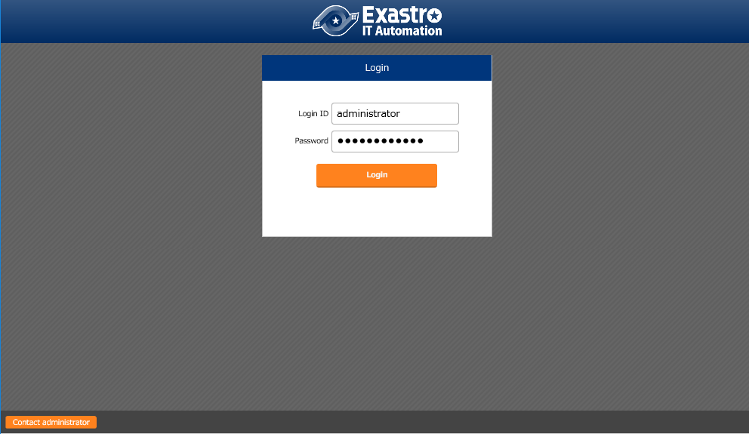
4.2 Operation Check (2/6)
IT Automation login screen
Having been successfully installed, IT Automation displays the following login screen:
Login ID: administrator
Initial password: password

Slide 23
4.3 Operation Check (3/6)
Checking the content by displaying the menus
After logging in, check that the following menus are shown properly:
Function | Menu
IT Automation (main body) | Management Console
 | Basic Console
 | Export/Import
 | Symphony
 | Conductor
Creating menus | Create menu
Hostgroup | HostGroup management
Ansible driver | Ansible Common
 | Ansible-Legacy
 | Ansible-Pioneer
 | Ansible-LegacyRole

Slide 24
4.4 Operation Check (4/6)
Preparation for accessing from HTTPS
Specify the IP address and host name of the IT Automation server in the hosts file of the Windows client.
For Windows 10, the hosts file is located at the following:
To the hosts file, add the following settings:
C:\Windows\System32\drivers\etc\hosts
“ITA実装サーバのIPアドレス” exastro-it-automation 例） 192.168.0.3 exastro-it-automation

Slide 25
4.5 Operation Check (5/6)
Import the certificate into the operating device(Windows). The certificate is stored in the following directory of the IT Automation installation package.
Use a tool (such as FFFTP and WinSCP) to download the client.
Import the certificate to a Web browser.
For Google Chrome, import the certificate as follows.
Start up Google Chrome. Then select Settings button in the upper right > settings.
Select Advanced in the Lower part of browser > Manage certificates.
In the Trusted Root Certification Authorities tab click the Import button in the lower left.
When the certificate import wizard appears, click Next.
Specify the name of the file to be imported. Then click Next.
Make sure that the Place all certificates in the following store option is selected.
Select Trusted Root Certification Authorities and click Next.
※If not selected, select Trusted Root Certification Authorities from Reference on the right.
Click Finish.
OS of the IT Automation server | File path | File name
RHEL 7, CentOS 7 | /(extract path)/ita_install_package/ext_files_for_CentOS7.x/etc_pki_tls_certs/ | exastro-it-automation.crt
RHEL 8, CentOS 8 | /(extract path)/ita_install_package/ext_files_for_CentOS8.x/etc_pki_tls_certs/ | exastro-it-automation.crt

Slide 26
4.6 Operation Check (6/6)
Accessing the login screen from HTTPS
Access the login screen with the following URL:
URL: https:// exastro-it-automation
＊ It is possible to access with the IP address of server instead of host name.
After connecting, follow the same procedure as from HTTP.

Slide 27
4.7 Reference
Restrict HTTP or HTTPS access
Please perform the following procedure to resctrict HTTP or HTTPS access.
Edit file ”/etc/httpd/conf.d/vhosts_exastro-it-automation.conf”.
To restrict HTTP access, please comment out(#) the section from 「<VirtualHost *:80 >」to「</VirtualHost>」
To restrict HTTPS access, please comment out(#) the section from 「<VirtualHost *:443 >」to「</VirtualHost>」
Restart Apache with the following command. systemctl restart httpd

