Slide 1


Version Update
※ In this document, “Exastro IT Automation” is described as “ITA".
Exastro IT Automation Version 1.9
Exastro developer

Slide 2
Table of contents
Introduction
1.1 About this guide
System configuration
2.1 System requirement
ITA update procedure
3.1 Preparation（1/1）
3.2 ITA update work flow
3.3 Update（1/6）
3.4 Update（2/6）
3.5 Update（3/6）
3.6 Update（4/6）
3.7 Update（5/6）
3.8 Update（6/6）
ITA operation check
4.1 Operation check（1/1）

Slide 3
1. Introduction

Slide 4
1.1 About this guide
About this guide
This document describes the procedure to update the ITA environment constructed in all-in-one configuration.

Slide 5
2. System configuration

Slide 6
2.1 System requirement
About the environment of ITA to perform update
The procedure in this document can be performed on ITA environment constructed in all-in-one configuration.
Version update is supported by ITA version 1.4.0 and later. ITA environments running on version 1.4.0 or later can be updated by following the procedure in this document.

Slide 7
3. ITA update procedure

Slide 8
3.1 Preparation（1/1）
List of ITA construction tool
The list of ITA construction tool is as follows.
Description | File | Storage destination
ITA installer | ita_installer.sh | /(Installation file extraction path)/ita_install_package/install_scripts/
Answer file | ita_answers.txt | /(Installation file extraction path)/ita_install_package/install_scripts/

Slide 9
3.2 ITA update work flow
Version update work flow
The work flow of version update is as follows.
①Back up ITA environment
②Download file from GitHub
③Edit answer file
④Execute ITA Installer (Update tool)
Operation content
Install library (optional)
Update database
Update ITA file

Slide 10
3.3 Update（1/7）
*Run the update as root user.
Back up ITA environment
Please back up the ITA environment before updating.
Download file from GitHub
Download file with the following command # curl -OL https://github.com/exastro-suite/it-automation/releases/download/vx.x.x/exastro-it-automation-x.x.x.tar.gz ※Please install curl command beforehand.
※Please change the version (x.x.x) according to the file.
Deploying the materials.
Unzip the .tar.gz file. # tar zxf exastro-it-automation-x.x.x.tar.gz
Change directory
Switch the current directory to the directory where the answer file and shell is located. # cd it-automation-x.x.x/ita_install_package/install_scripts

Slide 11
3.4 Update（2/7）
Edit answer file (ita_answers.txt)
Please edit the answer file to set ITA update.
If the user wishes to install any library when updating to a new version, input “Versionup_All” to the “Install_mode” value. If not, input “Versionup_ITA”.
“ita_directory” and “Install_mode” are the only items used for update, other items are not used.
Item | Necessary | Initial value | Description
install_mode | ○ | Install_Online | Install mode settings ・Install_Online：Install online ・Install_Offline：Install offline ・Gather_Library：Gather library ・Install_ITA：Install ITA ・Versionup_All：Update ITA（With library install） ・Versionup_ITA：Update ITA（Without library install） ・Uninstall：Uninstall ITA
ita_directory | ○ | /exastro | Installation directory Please specify an absolute path for the ITA Installation directory. Make sure the directory can be referenced by all users. If no installation directory exists, one will be created.
ita_language | ー | en_US | ITA display language（Japanese（ja_JP）／English（en_US））
ita_os | ー | RHEL7 | ITA OS(for RHEL7 type OS (RHEL7)/ for RHEL8 type OS (RHEL8))
ita_domain | ー | exastro-it-automation.local | ITA domain name specification (used when the ITA installer creates a self-certificate.
certificate_path | ー | ー | Specify the path of the file used for the user specified SSL server certificate (Enter only when using a user specified SSL certificate. Specify an absolute path)
private_key_path | ー | ー | Specify the path of the file used for user-specified SSL private keys. (Enter only when using a user-specified SSL private key. Specify an absolute path)
Not used when updating

Slide 12
3.5 Update（3/7）
Install modes
From ITA Version 1.6.0 and onwards, the shell executed when the installer is booted is only integrated to the ita_installer. The installer behavior is branched depending on the answer file’s install mode. Choose one of the following when updating.
Versionup_All：ITA will be updated after the necessary library is installed. Install the library online.
Versionup_ITA：Updates ITA without installing any libraries.
If the user wants to automatically install the library in an online environment, input “Versionup_All” for “install_mode”. For offline environments or non-automatic installations, pleaser enter “Versionup_ITA”.

Slide 13
3.6 Update（4/7）
Sample of the answer file (ita_answers.txt)
The following shows an example of the answer file (ita_answers.txt)
# Select install mode.
# ("Install_Online","Install_Offline","Gather_Library","Install_ITA",
# "Versionup_All","Versionup_ITA","Uninstall")
# e.g) install_mode:Install_Online
# *This installer operates according to the inputted values below.
# Install_Online: ITA will be installed after the necessary libraries
# has been installed via internet.
# Install_Offline: ITA will start installing using the package created
# in Gather Library.
# Gather_Library: Gathers the necessary libraries via internet and creates
# the package necessary to execute Install_Offline.
# (Execute this before executing Install_Offline)
# Install_ITA: Installs ITA without installing any libraries.
# Versionup_All: Installs ITA after installing the necessary libraries for
# the desired ITA version via internet.
# Versionup_ITA: Updates ITA without installing any libraries.
# Uninstall: ITA Uninstalls ITA.(Libraries will not be uninstalled)
install_mode: Versionup_All
# e.g) ita_directory:/exastro
ita_directory:/exastro
# Select language. ("en_US" or "ja_JP")
# e.g) ita_language:en_US
ita_language:en_US
#############################################################
# Enter when using user-specified certificates and private keys.
# If no file path is entered for both "certificate_path" and "private_key_path",
# the ITA installer creates and installs a self-certificate and private key
# using the values entered in "ita_domain".
# Enter the file path where the certificate to be install.
# e.g) certificate_path:/temp/etc_pki_tls_certs/exastro-it-automation.crt
certificate_path:
# Enter the file path where the private key to be install.
# e.g) private_key_path:/temp/etc_pki_tls_certs/exastro-it-automation.key
private_key_path:
#############################################################
“ita_directory” and “install_mode” are the only items used for update, other items are not used.
Items in the answer file (ita_answer.txt) does not support full-width characters.

Slide 14
3.7 Update（5/7）
Execute ITA Installer (Update tool)
Execute the update tool with the following command
# sh ita_version_up.sh
If the " install mode" in the answer file (ita_answers.txt) is "Verisionup_all", The library will be automatically installed in the middle of the process. Please see the next page for each version's installation library
Check process
If the operation is ended normally, the version will be updated to the version of the downloaded file.
The content of operation executed by update tool is output to ita_version_up.log
Log storage path
/(Installation file extract path)/ita_install_package/install_scripts/log/
Exit status
The ITA installer returns one of the exit statuses listed below depending on the shell process exit status.
Normal exit：0
Abnormal exit：1

Slide 15
3.8 Update（6/7）
List of libraries that will be installed during update
If "Versionup_all" is entered for "install_mode" in the answer file, The following libraries will be installed according to the drivers already installed. If "Versionup_ITA" was input, the library needs to be isntalled manually.
Version | Installed driver | Library name | Install command | Required | Usage
1.5.0 | ita_base | php-devel | yum install –y php-devel | 〇 | Used for YAML analysis library (yaml)
 |  | libyaml | yum install –y libyaml | 〇 | Used for YAML analysis library (yaml)
 |  | libyaml-devel | yum install –y libyaml-devel | 〇 | Used for YAML analysis library (yaml)
 |  | make | yum install –y make | 〇 | Used for YAML analysis library (yaml)
 |  | yaml | pecl install yaml | 〇 | Used for YAML analysis library (yaml)
 | ansible-driver | nc | yum install –y nc | - | Used for SSH command option when executing Ansible Playbook by connecting SSH from ITA under proxy environment to external server such as AWS via proxy server.
 |  | paramiko | pip3 install paramiko | - | Required to connect to a network device by specifying network_cli for ansible_connection.
1.6.0 | There are no libraries added in 1.6.0
1.6.1 | There are no libraries added in 1.6.1
1.6.2 | There are no libraries added in 1.6.2
1.6.3 | There are no libraries added in 1.6.3
1.7.0 | ansible-driver | boto | Pip3 install boto | - | Used for Ansible module’s community.aws.iam
1.7.1 | There are no libraries added in 1.7.1
1.7.2 | There are no libraries added in 1.7.2

Slide 16
3.8 Update（7/7）
Version | Installed driver | Library name | Install command | Required | Usage
1.8.0 | There are no libraries added in 1.8.0
1.8.1 | There are no libraries added in 1.8.1
1.8.2 | There are no libraries added in 1.8.2
1.9.0 | There are no libraries added in 1.9.0

Slide 17
4. ITA Operation check

Slide 18
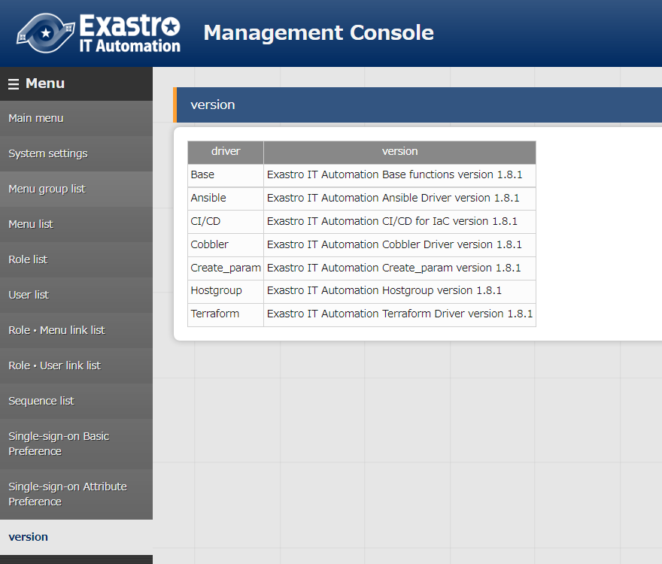
4.1 Operation check（1/2）
Check version
After logging into ITA, check that the version has been updated in “Management console” - “Version”.

Slide 19
4.2 Operation check（2/2）
Deleted functions
Following functions were deleted on listed versions.
Functions installed beforehand will remain, but they may not work properly after the listed version.
Function | Version
DSC-Driver | v1.5.0
OpenStack-Driver | v1.6.1
Construction file management function | v1.8.0

