Slide 1


Ansible Driver Tutorial
※In this document, “Exastro IT Automation” will be written as “ITA”
Version 1.3
Exastro developer

Slide 2
Table of contents
Introduction
What is Ansible Driver?
Linking to Ansible Tower
Explanation of the different Ansible Modes
Features of each mode
Legacy mode
LegacyRole mode
Pioneer mode

Slide 3
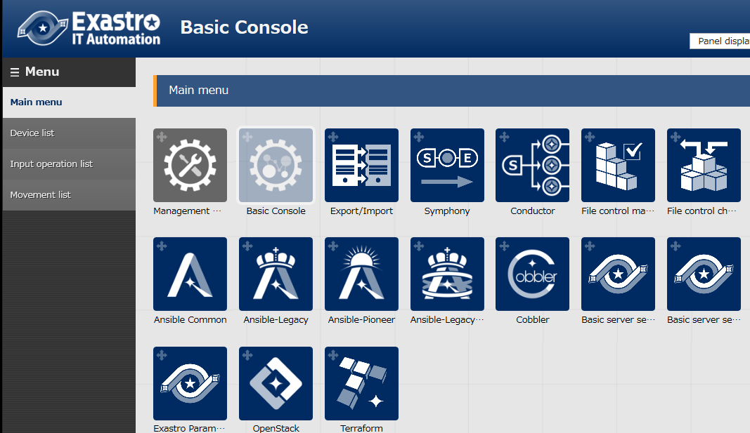
1.1 Ansible driverについて X/X
1. Introduction
Main Menu
This document will explain the functions andconcept of the menu groups: "Ansible-Legacy", "Ansible-LegacyRole" and "Ansible-Pioneer".
We`ve prepared a practice document that uses screenshots to explain, so feel free to use that together with this document.
The "Ansible Common" menu group manages menus used by the other Ansible menu groups. The menus are as following.
Interface information
Ansible tower host list
Global variable list
File list
Template list
This document will mainly explain these 3 menu groups.

Slide 4

2. What is Ansible Driver?
Ansible Driver links the system parameters that ITA centrally manages and the variables of IaC (Playbooks and such) and allows the system to cooperate with Ansible.
※We will explain the merits of using Ansible Tower in "3. Connecting to Ansible Tower".
ITA
System
Symphony
CMDB
Start
Movement
Ansible-Legacy
NW
Ansible-Legacy Playbook parts
Movement
Ansible-LegacyRole
System Parameter
Ansible-LegacyRole Package file
ST
Movement
Ansible-Pioneer
Ansible-Pioneer Dialog file (Original IaC)
End
SV

Slide 5
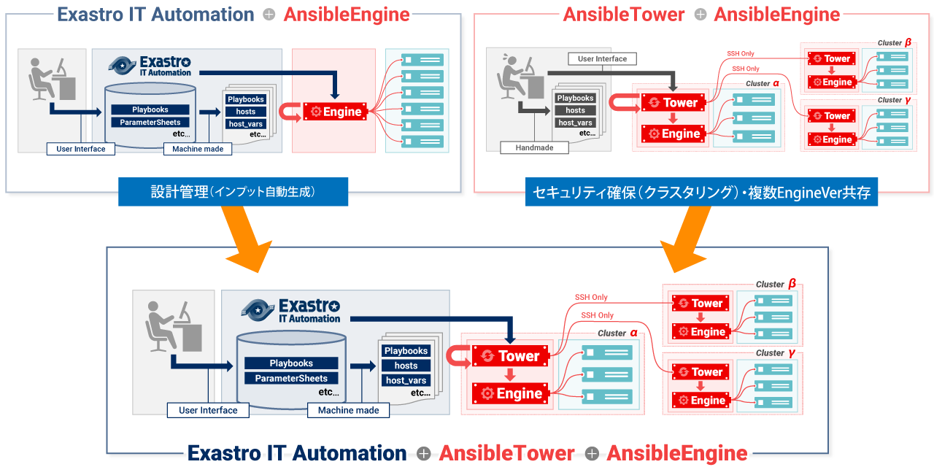
1.1 Ansible driverについて X/X
3. Linking to Ansible Tower
IT Automation stores and manages settings data and creates the directories and configuration files necessary to operate Ansible.
AnsibleTower makes the signals between clusters more secure and controlls Ansible Engine
Executing operations on an automatically constructing system created by combining the features of the 3 modes, IT Automation + AnsibleTower + AnsibleEngine, can be both save labour and be more efficient.
Settings management (auto run input)
Ensure security (Clustering) Multiple EngineVer coexisting

Slide 6
4. Explanation of the different Ansible Modes
Ansible Driver provides three modes with features that can handle different situations.
The three modes, Ansible-Legacy, Ansible-LegacyRole and Ansible Pioneer, and their features are explained below.
◆IaC reusability
Ansible-Legacy
Ansible-Pioneer
Ansible-LegacyRole
◆Know-how application
Ansible-Legacyrole
Ansible-Legacy
Ansible-Pioneer
◆Application range
Ansible-Pioneer
Ansible-LegacyRole
Ansible-Legacy
※Remarks
◎ | : | Strong point/ Specialty
○ | : | Normal / Possible to do
× | : | Not possible/Possible with the help of other modes
 | Description | Ansible -Legacy | Ansible-Legacyrole | Ansible-Pioneer
IaC reusability | Turning Playbooks into modules and reuse them in Exastro. | ◎ | × | ○
Applying know-how | Apply the many features that Ansible provides. Use Playbook Roles released by Ansible Galaxy and such. | ○ | ◎ | ×
Range of application | Big variety of what kind of operation that can be operated. | ○ | ○ | ◎

Slide 7
5. Features of each mode 5.1 Ansible-Legacy mode

Slide 8
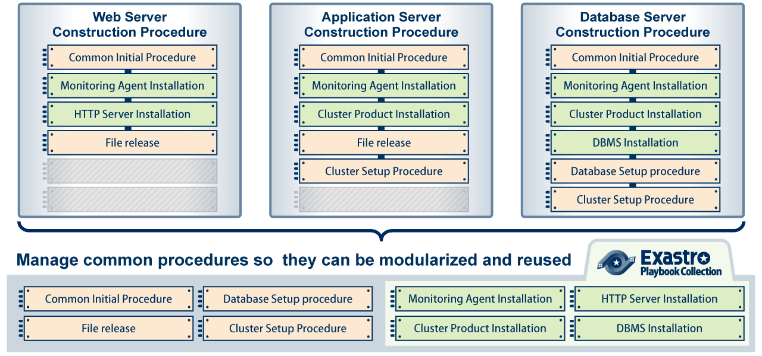
5.1 Ansible-Legacy mode
The real charm of using IT as base – Ansible Legacy Mode
The prime feature of Legacy is modulating IaC and reusing them.
By reusing registered IaC, it is possible to construct more efficient systems.

Slide 9
5.1 Ansible-Legacy mode (2/5)
The relation ship between the operation execution unit used in Exastro, "Movement" and Playbook are regulated on two levels.
Automatically created in Exastro ITA
Movement
A
Movement
B
Directly executed Playbook
- hosts: all
tasks:
- include: aaaa.yml
- include: bbbb.yml
- include: cccc.yml
- hosts: all
tasks:
- include: cccc.yml
- include: dddd.yml
- include: eeee.yml
1
2
3
1
2
3
aaaa.yml
bbbb.yml
cccc.yml
dddd.yml
eeee.yml
Playbook files

Slide 10
5.1 Ansible-Legacy mode (3/5)
When executing, the parameters given to variables can be managed in the parameter sheets in Exastro ITA.
Parameter sheet
Movement
A
hosts | OPERATON_ID | para1 | para2 | para3 | para4 | …
host_a | 888 | AAAA | 1 | 100 | 1
host_b | 111 | BBBB | 2 | 78 | 0
host_c | 888 | CCCC | 3 | 93 | 0
…
Directly executed Playbook
- hosts: all
tasks:
- include: aaaa.yml
- include: bbbb.yml
- include: cccc.yml
Links Parameter sheet and Variable and sets them to Playbook
Movement | Parameter | Variable
A | para1 | VAR_1
 | para2 | VAR_2
… | … | …
1
2
3
aaaa.yml
- name: “set aaaa”
debug: msg= “{{ VAR_4 }}”
- command: sleep {{ VAR_2 }}
bbbb.yml
- name: “set bbbb”
debug: msg= “{{ VAR_5 }}”
- command: sleep {{ VAR_3 }}
cccc.yml
- name: “set cccc”
debug: msg= “{{ VAR_1 }}”
- command: sleep {{ VAR_2 }}

Slide 11
5.1 Ansible-Legacy mode (4/5)
While it isn't necessary to be aware about this when using ITA, this is what happens in the background.
Work execution directory
├─in
│ ├─hosts
│ ├─playbook.yml
│ ├─child_playbooks
│ │ ├─aaaa.yml
│ │ ├─bbbb.yml
│ │ └─cccc.yml
│ ├─host_vars
│ │ ├─host_a
│ │ │ └─main.yml
│ │ ├─host_c
│ │ │ └─main.yml
│ │ ├─host_f
│ │ │ └─main.yml
│ │ ├─
│ │ │
│ │ ├─
│
├─out
│ ├─
Parameter sheet
hosts | OPERATON _ID | para1 | para2 | para3 | para4 | …
host_a | 888 | AAAA | 1 | 100 | 1
host_b | 111 | BBBB | 2 | 78 | 0
host_c | 888 | CCCC | 3 | 93 | 0
host_d | 222 | DDDD | 10 | 78 | 0
host_e | 333 | EEEE | 5 | 84 | 1
host_f | 888 | FFFF | 4 | 80 | 0
host_g | 111 | GGGG | 3 | 90 | 1
…
※For more information about Operation ID, Please check Learn:BASE.
・hosts | : | The operation target movement list. (OPERATION_ID=888)
・playbook.yml | : | Directly executed Playbook
・child_playbooks | : | Stores Playbook files
・host_vars | : | Stores all variables unique to every host defined by playbooks

Slide 12
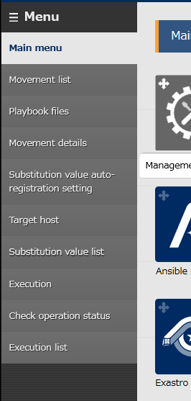
5.1 Ansible-Legacy mode (5/5)
Menu functions explanation
Movement list
Create Movements and check them in a list.
Playbook files
Register IaC and check them in a list.
Movement details
Manage the playbooks that are going to be included in Movement.
Substitution value auto-registration settings
Link the set value of the item of registered operations and every host. Also possible to manage movement variables.
Target host
Manage host and movements linked to Operation.
Substitution value list
Manage the substitute values for Playbooks and Variables (VAR_) used in Movements.
Execution
Execute created movements.
Check operation status Check detailed status of executed Movement.
Execution list
Check created and executed operations and the execution history list.

Slide 13
5. Features of each mode 5.2 Ansible-LegacyRole mode

Slide 14
5.2 Ansible-LegacyRole mode (1/4)
All the wisdom in the whole world – Ansible LegacyRole mode.
The prime feature of Ansible-Legacy is to register and use role packages.
You can use roles that you`ve created yourself or roles acquired from Ansible-Galaxy
Roles
Ansible-galaxy
ITA
CMDB
Ansible- LegacyRole
Roles

Slide 15
5.2 Ansible-LegacyRole mode (2/4)
Link the roles inside Role packages and Movements in ITA.
Movement
R
Role package file
Role.zip
Role0001 ・ ・ ・
Role0005
Directly executed Playbook
- hosts: all
roles:
- role: 0001
- role: 0004
- role: 0002
You can choose from multiple roles.
0001
0002
0003
0004
0005
1
3
2
tasks
main.yml
tasks
main.yml
tasks
main.yml
tasks
main.yml
tasks
main.yml

Slide 16
5.2 Ansible-LegacyRole mode (3/4)
While it isn't necessary to be aware about this when using ITA, this is what happens in the background.
Work execution directory
├─in
│ ├─hosts
│ ├─site.yml
│ ├─host_vars
│ │ ├─host_a
│ │ └─host_b
│ └─roles
│ ├─role①
│ │ ├─defaults
│ │ │ └main.yml
│ │ ├tasks
│ │ │ └main.yml
│ │ └template
│ │ └xxxx.yml
│ ├─role②
│ ・
│ ・
│ ・
├─out
│ ├─
The role packages compresses directories that has roles in it into a zip file.
The name of the execution role directory will be stay the same , Site.yml (Directly executed playbook)
※The directory to the left is an example.
・hosts |  |  | : | Operation target host list(created by ITA)
・site.yml |  |  | : | Directly executed Playbook (created by ITA)
・host_vars |  |  | : | Stores playbooks that defines host-unique variables.
・roles |  |  | : | Stores Roles that executes playbooks.
 | ⇒Under each role
 |  | ・defaults | : | Lists the parameters of the variant part of playbooks.
 |  | ・tasks | : | Execute playbook
 |  | ・template | : | The text file used for the playbook getting executed

Slide 17
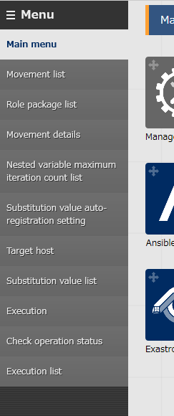
5.2 Ansible-Legacyrole mode (4/4)
Menu function explanation. (Here we will explain the similarities it has to Ansible-Legacy mode. )
Role package list
Manage already created role package files.
Nested variable maximum iteration count list
Manage the Maximum amount of cycles the of the arrays among the multistate variables defined inside role packages.

Slide 18
5. Features of each mode 5.3 Ansible-Pioneer mode

Slide 19
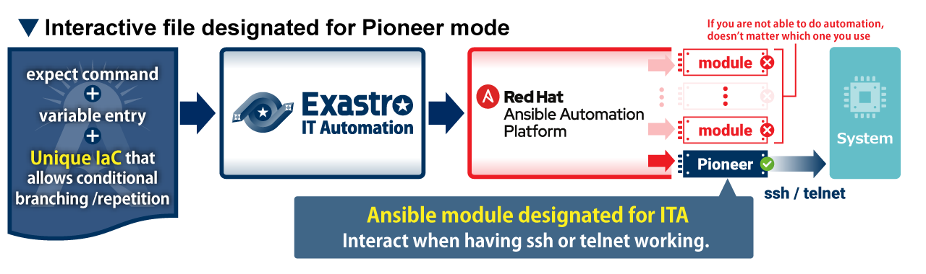
5.3 Ansible-Pioneer mode (1/5)
Ansible Pioneer mode – The final trump card that doesn’t stop Automation
If users can’t automate even by using all of the Ansible modules, the benefits of autimating will be cut down to half. Therefore, ITA offers Pioneer mode which acts as a trump card that doesn’t stop the automation.

Slide 20
5.3 Ansible-Pioneer mode (2/5)
Pioneer mode uses the Pioneer module ( ITA original module) from the directly executed Playbook to execute dialog files ※ in order. ※More about dialog files will be explained in the next slide.
Movement
P
The playbook is automatically created in Exastro ITA
- hosts: all
tasks:
- command: pioneer_module {{ Dialog file 1 }}
- command: pioneer_module {{ Dialog file 2 }}
- command: pioneer_module {{ Dialog file 3 }}
Directly executed Playbook
Dialog file 1
Dialog file 2
Dialog file 3

Slide 21
5.3 Ansible-Pioneer mode (3/5)
In Ansible-Pioneer, users can write Target settings in a dialog format. Additionally, by comparing and cycling simple expect commands and using conditional processing and such, users can create high-grade dialogs. ※For more information regarding Dialog files, please refer to this manual.
Dialog file "Template" example
Log into the target system and check the status of the service defined by the variables.
If the status is "disable", post-error processing will start. If the status is anything other than "disable", the "complete" will be output to the prompt.
※The red text in the dialog file represents the variables that refers to parameter sheets.
01
02
03
04
05
06
07
08
09
10
①
- expect: 'password:'
exec: “{{ Login password }}“
- command: 'systemctl status {{ item.0 }}'
prompt: '{{ Login user }}@'
with_items:
- ‘{{ Service name 1 }}‘
- ‘{{ Service name 2}}‘
failed_when:
- stdout match(disable)
- command: 'echo complete!'
Iterative processing by “with_items”
②
Branch processing by “Failed_when”

Slide 22
5.3 Ansible-Pioneer mode (4/5)
In Pioneer , it is possible to execute operations that doesnt get affected when there are different types of OS by setting"os type" and "Dialog type“.
OS Type - Set to Dialog dile and Target device. It will come handy when you`re choosing what dialog file is getting executed.
Dialog type - link dialog files with the same objective.
Dialog file A OS type：BigIP
- command: ‘create / ltm node {{VAR_host_ip}} up’
prompt: ‘(tmos)’
When applying settings
OS type：BigIP
Movement P
Dialog file B OS type：Cisco ACE
- expect: ‘{{ __loginhostname__ }}/Admin(config)’
exec: ‘rserver {{ VAR_group_name }}’
- command: ‘ip address {{ VAR_host_ip }} ’
prompt: ‘{{ __loginhostname__ }}/Admin(config-rserver-host)’
Registers Load Balance to the true server.
Dialog type A
OS type：Cisco ACE
Dialog file C OS type：A10
- command: ‘slb server {{ VAR_server_name}} {{VAR_host_ip}}’
prompt: ‘(config)#’
OS type：A10
When executing
Movement P
対話ファイルA
Registers Load Balance to the true server.
対話ファイルB
Dialog type A
対話ファイルC
Because the dialog files that are getting executed follows the OS of the target device, there is no need for the user to worry about it.

Slide 23
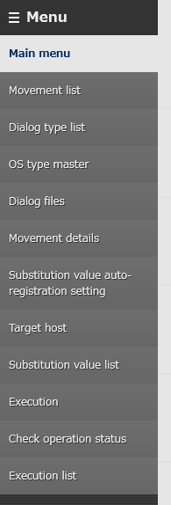
5.3 Ansible-Pioneer mode (5/5)
Menu function explanation (We will now explain the similarities it has to Ansible-Legacy mode)
OS type master
Maintain OS types (monitor/register/update/abolish)
Dialog type list
Maintain Dialog types (monitor/register/update/abolish)
Dialog files
Manage dialog files per host

