Slide 1


Export/Import
【Tutorial】
※In this document, “Exastro IT Automation” is described as “ITA".
Version1.0
Exastro developer

Slide 2
Table of contents
Introduction 1. About document
Export/Import function
Overview(overall)
Overview(menu)
Overview(symphony/operation)
Data that can be acquired by exporting
Menu overview
Work flow
Each menu description

Slide 3
2. Export/Import function

Slide 4
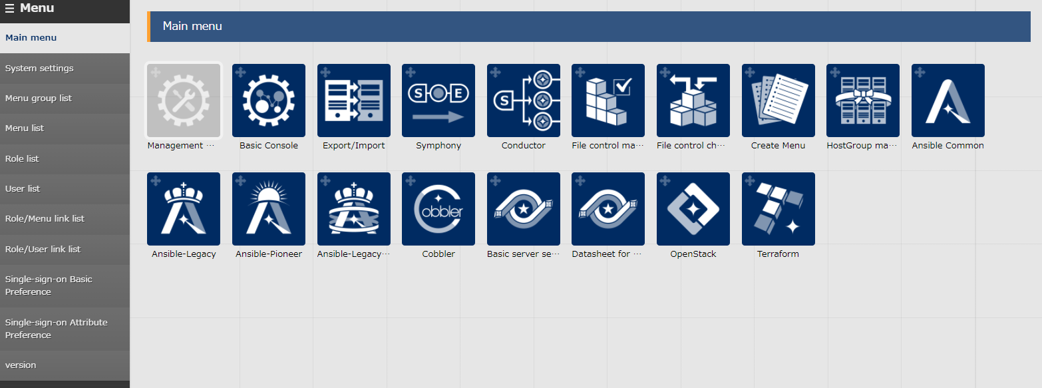
1.1 Ansible driverについて X/X
1.1 Introduction
About this document This document will explain the "Export/Import " Menu and its functions. Detailed specifications are described in the User Instruction Manual
Please refer to it as needed.

Slide 5
2. Export/Import function

Slide 6



2.1 Overview(overall)
Overview of Export/Import function
The following data can be migrated to another ITA server by using the "Export/Import" function.
Menu and Registered data
Created Symphony and Operation
Export
kym
ITA Server A
S
E
Transition data
(kym file)
Import
kym
ITA Server B
S
E
Transition data
(kym file)
Notes:
ｖ

Slide 7




2.2 Overview(menu)
Export/Import menu Register information can be migrated to the ITA server as menu units. During import, all existing same menus will be replaced. It is possible to export all menus that exist on the ITA server and select and export only the required menus.
Figure
I want to only move the required menus from the test environment to the main environment (ITA Server B)
kym
kym file
ITA Server A
ITA Server B

Slide 8
2.3 Overview(Symphony/Operation)
Export/Import Symphony/Operation Users are able to migrate selected Symphony or operation to another ITA servers. Information such as Movement linked to it will also be migrated.(For details refer to the next section) Compared to Export menu, only the records linked with the selected Symphony/Operation are acquired and added to the receiving menu.
Symphony export example
Export Symphony with ID 1 and 3.
S
Symphony list
１
S
S
1 | Sp1 | …
2 | Sp2 | …
3 | Sp3 | …
Import kym file.
kym
２
E
Replace and add the Symphony
With ID1 and ID3.
E
３
ITA Server A
E
S
S
S
S
1 | SpA | …
2 | SpB | …
S
1 | Sp1 | …
2 | SpB | …
3 | Sp3 | …
E
E
E
ITA Server B
E
ITA Server B
E

Slide 9
2.4 Data that can be acquired by exporting (1/3)
Data that can be acquired during Symphony export (Ansible-Driver) When exporting Symphony, you will acquire all the information needed by following the related menus. ・The required data is acquired by the Orchestrator. ・The change history of each record is also acquired. ・If a record with the same ID exists, it will be overwritten with the migrated data.
S
E
Ansible-legacy
Common
Playbook files
Movement list
Common
Ansible-Pioner
Movement detail
Dialog files
Template list
File list
Dialog type list
OS type master
Global variable list
Ansible-LegacyRole
Role package list
※In regards of the data shown in Orange color, Export data will also include uploaded files.
Maximum amount of Multi-stage variable repetition

Slide 10
2.4 Data that can be acquired by exporting (2/3)
Data that can be acquired during Symphony export(Terraform/OpenStack)
If the Orchestrator is Terraform or OpenStack, the data will be acquired as shown below.
OpenStack
Movement list
Terraform
Movement list
Movement details
Module files
Workspaces list
Organizations list
PolicySet-Workspace link list
PolicySet-Policy link list
Policies list
Policy Sets list

Slide 11
2.4 Data that can be acquired by exporting (3/3)
Data that can be acquired during Operation export
The data acquired when exporting the operations are shown below. Data related to the Substitution value list and Target host are acquired.
Common
Ansible-Driver
Input operation list
Target host
Device list
OS type master
Substitution value list
※Ansible-Pioneer only
Template list
File list
OpenStack
Substitution value list
Terraform
Substitution value list

Slide 12
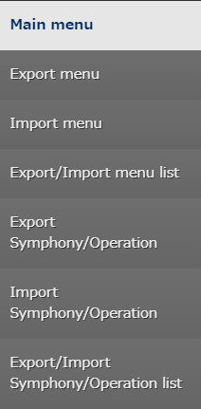
2.5 Menu overview
Menu overview Here is an overview of the Export/Import menus and their functions.
Select and export Menus
Import files exported in "Export menu".
Check the Export/Import status and download it`s data.
Select and export Symphony and Operations.
Import the files exported in Export Symphony/Operation.
Check the Export/Import status and download it`s data.

Slide 13
2.6 Work flow
Work flow
The work flow of export/import are as follows. In the practice document, we handle each work in more detail, so please check it.
1. Export
Export menu
Export Symphony/Operation
2. Download kym file
Export/Import list
Export/Import
Symphony/Operation list
3. Import
Import menu
Import Symphony/Operation
4. Check Import
Export/Import list
Export/Import
Symphony/Operation list

Slide 14
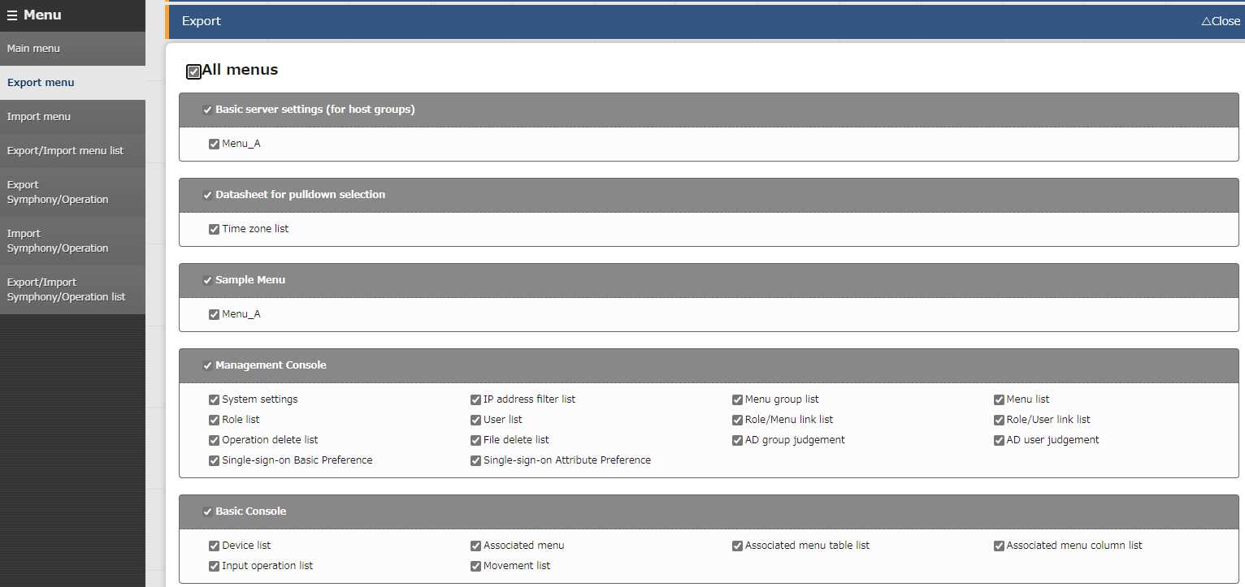
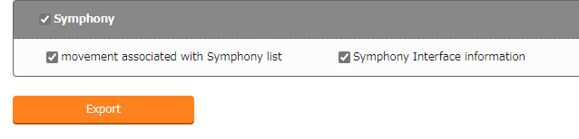
2.7 Description of each menu (1/6)
Export menu
All the menus are displayed in a list. Users can select the required menus and export them.
Select the menus to be
exported with the check box.
Click “Export” to execute.

Slide 15
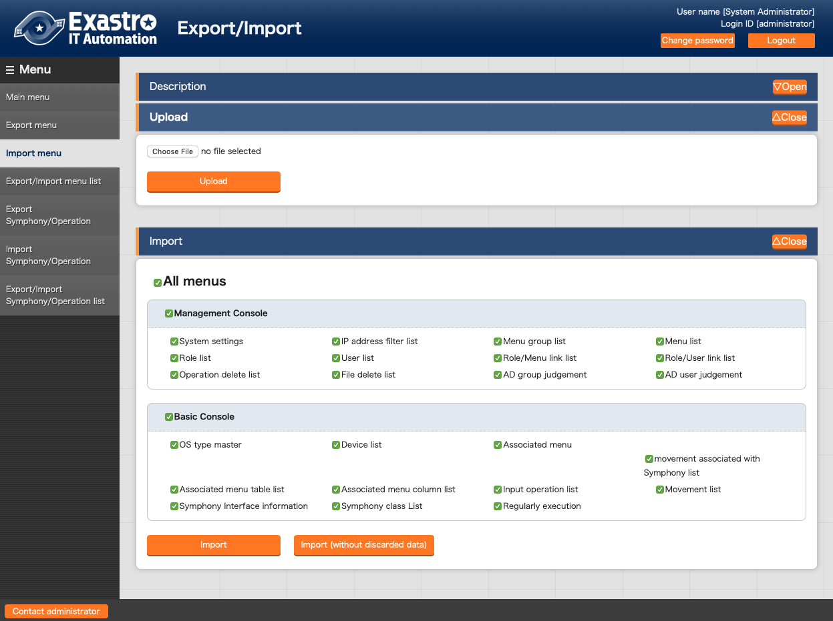
2.7 Description of each menu (2/6)
Import menu
Upload the exported data in the "Export menu " and import the required menus.
Users can upload kym files.
Select the menu you want to import with the check box.
Click here to execute the Import.
Users can import excluded obsolete data.

Slide 16
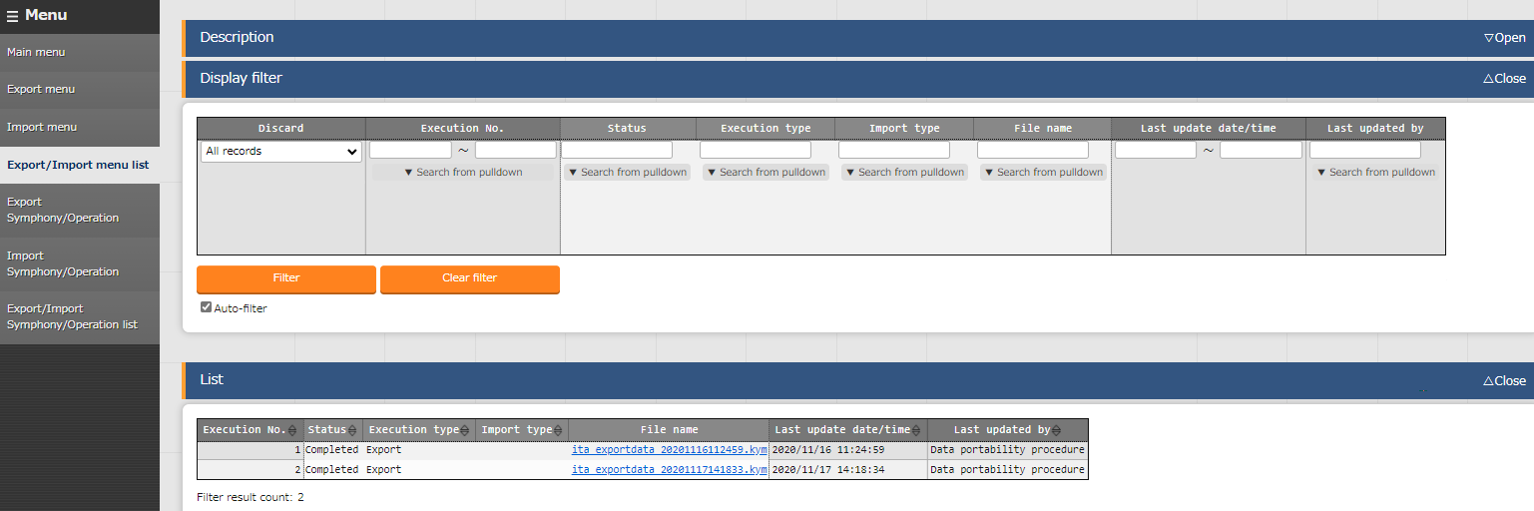
2.7 Description of each menu (3/6)
Export/Import menu list
Check the information that can be executed Export/Import. User can check the progress status of each operation and download moved data.
Check the status here.
The transition is in the order of "Not Executed“ , "Executing" and "End".
Users can check and download the
exported/imported files.

Slide 17
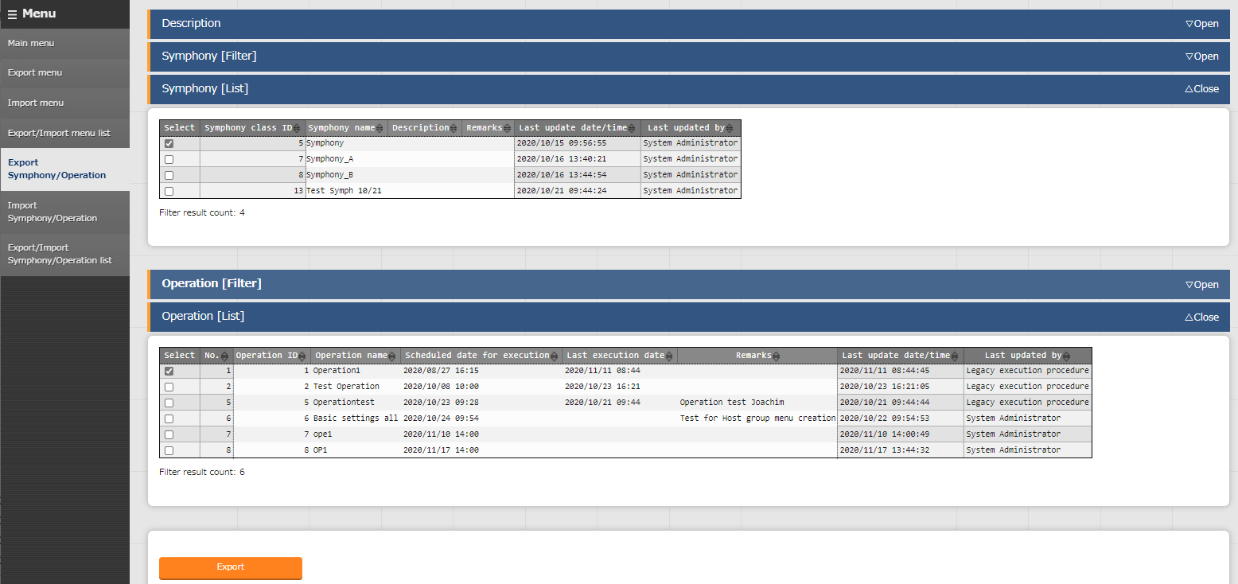
2.7 Description of each menu (4/6)
Export Symphony/Operation
All Symphonies and Operations are displayed in a list. Users can select the required items and export them.
Select the export target
with the check box.
Click to execute the Export.

Slide 18
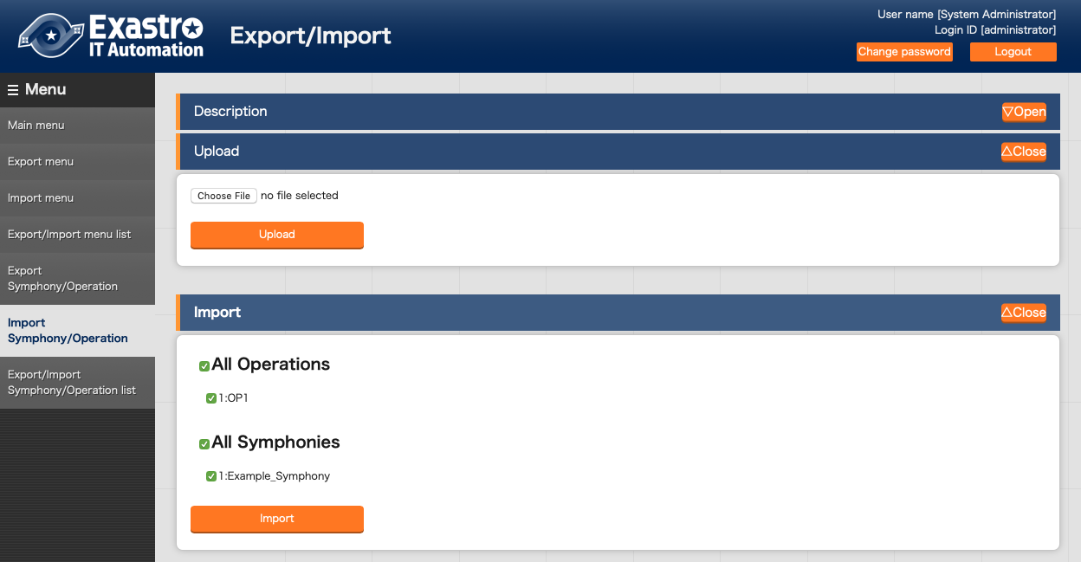
2.7 Description of each menu (5/6)
Import Symphony/Operation
Users can upload the data exported in “Export Symphony/Operation” and import the required menus.
Users can upload kym files.
Select the menu you
want to import with the check box.
Click to execute the Import.

Slide 19
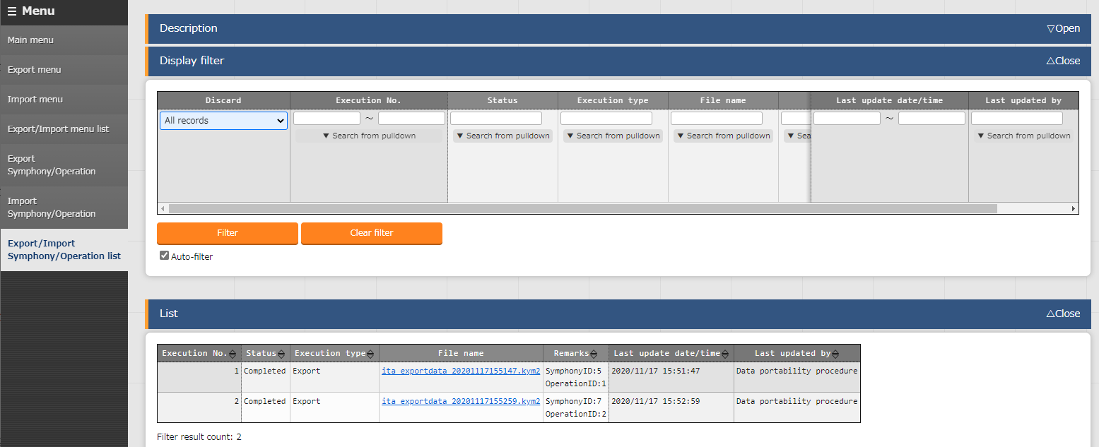
2.7 Description of each menu (6/6)
Export/Import Symphony/Operation list
Check the information that can be executed Export/Import. User can check the progress status of operation and download moved data.
Check the status.
The transition is in the order of "Not Executed", "Executing" and "End".
Users can check and download the
exported/imported files.

