Slide 1


Export/Import 【Practice】
※”Exastro IT Automation” will be shortened to ITA in this document.
Version 1.0
Exastro developer

Slide 2
Table of contents
Introduction
About this document
Work Environment
Practice 1. Menu export
Work procedure
Data registration
Input/Create Menu
Export
Import
Practice 2. Symphony/Operation export
Work procedure
Data registration
Export
Import

Slide 3
1. Introduction

Slide 4
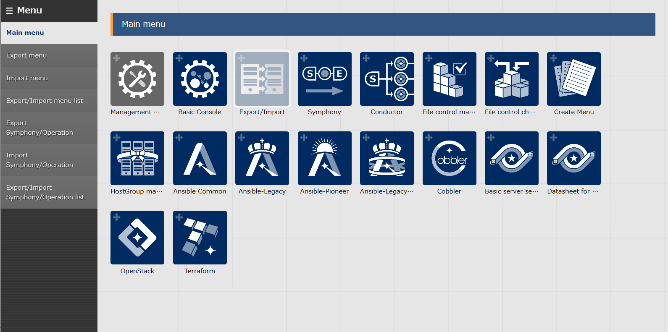
1.1 Ansible driverについて X/X
1.1 About this document
About this document
In this document, you will learn about the “Export/Import” menu by trying it hands on.
Practice 1 will operate in the Export menu
Practice 2 will operate in the Symphony/Operation export menu.

Slide 5

1.2 Work environment
Work environment The work environments used in this documents are shown below Please prepare two ITA servers. One for sending and one for receiving. 2 ITA servers ・CentOS 7 (※1) ・ITA 1.5.0 ・Ansible 2.9.12
CentOS 7
CentOS 7
ITA
1.5.0
kym
ITA
1.5.0
Ansible
2.9.12
Ansible
2.9.12
ITA Server(Sender)
ITA Server(Receiver)
※1 This time, we will use CentOS7 though the host server, but ITA can be installed into any RHEL7 and RHEL8 type OS.

Slide 6
2. Practice ①. Menu export

Slide 7
2.1 Work procedure
Work procedure
This scenario will follow the procedure shown below.
1. Device information
① Data registration
2. Operation
3. Menu creation / Input group creation
② Menu creation/Input
4. Menu creation
5. Input created menus
6. Execute export
③ Export
7. Download Kym file.
8. Execute import
④ Import
9. Check import results

Slide 8
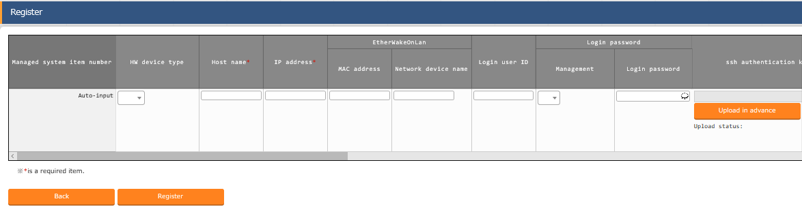
2.2 Data registration (1/2)
Device registration Menu: Basic console> Device list
Click ”Start Registration” under the “Register” sub-menu
Select or input the following information for each item and click “Register”
Data registration
Device Info
Operation
Create/Input menu
Export
Import
2
Item | Input content
HW device type | SV
Host name | (Enter arbitrary value)
IP address | Target device`s IP Address
Login user ID | (Enter arbitrary value)
Management | ●
Login password | (Enter arbitrary value)
Authentication method | ssh

Slide 9
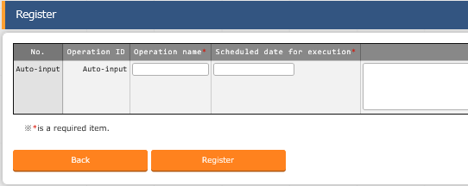
2.2 Data registration (2/2)
Register a new operation Menu: Basic Console> Input operation list
Click “Start Registration” under the “Register” sub-menu.
Input the following information for each item and click “Register”
Data registration
Device info
Operation
Create/Input menu
Export
Import
2
Operation name | Scheduled date for execution
OP1 | (Enter arbitrary value)

Slide 10
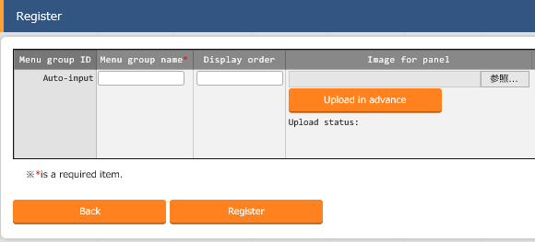
2.3 Input/Create Menu(1/4)
Menu group creation
Menu: Management Console> Menu group list.
Click the “Start Registration” button under the “Register” sub-menu
Input the following information for each item and click “Register”
Data registration
Input/Create Menu
Menu group
Menu
Created Menu
Export
Import
2
Menu group name | Display Order
Basic Server Settings | 125
Basic Server Settings (For referencing) | 130

Slide 11
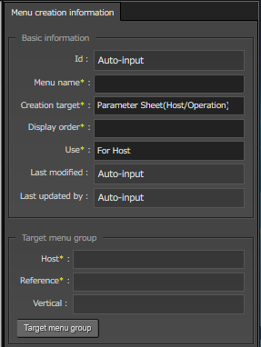
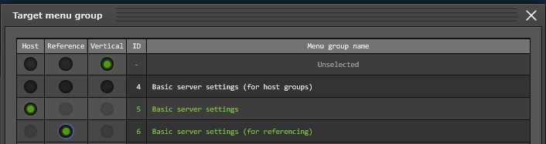
2.3 Input/Create Menu(2/4)
Create Parameter sheets
Menu: Create menu> Create/Define menu
Input the following for “Menu creation information”
Click “Target menu group” and select the target menu group.
Data registration
Input/Create Menu
Menu group
Menu
Created Menus
Export
Import
１
Item | Input content
Menu name | Directory settings
Creation target | Parameter Sheet(Host/Operation)
Display order | 1
Use | For Host
2

Slide 12
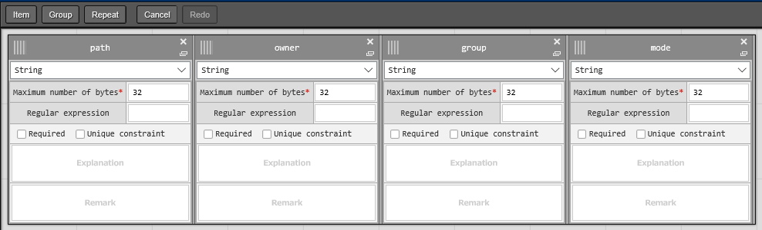
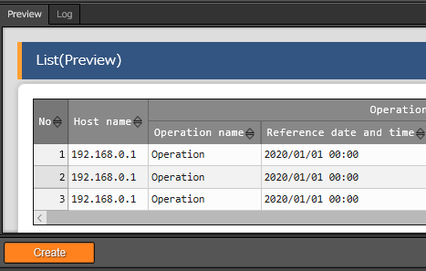
2.3 Input/Create Menu (3/4)
Define Parameter Item names.
Menu: Create Menu> Create/Define menu.
Press “Item” and add new items.
Select or input the following for each item and click “Register”
Click “Create” on the bottom of the screen.
Data registration
Input/Create Menu
Menu group
Menu
Created Menus
Export
Import
１
2
Item name | Input method | Maximum number of bytes
path | String | 32
owner | String | 32
group | String | 32
mode | String | 32
３

Slide 13
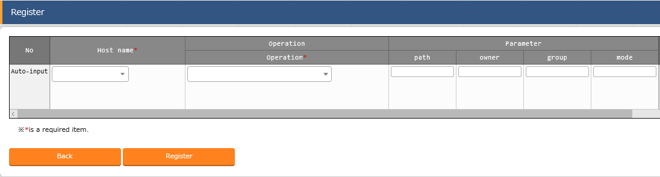
2.3 Input/Create Menu (4/4)
Register data to Parameter sheet.
Menu: Basic Server Settings> Directory Settings
Click “Start Registration” under the “Register” sub-menu.
Select or input the following for each item and click “Register”
Update the data created in ② to match the data below.
Data registration
Input/Create Menu
Menu group
Menu
Created Menu groups
Export
Import
2
Host name | Operation | path | owner | group | mode
Arbitrary | OP1 | /tmp/work1 | root | root | 0644
3
Host name | Operation | path | owner | group | mode
Arbitrary | OP1 | /tmp/work2 | root | root | 0644

Slide 14
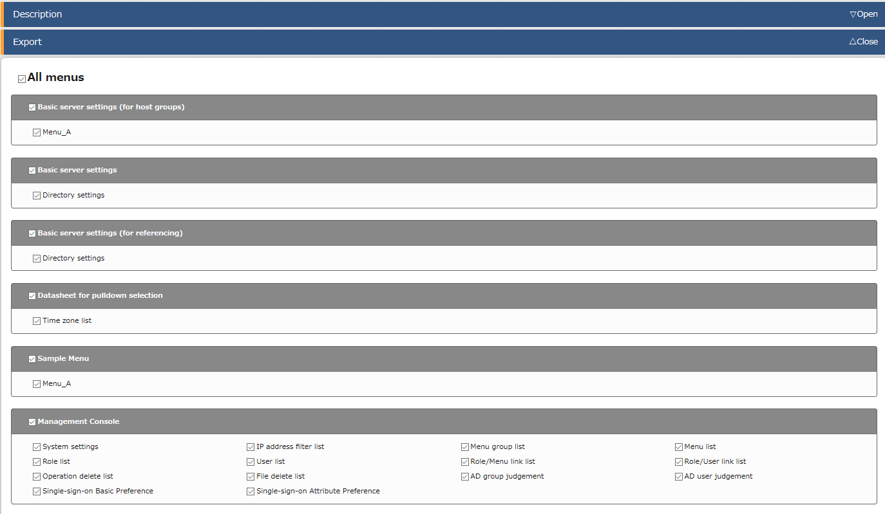
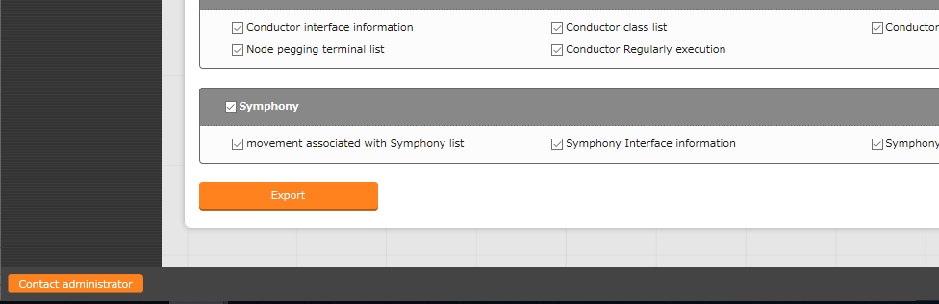
2.4 Export(1/2)
Export Execution
Choose and export the registered information
Menu: Export/Import> Export menu
Data registration
Input/Create Menu
Export
Start Export
Download kym file
Import
1
Tick the “All Menus” checkbox
２
Click the ”Export” button.

Slide 15
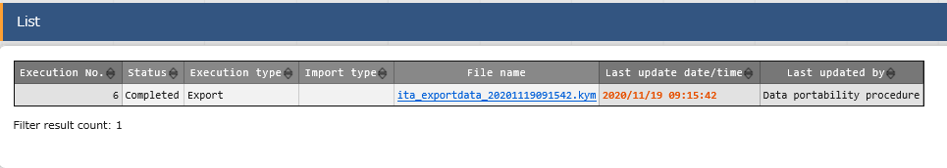
2.4 Export(2/2)
Download Kym File
Let download the exported data.
Menu: Export/Import> Export/Import menu list
Click “List”
Click the “Filter” button.
Download Kym file from the export status list.
Data registration
Input/Create Menu
Export
Start Export
Download kym file
Import
3

Slide 16
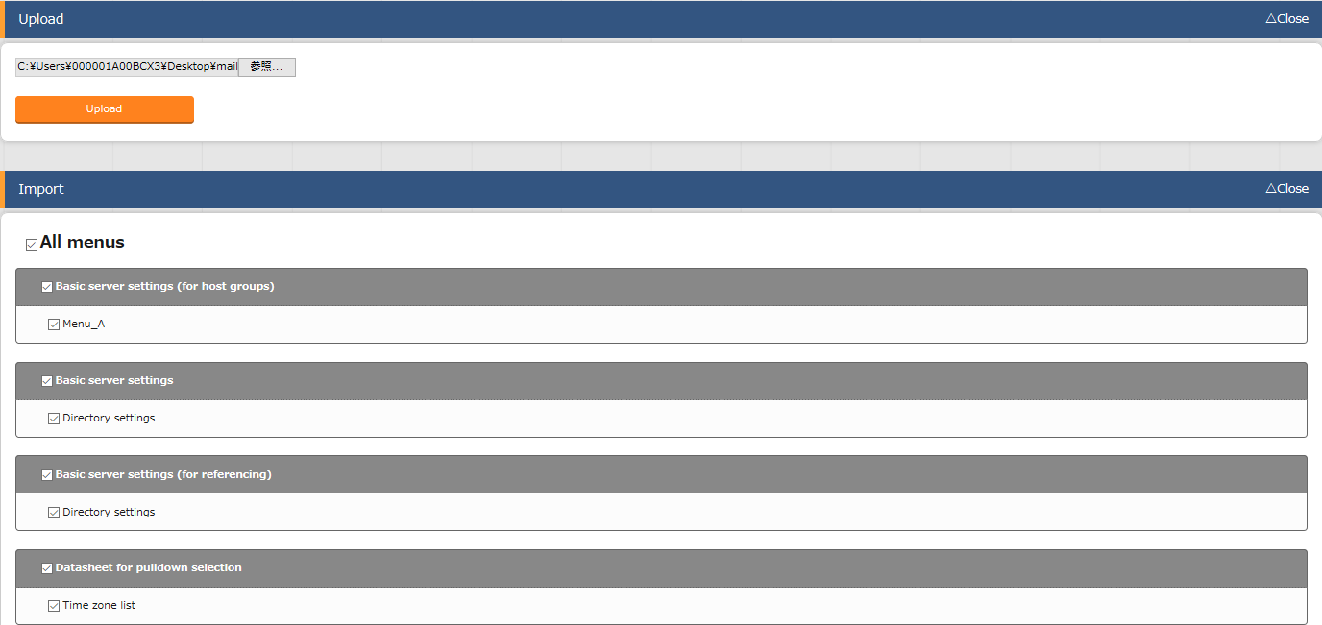

2.5 Import(1/3)
Execute Import
From here, we will use the receiving server to operate. Upload the Kym file and import it.
Menu: Export/Import> Import Menu
Data registration
Input/Create Menu
Export
Import
Start Import
Download kym file
1
Upload Kym File
２
Tick the “All Menus” Checkbox.
Tips
３
Users can exclude discarded data and import the rest of the data.
Click the “Import” button.

Slide 17
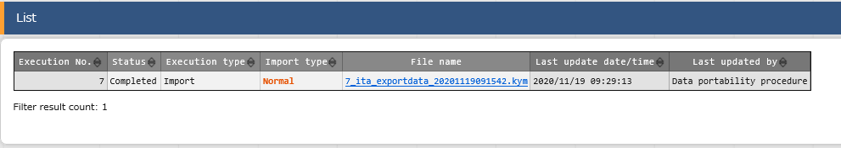
2.5 Import(2/3)
Check Import status
Let`s check the imported information and see if the status is “Completed”
Menu: Export/Import> Export/Import menu list
Click “List”
Click the “Filter” button.
Check if the status of the executed import is “Completed”
Data registration
Input/Create Menu
Export
Import
Start Import
Check Import

Slide 18
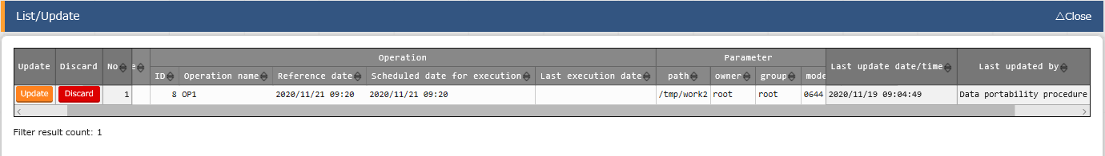
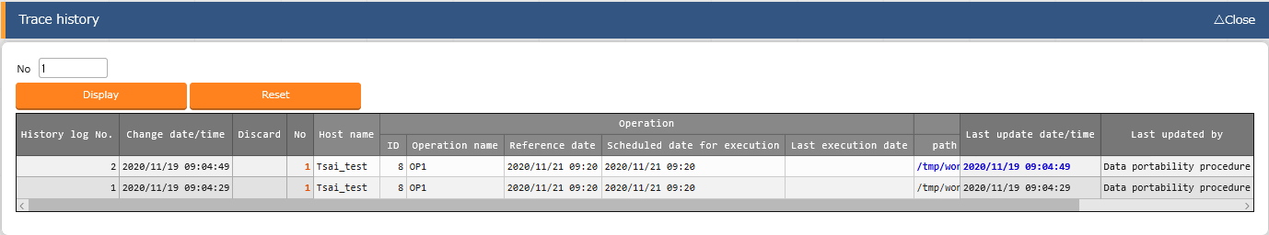
2.5 Import(3/3)
Check Import results
Lets check the imported menus. All change history for each record should also be moved. Let`s put them together and check them.
Menu: Server Basic Settings> Directory settings.
Click “Filter”
Check if the Menu information has been migrated by “Data Portability Procedure”
Data registration
Input/Create Menu
Export
Import
Start Import
Check Import
Click “Trace History” and input the numbers for the records you registered.
Click “Display” and check if the change history information has been migrated or not.
３

Slide 19
3. Practice ② Symphony/Operation Export

Slide 20
Before doing anything.
Playbook creation We prepared some playbook samples that can be migrated Save the playbook below as an YML File.
(Attention) Create the YML file with character code “UTF-8” and newline code ”LF”.
- name: Copy Test File to Locale
copy:
src: "{{ CPF_test_text }}“ dest: “{{ VAR_directory }}”
owner: root
group: root
mode: 0644
Filename: copy_file.yml

Slide 21
3.1 Work Procedure
Work procedure
This scenario will follow the flow shown below.
1. Device information
2. Operation
3. Movement
① Register the data going to be moved Most of the operation will be done in Ansible-Legacy. The following operation will be done from the Sender server
※You can skip this step if you`ve already registered all the files.
4. Playbook
5. Content files
6. Movement details
7. Target host
8. Substitute value list
9. Symphony
10. Execute export
② Export
11. Download kym file
12. Execute Import
③ Import
13. Check import results

Slide 22
3.2 Data registration (1/9)
Device registration Menu: Basic console> Device list
Click “Start Registering” under the “Register” sub-menu.
Select or input the following information for each item and click enter ※This part can be skipped if you already registered a device in Practice ①
Data Registration
Device info
Operation
Movement
Playbook
Content File
Movement details
Target host
Substitute Value list
Symphony
Export
2
Import
Item | Input content
HW Device type | SV
Host name | (Enter arbitrary value)
IP Address | Target Device IP Address
Login User ID | (Enter arbitrary value)
Management | ●
Login password | (Enter arbitrary value)
Authentication method | ssh

Slide 23
3.2 Data Registration (2/9)
Register a new Operation Menu: Basic console> Input operation list
Click “Start Registering " under the “Register” sub-menu
Input the following information for each item and click “Register” ※You can skip this step if you registered an operation in Practice ①
Data registration
Device info
Operation
Movement
Playbook
Content File
Movement details
Target host
Substitute Value list
Symphony
Export
2
Import
Operation Name | Scheduled execution data
OP1 | (Enter arbitrary value)

Slide 24
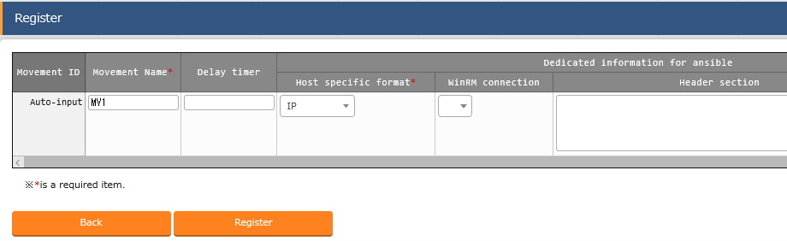
3.2 Data Registration (3/9)
Create a Movement Menu: Ansible Legacy> Movement list
Click “Start Registration” under the “Register” sub-menu.
Select or input the following information for each item and click “Register”
Data registration
Device info
Operation
Movement
Playbook
Content File
Movement details
Target host
Substitute Value list
Symphony
Export
2
Import
Movement name | Host specific format
MV1 | IP

Slide 25
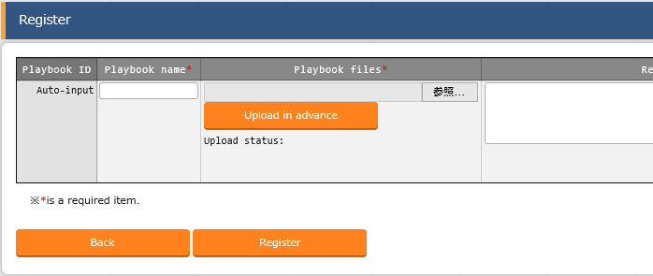
3.2 Data registration (4/9)
Register Playbook
Menu: Ansible-legacy> Playbook files
Click “Start Registration” under the “Register” sub-menu.
Click the Browse button and select desired Playbook
Select or Input the following data below for the different items and click “Register”
Data registration
Device info
Operation
Movement
Playbook
Content File
Movement details
Target host
Substitute Value list
Symphony
Export
３
Import
Playbook name | Playbook files
copy_file | copy_file.yml

Slide 26
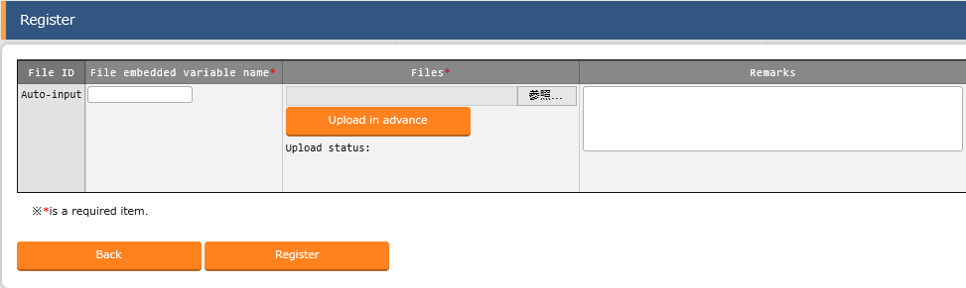
3.2 Data registration (5/9)
Register content files. Let`s register content files. The contents be whatever.
Menu: Ansible-Common> File list
Click “Start Registration” under the “Register” sub-menu.
Browse and find the test file and then click “ Upload in advance”.
Enter the following for each item and click “Register”
Data registration
Device info
Operation
Movement
Playbook
Content File
Movement details
Target host
Substitute Value list
Symphony
Export
３
Import
File embedded variable name | Files
CPF_test_text | test_text.txt

Slide 27
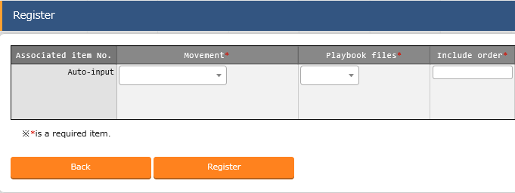
3.2 Data registration (6/9)
Register Playbook to Movement Menu:Ansible Legacy>Movement details
Click “Start Registration” under the “Register” sub-menu.
Select or enter the following for each item and click “Register”.
Data registration
Device info
Operation
Movement
Playbook
Content File
Movement details
Target host
Substitute Value list
Symphony
Export
Import
2
Movement | Playbook files | Include order
MV1 | copy_file | 1

Slide 28
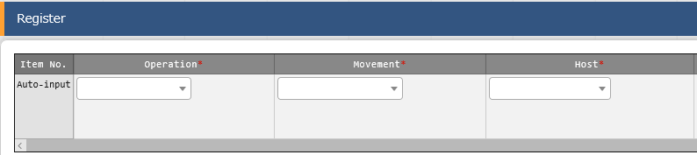
3.2 Data registration (7/9)
Register target host Menu: Ansible Legacy> Target host.
Click “Start Registration” under the “Register” sub-menu.
Select or enter the following for each item and click “Register”
Data registration
Device info
Operation
Movement
Playbook
Content File
Movement details
Target host
Substitute Value list
Symphony
Export
Import
2
Operation | Movement | Host
OP1 | MV1 | (Arbitrary Host)

Slide 29
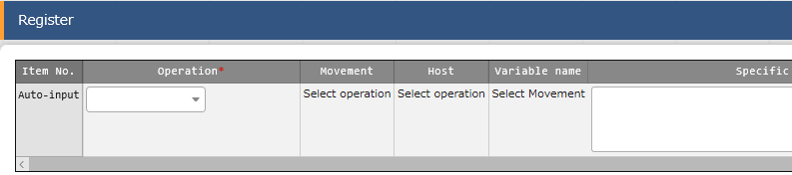
3.2 Data registration (8/9)
Manage substitute values.
Menu: Ansible Legacy> Substitution value list.
Press “Start Registration” under the “Register” sub-menu.
Select or enter the following for each item and click “Register”
Data registration
Device info
Operation
Movement
Playbook
Content File
Movement details
Target host
Substitute Value list
Symphony
2
Export
Operation | Movement | Host | Variable name | Specific value
OP1 | MV1 | 任意 | VAR_directory | /tmp/work1
Import
Tips
We now directly changed the “Target Host” and “Substitution value list”, but records created from the substitution value auto-registration setting menu can also be moved.

Slide 30
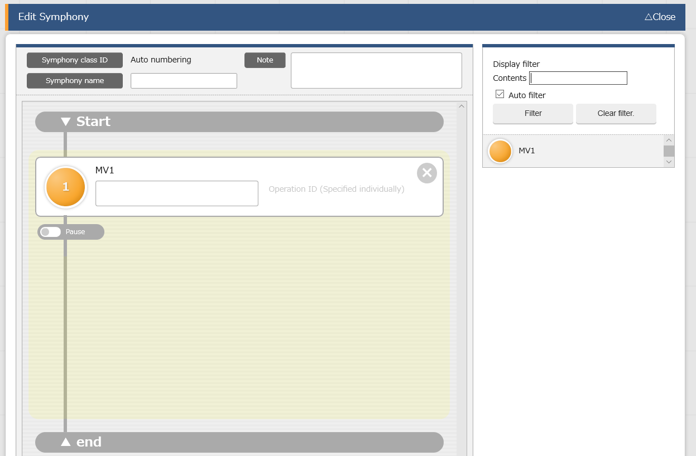
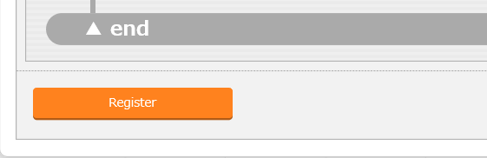
3.2 Data registration (9/9)
Register Symphony
Menu: Symphony>Symphony class edit.
Data registration
Device info
Operation
1
Enter symphony name.
Movement
Item | Value
Symphony class name | SP1
Playbook
Content File
Movement details
Target host
Substitute Value list
Symphony
２
Export
Add “MV1” By dragging and dropping it into the yellow area
Import
3
Click “Register”.

Slide 31
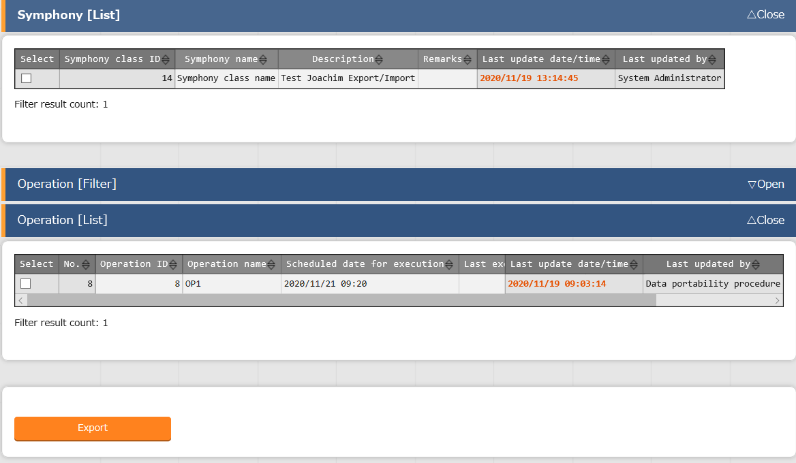
3.3 Export(1/2)
Execute Export
Select and export the registered information.
Menu: Export/Import> Export Symphony/Operation
Data registration
Export
Start Export
Download kym2 file
Import
1
1
Select the Symphony and Operation we created earlier.
２
Click “Export”

Slide 32
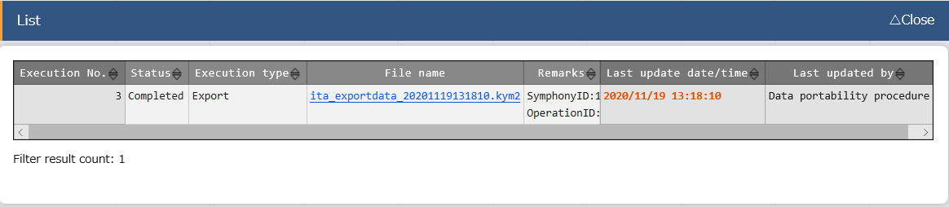
3.3 Export(2/2)
Download kym2 file
Let`s download the exported data.
Menu: Export/Import> Export/Import Symphony/Operation list
Press the “List” sub-menu.
Click the “Filter” button.
Download Kym2 file from the Export status list.
Data registration
Export
Start Export
Download kym2 file
Import

Slide 33
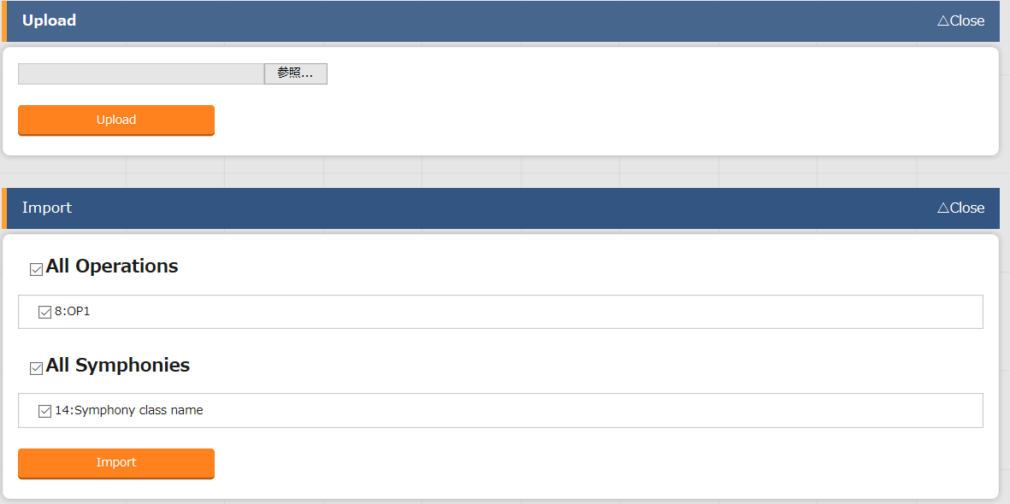
3.4 Import(1/3)
Execute Import
We will use the receiving server from this point on Let`s upload the kym2 file and import it.
Menu: Export/Import> Import Symphony/Operation
Data registration
Export
Import
Start Import
Check Import
1
Upload Kym2 File
２
Select the Symphony and Operation we created earlier.
３
Click “Import.

Slide 34
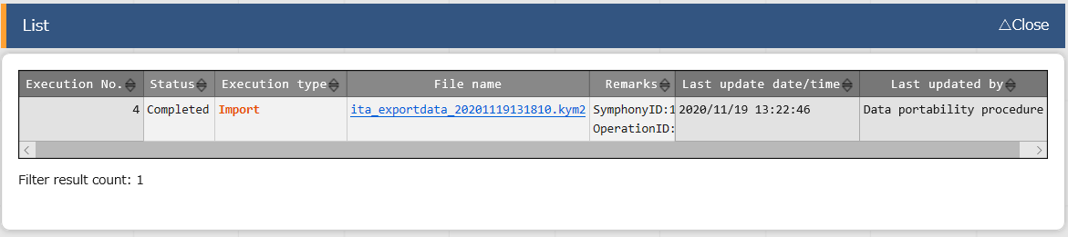
3.4 Import(2/3)
Check Import Status
Let`s check the imported information and see if the status is “Completed”
Menu: Export/Import> Export/Import Symphony/Operation list
Press the “List” sub-menu
Click the “Filter” button.
Check if the status of the executed import is “Completed”
Data registration
Export
Import
Start Import
Check Import

Slide 35
3.4 Import(3/3)
Check Import results
Let`s move the menus we registered and check the imported data.
Data registration
Export
Symphony class list
Import
Start Import
Movement list
Check Import
File list
Input operation list
Target host
Other menus where items were imported:
Device list
Playbook files
Movement details
Substitute value list
Tips
The change history of each record will also be imported.

