Slide 1
PSSO Method Guidebook ~Optimizing Exastro System Construction/Operation~

Slide 2
Table of contents
Introduction
Overview Image.
Automation Preparation
Step 1：Central management of the Configuration info.
Step 2：Actualize Automatic Execution.
Step 3：Linking Central management and automatic execution.
Implementing automated SI
Effects and Estimations
Post-Automation Process changes and results.
Summary

Slide 3
Introduction

Slide 4
About this document
IT Engineers who are currently working in the field are struggling with inefficient system operation and construction. While the obvious solution is to make it more efficient, there are many who are wondering how to do it.
This document uses an on premise environment to show what obstacles to get rid off and what kind of preparation one must do in 3 simple steps (AKA PSSO Method).
Step 1：Central management of the Configuration info
Step 2：Actualize Automatic Execution
Step 3：Linking Central management and automatic execution.
In order to estimate the automation/efficiency rate, the process changes and results will be divided into phases.

Slide 5
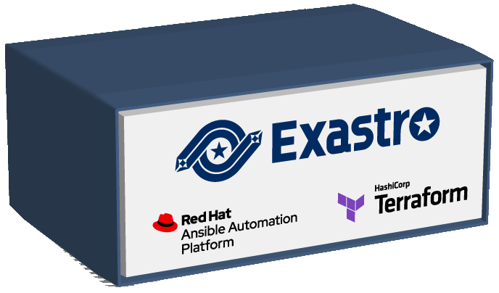
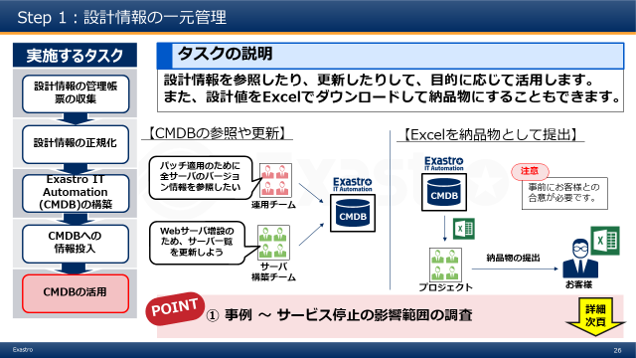
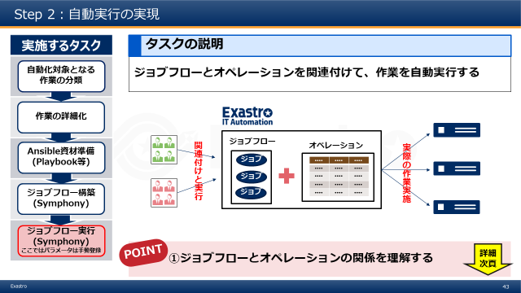
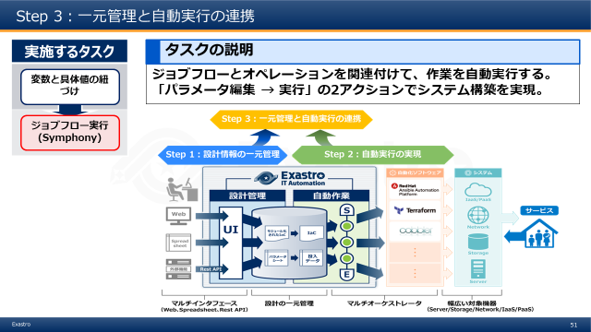
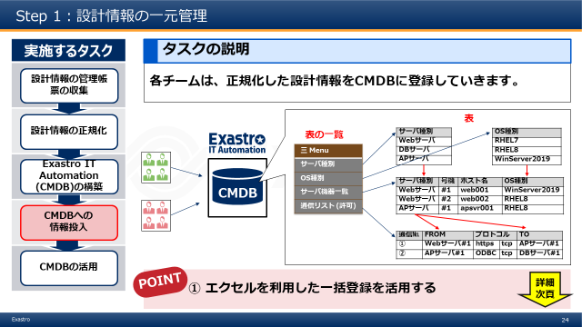
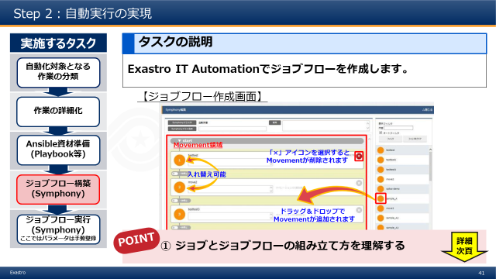
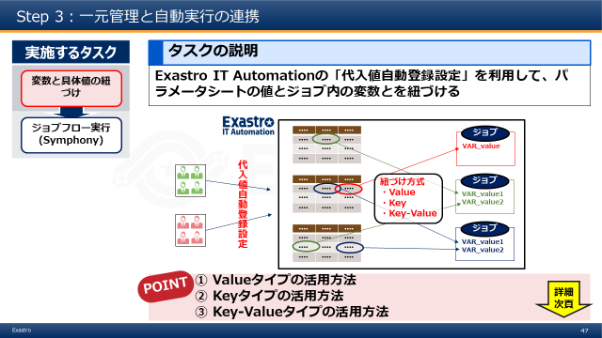
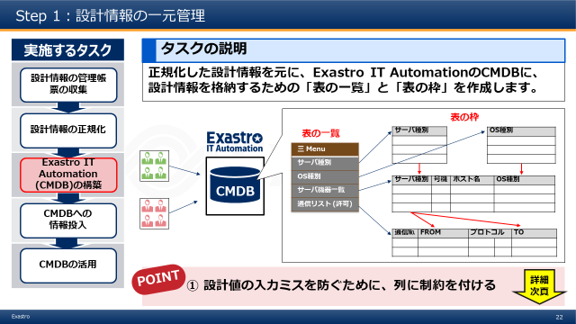
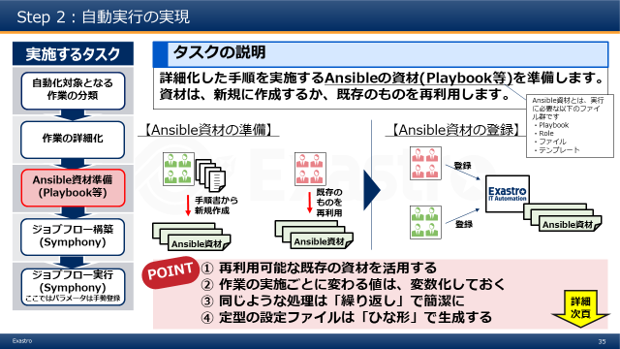
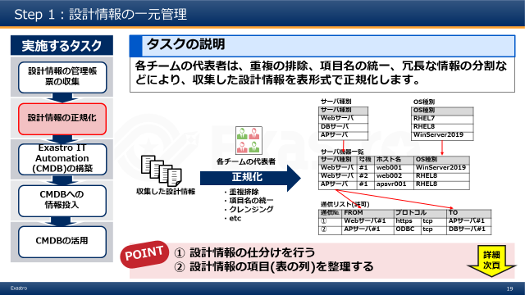
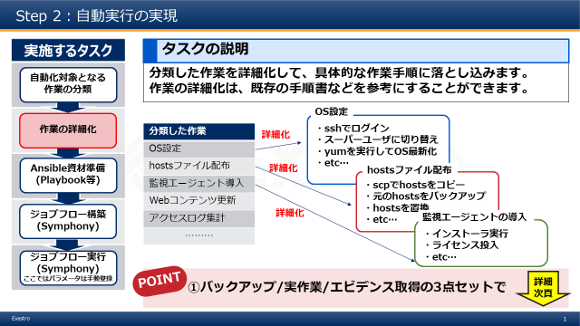
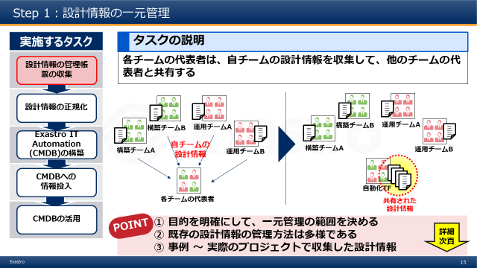
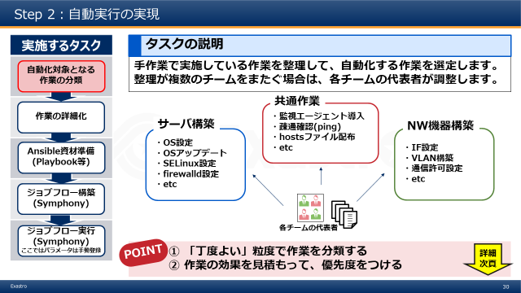
What is the PSSO Method?
The PSSO (Procedures for streamlining system operation) method is a process of changing conventional “Manual system construction/operation” to “Automated system construction/operation” and solves problems often found during the Design, Preparation and Execution phases.
Conventional system operation process
(Manually・Inefficient)
Optimized operation process
（Automatic・Efficient）
Inventory
“PSSO” Method
Requirement definitions
(Setting goals)
[Step1]
Centrally managing setting information
[Step2]
Preparing Automatic execution
[Step3]
Linking Central management and automatic execution
Operate・Maintain
※Paid services in Operation and Maintenance support
5 tasks
5 tasks
2 tasks

Slide 6
Roles used in this document.
For the sake of convenience, we will explain the roles used in this document below.
Development/Construction team
In this document, the team responsible for system construction will be called “Construction team”. Normally in a real project, this would also include someone responsible for business/affairs and infrastructure.
Operation team
The team responsible for operating running systems is called “Operation team”.
Team leader
Representatives from each team who shares information and coordinates the team.

Slide 7
Overview image

Slide 8
AS-IS and TO BE in Automation.
By following step 1-3, we can automate system operation/construction.
Additionally, by changing the process, we can improve the efficiency of the automation.
TO-BE
Automated system construction/operation
Preparing for Automation (Step 1,Step 2,Step 3)
Implementing Automated SI (Changes to the process and results )
AS-IS
Manual system construction/operation

Slide 9




The “pain” of IT Engineers
The “pain” of IT Engineers that works with Constructing/Operating systems
Design
Delays and errors occurs when communicating between teams.
Double managing data and proprietary wording leads to errors in the design
Multiple development leads to complications with managing design documents (forms)
As a result, we don’t know what information is the newest.
Preparation
Work orders between teams are complex. Each time a time chart is created, it gets discarded.
Every operation’s Manual is discarded after its created/reviewed.
Configurations are embedded in each procedure, and the number of patterns increases each time a new model/OS is added (barrier to multi-vendor support)
Execution
Since the operations are done manually, the production time is inconsistent. ⇒People often have to wait before they can continue.
Since most of the operations are done manually, human error is inevitable.

Slide 10
The “Pain” of IT Engineers
The “pain” of IT Engineers that works with Constructing/Operating systems
Said problems can be solved in 3 Steps
POINT
Step 1 is the most important step in the PSSO Method
Design
Delays and errors occurs when communicating between teams.
Double managing data and proprietary wording leads to errors in the design
Multiple development leads to complications with managing design documents (forms)
As a result, we are unable to check before and after the settings.
Design
Step 1
Centrally Manage conf info
Solution
Conf info
CMDB
Conf info
Step 3
Linking Central management
and automatic execution
Conf info
Preparation
Link
Preparation
Work orders between teams are complex. Each time a time chart is created, it gets discarded.
Every operation’s Manual is discarded after its created/reviewed.
Configurations are embedded in each procedure, and the number of patterns increases each time a new model/os is added (barrier to multi-vendor support)
Conf info
Job
Execute
Step 2
Automate
CMDB
Conf info
Conf info
Job
Solution
Job
Execution
Job
Execute
Execution
Since the operations are done manually, the production time is inconsistent. ⇒People often have to wait before they can continue.
Since most of the operations are done manually, human error is inevitable.
Job
Job

Slide 11



Relationship between the Automatization scope and the different steps
Step２ only ⇒ “Narrow Automatization”
Step１～Step３⇒ “Broad Automatization”
Workflow (Link organizations)
IaC management/ Parameter management (CMDB)
Conductor (Job Flow)
IaC execution
System (Device sets)
Per Project
(Development/ Construction)
ServiceNOW
(Operation)
Org.A
Org.B
Run Job
Org.A
Org.B
Run Job
Terraform Template parts
Playbook
parts
Broad Automatization
Automation 2.0
Structure Management (CMDB)
System parameters
Start
Movement
Movement
End
(Uses Terraform parts)
(Runs Playbook parts in order)
Terraform Link function
Ansible Link function
Organization
CFn/ARM/…
RedHat
Ansible Tower
ITA
Ansible Agent
Narrow Automatization
Automation 1.0
Scripted
Language selection
Workspace α
or
State File
Terraform Binary
RedHat Ansible Engine
SaaS
PaaS
IaaS
Application
Middleware
OS
Physical device

Slide 12
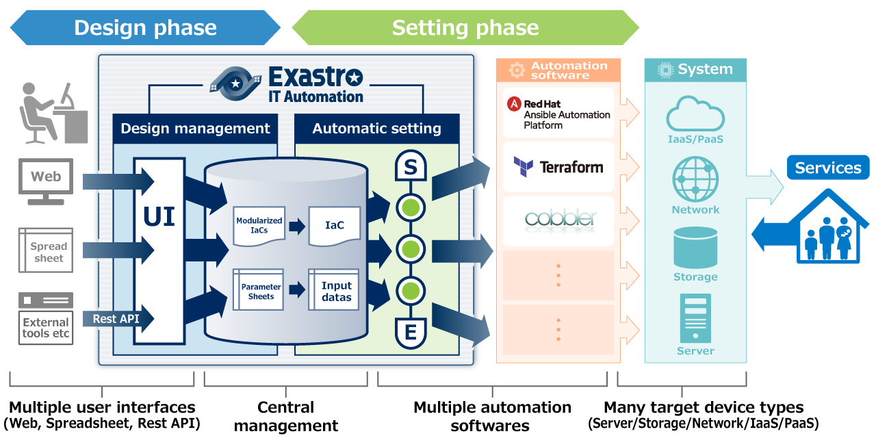
Overview over Exastro IT Automation
Exastro IT Automation supports the 3 step solution
Step 3：Linking Central management
and automatic execution
Step 1：Centrally manage conf info
Step 2：Automate

Slide 13
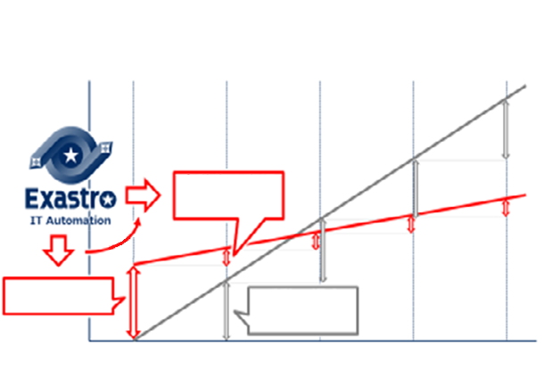
Automation changes QCD and Tasks/results.
QCD (Quality・Cost・Delivery) | Tasks and Results
Manual labor→ QCD Reform from Automation.
Tasks and Result changes can be divided in these 4 groups → 1.No changes 2.With changes 3.New 4,Deleted
Task
Task
Task
Before Automation
Result
Result
Result
Automated (one operation)
①No changes
③New
Task
Task
Task
Task
After Automation
Result
Result
Result
Result
Automation Preparation
Manually (one operation)
②With changes
④Deleted
Preparation
1st time
2nd time
3rd time
4th time

Slide 14
Automation Preparation Step 1：Central management of the Configuration info. Step 2：Actualize Automatic Execution. Step 3：Linking Central management and automatic execution.

Slide 15
Automation Preparation Step 1：Central management of the Configuration info. Step 2：Actualize Automatic Execution. Step 3：Linking Central management and automatic execution.

Slide 16
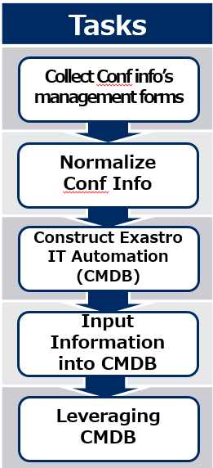
Step 1：Central management of the Configuration info
The “pain” of IT Engineers that works with Constructing/Operating systems
Solve the problems in 3 steps.
The next slides explains the 5 tasks in Step 1.
Design
Delays and errors occurs when communicating between teams.
Double managing data and proprietary wording leads to errors in the design
Multiple development leads to complications with managing design documents (forms)
As a result, we are unable to check before and after the settings.
Design
Step 1
Centrally Manage conf info
Solution
Step 1
Centrally Manage conf info
Conf info
Design info
CMDB
CMDB
Conf info
Step 3
Linking Central management
and automatic execution
Design info
Conf info
Design info
Preparation
Link
Preparation
Work orders between teams are complex. Each time a time chart is created, it gets discarded.
Every operation’s Manual is discarded after its created/reviewed.
Configurations are embedded in each procedure, and the number of patterns increases each time a new model/os is added (barrier to multi-vendor support)
Conf info
Job
Execute
Step 2
Automate
CMDB
Conf info
Conf info
Job
Solution
Job
Execution
Job
Execute
Execution
Since the operations are done manually, the production time is inconsistent. ⇒People often have to wait before they can continue.
Since most of the operations are done manually, human error is inevitable.
Job
Job

Slide 17
Step 1：Central management of the Configuration info
Tasks
Task Explanation
Collect Conf info’s management forms
Each team leader collects the conf info from their own teams and share it with each other.
Normalize
Conf Info
三
三
三
三
三
三
三
三
Construction team B
Operation team A
Construction team B
Operation team A
三
三
三
三
三
三
三
三
Construct Exastro IT Automation (CMDB)
Each team’s conf info
Construction team A
Operation team B
Construction team A
Operation team B
三
三
Input Information into CMDB
三
三
三
三
三
三
Automation Team F
POINT
Each team’s leader
Shared conf info
Leveraging CMDB
Check next page
① Clarify the purpose and decide the scope of the management
② There are several ways to manage existing conf info
③ Example) conf info collected from an actual project.

Slide 18
Step 1：Central management of the Configuration info
Tasks
POINT
① Clarify the purpose and decide the scope of the management
Collect Conf info’s management forms
First, one should clarify the goal. After that, we can decide the scope of the conf information we want to collect. A more specific example can be found below 。
0
Problems such as collecting too much or unnecessary information may occur if there are no clear goals.
If there are multiple goals, we recommend to number them by priority and create the CMDBs in order.
File Management
Goals often used | Scope of information
1) IP Address Management | IP, Segments, Etc.
2) Assets Management | Serial Number, License, etc.
3) Server construction | IP, Host name, etc.
4) NW device construction | Interface Numbers, VLAN, etc.
5) VM Payout | Hypervisor, VM name, etc.
6) DNS maintaining | DNS server, domain name, etc.
Application
Normalize
Conf Info
Server Construction
Middleware
VM payout
OS
Construct Exastro IT Automation (CMDB)
VM
IP management
DNS maintenance
Hypervisor
Physical machine.
Input Information into CMDB
NW Device Construction
Network
Leveraging CMDB

Slide 19


Step 1：Central management of the Configuration info
Tasks
POINT
② There are several ways to manage existing conf info
Collect Conf info’s management forms
Many projects uses Excel or Word formats to manage conf info, so let’s start with collecting those files. If you are storing conf info in databases, you might consider dumping it in CSV Format or to link the database directly with Exastro IT Automation.
Depending on the project, users might have to gather information straight from a running machine ( such as a VM) instead of the conf info documents. In that case, we can use Exastro ITA and Ansible to easily collect data from the machines.
Normalize
Conf Info
・CSV input
・ITA Link
Construct Exastro IT Automation (CMDB)
DB Server
Excel
Team leaders
・Login and gather
・ITA + Ansible
Input Information into CMDB
Word
Running machine
Leveraging CMDB

Slide 20
Step 1：Central management of the Configuration info
Tasks
POINT
③ Case ～ Collecting Conf info from a real project.
Collect Conf info’s management forms
Here is an example of how Construction management of servers and network devices can be achieved. In this case, the following conf info was shared among the team leaders in order to easily identify the scope of the outage impact of the service.
For more details regarding this case, please refer to the URL below.
https://exastro-suite.github.io/it-automation-docs/case.html
Normalize
Conf Info
Team | Collected Conf info
Server G | ・Server list ・Software installed on the server list
Network G | ・IP address list ・Network device list ・Network route list
Storage G | ・Path list ・Storage disk list
Operation monitoring G | ・Message list
Business G | ・Components list ・Server components list ・Communication conditions list
Construct Exastro IT Automation (CMDB)
Input Information into CMDB
Leveraging CMDB

Slide 21
Step 1：Central management of the Configuration info
Tasks
Task explanation
Collect Conf info’s management forms
The team leaders normalizes the collected conf info in a table format by eliminating duplicates, unifying names and breaking up redundant info.
Normalize
Conf Info
Server type
Server
Web server
DB server
AP server
OS type
OS
RHEL7
RHEL8
WinServer2019
Construct Exastro IT Automation (CMDB)
Server device list
Server | Model | Host name | OS
Web server | #1 | web001 | WinServer2019
Web server | #2 | web002 | RHEL8
AP server | #1 | apsvr001 | RHEL8
三
三
三
三
Team leaders
三
三
三
三
Normalize
Input Information into CMDB
Collected conf info
・Deleting Duplicates
・Unifying Item names
・Cleansing
・Etc.
Communication list (allowed)
Comm№ | FROM | Protocol |  | TO
① | Web server#1 | https | tcp | AP server#1
② | AP server#1 | ODBC | tcp | DB server#1
Leveraging CMDB
POINT
① Sort the conf info
② Organize the conf info items (Columns)
Check next page

Slide 22
Step 1：Central management of the Configuration info
Tasks
POINT
① Sort the conf info
Collect Conf info’s management forms
Each team’s collected conf info is sorted according to the following
① If the info is enclosed to single teams or if it is shared with other teams.
If there is info linked with other teams, separate it from other info. By doing so, we can share the info with each others.
② If we’re making the user select info from a pull-down menu in Exastro ITA.
We divide the info into two categories when registering conf info. Info selectable from pull-down menus and info that can be entered manually. Info selected from pull-down menus will have their values registered as “Master”.
③ The relationship of the conf information.
We must decide the relationship (dependency) of the conf info. This is important, as it directly affects the order in which we create and register conf info. For example, in order to create a “server list” , we first have to create and register “OS types”.
Normalize
Conf Info
Construct Exastro IT Automation (CMDB)
Input Information into CMDB
Leveraging CMDB

Slide 23
Step 1：Central management of the Configuration info
Tasks
POINT
② Organize the conf info items (Columns)
Collect Conf info’s management forms
Eventually, the conf info is collected in a table format. Therefore, it is necessary to organize what the “column” in the table should be according to the points below.
① Unification of the settings info item names (table column names).
Different teams often have different names for the same information. For example, the server team might call “IP Address” for just “IP”, while the network team might call it for “ip_addr”. In this case, we need to have the teams use the same name so the information can be counted as shared conf info.
② Grouping the settings info.
In many cases, settings info becomes more readable if it is grouped up. To give an example, by grouping “IP Address”# and “Port Number” into “Connection Information”, we can improve both the readability and maintainability.
Normalize
Conf Info
Construct Exastro IT Automation (CMDB)
Input Information into CMDB
Leveraging CMDB

Slide 24

Step 1：Central management of the Configuration info
Tasks
Task explanation.
Collect Conf info’s management forms
Based on the normalized conf info, create a “table list” and a “table frame” to store the conf info in the CMDB in Exastro IT Automation.
Normalize
Conf Info
Table Frame
Server type
OS type
Table list
三 Menu
Server type
OS type
Server device list
Comm. list (Allowed)
Construct Exastro IT Automation (CMDB)
CMDB
Server type | Model | Host name | OS type
Input Information into CMDB
Comm.№ | FROM | Protocol |  | TO
Leveraging CMDB
POINT
① Put restrictions on the columns to prevent input errors in the design values.
Check next page

Slide 25
Step 1：Central management of the Configuration info
Tasks
POINT
① Put restrictions on the columns to prevent input errors in the design values
Collect Conf info’s management forms
Keeping the CMDB clean is impossible there are spelling/input errors when registering design values.
By setting restrictions to the table columns in Exastro IT Automation, it becomes easier if there any spelling/input errors when inputting new design values. As a result, the CMDB can be kept clean.
Normalize
Conf Info
Restriction
Restriction
Construct Exastro IT Automation (CMDB)
Restriction
n.n.n.n format
(n= number)
Pulldown selection
Letters, Hyphens , Periods
Pulldown = No errors
Input Information into CMDB
Host name | IP address | OS type | ・・・
web-server | 10.0.10.100 | Windows Server 2019 | ・・・
log-server | log-server |  | ・・・
DB_server | 10.0.10.300 |  | ・・・
・・・・・ | ・・・・・ |  | ・・・
▼
RHEL 8
Windows Server 2019
Windows Server 2016
RHEL 8
▼
Leveraging CMDB
Error
Error

Slide 26
Step 1：Central management of the Configuration info
Tasks
Task explanation
Collect Conf info’s management forms
Every team registers the conf info to the CMDB
Normalize
Conf Info
Table
Server type
Web server
DB server
AP server
OS type
RHEL7
RHEL8
WinServer2019
Table list
三 Menu
Server type
OS type
Server device list
Comm. list (Allowed)
Construct Exastro IT Automation (CMDB)
CMDB
Server type | Model | Host name | OS type
Web server | #1 | web001 | WinServer2019
Web server | #2 | web002 | RHEL8
AP server | #1 | apsvr001 | RHEL8
Input Information into CMDB
Comms.№ | FROM | Protocol |  | TO
① | Web server#1 | https | tcp | AP server#1
② | AP server#1 | ODBC | tcp | DB server#1
Leveraging CMDB
POINT
① Use Excel to register in batches.
Check next page

Slide 27
Step 1：Central management of the Configuration info
Tasks
POINT
① Use Excel to register in batches.
Collect Conf info’s management forms
The tables in Exastro IT Automation can be downloaded in Excel format. We can register conf info more efficiently by adding/updating the information directly to the Excel file and then uploading it.
Normalize
Conf Info
●●●● | ●●●● | ●●●●
●●●● | ●●●● | ●●●●
●●●● | ●●●● | ●●●●
●●●● | ●●●● | ●●●●
●●●● | ●●●● | ●●●●
●●●● | ●●●● | ●●●●
●●●● | ●●●● | ●●●●
●●●● | ●●●● | ●●●●
●●●● | ●●●● | ●●●●
●●●● | ●●●● | ●●●●
●●●● | ●●●● | ●●●●
CMDB
CMDB
CMDB
Construct Exastro IT Automation (CMDB)
Download
Upload
Changes are reflected.
Input Information into CMDB
Leveraging CMDB
●●●● | ●●●● | ●●●●
●●●● | ●●●● | ●●●●
●●●● | ●●●● | ●●●●
●●●● | ●●●● | ●●●●
●●●● | ●●●● | ●●●●
●●●● | ●●●● | ●●●●
●●●● | ●●●● | ●●●●
●●●● | ●●●● | ●●●●
●●●● | ●●●● | ●●●●
●●●● | ●●●● | ●●●●
Add Update

Slide 28
Step 1：Central management of the Configuration info
Tasks
Task explanation
Collect Conf info’s management forms
Refer and update the conf info to suit the final goal.
Additionally, it is possible to store the setting values by downloading it as an Excel file.
Normalize
Conf Info
【Referring and Updating CMDB】
【Submit the final product as an excel file】
We want to see the version info for all the servers that are getting patched.
Attention
Construct Exastro IT Automation (CMDB)
CMDB
The client must have agreed to this in advance.
Operation team
CMDB
Input Information into CMDB
Let’s update the server list now that there are additional web servers.
Deliver the final product
Server construction team
Leveraging CMDB
Project
Client
POINT
① Case~ Investigating the scope of service outage impacts.
Check next page

Slide 29
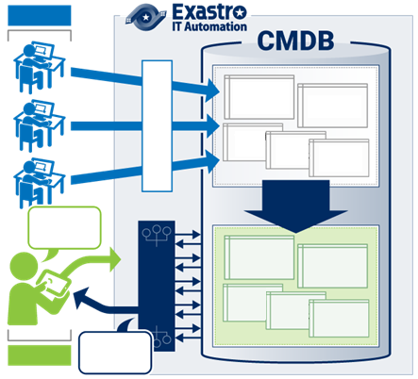
Step 1：Central management of the Configuration info
Tasks
POINT
① Case~ Investigating the scope of service outage impacts.
Collect Conf info’s management forms
Here, we will show an example of using CMDB to investigate the impact of a service outage.
Developer
Problem | Large-scale carrier systems require a lot of man-hours to investigate service impacts of both expected and unexpected equipment outages.
Registers conf info
Normalize
Conf Info
Service sequence
Path list
Server list
Netw devi
Construct CMDB
Storage Device list
Construct Exastro IT Automation (CMDB)
Extract Chrono- logically
Solution | By managing the configuration of the system, it is possible to automatically predict the impact of equipment outages.
If X machines stops for Y seconds…
Estimation
Service sequence
Input Information into CMDB
Path list
Server list
Netw devi
Effect | Don’t have to pay 800 000 Yen per investigation. The annual cost was reduced by about 94 mil. Yen. (checked 120 times)
Storage Device list
Operator
This will affect Service A and Service B
Leveraging CMDB
For more details regarding this case, please refer to the URL below.
https://exastro-suite.github.io/it-automation-docs/case.html#case003

Slide 30
Automation Preparation Step 1：Central management of the Configuration info. Step 2：Actualize Automatic Execution. Step 3：Linking Central management and automatic execution.

Slide 31
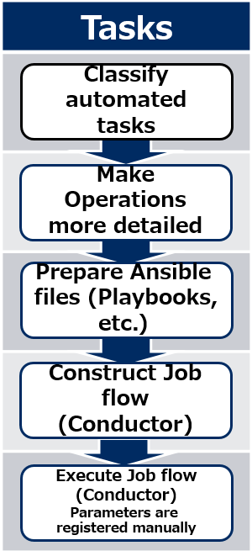
Step 2：Actualize Automatic Execution
The “pain” of IT Engineers that works with Constructing/Operating systems
Solve the problems in 3 steps.
The next slides explains the 5 tasks in Step 2.
Design
Delays and errors occurs when communicating between teams.
Double managing data and proprietary wording leads to errors in the design
Multiple development leads to complications with managing design documents (forms)
As a result, we are unable to check before and after the settings.
Design
Step 1
Centrally Manage conf info
Solution
Step 1
Centrally Manage conf info
Conf info
Design info
CMDB
CMDB
Conf info
Step 3
Linking Central management
and automatic execution
Design info
Conf info
Design info
Preparation
Link
Preparation
Work orders between teams are complex. Each time a time chart is created, it gets discarded.
Every operation’s Manual is discarded after its created/reviewed.
Configurations are embedded in each procedure, and the number of patterns increases each time a new model/os is added (barrier to multi-vendor support)
Conf info
Job
Execute
Step 2
Automate
CMDB
Conf info
Conf info
Job
Solution
Job
Execution
Job
Execute
Execution
Since the operations are done manually, the production time is inconsistent. ⇒People often have to wait before they can continue.
Since most of the operations are done manually, human error is inevitable.
Job
Job

Slide 32
Step 2：Actualize Automatic Execution
Tasks
Task explanation
Classify automated tasks
Organize the manually executed tasks and select which ones to automate.
If the organized tasks crosses more than one team, the team leaders will do the coordination.
Shared operations
Make Operations more detailed
・Implement Monitor agent
・Communication check(ping)
・Distribute hosts files
・etc
Server construction
NW device construction
・OS settings
・OS update
・SELinux settings
・firewalld settings
・etc
・IF settings
・VLAN construction
・Communication access settings
・etc
Prepare Ansible files (Playbooks, etc.)
Construct Job flow (Conductor)
三
三
三
三
三
三
三
三
Execute Job flow (Conductor)
Parameters are registered manually
Team leaders
① Categorize tasks with “just right” granularity.
② Estimate the effects of the operation and arrange them by priority.
POINT
Check next page

Slide 33
Step 2：Actualize Automatic Execution
Tasks
POINT
① Categorize tasks with “just right” granularity.
Classify automated tasks
Categorize the tasks that are getting automated with “just right” granularity. For example, for server construction, the example in the bottom right has too much information. On the other hand, the one on the left is too broad.
As can be seen in the middle figure, the “OS Settings” illustrates the perfect amount of granularity.
Make Operations more detailed
Server construction
Server construct
Server construction
Prepare Ansible files (Playbooks, etc.)
Too broad
Just right
Too narrow
OS
OS settings
OS settings
・Log in with SSH
・Change to super user
・Execute .yum and update OS
・Log in with SSH
・Change to super user
・Execute .yum and update OS
・Log in with SSH
・Change to super user
・Execute .yum and update OS
Construct Job flow (Conductor)
●
●
●
●
●
●
●
●
●
Distribute Hosts files
Distribute Hosts files
Distribute Hosts files
・Copy hosts in scp
・Backup old hosts
・Replace hosts
・Copy hosts in scp
・Backup old hosts
・Replace hosts
・Copy hosts in scp
・Backup old hosts
・Replace hosts
Execute Job flow (Conductor)
Parameters are registered manually
●
●
●
●
●
●
●
●
●
Implement monitor agent
Implement monitor agent
Implement monitor agent
・Start installer
・Insert license
・Start installer
・Insert license
・Start installer
・Insert license

Slide 34
Step 2：Actualize Automatic Execution
Tasks
POINT
② Estimate the effects of the operation and arrange them by priority
Classify automated tasks
Estimate the effects of the operations and arrange them by priority. Once we know the effects, we can prioritize the tasks and decide whether to automate them or not.
Estimated effects includes the number of times the operation is used per year, the number of target devices and the number of man-hours per project. If the number isn’t a quantitative number, it is possible to sort them by “Large”, “Medium”, or “Small". The following is an example of an organized list of operations with priority.
As a general rule, automation tends to be more effective for common tasks, since they are used more often per year. Additionally, by reviewing the granularity of the tasks, we can find out which tasks are common.
Make Operations more detailed
Operation | Times used | Number of devices | Man-hour per worker | Man-hour | Priority | Remarks
OS settings | 50 | 50 | 10H | 5H | High | Requires 2 persons
Distribute Hosts files | 200 | 50 | 1H | 0.5H | Middle | Updates 4 times a year
Implement monitor agent | 30 | 30 | 5H | 5H | Low
Update Web contents | 600 | 5 | 1H | 1H | High | Updates 10 times a month
Summarize Access log | 60 | 5 | 2H | 2H | Low | Executed at the end of the month
Prepare Ansible files (Playbooks, etc.)
Construct Job flow (Conductor)
Execute Job flow (Conductor)
Parameters are registered manually

Slide 35
Step 2：Actualize Automatic Execution
Tasks
Task explanation
Classify automated tasks
Make the categorized tasks more detailed and reduce them to more specific operations.
Detailing operations can be based on existing procedures and other documents.
OS settings
Make Operations more detailed
・Log in with SSH
・Change to super user
・Execute .yum and update OS
・etc…
Categorized tasks
OS settings
Distribute Hosts files
Implement monitor agent
Web container
Summarize access log
………
Detailed
Prepare Ansible files (Playbooks, etc.)
Detailed
Distribute Hosts files
・Copy hosts in scp
・Backup old hosts
・Change hosts
・etc…
Construct Job flow (Conductor)
Detailed
Implement Monitor agent.
・Start installer
・Insert license
・etc…
Execute Job flow (Conductor)
Parameters are
registered manually
POINT
①Backup, Run operation and Acquire backup.
Check next page

Slide 36
Step 2：Actualize Automatic Execution
Tasks
POINT
① Backup, Run operation and Acquire backup.
Classify automated tasks
We recommend to structure the detailed operations in sets of 3
This configuration ensures that backups and evidence are available at all times, meaning that the operations can be safely re-used.
As an example, the following is the configuration of a procedure that distributes hosts files.
(1) Backup
(2) Run Operation
(3) Acquire evidence
Make Operations more detailed
Prepare Ansible files (Playbooks, etc.)
Construct Job flow (Conductor)
Process | Specific procedure
Backup | Takes back up of current hosts files.
(2) Run operation | Copies new host files to the designated place.
(3) Acquire evidence | Saves successful name resolution results.
Execute Job flow (Conductor)
Parameters are registered manually

Slide 37
Step 2：Actualize Automatic Execution
Tasks
Task explanation
Classify automated tasks
Prepare Ansible files (Playbook, Etc.) to execute the procedure. You can create new one or use existing ones.
【Ansible files registration】
Ansible files is a set of files required for an operation to run.
・Playbook
・Role
・File
・Template
Make Operations more detailed
【Ansible file preparation】
三
三
Register
三
三
Prepare Ansible files (Playbooks, etc.)
三
三
三
三
Create new from user manuals
Reuse existing files
Construct Job flow (Conductor)
Register
Ansible files
Ansible files
Ansible files
POINT
① Reuse any existing files available
② Variablize any values that changes for each operation run.
③ Keep similar processes concise by repeating.
④ Create a standard configuration for templates.
Execute Job flow (Conductor)
Parameters are registered manually
Check next page

Slide 38




Step 2：Actualize Automatic Execution
Tasks
POINT
① Reuse any existing files available
Classify automated tasks
You don’t need to create every part manually in an Ansible file. If you have any existing files, it is possible to use parts of them to create other files more efficiently.
The following example illustrates how to build a web server by using Ansible files from various sources.
Make Operations more detailed
OS settings
Prepare Ansible files (Playbooks, etc.)
Web server construction procedure
Ansible file
From the internet
Distribute Hosts files
Construct Job flow (Conductor)
Ansible file
From an earlier project
Implement monitor agent
Ansible file
From Monitor software vendor
Execute Job flow (Conductor)
Parameters are registered manually
Web server construction
Ansible file
From in-house engineering department.

Slide 39
Step 2：Actualize Automatic Execution
Tasks
POINT
② Variablize any values that changes for each operation run.
Classify automated tasks
Some values, such as the host name for the machine, will change when the operations are executed. If you embed these values as fixed values in the Ansible files, you will need to modify the files every time you run an operation.
In order this, we use “variables” in Ansible files.
The playbook on the left has a fixed host name,”web01”. If we don’t change it, we will need to modify the playbook in order to set up “web02” on another machine.
On the other hand, the playbook on the right has the host name converted into a variable, {{ VAR_hostname }}. By setting specific values for the variables separately, the variablized parts can be replaced with any expected values when the operation is executed.
Make Operations more detailed
Playbook before variablization
Playbook after variablization
- hostname:
name: web01
- hostname:
name: {{ VAR_hostname}}
Prepare Ansible files (Playbooks, etc.)
Construct Job flow (Conductor)
Execute Job flow (Conductor)
Parameters are registered manually

Slide 40
Step 2：Actualize Automatic Execution
Tasks
POINT
③ Keep similar processes concise by repeating.
Classify automated tasks
If the tasks are organized to be executed automatically, you might see that some similar tasks are used multiple times. In those cases, we can keep the process concise by using repetition. In the case of Ansible’s Playbooks, we can use the “Loop” instruction.
The following is an example of a playbook that creates three directories: /dir1, /dir2 and /dir3. The playbook on the left runs 3 different processes. On the other hand, the one on the right uses “loop” to repeat the process, which makes it more concise and easier to maintain.
Make Operations more detailed
Prepare Ansible files (Playbooks, etc.)
Not repeated playbook
- file:
path: /dir1
state: directory
- file:
path: /dir2
state: directory
- file:
path: /dir3
state: directory
Repeated playbook
Construct Job flow (Conductor)
- file:
path: ”{{ item }}”
state: directory
loop: {{ VAR_dirs }}
Repeat
Execute Job flow (Conductor)
Parameters are registered manually

Slide 41
Step 2：Actualize Automatic Execution
Tasks
POINT
④ Create a standard configuration for templates.
Classify automated tasks
In situations where setting files are distributed to multiple servers, the contents of the files are in many cases almost the same, which only some of the values being different. In these cases, we can be more efficient by creating setting files using formats.
In Ansible, Files with .j2 extensions are “Format” files. Similarly to playbooks, formats can also use variables. The following is an example of an Apache settings file being created. The blue text are variables and the red text are values after it has been created.
Make Operations more detailed
Prepare Ansible files (Playbooks, etc.)
httpd.conf.j2 (Format)
<VirtualHost *:80>
ServerName www.test.com
DocumentRoot /contents
</VirtualHost>
Construct Job flow (Conductor)
Create
<VirtualHost *:80>
ServerName {{ VAR_hostname }}
DocumentRoot {{ VAR_docroot }}
</VirtualHost>
Execute Job flow (Conductor)
Parameters are registered manually
Create
<VirtualHost *:80>
ServerName www.dev.com
DocumentRoot /public
</VirtualHost>

Slide 42
Step 2：Actualize Automatic Execution
Tasks
Appendix：Managing Playbooks
Classify automated tasks
This section describes how to manage Ansible materials (Playbooks,etc.), using problems and solutions that actually happened as examples.
Make Operations more detailed
PROBLEM
① The same playbook exists across multiple directories.
② Playbooks with different contents have the same name.
③ There are differences in playbook contents between the version management tool and ITA.
Prepare Ansible files (Playbooks, etc.)
SOLUTION
Construct Job flow (Conductor)
① Create a directory for common processes.
② Decide on a naming convention in advance and don’t allow files with same name
③ Manage using a version management tool and CICD tool.
Execute Job flow (Conductor)
Parameters are registered manually
Check next page

Slide 43
Step 2：Actualize Automatic Execution
Tasks
① The same playbook exists across multiple directories.
PROBLEM
Classify automated tasks
When we managed a shared directory, we created a new directory for each process, causing files to exist over multiple directories.
Shared SV
Shared Directory
share/add/
Pre.yml
Add.yml
Post.yml
share/add/
Pre.yml
change.yml
Post.yml
Make Operations more detailed
Prepare Ansible files (Playbooks, etc.)
SOLUTION
① Use one Playbook for multiple processes.
ITA allows users to manage Playbooks in one central place, making it possible to use the same Playbook in different Movements.
Construct Job flow (Conductor)
Movement details
Playbook File collection
Add
Pre.yml
Add.yml
Post.yml
１．Pre.yml(preprocess)
２．Add.yml(add)
３．Post.yml（preprocess）
４．Change.yml（Change）
Execute Job flow (Conductor)
Parameters are registered manually
Change
Pre.yml
change.yml
Post.yml

Slide 44
Step 2：Actualize Automatic Execution
Tasks
PROBLEM
② Playbooks with different contents have the same name.
Classify automated tasks
Two files with the same name but different contents was accidentally created in Ansible Legacy Role.
Therefore, altering the “add” Pre.yml also changes the “change” Pre.yml, leading to a bug occurring.
Movement list
Role package management
Pre.yml（add）
name: Start add process
debug: “Start adding”
Make Operations more detailed
１．Add
２．Change
roles（add）
└tasks
└ Pre.yml
└ Add.yml
└ End.yml
roles（change）
└tasks
└ Pre.yml
└ Change.yml
└ Post.yml
The contents are different!
Pre.yml（change）
Name: check for files
stat: /var/tmp/test.txt
register: RegStat
Prepare Ansible files (Playbooks, etc.)
SOLUTION
② Decide on a naming convention in advance and don’t allow files with same name
Construct Job flow (Conductor)
Ansible Role allows for files with same name but different packages.
However, as this often leads to bugs, we recommend deciding on a naming convention and forbidding files with same name.
Example: Playbooks are named in this format "Process_XXX.yml"
Movement list
Role ppackage management
Execute Job flow (Conductor)
Parameters are registered manually
１．Add file
２．Change file
roles（add）
└tasks
└ AddFile_Pre.yml
└ AddFile_Add.yml
└ AddFile_End.yml
roles（change）
└tasks
└ ChangeFile_Pre.yml
└ ChangeFile_Change.yml
└ ChangeFile_Post.yml

Slide 45
Step 2：Actualize Automatic Execution
③ There are differences in playbook contents between the Version management tool and ITA.
Tasks
PROBLEM
Classify automated tasks
When adding and repairing Playbooks, we upload them both to ITA and a version management tool (Git, and such), but I forgot to upload it to ITA, meaning that the fix/new one wont get displayed.
Local
Playbook file coll.
Version mgt tool
１．Pre.yml
２．Add.yml
３．Post.yml
４．Change.yml
xxx/add〇〇/
Add.yml
Make Operations more detailed
Pre.yml
xxx/〇〇common process/
Pre.yml
Post.yml
xxx/change〇〇/
change.yml
Forgot to upload
Prepare Ansible files (Playbooks, etc.)
SOLUTION
③ Manage using ITA's CI/CD for IaC function.
Construct Job flow (Conductor)
For cases like these, we recommend that you use the ITA CI/CD for IaC function. This function automatically updates the files uploaded to ITA when the files in the version management tools are updated. If linked together with a Movement, users can easily use CI/CD.
Execute Job flow (Conductor)
Parameters are registered manually
Local
Version mgt tool
Movement details
Add
Pre.yml
Add.yml
Post.yml
Pre.yml
xxx/〇〇common /
Pre.yml
Post.yml
Post.yml
Playbook File
collection
Target device
１．Pre.yml
２．Add.yml
３．Post.yml
Change
Pre.yml
change.yml
Post.yml
Generate
clone/ Update
Run operation
(Dry runs are also possible)

Slide 46
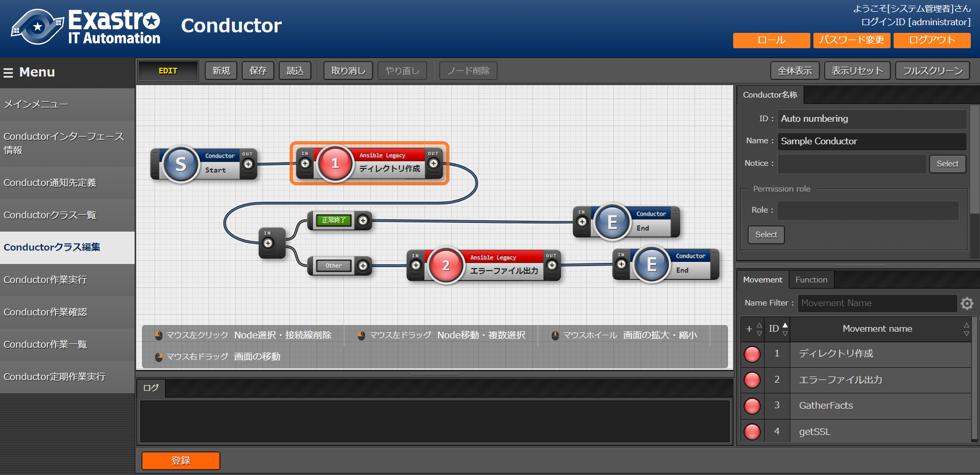

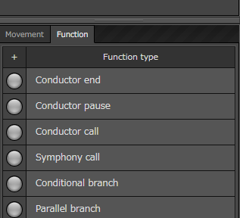
Step 2：Actualize Automatic Execution
Tasks
Task explanation
Classify automated tasks
Create a Jobflow in IT Automation.
【Jobflow Creation screen】
Make Operations more detailed
Movement
Movements and Functions
can be linked to the user's liking
Users can also use functions
such as Conditional branches.
Prepare Ansible files (Playbooks, etc.)
Function
Construct Job flow (Conductor)
Drag and Drop to
add Movements
Execute Job flow (Conductor)
Parameters are registered manually
POINT
① Understand the process of creating Jobs and Jobflows.
Check next page

Slide 47
Step 2：Actualize Automatic Execution
Tasks
POINT
① Understand the process of creating Jobs and Jobflows.
Classify automated tasks
The operations that we categorized in the first task of step 2, Classifying Automated Tasks, is called a “job”. A “Jobflow” is a string of several jobs that are executed in a specific order.
In Exastro IT Automation, jobflows are made possible with the “Conductor” function, and “Jobs” by the “Movement” function. By linking an Ansible file (Playbook, etc.) to a movement, it becomes possible to run operations with real effects.
Make Operations more detailed
Web server construction procedure (= Conductor)
Jobflow
Movement
Prepare Ansible files (Playbooks, etc.)
Job
Distribute hosts files
Ansible file
Realized with Exastro
Movement
Job
Implement web server
Ansible file
Construct Job flow (Conductor)
Movement
Job
Transfer contents
Ansible file
Execute Job flow (Conductor)
Parameters are registered manually

Slide 48
Step 2：Actualize Automatic Execution
Tasks
Task explanation
Classify automated tasks
Link Jobflow and Operation and Automatically execute the Operation.
Make Operations more detailed
Links and Executes
Jobflow
Operation
Prepare Ansible files (Playbooks, etc.)
Starts real operation
Job
●●●● | ●●●● | ●●●●
●●●● | ●●●● | ●●●●
●●●● | ●●●● | ●●●●
●●●● | ●●●● | ●●●●
●●●● | ●●●● | ●●●●
Job
Construct Job flow (Conductor)
Job
Execute Job flow (Conductor)
Parameters are registered manually
POINT
①Understand the relationship between Operations and Jobflows
Check next page

Slide 49
Step 2：Actualize Automatic Execution
①Understand the relationship between Operations and Jobflows
Tasks
POINT
Classify automated tasks
An Operation links a target device and specific setting values to a Jobflow. The following illustrates a simple Jobflow that transfers files to a server.
With the help of the Operation, “Target Device” ,”Sender” and “Receiver” gets linked to the Jobflow. The combination above deploys Data.txt to the web server.
By changing the inside of the Operation, we can choose to send different files to different target devices.
Make Operations more detailed
Jobflow
Operation
webserver
data.txt
Target Device | Sender | Receiver
webserver | data.txt | /etc/conf
Prepare Ansible files (Playbooks, etc.)
File Transfer
Run
/etc/conf/data.txt
Construct Job flow (Conductor)
Execute Job flow (Conductor)
Parameters are registered manually

Slide 50
Automation Preparation Step 1：Central management of the Configuration info. Step 2：Actualize Automatic Execution. Step 3：Linking Central management and automatic execution.

Slide 51
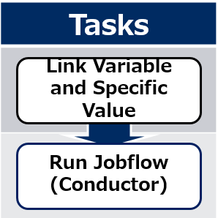
Step 3： Linking Central management and automatic execution
The “pain” of IT Engineers that works with Constructing/Operating systems
Solve the problems in 3 steps.
The following slides explains the 2 tasks in step 3.
Design
Delays and errors occurs when communicating between teams.
Double managing data and proprietary wording leads to errors in the design
Multiple development leads to complications with managing design documents (forms)
As a result, we are unable to check before and after the settings.
Design
Step 1
Centrally Manage conf info
Solution
Step 1
Centrally Manage conf info
Conf info
Design info
CMDB
CMDB
Conf info
Step 3
Linking Central management
and automatic execution
Design info
Conf info
Design info
Preparation
Link
Preparation
Work orders between teams are complex. Each time a time chart is created, it gets discarded.
Every operation’s Manual is discarded after its created/reviewed.
Configurations are embedded in each procedure, and the number of patterns increases each time a new model/os is added (barrier to multi-vendor support)
Conf info
Job
Execute
Step 2
Automate
CMDB
Conf info
Conf info
Job
Solution
Job
Execution
Job
Execute
Execution
Since the operations are done manually, the production time is inconsistent. ⇒People often have to wait before they can continue.
Since most of the operations are done manually, human error is inevitable.
Job
Job

Slide 52
Step 3： Linking Central management and automatic execution
Tasks
Task explanation
Link Variable and Specific Value
Use the “Substitute automatic value registration list” function in IT Automation to link the parameter sheet values and the job variables.
Run Jobflow
(Conductor)
●●●● | ●●●● | ●●●●
●●●● | ●●●● | ●●●●
●●●● | ●●●● | ●●●●
●●●● | ●●●● | ●●●●
Job
VAR_value
Substitute value
●●●● | ●●●● | ●●●●
●●●● | ●●●● | ●●●●
●●●● | ●●●● | ●●●●
●●●● | ●●●● | ●●●●
Link formats
・Value
・Key
・Key-Value
Job
VAR_value1
VAR_value2
●●●● | ●●●● | ●●●●
●●●● | ●●●● | ●●●●
●●●● | ●●●● | ●●●●
●●●● | ●●●● | ●●●●
Job
VAR_value1
VAR_value2
POINT
① How to use Value-types
② How to use Key-types
③ How to use Key-Value types
Check next page

Slide 53
Step 3： Linking Central management and automatic execution
Tasks
POINT
① How to use Value-types
Link Variable and Specific Value
Value type is a basic type and links the values inside the chart to the variables. It can be used for many things, such as for system settings and command line arguments.
The following illustrates how variables are linked to each of the server type settings.
In the example above, each value in “web2” is linked with the job variables.
Run Jobflow
(Conductor)
Jobflow
Host name | Time out | Threads | SELinux
web1 | 60 | 200 | enforcing
web2 | 60 | 200 | enforcing
db-server | 30 | 50 | permissive
Job
VAR_timeout: 60
VAR_thread: 200
VAR_selinux: enforcing

Slide 54
Step 3： Linking Central management and automatic execution
Tasks
POINT
② How to use Key-types
Key type is used to tie table column names to variables. It is mainly used as a flag. The following shows an example on how variables are linked to running services on a server.
In the example above, “Web2” has the columns, “httpd” and ”firefalld” set to “yes”, so the column names will be linked to the values of the variables and then execute the job.
Link Variable and Specific Value
Run Jobflow
(Conductor)
Jobflow
Job
Host name | Systemctl Service name
 | httpd | mariadb | firewalld
web1 | yes |  | yes
web2 | yes |  | yes
db-server |  | yes | yes
VAR_service: httpd
Job
VAR_service: firewalld

Slide 55
Step 3： Linking Central management and automatic execution
Tasks
POINT
③ How to use Key-Value types
Link Variable and Specific Value
Key-Value types can be used to tie both they key and value to a variable. The following example shows how to set environment variables on the server using the Environment variable definition table.
In the example above, the column name is the environment name.
Both the environment variable name, “http_proxy”, and it’s value ,”http://host” are linked to the variable.
Run Jobflow
(Conductor)
Jobflow
Host name | PATH | http_proxy
web1 | /bin:/usr/bin | http://host
web2 | /bin:/usr/bin | http://host
db-server | /bin:/sbin | http://proxy
Job
VAR_key: http_proxy
VAR_value: http://host

Slide 56
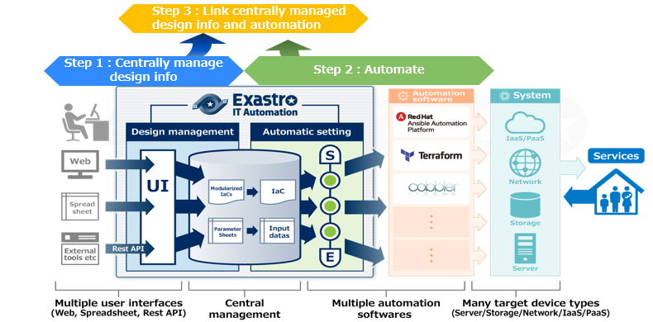
Step 3： Linking Central management and automatic execution
Tasks
Task explanation
Link Variable and Specific Value
Link Jobflow and Operation and automatically execute the operation.
Users can create systems by using these two actions: Edit parameters→ Execute.
Run Jobflow
(Conductor)

Slide 57
Implementing automated SI Effects and Estimations Post-Automation Process changes and results.

Slide 58
Implementing automated SI Effects and Estimations Post-Automation Process changes and results.

Slide 59
Estimate the effects of the operation (repost)
Estimate the effects of the operations and arrange them by priority. Once we know the effects, we can prioritize the tasks and decide whether to automate them or not. Estimated effects includes the number of times the operation is used per year, the number of target devices and the number of man-hours per project.
If the number isn’t a quantitative number, it is possible to sort them by “Large”, “Medium”, or “Small". The following is an example of an organized list of operations with priority.
Operation | Times used | Number of devices | Man-hour per worker | Man-hour | Priority | Remarks
OS settings | 50 | 50 | 10H | 5H | High | Requires 2 persons
Distribute Hosts files | 200 | 50 | 1H | 0.5H | Middle | Updates 4 times a year
Implement monitor agent | 30 | 30 | 5H | 5H | Low
Update Web contents | 600 | 5 | 1H | 1H | High | Updates 10 times a month
Summarize Access log | 60 | 5 | 2H | 2H | Low | Executed at the end of the month

Slide 60
Case: Constructing Network Device(1/2)
Overview
Adding more network devices in a carrier type system
Automate the operations of adding virtual IP and compare the operational costs of with and without automation.
Construction of the automated operations.
Refer to the picture on the left for the construction.
Total of 30 network devices
Automation construction and tasks
Add Virtual IP and Member to Load balancer.
Add policy to firewall
Add static-route to switch.
Adds VIP Adds User
Load balancer
Adds policy
Switch
Fire wall
Switch
DMZ
Server
Adds static-Route

Slide 61
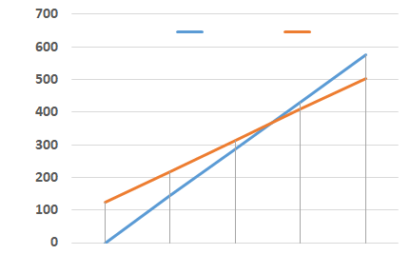
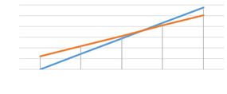
Case: Constructing Network Device(2/2)
Increase/Decrease in man-hours before and after automation + added work.
Return on Investment Concept.
Man-hours used for Automation (Initial)：123.4H
Step 1：44.7H Step 2：63.5H Step 3：15.2H
Hours before Automation：143.8H ⇒ After Automation：95.2H
The number of man hours is reduced by34%. Additionally, the investment returns profit after the Third time (including the Initial stage)
Depending on the case, preparation for automation and implementing the automation may be done separately or at the same time. In this case, they were done separately.
 |  | Defining | Basic Design | Detailed Design | Operation design | Production | Evaluation |  |  | Total
Before | Hours(Per worker) | 20.1 | 22.4 | 11.2 | 0 | 19.7 | 12 | 58.4 |  | 143.8
After | Hours(Per worker) | 28.7 | 20.6 | 20.3 | 0 | 12.1 | 4 | 9.5 |  | 95.2
 | Increase/Decrease(%) | (↑43%) | (↓8%) | (↑81%) | ----- | (↓39%) | (↓67%) | (↓84%) |  | (↓34%)
 | Added work | Consider Automation |  | Register CMDB |  | Run Jobflow
Before
After
Hours
Investment returned after 3rd time.
Individually implemented
Implemented at the same time
Hours
Hours
Initial
1st time
2nd time
3rd time
4th time
Graph of Man-hours (costs)
Initial
1st time
2nd time
3rd time
4th time
Initial
1st time
2nd time
3rd time
4th time

Slide 62
Implementing automated SI Effects and Estimations Post-Automation Process changes and results.

Slide 63
Defining Requirements
Changes in QCD per phase
Product and Process changes
Legend:
No changes
Better
Might have additional work
Explanation
 | Defining |  |  | Design |  |  | Det.Design |  |  | Op. Design |  |  | Production |  |  | Test |  |  | Release
 | Q | C | D | Q | C | D | Q | C | D | Q | C | D | Q | C | D | Q | C | D | Q | C | D
Before
After
At the defining stage, the scope of where Automation should be applied, etc. needs to be discussed and agreed upon. Therefore, C and D will increase.
Legend：
No changes
Work
With changes
Work
Add
Work
De- lete
Work
Before | Process
 | Results
After | Process
 | Results
Confirm Requirements
Create requirement definition doc.
・Requirement list
・Definition
<With Changes>
<No Changes>
Confirm requirements
(Might use Automation)
Create requirement definition doc.
・Requirement list
・Results
・Definition list

Slide 64
Design
Changes in QCD per phase
Product and Process changes
Legend:
No changes
Better
Might have additional work
Explanation
 | Defining |  |  | Design |  |  | Det.Design |  |  | Op. Design |  |  | Production |  |  | Test |  |  | Release
 | Q | C | D | Q | C | D | Q | C | D | Q | C | D | Q | C | D | Q | C | D | Q | C | D
Before
After
Since the contents that are going to get incorporated into the Design phase already is decided in the preparation phase, there is no work to be added here.
Legend：
No changes
Work
With changes
Work
Add
Work
De- lete
Work
Before | Process
 | Results
After | Process
 | Results
Create Design Document
・Design Document
<No changes>
Create Design Document
・Design Document

Slide 65
Det. Design
Changes in QCD per phase
Product and Process changes
Legend:
No changes
Better
Might have additional work
Explanation
 | Defining |  |  | Design |  |  | Det.Design |  |  | Op. Design |  |  | Production |  |  | Test |  |  | Release
 | Q | C | D | Q | C | D | Q | C | D | Q | C | D | Q | C | D | Q | C | D | Q | C | D
Before
After
Parameters created in the parameter design will be registered to the CMDB. This will formalize parameters and help eliminate ambiguity, improving Q.
Additionally, the operation procedures, such as the order of application of parameters, will be replaced by the job flow created in the early preparation stage. As a result , creating operation procedures will be deleted. This will improve both C and D
Legend：
No changes
Work
With changes
Work
Add
Work
De- lete
Work
Before | Process
 | Results
After | Process
 | Results
Parameter design
Create Parameter sheet
Create operation procedure
・Parameter design document
・Parameter sheet
・Operation procedure
<No changes>
<With Changes>
<Delete>
Parameter design
Register parameter to CMDB
Create operation procedure
・Parameter design document
・CMDB
・Operation procedure

Slide 66
Op.Design
Changes in QCD per phase
Product and Process changes
Legend:
No changes
Better
Might have additional work
Explanation
 | Defining |  |  | Design |  |  | Det.Design |  |  | Op. Design |  |  | Production |  |  | Test |  |  | Release
 | Q | C | D | Q | C | D | Q | C | D | Q | C | D | Q | C | D | Q | C | D | Q | C | D
Before
After
Since this section focuses on automating construction, automating the operations is not taken into consideration.
When operational automation is implemented, the process and QCD will most likely change.
Legend：
No changes
Work
With changes
Work
Add
Work
De- lete
Work
Before | Process
 | Results
After | Process
 | Results
Create monitoring design document
Create Operation procedures
・Monitoring design document
・Operation Procedures
<No changes>
<No changes>
Create monitoring design document
Create Operation procedures
・Monitoring design document
・Operation Procedures

Slide 67
Production
Changes in QCD per phase
Product and Process changes
Legend:
No changes
Better
Might have additional work
Explanation
 | Defining |  |  | Design |  |  | Det.Design |  |  | Op. Design |  |  | Production |  |  | Test |  |  | Release
 | Q | C | D | Q | C | D | Q | C | D | Q | C | D | Q | C | D | Q | C | D | Q | C | D
Before
After
The configuration file is created based on the Detailed design. It is automatically generated from IaC and CMDB, so the tasks of creating config files is deleted.
Legend：
No changes
Work
With changes
Work
Add
Work
De- lete
Work
Before | Process
 | Results
After | Process
 | Results
Create Config file
・Config File
<Delete>
Create Config file
・Config File

Slide 68
Test
Changes in QCD per phase
Product and Process changes
Legend:
No changes
Better
Might have additional work
Explanation
 | Defining |  |  | Design |  |  | Det.Design |  |  | Op. Design |  |  | Production |  |  | Test |  |  | Release
 | Q | C | D | Q | C | D | Q | C | D | Q | C | D | Q | C | D | Q | C | D | Q | C | D
Before
After
Again, this time, we’re focusing on automating the construction of a system. Therefore, the test itself is not getting automated.
Similar to the production phase, the QCD/process will change if the test phase is automated.
Legend：
No changes
Work
With changes
Work
Add
Work
De- lete
Work
Before | Process
 | Results
After | Process
 | Results
Create Test design documents
Run tests
・Test design document
・Test results
<No changes>
<No changes>
Create Test design documents
Run tests
・Test design document
・Test results

Slide 69
Release
Changes in QCD per phase
Product and Process changes
Legend:
No changes
Better
Might have additional work
Explanation
 | Defining |  |  | Design |  |  | Det.Design |  |  | Op. Design |  |  | Production |  |  | Test |  |  | Release
 | Q | C | D | Q | C | D | Q | C | D | Q | C | D | Q | C | D | Q | C | D | Q | C | D
Before
After
The main task is to run the job flow created in the Detailed Design phase.
Since the time chart is replaced by the Jobflow, it will be deleted.
Since the evidence is checked in the Jobflow, the evidence check task will also be deleted.
Therefore, execution of the job
Legend：
No changes
Work
With changes
Work
Add
Work
De- lete
Work
Before | Process
 | Results
After | Process
 | Results
Create Time chart
Start Operation
Check Evidence
・Time chart
・Updated system
・Evidence
・Evidence confirmation results
<Delete>
<With Changes>
<Delete>
<Add>
Create Time chart
Run Jobflow
Check Evidence
Check Jobflow confirmation results
・Time chart
・Updated system ・Evidence
・Evidence confirmation results
・Evidence confirmation results
・Confirmation results

Slide 70
Summary

Slide 71
Summary
By following step 1-3, we can automate system operation/construction.
Additionally, by changing the process, we can improve the efficiency of the automation.
TO-BE
Automated system construction/operation
Preparing for Automation (Step 1、Step 2、Step 3)
Implementing Automated SI(Changes to the process and results )
AS-IS
Manual system construction/operation

