Slide 1


Host group management・
Menu creation
【Tutorial】
※Exastro IT Automation is written as ITA in this document
Ver. 1.5
Exastro developer

Slide 2
Table of contents
1.Introduction
1.1 About this document ............................................................ 4
2. Host group Management
2.1 Menu creation ..................................................................... 6
2.2 Host group management...................................................... 7
2.3 Host group parent-child relationship....................................... 8
2.4 Parameter succession........................................................... 9
2.5 Example of using Host groups............................................... 10
3. Menu creation functions
3.1 Menu overview .................................................................. 15
3.2 Menu construction............................................................... 16
3.3 Parameter sheets ............................................................... 17
3.4 Data sheets ................................................................ 18
3.5 Menu creation flow .................................................. 19
3.6 Parameter purpose and Menu groups .............................. 20
3.7 Parameter sheet`s Menu groups ....................................... 21
3.8 Operating Parameter sheet`s Menu groups ............................. 23
3.8.1 Reference<Separating menu groups for Host groups> ..... 25
3.9 Other menu groups for Parameter sheets ........................... 26
3.10 Item registration................................................................ 27
3.10.1 Other menu references................................................ 28
3.11 Parameter sheets for referencing......................................... 29
3.12 Example of using Parameter sheets for referencing ............... 31

Slide 3
1. Introduction

Slide 4
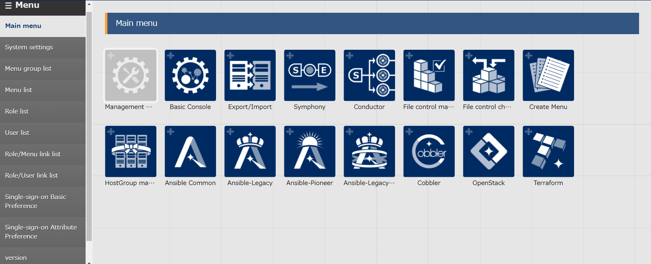
1.1 About this document
This document describes “ Host menu Management” and “ Menu creation”.
This document aims to explain the overview of Exastro IT Automation as well as introducing its functions.
The practice Document uses pictures of the ITA screen to explain, so please look at both documents.
Detailed specifications of each functions are written in their respective user manuals.

Slide 5
2. Host group management

Slide 6
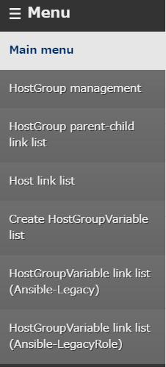
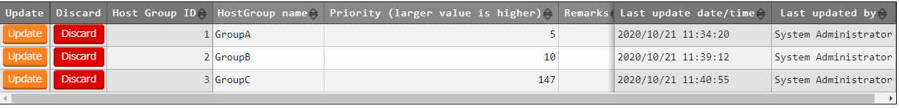
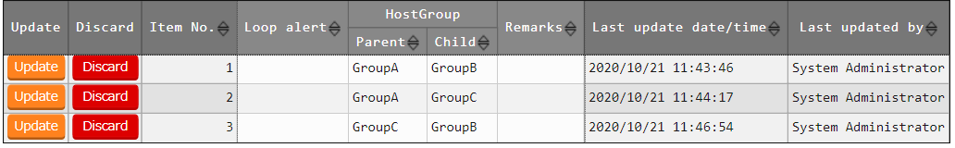
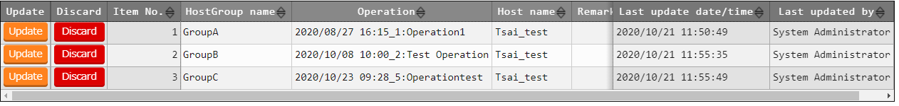
2.1 Menu overview
Main Menus used in this document
①Registering host groups/ Referencing menus
①
②
②Registering parent-child host to host menus
③
③Menu for registering links between Host, Operations and Groups names.
※For more information on menus other than ①②③
Please refer to Exastro-ITA_User_Instruction_Manual_Host_group_Function

Slide 7
2.2 Host group management
Users can group hosts together and instruct them simultaneously by using the group management function.
This function is necessary to manage multiple hosts in a large scale system.
With host groups
Without host groups
Host group A
Host A
Host B
Host C
Host A
Host B
Host C
Can give instructions to everyone
Must give instruction individually

Slide 8
2.3 Host groups Parent-Child relationship
Users can define Parent-Child relationships between Host groups .By doing so, parameters can be succeeded and host management becomes easier.(→Next Page)
Host group Parent-Child relationship
【Legend】
Host Group
ALL
Parent
Child
Group_A1
Group_A2
Group_B1
Group_B2
Group_B3

Slide 9
2.4 Succeeding Parameters.
By succeeding parameters from the Parent to the child, host groups can work more closely together. As a result, it is possible to handle Large scale systems.
Succeeding Parameters
【Legend】
Parameter settings
Host Group
Succeed
ALL
Succeed
Parent
Child
Succeed
Group_A1
Group_A2
Succeed
Group_B1
Group_B2
Settings
Settings
host_A
host_B
host_C
host_D
host_E
Parameters are set to individual hosts

Slide 10
2.5 Example of using host groups(1/4)
There are 3 hosts groups. “Overall management”, “DB Server group” and “Web server groups”. They are all defined in a parent-child relationship. Right now, there is no value set to the parameters in Host A~D
【Legend】
Overall Management (ALL)
Host Group
Parent
Child
DB Server group(Group_A1)
WEB server group(Group_B1)
Host A
Host B
Host C
Host D
【Parameter for each host】
Host | hostname | nameserver | password | server-admin
Host A | - | - | - | -
Host B | - | - | - | -
Host C | - | - | - | -
Host D | - | - | - | -

Slide 11
2.5 Example of using host groups(2/4)
Set the parameters for the “Overall Management” host group.
【Legend】
Overall management
nameserver : 8.8.8.8
Host group
Parent
Child
DB Server groups
WEB Server group
Parameter: Value
Host A
Host B
Host C
Host D
【Parameter for each host】
Host | hostname | nameserver | password | server-admin
Host A | - | 8.8.8.8 | - | -
Host B | - | 8.8.8.8 | - | -
Host C | - | 8.8.8.8 | - | -
Host D | - | 8.8.8.8 | - | -

Slide 12
2.5 Example of using host groups(3/4)
Set the different parameters for Host groups “DB Server group” and “Web server group”.
【Legend】
server-admin : admin@xxx.com
password : password1
Overall Management
Host group
Parent
Child
DB server group
WEB server group
Parameter : Value
Host A
Host B
Host C
Host D
【Parameter for each host】
Host | hostname | nameserver | password | server-admin
Host A | - | 8.8.8.8 | password1 | -
Host B | - | 8.8.8.8 | password1 | -
Host C | - | 8.8.8.8 | - | admin@xxx.com
Host D | - | 8.8.8.8 | - | admin@xxx.com

Slide 13
2.5 Example of using host groups(4/4)
Set individual parameters for each host.
【Legend】
Overall Management
Host group
Parent
Child
DB Server group
WEB Server group
Parameter : Value
Host A
Host B
Host C
Host D
hostname : host-A
hostname : host-B
hostname : host-C
hostname : host-D
【Parameters for each host】
Host | hostname | nameserver | password | server-admin
Host A | host-A | 8.8.8.8 | password1 | -
Host B | host-B | 8.8.8.8 | password1 | -
Host C | host-C | 8.8.8.8 | - | admin@xxx.com
Host D | host-D | 8.8.8.8 | - | admin@xxx.com

Slide 14
3. Menu creation functions

Slide 15
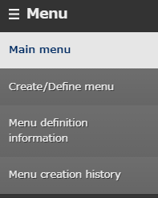
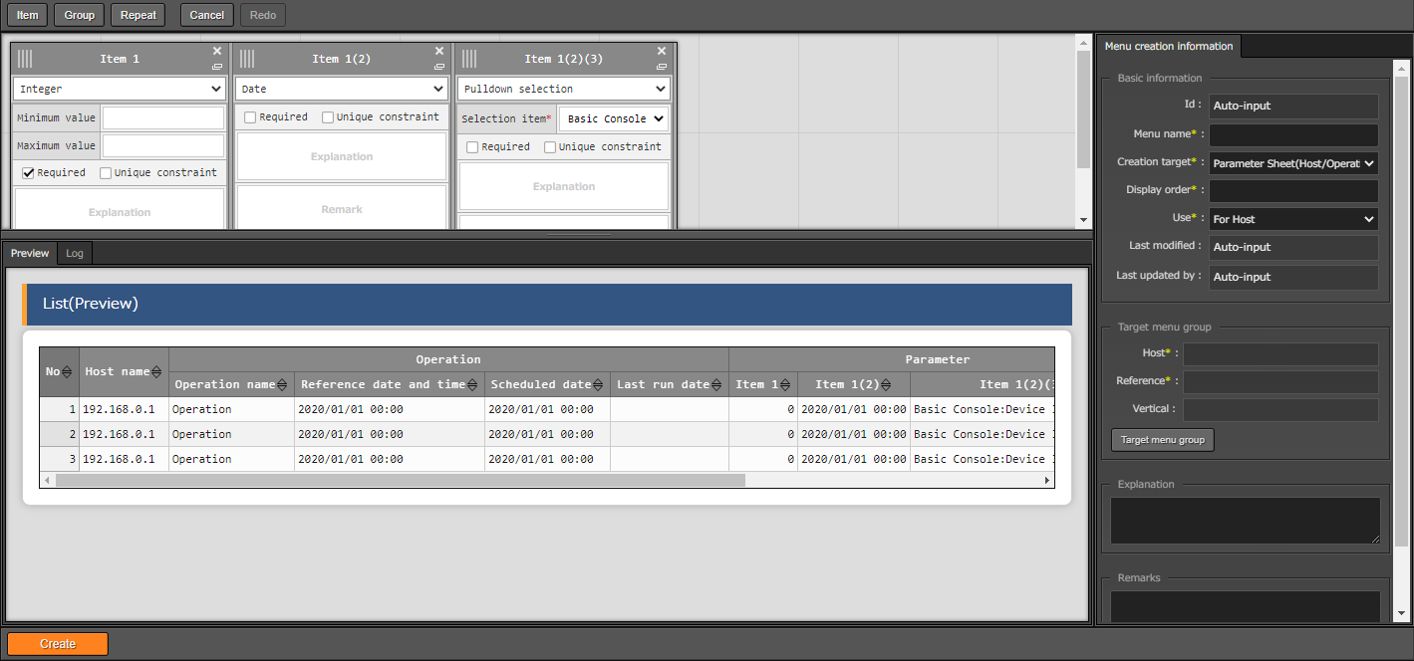
3.1 Menu overview
Main Menus used in this document
①Menu Create/Define Menu
①
②
③
②Referencing Menu
③Creation history Menu

Slide 16
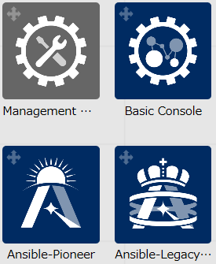
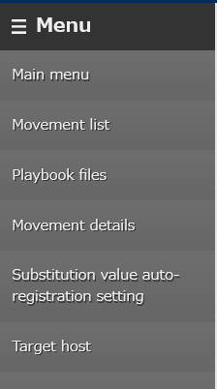
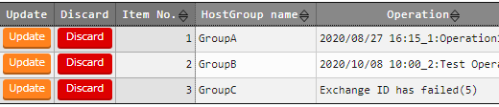
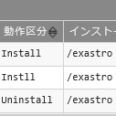
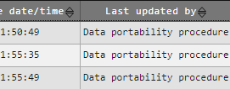
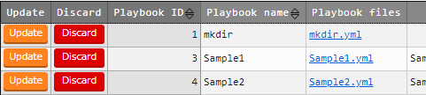
3.2 Menu construction
The Menus that can be created with the Menu creation functions are as follows.
[Menu group >> Menu >> Parameter sheet or Data sheet]
The following two types of menu sheets are creatable
Parameter sheets. Sheets that manages IaC variable values.
Data sheets. Sheets that does not link specific host and operations
Menu structure
Menu group
Menu
Parameter sheet
Arbitrary column
Data sheet
Arbitrary column
(※)The menus and menu groups shown above are examples

Slide 17
3.3 Parameter Sheet
In Parameter sheet, manage and register the variable substitute values used in IaC.
Create execution codes from Parameter sheets and IaC.
Image of creating an Execution code
Parameter Sheet
Variable | VAR_x | VAR_y | VAR_z
Value | AAA | BBB | CCC
Execution Code
Create
AAA ・ ・・ ・
・・ BBB ・・ ・
・・ ・・ CCC ・・
IaC
Variable
{{ VAR_x }}・・・ ・
・・ {{ VAR_y }} ・ ・
・ ・ ・ {{ VAR_z }} ・
(※)For linking variables, please take a look at the “practice document”

Slide 18
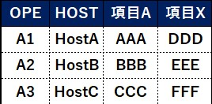
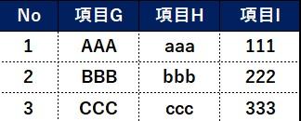
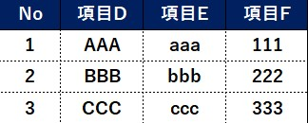
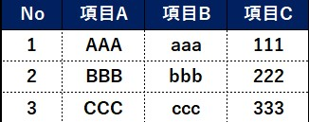
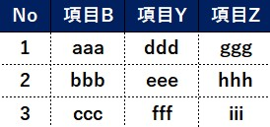
3.4 Data Sheet
Data sheet is managing data as CMDB(Configured Management Data Base).
The figure below shows an example of linking data sheet A with other sheets in “other menu references”.
Operating data sheets
Register Parameter
ITA
Parameter sheet B
Item A
Item X
Data sheet A
Item G
Item H
Item I
Item D
Item E
Item F
Item A Item B Item C
Other menu references
Data sheet B
Item B
Item Y
Item Z
Users can register parameters from Web menus, Excel files and RestAPI.(Same with Parameter sheets)

Slide 19
3.5 Menu creation flow
The general flow when creating a menu is shown below. This document will describe it in a similar order.
It is recommended to follow the practice document and operating the system after reading this slide.
Flow when creating a menu
Explanation
Creating a menu group
・To learn about how to create Menu groups, please refer to the practice document.
・From “Target creation”, choose “Parameter sheet” or “Data sheet”
Creating a menu
・In the case of creating a parameter sheet, choose “Purpose”(More information in 3.6 Item registration in this document)
・Select the destination where the Menu group will be created
・Select the Item`s input method
Creating an item
・Create sheet item (more information in “3.9 Item registration” in this document)

Slide 20

3.6 Purpose of parameter sheets and menu groups.
Select either “For Host” or “For Host groups” for the parameter sheet ”Purpose”.
After that, specify the Menu group that is going to be created
【Parameter sheet purposes and creatable menu groups】
Purpose: For host
Create
Parameter sheet creation information
Menu group for host
Menu group
For referencing
Purpose: For Host group
Create
Parameter sheet
Creation information
Menu group for Hostgroup
Menu group for host
Menu group for referencing
※The menus with red text are mandatory
(※)The parameter sheets shown above does not use vertical management tools.
For more information on Vertical Management Tools, please refer to Exastro-ITA_User_Instruction_Manual_Menu_creation_function

Slide 21
3.7 Menu groups in Parameter sheets)
The relationship between “Menu group for hosts” and “Menu group for referencing” is shown in the figure below.
ITA
Menu group for hosts
Menu group for referencing
(※)Menu group for Hosts parameters can link with IaC Variables. Please refer to the Practice document for on how to link.
Search target
The parameter settings are done, so I will register them to the parameter sheets.
Registering Parameters
Referencing Parameters
I want to check the parameters that the host should have.
In charge of settings
In charge of operating
Person in charge of settings does not have to worry about the current parameters
⇒ Can focus on Settings
Person in charge of operating only references the desired parameters
⇒ Can focus on Operating

Slide 22
3.7 Menu groups in Parameter sheets(2/2)
The relationship between the menu groups with Parameter sheets with "For Host groups" set as purpose, "Menu group for hosts", "Menu group for referencing" and "Menu group for Host groups" are as shown below
ITA
Menu group for Hostgroup
Menu group for Host
Menu group for referencing
Divided per host
Search target
The parameter settings are done, so I will register them to the parameter sheets.
I want to check the parameters that the host should have.
Register Parameters
References Parameters
(※)The parameter sheets for Menu groups can link with IaC.
Refer to the Practice document for more information on Linking.
In charge of settings
In charge of operating

Slide 23
3.8 Operating the Parameters` Menu groups(1/2)
Parameter sheets with "For host" purposes `Menu group for Host`s parameter will be set to separate hosts.
【Parameter sheets for Menu group for Hosts】
Host Name | Operation | Parameter 1 | Parameter 2 | Parameter 3
Host A | Operation A | AAA | CCC | EEE
Host D | Operation A | BBB | DDD | FFF
【Parameter settings】
【Legend】
Overall Management
Host Group
Parent
Child
DB server group
WEB server group
Host A
Host B
Host C
Host D
Parameter
Parameter

Slide 24
3.8 Operating the Parameters` Menu groups(1/2)
The “for host group” parameters sheets in “ For Host group” purpose parameter sheets will be divided into parameter sheets “for hosts”.( More details on the next page) Parameters will be set to hosts in the host group.(Figure below)
【Parameter sheet for Menu group for Host groups】
Host group name(※) | Operation | Parameter 1 | Parameter 2 | Parameter 3
DB server group | Operation A | AAA | CCC | EEE
WEB server group | Operation A | BBB | DDD | FFF
※It is also possible to assign host name names
【Parameter settings】
【Legend】
Overall management
Host group
Parameter
Parameter
Parent
Child
DB Server group
WEB server group
Divided Parameter
Divided Parameter
Divided Parameter
Divided Parameter
Host A
Host B
Host C
Host D

Slide 25
3.8.1 Reference – Dividing Menu groups for Host groups
Parameter sheets with "For host" purposes` Menu group for Host`s parameter will be divided per hosts and automatically registered to parameter sheets for hosts.
Dividing menu groups for host groups` parameter sheets
Parameter sheet for Menu group for Host groups
Host group name | Operation | Parameter 1 | Parameter 2 | Parameter 3
DB server group | Operation A | AAA | CCC | EEE
WEB server group | Operation A | BBB | DDD | FFF
Divide
Host A and B belongs to Host Group DB Server group. Host C and D belongs to Host group Web Server group.
Parameter sheet after division
Host name | Operation | Parameter 1 | Parameter 2 | Parameter 3
Host A | Operation A | AAA | CCC | EEE
Host B | Operation A | AAA | CCC | EEE
Host C | Operation A | BBB | DDD | FFF
Host D | Operation A | BBB | DDD | FFF
Registration
Parameter sheet for Host

Slide 26
3.9 Other menu groups in Parameters
Menu group for vertical management
For more information regarding Menu groups for vertical management, please refer to " Exastro-ITA_User_Instruction_Manual_Menu_creation_function"
Parameter sheets for referencing
More information on " Parameter sheets for Referencing" can be found in “3.10 Parameter sheet for referencing” in this document

Slide 27
3.10 Item registration
Functions that can be used when creating parameter sheets or data sheet items are as shown below.
【 Functions when creating menu items 】
Reference other menus
Users can choose sheet values found in other menus from a pulldown.
Necessary input items settings
Unique constraint settings
Biggest byte size settings
Input value check from regular expression settings
Please refer to Exastro-ITA_User_Instruction_Manual_Menu_creation_function (P.16-17)

Slide 28
3.10.1 Referencing other menus
By specifying Parameter sheets or Data sheet items in “ Other Menu references” (※) when creating menu items, users can select from a pulldown when entering parameters.
(※)For more information on referencing other menus, please refer to Exastro-ITA_User_Instruction_Manual_Menu_creation_function
Referencing other menus
Data sheet A
Data sheet B
Value1 | Value2 | Value3
AAA | CCC | EEE
BBB | DDD | FFF
Value4 | Value5 | Value6
111 | 300 | 500
222 | 400 | 600
Parameter sheet A
Host Name | Operation | Parameter 1 | Parameter 2 | Parameter 3 | Parameter 4
Host1 | Operation A | AAA | FFF | 200 | 111
Host2 | Operation B | △ | EEE | 500 | 222
AAA
Pull down
BBB
By using Other menu references, users can prevent miss-writing and such in other works.

Slide 29
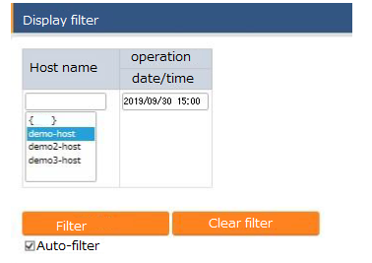
3.11 Parameter sheet for referencing（1/2）
Users can search for parameters from Menu groups for host parameter sheets by inputting the standard time and host name.
if no date is entered when searching, the newest data will be displayed.
Parameter sheet for referencing
Select host name
Enter the basic date/time

Slide 30
3.11 Parameter sheets for referencing（2/2）
Standard time and date
⇒ If the corresponding operation has been executed before, the Standard date and time will be " last executed date". If not, the standard time and date will be " Scheduled execution date".
Example of standard time and date.
No | Target host | Operation name | Schedule execution date | Last executed date | Standard time/date
1 | Host A | Operation 1 | 9/1 00:00:00 | 9/15 00:00:00 | 9/15 00:00:00
2 | Host A | Operation 2 | 11/1 00:00:00 |  | 11/1 00:00:00
3 | Host A | Operation 3 | 12/24 00:00:00 |  | 12/24 00:00:00
※Operation No.2 and No.3 has yet to be executed.

Slide 31
3.12 Example of using Parameter sheets for referencing(1/5)
Pre condition
前提条件
Case 1-4 will be executed on the 10/1(Execution date)
Parameter sheet
Host | Operation | Operation Standard Time/Date | Parameter A | ・・・
Host A | Operation 1 | 9/15 00:00:00 | AAA | ・・・
Host A | Operation 2 | 11/1 00:00:00 | BBB | ・・・
Host A | Operation 3 | 12/24 00:00:00 | CCC | ・・・
Operation set to Parameter A as host.
【Host A`s work schedule】
Operation 1
Operation 2
Operation 3
set “AAA”
Execution date
set “BBB”
set “CCC”
9/15
10/1
11/1
12/24
Standard time/date(Time is shortened)

Slide 32
3.12 Example of using Parameter sheets for referencing(2/5)
Case①
Setting「9/1 00:00:00」and executing search.
【Host A`s work schedule`s standard time and date.】
Set to Standard time/date
Set “AAA”
Execution date
Set “BBB”
Set “CCC”
9/1
9/15
10/1
11/1
12/24
Host | Operation | Operation standard time/date | Parameter A | ・・・
Host A | Operation 1 | 9/15 00:00:00 | AAA | ・・・
Host A | Operation 2 | 11/1 00:00:00 | BBB | ・・・
Host A | Operation 3 | 12/24 00:00:00 | CCC | ・・・
結果
Since no parameter settings are set by now ( 9/1), there will be no corresponding search results

Slide 33
3.12 Example of using Parameter sheets for referencing(3/5)
Case②
ケース②
Setting the standard time/date to「10/2 00:00:00」and executing search.
【Host A`s work schedule`s standard time and date.】
Set to Standard time/date
set “AAA”
Execution date
set “BBB”
set “CCC”
9/15
10/1
10/2
11/1
12/24
Host | Operation | Operation standard time/date | Parameter A | ・・・
Host A | Operation 1 | 9/15 00:00:00 | AAA | ・・・
Host A | Operation 2 | 11/1 00:00:00 | BBB | ・・・
Host A | Operation 3 | 12/24 00:00:00 | CCC | ・・・
７/3の時点では”パラメータA”には“BBB”が設定されているため、“BBB”が検索結果として表示されます。
Since AAA is set to Parameter A now (1/2), AAA Will show up in the search results.

Slide 34
3.12 Example of using Parameter sheets for referencing(4/5)
Case ③
Setting the standard time/date to「12/23 00:00:00」and executing search.
【Host A`s work schedule`s standard time and date.】
Set to standard time/date
set “AAA”
set “BBB”
Set “CCC”
Execution date
9/15
10/1
11/1
12/23
12/24
Host | Operation | Operation standard time/date | Parameter A | ・・・
Host A | Operation 1 | 9/15 00:00:00 | AAA | ・・・
Host A | Operation 2 | 11/1 00:00:00 | BBB | ・・・
Host A | Operation 3 | 12/24 00:00:00 | CCC | ・・・
結果
Since BBB is set to Parameter A by now (12/23), BBB will show up in the search results.

Slide 35
3.12 Example of using Parameter sheets for referencing(5/5)
Case③
ケース
Leaving the standard time blank and executing a search.
【Host A`s work schedule`s standard time and date.】
set “AAA”
Execution date
set “BBB”
set “CCC”
9/15
10/1
11/1
12/24
Host | Operation | Operation standard time/date | ParameterA | ・・・
Host A | Operation 1 | 9/15 00:00:00 | AAA | ・・・
Host A | Operation 2 | 11/1 00:00:00 | BBB | ・・・
Host A | Operation 3 | 12/24 00:00:00 | CCC | ・・・
結果
Searching when the standard time is left blank will display the latest values from when the search was executed as search results. Therefore, AAA will be displayed in the search results.

