Slide 1


Ansible Driver【Practice】
※In this document, “Exastro IT Automation” is described as “ITA".
Exastro IT Automation ver 1.9.0
Exastro developer

Slide 2
Table of contents
■Introduction
Ansible-Legacy
Work environment and Scenario
Required file creation
Moment configuration
Conductor creation
Operation registration
Register to device list
Parameter sheet creation
Data registration
Substitution value automatic
registration configuration
Check Substitution value and
Target host
Execution
Ansible-LegacyRole
Work environment and Scenario
Role package preparation
Moment configuration
Operation registration
Register to device list
Parameter sheet creation
Data registration
Substitution value automatic registration setting
Check Substitution value and Target host
Execution
Ansible-Pioneer
Work environment and Scenario
Dialog file creation
OS type creation
Moment configuration
Operation registration
Register to device list
Parameter sheet creation
Data registration
Substitution value automatic
registration configuration
Check Substitution value and
Target host
Execution
Appendix

Slide 3



Introduction - How to use this document
How to use this document
This document will cover 3 scenarios. [Ansible-Legacy] [Ansible-LegacyRole] [Ansible-Pioneer] Users can learn how to use the different modes as well as their strengths by getting hands on experience. As each scenario is independent, users can choose and learn whatever chapter they want.
Chapter 1 Ansible-Legacy Register and use Playbook (YAML file).
Chapter 2 Ansible-LegacyRole Register and use Role package.
Chapter 3 Ansible-Pioneer Register and use Dialog files by using Ansible's original module provided by ITA.

Slide 4
Chapter 1 Ansible‐Legacy

Slide 5


1.1 Work environment and Scenario
Work environment The work environment used in this document is as follows.(The same as Chapter 2 Ansible-Legacy Role) Please prepare a server in addition to the ITA Host server. The additional server will be target for operation. ITA Host Server ・CentOS 7 (※1) ・ITA 1.9.0 ・Ansible 2.11.2 Target ・CentOS 7 (※2)
CentOS 7
ITA
1.9.0
Ansible
2.11.2
CentOS 7 target Server
ITA Host Server
※1 In this scenario, CentOS7 will be used for the host server, but ITA can be installed on any RHEL7 and RHEL8 type OS. ※2 Any OS compatible with Ansible can be used.

Slide 6

1.1 Work environment and Scenario
Scenario You can experience the reusability of Playbooks by going through a task that consists of three major steps. ① Combine Movements and create Conductor. ② Create menu and register parameters. ③ Execute the created Conductor. In this scenario, we will install and start both "Apache" and "Tomcat“.
Scenario Image
① Create one Conductor
② Create Parameter sheet (Manage the substitution values to the Playbook and work target)
Playbook① Yum install
③ Check the addition of both services. ・Apache
・Tomcat
Playbook② Opening port
Playbook③
index.html arrangement
Playbook④ Service start
Target Server
Playbook⑤ Service start confirmation

Slide 7
1.2 Creation of required files(1/3)
Playbook creation This scenario will create the following five Playbooks. [Attention] Create the yml file with Character code " UTF-8“ and New line code "LF".
- name: install package with yum
yum:
name: "{{ item }}"
state: present
with_items: "{{ VAR_package_name }}"
File name：1-yum_install.yml
Installs the specified package. Multiple specific value variables are substituted in the Variables.
- name: install firewalld
yum: pkg=firewalld state=present
- name: start firewalld
service: name＝firewalld state=started enabled=yes
- name: open ports
firewalld:
port: "{{ VAR_port_number }}"
state: enabled
permanent: yes
immediate: true
File name：2-open_port.yml
Install and run firewalld. Allows communication to the specified port.

Slide 8
1.2 Creation of required files(2/3)
Playbook creation
- name: copy index.html
copy:
src: “{{ CPF_index_html }}”
dest: /var/www/html/index.html owner: root group: root
mode: 0644
backup: yes when: ‘VAR_service_name == “httpd”’
File name: 3-copy_index.yml
Copies and arranges files
- name: start service
service:
name: "{{ VAR_service_name }}"
state: started
enabled: yes
File name: 4-start_service.yml
Starts the specified service.
- name: check if service is running and enabled
command: 'systemctl status {{ VAR_service_name }}'
register: command_result
failed_when:
- '"enabled" not in command_result.stdout'
- '"running" not in command_result.stdout'
File name: 5-check_service.yml
Checks if the service has started.

Slide 9
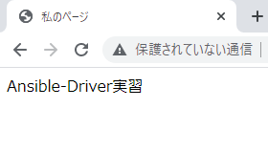
1.2 Creation of required files (3/3)
index.html creation
In this scenario, the configuration file is deployed using the "File Management Function“.
File name: index.html
Place this html file directory under
document root.
When correct index.html file is placed after operation is completed, following screen should appear.
<html>
<head>
<title>my page</title>
</head>
<body>
Ansible-Driver practice
<br>
</body>
</html>

Slide 10
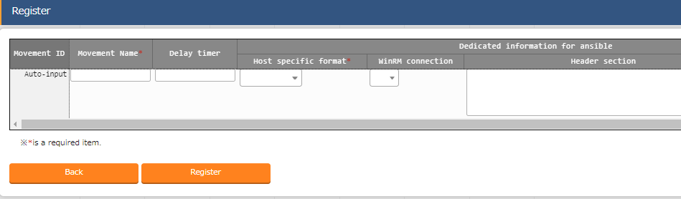
1.3 Movement configuration(1/4)
Create Movement Register the Movements that is going to be associated with the Playbooks. Menu : Ansible-Legacy > Movement list
Click Register > Start Registration.
Select or input the following information for each item and click "Register".
２
Movement name | Host specific format
Install_Packages | IP
Open_Ports | IP
Start_Service | IP

Slide 11
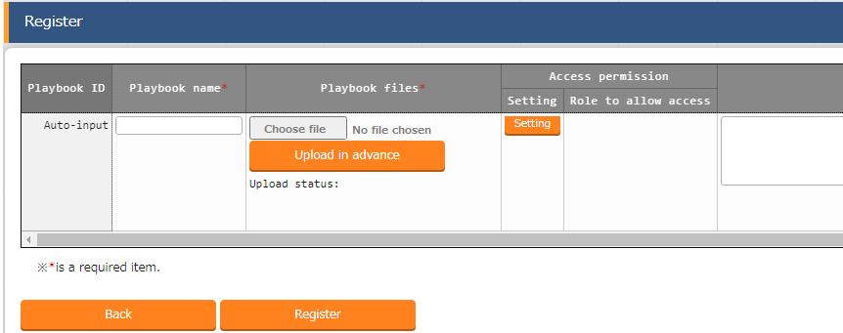
1.3 Movement configuration(2/4)
Register Playbook Register the Playbooks we created.
Menu : Ansible-Legacy > Playbook files
Click Register > Start Registration.
Select a Playbook from "Browse" and click "Upload in advance".
Input the following information for each item and click "Register".
３
Playbook files name | Playbook files
yum_install | 1-yum_install.yml
open_ports | 2-open_ports.yml
copy_index | 3-copy_index.yml
start_service | 4-start_service.yml
check_service_state | 5-check_service.yml

Slide 12
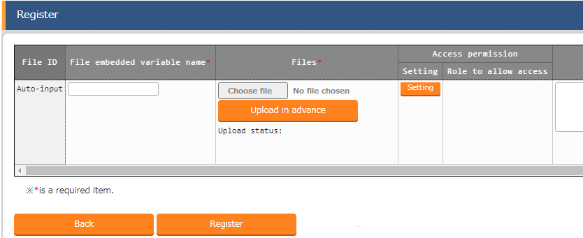
1.3 Movement configuration(3/4)
Register file Register the httpd configuration file.
Menu : Ansible Common > File list
Click Register > Start Registration.
Select the file from "Browse" and click "Upload in advance".
Input the following information for each item and click "Register".
３
File embedded variable name | File
CPF_httpd_conf | httpd_config.txt

Slide 13
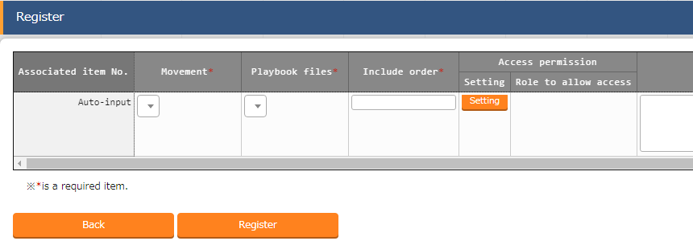
1.3 Movement configuration(4/4)
Register the Playbook to Movement Link the created Movement and Playbook files. By dividing the contents of the operation and giving them names makes it easier to reuse them. Menu: Ansible-Legacy > Movement playbook link
Click Register > Start Registration.
Select or input the following information for each item and click "Register".
２
Associate Table
Movement | Playbook files | Include order
Install Packages | yum_install | 1
Open Ports | open_ports | 1
Start Service | copy_index | 1
Start Service | start_service | 2
Start Service | check_service_state | 3
“Start Service” links the 3 Playbook
files and executes them together.
Point

Slide 14
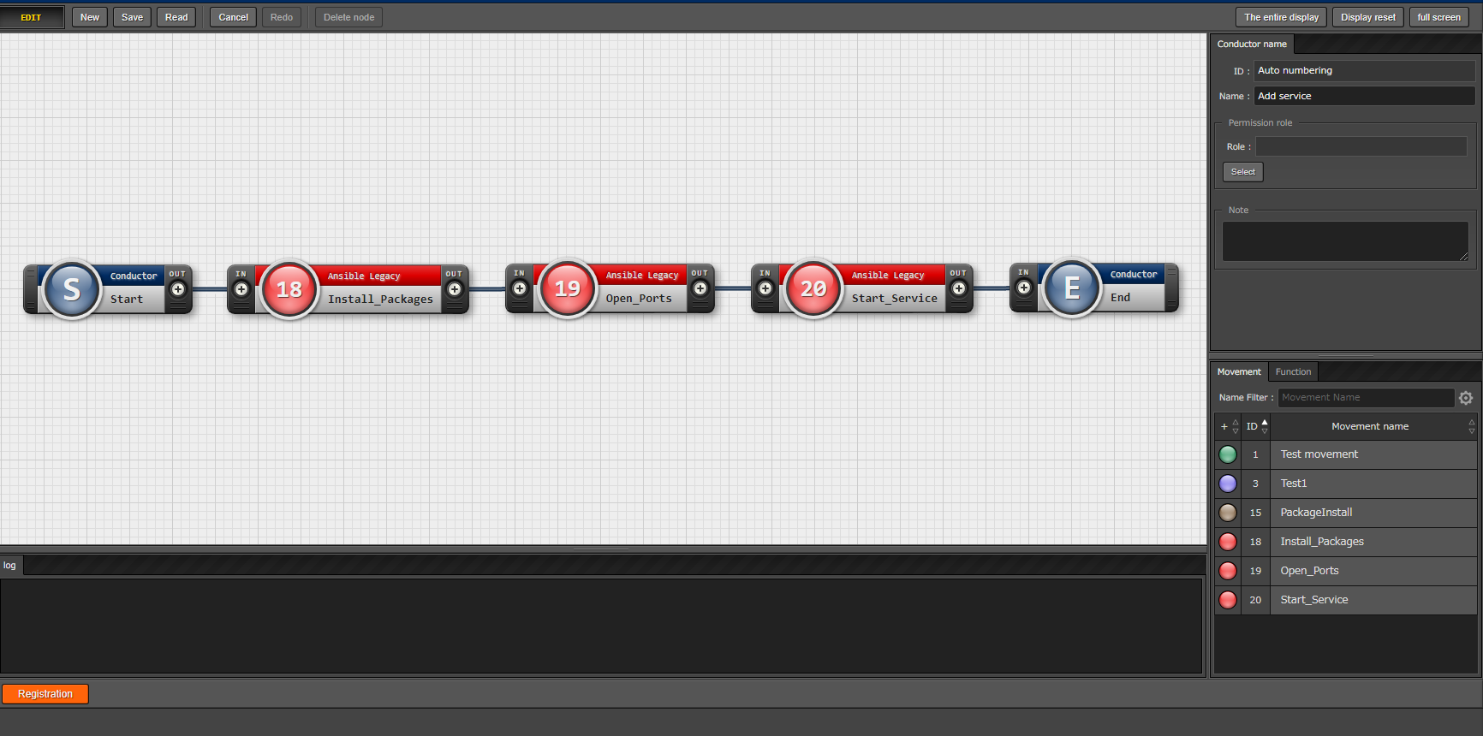
1.4 Conductor creation
Create Conductor Create a Conductor that collects the defined Movements.
Menu: Conductor > Conductor class edit
１
Input Conductor name.
Conductor name
Add service
３
Connect nodes to each others.
Movement | Operation order
Install Packages | 1
Open Ports | 2
Start Service | 3
２
Add the Movements by
dragging and dropping.
４
Click "Registration".

Slide 15
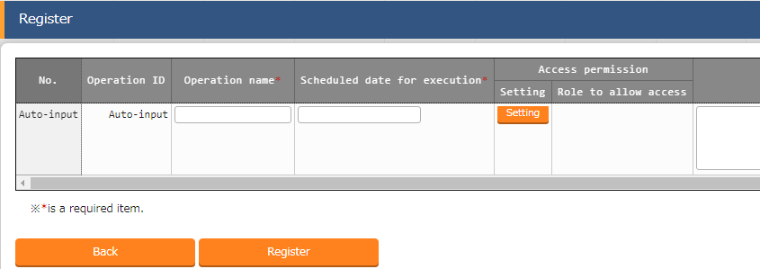
1.5 Operation registration
Register new operation Create operation. Link Movement and Host. ※ “Operation” is the name of the work operation used in the ITA System and represents the entire operation.
Menu : Basic Console > Operation list
Click Register > Start Registration.
Input the following information for each item and click "Register".
２
Operation name | Scheduled date for execution
Install Apache | (Enter arbitrary value)
Install Tomcat | (Enter arbitrary value)
※ "Scheduled date for execution" is just an item for management. It will not be executed automatically.

Slide 16
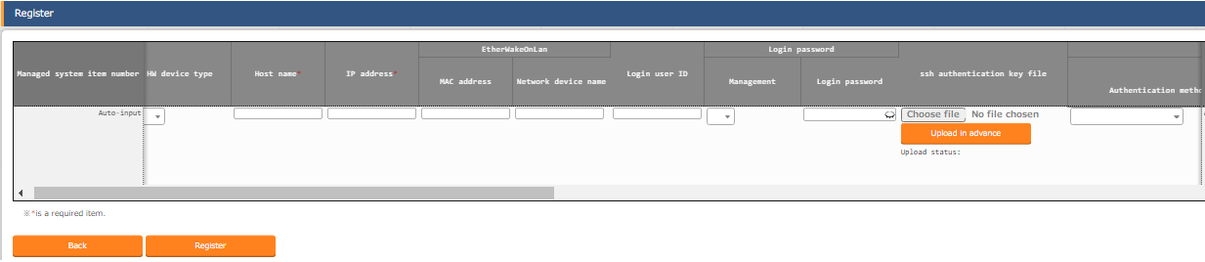
1.6 Register to device list
Register a host to the device list Register host that will execute the operation in ITA. Menu : Basic Console > Device list
Click Register > Start Registration.
Select or input the following information for each item and click "Register".
２
Item | Input contents
HW device type | SV
Host name | (Arbitrary value)
IP address | (Arbitrary value)
Login user ID | (Arbitrary value)
Management | ●
Login password | (Arbitrary value)
Authentication method | Password Authentication

Slide 17
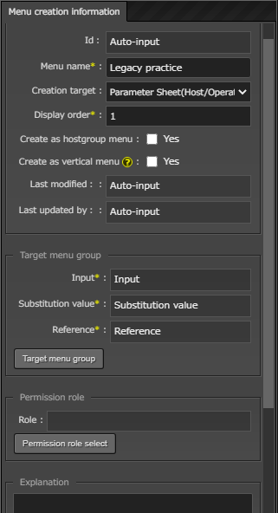
1.7 Parameter sheet creation (1/2)
Create menu Create a parameter sheet and manage the parameters that apply to the target host.
Menu : Create menu > Create/Define menu
Input the following information.(Next item)
１
Item name | Input contents
Menu name | Legacy practice
Target | Parameter sheet (Host/Operation)
Display order | 1

Slide 18
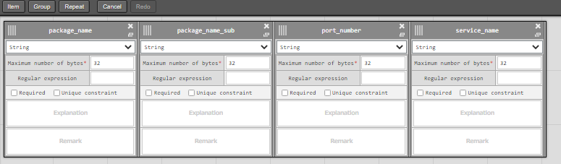
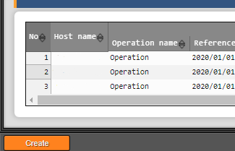
1.7 Parameter sheet creation (2/2)
Define the item name of the parameters sheet Continuing from the previous section, define the items on the sheet.
Menu : Create menu > Create/Define menu
Click item.
Select or input the following information for each item and click “create".
１
2
Item name | Input method | Maximum number of bytes
package_name | String | 32
package_name_sub | String | 32
port_number | String | 32
service_name | String | 32
2

Slide 19
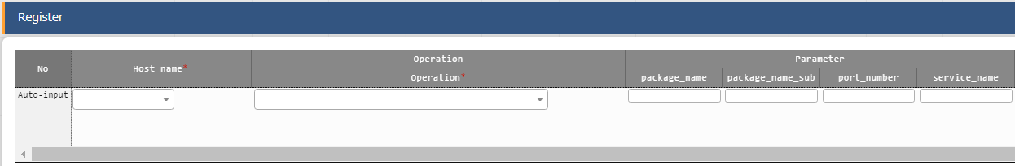
1.8 Data registration
Register data to the parameter sheet The parameter sheet was created by the operation in the previous section. Move to the created menu and input the data.
Menu: Input > Legacy practice(Created menu)
Click Register > Start Registration.
Select or input the following information for each item and click "Register".
2
Host name | Operation | package_name | package_name_sub | port_number | service_name
(Target host) | Install Apache | httpd | (blank) | 80/tcp | httpd
(Target host) | Install Tomcat | tomcat | tomcat-webapps | 8080/tcp | tomcat

Slide 20
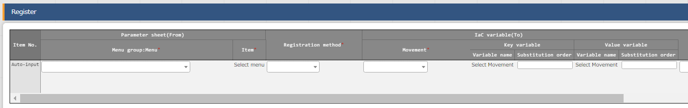
1.9 Substitution value automatic registration setting
Set Substitute Value Automatic Registration settings Connect the variables to each item after entering the data in the parameter sheet.
Menu: Ansible-Legacy > Substitution value automatic registration setting
Click Register > Start Registration.
Select or input the following information for each item and click "Register".
2
Menu | Item | Registration method | Movement | Value variable variable name | Substitution order
Legacy practice | package_name | Value type | Install Packages | VAR_package_name | 1
Legacy practice | package_name_sub | Value type | Install Packages | VAR_package_name | 2
Legacy practice | port_number | Value type | Open Ports | VAR_port_number | (Blank)
Legacy practice | service_name | Value type | Start Service | VAR_service_name | (Blank)

Slide 21
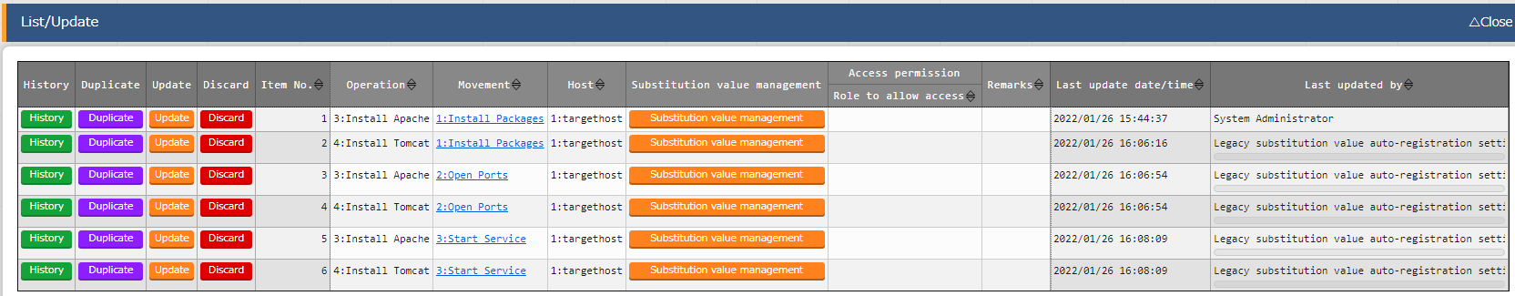
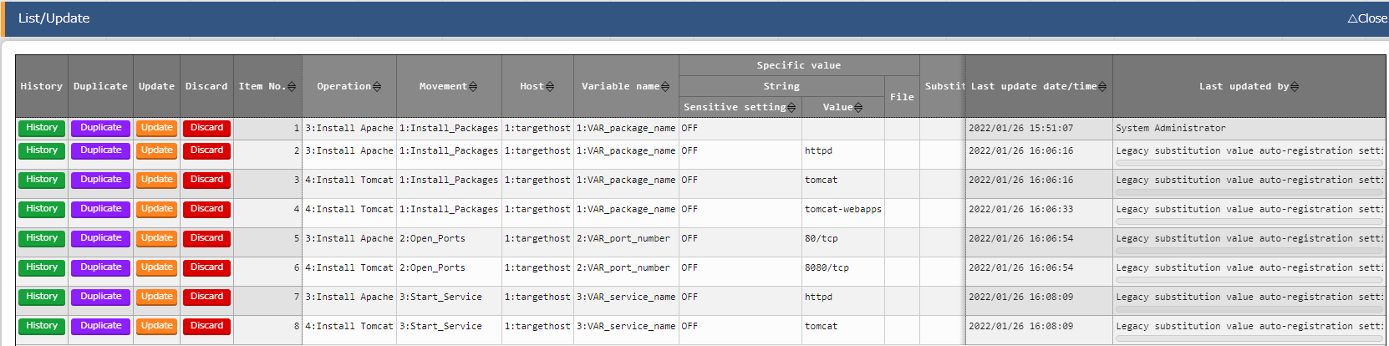
1.10 Check Substitution value and Target host
Check Substitution value and Target host Check target host and values specified by substitution value automatic registration.
Menu: Ansible-Legacy > Target host
Ansible-Legacy > Substitution value list
Click "Filter".
Check that the correct value is specified by "legacy substitution value automatic registration setting procedure".
Target host
Substitution
value list

Slide 22
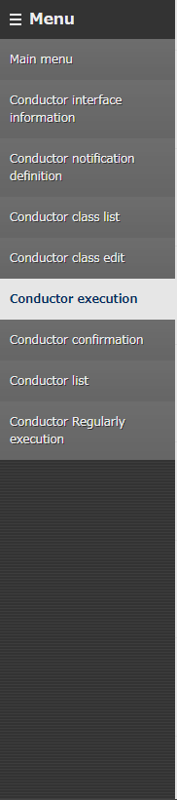
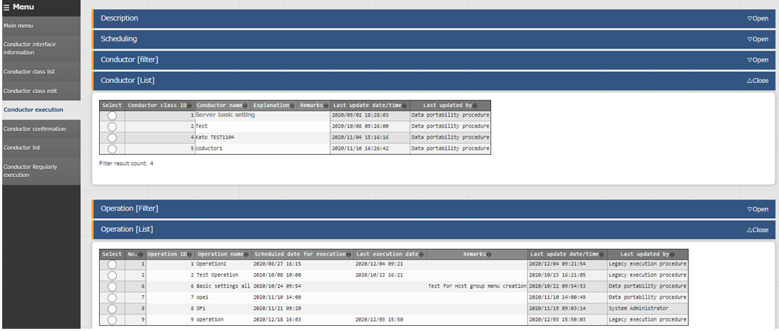
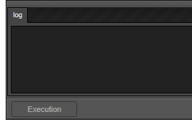
1.11 Execution (1/3)
Execute Conductor If you finished the operations in the previous section, the Conductor should be created and the substitute values should be registered. Finally, execute Conductor and check the result on the target host.
Menu： Conductor > Conductor Execution
Select the Conductor to execute.
１
Select Operation.
２
Tips
Click "Execution" at the bottom
of the screen.
The screen will automatically change
to the "Conductor Confirmation"
screen after executing.
3

Slide 23
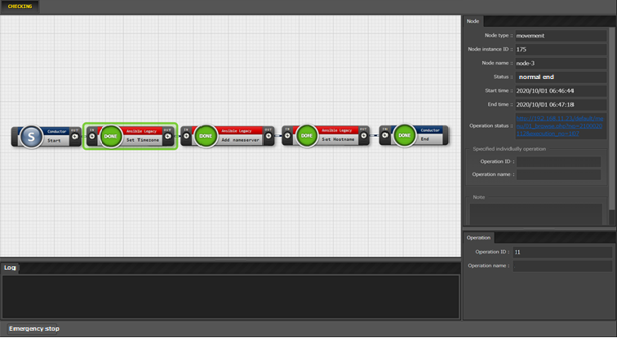
1.11 Execution (2/3)
Check the Conductor Execution results In the work confirmation screen, you can check the results of the whole execution or execution per node. Selecting an inputted Movement will show a link to a more detailed result screen.
Menu： Conductor > Conductor Confirmation
Select the node you want to check.
Link and operation
information are displayed.
２
１
Tips
Click “DONE” to move to detailed
Result screen

Slide 24
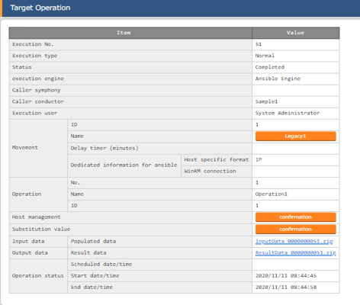
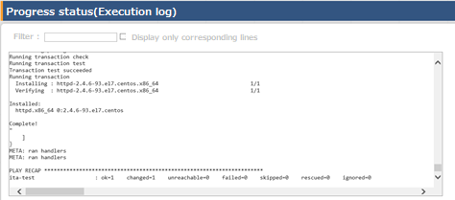
1.11 Execution (3/3)
Check the detailed results for each Movement Clicking the link will transfer the user to a screen where Execution status and logs are displayed.. Users can also check the input data and output data.
Tips
Users can download a zip file that collects input data
and result data.
Tips
Users can check the installation of Apache
and Tomcat in the following URLs. Apache- http://(Host IP address):80
Tomcat- http://(Host IP address):8080

Slide 25
Chapter２ Ansible-LegacyRole

Slide 26
2.1 Work environment and Scenario (1/3)
Work environment The work environment used in this document is as follows.(The same as Chapter 1 Ansible-Legacy Role) Please prepare a server in addition to the ITA Host server. The additional server will be target for operation. ITA Host Servers ・CentOS 7 (※1) ・ITA 1.9.0 ・Ansible 2.11.2 Target ・CentOS 7 (※2)
CentOS 7
ITA
1.9.0
Ansible
2.11.2
CentOS 7 Target Server
ITA Host Server
※1 In this scenario, CentOS7 will be used for the host server, but ITA can be installed on any RHEL7 and RHEL8 type OS. ※2 Any OS compatible with Ansible can be used.

Slide 27
2.1 Work environment and Scenario (2/3)
Scenario image
The most important feature of LegacyRole is that allows users to register and use role packages. In this document, we will register and execute the Role downloaded from Ansible Galaxy to ITA.
Menu creation
Create parameter sheet
(Substitution value management)
Role
Ansible-Galaxy
ITALegacyRole
Execute the operation
①Download
Create ITAreadme and substitution table.
Register Movement and Operation.

Slide 28

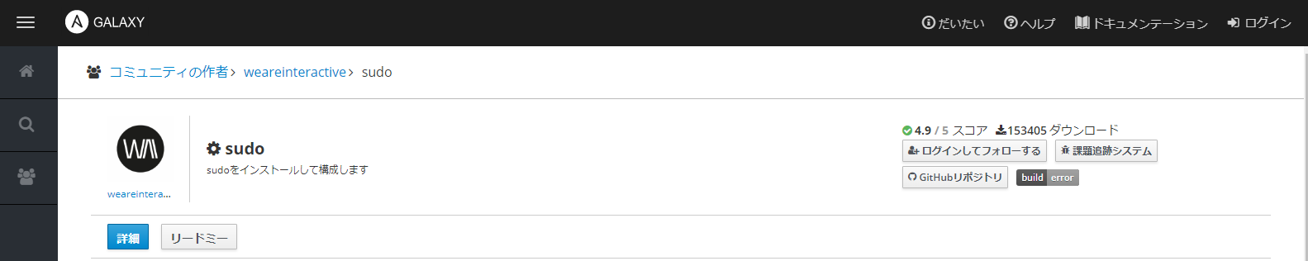
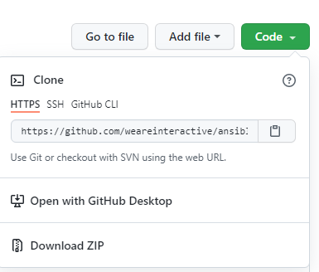
2.1 Work environment and Scenario (3/3)
Role download First, access the URL below and download the role.
Role package that adds files under /etc/sudoers.d
Click Github repository
Click Code
Click DownLoadZIP
https://galaxy.ansible.com/weareinteractive/sudo
Download method
１
２
3
Notes:
Ansible-LegacyRole
Scenario
事前準備
ロールの登録
Moment configuration
オペレーションの設定
代入値のManagement Parameter sheet creation パラメータシート入力
Execution

Slide 29
2.2 Role package preparation(1/4)
Before preparing the package Let's look at the role's defaults/main.yml that we are going to use.(Refer to the figure below) There are two points that need to be changed before execution. In cases like these, by creating ITAreadme and substitution tables, users can make necessary changes to the variable definitions without changing the file inside the package.
---
# sudo_defaults:
#(omission) ~~~~
# package name (version)
sudo_package: sudo
# list of username or %groupname
sudo_users: []
# list of username or %groupname and their defaults
sudo_defaults: []
# default sudoers file
sudo_sudoers_file: ansible
# path of the sudoers.d directory
sudo_sudoers_d_path: /etc/sudoers.d
# delete other files in `sudo_sudoers_d_path`
purge_other_sudoers_files: no
- defaults: env_reset
# - name: user1
# defaults: requiretty
# sudo_users:
# - name: '%group1'
# - name: 'bar'
# nopasswd: yes
~~~~
The correct mapping example is commented
out and only an empty array is defined.
１
Change the structure using ITAreadme. Use the substitution table to enable editing in ITA.
The part that the user wants to change is the
name of the file when it is generated during
execution time.
２
Use the substitution table to enable editing in ITA.

Slide 30

2.2 Role package preparation(2/4)
ITAreadme descriptions ita_readme is a configuration file for adding and changing variable definitions. ※ For details about ITAreadme, please refer to this Manual.
File name: ita_readme_ansible-sudo-master.yml
sudo_users:
- name:
Change to the correct mapping.
Image
Actual variables used
defaults/main.yml sudo_package: sudo
sudo_users: []
１
sudo_package: sudo sudo_users:
- name: example_name
Fill in the correct mapping.
２
Substitution value
management
ITAreadme sudo_users:
- name:
Variable name | Member variable name | Specific value
LCA_sudo_users | [0].name | example_name
読替表
The substitution table will be described in the next section.

Slide 31
2.2 Role package preparation(3/4)
Substitution table description The substitution table is defined in the defaults variable definition file or ITAreadme. It is a file that allows for specific values of variables other than "VAR_..." to be set in ITA. ※For details about the substitution table, please refer to this Manual.
File name: ita_translation-table_ansible-sudo-master.txt
LCA_sudo_users: sudo_users
LCA_sudo_sudoers_file: sudo_sudoers_file
Image
Actual variables used
defaults/main.yml sudo_users: []
~~~~ (omission) ~~~~
sudo_sudoers_file: ansible
ITAreadme sudo_users:
- name:
sudo_users:
- name: example_name
sudo_sudoers_file: example_sudoers
Substitution value management
substitution table
LCA_sudo_users: sudo_users
LCA_sudo_sudoers_file: sudo_sudoers_file
Variable name | Member variable name (Added ITAreadme) | Specific value
LCA_sudo_users | [0].name | example_name
LCA_sudo_sudoers_file |  | example_sudoers

Slide 32
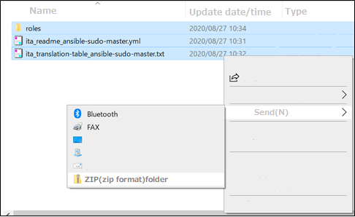
2.2 Role package preparation(4/4)
Collect the necessary files into a zip file Let's collect all the items we've created into a zip file and register them to ITA. Please create a zip file as described below.
Create a "roles" folder and put the downloaded Role in it.
Arrange the substitution table and ITAreadme side by side in the "roles" folder.
Compress the "roles" folder, Substitute table and the ITAreadme into one zip file.
１
Put "Ansible-sudo-master" under "roles“.
２
Move the Substitute table and ITAreadme into the
folder.
３
Tips
Compress them into one
zip file.
LegacyRole will handle folders as Roles
as long as they fulfill the following two
conditions. ① It is under the "roles" folder.
② It includes a "tasks" folder.

Slide 33
2.3 Movement configuration(1/3)
Create Movement
Create a movement that is going to be linked to the Role.
Menu：Ansible-LegacyRole > Movement list
Click Register > Start Registration.
Select or input the following information for each item and click "Register".
2
Item name | Input contents
Movement name | RegisterSudoer
Host specific format | IP

Slide 34
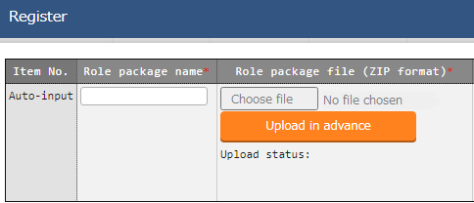
2.3 Movement configuration(2/3)
Role package registration Register the role package file you created.
Menu: Ansible-LegacyRole > Role package list
Click Register > Start Registration.
Select the created zip file from "Browse" and click "Upload in advance".
Input the following information for each item and click "Register".
3
Role package name | sudo-master

Slide 35
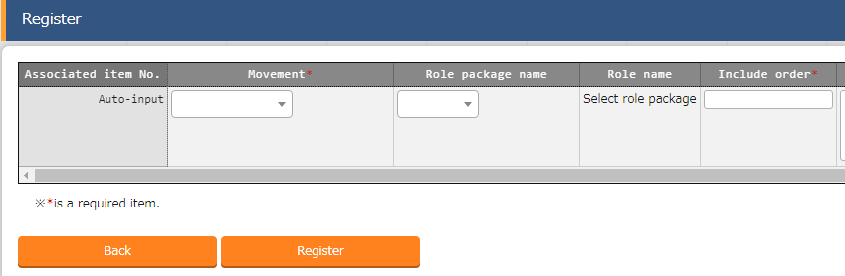
2.3 Movement configuration(3/3)
Register role names to Movement Register individual role names to Movement.
Menu: Ansible-LegacyRole > Movement details
Click Register > Start Registration.
Select or input the following information for each item and click "Register".
2
※ Do not register multiple role packages in the same Movement. Unexpected errors will occur when executed
Movement name | Role package name | Role name | Include order
Sudoer registration | sudo-master | ansible-sudo-master | 1

Slide 36
2.4 Operation configuration
Register new operation Create operation. Link Movement and Host.
Menu : Basic Console > Input operation list
Click Register > Start Registration.
Input the following information for each item and click "Register".
2
Item name | Input contents
Operation name | LegacyRole_Practice
Scheduled date for execution | (Enter arbitrary value)
※ "Scheduled date for execution" is just an item for management. It will not be executed automatically.

Slide 37
2.5 Register to device list
Register a host to the device list Register host to execute the operation in ITA. Menu : Basic Console > Device list
Click Register > Start Registration.
Select or input the following information for each item and click "Register".
2
Item | Input contents
HW device type | SV
Host name | (Arbitrary value)
IP address | (Arbitrary value)
Login user ID | (Arbitrary value)
Management | ●
Login password | (Arbitrary value)
Authentication method | Password Authentication

Slide 38
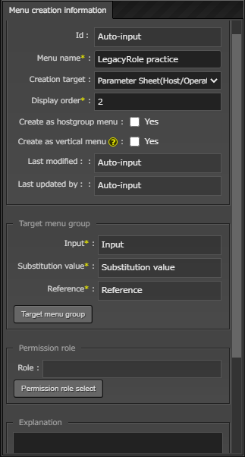
2.6 Parameter sheet creation(1/2)
Create menu Create a parameter sheet and manage the parameters that apply to the target host.
Menu : Create menu > Create/Define menu
１
Input the following information.(Next item)
Item name | Input contents
Menu name | LegacyRole practice
Creation target | Parameter sheet (Host/Operation)
Display order | 2

Slide 39
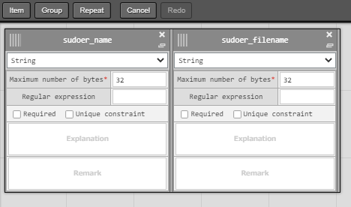
2.6 Parameter sheet creation(2/2)
Define the item name of the parameters sheet Continuing from the previous section, define the items on the sheet.
Menu : Create menu > Create/Define menu
Press “Item” to add a new item
input the following information for each item and click “Create".
１
2
Item name | Input method | Maximum number of bytes
sudoer_name | String | 32
sudoer_filename | String | 32
2

Slide 40
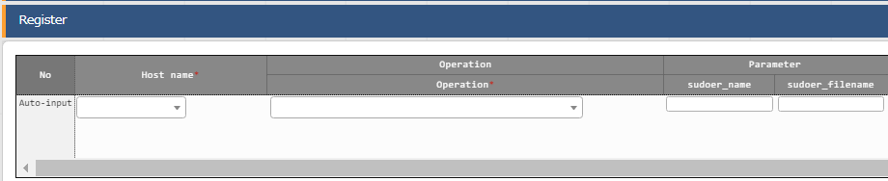
2.7 Data registration
Register data to the parameter sheet The parameter sheet was created by the operation in the previous section. Move to the created menu and input the data.
Menu: Input > LegacyRole practice(Created menu)
Click Register > Start Registration.
Select or input the following information for each item and click "Register".
２
Host name | Operation | sudoer_name | sudoer_filename
(Target host) | LegacyRole_Practice | example_name | example_sudoers

Slide 41
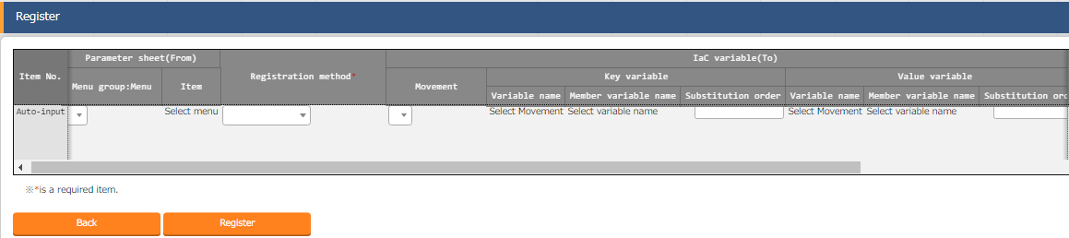
2.8 Substitution value automatic registration setting
Set Substitute Value Automatic Registration settings Connect the variables to each item after entering the data in the parameter sheet.
Menu: Ansible-LegacyRole > Substitution value auto-registration setting
Click Register > Start Registration.
Select or input the following information for each item and click "Register".
２
Menu group：Menu | Item | Registration method | Movement | Value variable Variable name | Value variable member variable name
LegacyRole for practice | sudoer_name | Value type | RegisterSudoer | LCA_sudo_users | [0].name
LegacyRole for practice | sudoer_filename | Value type | RegisterSudoer | LCA_sudo_sudoers_file | (blank)

Slide 42
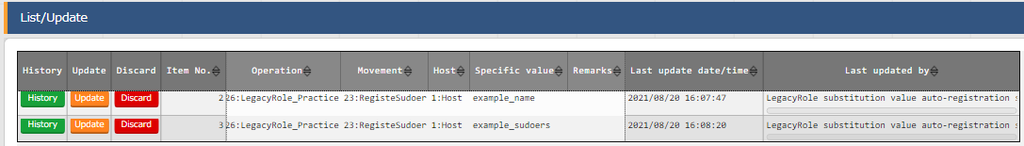
2.9 Check Substitution value and Target host
Check Substitution value and Target host Check the value specified by the substituted value automatic registration and the target host.
Menu: Ansible-LegacyRole > Target host
Ansible-LegacyRole > Substitution value list
Click "Filter".
Check that the correct value is specified by “LegacyRole substitution value automatic registration setting procedure".
Target host
Substitution value list

Slide 43
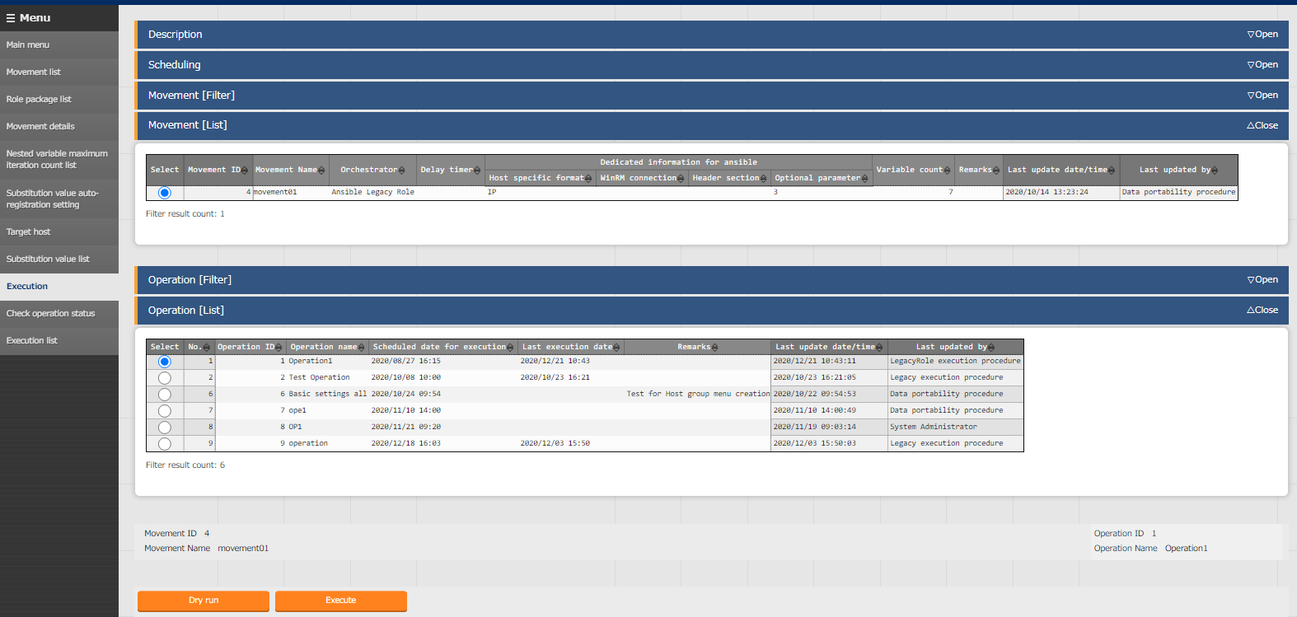
2.10 Execution (1/2)
Execute Movement directly The Movement created in this scenario is one. Let's skip the Conductor creation and use the direct execution feature.
Menu: Ansible-LegacyRole > Execution
Select the Movement to execute.
１
Select Operation.
２
Tips
The screen will automatically change
to the "Check work status"
screen after executing.
3
Click "Execute".

Slide 44
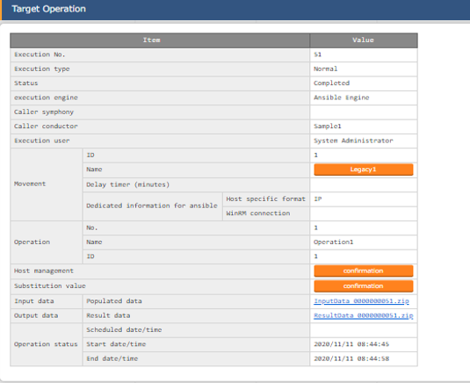
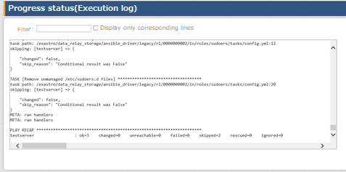
2.10 Execution (2/2)
Check execution results Clicking the link will transfer the user to a screen where Execution status and logs are displayed.
Menu： Ansible-LegacyRole > Check operation status
Tips
Users can download a zip file that contains
input and result data..
Tips
To check the results on the target host,
please refer to /etc/sudoers.d

Slide 45
Chapter 3 Ansible-Pioneer

Slide 46
3.1 Work environment and Scenario
Work environment The work environment used in this document is as follows. We will operate on a NW Device, so please prepare the following environment. ITA Host Servers ・CentOS 7 (※1) ・ITA 1.9.0 ・Ansible 2.11.2 Target ・Virtual router「vyos」 1 server ・Cisco NW device 1 server(※２)
CentOS 7
Virtual router 「vyos」1 server
ITA
1.9.0
Ansible
2.11.2
Cisco NW device
1 server
ITA Host Servers
Operation target group
※1 In this scenario, CentOS7 will be used for the host server, but ITA can be installed on any RHEL7 and RHEL8 type OS. ※2 This document uses Layer 3 switches for input examples for each item. If you are using a router or Layer 2 switch, please make sure to replace it accordingly.

Slide 47
3.1 Work environment and Scenario
Scenario Ansible-Pioneer is used to specify log servers for NW device with different vendors. This scenario lets you experience the following 3 features of the Pioneer mode.
Being able to execute dialog files as well as Telnet or ssh communication is provided.
Execution without having to worry about OS, Differences by utilizing Dialog types and OS types.
Repetition of tasks and condutional branching using proprietary modules.
Scenario images
Movement creation
Setting the substitution value and target host using the parameter sheet
Movement①
START
Dialog type① syslog server configuration
OS type① vyos_RT
END
YML
YML
OS type① vyos_RT
OS type② Cisco_L3SW
OS type② Cisco_L3SW

Slide 48
3.2 Dialog file creation(1/2)
Dialog file creation Create the files that we are going to use in this scenario. 【Attention】 Please use "UTF-8" for the character code.
conf:
timeout: 10
exec_list:
- expect: 'password:'
exec: '{{ __loginpassword__ }}'
- expect: '{{ __loginuser__ }}@{{ __loginhostname__ }}'
exec: 'set terminal length 0'
- expect: '{{ __loginuser__ }}@{{ __loginhostname__ }}'
exec: 'configure'
- command: 'set system syslog host {{ item.0 }} facility all level {{ VAR_log_severity }}'
prompt: 'vyos@{{ __loginhostname__ }}'
with_items:
- '{{ VAR_syslog_server_ip }}'
when:
- VAR_log_severity is define
- expect: 'vyos@{{ __loginhostname__ }}'
exec: 'commit'
- expect: 'vyos@{{ __loginhostname__ }}'
exec: 'save'
- expect: 'vyos@{{ __loginhostname__ }}'
exec: 'exit'
- command: 'show configuration'
prompt: 'vyos@{{ __loginhostname__ }}'
with_items:
- '{{ VAR_syslog_server_ip }}'
failed_when:
- stdout match(host *{{ item.0 }})
File name: vyos_set_syslog_server.yml
Log server registration command to vyos.
This will use "with_items" to do iterative processing.
This will check settings.
Outputs settings information and returns "failed“ if the specified string is missing.
Conditional judgement will be made for each iteration by "with_items".

Slide 49
3.2 Dialog file creation(2/2)
conf:
timeout: 10
exec_list:
- expect: 'Username:'
exec: '{{ __loginuser__ }}'
- expect: 'Password:'
exec: '{{ __loginpassword__ }}'
- expect: '{{ __loginhostname__ }}'
exec: 'enable'
- expect: 'Password:'
exec: '{{ __loginpassword__ }}'
- expect: '{{ __loginhostname__ }}'
exec: 'terminal length 0'
- command: 'show logging'
prompt: '{{ __loginhostname__ }}'
register: result_stdout
- expect: '{{ __loginhostname__ }}'
exec: 'configure terminal'
- command: 'logging host {{ item.0 }}'
prompt: '{{ __loginhostname__ }}'
with_items:
- '{{ VAR_syslog_server_ip }}'
exec_when:
- result_stdout no match(Logging to {{ item.0 }})
- command: 'logging facility {{ VAR_log_facility }}'
prompt: '{{ __loginhostname__ }}'
when:
- VAR_log_facility is define
- command: 'logging trap {{ VAR_log_severity }}'
prompt: '{{ __loginhostname__ }}'
when:
- VAR_log_severity is define
File name: ios_set_syslog_server.yml
Prepare the dialog file Similarly, create file on the right.
Displays configurations for the log and stores the contents of the standard output in "register".
Log server registration command to CiscoIOS.
Will use"with_items" to do iterative procesing.
In "exec_when", the decision to execute the process is made according to the contents stored above.

Slide 50
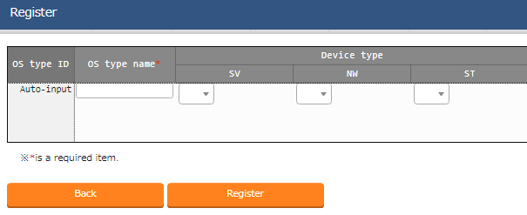
3.3 OS type creation
Create “OS type” Pioneer can choose the code to be dropped depending on the OS of the target host. First, register "OS type" to ITA.
Menu: Ansible-Pioneer > OS type master
Click Register > Start Registration.
Input the following information for each item and click "Register".
2
OS type name | Device type/NW
vyos_RT | ●
Cisco_L3SW | ●

Slide 51
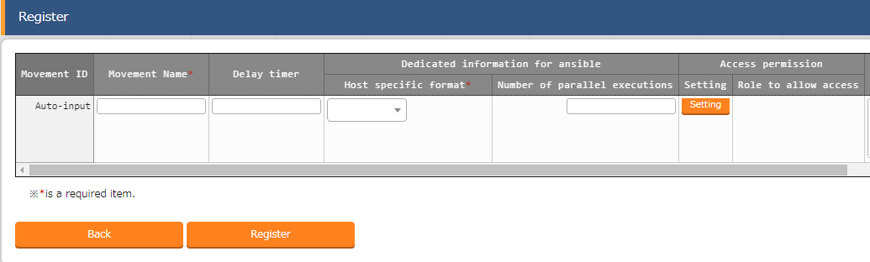
3.4 Movement configuration(1/4)
Create Movement Movement is the smallest unit of operation in ITA. Create a Movement and link it to the dialog type. Menu：Ansible-Pioneer > Movement list
Click Register > Start Registration.
Select or input the following information for each item and click "Register".
2
Item | Input contents
Movement name | Log server configuration
Host specific format | IP

Slide 52
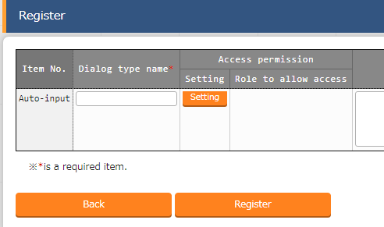
3.4 Movement configuration(2/4)
Create dialog type Next, create "Dialog type".
Menu: Ansible‐Pioneer > Dialog type list
Click Register > Start Registration.
Input the following information for each item and click "Register".
2
Item name | Input contents
Dialog type name | syslog server specification

Slide 53
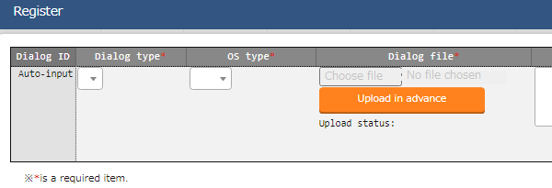
3.4 Movement configuration(3/4)
Register Dialog files When you're done preparing, register the Dialog file. We will link all the Dialog types and the OS Types we've created up until this point.
Menu: Ansible-Pioneer > Dialog files
Click Register > Start Registration.
Choose a Dialog file from "Browse" and click "Upload in advance".
Select the following for the other items and click "Register".
2
Dialog type | OS type | Dialog files
syslog server specification | vyos_RT | vyos_set_syslog_server.yml
syslog server specification | Cisco_L3SW | ios_set_syslog_server.yml

Slide 54
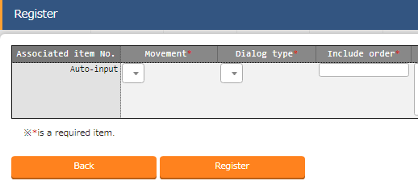
3.4 Movement configuration(4/4)
Register the Dialog type to Movement Link movement and Dialog type.
Menu: Ansible-Pioneer > Movement dialogue type link
Click Register > Start Registration.
Select or input the following information for each item and click "Register".
2
Item | Input contents
Movement | Log server configuration
Dialog type | syslog server specification
Include order | 1

Slide 55
3.5 Operation registration
Register new operation Create operation. Link Movement and Host.
Menu : Basic Console > Input operation list
Click Register > Start Registration.
Input the following information for each item and click "Register".
2
Item name | Input contents
Operation name | Pioneer_Practice
Scheduled date for execution | (Enter arbitrary value)
※ "Scheduled date for execution" is just an item for management. It will not be executed automatically.

Slide 56
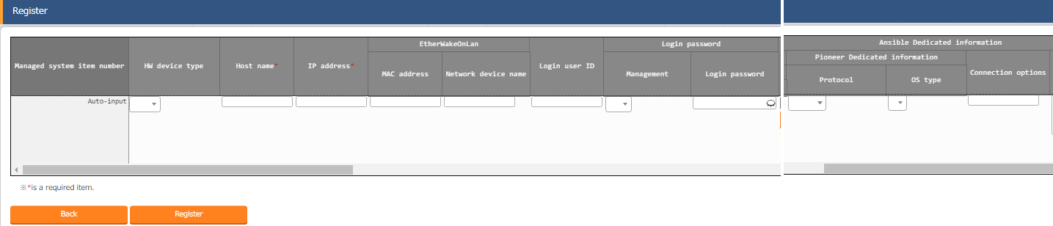
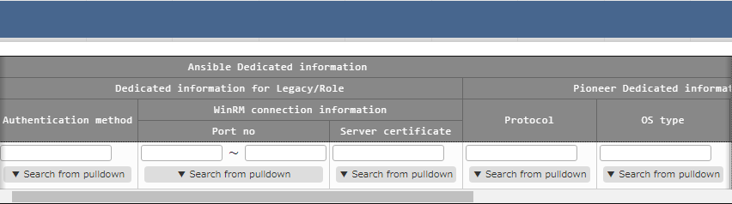
3.6 Register to device list (1/2)
Register NW device to the device list Register this work target from the device list. Please note that, different from Legacy mode and Legacy-Role mode, you will need to fill in "Pioneer Usage Information".
Menu: Basic Console > Device list
Click Register > Start Registration.
Select the following information for each item and click "Register".
2
Item | Vyos Virtual router
HW device type | NW
Host name | (Free value）
IP address | (Free value）
Login user ID | (Free value）
Management | ●
Login password | (Free value）
Authentication method | Password authentication
Pioneer user information/Protocol | ssh
Pioneer user information/OS type | vyos_RT

Slide 57
3.6 Register to device list (2/2)
Register NW device to the device list Register this work target from the device list.
Menu: Basic Console > Device list
Click Register > Start Registration.
Select the following information for each item and click "Register".
2
Item | Cisco device
HW device type | NW
Host name | (Free value)
IP address | (Free value)
Login userID | (Free value)
Management | ●
Login password | (Free value)
Pioneer user information/Protocol | telnet
Pioneer user information/OS Type | Cisco_L3SW

Slide 58
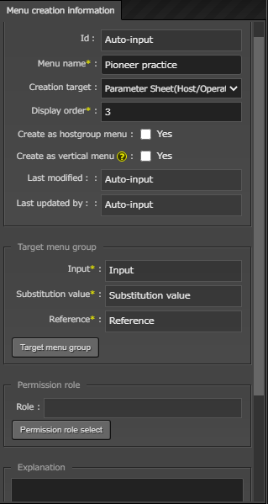
3.７ Parameter sheet creation (1/2)
Create menu
Create parameter sheet. create and manage parameters to apply to the target host.
Menu : Create menu > Create/Define menu
１
Input the following information.(Next item)
Item | Input contents
Menu name | Pioneer practice
Creation target | Parameter sheet(Host/Operation)
Display order | 3

Slide 59
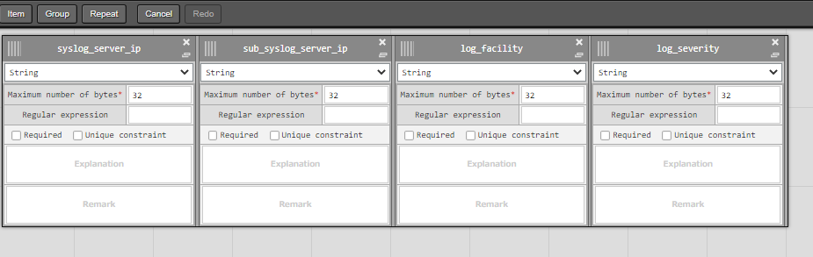
3.7 Parameter sheet creation (2/2)
Define the item name of the parameters sheet Continuing from the previous section, define the items on the sheet.
Menu : Create menu > Create/Define menu
Define the item name of the parameters sheet Continuing from the previous section, define the items on the sheet.
１
Press “item” to add a new item.
2
Item name | Input method | Maximum number of bytes
syslog_server_ip | String | 32
sub_syslog_server_ip | String | 32
log_facility | String | 32
log_severity | String | 32
Press the “create” button to create the menu.
3

Slide 60
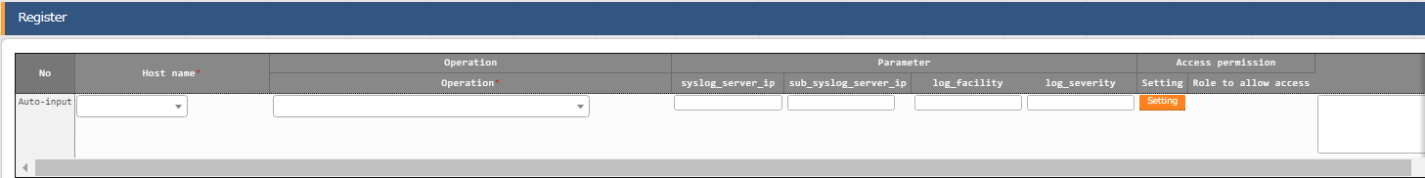
3.8 Data registration
Register data to the parameter sheet Now that we have created the Menu, let's register the data we're going to use to configure the target host.
Menu: Input > Pioneer practice (Created Menu)
Click Register > Start Registration.
Select or input the following information for each item and click "Register".
2
Host name | Operation | syslog_server_ip | sub_syslog_server_ip | log_facility | log_severity
(Cisco device selection) | Pioneer_practice | IP address | IP address | local7 | info
(vyos router selection) | Pioneer_practice | IP address | IP address | local7 | info

Slide 61
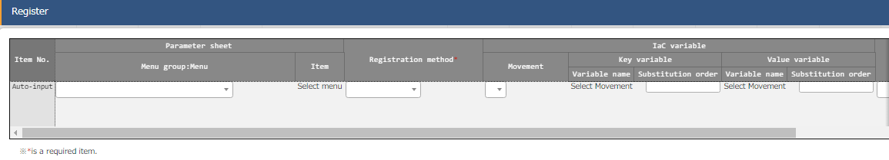
3.9 Substitution value automatic registration setting
Set Substitute Value Automatic Registration settings Connect the variables to each item after entering the data in the parameter sheet.
Menu: Ansible-Pioneer > Substitution value auto-registration setting
Click Register > Start Registration.
2
Menu | Item | Registration method | Movement | Value variable Variable name | Substitution order
Pioneer practice | syslog_server_ip | Value type | Log server configuration | VAR_syslog_server_ip | 1
Pioneer practice | sub_syslog_server_ip | Value type | Log server configuration | VAR_syslog_server_ip | 2
Pioneer practice | log_facility | Value type | Log server configuration | VAR_log_facility | Blank
Pioneer practice | log_severity | Value type | Log server configuration | VAR_log_severity | Blank

Slide 62

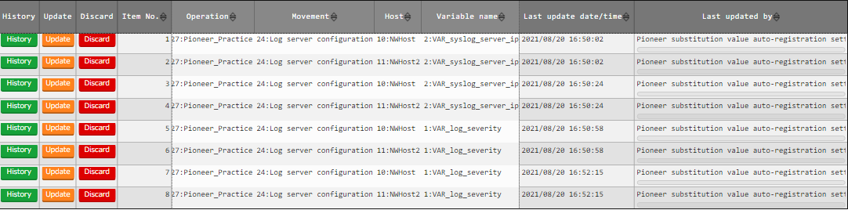
3.10 Check Substitution value and Target host
Check Substitution value and Target host Check target host and values specified by substitution value automatic registration.
Menu: Ansible-Pioneer > Target host
Ansible-Pioneer > Substitution value setting
Click "Filter".
Check that the correct value is specified by “Pioneer substitution value automatic registration setting procedure".
Target host
Substitution
value list

Slide 63
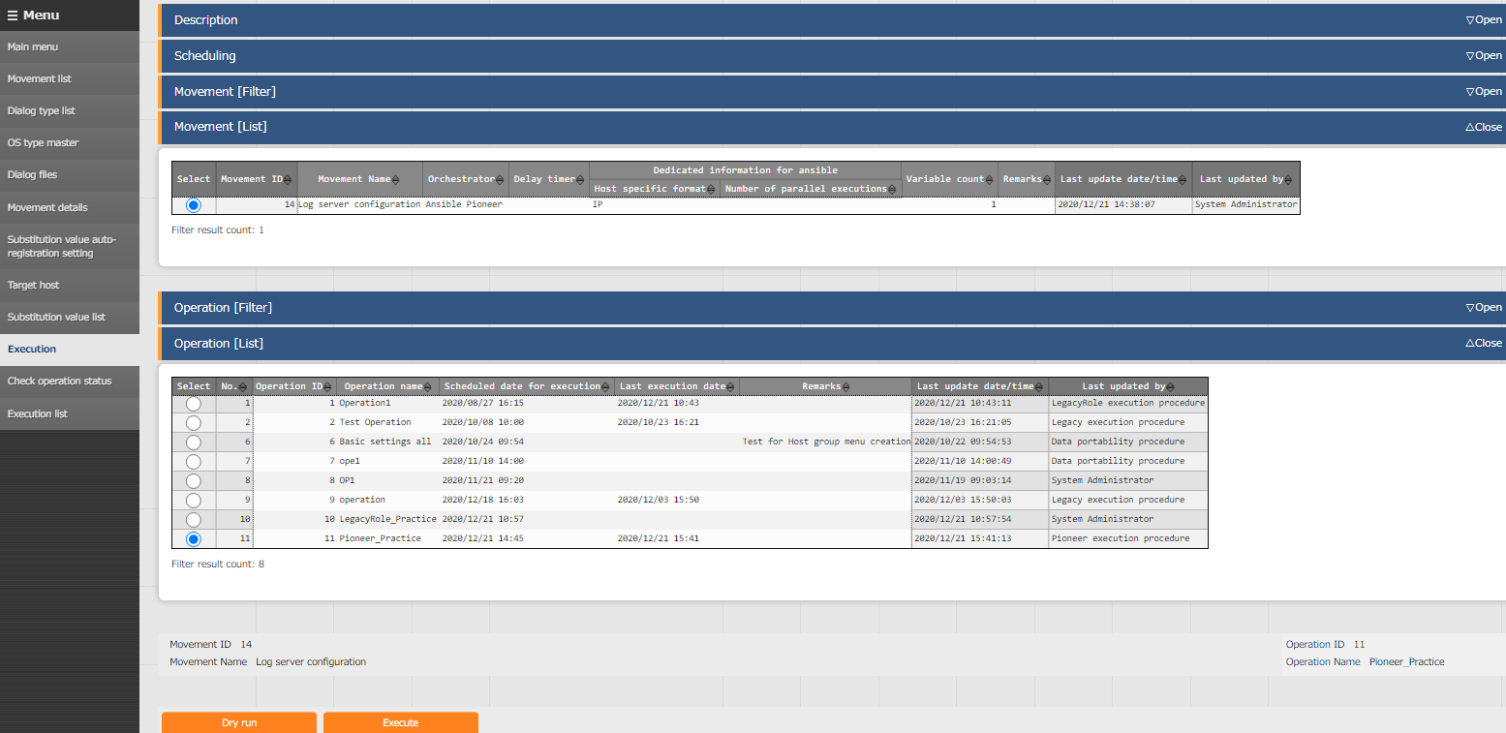
3.11 Execution (1/2)
Execute Movement directly The number of Movements created in this scenario is 1. There is no need to create any Conductors. Execute them individually from the "Execution" menu.
Menu： Ansible-Pioneer > Execution
Select the Movement to execute.
１
Select Operation.
２
Tips
The screen will automatically change
to the "Check operation status“
screen after executing.
Click "Execute".
3

Slide 64
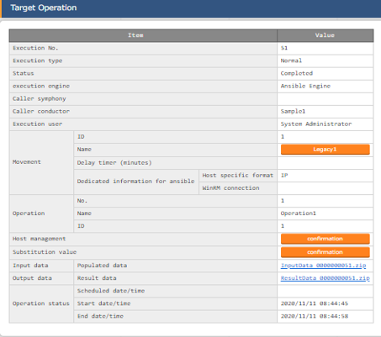
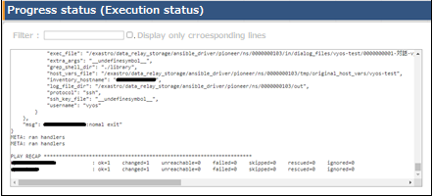
3.11 Execution (2/2)
Check execution results Executing the operation will transfer the user to a screen where Execution status and logs are displayed.
Menu： Ansible-Pioneer > Check operation status
Execution status
Log
Tips
Users can download a zip file that contains input
and result data.
Tips
If you want to check the results of the execution by using commands, you can use the commands below to check the log settings. IOS - “# show logging”
vyos - ”$ show configuration”

Slide 65
A) Appendix

Slide 66
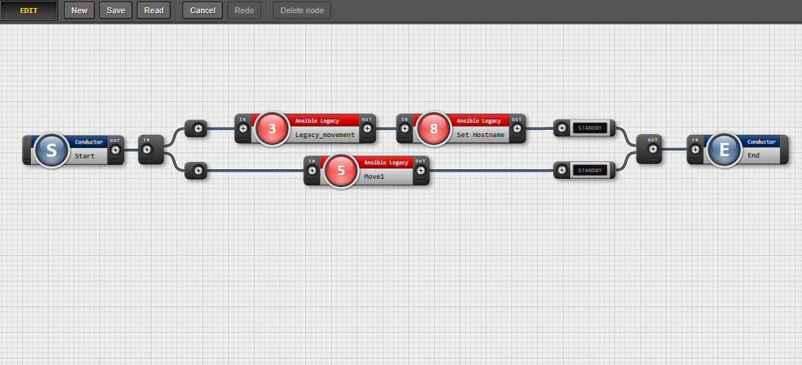
Appendix 1) Bundling and running 3 modes in Conductor
Bundle up the 3 modes and execute them In this document, we executed the work for each mode individually, but users can also create a work flow that executes work in multiple modes by using Conductor.
Point
Movements created in each mode and different conductors
are introduced to form a single work flow.

