Slide 1


Export/Import
【Tutorial】
※In this document, “Exastro IT Automation” is described as “ITA".
Exastro IT Automation Version 1.10
Exastro developer

Slide 2
Table of contents
Introduction 1. Introduction
Export/Import function
Overview
Menu overview
Work flow
Menu description
Mode description
3. Excel bulk export/import function
Overview
Menu overview
Work flow
Menu description

Slide 3
2. Export/Import function

Slide 4
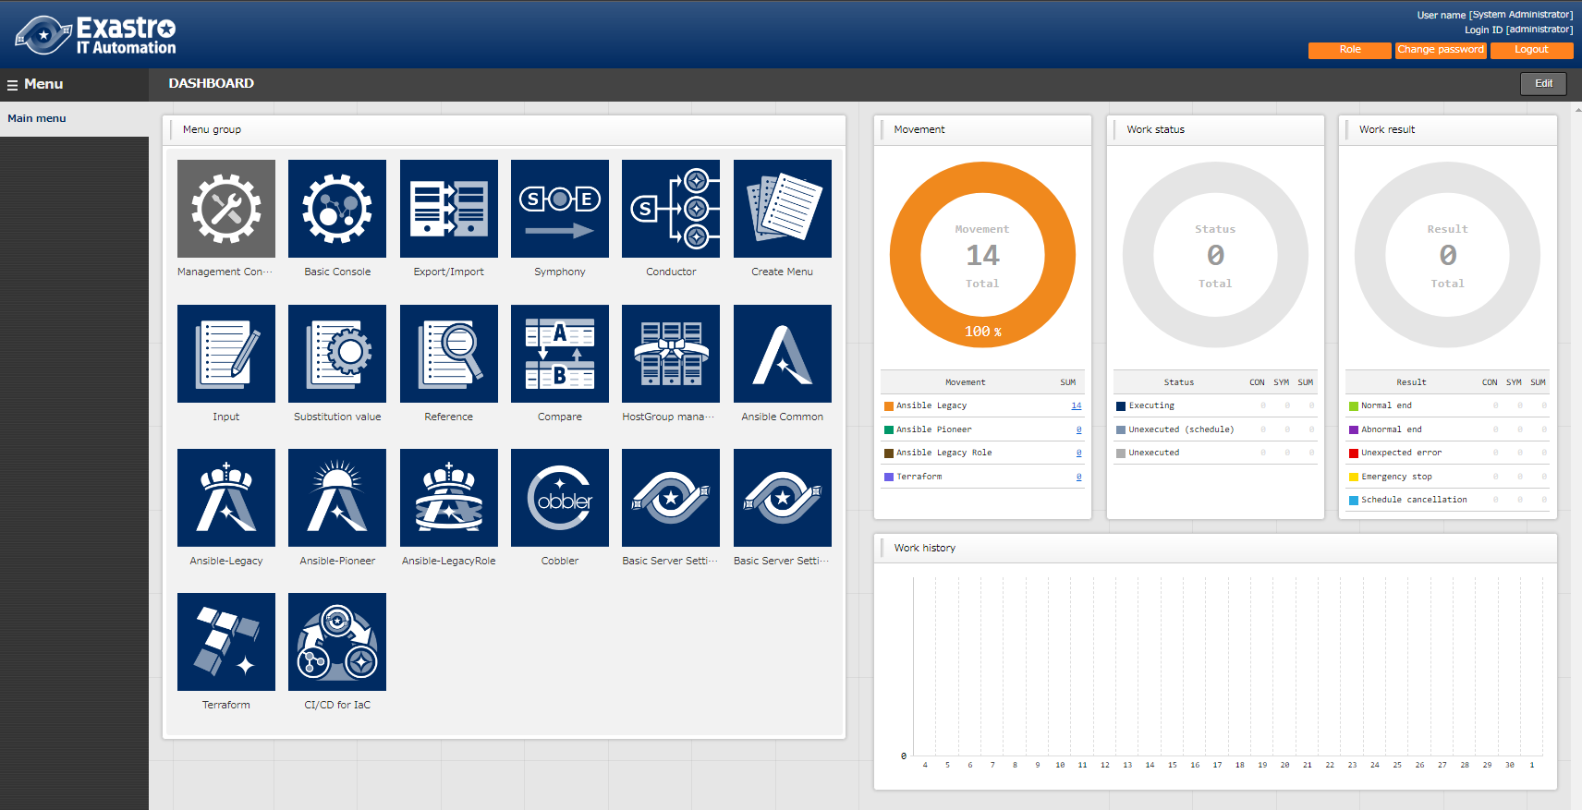
1.1 Ansible driverについて X/X
1.1 Introduction
About this document This document aims to explain the "Export/Import " Menu and its functions. Detailed specifications are described in the User Instruction Manual

Slide 5
2. Export/Import function

Slide 6







2.1 Overview
Overview of Export/Import function
By using the "Export/Import" function, users can move Data registered in one ITA System (Parameter sheets, Conductor, Playbooks, etc) to a different ITA server.
Export
Import
kym
S
E
Export/Import Data
(kym file)
S
E
ITA Server A
ITA Server B
Figure
I want to move only the required menus from the test environment to the main environment (ITA Server B)
kym
kym file
ITA Server B
Notes:
ｖ

Slide 7
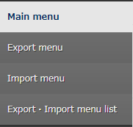
2.2 Menu overview
Menu overview Here is an overview of the Export/Import menus and their functions.
Select and export Menus
Import files exported in "Export menu".
Check the Export/Import status and download the data.

Slide 8
2.4 Work flow
Work flow
The export/import workflow is as follows. The practice document goes through the operations in more detail.
1. Export
Export menu
2. Download kym file
Export/Import list
3. Import
Import menu
4. Check Import
Export/Import list

Slide 9
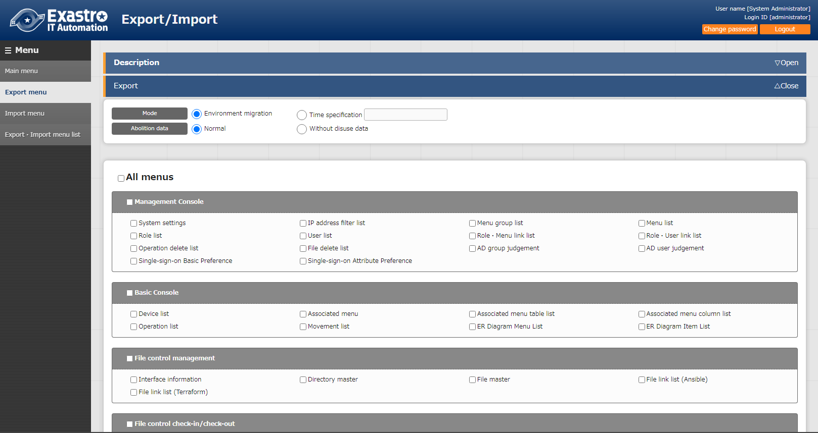
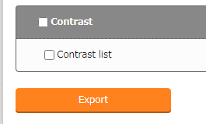
2.7 Menu Description (1/3)
Export menu
All menus are displayed in a list and can be selected if the user wishes to export them. There are two types of modes. One that overwrites all the existing data and one where users can choose whether to insert or overwrite data based on unique menu items (ID,No, Etc) after a specified time has passed.
"Abolition data" decides if you want to include abolished data or not when you import.
Select the menus to be
exported with the check box.
Click “Export” to execute.

Slide 10
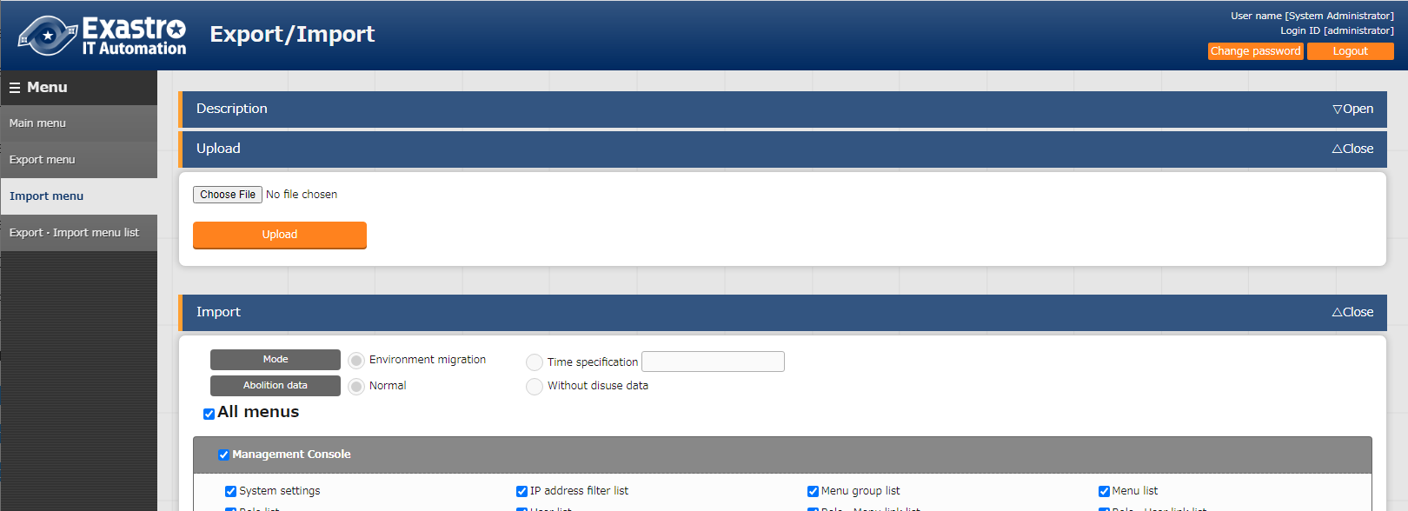
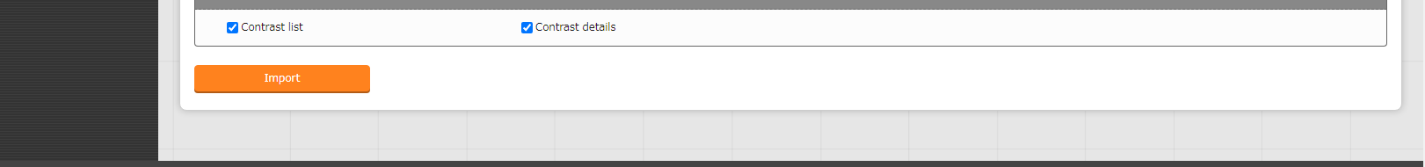
2.7 Menu Description (2/3)
Import menu
Upload the exported data in the "Export menu " and import the desired menus.
Use these buttons to upload kym files
Select the menu you want to import by marking menu’s check box.
Click here to start the Import.

Slide 11
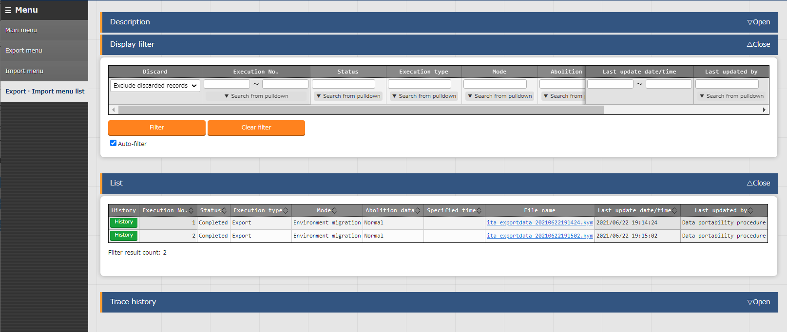
2.7 Menu Description (3/3)
Export/Import menu list
Check the information that can be executed Export/Import. User can check the progress status of each operation and download moved data.
Check the status here.
It will go from "Not Executed“ to "Executing" and lastly “Completed".
Check/Download the export/import file here
See here for mode and Abolition data status

Slide 12
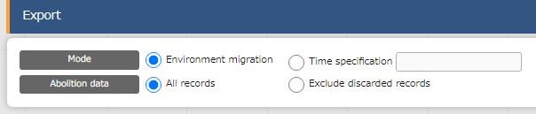
2.5 Mode overview (1/3)
Mode overview
The Menu export functions comes with 2 modes.
① Environment migration
Exports all data from the user-selected menus.
② Time specification
Exports only data edited/registered after the specified time.

Slide 13
2.5 Mode overview (2/3)
Environment migration
The “Environment migration” allows users to export all registered data from the menus specified by the user. Using this function will overwrite the entirety of specified menus.
Example
I need to move Menu A from the test environment, “ITA Server A”,
to the production environment, ITA Server B”
kym
Menu A
Menu B
Menu A
No.１
No.１
Kym file
No.１
No.２
No.２
No.２
ITA server A
ITA server B

Slide 14
2.5 Mode overview (3/3)
Time specification
The “Time specification” mode lets users export data that has only been registered/edited after the specified time. If data and unique items (ID, No, etc.) overlaps with existing data, the exported data will be prioritized and overwrite the old data when imported.
Example
I need to move after the move data from before 2022/01/02 from "ITA Server B"
Before importing
Menu A
kym
No.1 2022/01/01 17:00
No.2 2022/01/02 8:00
Menu A
Kym file
No.1 2022/01/01 17:00
After importing
No.2 2022/01/02 17:00
No.3 2022/01/03 17:00
Menu A
ITA server A
ITA server B
No.1 2022/01/01 17:00
No.2 2022/01/02 17:00
No.3 2022/01/03 17:00

Slide 15
3. Excel bulk import/export function

Slide 16
3.1 Overview
Excel bulk export/import function overview
The Excel Bulk export/import function allows users to download and upload multiple files from/to menus.
※users can press the “Excel output” button in the “Display/List” in menus in order to download bigger amount of data registered to ITA.
Users can then change the contents of the excel files and then upload them collectively to the menus.
Export
Import
Zip file
Bulk export
Excel①
Edit file
Bulk import
Excel②
Excel③
ITA Server A

Slide 17
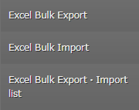
3.2 Menu overview
Menu overview
Here is an overview of the Excel bulk Export/Import menus and their functions.
Select and export menus
Imports edited excel files in bulks.
Check the Export/Import status and download the data.
Notes:
説明文追加

Slide 18
3.3 Work flow
Work flow
The Excel bulk export/import workflow is as follows. The practice document goes through the operations in more detail.
。
1. Export
Excel bulk export
2. Download zip file
Excel bulk export/Import list
3. Extract files, edit contents and save the file.
4. Import
Excel bulk import
5. Check import status
Excel bulk import/Import list

Slide 19
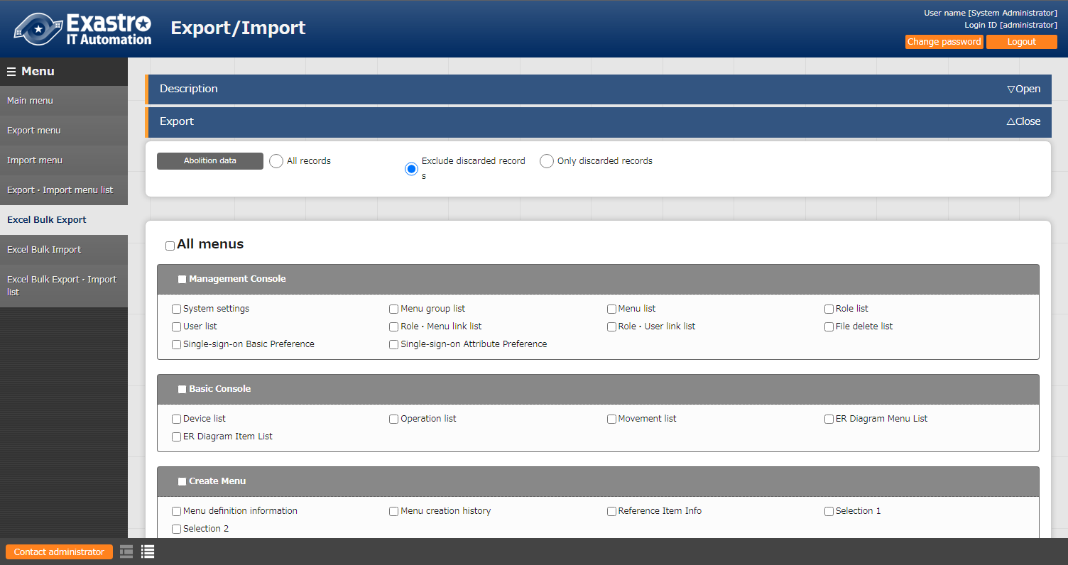
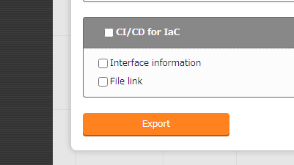
3.4 Menu description(1/4)
Excel bulk export
The available menus are displayed and users can select the menus they want to export.
Users can choose if they want to include or exclude deleted information when importing.
Select what menus to export
Press “Export” to export.

Slide 20
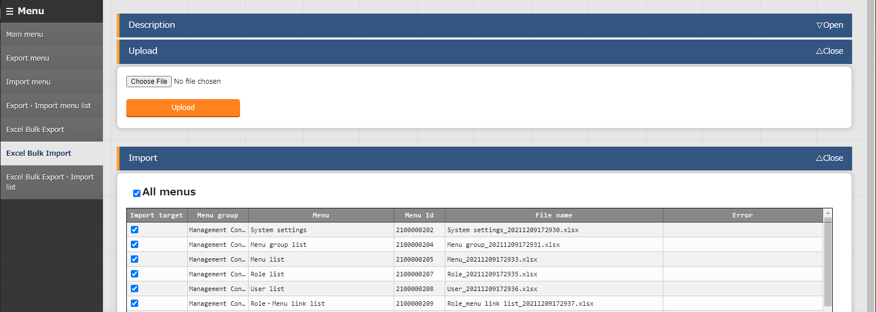
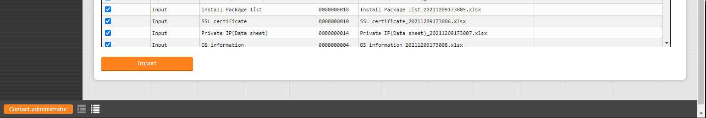
3.4 Menu description(2/4)
Excel bulk import
Upload the file downloaded from the "Excel bulk export" menu and select what menus to import.
Upload Zip file
Select what menus to import.
Press "Import" to import.

Slide 21
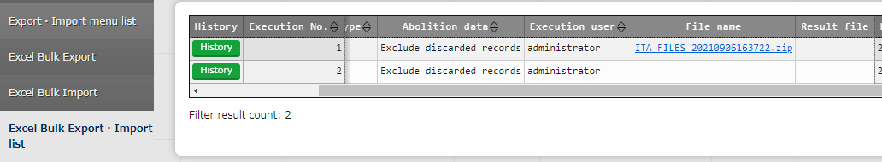
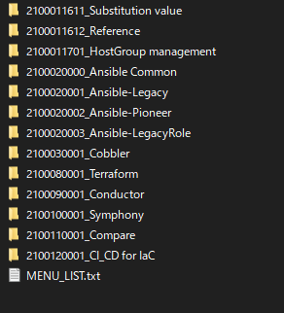
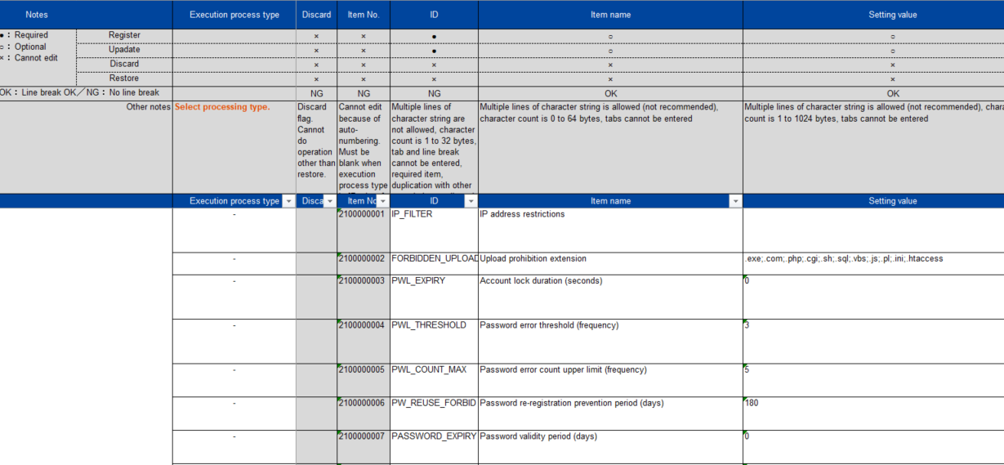
3.4 Menu description(3/4)
Excel bulk export/import list Download and extract files and edit them.
Download and extract files
Exported/Imported content (File folder)
Use this field to edit the files
Point
The "MENU_LIST.txt" file contains the file names of the menus when exported. When importing, the files written in the "MENU_LIST.txt" file are imported starting from the top of the list.
See the User manual for more information.

Slide 22
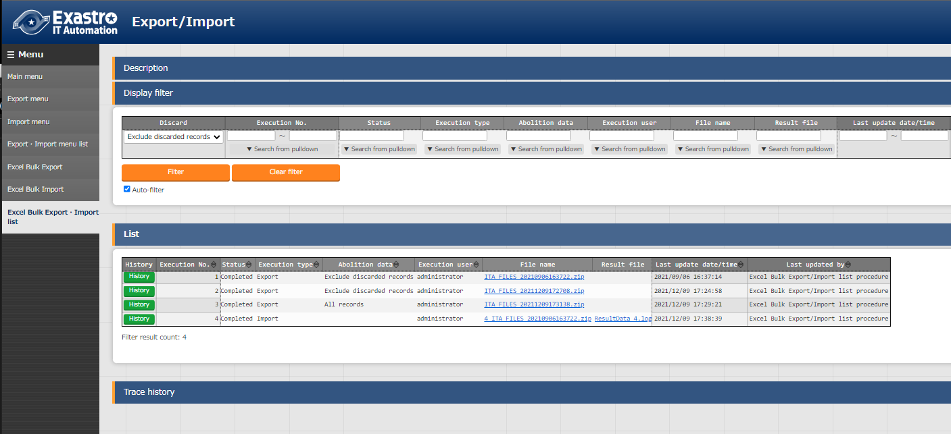
3.4 Menu description(4/4)
Excel bulk export/import list
This menu allows users to see the information for previous excel bulk exports/imports. Users can also see the progress status for the operations and download their respective data.
Displays the status of the operation. The operation will go through the following statuses: "Not executed", "Executing", "Finished".
Check/Download exported/imported files.
Check the result of previous exports/imports.
Check the execution user and if the operation includes/excludes abolished information

