Slide 1


BASE Practice
※Exastro IT Automation is written as “ITA” in this document.
Exastro IT Automation Version 1.7.2
Exastro developer

Slide 2
Table of contents
Management console
Scenario
Practice①
Create new user
Register role
Role/Menu link
Role/User link
Confirm link
Basic console
Scenario
Pre-preparation
Practice②
Register work target host
Register operation
Register IaC
Register Movement
Register Movement details
Register Movement and Host that connects to Operation
Manage Substitute Value
Register Symphony
Execute Symphony
Confirm Symphony

Slide 3
1. Management Console

Slide 4
1.1 Scenario 1/2
In this scenario, we will create a new user called “testuser”. This user will be able to see the “Device list” menu and its contents.
2.1 Create a new user
2.2 Register role
2.3 Link Role and Menu
2.4 Link Role and User
2.5 Confirm Link

Slide 5
1.1 Scenario (2/2)
In this scenario, we assume that step 2.1”Creating a new user” and 2.4,”Link Role and user” are routine tasks.
Irregular operations
2.2 Register role
2.3 Link Role and Menu
Routine tasks
2.1 Create new user
★Repeat★
2.4 Link Role and User

Slide 6
2. Practice①

Slide 7
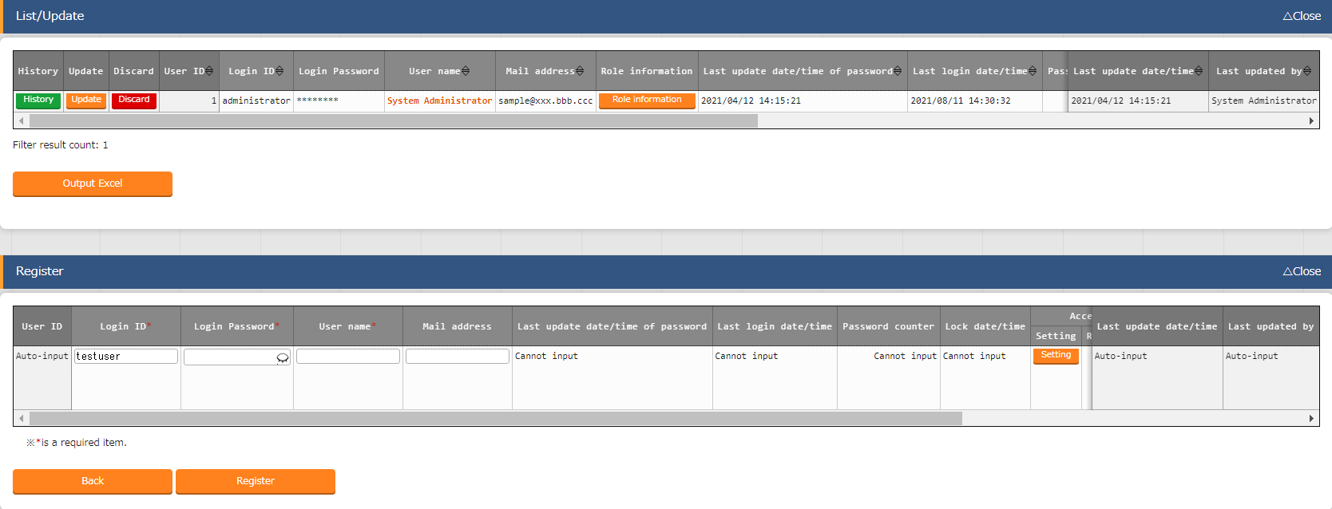
2.1 Create new user
Create new user
“Management Console” Menu group-> “User list” Menu-> “Register” Sub-menu-> “Start Register” Button.
Input values for “Login ID”, “Login PW”, “Username” and ”Mail Address”
Press the “Register” button.
Create new User
Register Role
Link Role and Menu
Link Role and User
１
Confirm Link
Enter the following for each item
Item | Value
Login ID | testuser
Login PW | (free space)
User name | test
Mail address | test@aa.bb.cc
２

Slide 8
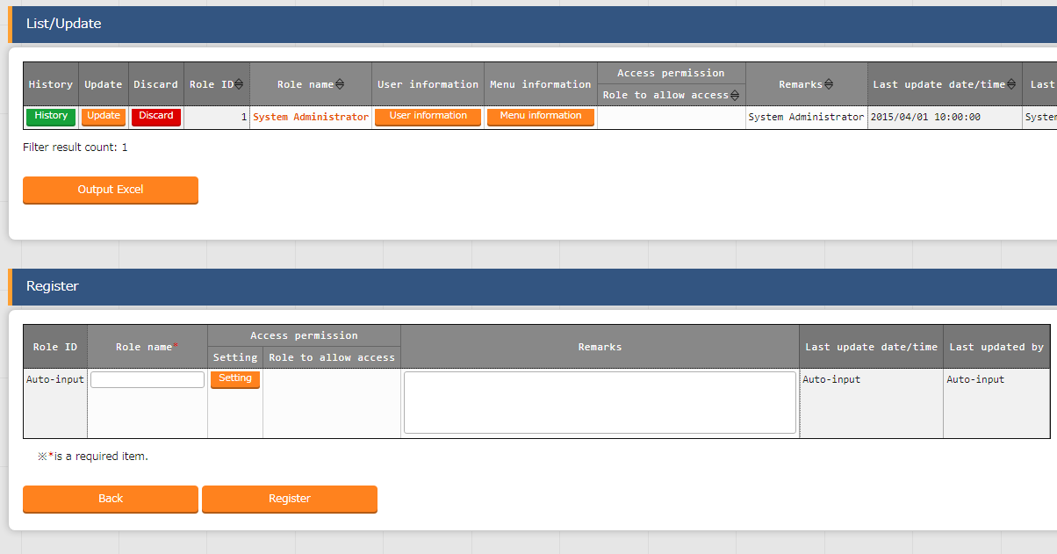
2.2 Register Role
Register Role
“Management Console” Menu group-> “Role list”-> Menu-> “Register” Sub-menu-> “Start Register” button
Input “Role name”
Press the “Register” button
Create new user
Register role
Link Role and Menu
Link Role and User
Enter the following
Confirm Link
１
Item | Value
Role name | Role test
２

Slide 9
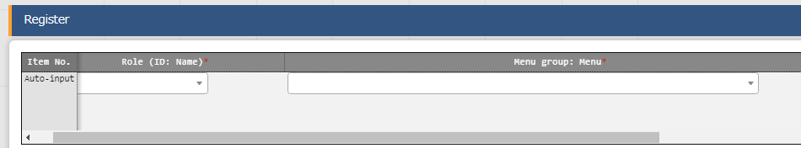
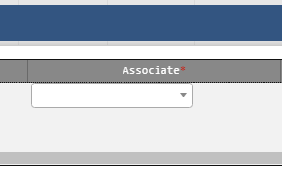

2.3 Link Role and Menu (1/2)
Link Role and Menu①
“Management console” Menu group-> “Role/Menu link list” Menu-> “Register” Sub-menu-> “Start Register” Button.
Input values for “Role(ID:Name)”, “Menu group:Menu”, and “Associate”.
Press the “Register” button
Create new user
１
Set the following value for each item
Register Role
Item | Value
Role (ID:Name) | Role test
Menu group: Menu | Device list
Associate | View only
Link Role and Menu
Link Role and User
Confirm Link
２

Slide 10
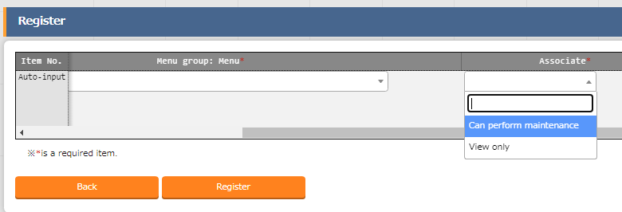
2.3 Link Role and Menu (2/2)
Link Role and Menu②
There are two types of “Associate”. “Can perform maintenance” and “View only”.
※If set to “Can perform maintenance”, various edit tools will become available.
Create new user
Register role
Link Role and Menu
Link Role and User
Confirm Link
For this scenario, we will set it to “View only”

Slide 11
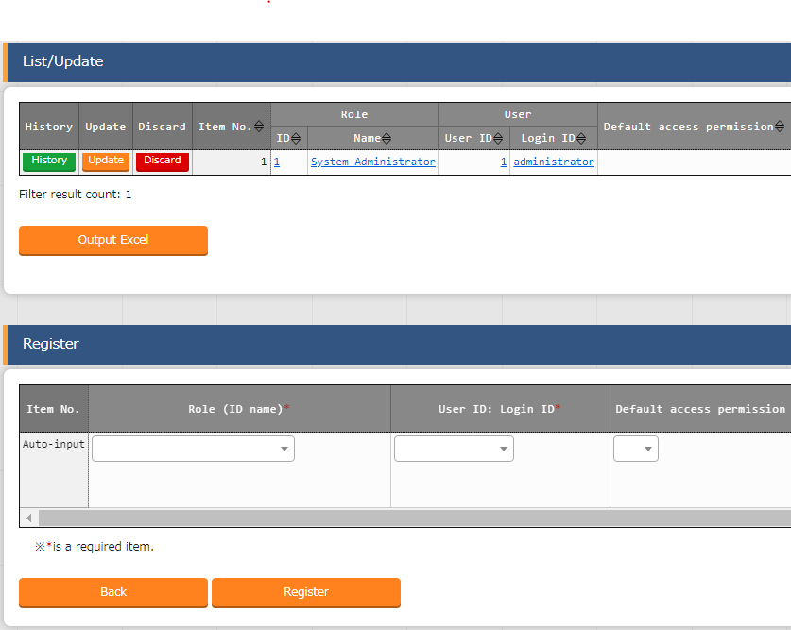
2.4 Link Role and User
Link Role and User
“Management console” Menu group-> “Role/User Link list” Menu-> “Register” Sub-Menu-> “Start Registration” button
Input values for “Role (ID:Name) and “User ID:Login ID”
Press the “Register” Button.
Create new user
Register Role
Link Role and Menu
Link Role and User
Confirm Link
１
Enter the following for each item
Item | Value
Role(ID:Name） | Role test
User ID:Login ID | testuser
２

Slide 12
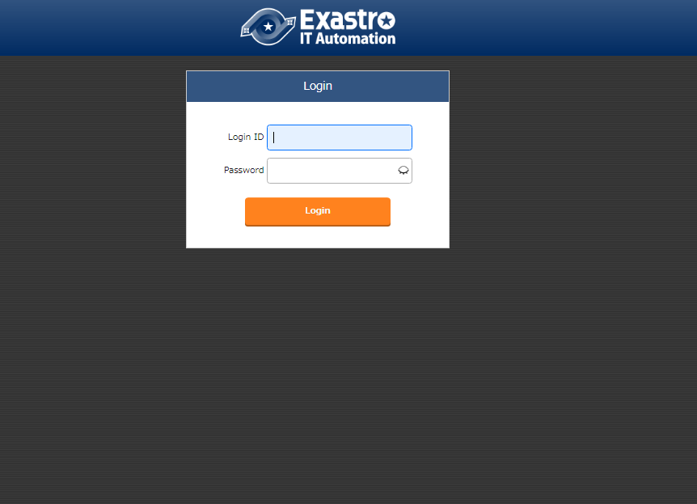
2.5 Confirm Link (1/4)
Re-login
First, Log out. Then, log in using the “Username” and “Login PW” we created in 2.1.
Create new user
Register Role
Link Role and Menu
Link Role and User
Confirm Link

Slide 13
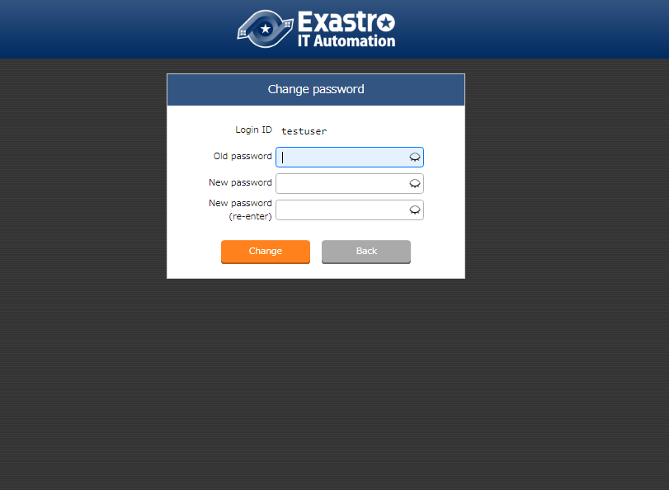
2.5 Confirm Link (2/4)
Set new password.
Every user who log in for the first time will be asked to change their password, so please do so.
Create new user
Register Role
Link Role and Menu
Link Role and User
Confirm Link

Slide 14
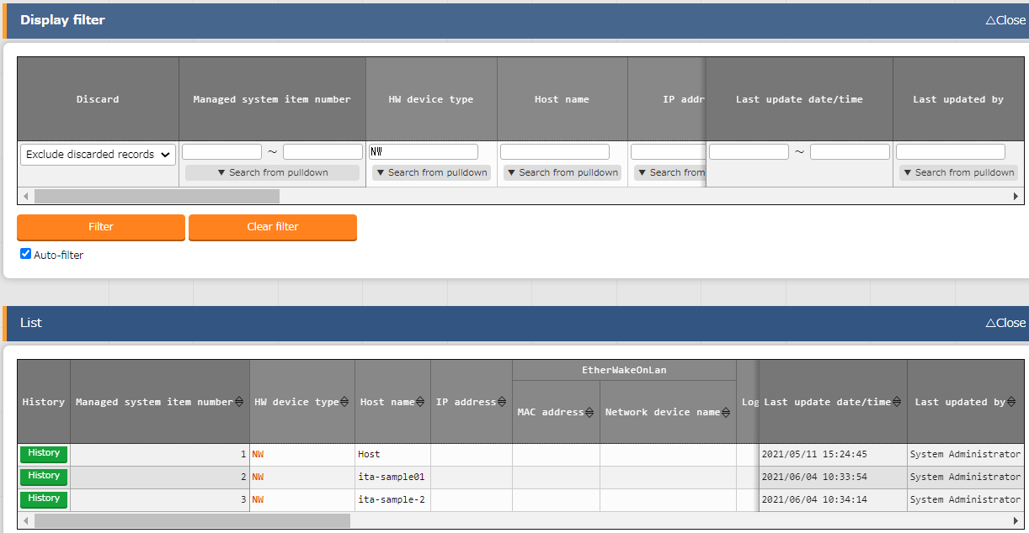
2.5 Confirm Link (3/4)
Check the Menu screen (If the permission is “View only”)
Since the link settings are set to “View only”, the user is unable to use any editing tools.
Create new user
Register Role
Link Role and Menu
Link Role and User
Confirm Link
In this scenario, we will set the “Item list” menu to “View only”

Slide 15
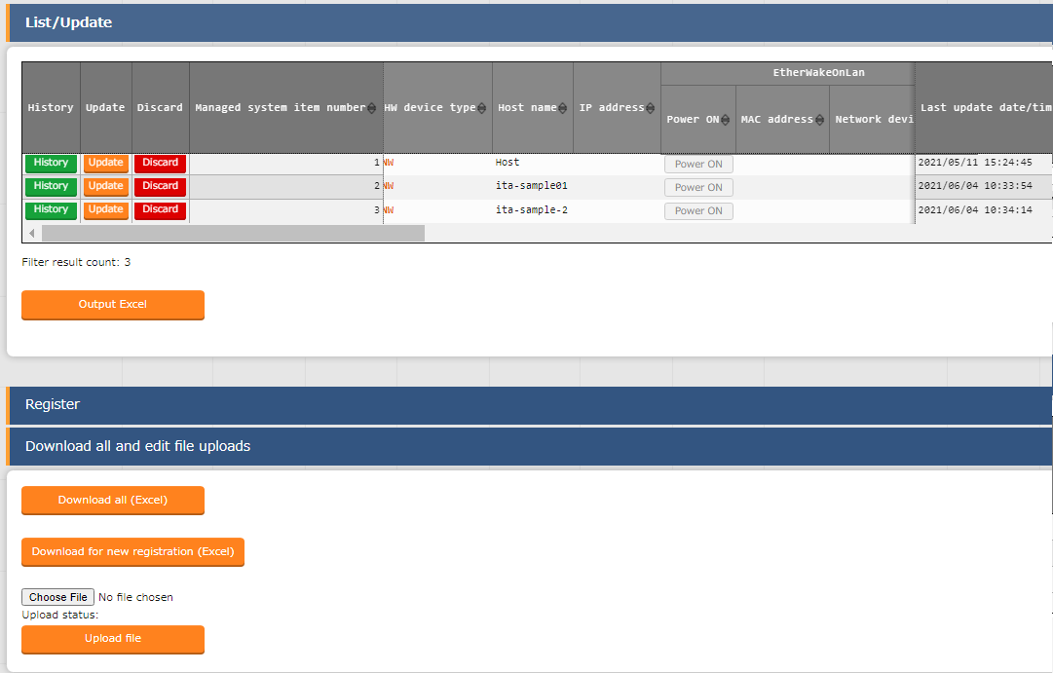
2.5 Confirm Link(4/4)
Check the menu screen (When the permission is “Can perform maintenance”.
If the link settings are set to “Can perform maintenance”, all the edit tools will appear and be useable by the user.
Create new user
Register Role
Link Role and Menu
Link Role and User
Confirm Link
When the permission is set to " Can perform maintenance“, several editing tools such as "Update", "Register", and "Upload File" will be displayed.

Slide 16
3.1 Scenario
In this scenario, a directory called “testdirectory” will be created under the tmp directory of the target host.
Please also keep in mind that since Ansible-Driver is required in order to proceed , we will use Ansible-Legacy.
4.1 Register Work target host
4.6 Register Movement and Host that connects to Operation
4.2 Register Operation
4.7 Register Symphony
4.3 Register IaC
4.8 Execute Symphony
4.4 Register Movement
4.9 Confirm Symphony.
4.5 Register Movement details
We will use the Ansible-Legacy menus in the steps between 4.3 and 4.7

Slide 17
3.2 Pre-preparation
Create IaC
This scenario will use Ansible Legacy as an example.
This scenario will need an Ansible playbook as an IaC Sample in order to finish this scenario.
The sample playbook is written below.
Character code is “UTF-8”, Newline code is “LF”, File name extension is “yml” format. Please make sure that the indents are correct.
- name: Make Work Directory demonstration
file: path: ”/tmp/{{ VAR_DIRECTORY }}” state: directory mode: 0755
This IaC creates a new directory underneath /tmp. In this scenario, the file name will be “sample1”.

Slide 18
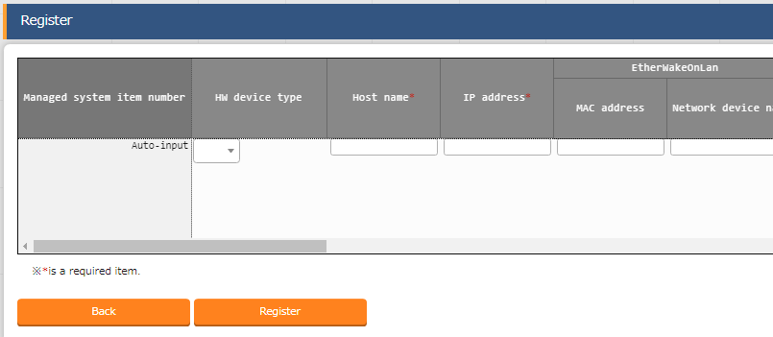
4.1 Register Target work host
Register Target work host
"Basic console" Menu group->"Device list"Menu->"Register"Sub-menu->"Start registration" button.
Enter values for "Host name", "IP Address", "Login User ID", "Management", "Login Password" and "Authentication method".
Press the “Register” button.
Register Target work host
Register Operation
Register IaC
１
Enter the following for each item
Register Movement
Item | Value
Host name | testserver
IP Address | （Free space）
Login User ID | （Free space）
Management | ●
Login Password | （Free space）
Authentication method | Password Authentication
Register Movement Details
Register Movement and host that connects to Operation
Manage Substitute Value
２
Register Symphony
Execute Symphony
Confirm Symphony
This scenario assumes that there is an ssh password connection to the target host.
For the values "IP Address", "Login User ID" and "Login password", please enter the same values set in the environment settings.

Slide 19
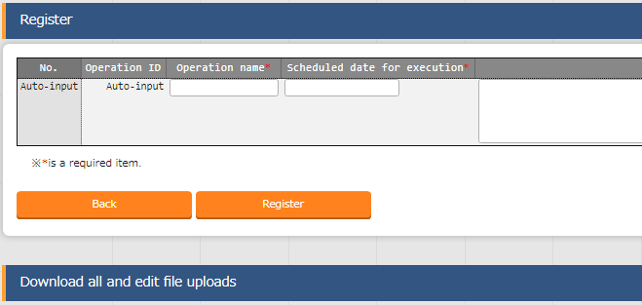
4.2 Register Operation
Register Operation
”Basic Console” Menu group->"Input Operation list" Menu->"Register"Sub-menu->"Start Register" button.
Input "Operation name" and "Scheduled execution date/time“
Press the “Register” button.
Register Work target host
Register Operation
１
Register IaC
Enter the following for each item
Register Movement
Register Movement Details
Item | Value
Playbook file name | operation
Scheduled date for execution | （Free space）
Register Movement and host that connects to Operation
２
Manage Substitute Value
Register Symphony
Execute Symphony
Confirm Symphony
The operation will not be automatically executed at the date/time specified here.

Slide 20
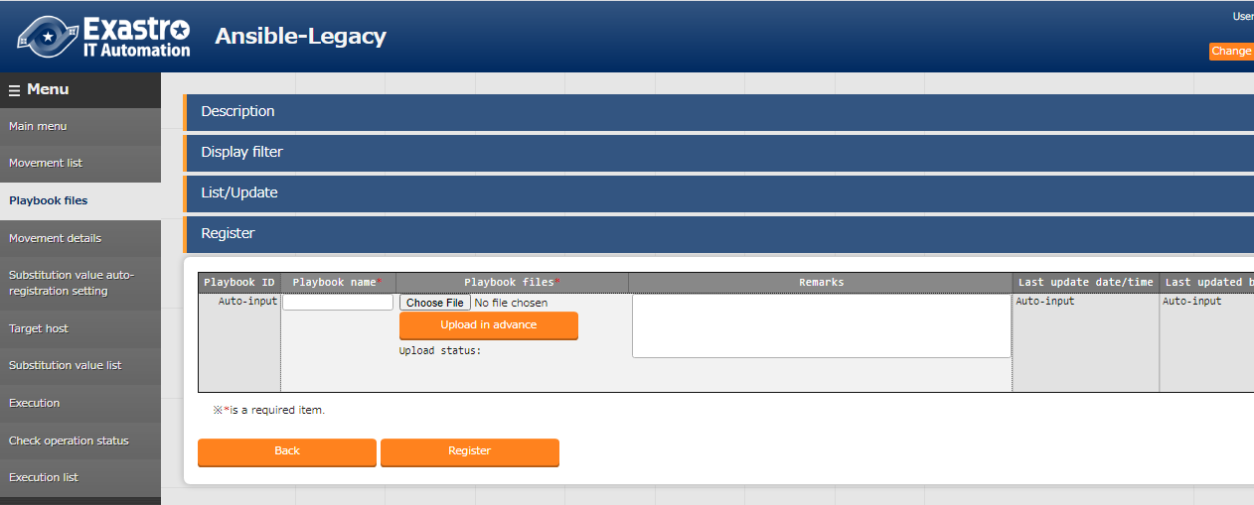
4.3 Register IaC
Register IaC
"Ansible-Legacy"Menu group-> "Playbook files" Menu-> "Register" sub menu->"Start Registration" button.
Input value for "Play book file name" and click the "Browse" button in the "Playbook file" field to upload "Sample1.yml" that we created earlier. ( Click the "Upload in advance" button)
Press the “Register” button
Register Work target host
Register Operation
Register IaC
Register Movement
Register Movement Details
Register Movement and host that connects to Operation
１
Manage Substitute Value
Enter the following for each item
Register Symphony
Execute Symphony
Item | Value
Playbook file name | sample1
Playbook file | sample1.yml
Confirm Symphony
２
For more information on creating IaC, please refer to section 3.2,”Pre-preparation”.

Slide 21
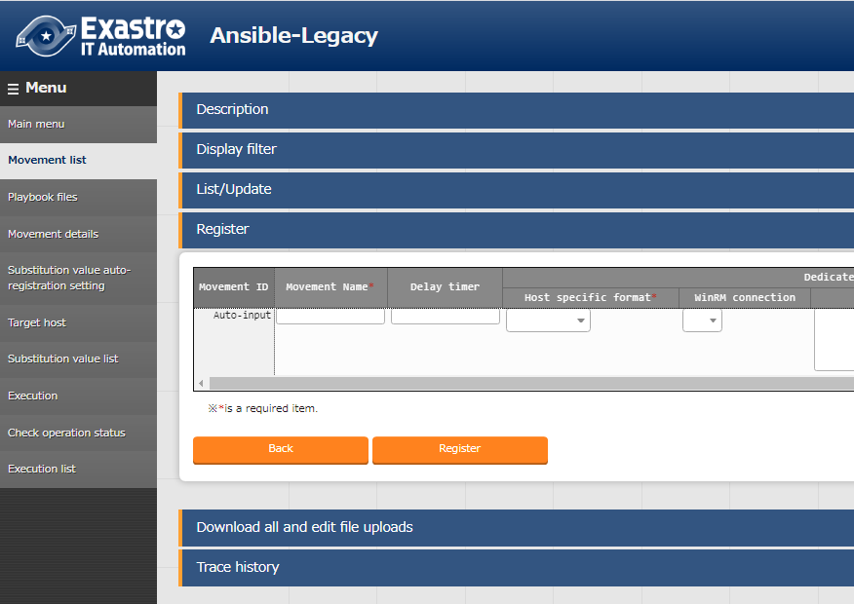
4.4 Register Movement
Register Movement
"Ansible-Legacy"Menu group-> "Movement list"Menu-> "Register" sub-menu->"Start Registration" button.
Input values for "Movement name" and "Host specific format".
Press the ”Register" button
Register Work target host
１
Register Operation
Set the following for each item
Register IaC
Item | Value
Movement name | Move1
Host specific format | IP
Register Movement
Register Movement Details
Register Movement and host that connects to Operation
Manage Substitute Value
Register Symphony
Execute Symphony
Confirm Symphony
２

Slide 22
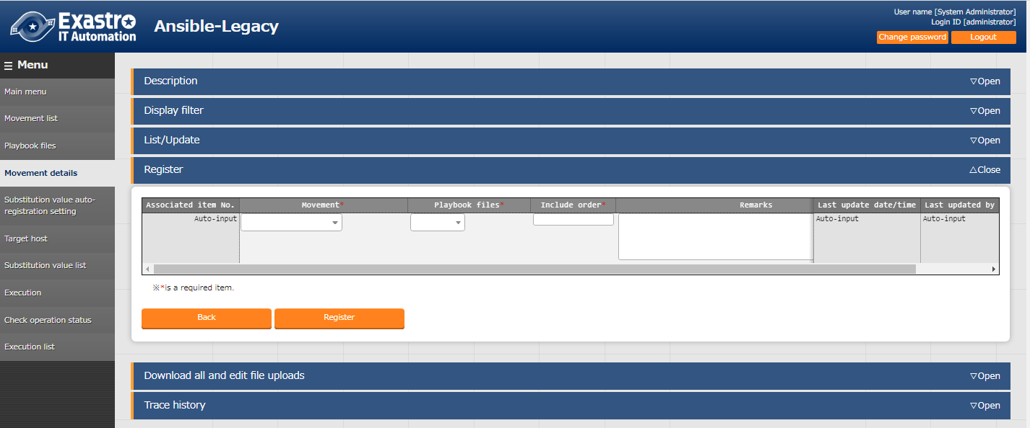
4.5 Register Movement details
Register Movement details
"Ansible-Legacy" Menu group->"Movement details"Menu->"Register"Sub-menu->"Start Registration" button .
Input values for "Movement", "Playbook file" and "Include order"
Press the ”Register" button
Register Work target host
Register Operation
Register IaC
Register Movement
Register Movement Details
Register Movement and host that connects to Operation
Manage Substitute Value
Register Symphony
Execute Symphony
２
１
Enter the following for each item
Confirm Symphony
Item | Value
Movement | move1
Playbook file | sample1
Include order | 1

Slide 23
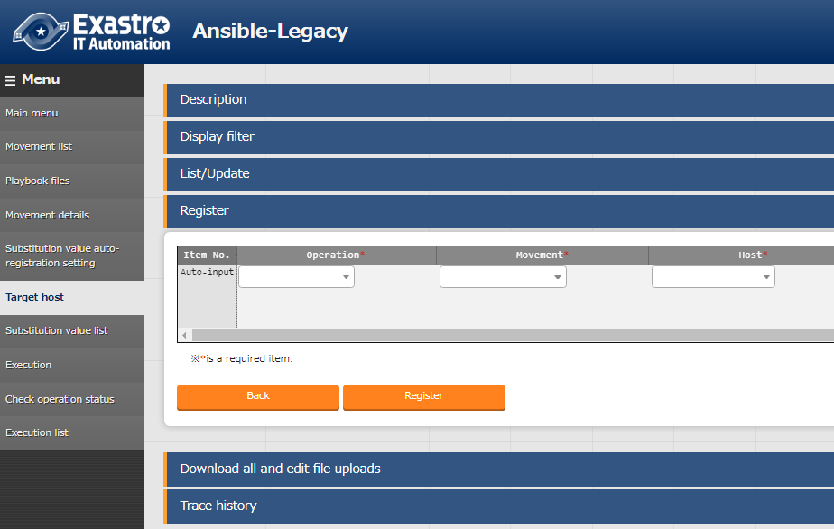
4.6 Register Movement and host that connects to Operation
Register Movement and host that connects to Operation
"Ansible-Legacy" Menu group->"Target host" Menu-> "Register" Sub-menu-> "Starter Registration" button .
Input values for “Operation”, “Movement” and “Host”
Press the “Register” button.
Register Work target host
Register Operation
Register IaC
Register Movement
Register Movement Details
Register Movement and host that connects to Operation
Manage Substitute Value
Register Symphony
Execute Symphony
１
Enter the following for each item
Confirm Symphony
２
Item | Value
Operation | operation
Movement | move1
Host | testserver

Slide 24
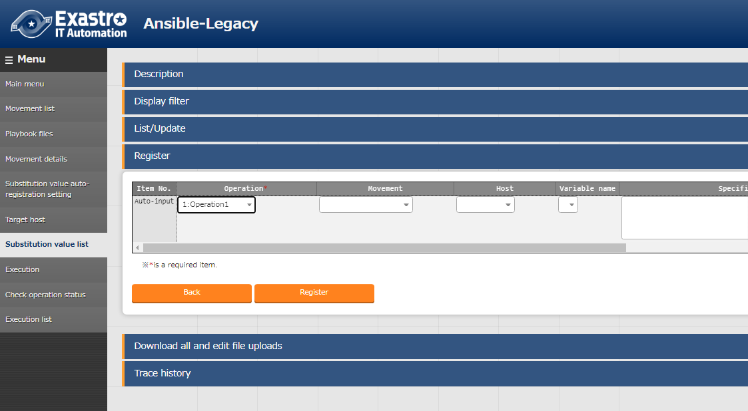
4.7 Manage Substitute Values
Manage Substitute Values
"Ansible-Legacy"Menu group->"Substitute value list"->"Register"Sub menu->"Start Register" button .
Input values for "Operation", "Movement", "Host","Variable name" and "Specific value.
Press the “Register” button.
１
Enter the following for each item
Register Work target host
Item | Value
Operation | operation
Movement | move1
Host | testserver
Variable Name | VAR_DIRECTORY
Specific Value | testdirectory
Register Operation
Register IaC
Register Movement
Register Movement Details
Register Movement and host that connects to Operation
Manage Substitute Value
Register Symphony
Execute Symphony
Confirm Symphony
２

Slide 25
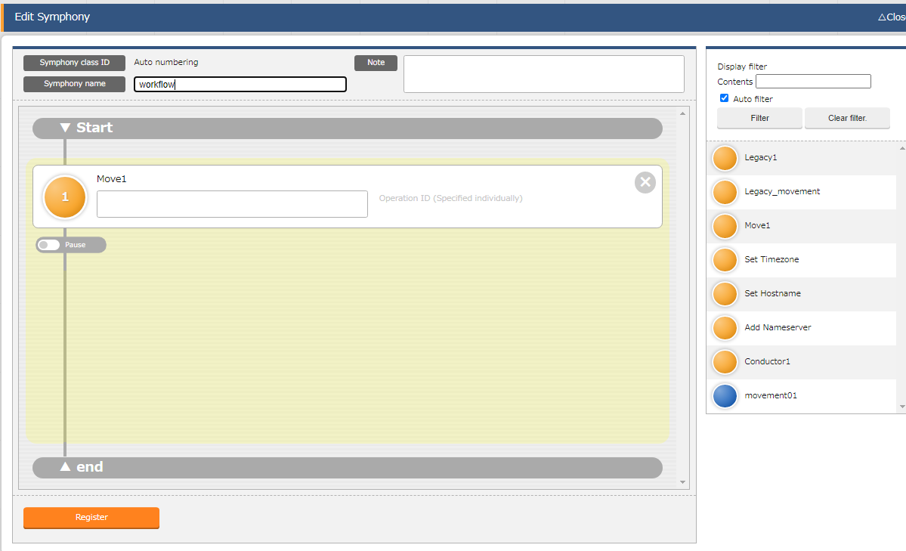
4.8 Register Symphony
Register Symphony
"Symphony" Menu group->"Symphony Class editor“ Menu->"Symphony edit"Sub-menu.
Input “Symphony Class name”.
Drag the item “move1” from the right to the middle of the screen and drop it.
Press the “Register” button
Register Work target host
Register Operation
Enter the following for each item
Register IaC
１
Item | Value
Symphony class name | workflow
Register Movement
Register Movement Details
Register Movement and host that connects to Operation
Manage Substitute Value
Drag and Drop
Register Symphony
Execute Symphony
２
Confirm Symphony
３

Slide 26
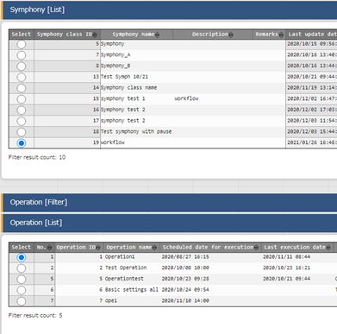
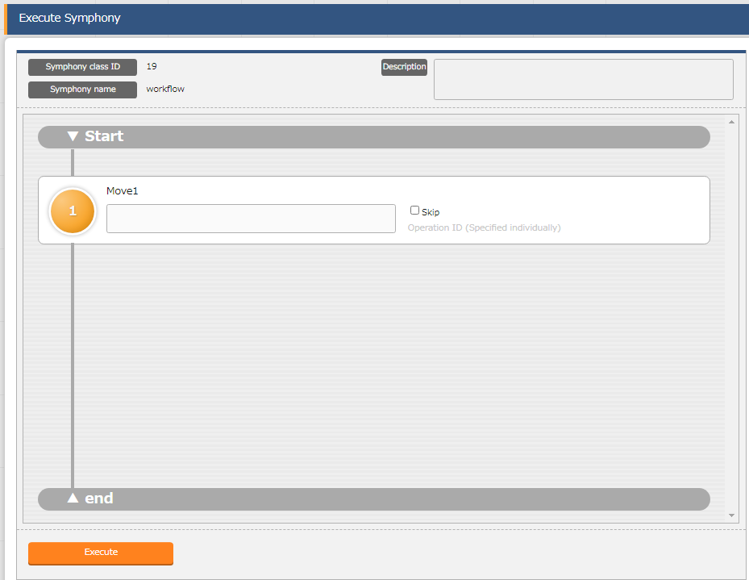
4.9 Execute Symphony
Execute Symphony
“Symphony” Menu group-> “Symphony execution” Menu.
Select “Workflow” in the “Symphony name” item in the “Symphony(list)” Sub-menu.
Select “Operation” in the “Operation Name” item inside the “Operation(list)” Sub-menu.
Press the “Execute” button
Register Work target host
Register Operation
Register IaC
Register Movement
１
Register Movement Details
Select the following
Register Movement and host that connects to Operation
Item | Value
Symphony name | workflow
Manage Substitute Value
Register Symphony
Execute Symphony
Confirm Symphony
２
Select the following
Item | Value
Operation name | operation
３

Slide 27
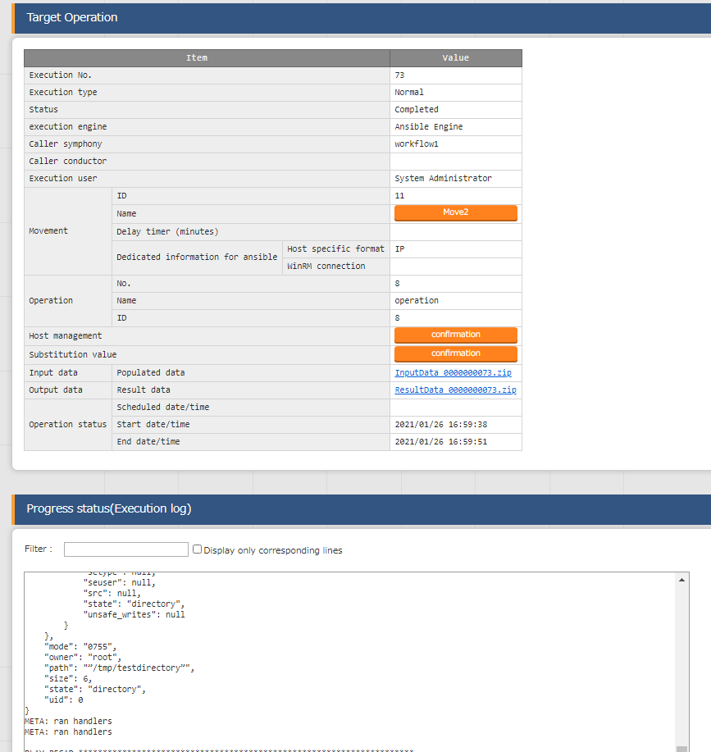
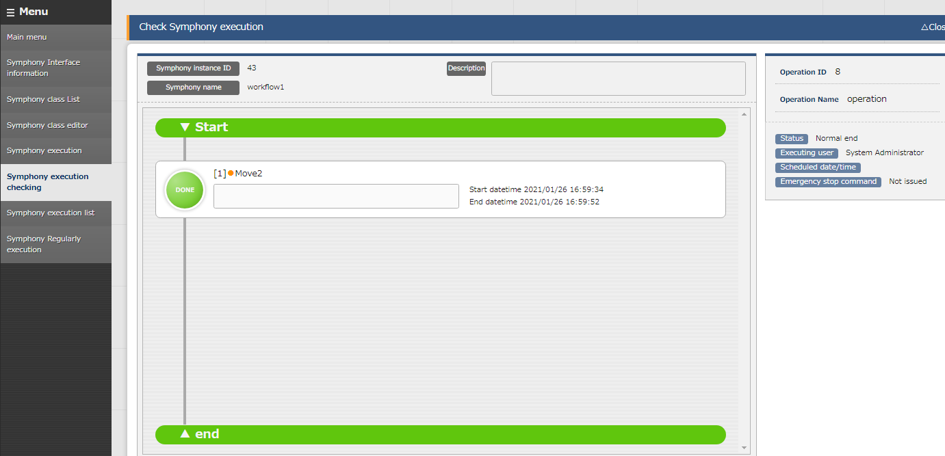
4.10 Confirm Symphony
Confirm Symphony
Selecting a movement that is running or has finnished will take the user to a screen where they can check the status and the log of the operation.
Register Work target host
Register Operation
Register IaC
Register Movement
Register Movement Details
Register Movement and host that connects to Operation
Manage Substitute Value
Register Symphony
Execute Symphony
Confirm Symphony

