Slide 1


Online Installation
※ In this document, “Exastro IT Automation” is described as “ITA".
Version 1.1
Exastro developer

Slide 2
Table of Contents
Introduction
1.1 About This Guide
System Organization
2.1 Functions executed in conjunction with other tools
2.2 System Requirements
IT Automation Configuration Procedure
3.1 Online Installation
3.2 Preparation (1/2)
3.3 Preparation (2/2)
3.4 Flow of IT Automation Configuration
3.5 Configuration (1/7)
3.6 Configuration (2/7)
3.7 Configuration (3/7)
3.8 Configuration (4/7)
3.9 Configuration (5/7)
3.10 Configuration (6/7)
3.11 Configuration (7/7)
IT Automation Operation Check
4.1 Operation Check (1/5)
4.2 Operation Check (2/5)
4.3 Operation Check (3/5)
4.4 Operation Check (4/5)
4.5 Operation Check (5/5)

Slide 3
1. Introduction

Slide 4
1.1 About This Guide
About this guide
This guide describes how to set up IT Automation in an all-in-one configuration by using its installer and external repositories.

Slide 5
2. System Organization

Slide 6
2.1 Functions executed in conjunction with other tools
Functions executed in conjunction with other tools
IT Automation supports the tools for the following functions:
Driver | Tool name (orchestrator) | Function name | Description | Installable with the IT Automation configuration tool | To be installed through this guide
Material | Git | Management of configuration materials | This function allows you to “Check out” and “Check in” configuration materials registered in the standard configuration tools and to manage the versions of the materials via Git. | Yes | No
Create_param | - | Creation of parameter sheets | This function allows you to create and manage parameter sheets (Web menus). | - | Yes
Hostgroup | - | Host grouping | This function allows you to group hosts into logical units (functions and roles) and to manage the parameters to be applied. | - | No
Ansible driver | Ansible | System construction | A Red Hat-provided OSS tool for setting up a platform. For a networked device, this tool allows you to install software, configure various settings, transfer files, and apply patches, based on an IaC called Playbook. | Yes | Yes
AnsibleTower driver | Ansible Tower | System construction | A management platform to enhance Ansible with such functions as access control, job scheduling, and task visualization. | No | No
Cobbler driver | Cobbler | OS installation | An OSS tool for automating installation. For a networked device, this tool allows you to install an OS, based on a prepared template. | Yes | No
OpenStack driver | OpenStack | Virtual system construction | An OSS tool for setting up a cloud environment. This tool allows you to set up virtual machines, storages, and networks. | No | No
PowerShell DSC driver | PowerShell DSC | System construction | A Microsoft-provided tool for setting up a platform. For a Windows environment, this tool allows you to create server users and install software. | No | No

Slide 7
2.2 System Requirements
The followings are the system requirements to use IT Automation:
Operating conditions for the server
Minimum specifications for the server
Operating conditions for the client PC
OS | Red Hat Enterprise Linux | 6.6 or later
 | CentOS | 6.6 or later
CPU | 1 Core
Memory | 1 GB
Disk capacity | 1 GB (only for the IT Automation)
OS | Windows | Windows 7 or later
Application | Excel | MS Office 2007 or later
Browser | Google Chrome | 73 or later
 | Firefox | 41 or later
 | Microsoft Edge | 20 or later

Slide 8
3. IT Automation Configuration Procedure

Slide 9

3.1 Online Installation
Installation procedure
When the IT Automation server has an internet-connection, install necessary libraries via the Internet and execute the IT Automation installer to perform configuration.
IT Automation server
IT Automation
IT Automation installation package
Repositories
PHP
httpd
aaaaaayum
MySQL
IT Automation server
Internet

Slide 10
3.2 Preparation (1/2)
Enabling repositories (only for online installation)
Depending on your OS version, enable the following repositories:
OS | Repository
RHEL 7 | http://ftp-srv2.kddilabs.jp/Linux/distributions/fedora/epel/7/x86_64/Packages/ e/epel-release-7-11.noarch.rpm
 | https://repo.mysql.com/mysql57-community-release-el7-11.noarch.rpm
 | http://rpms.remirepo.net/enterprise/remi-release-7.rpm
RHEL 6 | http://ftp-srv2.kddilabs.jp/Linux/distributions/fedora/epel/6/x86_64/Packages/ e/epel-release-6-8.noarch.rpm
 | https://repo.mysql.com/mysql57-community-release-el6-11.noarch.rpm
 | http://rpms.remirepo.net/enterprise/remi-release-6.rpm
CentOS 7 | epel-release
 | https://repo.mysql.com/mysql57-community-release-el7-11.noarch.rpm
 | http://rpms.remirepo.net/enterprise/remi-release-7.rpm
CentOS 6 | epel-release
 | https://repo.mysql.com/mysql57-community-release-el6-11.noarch.rpm
 | http://rpms.remirepo.net/enterprise/remi-release-6.rpm

Slide 11
3.3 Preparation (2/2)
IT Automation configuration tools
The following table lists tools for configuring IT Automation:
Description | File | Path location
Library collection script | ita_gather_library.sh | /(Extract path)/ita_install_package/install_scripts/
Configuration tool (for offline installation) | ita_builder_offline.sh | /(Extract path)/ita_install_package/install_scripts/
Configuration tool (for online installation) | ita_builder_online.sh | /(Extract path)/ita_install_package/install_scripts/
Setting file | ita_builder_setting.txt | /(Extract path)/ita_install_package/install_scripts/
IT Automation installer | ita_installer.sh | /(Extract path)/ita_install_package/install_scripts/
Answer file | ita_answers.txt | /(Extract path)/ita_install_package/install_scripts/

Slide 12
3.4 Flow of IT Automation Configuration
Configuration flow (online)
The configuration flow is as follows:
(1) Downloading the materials from Github
(2) Changing the permission of the installation scripts
(3) Editing the setting file
(4) Editing the answer file
(5) Executing the configuration tools
(for online installation)
Process flow
Configuring the OS
Configuring the settings of the yum repository
Installing MySQL
Installing Apache
Installing PHP and related programs
(Installing Ansible)
Executing the IT Automation installer

Slide 13
3.5 Configuration (1/7)
Downloading the materials from Github
Download the materials with the following command: $ wget https://github.com/exastro-series/it-automation/archive/vx.x.x.tar.gz *The wget command needs to be installed in advance. *Change the (x.x.x) for the version to be installed.
Changing the permission of the installation scripts
Unzip the .gz file and change the permission of the installation scripts. $ tar zxf vx.x.x.tar.gz $ find ./it-automation-x.x.x/ita_install_package/ -type f –name *.sh | xargs chmod 755
Changing the directory
Move to the directory where the setting file and the shell are stored for configuration. $ cd it-automation-x.x.x/ita_install_package/install_scripts

Slide 14
3.6 Configuration (2/7)
Editing the setting file
The following table lists what to be edited in the setting file (ita_builder_setting.txt) for IT Automation configuration:
Item | Required | Initial value | Description
linux_os | Yes (for all OS) | - | OS of the IT Automation server: CentOS 6, CentOS 7, RHEL 6, or RHEL 7
redhat_user_name | For RHEL OS | - | Username for the Red Hat account
redhat_user_password | For RHEL OS | - | Password for the Red Hat account
pool_id | For RHEL OS | - | Pool ID for the Red Hat account
server_address | For Cobbler | - | IP address of the IT Automation server (Cobbler server) to be set in the settings file of Cobbler
default_password | For Cobbler | - | Root password for the OS installation target server to be set in the settings file of Cobbler *The hash value of the entered value will be set in the settings file.
cobbler_ip | For Cobbler | - | IP address to be set for subnet of dhcp.template
cobbler_subnet | For Cobbler | - | IP address to be set for netmask of dhcp.template
cobbler_gateway | For Cobbler | - | IP address to be set for option routers of dhcp.template
cobbler_dns | For Cobbler | - | IP address to be set for domain-name-servers of dhcp.template
dynamic_address_min | For Cobbler | - | IP address (minimum value) to be set for range dynamic-bootp of dhcp.template
dynamic_address_max | For Cobbler | - | IP address (maximum value) to be set for range dynamic-bootp of dhcp.template

Slide 15
3.7 Configuration (3/7)
Sample of the setting file (ita_builder_setting.txt)
The following shows an example of the setting file (ita_builder_setting.txt):
# Select Operation System. ("CentOS6","CentOS7","RHEL6","RHEL7")
# e.g) linux_os:RHEL7
linux_os: RHEL7
#####################################################
#Only when you select linux_os with RHEL6 or RHEL7
# Enter the Red Hat user name and user password
# e.g) redhat_user_name:sample
redhat_user_name:sample
# e.g) redhat_user_password:sample_password
redhat_user_password: sample_password
# e.g) pool_id:samplePoolID
pool_id: samplePoolID
#####################################################
#Only when you install cobbler driver
#Cobra server IP address
server_address:10.10.10.10
#Password set for OS installation target server
default_password:sample_password
#DHCP setting
#Network address of cobbler server
cobbler_ip:10.10.10.0
#subnet mask of cobbler server
cobbler_subnet:255.255.255.0
#default gateway of cobbler server
cobbler_gateway:0.0.0.0
#DNS server IP address (Separate space if more than one)
cobbler_dns:8.8.8.8
#dynamic dhcp IP address(min)
dynamic_address_min:10.10.10.230
#dynamic dhcp IP address(max)
dynamic_address_max:10.70.10.250
OS of the installation target server: RHEL 7
Enter values for these items only if you use RHEL.
Entering values for these items is unnecessary because this procedure does not require installing the Cobbler driver.

Slide 16
3.8 Configuration (4/7)
Editing the answer file (ita_answers.txt)
Edit the answer file for IT Automation installation in advance.
For ita_base, ansible_driver, and create_param, each of the initial values is set to yes. Change the value to no if the corresponding installation is not necessary.
Item | Required | Default value | Description
install_mode | Yes | Install | Installation mode: Install or Uninstall
ita_directory | Yes | － | Specify the absolute path to the directory where IT Automation will be installed. If the directory does not exist, it will be newly created.
ita_language | Yes | en_US | IT Automation display language: ja_JP (Japanese) or en_US (English)
ita_os | Yes | RHEL7 | OS for IT Automation: RHEL6 or RHEL7
db_root_password | Yes | － | Root password for MySQL
db_name | Yes | － | Database name for MySQL
db_username | Yes | － | Database username for MySQL
db_password | Yes | － | Database password for MySQL
ita_base | Yes | yes | Only yes can be specified to install IT Automation.
Material | Yes | no | Whether the Management of configuration materials function is to be installed
create_param | Yes | yes | Whether the Creation of parameter sheets function is to be installed
Hostgroup | Yes | no | Whether the Host grouping function is to be installed
ansible_driver | Yes | yes | Whether the Ansible driver is to be installed
cobbler_driver | Yes | no | Whether the Cobbler driver is to be installed
openstack_driver | Yes | no | Whether the OpenStack driver is to be installed
dsc_driver | Yes | no | Whether the DSC driver is to be installed
ansibletower_driver | Yes | no | Whether the Ansibletower driver is to be installed

Slide 17
3.9 Configuration (5/7)
Sample of the answer file (ita_answers.txt)
The following shows an example of the answer file (ita_answers.txt):
#Select install mode. ("Install" or "Uninstall")
# e.g) install_mode:Install
install_mode:Install
#Enter install directory.
# e.g) ita_directory:/ exastro
ita_directory:/ exastro
# Select language. ("ja_JP" or "en_US")
# e.g) ita_language:en_US
ita_language:en_US
# Select Operation System. ("RHEL6" or "RHEL7")
# e.g) ita_os:RHEL7
ita_os:RHEL7
# Enter the MySQL root user's password
# e.g) db_root_password:sample_root_password
db_root_password: sample_root_password
# Decide the database name, username, and password for ITA.
# e.g) db_name:sample_db_name
db_name:sample_db_name
# e.g) db_username:sample_db_username
db_username:sample_db_username
# e.g) db_password:sample_db_password
db_password:sample_db_password
# Select the target you need to install.
# yes : need
# no : no need
ita_base:yes
material:no
createparam:yes
hostgroup:no
ansible_driver:yes
cobbler_driver:no
openstack_driver:no
dsc_driver:no
ansibletower_driver:no
With the answer file, define the password for MySQL.

Slide 18
3.10 Configuration (6/7)
Executing the configuration tool (for online installation)
Execute the configuration tool with the following command:
$sh ita_builder_online.sh
Checking the process
Executing the configuration tool outputs the process details to ita_builder.log and ita_installer.log.
Path to the logs
/(Extract path)/ita_install_package/install_scripts/log/

Slide 19
3.11 Configuration (7/7)
Libraries installed through the configuration
The following table lists the libraries installed through the execution of the configuration tool:
Installation driver | Library type | Library name
ita_base | Installation tool | yum-utils, createrepo
ita_base | IT Automation common | zip, telnet, mailx, unzip
ita_base | MySQL | mysql-community-server, expect pexpect, pywinrm
ita_base | httpd | httpd, mod_ssl
ita_base | php | php, php-bcmath, php-cli, php-ldap, php-mbstring, php-mcrypt, php-mysql, php-mysqlnd, php-pear, php-pecl-crypto, php-pecl-zip, php-process, php-snmp, php-xml
ita_base | php plug-in | PHPExcel, Spyc, Twig, MDB2, HTTP_Request2, Auth, HTML_AJAX-beta
material | git | git
ansible_driver | Ansible | ansible, python-pip
cobbler_driver | Cobbler | cobbler, cobbler-web, dhcp, pykickstart, fence-agents, debmirror, xinetd

Slide 20
4. IT Automation Operation Check

Slide 21
4.1 Operation Check (1/5)
Checking the main menu
After completing the installation, take the following steps with a Windows PC client to access the main menu of IT Automation and to check that the IT Automation and all the drivers are shown properly.
Preparation
Specify the IP address and host name of the IT Automation server in the hosts file of the Windows client.
For Windows 7, the hosts file is located at the following:
To the hosts file, add the following settings:
C:\Windows\System32\drivers\etc\hosts
"IP address of the IT Automation server" exastro-it-automation e.g., 192.168.0.3 exastro-it-automation

Slide 22
4.2 Operation Check (2/5)
Importing the certificate to the Windows client
The certificate is stored in the following directory of the IT Automation installation package.
Use a tool (such as FFFTP and WinSCP) to download the client.
Import the certificate to a Web browser.
For Google Chrome, import the certificate as follows.
Start up Google Chrome. Then select Settings button in the upper right > settings.
Select Advanced in the Lower part of browser > Manage certificates.
In the Trusted Root Certification Authorities tab click the Import button in the lower left.
When the certificate import wizard appears, click Next.
Specify the name of the file to be imported. Then click Next.
Make sure that the Place all certificates in the following store option is selected.
Select Trusted Root Certification Authorities and click Next.
※If not selected, select Trusted Root Certification Authorities from Reference on the right.
Click Finish.
OS of the IT Automation server | File path | File name
RHEL 6, CentOS 6 | /(extract path)/ita_install_package/ext_files_for_CentOS6.x/etc_pki_tls_certs/ | exastro-it-automation.crt
RHEL 7, CentOS 7 | /(extract path)/ita_install_package/ext_files_for_CentOS7.x/etc_pki_tls_certs/ | exastro-it-automation.crt

Slide 23
4.3 Operation Check (3/5)
Accessing the login screen
Access the login screen with the following URL:
URL: https://exastro-it-automation/
Logging in
When the IT Automation login screen appears, enter the given login ID and initial password and then click the Login button.
- Login ID: administrator
- Initial password: password
If you have logged in for the first time after the installation, you will be prompted to change the password.
Change the initial password.

Slide 24
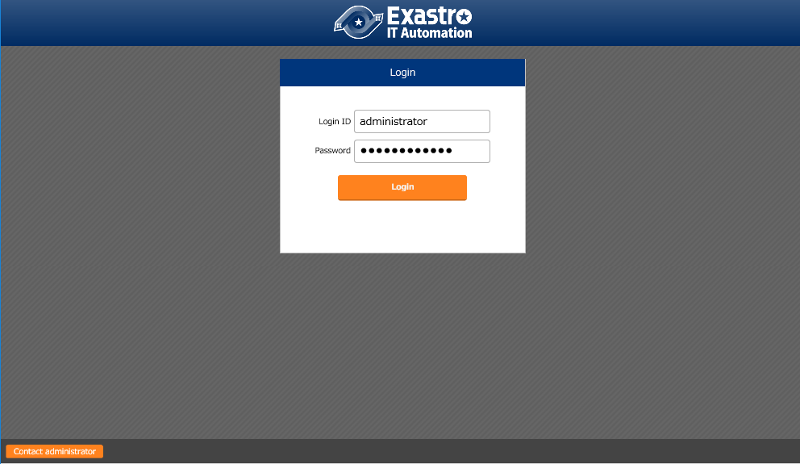
4.4 Operation Check (4/5)
IT Automation login screen
Having been successfully installed, IT Automation displays the following login screen:
Login ID: administrator
Initial password: password

Slide 25
4.5 Operation Check (5/5)
Checking the content by displaying the menus
After logging in, check that the following menus are shown properly:
Function | Menu
IT Automation (main body) | Management Console
 | Basic Console
Creating parameter sheets | Create master menu
 | Create parameter list menu
Ansible driver | Ansible Common
 | Ansible-Legacy
 | Ansible-Pioneer
 | Ansible-LegacyRole

