Slide 1


Quick Start
※ In this document, “Exastro IT Automation” is described as “ITA".
Version 1.1
Exastro developer

Slide 2
Table of Contents
Introduction
1.1 Web Console Login Screen
1.2 Screen Description: Main menu
1.3 Screen Description: Other Menus (1/2)
1.4 Screen Description: Other Menus (2/2)
Procedure Description
2.1 Overall Procedure and Work Scope
Preparation
3.1 Registering an IaC (1/3)
3.2 Registering an IaC (2/3)
3.3 Registering an IaC (3/3)
3.4 Creating the Workflow Including the IaC
3.5 Registering a Target Linux Machine in Device list
Execution
4.1 Registering a New Operation Name
4.2 Connecting the Target to the IaC
4.3 Executing the Workflow
A Appendix
Reference 1 Ansible-Legacy: Single Execution
Reference 2 Ansible-Legacy: Checking the Operation Results
Reference 3 How to Check the Symphony Execution Results
Reference 4 Sample Collection of Playbook

Slide 3
1. Introduction

Slide 4
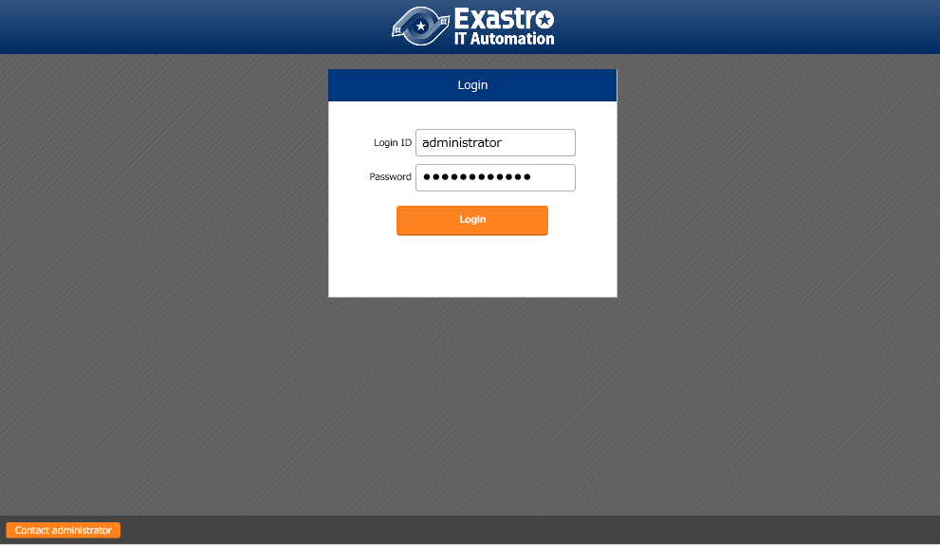
1.1 Web Console Login Screen
Web console Login Screen
Access the following URL to display the Login screen: https://exastro-it-automation/
Immediately after the first login, you will be prompted to change your password.
To deploy IT Automation, refer to “ITA-online-install_en.pdf".

Slide 5
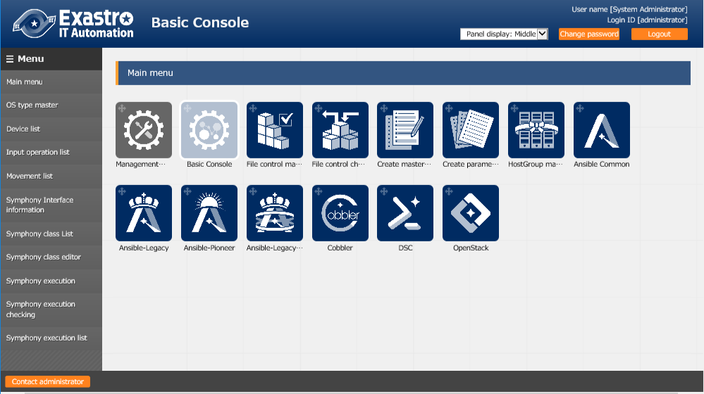
1.2 Screen Description: Main menu
Screen description: Main menu
Basic names are as follows:
Menu group
Refer to the manual
for the details of each function.
Menu

Slide 6
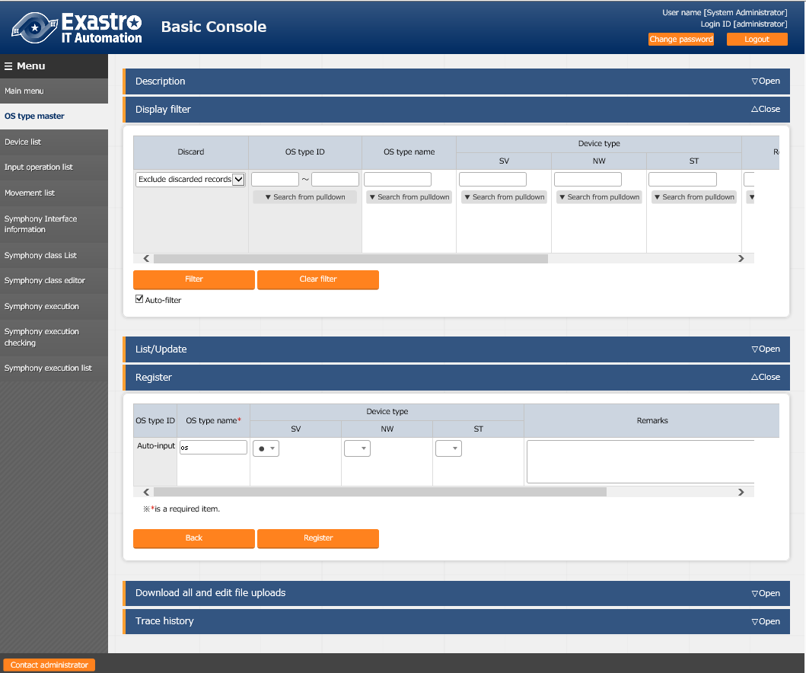
1.3 Screen Description: Other Menus (1/2)
Screen description: other menus
Basic names are as follows:
Refer to the manual
for the details of each function.
Submenu outline
Description : Describes the menu being displayed.
Display filter : Allows you to search for
registered information.
List/Update : Displays the registered information.

Slide 7
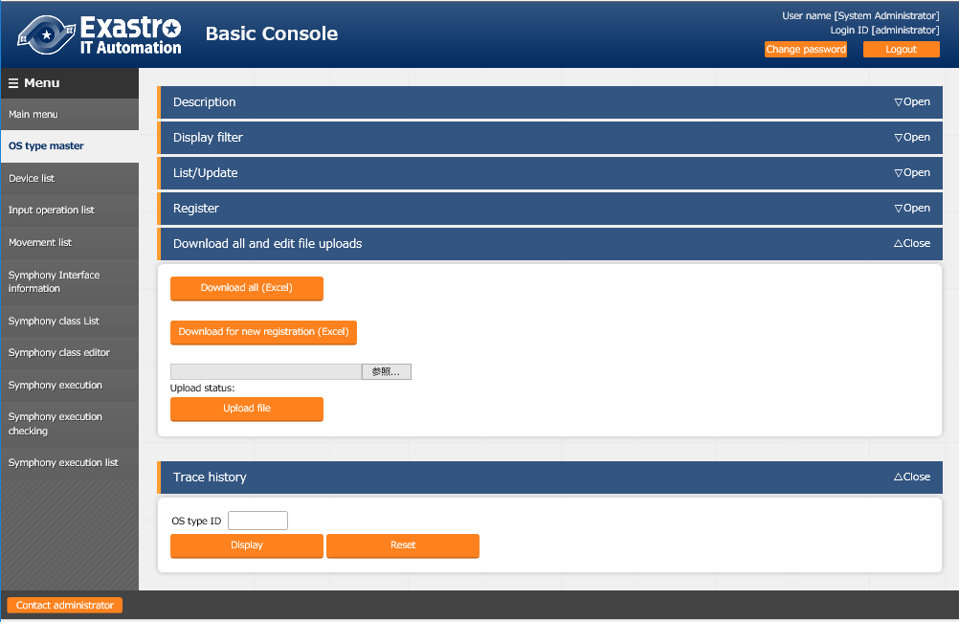
1.4 Screen Description: Other Menus (2/2)
Screen description: other menus
Basic names are as follows:
Refer to the manual
for the details of each function.
Submenu outline
Register : Allows you to register records from the Web.
Download all and edit file uploads
: Allows for IN/OUT processing with Excel.
Trace history : Allows you to display the track changes of registered records.

Slide 8
2. Procedure Description

Slide 9
2.1 Overall Procedure and Work Scope
Post-deployment procedure including executing Ansible-Legacy
The following illustrates the overall procedure and work scope for developers/operators:
Preparation
Registering an IaC (Movement)
Creating the Workflow (Symphony) Including the IaC
Registering a Target Linux Machine in Device list
Execution
Registering a New Operation Name
Repeat
Connecting the Target to the IaC
Executing the Workflow
The preparation contains IaC registration and workflow creation.
The execution includes repeatedly performing the registered workflow.

Slide 10
3. Preparation

Slide 11
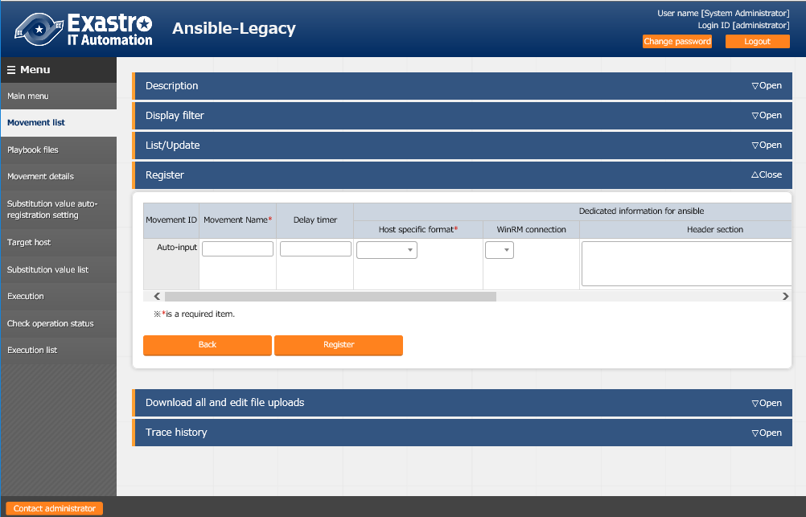
3.1 Registering an IaC (1/3)
Registering a new Movement in Movement list
From the Main menu screen, select Ansible-Legacy > Movement list. To start the registration, click the Register button.
Registering an IaC
Creating the Workflow Including the IaC
Registering a Target Linux Machine in Device list
1
Registering a New Operation Name
Connecting the Target to the IaC
Executing the Workflow
2
The following are mandatory fields:
- Movement Name
- Host specific format
*Movement: A name of minimum work

Slide 12
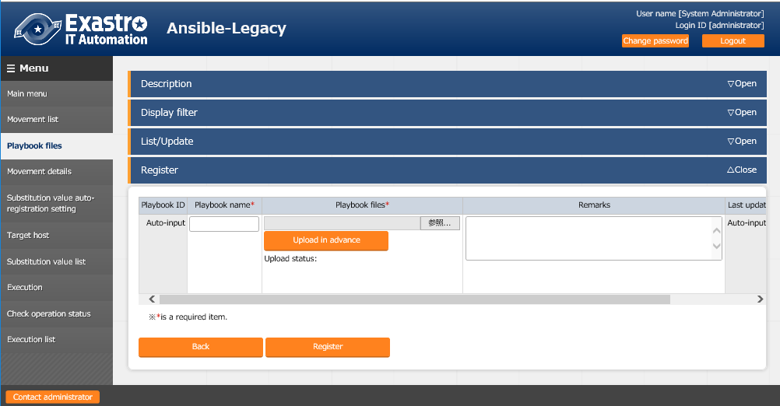
3.2 Registering an IaC (2/3)
Registering a new playbook in Playbook files
From the Main menu screen, select Ansible-Legacy > Playbook files. To start the registration, click the Register button. *If no playbook is prepared, use any of the playbooks described in Appendix (Reference 4).
Registering an IaC
Creating the Workflow Including the IaC
*When uploading a playbook, specify the file and then make sure to click the Upload in advance button.
Registering a Target Linux Machine in Device list
1
Registering a New Operation Name
Connecting the Target to the IaC
Executing the Workflow
2
The following are mandatory fields:
- Playbook name
- Playbook files

Slide 13
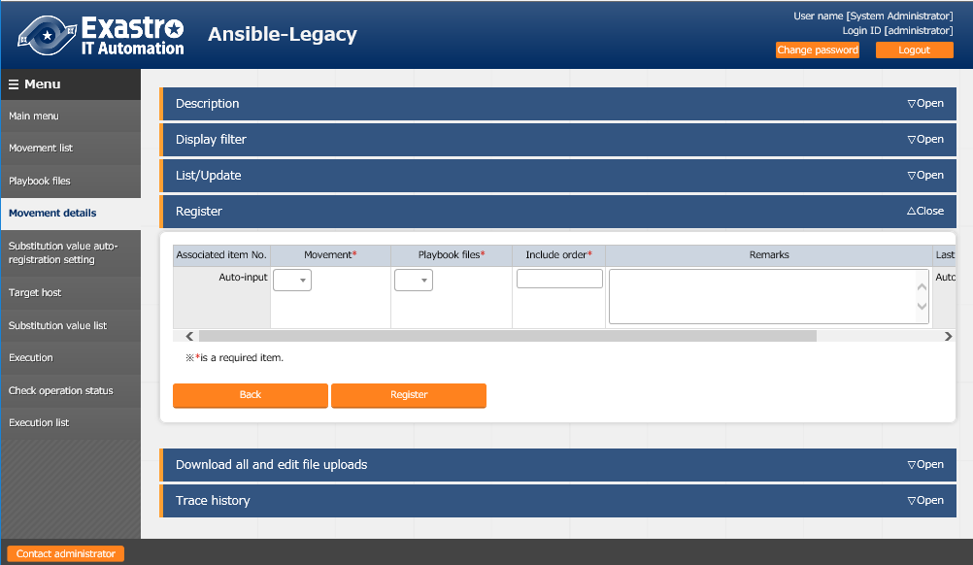
3.3 Registering an IaC (3/3)
Registering in Movement details
From the Main menu screen, select Ansible-Legacy > Movement details. To start the registration, click the Register button.
Registering an IaC
In the Include order field, specify the order in which multiple playbooks are registered for each Movement. For 1:1, enter 1.
Creating the Workflow Including the IaC
Registering a Target Linux Machine in Device list
1
Registering a New Operation Name
Connecting the Target to the IaC
Executing the Workflow
2
The following are mandatory fields:
- Movement
- Playbook files
- Include order

Slide 14
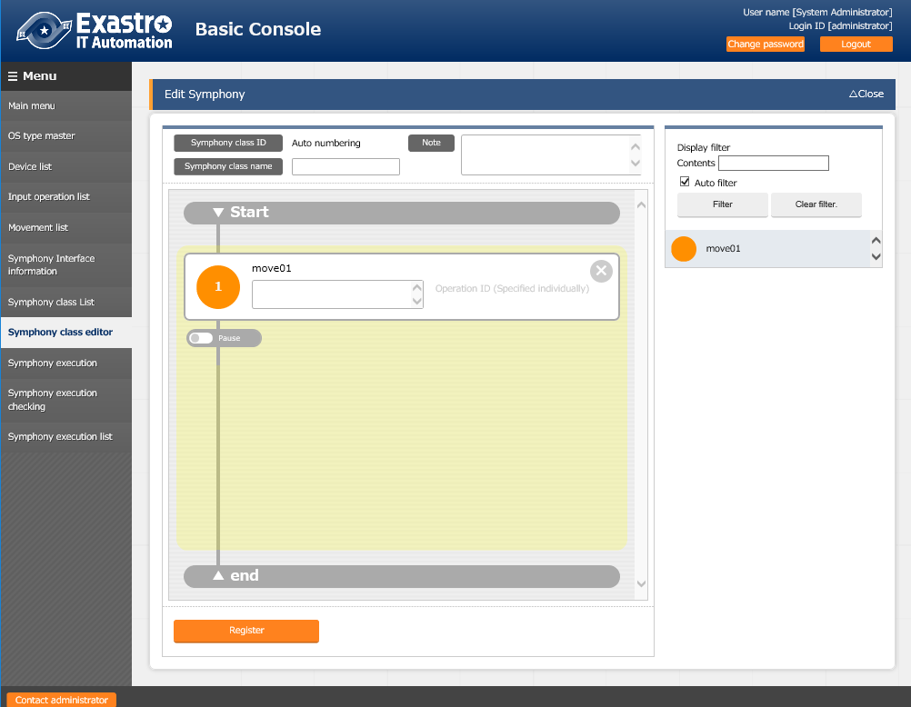
3.4 Creating the Workflow Including the IaC
Creating a workflow in Symphony class editor
From the Main menu screen, select Basic Console > Symphony class editor.
Register
a Symphony name.
Registering an IaC
1
Creating the Workflow Including the IaC
Drag and drop
Registering a Target Linux Machine in Device list
Registering a New Operation Name
Text such as a work description can be entered.
2
Connecting the Target to the IaC
Executing the Workflow
From the list of created Movements, drag and drop the desired Movement to register it.
3

Slide 15
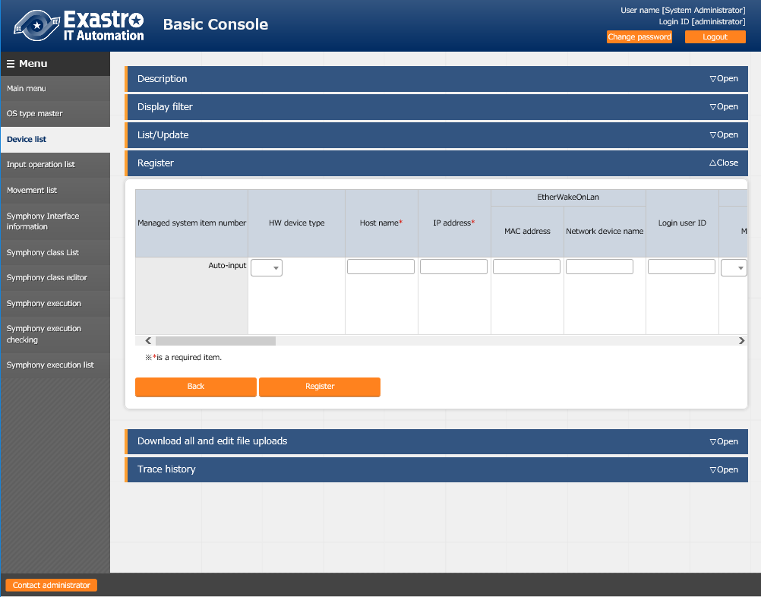
3.5 Registering a Target Linux Machine in Device list
Registering a new target host in Device list
From the Main menu screen, select Basic Console > Device list. To start the registration, click the Register button.
Registering an IaC
Creating the Workflow Including the IaC
3
Registering a Target Linux Machine in Device list
Registering a New Operation Name
Connecting the Target to the IaC
Executing the Workflow
4
For executing Ansible-Legacy, the following are mandatory fields: - Host name - IP address - Login user ID - Login password management - Login password - Authentication method*
*This document describes it as password authentication.

Slide 16
4. Execution

Slide 17
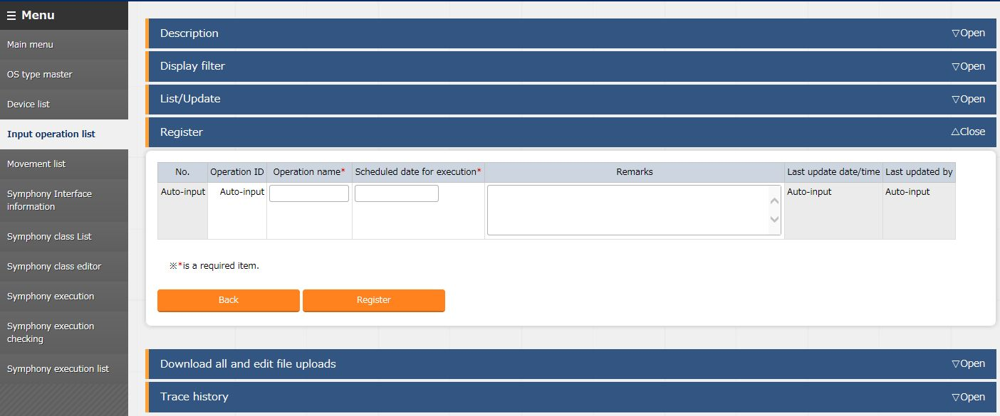
4.1 Registering a New Operation Name
Registering a new operation name on Input operation list
From the Main menu screen, select Basic Console > Input operation list. To start the registration, click the Register button. *Operation refers to the operation name used in the IT Automation system that indicates the whole operation.
Registering an IaC
Creating the Workflow Including the IaC
3
Registering a Target Linux Machine in Device list
Registering a New Operation Name
4
Connecting the Target to the IaC
Executing the Workflow
The following are mandatory fields:
- Operation name
- Scheduled date for execution

Slide 18
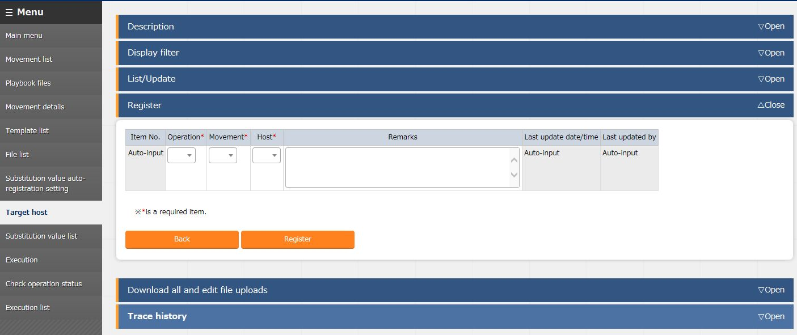
4.2 Connecting the Target to the IaC
Registering on Target host
From the Main menu screen, select Ansible-Legacy > Target host. To start the registration, click the Register button.
Registering an IaC
Creating the Workflow Including the IaC
1
Registering a Target Linux Machine in Device list
From the Host list, select the desired target device.
Registering a New Operation Name
2
Connecting the Target to the IaC
Executing the Workflow
The following are mandatory fields:
- Operation
- Movement
- Host

Slide 19
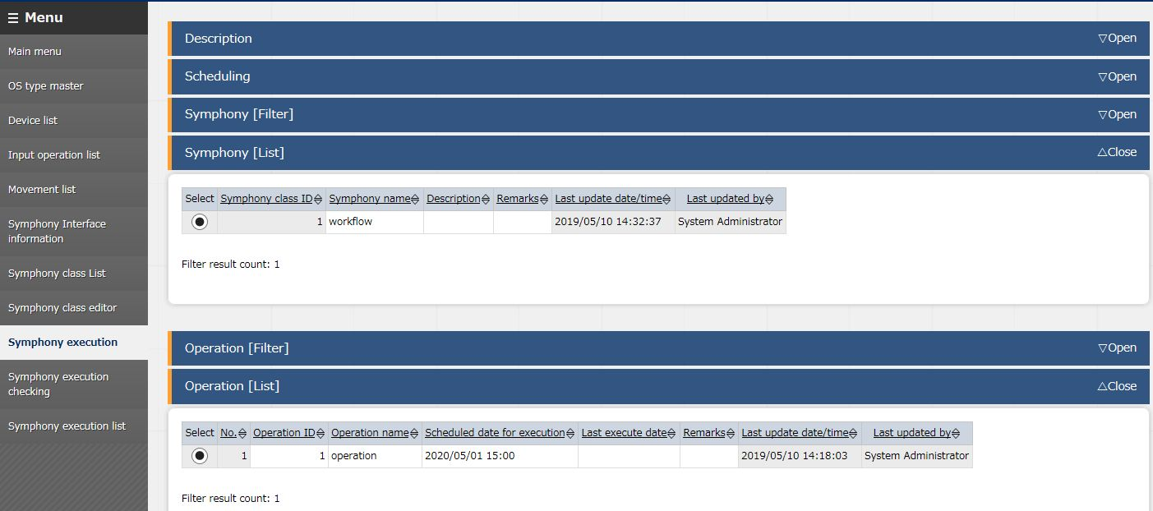
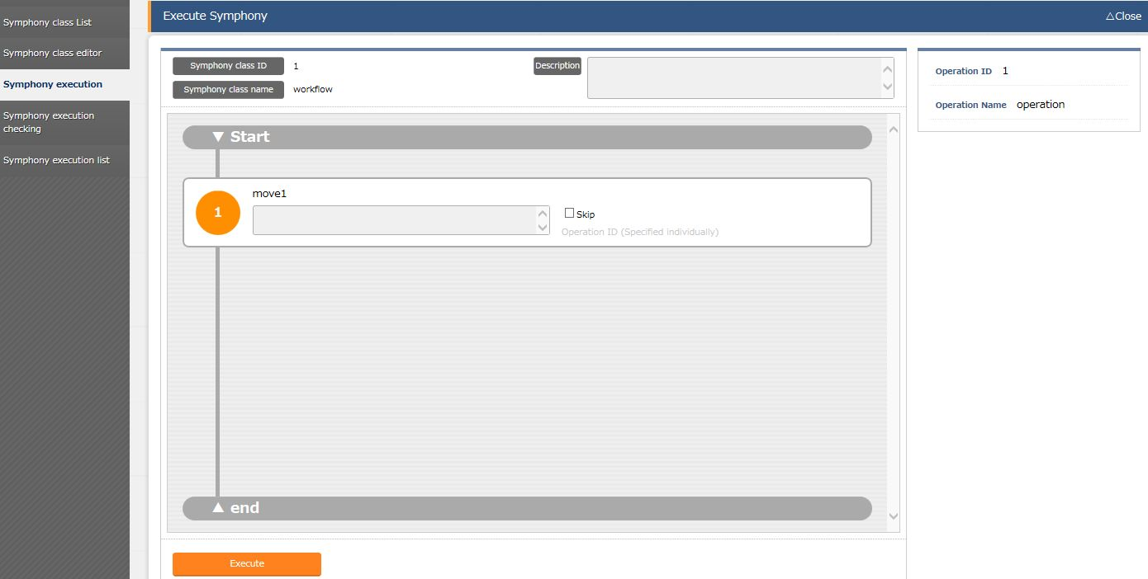
4.3 Executing the Workflow
Executing Symphony
From the Main menu screen, select Basic Console > Symphony execution.
Registering an IaC
Creating the Workflow Including the IaC
From Symphony and Operation, select items to be executed.
*General procedure manual > Symphony
*Replacement table > Operation
Registering a Target Linux Machine in Device list
1
Registering a New Operation Name
Connecting the Target to the IaC
Executing the Workflow
2
3

Slide 20
A Appendix

Slide 21
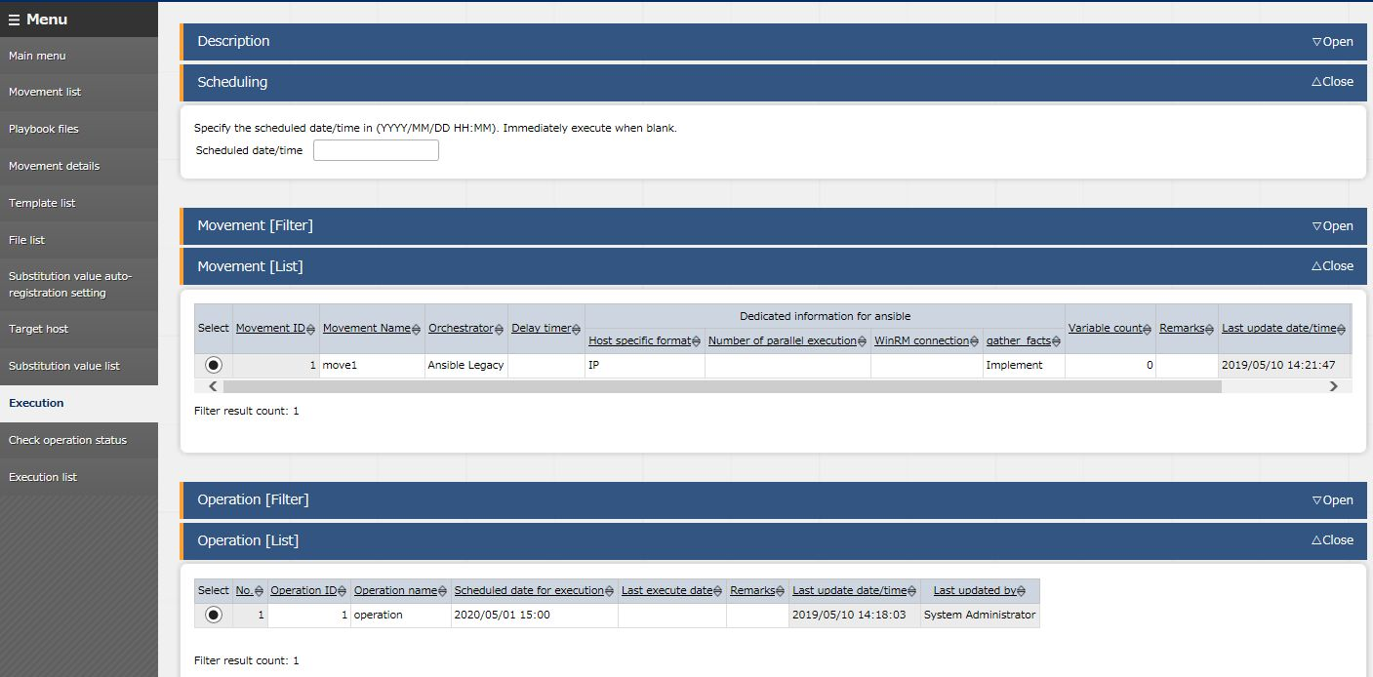
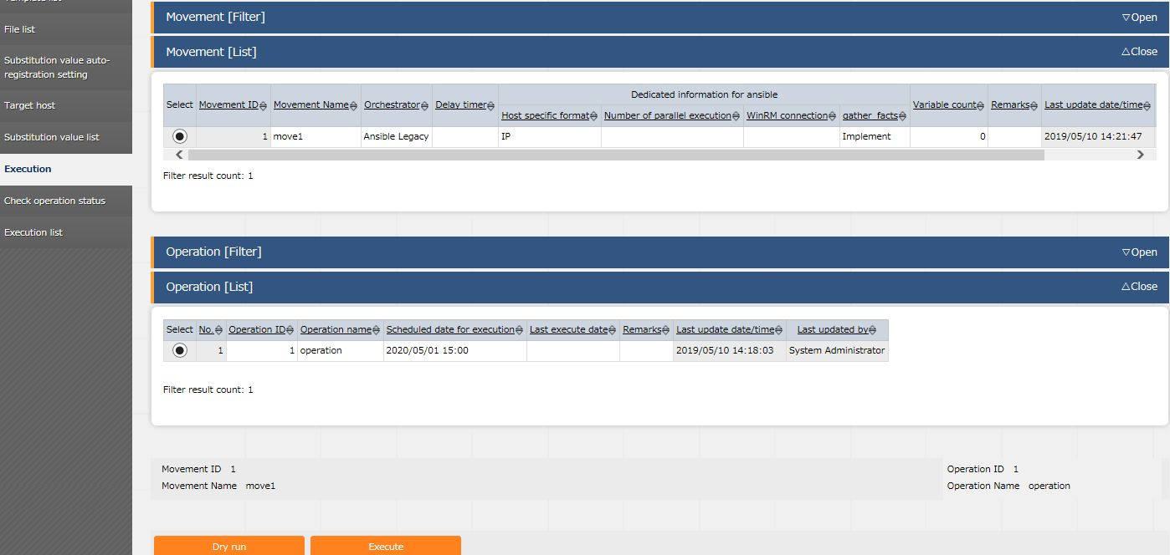
Reference 1 Ansible-Legacy: Single Execution
Execution
In Ansible-Legacy, the Execution menu offers the Execute and Dry run functions for each Movement.
Select the created Movement
1
Select the operation
connected to the Movement
Dry run:
Checks the playbook connection/syntax
Execute:
Executes the playbook
2
3

Slide 22
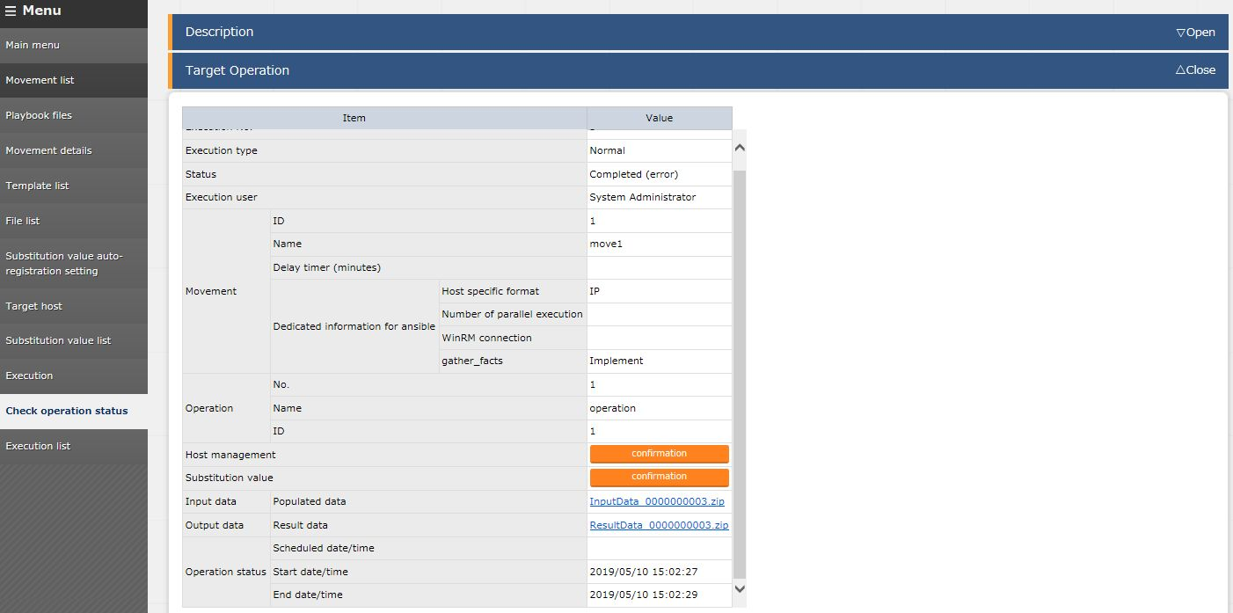
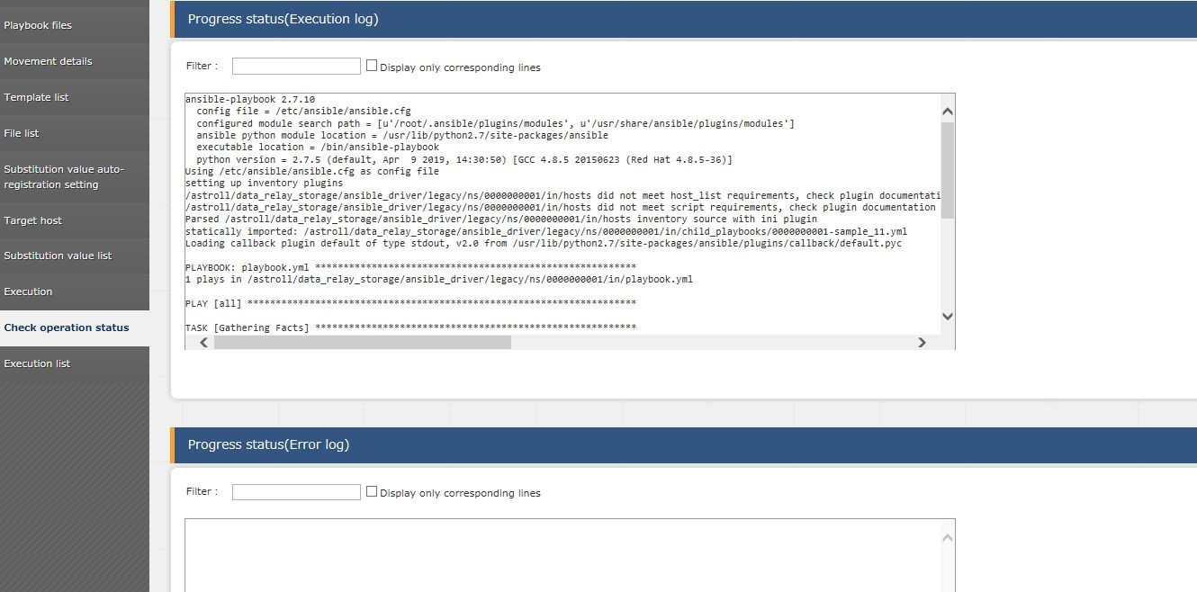
Reference 2 Ansible-Legacy: Checking the Operation Results
Checking the operation results
Performing the function (Execute or Dry run) displays the execution status and logs.
Execution status: Allows you to check the execution evidence and the input data.
point
point
Execution log and Error log:
Can be checked in real time.

Slide 23
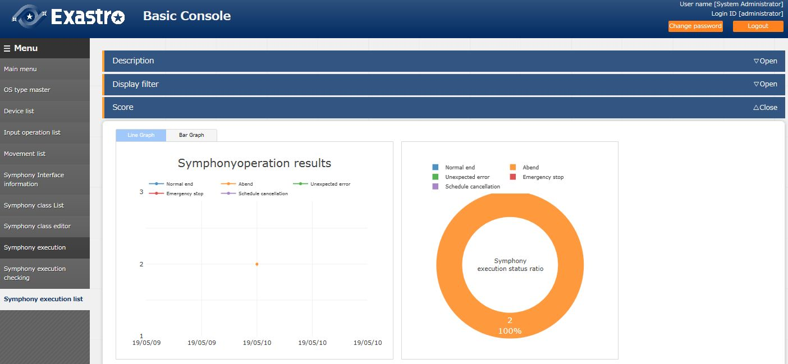
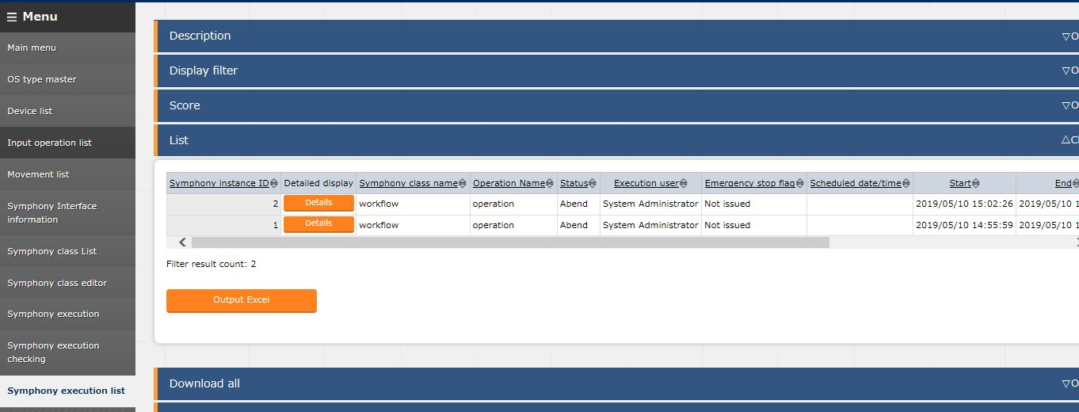
Reference 3 How to Check the Symphony Execution Results
Checking the execution results on Symphony execution list
From the Main menu screen, select Basic Console > Symphony execution list.
point
Graphs based on data narrowed down
through the display filter
are dynamically generated.
Data narrowed down through
the display filter is output on the list.
Click the Details button to
display the detailed information
in a separate tab.
point

Slide 24
Reference 4 Sample Collection of Playbook
Sample playbooks (for Linux servers)
The following playbooks are samples. They can be used as is, but you can freely change the parts in red. *The character code is "UTF-８", the line feed code is "LF", and the extension is "yml" format.
Keep the indents in mind.
- name: Make Work Directory demonstration
file: path: /tmp/demodirectory state: directory mode: 0755
A directory called ”demodirectory” is
created under the /tmp directory.
point
- name: Sample User add user: name: ITA createhome: no uid: 4401 group: users
point
An ITA user is created. Delete the user after checking the operation.
point
The following definition is reserved variables
prepared in advance that are used
when a file is brought back to the
IT Automation server.
{{ __workflowdir__ }}/{{ inventory_hostname }}
point
- name: Collect Files fetch: src=/etc/hosts dest={{ __workflowdir__ }}/{{ inventory_hostname }} flat=yes
/etc/hosts files are collected.
The collected files are gathered in the zip file of the result data.

