Slide 1


Export/Import 【Practice】
※”Exastro IT Automation” will be shortened to ITA in this document.
Exastro IT Automation Version 1.9
Exastro developer

Slide 2
Table of contents
Introduction
About this document
Scenario ① Menu export/import
Environment
Export/Import procedure
Data registration
Create menu
Export menu
Import menu
3. Scenario ② Excel bulk export/import
Environment
Excel bulk export/import procedure
Excel bulk export
Excel file edit
Excel bulk import

Slide 3
1. Introduction

Slide 4
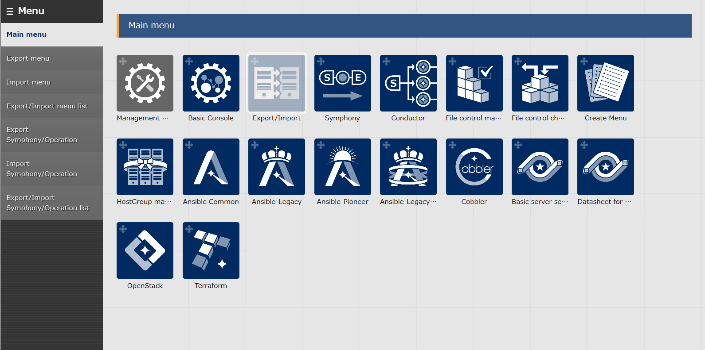
1.1 Ansible driverについて X/X
1.1 About this document
About this document
This document aims to introduce the reader to the Export/Import function by teaching them through a hands-on scenario

Slide 5
2. Practice ①. Menu export

Slide 6

2.1 Environment
Work environment The environment used in this document is as following. The Export/Import function requires 2 systems in order to function (one for export and one for import).
Client machine
・Google Chrome
・Windows10
ITA Server (2) ・CentOS 7 (※1) ・ITA 1.9.0 ・Ansible 2.11.7
Google Chrome
Windows10
CentOS 7
CentOS 7
kym
ITA
1.9.0
ITA
1.9.0
Ansible
2.11.7
Ansible
2.11.7
ITA server(Export)
ITA server(Import)
※1 In this scenario, the host server is running on CentOS7, but ITA can be installed on any RHEL7/RHEL8 type OS.

Slide 7
2.1 Export/Import procedure
Work procedure
This scenario will follow the procedure shown below.
1. Device information
① Data registration
2. Operation
3. Menu creation / Input group creation
② Menu creation/Input
4. Menu creation
5. Input created menus
6. Execute export
③ Export
7. Download Kym file.
8. Execute import
④ Import
9. Check import results

Slide 8
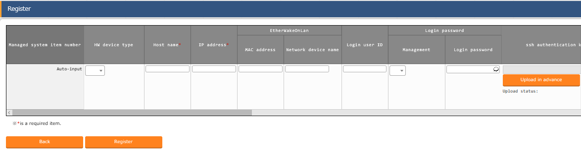
2.2 Data registration (1/2)
Device registration Menu: Basic console> Device list
Click ”Start Registration” under the “Register” sub-menu
Select or input the following information for each item and click “Register”
Data registration
Device info
Operation
Create/Input menu
Export
Import
2
Item | Input content
HW device type | SV
Host name | (Free value)
IP address | Target device IP Address
Login user ID | (Free value)
Management | ●
Login password | (Free value)
Authentication method | Password authentication

Slide 9
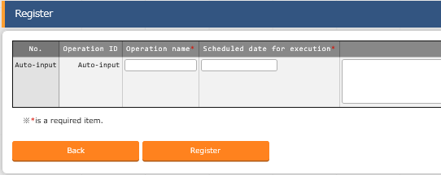
2.2 Data registration (2/2)
Register a new operation Menu: Basic console> Operation list
Click “Start Registration” under the “Register” sub-menu.
Input the following information for each item and click “Register”
Data registration
Device info
Operation
Create/Input menu
Export
Import
2
Operation name | Scheduled date for execution
OP1 | (Free value)

Slide 10
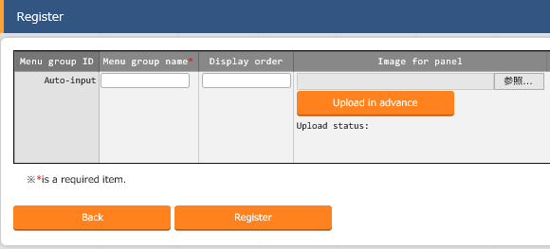
2.3 Create Menu(1/4)
Menu group creation
Menu: Management console> Menu group list.
Click the “Start Registration” button under the “Register” sub-menu
Input the following information for each item and click “Register”
Data registration
Input/Create Menu
Menu group
Menu
Created Menu
Export
Import
2
Menu group name | Display Order
Basic Server Settings | 125
Basic Server Settings (For referencing) | 130

Slide 11
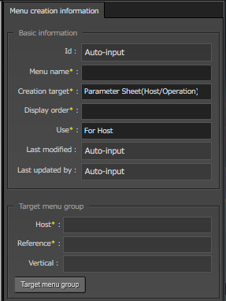
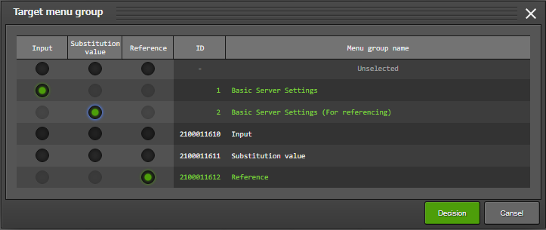
2.3 Create Menu(2/4)
Create Parameter sheets
Menu: Create menu> Create/Define menu
Input the following for “Menu creation information”
Click “Target menu group” and select the target menu group.
Data registration
Input/Create Menu
Menu group
Menu
Created Menus
Export
Import
１
Item | Input content
Menu name | Directory settings
Creation target | Parameter Sheet(Host/Operation)
Display order | 1
2

Slide 12
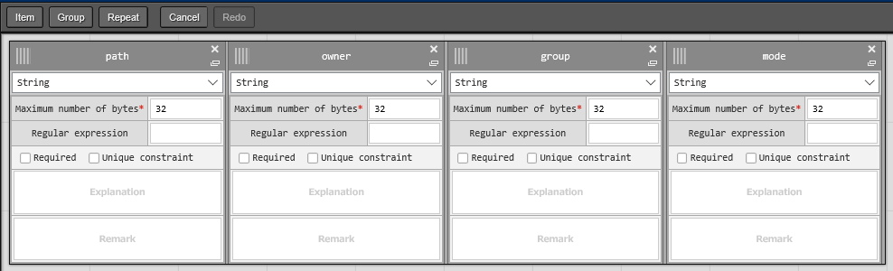
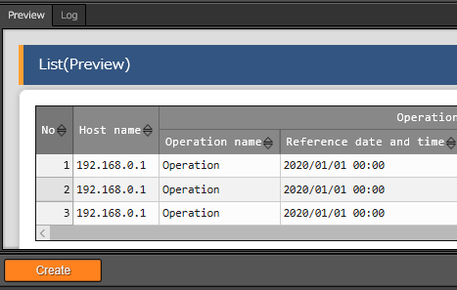
2.3 Create Menu (3/4)
Define Parameter Item names.
Menu: Create Menu> Create/Define menu.
Press “Item” and add new items.
Select or input the following for each item and click “Register”
Click “Create” on the bottom of the screen.
Data registration
Input/Create Menu
Menu group
Menu
Created Menus
Export
Import
１
2
Item name | Input method | Maximum number of bytes
path | String | 32
owner | String | 32
group | String | 32
mode | String | 32
３

Slide 13
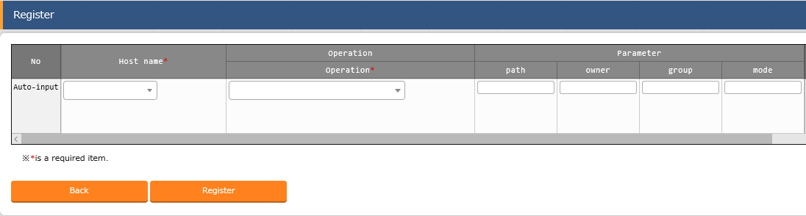
2.3 Create Menu (4/4)
Register data to Parameter sheet.
Menu: Basic Server Settings> Directory Settings
Click “Start Registration” under the “Register” sub-menu.
Select or input the following for each item and click “Register”
Update the data created in ② to match the data below.
Data registration
Input/Create Menu
Menu group
Menu
Created Menu groups
Export
Import
2
Host name | Operation | path | owner | group | mode
(Free) | OP1 | /tmp/work1 | root | root | 0644
3
Host name | Operation | path | owner | group | mode
(Free) | OP1 | /tmp/work2 | root | root | 0644

Slide 14
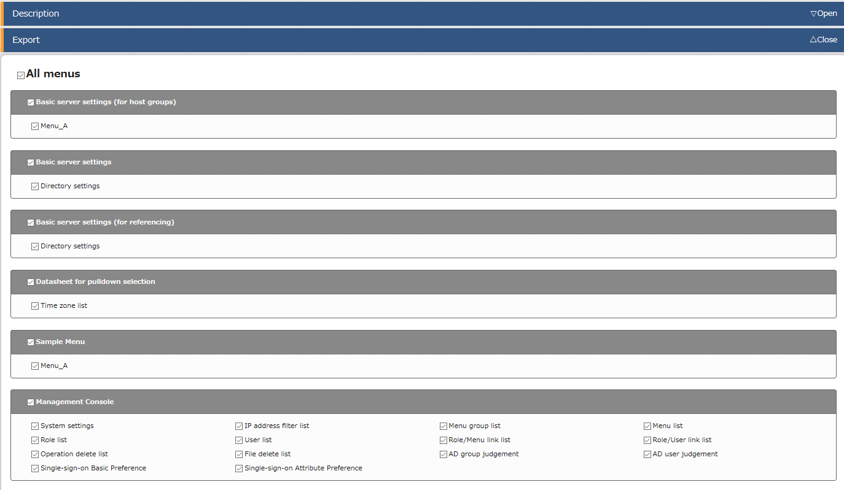
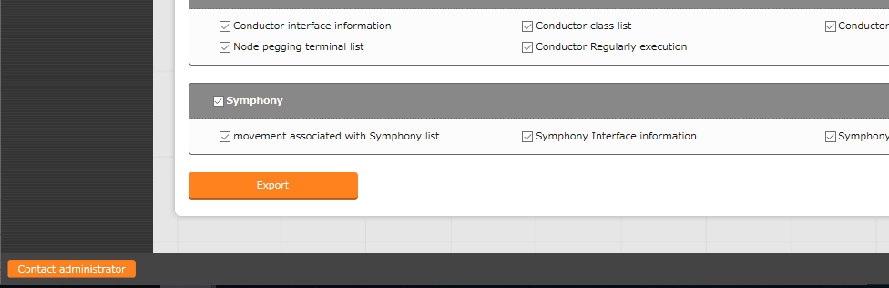
2.4 Export(1/2)
Export Execution
Choose and export the registered information
Menu: Export/Import> Export menu
Data registration
Input/Create Menu
Export
Start Export
Download kym file
Import
1
Tick the “All Menus” checkbox
２
Click the ”Export” button.

Slide 15
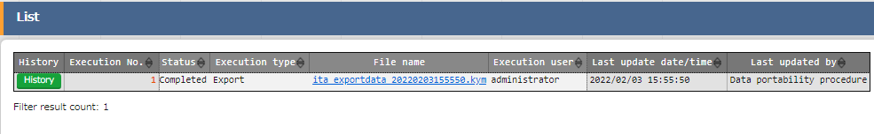
2.4 Export(2/2)
Download Kym File
Let download the exported data.
Menu: Export/Import> Export/Import menu list
Click “List”
Click the “Filter” button.
Download Kym file from the export status list.
Data registration
Input/Create Menu
Export
Start Export
Download kym file
Import
3

Slide 16
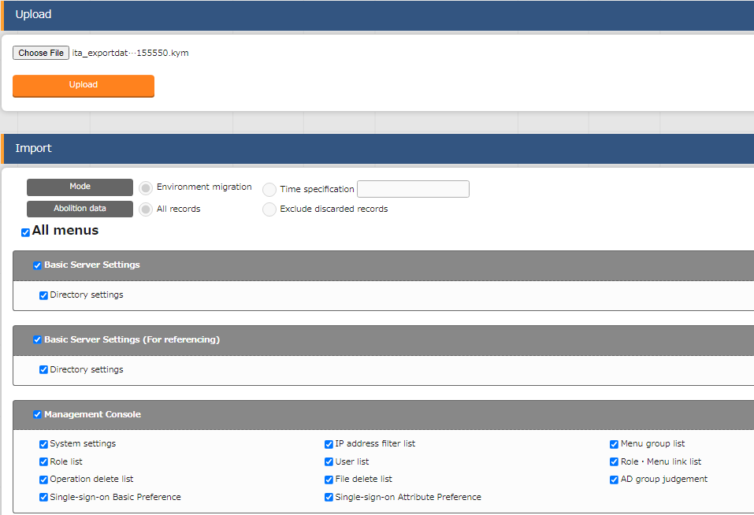

2.5 Import(1/3)
Execute Import
From here, we will use the receiving server to operate. Upload the Kym file and import it.
Menu: Export/Import> Import Menu
Data registration
Input/Create Menu
Export
Import
Start Import
Download kym file
1
Upload Kym File
２
Tick the “All Menus” Checkbox.
Tips
３
Users can exclude discarded data and import the rest of the data.
Click the “Import” button.

Slide 17
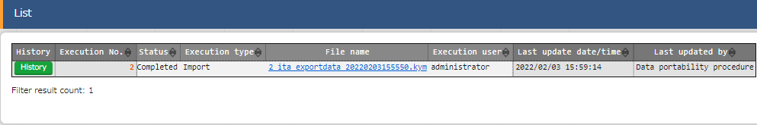
2.5 Import(2/3)
Check Import status
Let`s check the imported information and see if the status is “Completed”
Menu: Export/Import> Export/Import menu list
Click “List”
Click the “Filter” button.
Check if the status of the executed import is “Completed”
Data registration
Input/Create Menu
Export
Import
Start Import
Check Import

Slide 18
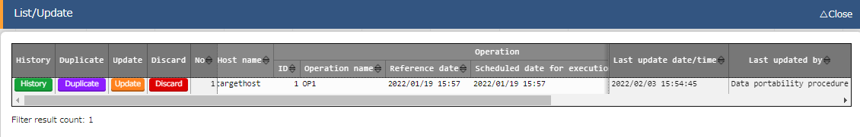
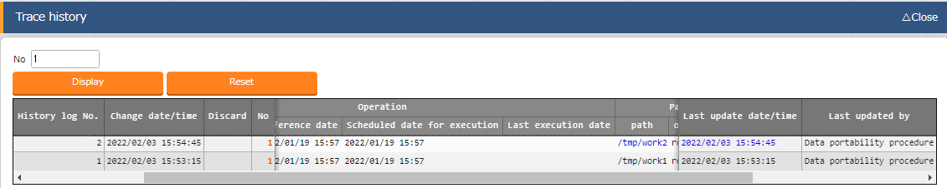
2.5 Import(3/3)
Check Import results
Lets check the imported menus. All change history for each record should also be moved. Let`s put them together and check them.
Menu: Server Basic Settings> Directory settings.
Click “Filter”
Check if the Menu information has been migrated by “Data Portability Procedure”
Data registration
Input/Create Menu
Export
Import
Start Import
Check Import
Click “Trace History” and input the numbers for the records you registered.
Click “Display” and check if the change history information has been migrated or not.
３

Slide 19
3. Practice ② Excel Bulk export/import

Slide 20
3.1 Environment
Work environment
The following scenario uses the following environment.
The scenario requires one ITA server.
Client device ITA server (x1) ・Windows10 ・CentOS 7 (※1) ・Google Chrome ・ITA 1.9.0
・Ansible 2.11.7
Google Chrome
Download export data
CentOS 7
zip
ITA
1.9.0
Ansible
2.11.7
Windows10
Upload the edited data
ITA server
※1 In this scenario, the host server is running on CentOS7, but ITA can be installed on any RHEL7/RHEL8 type OS.

Slide 21
3.2 Excel bulk export/import procedure
Workflow
This scenario will have the user use the Excel export function to register data to the Role list or the Operation list. The following figure illustrates the workflow.
1. Start export
① Excel bulk export
2. Download zip file
3. Extract files, edit and save them
② Excel file edit
4. Re-zip edited files
5. Start import
③ Excel bulk import
6. Check import results

Slide 22
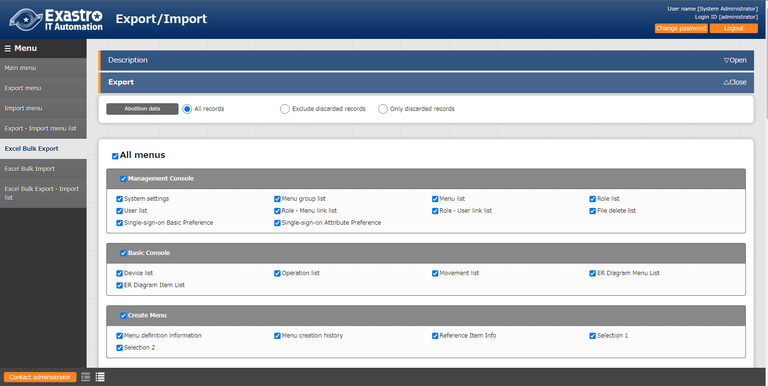
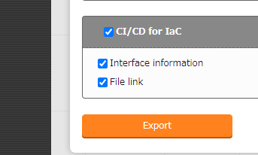
3.3 Excel bulk export (1/2)
Start the export
Start exporting menus.
Menu: Export/Import >Excel bulk export
Export
Start Export
Download Zip file
Edit and save file
Import
1
Check “All menus”
２
Press the “Export” button

Slide 23
3.3 Excel bulk export (2/2)
Download zip file
Download the exported data.
Menu: Export > Excel bulk export/import list
Press “List”
Download the Zip file from the export status list.
Export
Start Export
Download Zip file
Edit and save file
Import
２

Slide 24
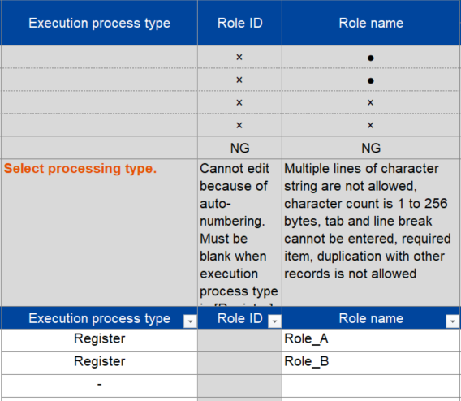
3.4 Excel file edit (1/3)
Extract zip file and edit contents
Extract the downloaded zip file
Open the file and open Management console> role (Excel file)
Edit the file so it matches the picture below and save it.
Export
Start Export
Download Zip file
Edit and save file
Import
Execution process type | Role name
Register | Role_A
Register | Role_B
３

Slide 25
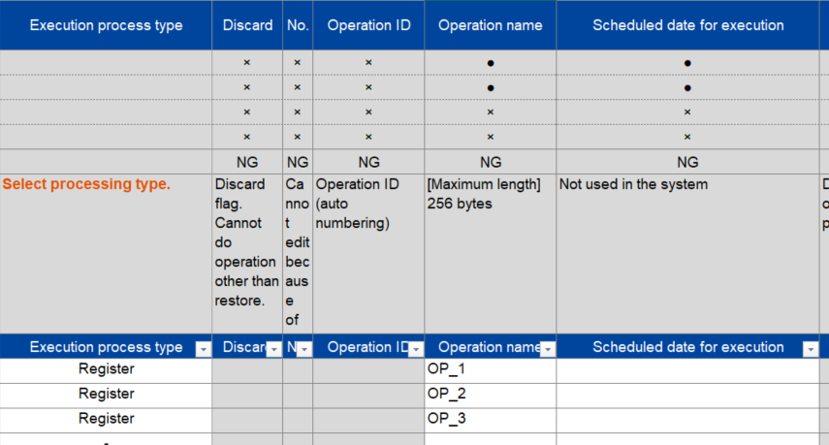
3.4 Excel file edit (2/3)
Extract zip file and edit contents
Edit the contents of the downloaded file
Extract the downloaded zip file
Open the file and open > Basic console >
Operation list (Excel file)
Edit the file so it matches the picture below and save it.
Export
Start Export
Download Zip file
Edit and save file
Import
Execution registration type | Operation name | Scheduled execution date
Register | OP2 | （Free value）
Register | OP3 | （Free value）
Register | OP4 | （Free value）
３

Slide 26
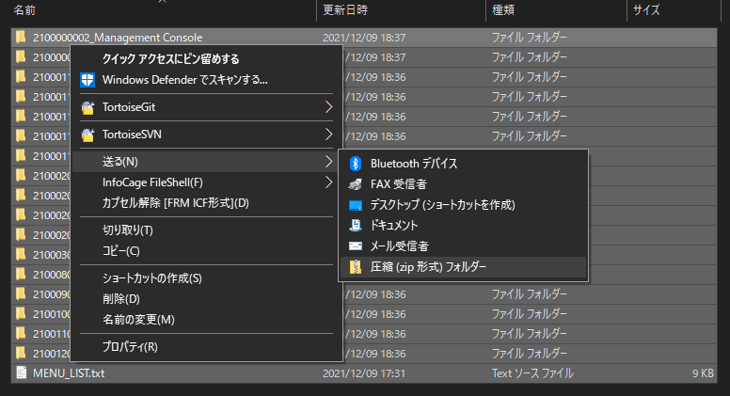
3.4 Excel file edit (3/3)
Zip the edited file
※Name the file to your liking
Export
Start Export
Download Zip file
Edit and save file
Import
２
Zip file
1
Select all the folders

Slide 27
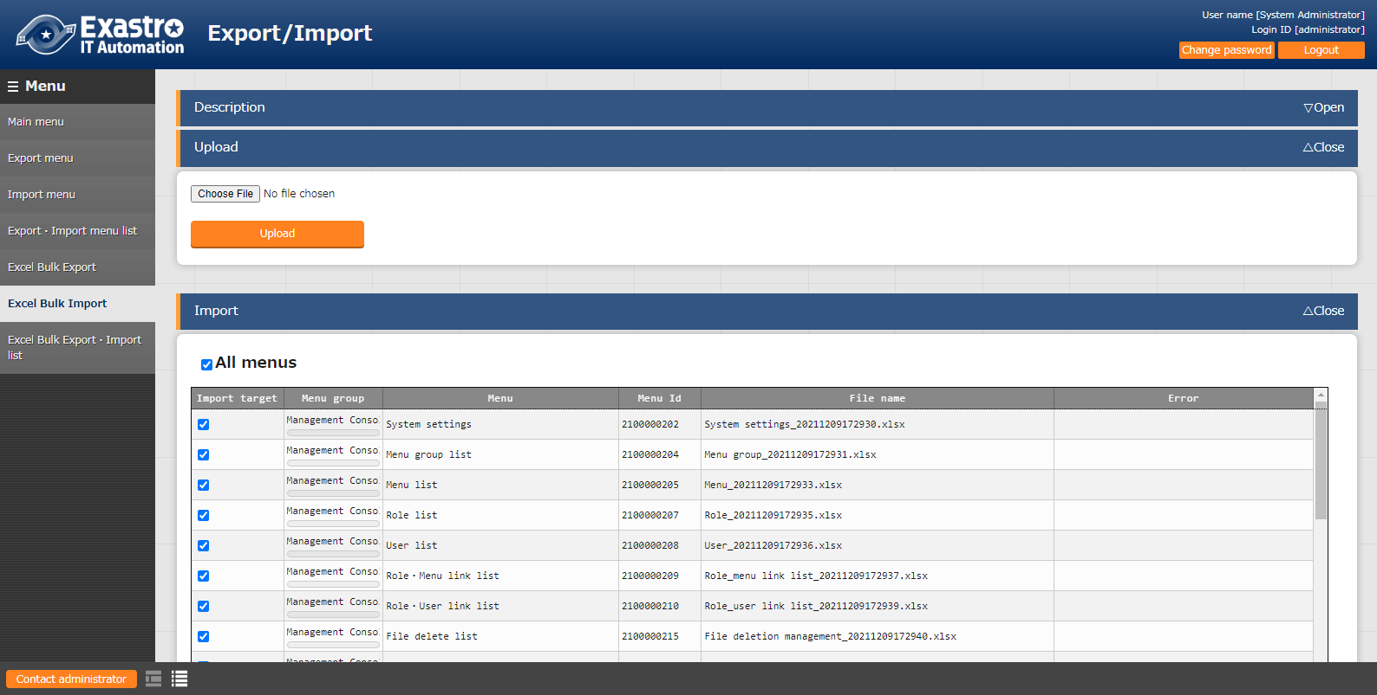
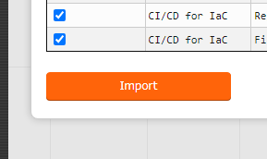
3.5 Excel bulk import (1/3)
Start excel bulk import
Upload the zip file and start importing
Menu：Export/Import > Excel bulk import
Export
Edit and save file
Import
Start Import
Check results
1
Upload the edited zip file
２
Check “All menus”
３
Press the “Import” button

Slide 28
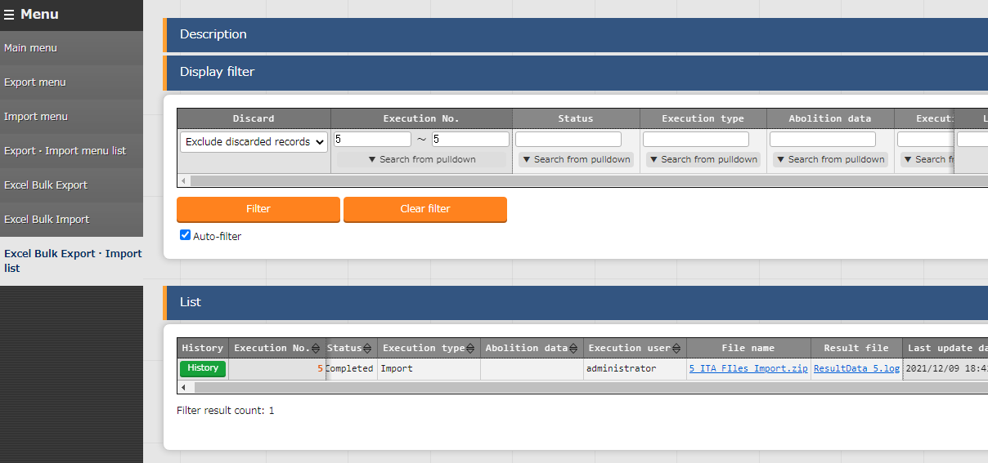
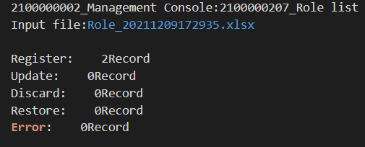
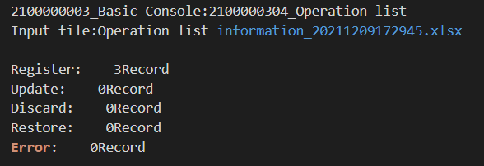
3.5 Excel bulk import (2/3)
Check the Import status and the Registration results
Check that the import has ended successfully and that all of the items has been registered.
Menu：Export/Import >
Excel export/import list
Export
Edit and save file
Import
Start Import
Check results
Inside the Log file
1
Press “Filter
２
３
Check that the status says: Completed
Download Log file
４
Check the number of registrations

Slide 29
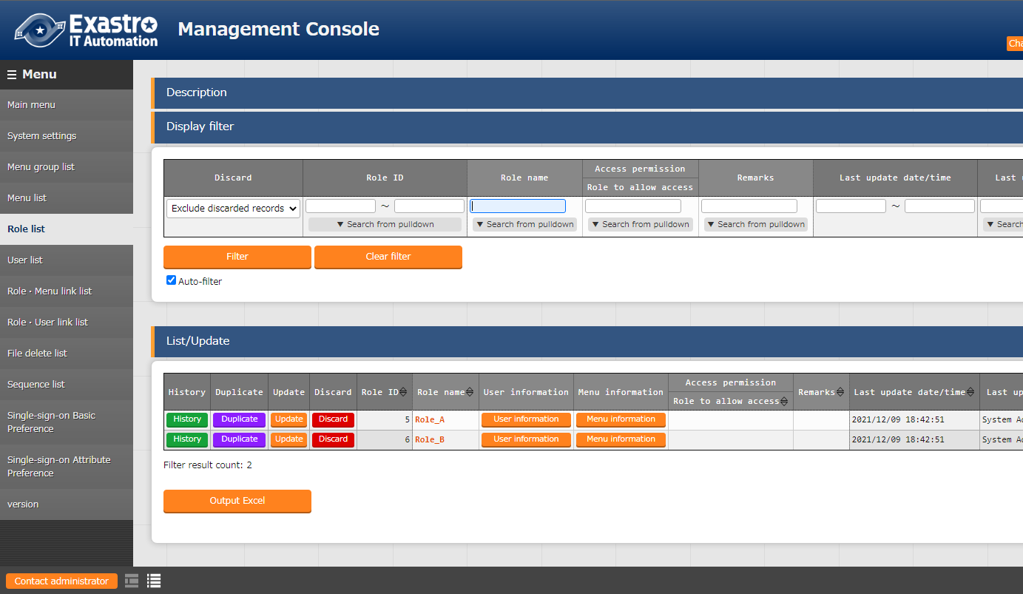
3.5 Excel bulk import (3/3)
Check registered contents
Check that the registered contents are being displayed.
Menu： Management console > Role list
Export
Edit and save file
Import
Start Import
Check results
1
Press “Filter”
2
Check that all the registered items show up

Slide 30
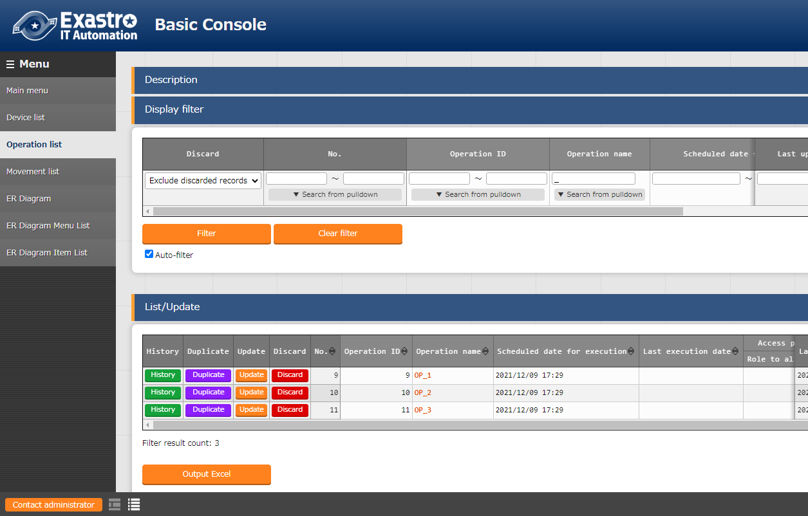
3.5 Excel bulk import (3/3)
Check registered contents
Check that the registered contents are being displayed.
Menu： Management console > Role list
Export
Edit and save file
Import
Start Import
Check results
1
Press “filter”
2
Check that all the registered items show up

