Slide 1


BASE Tutorial
※“Exastro IT Automation” is written as "ITA" in this document
Ver.1.3
Exastro developer

Slide 2
Table of contents
Introduction
About this document
Standard workflow for Management Console and Export/Import
Standard workflow for Basic Console and Symphony
Explanation for Management Console
System settings
RBAC（Role Based Access Control）
Export/Import
Device management in ITA
Operation outline
Symphony class definition
Symphony execution

Slide 3
1. Introduction

Slide 4
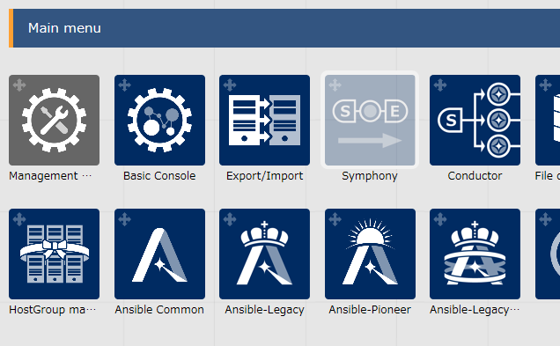
1.1 About this document
Main Menu
This document describes the Management console, Basic Console, Export/Import and Symphony menu groups
Management Console
System settings
RBAC（Role Based Access Control）
Basic Console
Device management in ITA
Operation overview
Export/Import
Export menu
Import menu
Symphony
Symphony class definition
Symphony execution

Slide 5
1.2 Standard workflow for Management Console and Export/Import
Workflow | Menu | Menu Group
2.1 System settings
System settings
Basic Console
2.2 RBAC
（Role Based Access Control）
Menu group list
Menu list
Role list
User list
Role/Menu link list
Role/User link list
2.3 Export/Import
Export menu
Export/Import
Import menu
Export/Import menu list

Slide 6
1.3 Standard workflow for Basic Console and Symphony
Workflow | Menu | Menu Group
Basic Console
2.4 Device management in ITA
Device list
2.5 Operation overview
Input operation list
Movement list
2.6 Symphony class definition
Symphony interface information
Symphony
Symphony class list
Symphony class edit
2.7 Symphony execution
Symphony execution
Symphony execution checking
Symphony execution list

Slide 7
2.1 System Settings (1/2)
Workflow | Menu | Menu Group
2.1 System settings
System settings
Management Console
2.2 RBAC
（Role Based Access Control）
Menu group list
Menu list
Role list
User list
Role/Menu link list
Role/User link list
2.3 Export/Import
Export Menu
Export /Import
Import Menu
Export/Import menu list

Slide 8
2.1 System Settings (2/2)
In the “System Settings” menu, users can register all the necessary information for operating the system. The settings items are as shown below.
Item name | Description
IP address restrictions | Choose if access by IP address to be regulated or not
Upload prohibition extension | Extension file names that prohibit upload
Account lock duration (seconds) | Time period(seconds) to maintain locked state from start time of account lock.
Password error threshold (frequency) | Password failure threshold before locking account
Password error count upper limit (frequency) | Max amount of times continuous password errors
Password re-registration prevention period (days) | Time period (days) to prevent registration of same password
Password validity period (days) | Validity period of password (days)
Authentication duration: Not operated(seconds) | Time period (seconds) the session is valid with no operation
Authentication duration : Maximum period (seconds) | Maximum time period (seconds) a session.

Slide 9
2.2 RBAC (Role Based Access Control) (1/4)
Workflow | Menu | Menu Group
2.1 System settings
System settings
Management Console
2.2 RBAC
（Role based access control）
Menu group list
Menu list
Role list
User list
Role/Menu link list
Role/User link list
2.3 Export/Import
Export Menu
Export/ Import
Import Menu
Export/Import Menu list

Slide 10
2.2 RBAC (Role Based Access Control) (2/4)
About RBAC
RBAC is a method that allows users to assign authority by role.
Since authorization isn't given directly to each user, but by a role basis, the access authority management is allocated by local access.

Slide 11
2.2 RBAC (Role Based Access Control) (3/4)
RBAC Example
Can Maintain
User
ITA Role
Spectate Only
User１
Menu A
developers
User２
Menu B
Menu C
User３
operators
■ Menu A・・・
Only User 1 can maintain
■ Menu B・・・
All users can maintain
■ Menu C・・・
User 1 can maintain, user 2 and 3 can only spectate
※ While user 1 has both the authorization “Can Maintain” and ”Spectate Only”, “Can Maintain” will be prioritized.

Slide 12
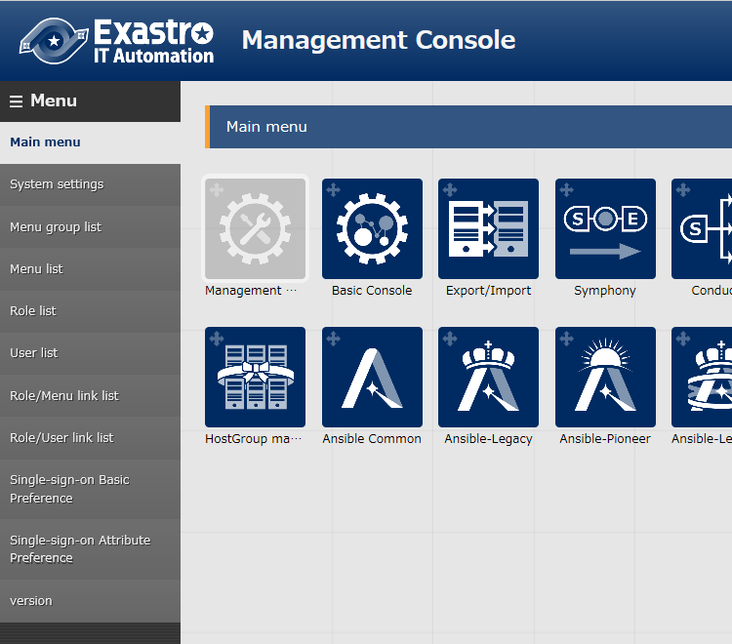
2.2 RBAC (Role Based Access Control) (4/4)
Description of the Menu groups inside “Management Console”
Menu group list
Multiple groups bundled.
Menu list
A Menu is always attached to a menu group.
Role List
Role define access authority to Menus
User list
A user can have multiple roles
It is possible to link with Active Directory and acquire user information.
Role/Menu link menu
Maintain each users access authority to menus
Role/User link menu
Maintain each users affiliation to other users.
Menu
Menu Group

Slide 13
2.3 Export/Import (1/2)
Workflow | Menu | Menu Group
2.1 System Settings
System settings
Management Console
2.2 RBAC
（Role Based Access Control）
Menu Group list
Menu list
Role list
User list
Role/Menu link list
Role/User link list
2.3 Export/Import
Export menu
Export/ Import
Import menu
Export/Import menu list

Slide 14
2.3 Export/Import (2/2)
Export/Import
Users can export and import menus registered in ITA.
For more information on how to operation method, please refer to the user manuals.
※Attention※ Exporting and Importing in ITA will overwrite Menu units.
Export
ITA Server A
kym
File
kym
File
Import
ITA Server B

Slide 15
2.4 Device management in ITA (1/3)
Workflow | Menu | Menu Group
Basic Console
2.4 Device management in ITA
Device list
2.5 Operation overview
Input operation list
Movement list
2.6 Symphony class definition
Symphony interface information
Symphony
Symphony class list
Symphony class edit
2.7 Symphony execution
Symphony execution
Symphony execution checking
Symphony execution list

Slide 16
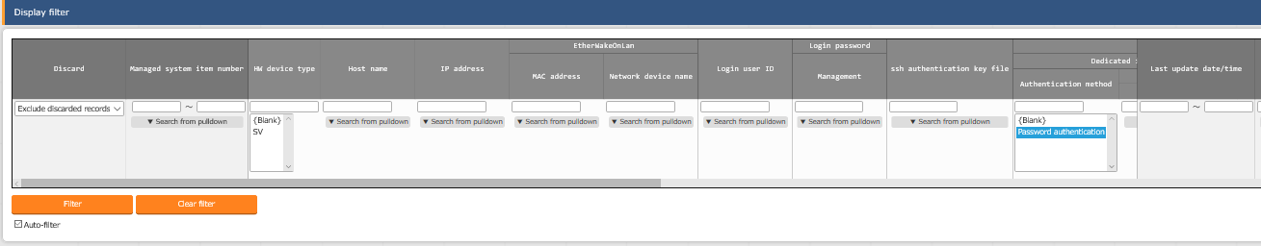
2.4 Device management in ITA (2/3)
Device management in ITA（１）
In the "Basic Console">"Device list" menu, users can register the needed information for the targeted host.
Users can check authorization information settings per host. For authentication, it is possible to choose from Password authentication and Key authentication.
Main registration items
 | ・HW Device type | ・Host name | ・IP Address
 | ・Log-in User ID | ・Log-in Password | ・Authentication method

Slide 17
2.4 Device management in ITA (3/3)
Device management in ITA（２）
in ITA, users can increase the reusability of device information as well as being able to respond flexibly to setting information changes by managing the user information separately.
Movement (original ITA terminology) means a work unit.
Host A
Password Authentication A
Movement A
Host B
Key authentication
Host C
Password Authentication B
Movement B
Host C
Password Authentication B
Host D
Password Authentication C
Movement C
Host C
Password Authentication B
Host E
Password Authentication D
Example: Host C will need to change password and the changes will be carried out
↓
Result: All movements connected to C will be automatically updated to show the updated information

Slide 18
2.5 Operation overview (1/2)
Workflow | Menu | Menu Group
Basic Console
2.4 Device management in ITA
Device list
2.5 Operation overview
Input operation list
Movement list
2.6 Symphony class definition
Symphony interface information
Symphony
Symphony class list
Symphony class edit
2.7 Symphony Execution
Symphony execution
Symphony Execution checking
Symphony Execution list

Slide 19
2.5 Operation overview (2/2)
About Operation
Operation is an execution unit in ITA.
It is possible to manage execution history and execution schedule.
Symphony Class
Operation X
Target device A/B is set
start
Target Device A/B
Parameter sheet
IaC①
……………………………
…………………
…………………………
 | P1 | P2 | P3 | …
A | - | - | -
B | - | - | -
Movement①
IaC②
……………………………
…………………
…………………………
Movement②
IaC③
……………………………
…………………
…………………………
Operation Y
Target device C is set
Target Device C
Parameter sheet
IaC④
 | P1 | P2 | P3 | …
C | - | - | -
end
……………………………
…………………
…………………………

Slide 20
2.6 Symphony class definition (1/4)
Workflow | Menu | Menu Group
Basic Console
2.4 Device management in ITA
Device list
2.5 Operation overview
Input operation list
Movement list
2.6 Symphony class definition
Symphony interface information
Symphony
Symphony class list
Symphony class edit
2.7 Symphony Execution
Symphony Execution
Symphony Execution checking
Symphony Execution list

Slide 21
2.6 Symphony class definition (2/4)
Workflow in ITA
Symphony（※ITA original terminology）
Combines work patterns called Movement and creates a workflow. Executes construction and settings operations..
Movement（※ITA original terminology）
Movement means a work unit.
Symphony
Parameter （Variable）
Movement A
IaC 1
VAR_a
IaC 2
VAR_b
Movement B
VAR_c
IaC 3
None
Movement C

Slide 22
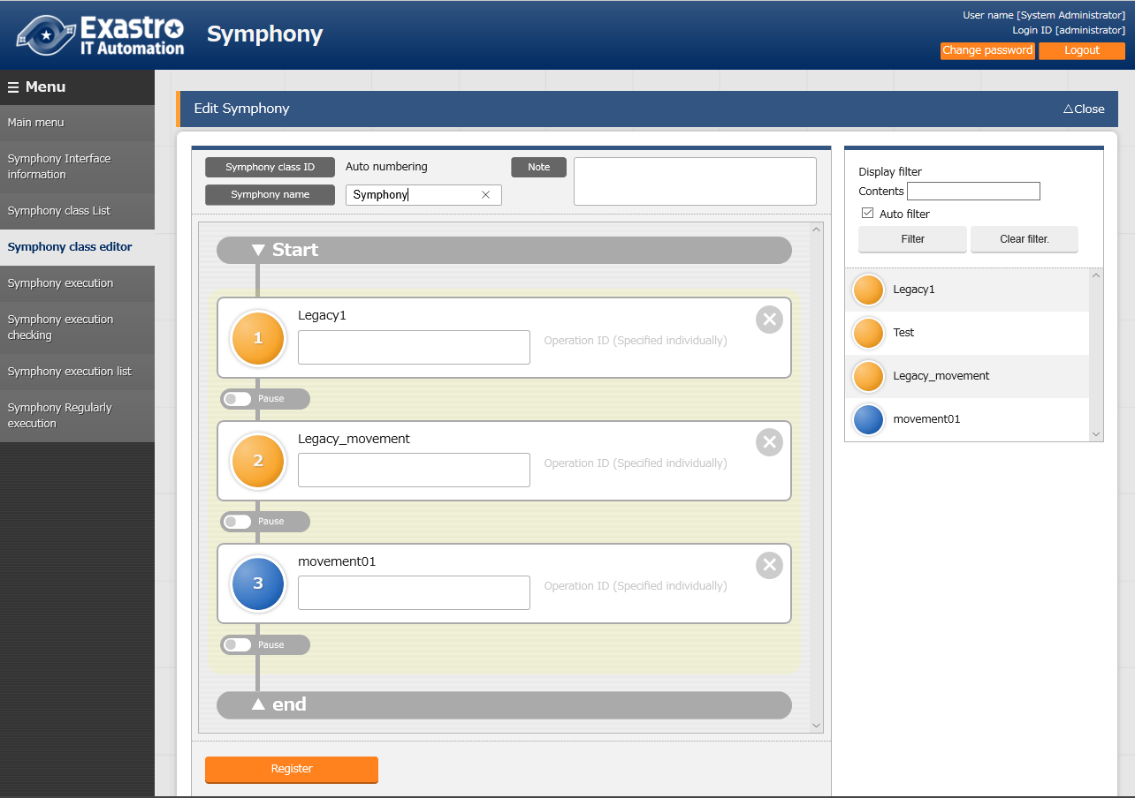
2.6 Symphony class definition (3/4)
Adding and removing Movement
Users can remove and add Movements in the Symphony> Symphony class edit menu screen.
"Symphony class editor“ screen
Pressing the X Icon will remove the Movement
Add Movement by dragging and dropping
Switch Movements by dragging and dropping

Slide 23
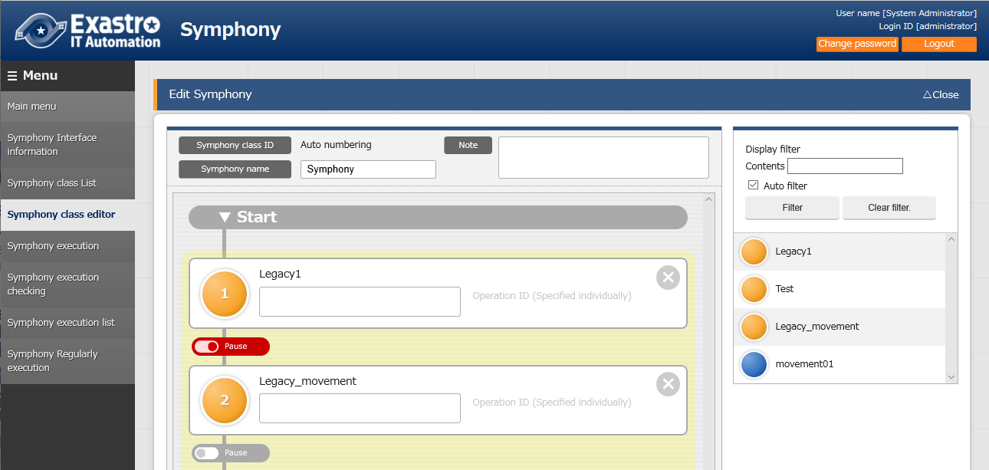
2.6 Symphony class definition (4/4)
About Pause settings
In the Symphony>Symphony class edit menu, users can press the pause button under the movement box. Pressing it will pause any process after the movement.
"Symphony class editor“ screen

Slide 24
2.7 Symphony Execution (1/8)
Workflow | Menu | Menu Group
Basic Console
2.4 Device management in ITA
Device list
2.5 Operation overview
Input operation list
Movement list
2.6 Symphony class
definition
Symphony interface information
Symphony
Symphony class list
Symphony class edit
2.7 Symphony execution
Symphony execution
Symphony execution checking
Symphony execution list

Slide 25
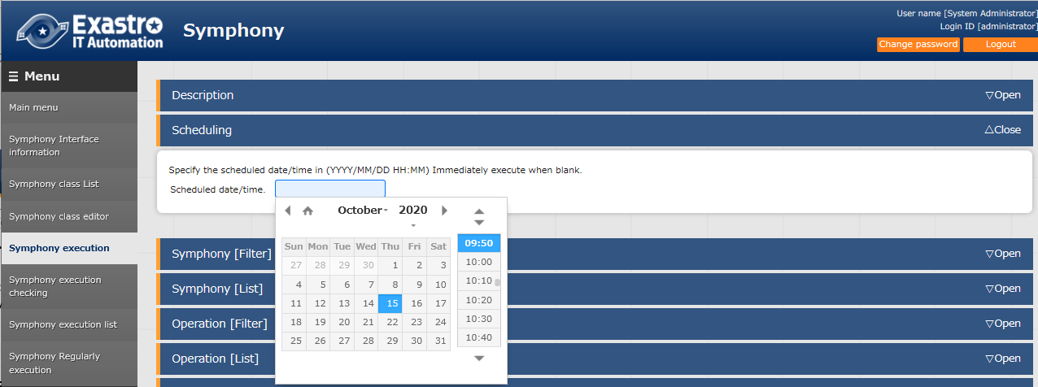
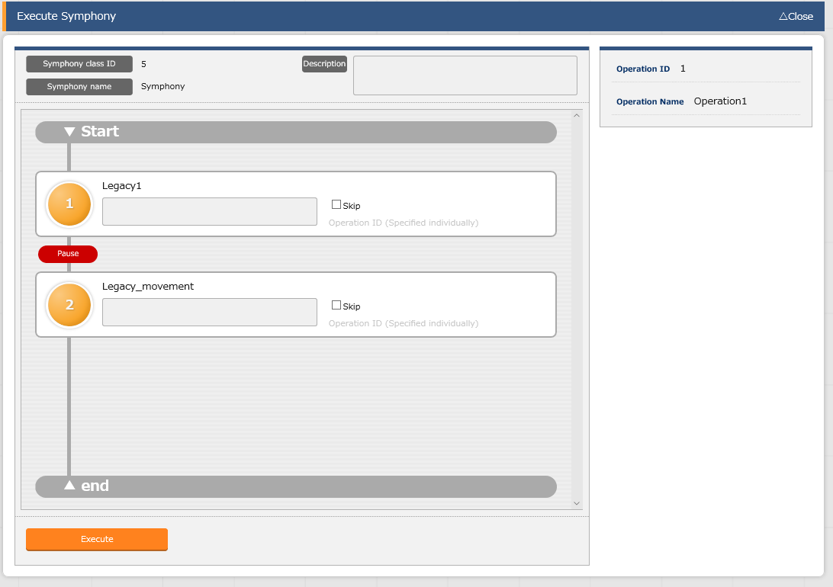

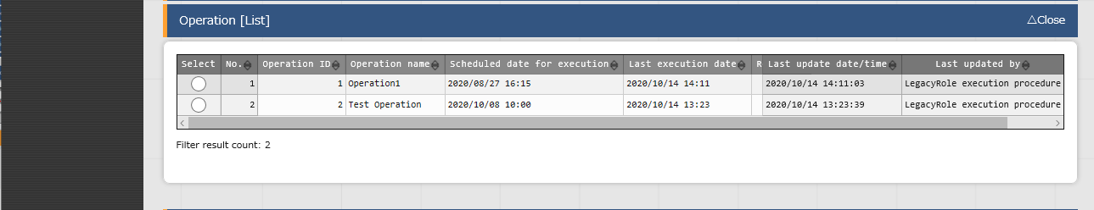
2.7 Symphony Execution (2/8)
Symphony Execution
In the Symphony>Symphony Execution menu, users can direct symphony executions.
Pressing the "Execution" button in Symphony "list", as well as Operation "list "sub menu will move the user to" Symphony Execution check" screen and start tracing. Users can reserve execution by entering time and date in the " Scheduling" field
" Symphony Execution "screen

Slide 26
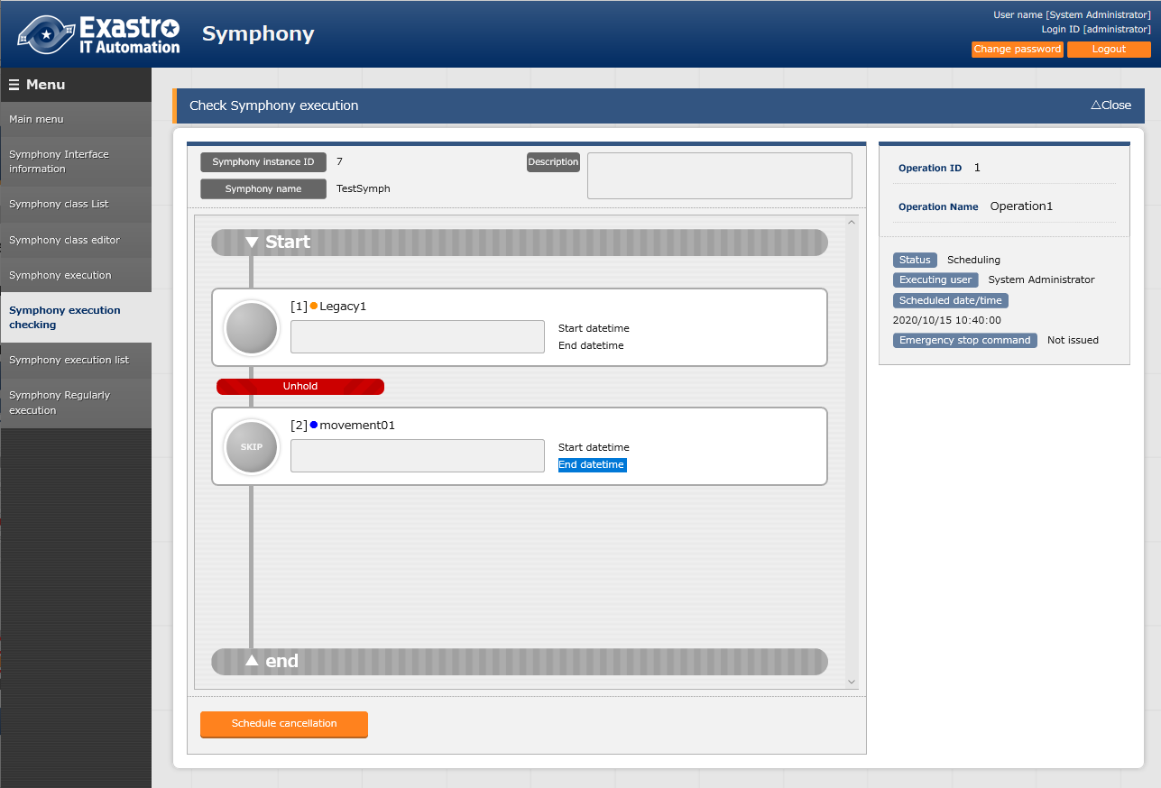
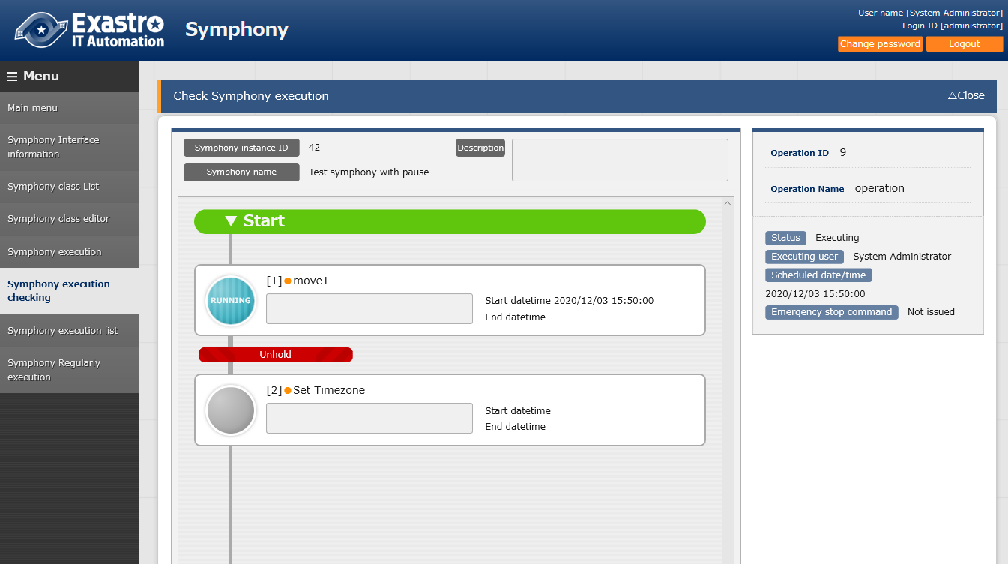
2.7 Symphony Execution (3/8)
About scheduling executions.
If scheduled, the Symphony will not be executed and the status will be changed to "Scheduling“ Choose " Schedule Cancellation" to cancel reservation.
"Symphony“ Menu Group >"Symphony execution checking“ Menu
Status: Scheduling
The symphony will automatically be executed when the time passes the scheduled date/time
Schedule cancellation button
Status : Executing

Slide 27
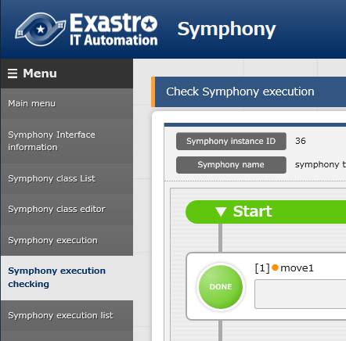
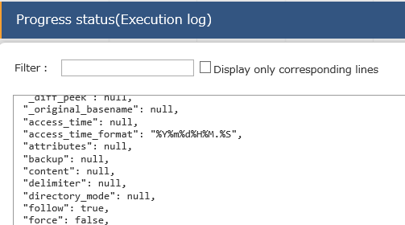
2.7 Symphony Execution (4/8)
Symphony Execution Checking
The Symphony execution state can be checked in the Symphony Execution checking menu. Users can to press "Unhold" and " emergency stop" depending on the situation. Clicking "Movement" will move you to " Execution state confirmation" screen
"Symphony Executing checking“ Screen
"Progress status (Execution log)"screen
You can see the operation status and check the log for errors in the “Progress Status” screen.

Slide 28
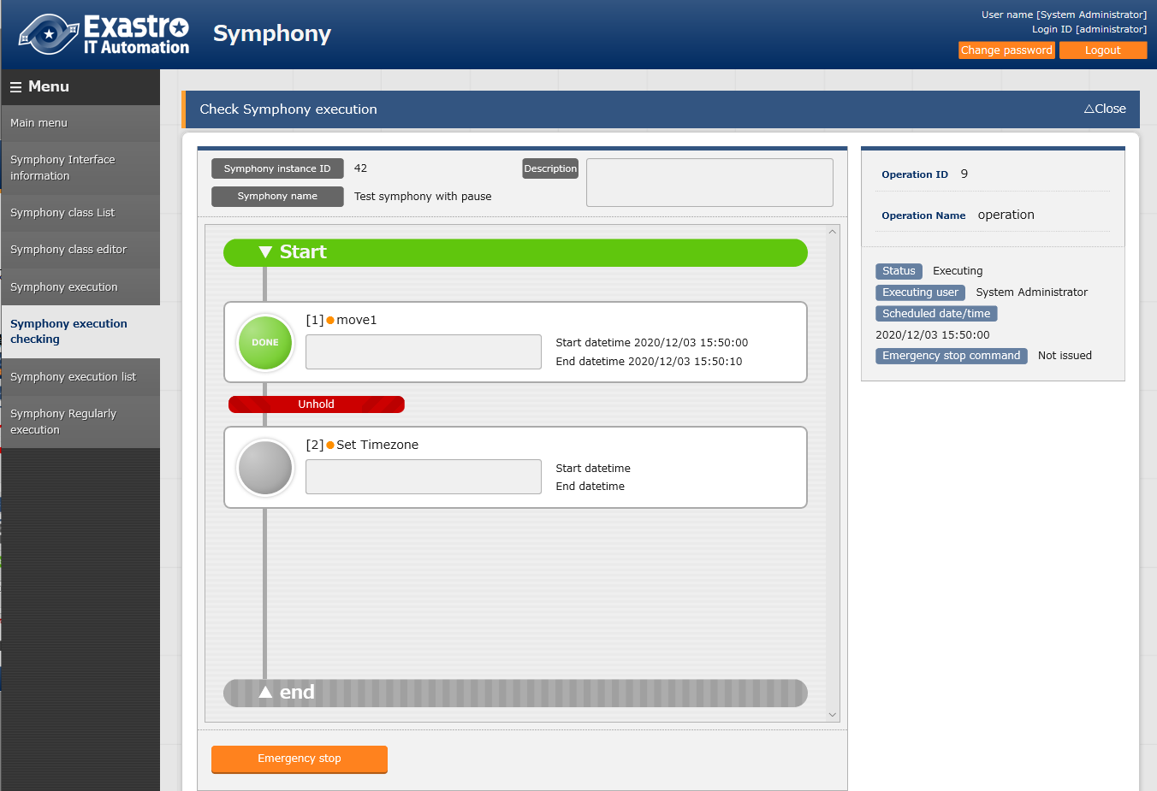
2.7 Symphony Execution (5/8)
About un-pausing
If the pause settings in the Symphony class edit menu is set to " active", the continuing process will be set to pause after the previous movement is completed. Press "cancel pause" to continue the movement.
“Symphony execution checking” screen when Symphony is paused
Unhold

Slide 29
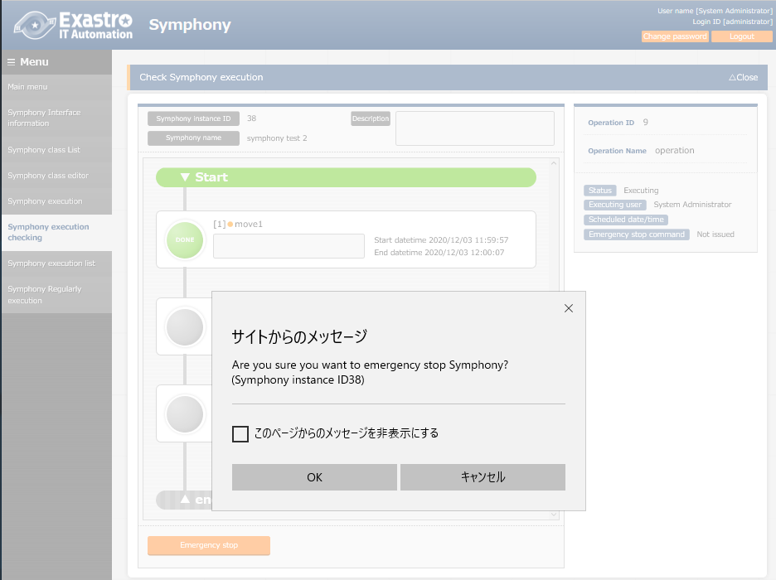
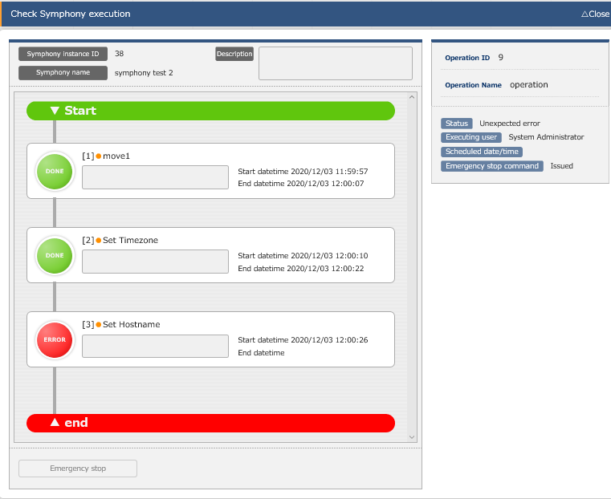
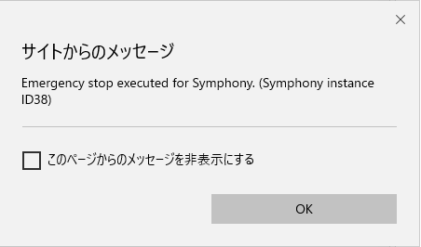
2.7 Symphony Execution (6/8)
About Emergency Stop（１）
In the Symphony>Symphony execution checking Menu, Users can stop the execution by pressing the "Emergency stop" button while the Symphony is executing.
Press the Emergency stop button
Press the OK on the pop-up window
Symphony emergency stop complete message will be displayed.
“Emergency stop command” will change from “Not issued” to “Issued”
３
２
１

Slide 30
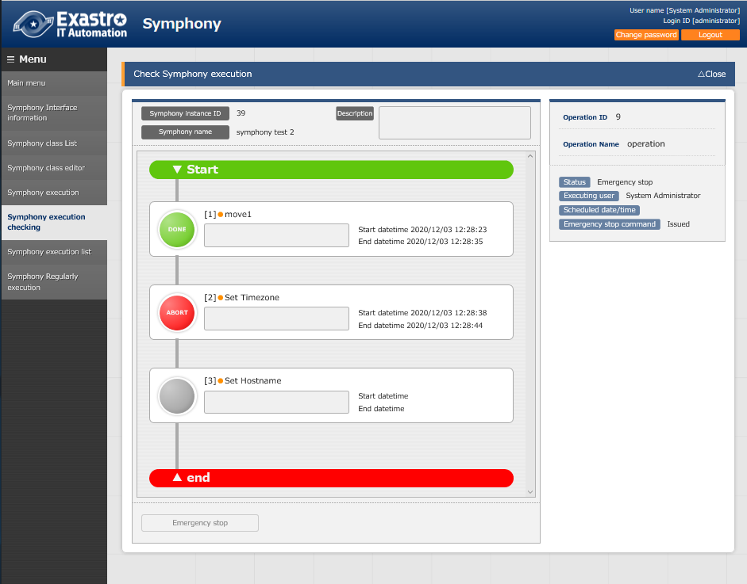
2.7 Symphony Execution (7/8)
About Emergency Stop（２）
In the Symphony>Symphony execution checking Menu, If an emergency stop happened during Movement ""Move02" execution, each movement status will be as shown below.
"move01"【Normal execution】
"move02"【Emergency stop】
"move03"【Not yet executed】
Normal execution
Emergency stop
Not yet executed

Slide 31
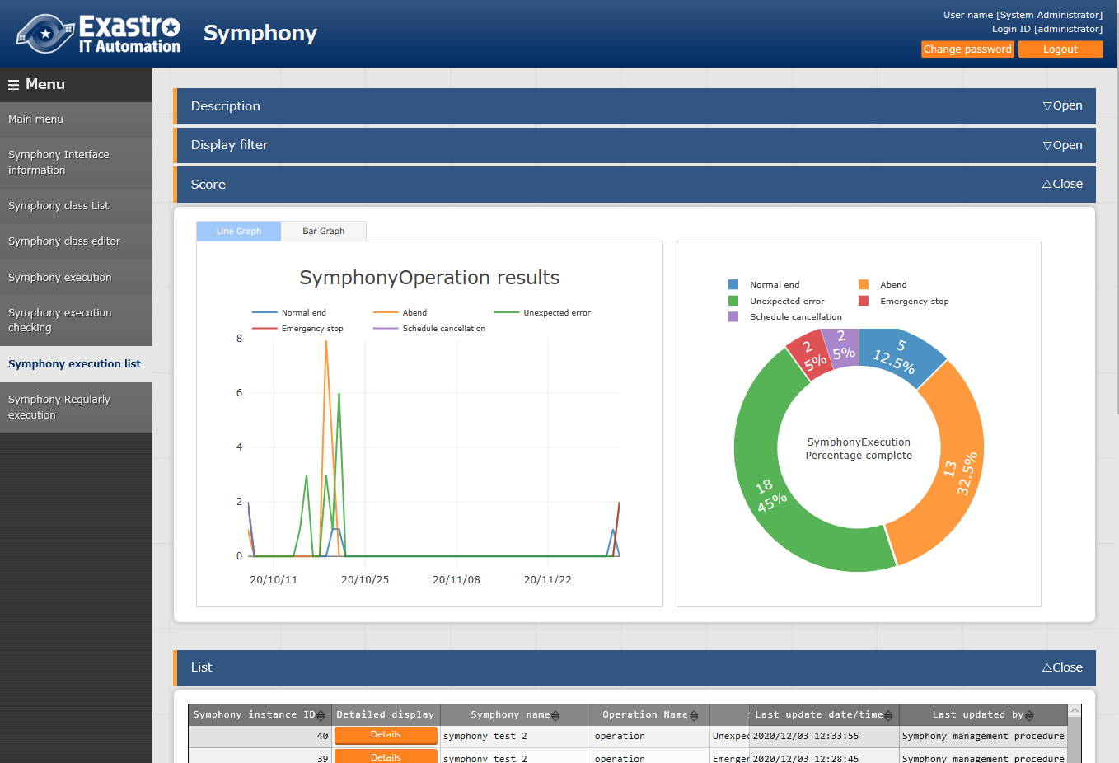
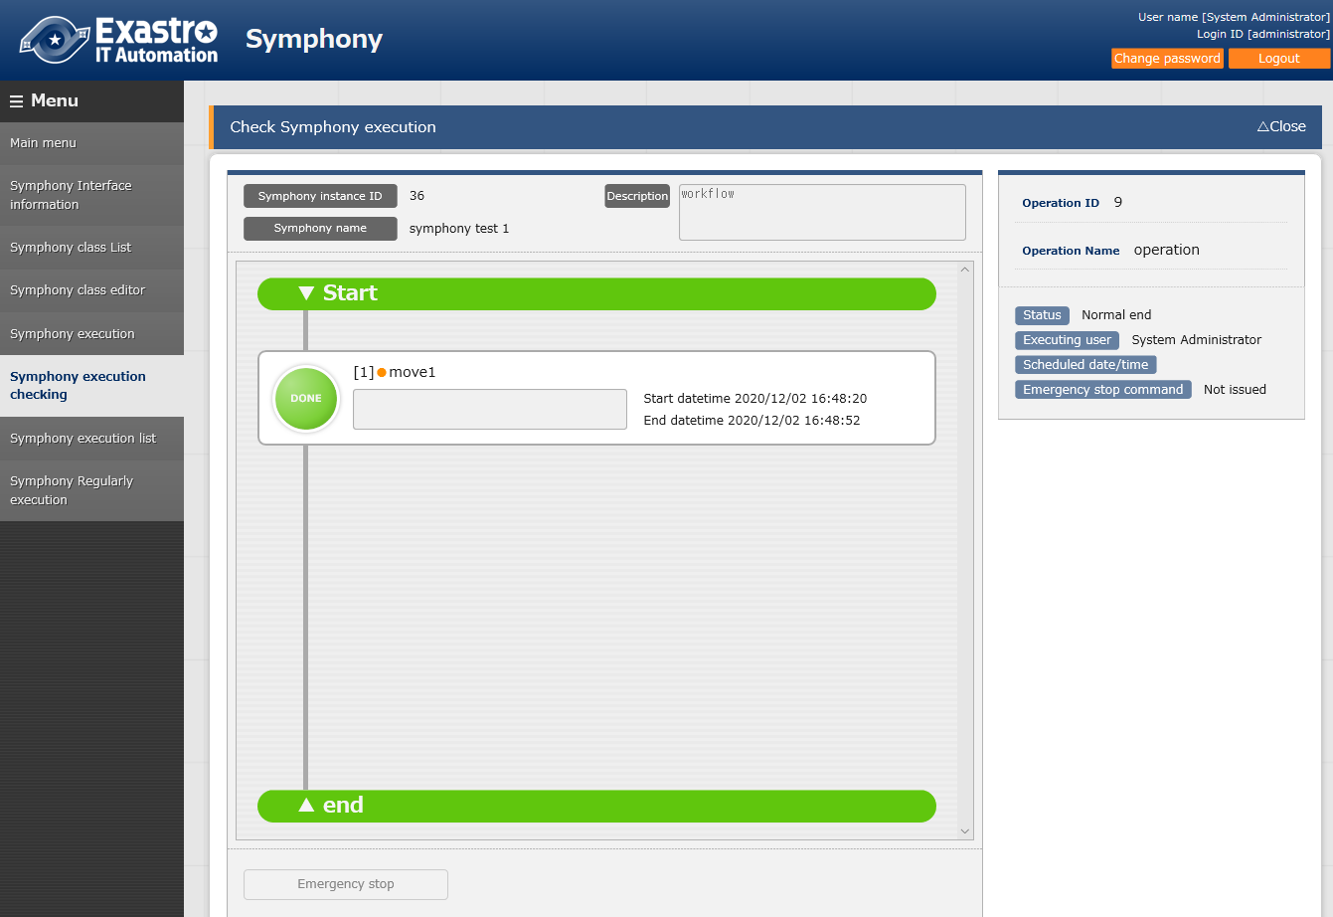
2.7 Symphony Execution (8/8)
Symphony Execution list
The Symphony execution history list is displayed in the symphony execution list.
Pressing the " Details" button will move the user to " Symphony execution check" screen. Users can check all the previous execution history.
“Symphony execution list” screen
The previous Symphony execution results will be shown in a graph.
“ Symphony execution checking” screen

