Slide 1
ARNAV BANSAL Bennett University
ALGORITHM

Slide 2

DEFINITION
A precise step-by-step plan for a computational procedure that possibly begins with an input value and yields an output value in a finite number of steps is called an algorithm.

Slide 3
Step-by-step unambiguous instructions used to achieve a particular task.
An algorithm can be written in any language, like English or other but a program is only written in a particular programming language, like JAVA, C, C++, PYTHON, etc.

Slide 4
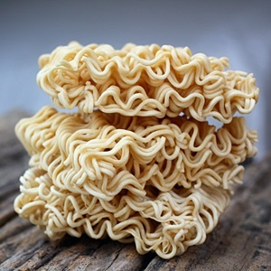
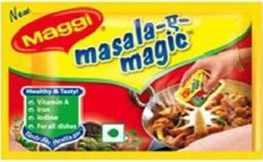
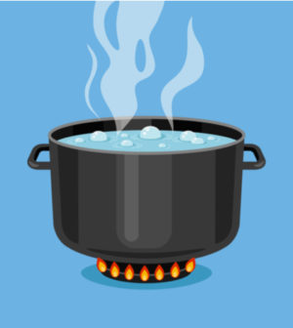
Cooking recipe may be considered as an algorithm as it takes a set of well defined instructions to prepare a dish.
PREPARATION OF MAGGI

Slide 5
Criteria of Algorithm
INPUT
OUTPUT
FINITENESS
DEFINITENESS
EFFECTIVENESS

Slide 6
Properties of Algorithm
They are independent of programming language.
There should not be any infinite loop.
Instructions may include arithmetic and logical operators.
It is sequence of operations performed on data.

Slide 7
Algorithm for adding two numbers
Start.
Enter two numbers a and b.
Add a and b.
Store the value of a+b in c.
Print c.
Stop.

Slide 8
Algorithm for swapping two numbers
Start.
Enter two numbers a and b.
Copy value of a to temp. (temp = a)
Copy value of b to a. (a = b)
Copy value of temp to b. (b = temp)
Print a and b.
Stop.

Slide 9
A precise step-by-step plan for a computational procedure that possibly begins with an input value and yields an output value in a finite number of steps is called an algorithm.

Slide 10
THANK YOU

