Slide 1
Mixing Console
SAE BUT 3 GEII ESE
MUHAMMAD Asad

Slide 2
Summary
Introduction
Key Objectives
How does It Work?
Core Features
Eco-Friendly and Cost-Effective
Development Timeline
Teamwork and Integration
Conclusion

Slide 3
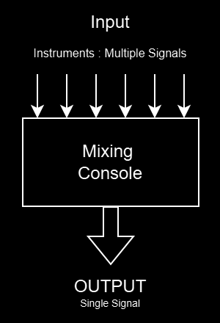
Introduction
Key points :
Designing an automated audio mixer.
Synchronizing multiple music streams (MIDI and analog).

Slide 4
Key Objectives
Develop a functional audio control system.
Ensure compatibility with 2 digital and 2 analog inputs.
Ensure Synchronisation of signals.
Incorporate sustainable, cost-effective design principles.

Slide 5
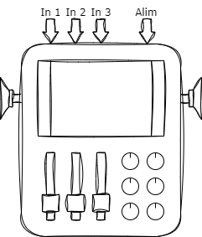
How does It Work?
Key functions:
MIDI and analog input handling.
Real-time synchronization.
Physical interface with faders, knobs, and display.
Power supply.

Slide 6
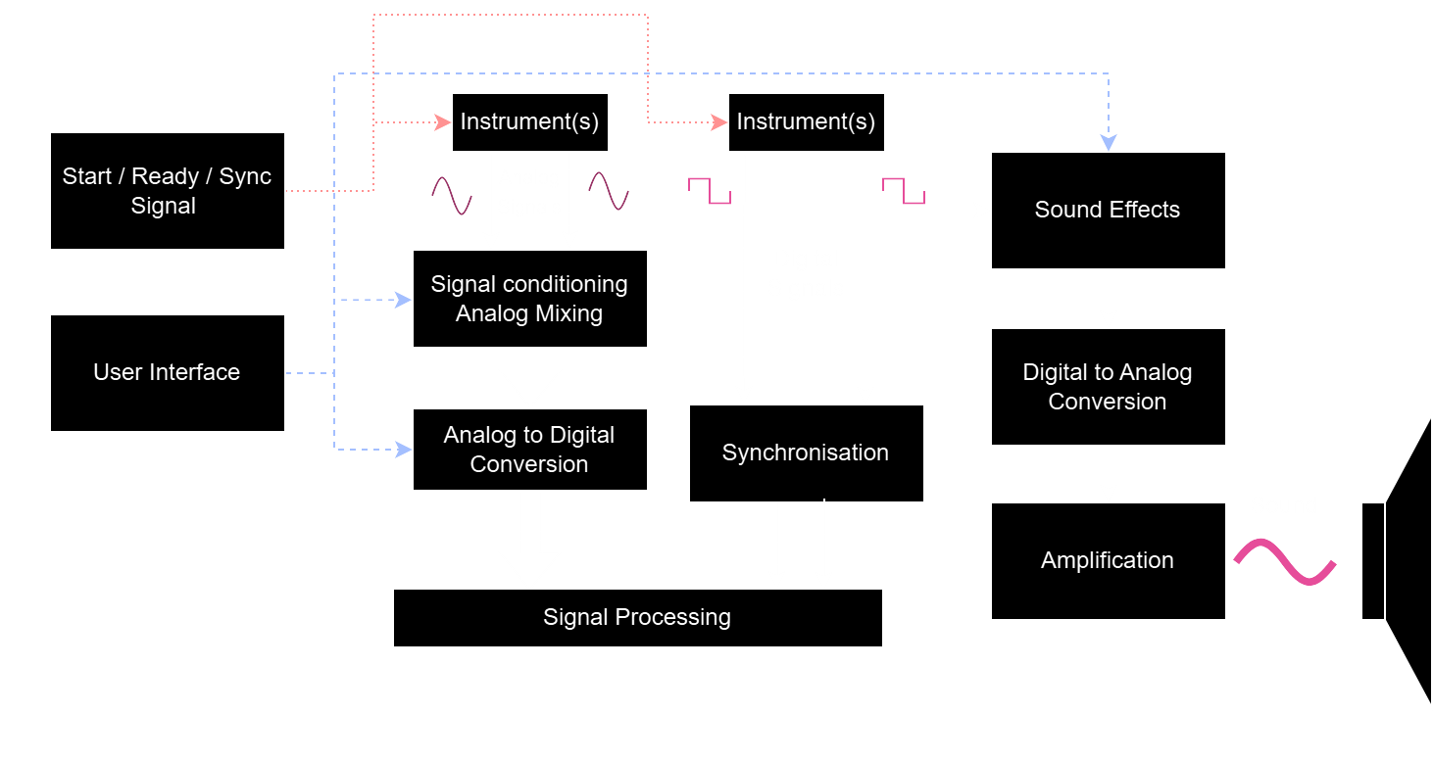
Core Features

Slide 7
Eco-Friendly and Cost-Effective
Key points
Reuse of existing materials.
Budget cap of €200 for new components.
Open-source principles for future use and transparency.

Slide 8
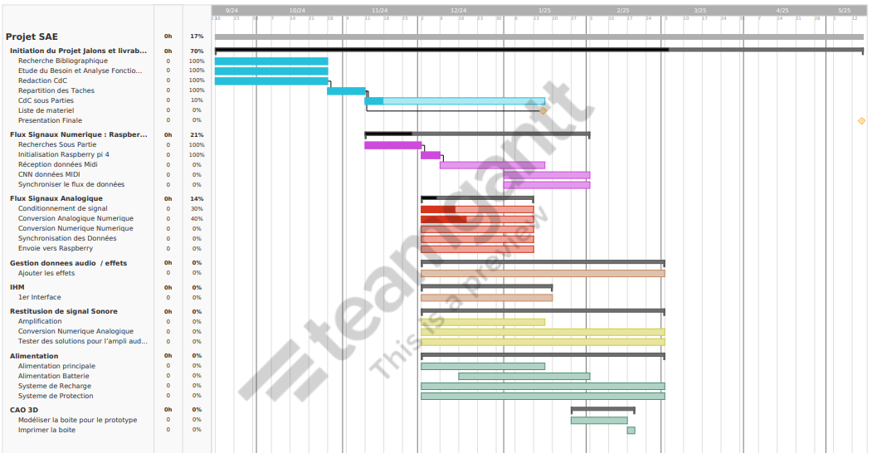
Development Timeline

Slide 9
Teamwork and Integration
Signal Input + Signal Processing
User Interface + Signal Effects
3D-CAD + Power supply
Signal Output + Amplification

Slide 10
Conclusion and current state
What the project achieves.
Importance of sustainability and innovation.
Future potential for advanced system.

Slide 11
Questions

