Slide 1
Clean Water Mapping in Morocco
2015 Challenge
Mohamed Bentaibi
Aymane Eddahmani
Ali Elabridi
Ayoub Makroz

Slide 2
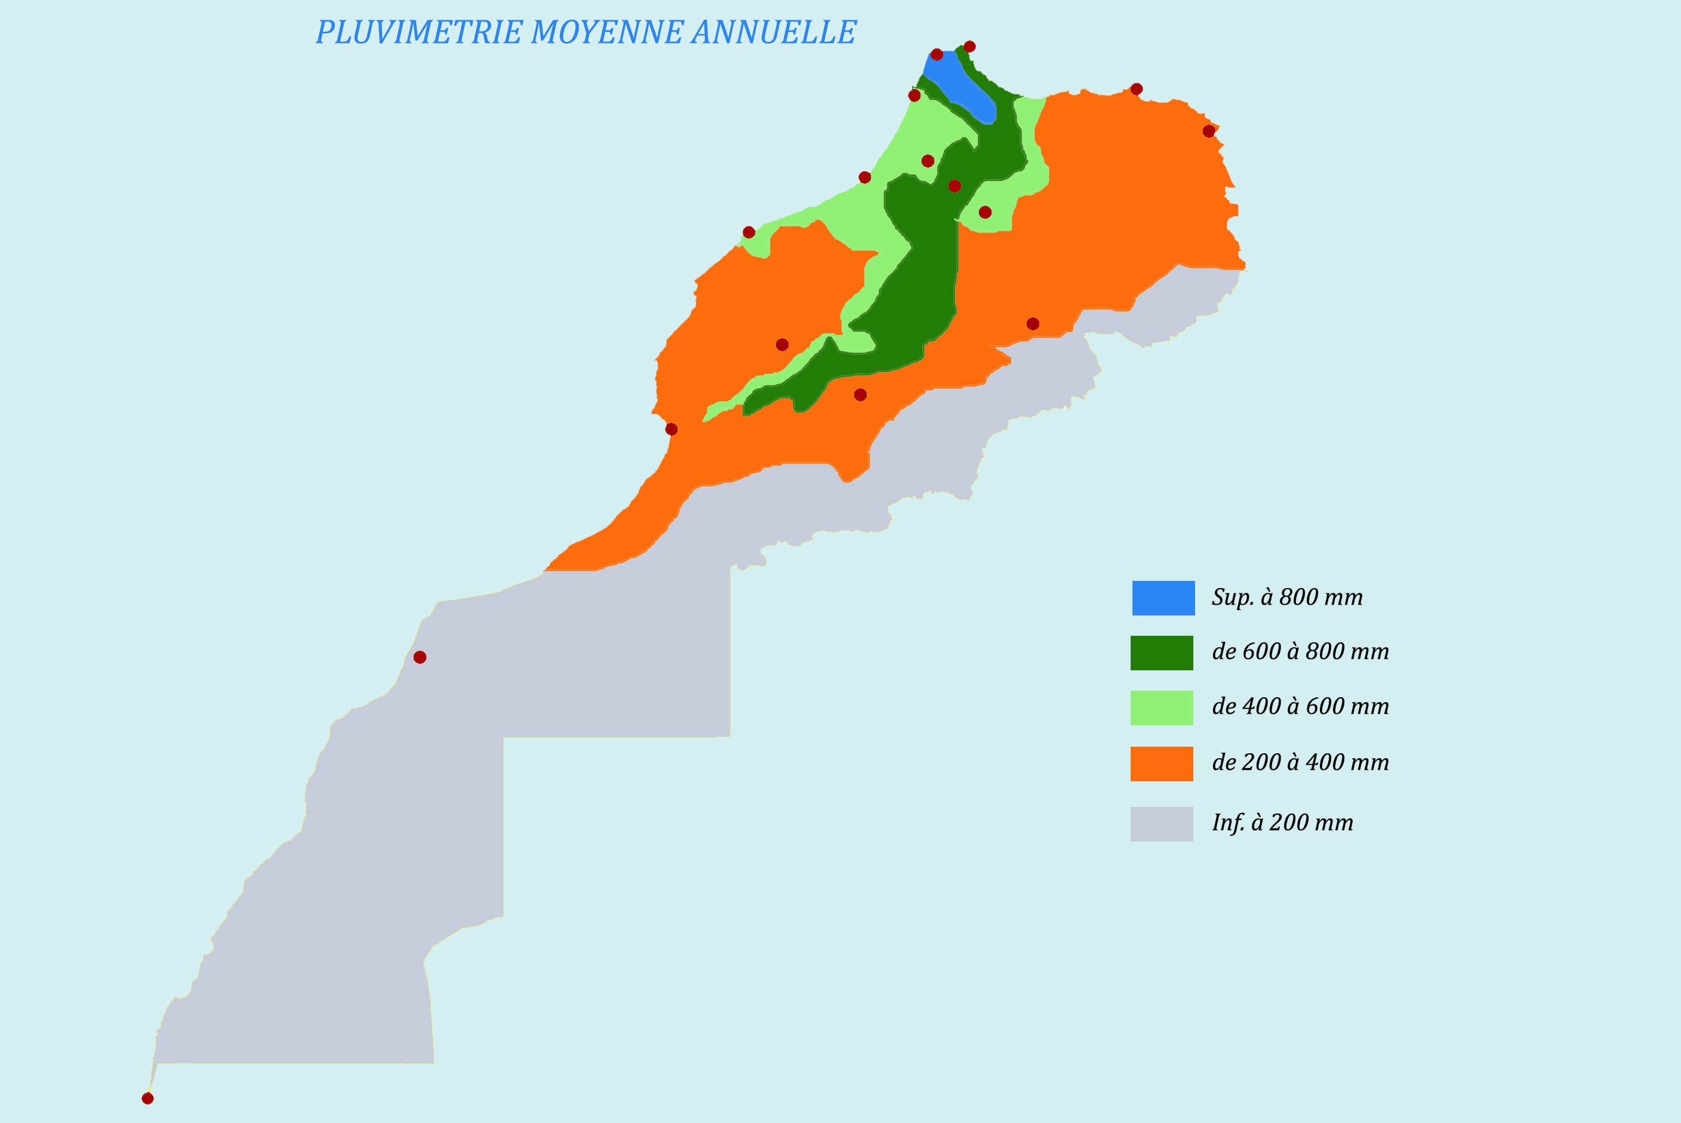
Hydrological Context
Irregularity and variability in precipitation
Heterogeneous distribution
Unequal distribution of precipitations
Necessary infrastructures.

Slide 3
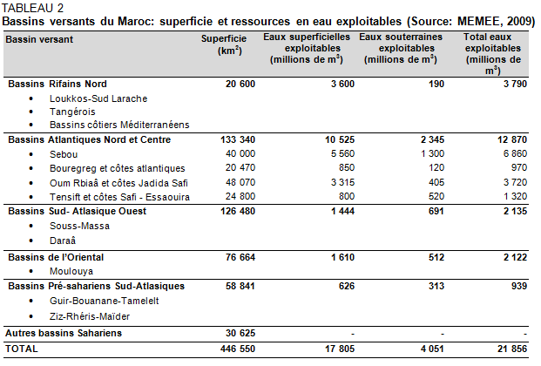
Water Resources

Slide 4


5 regions under water stress in 2014 !
Errachidia, Ouarzazate, Tensift, Oriental region, coastal zone Rabat-Casablanca.
Ratio = ressources disponibility / population
2014: 1000 m³/hab/year > 700 m³/hab/year (2014) > 500 m³/hab/year
1960: 2500 m³/hab/year (1960) > 1000 m³/hab/year
2025-2030: 500 m³/hab/year (2025-2030)
Demand of 13 billion m3, for a disponibility of 22 billion m3/year
88% agricultural irrigation, 10% potable water, 2% against pollution

