Slide 1
Case5
Lanco Catalogue Sales
Aman Sharma​
Bhavya Ahuja​​
Maninder Kaur​​
Santhamohan Manivannan​​
Simon Achkar​​
Zewei Yan

Slide 2
Clustering analysis
Cluster analysis, also called data segmentation, is a collection of techniques that seek to group or segment a collection of objects (i.e., observations or records) into subsets or clusters, such that those within each cluster are more closely related to one another than objects assigned to different clusters.

Slide 3
Assumption
We consider only the days interval of received day and shipped day and order size as predictor variables.
We consider K=5 is the best.

Slide 4
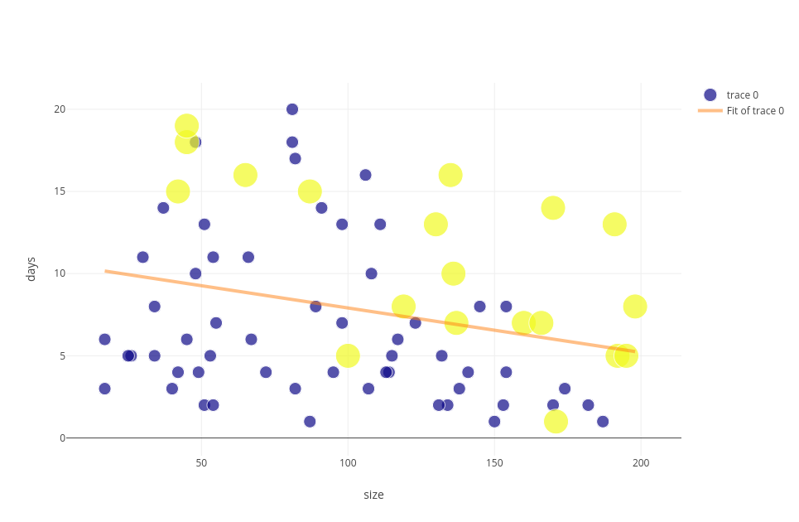
An Intuitive Classification

Slide 5
An Intuitive Classification
Linear function:
Days interval = -0.027 * order_size + 10.62
=> if Days interval + 0.027*order_size < 10.62, then the proportion of unclaimed order is high.

Slide 6
k -NearestNeighbors Classfication
The K in KNN refers to number of nearest neighbors that the classifier will use to make its predication.

Slide 7
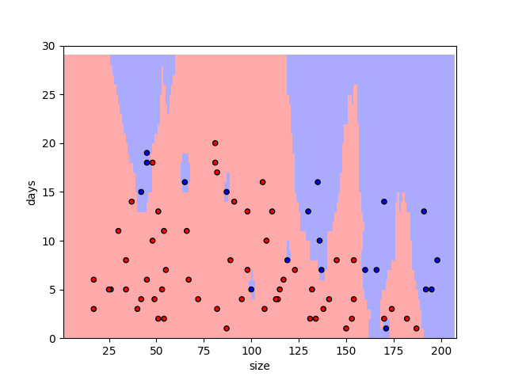
k -NearestNeighbors Classification

Slide 8
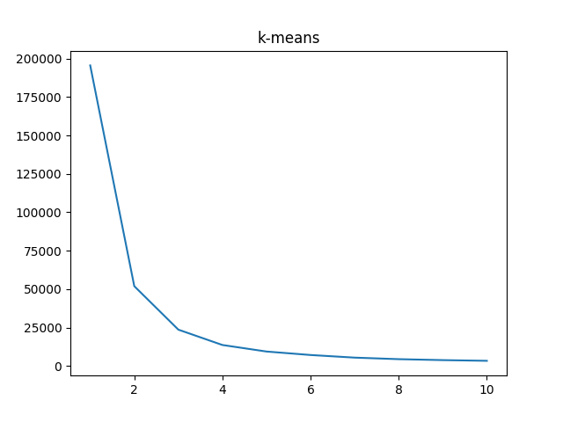
Find k

Slide 9
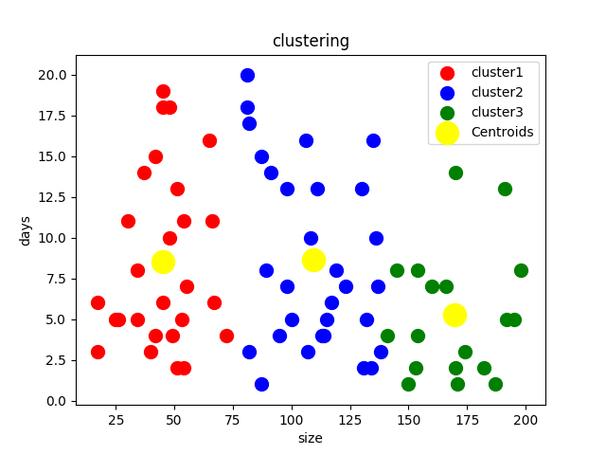
kmeans

