Slide 1

Introduction to Alteryx Designer
MSc in Computing and Data Analytics

Slide 2
Introduction to Alteryx Designer
Alteryx
Alteryx is a Self Service Analytics tool
Alteryx is used to build data workflows in Alteryx
We can build data workflows by quickly blending and preparing the data without any programming skills
Alteryx makes the ETL process easier
It’s used for Data Extraction, Data Preparation ,and Analytics and Data Science

Slide 3
Introduction to Alteryx Designer
Alteryx combines 3 products:
Alteryx Designer Desktop Tool – used for developing workflows and for performing analytics
Alteryx Server – A Cloud-Based application
Alteryx Gallery – Used to publish
Input Data
Data Preparation
Data Analytics
Data publish

Slide 4
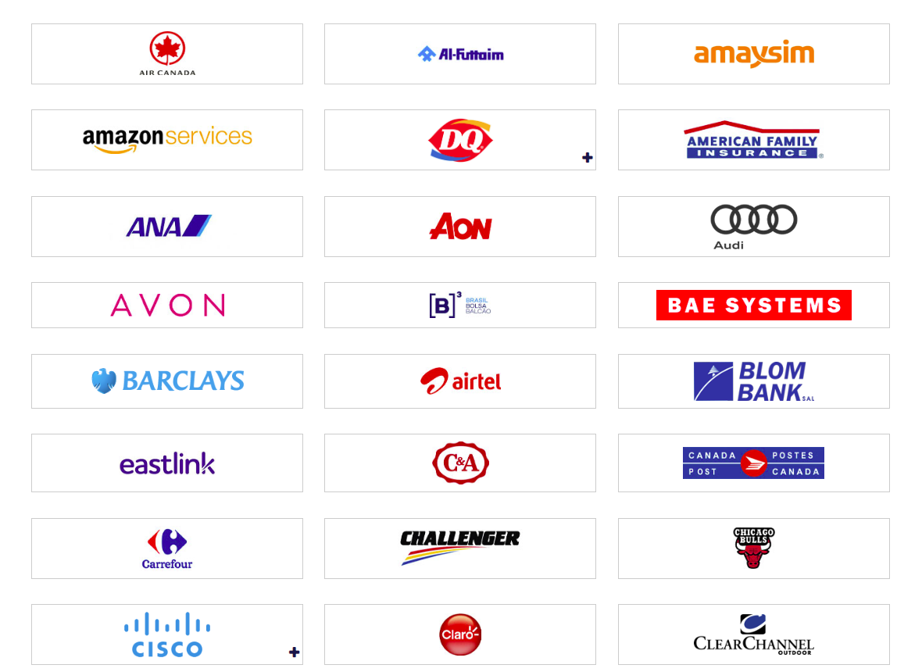
Introduction to Alteryx Designer
Companies Using Alteryx:

Slide 5
Alteryx Installation

Slide 6
Introduction to Alteryx Designer
Workshop overview
Installing Alteryx Designer ---- PDF guide
Getting started with alteryx designer
Interface walkthrough
One tool at a time – Input data, Text Input, Browse, Filter, Sort , Formula, Data Cleansing,analytics tool
Data Mining Assignments workflow
Exercise files

