Slide 1
LanCO Catalogue Sales
Group 6

Slide 2
Case Data
Lanco Catalog Sales - Mail order company with annual sales of $70,000,000.
Lanco used COD(Cash on delivery)
Returned merchandise accounted for over 30% of gross sales.
1% increase in return corresponds to profit loss of $ 400,000.
Refused items in mail for 5 weeks – additional cost and excess out of date inventory.
Debate over speeding up shipment or not.
Understand and control unclaimed returns

Slide 3
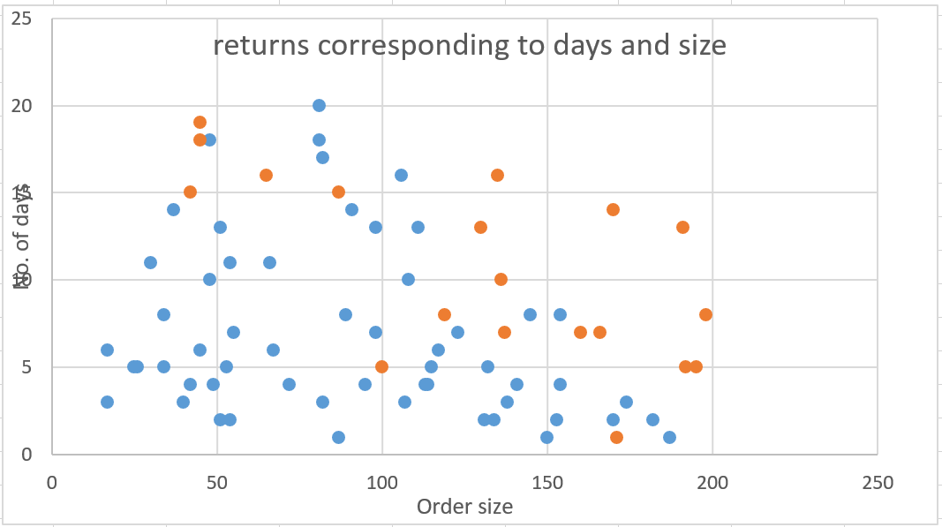
Determine if/how decision to return an order is influenced by order size and processing time.
Dependent Variable: Order Status
Most returns have large order size and/or high processing time.
Returned: 1, Not Returned: 0
Independent Variables:
Order Size
Processing Time
Approaches
K Mean Analysis
Logistic Regression - Better suited for accuracy

Slide 4
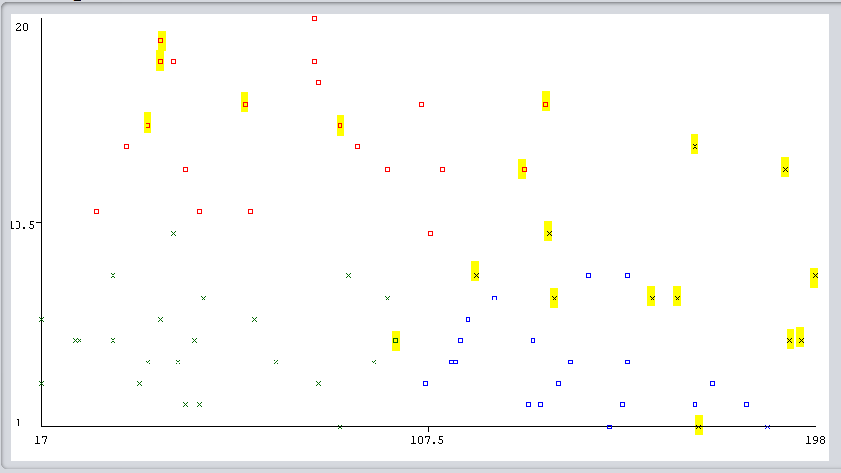
Clustering based on K –Mean Analysis
The data is divided into 3 cluster and the highlighted ones are the returned ones in each cluster
Time Taken
Order Size →

Slide 5
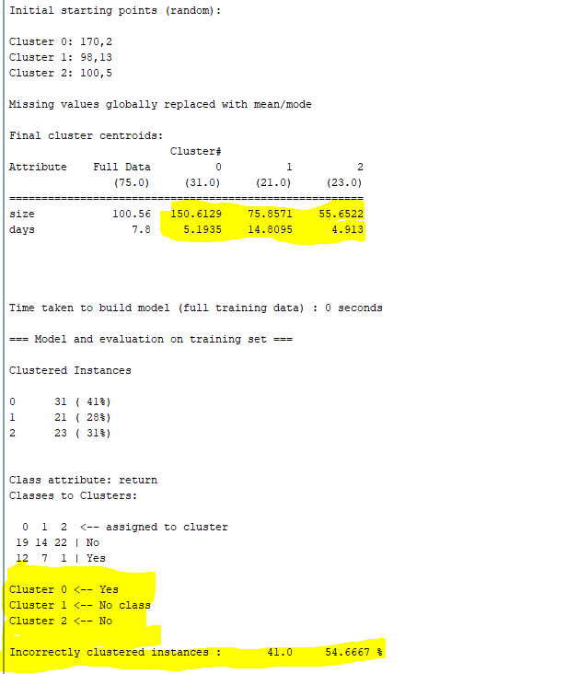
K –Mean Analysis Result

Slide 6
Influence of ORDERSIZE and Order Time
Inferences from 3 clusters
In Cluster 0[Blue] ,as the size of the order is increasing but the processing time is less, the probability of order return is rising
Cluster 1[Red] has mixed response because there is no clarity on judgement.
Cluster 2 [Green] has due minimum order size and order time. negligible returns
ORDER time and Order size both have high impact on Returns . Both are equally correlated with Returns, and both are statistically significant predictor.

Slide 7
Assumptions for BINARY LOGISTIC REGRESSION
Binary logistic regression model assumes binomial distribution of the response. The dependent variable does NOT need to be normally distributed
Does NOT assume a linear relationship between the dependent variable and the independent variables, but it does assume linear relationship between the logit of the response and the predictor variables;
Errors need to be independent but NOT normally distributed.

Slide 8
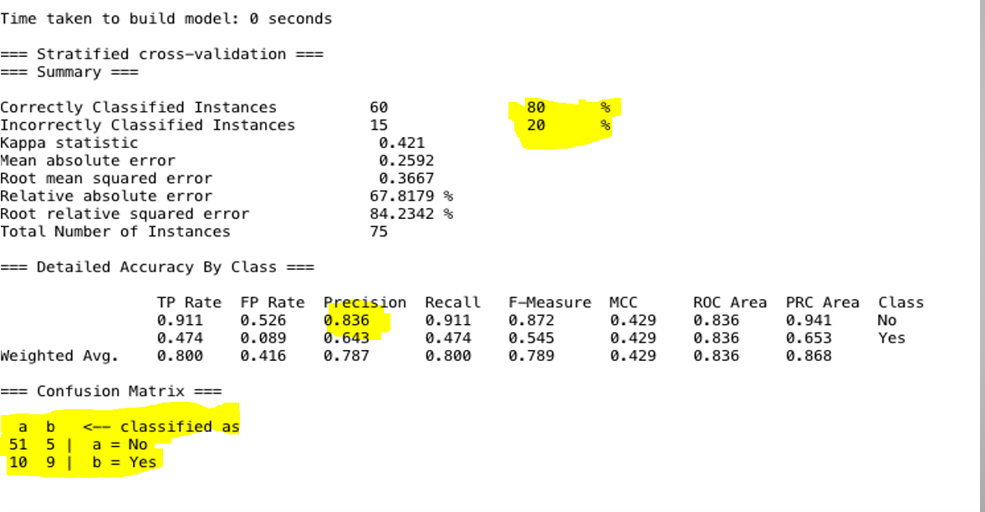
Logistic REGRESSION RESULT

Slide 9
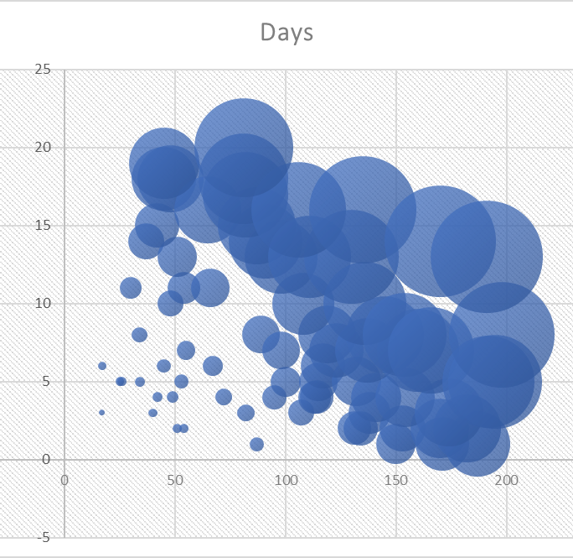
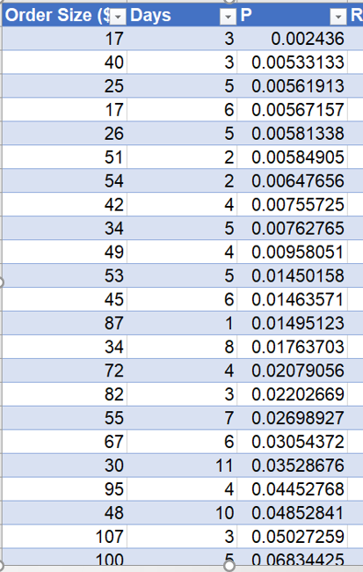
Graph for bubbling for order size , time and P -value

Slide 10
Recommendation
Shipping time/processing time should be reduced for order with high probability of return as determined by decision boundary. Reduce the processing time for larger/bigger order size.
Try to achieve processing time less than 5 days because the return rate is low irrespective of order size.
If order is < $100 and 10 days processing time then company will accept COD, for rest orders customer will pay first.
Two step Confirmation process is followed. (Order Confirmation and Before Shipping)

