Slide 1

MSCDA 5510 Case 1: Firestone
Group 6
Rishab Gupta
Vivek Anand
Mohd Nawaz Hussain
Vinay Govindan
Ravneet Singh Oberoi
Bhagya Shree
Ra

Slide 2
(Q1) Refund Probabilities Based On Last 10 Years Average Snowfall
Toronto
Vancouver
London
Mean :137.94 Std Dev :26.69 | P(X<=40%) = ((0.4 * 137.94) -137.94)/26.69 = -3.10 = z=0.0010 | Refund Probability (June 1983-May1984) 0.0010
Mean :44.1 Std Dev :30.16 | P(X<=40%) = ((.4 * 43.22) -43.22)/30.16 =-0.86 =z =0.1949 | Refund Probability (June 1983-May1984) 0.1949
Mean:203.3 Std Dev: 61.73 | P(X<=40%) = ((.4 * 199.17) -199.17)/61.73 =-1.94 =z=0.0264 | Refund Probability (June 1983-May1984) 0.0264

Slide 3
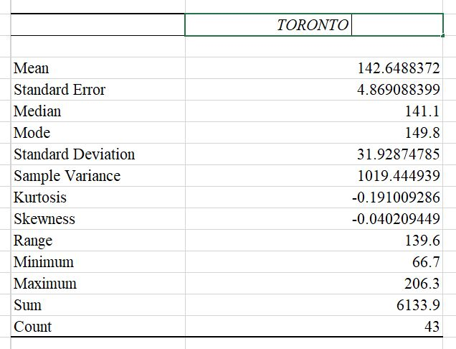
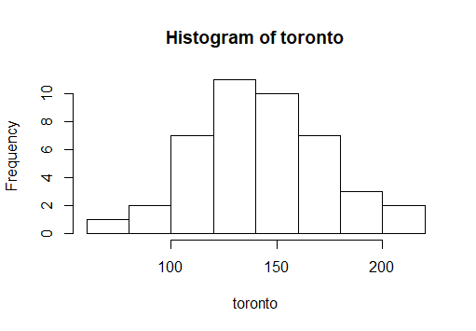
(Q2) Do the snowfall distributions (in cms/year) fit normal distribution?
TORONTO HISTO.png

Slide 4
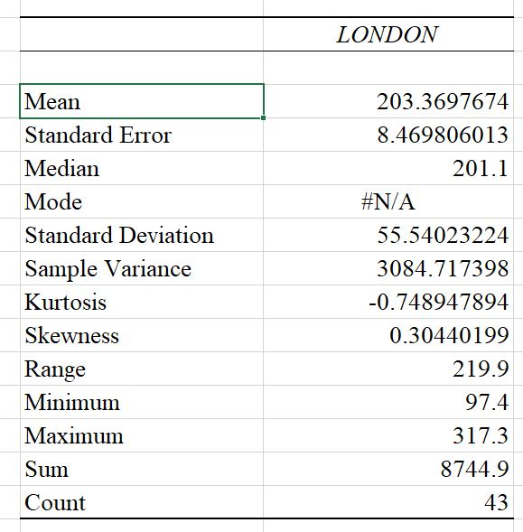
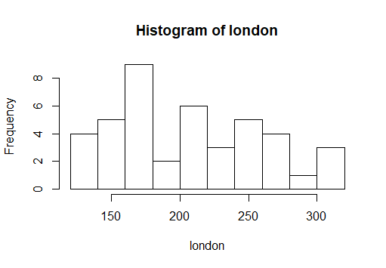
(Q2) Do the snowfall distributions (in cms/year) fit normal distribution?
TORONTO HISTO.png

Slide 5
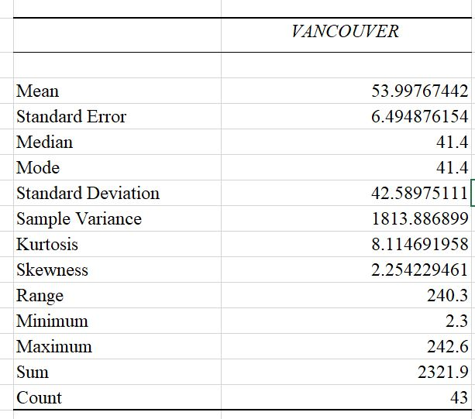
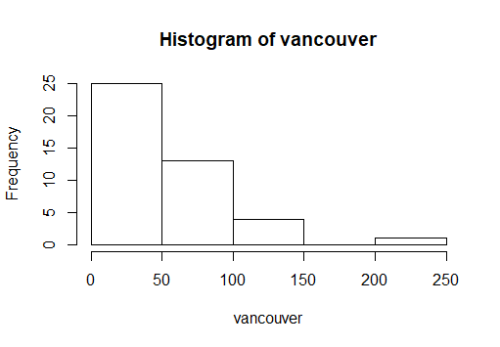
(Q2) Do the snowfall distributions (in cms/year) fit normal distribution?
TORONTO HISTO.png

Slide 6
(Q3) Does the way in which the official mean is computed affect the refund probabilities?
The official mean calculated by the insurance company was the period of 10 years till 31st may 1983.
the probability of refund calculated for the 3 cities using the above mean is as follows:
Toronto : 0.1% London : 2.6% Vancouver: 19.5%

Slide 7
(Q3) Does the way in which the official mean is computed affect the refund probabilities?
Lets take a new official mean to be calculated for the entire data set provided for the 3 cities to see if the probability of refund is affected.
The probability of refund calculated as per the new official mean is :
Toronto: 0.6% London : 1.4% Vancouver : 21.8%
As seen above the probability of return is high when the entire data set is considered opposed to just 10 .

Slide 8
(Q4) Expected value of the program to the consumer buying a snow tire in these cities?
Expected value is the sum of: [(each of the possible outcomes) × (the probability of the outcome occurring)]
E(X)=P(less than 20% snowfall)*(0/100)+
P(between 30%-20% snowfall)*(25/100)+
P(between 40%-30% snowfall )*(50/100)+
P(greater than 40)*(100/100)

Slide 9
(Q4) Expected value of the program to the consumer buying a snow tire in these cities?
E(X)=P(X<20)*(0)+
(P(X<30)-P(X<20))*(0.25)+
(P(X<40)-P(X<30))*(0.5)+
P(X>40)*(1)
E(X)=P(X<20)*(0)+
(P(X<30)-P(X<20))*(0.25)+
(P(X<40)-P(X<30))*(0.5)+
(1-P(X<40))*(1)

Slide 10
(Q4) Expected value of the program to the consumer buying a snow tire in these cities?
For Toronto
P(X<20)=((0.2*137.94)-137.94)/(26.6943273208205)
P (z<-4.13391 ) = 0
P(X<30)==((0.3*137.94)-137.94))/(26.6943273208205)
P(Z<-3.61717 ) = 0
P(X<40)=((0.4*137.94)-137.94))/(26.6943273208205)
P(Z<-3.10043 ) = 0.001
Plugging Value in E(X)
E(X_{Toronto}) = 0.9995
The Value for the customer = 1- 0.9995 = 0.0005

Slide 11
(Q4) Expected value of the program to the consumer buying a snow tire in these cities?
For Vancouver
P(X<20)=((0.2*43.22)-43.22))/(30.1646150315233)
P(Z<-1.14624) = 0.1271
P(X<30)=((0.3*43.22)-43.22))/(30.1646150315233)
P(Z<-1.00296) = 0.1587
P(X<40)=((0.4*43.22)-43.22))/(30.1646150315233)
P(Z<-0.85968) = 0.1977
Plugging Value in E(X)
E(X_{Vancouver}) = 0.8297
The Value for the customer = 1- 0.8297 = 0.1703

Slide 12
(Q4) Expected value of the program to the consumer buying a snow tire in these cities
For London
P(X<20)=((0.2*199.17)-199.17))/(61.7307423862338)
P(Z< -2.58115) = 0.0049
P(X<30)=((0.3*199.17)-199.17))/(61.7307423862338)
P(Z<-2.2585 ) = 0.0122
P(X<40)=((0.4*199.17)-199.17))/(61.7307423862338)
P(Z<-1.93586 ) = 0.0268
Plugging Values in E(X)
E(X_{London}) = 0.982325
The value for the customer = 1- 0.982325 = 0.017675

Slide 13
(Q5) Should Firestone Go Ahead With The Program
Based on the last decade’s data, the probability of refunds range from very low to low (Toronto at 0.1%, London at 2.6% and Vancouver at 19.4%)
Furthermore, the expected value to the consumers of these snow tires to them is high according to our calculations (Toronto at 0.05%, Vancouver at 17% and London at 1.8%)
Therefore looking at this information, we conclude that Firestone should go ahead with the program.

