Slide 1

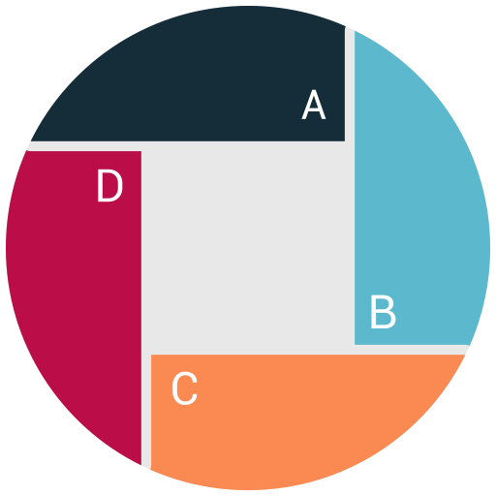
Executive Summary
Quality Alloys
Team 1
Team Members
Divya
Sidharth
Darshan
Gyaneshwar
Nishant
Sree Babu

Slide 2


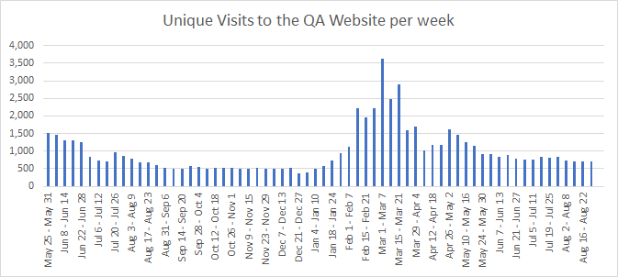
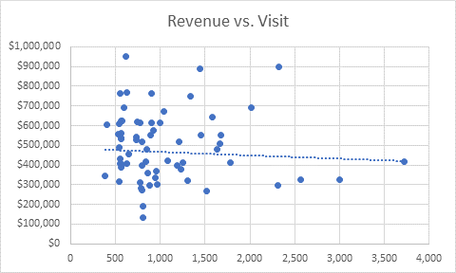
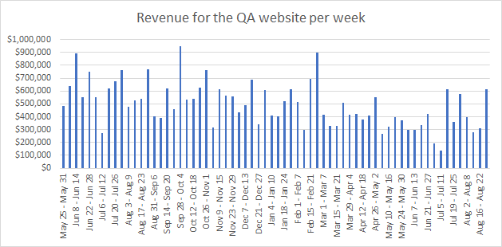
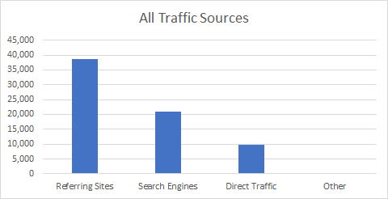


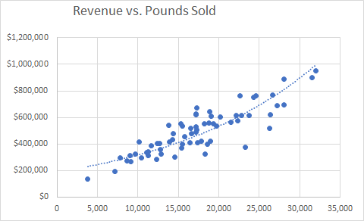
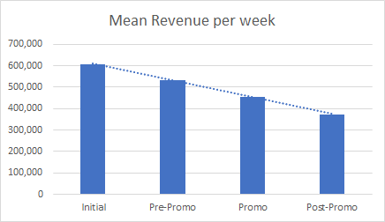
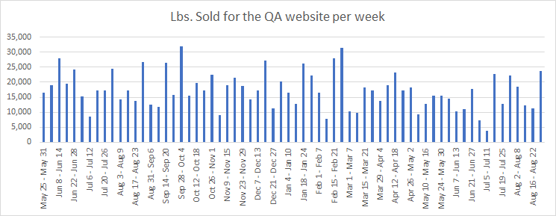
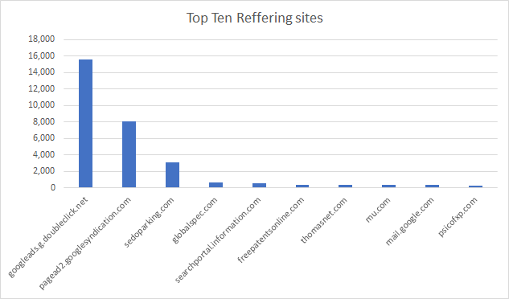
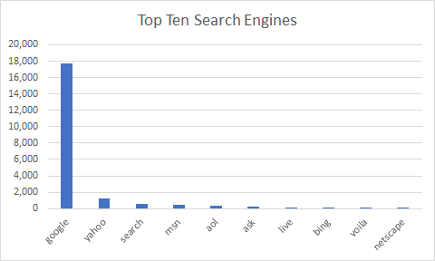
Does IT Matter ?
There has been a long standing debate among the QA leadership with respect to the value of organizational investments in IT (Information Technology), demonstrating ROI being the primary challenge.
Taking traditional QA’s customers (generally small companies) into consideration as future purchases cannot be predicted based on previous orders, QA continuously needs to rely on new customers in order to drive sales for which it needs to increase customer base.
Analyzing the available web and financial data with respect to general partitions
Unique Visits 65.2k
Bounce Rate
Revenue 33M
Initial
13.6 k
Pre-Promo
10.8k
Initial
67%
Pre-Promo
59%
Initial
8.5 M
Pre-Promo
$ 11.2 M
Promo
29.5k
Post Promo
11.2k
Promo
77%
Post Promo
66%
Promo
$ 7.75M
Post Promo
$ 5.2 M
Referring Sites: 38,754
Average Bounce Rate: 67%
Average Revenue : 8.25 M
Pages Viewed
Avg Time Spent
Initial
2.28 pg
Pre-Promo
2.66 pg
Initial
80 sec
Pre-Promo
96 sec
Promo
1.79 pg
Post Promo
2.18 pg
Promo
49 sec
Post Promo
70 sec
Average Pages Viewed: 2.22
Average Time Spent: 75 sec

Slide 3
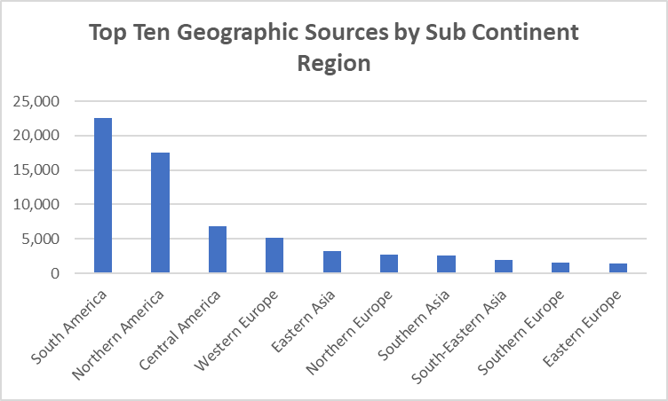

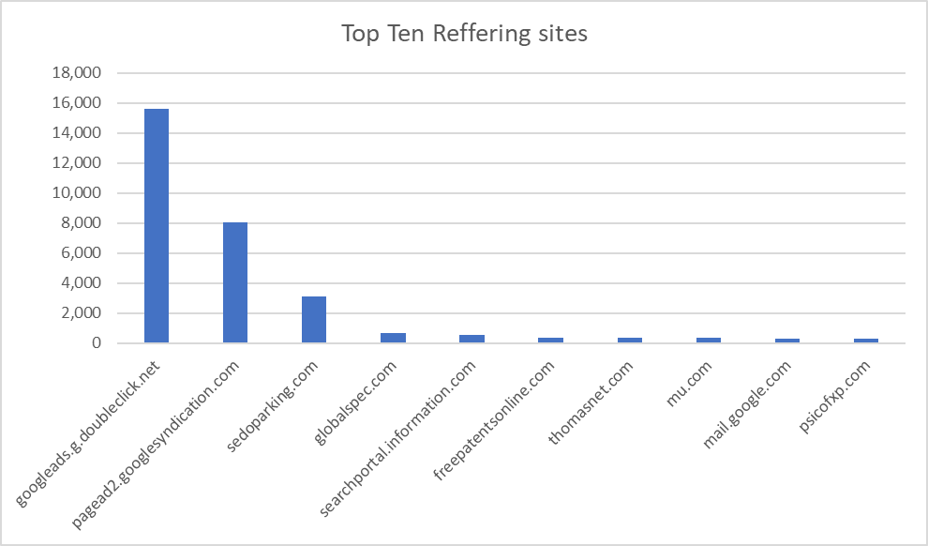
Total Visits =
(1738.8)
Volatile Visitors +
(938 visits)
Gained Visitors +
(284)
Visits of Pre-Promotion
(516.8)
(Unique Visits of Post – Promotion) -
(800.8)
Unique Visits of Pre-Promotion
(516.8)
54%
of Irrelevant traffic created havoc in pages per visit and Bounce rate in Promotion period.
Volatile Users
Looking at the Geographic sources, it is observed that QA needs to advertise more at Europe and Asia as the manufacturing is being moved to Pacific Rim
16%
of traffic has been Gained during Promotion period.
Gained Visitors
30%
of traffic have been the Regular Number of Users during Promotion period.
Regular Users
Google Adwords has proved to be a real deal as it has helped QA gained huge set of visitors during promotional periods
Looking at the Referring sites, it is understood that a very minimal amount of hits have been received from Global Spec and Thomas Net where QA has advertised

